Slide 1
Increasing Student Engagement Through Technology
Dr. Katherine christoffersen
Nicole nicholson, Mtesl

Slide 2
Yammer: Social networking service used for private communication in organizations
Applications in the classroom:
Whole-group announcements
Small group chats
Individual messaging with instructor
Access:
Yammer is provided to UTRGV automatically with the Office 365 Suite.
For Yammer support click here.

Slide 3
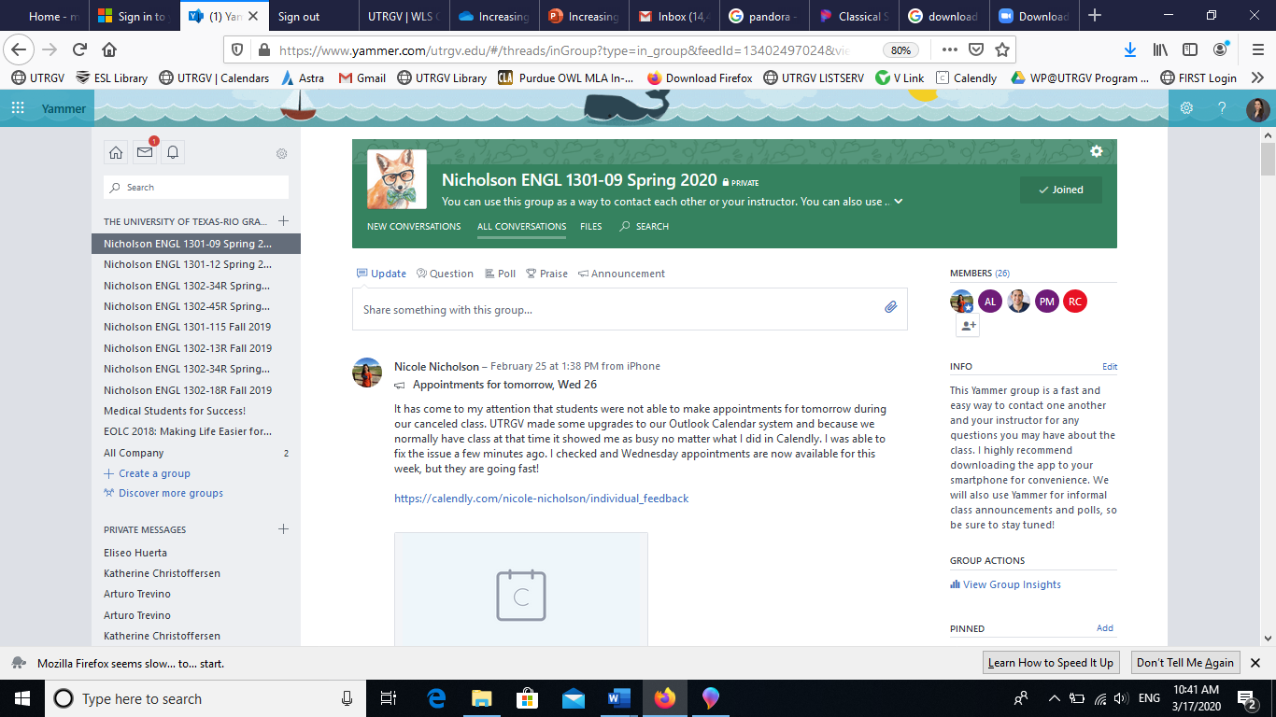
Sample course Yammer page.

Slide 4
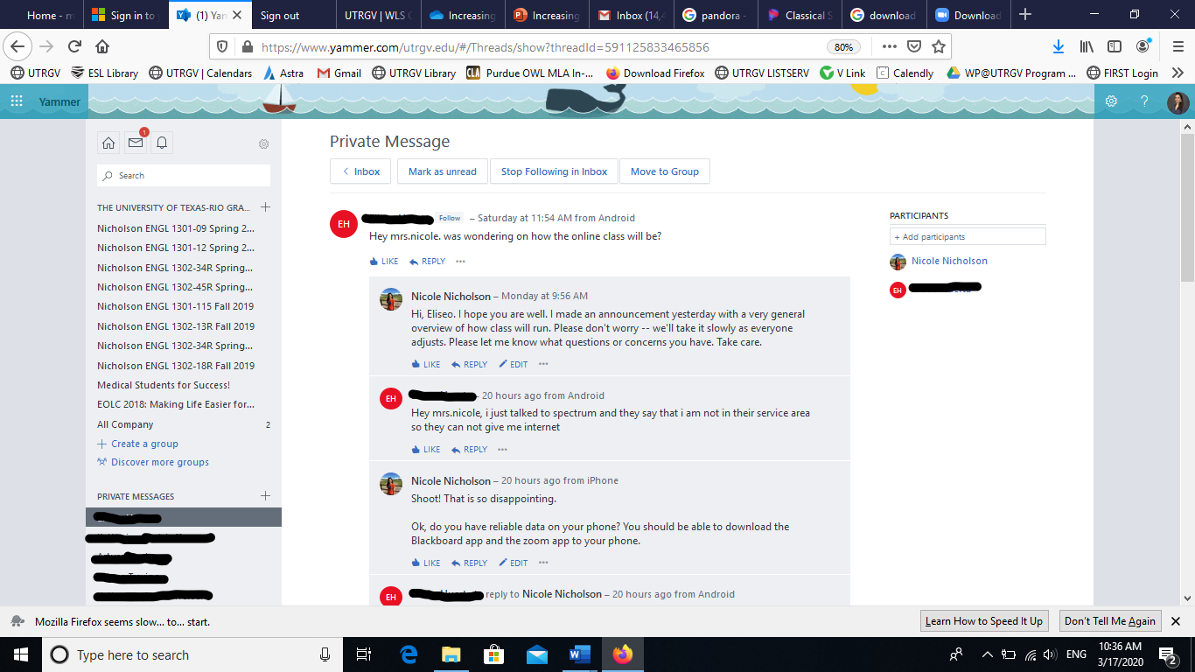
Sample direct message history with student. Several other users can be added for group chats.

Slide 5
Problem-Solving

Slide 6
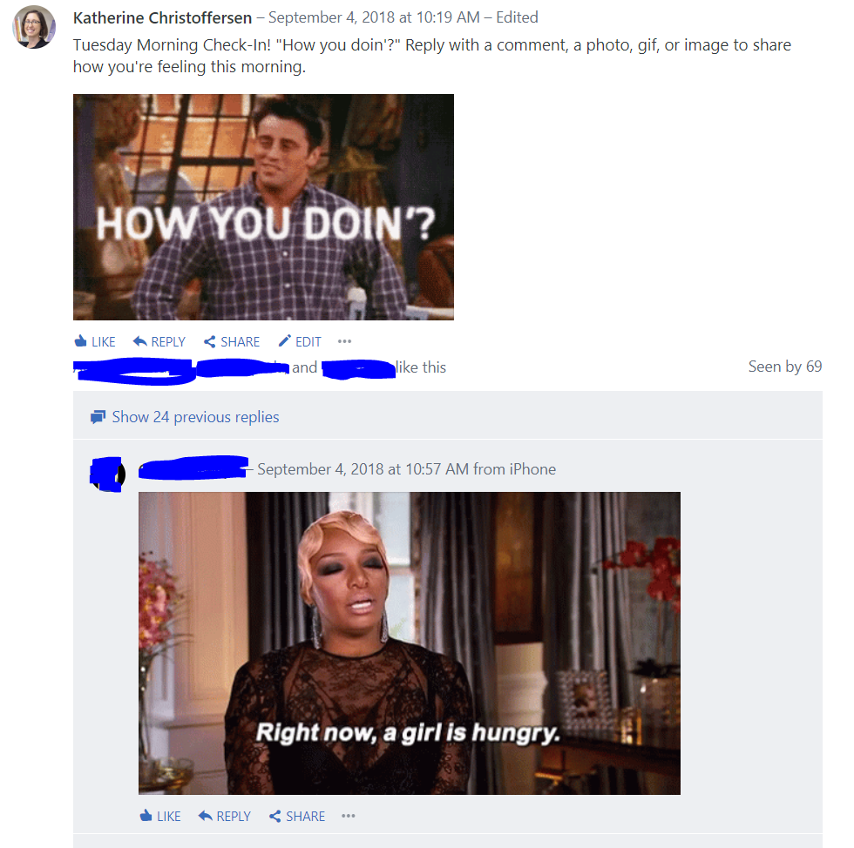
Introductions & Check-In

Slide 7
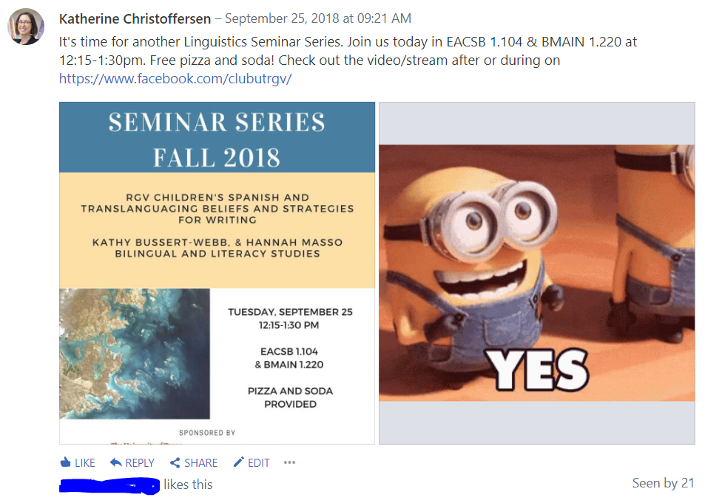
Reminders & Announcements

Slide 8
Class Activities

Slide 9
Class Activities

Slide 10
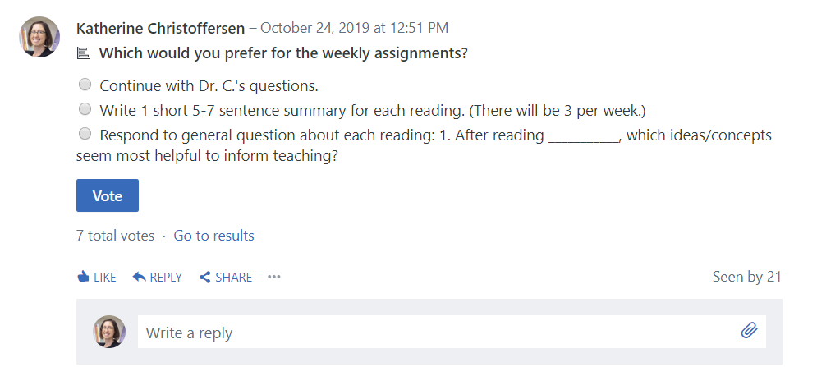
Polls & Feedback

Slide 11
OneDrive: File hosting and synchronization service, similar to GoogleDocs
Applications in the classroom:
Materials sharing with students
Collaborative writing/group work
Tracked changes
Online submission of assignments (essays, reports, etc.)
Access:
OneDrive is provided to UTRGV automatically with the Office 365 Suite.
For OneDrive support click here.

Slide 12
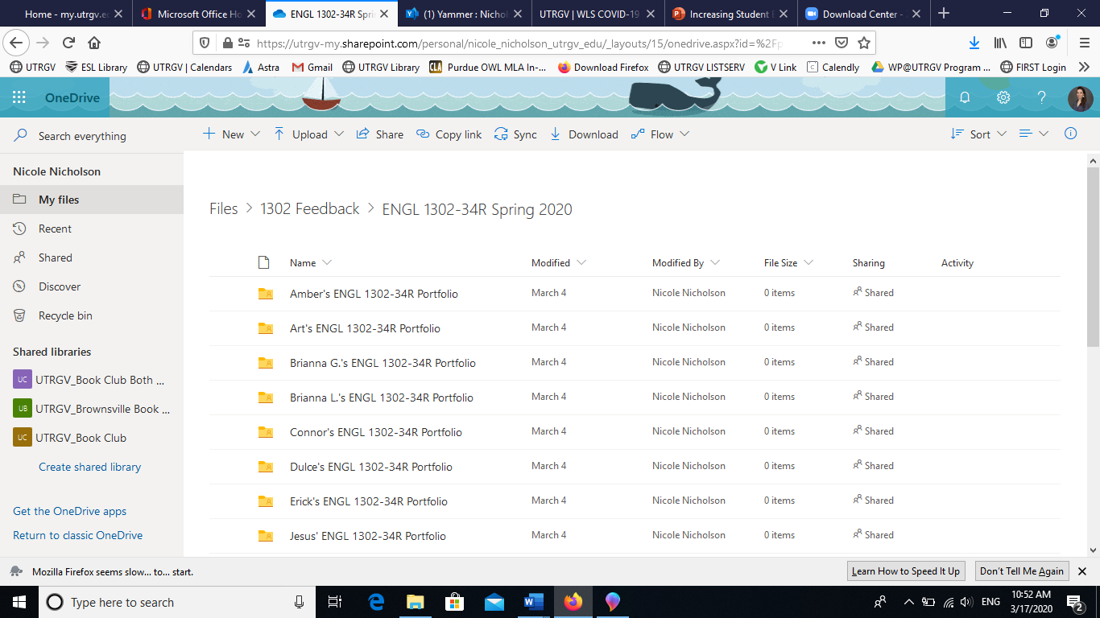
Student folders created by the instructor and shared with each individual student.

Slide 13
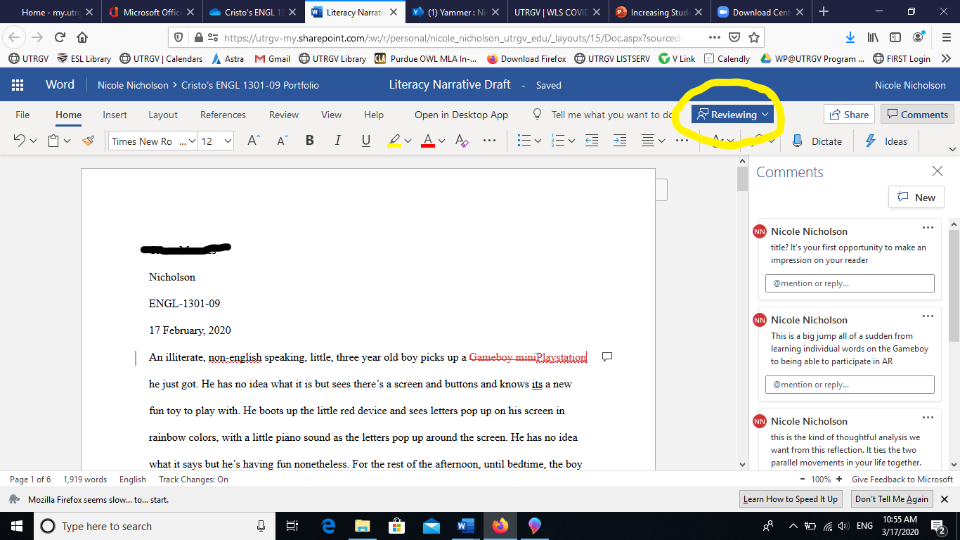
Sample of digital commenting on student work and tracked changes.

Slide 14
OneNote Class Notebooks: OneNote is a program for free-form information gathering and multi-user collaboration. It gathers users’ notes, drawings, screen clippings, and audio commentaries.
Applications in the classroom:
Research or reflection journals
Small group collaborative assignments
Assignment distribution and submission
Note: The Class Notebook feature is managed by the teacher; students have read-only access, collaborative space, and individual space.
Access:
OneDrive is provided to UTRGV automatically with the Office 365 Suite.
The Class Notebook option is also linked automatically to Blackboard courses (though not the gradebook).
For OneNote Class Notebook support click here.

Slide 15
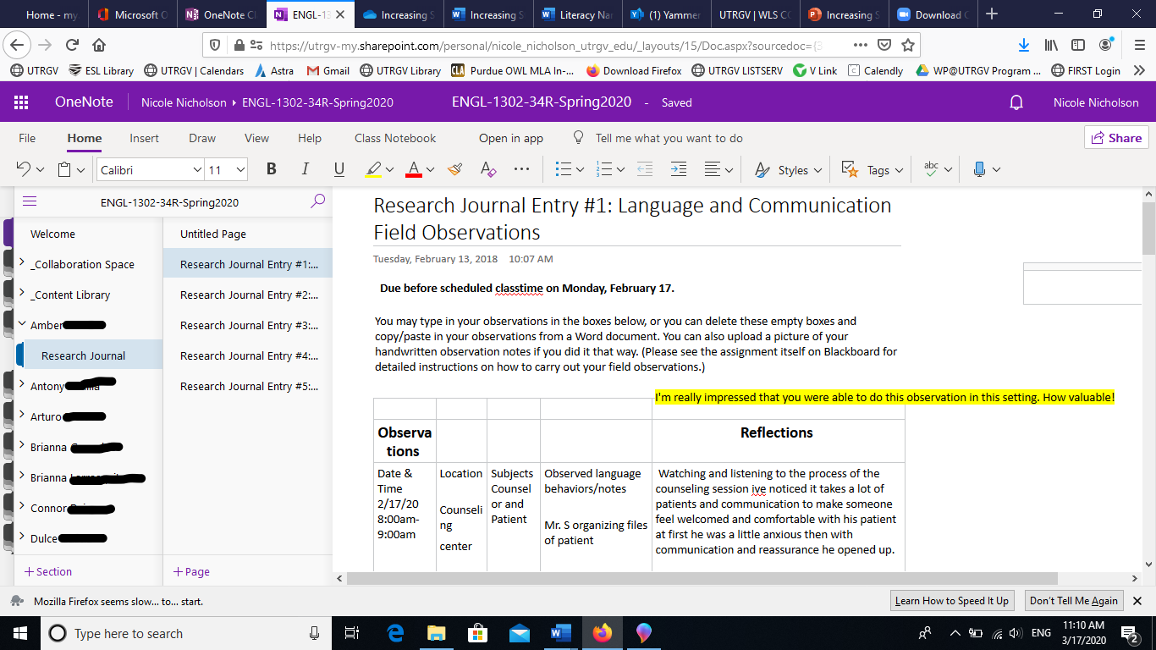
Sample student research journal.

Slide 16
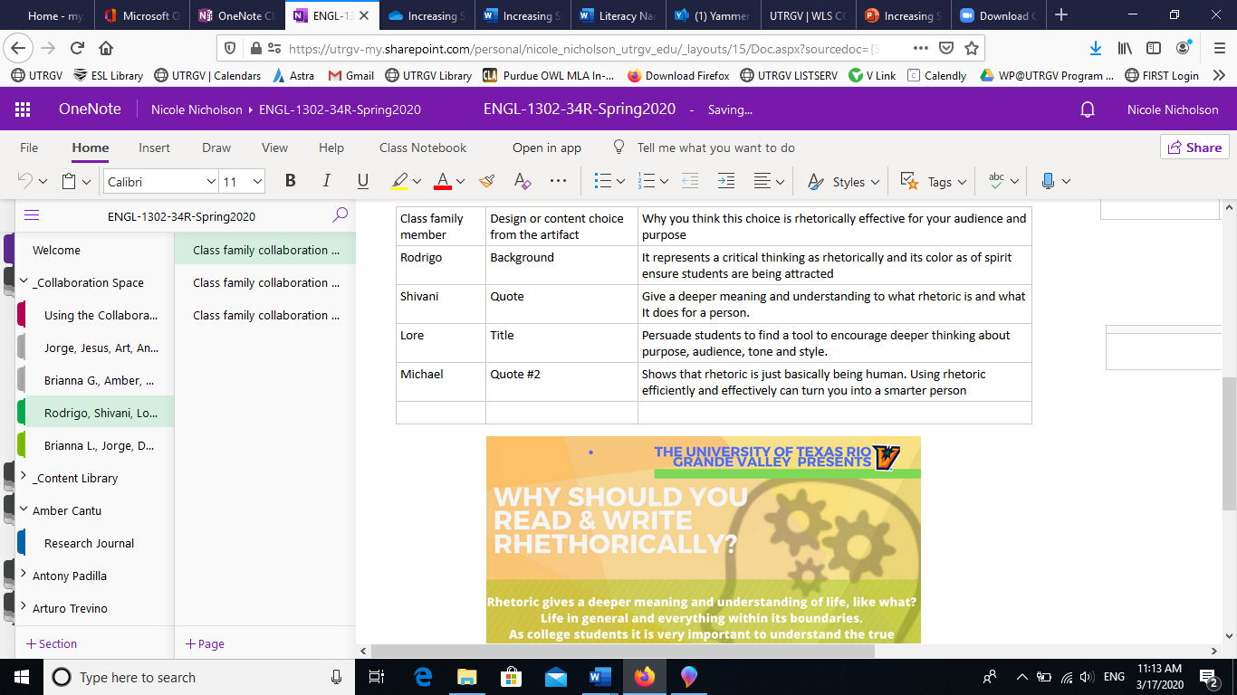
Sample student collaborative assignment space.

Slide 17
Zoom: Cloud-based communication that combines video conferencing, online meetings, chat, screen-sharing, and mobile collaboration.
Applications in the classroom:
Whole-group virtual instruction
Individual conferencing
Small group collaboration
Access:
Zoom is available to UTRGV students, faculty, and staff.
It can be used on computers and on smartphones.
For UTRGV instructions, click here.

Slide 18
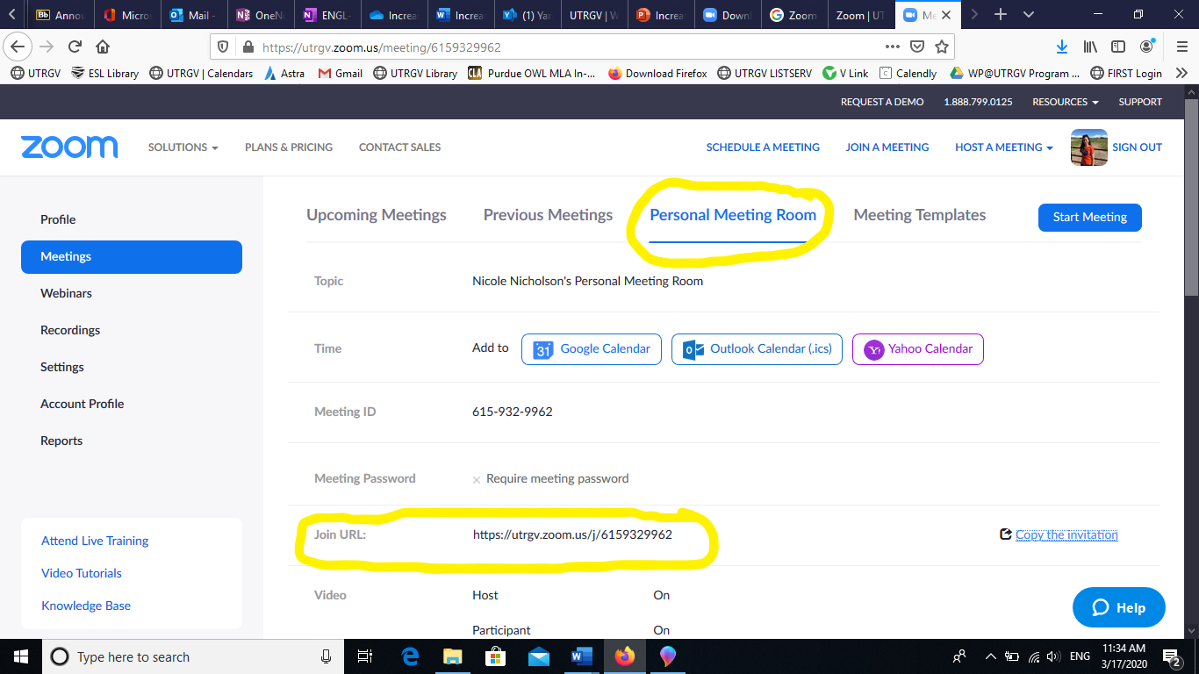
Instead of scheduling a new meeting every time, consider copying the URL for your personal meeting room.

Slide 19
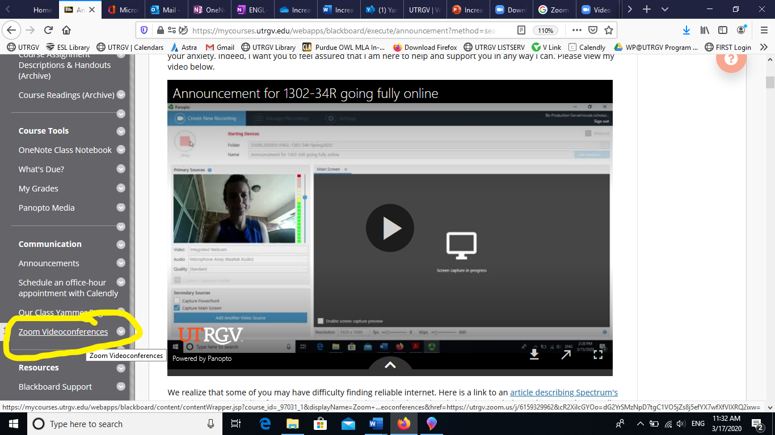
Then create a link on the left sidebar of your course Blackboard page for easy student access.

Slide 20
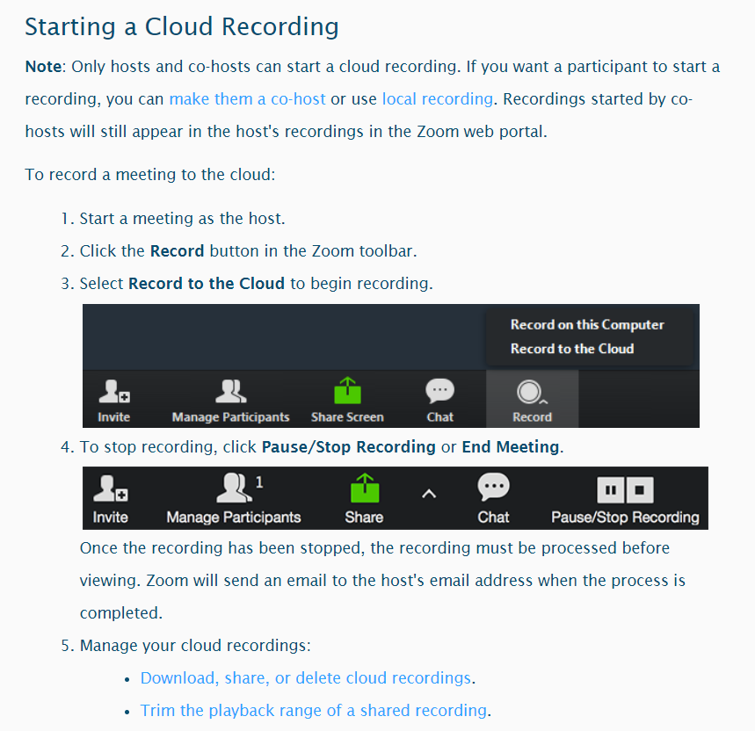
Recording Zoom Meetings
Notes:
Example in Zoom Recordings

Slide 21
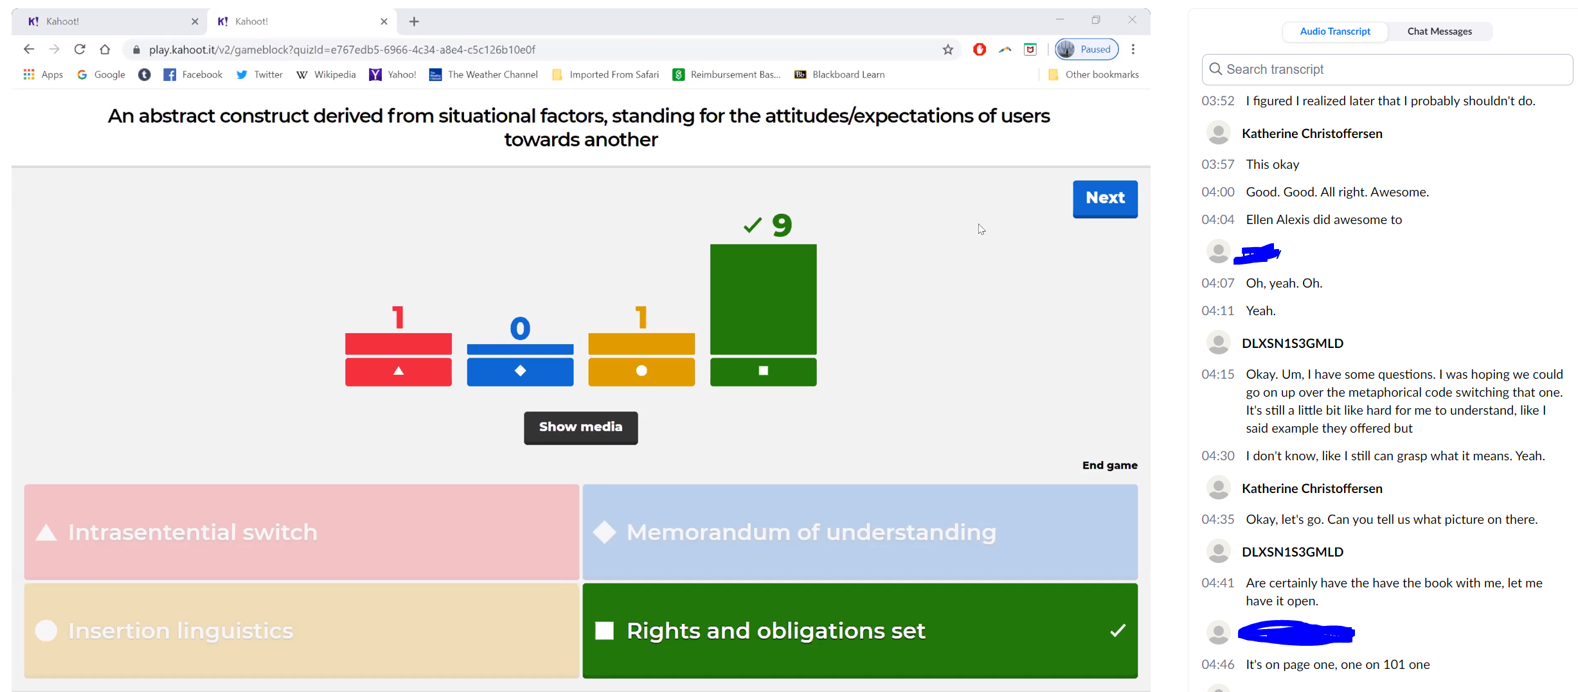
Recording Zoom Meetings

Slide 22
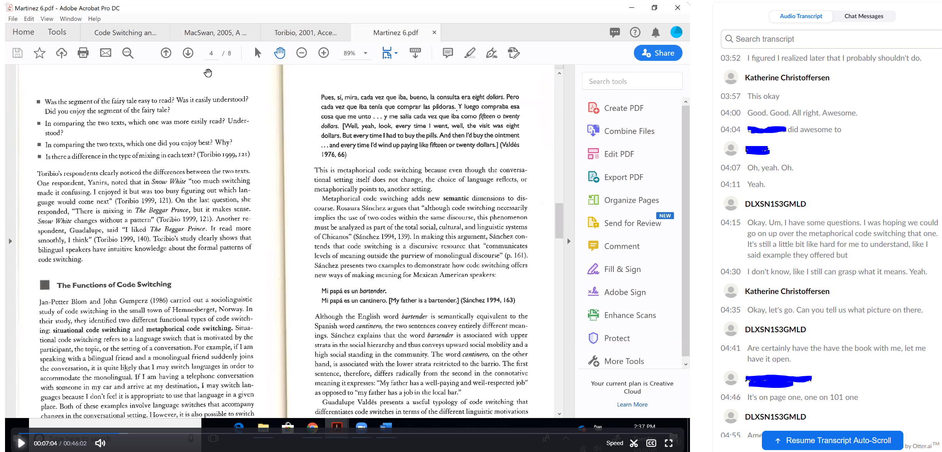
Recording Zoom Meetings

Slide 23
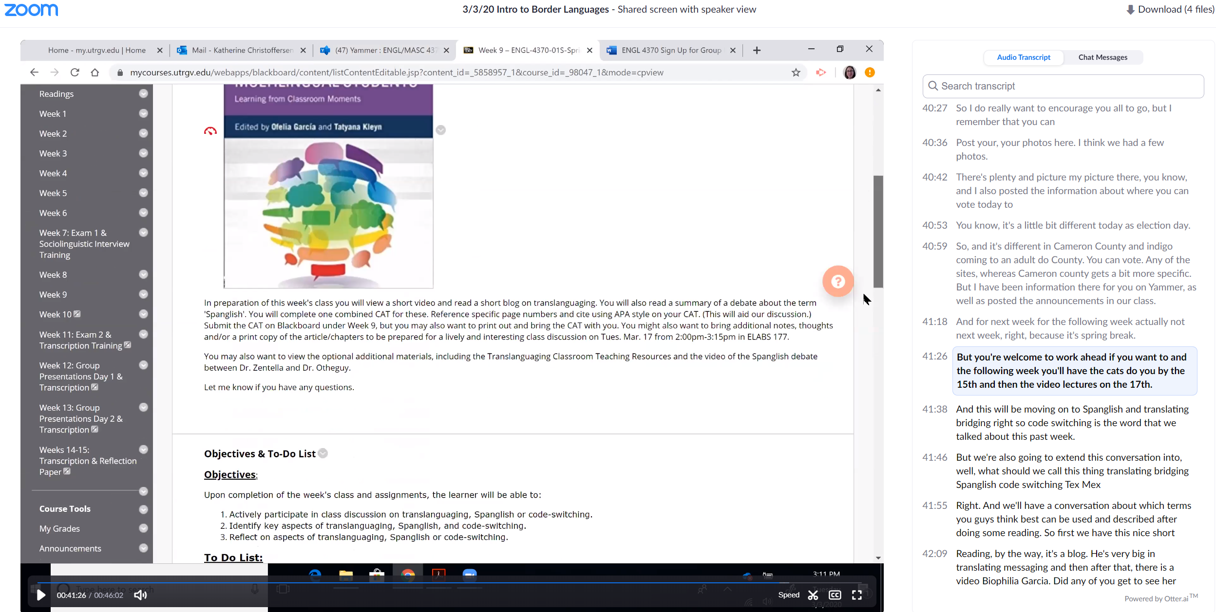
Recording Zoom Meetings

Slide 24
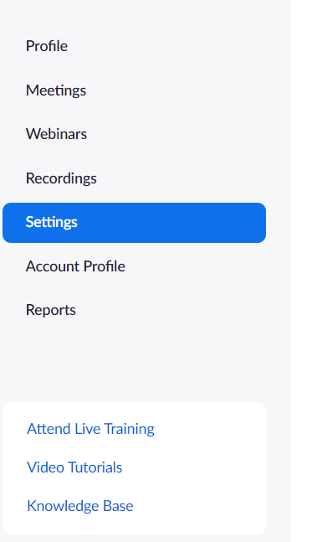
Breakout Rooms

Slide 25
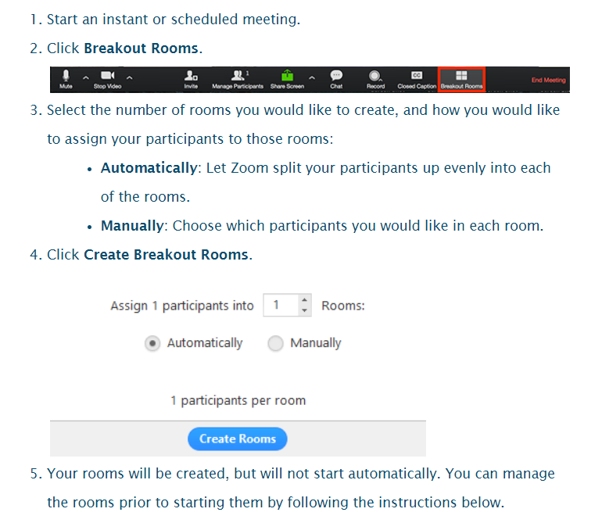
Breakout Rooms

Slide 26
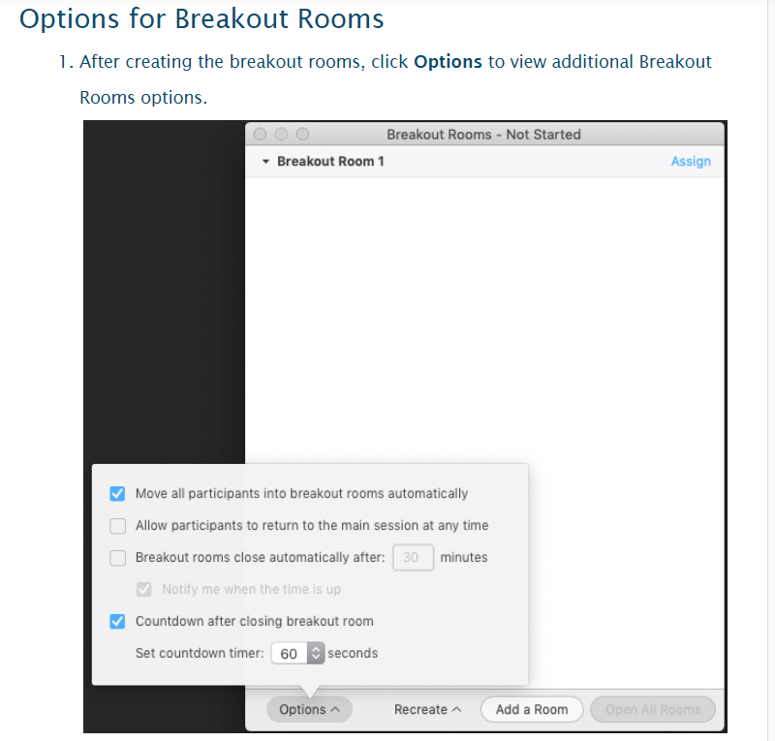
Breakout Rooms

Slide 27
Breakout Rooms

Slide 28
FlipGrid: Video discussion board
Applications in the classroom:
Video discussion board
Formative feedback
Alternative to written discussion boards
Access:
Free access at flipgrid.com (There is a separate educator log-on, and you can require that students use their UTRGV log-in.)
Students can download an app to their phone. You can also provide QR codes and/or links to each discussion prompt.
Notes:
Examples from ENGL 6375 Spring 2020

Slide 29
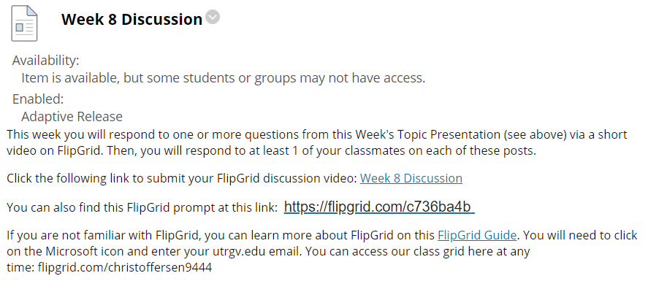
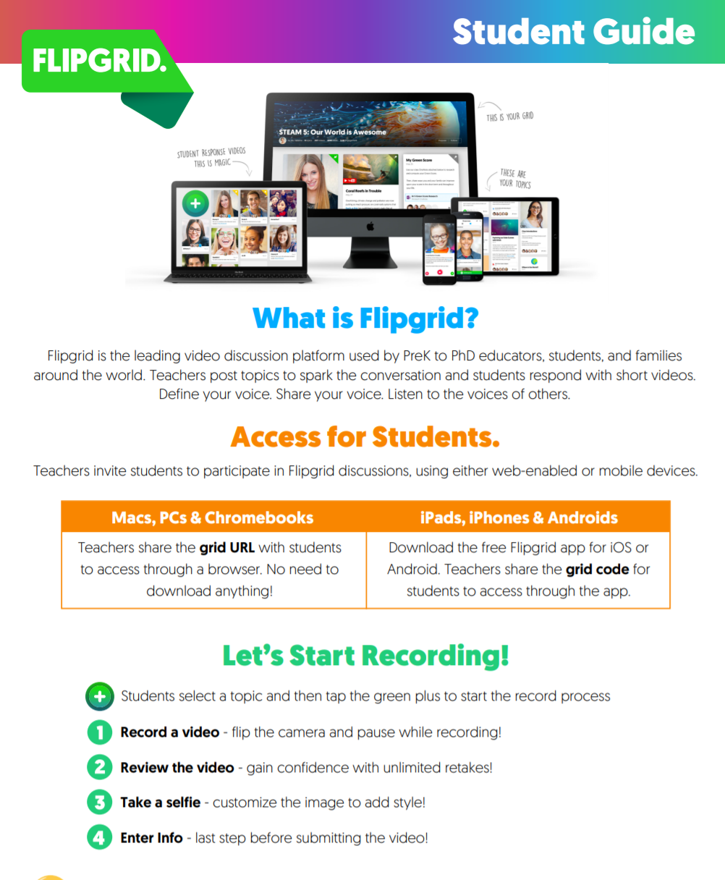
FlipGrid Guides

Slide 38
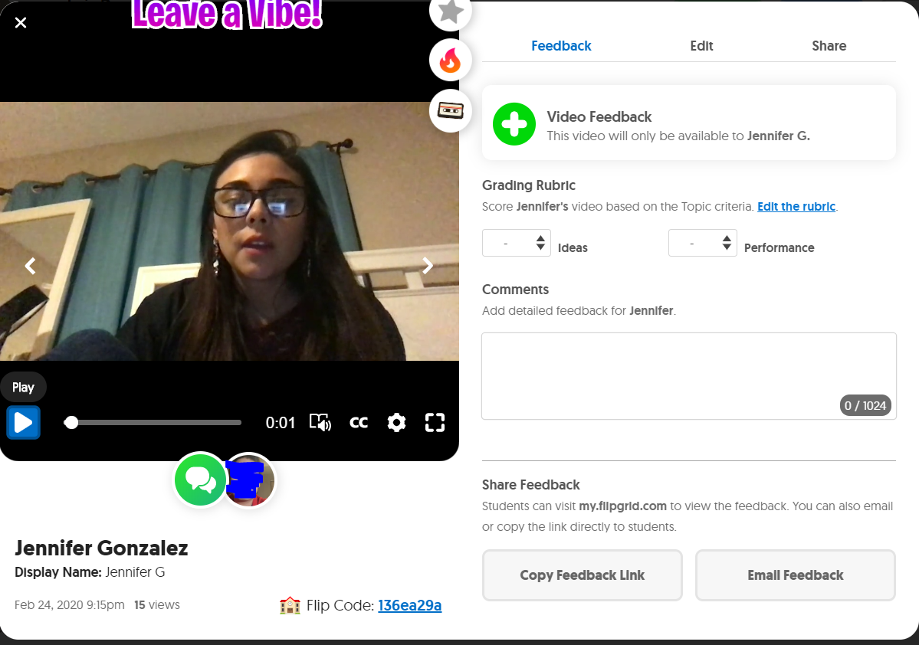
Feedback & Replies

Slide 39
Feedback & Replies

Slide 40
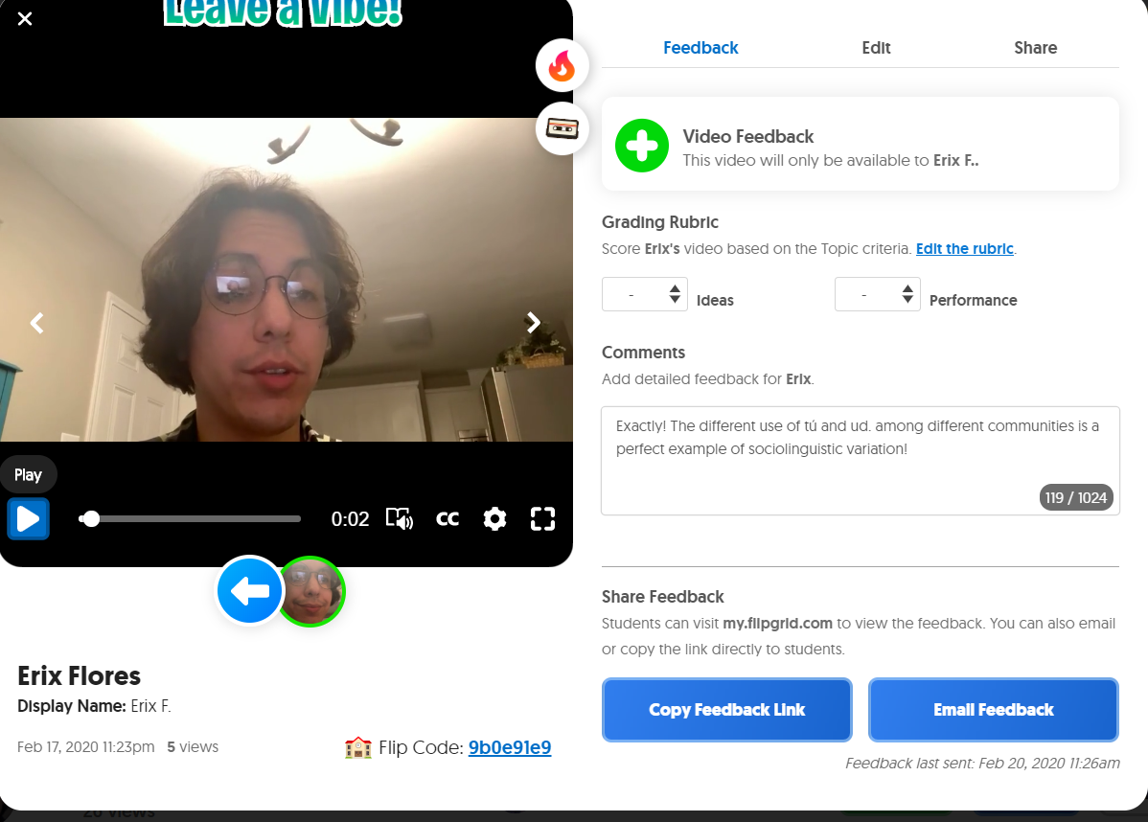
Feedback & Replies

Slide 41
Example Prompts
You may add a 'focus':
Image
Youtube Video
Recorded Video
Gif
Etc.

Slide 42
Kahoot: Online quiz game
Applications in the classroom:
Review
Check understanding
Formative feedback
Access:
Free access to all at kahoot.com
Students access the quiz through the unique code at kahoot.it
Notes:
Example on Fall 2019 ENGL 4370 Week 5

Slide 49
How to Create Kahoot Quiz

Slide 51
How to Create Kahoot Quiz

Slide 52
PollEverywhere: Free service for taking polls of student understanding or information, similar to clickers
Applications in the classroom:
Quick polls, quizzes
See graphs and responses in real time
Formative assessment
Access:
Free access at polleverywhere.com
You can integrate these into Powerpoint and Google Slides.
They are also quick to create 'on the fly.' (You can share these on your screen during a Zoom meeting.)
Great option for a starter activity or 'exit ticket.'

Slide 53
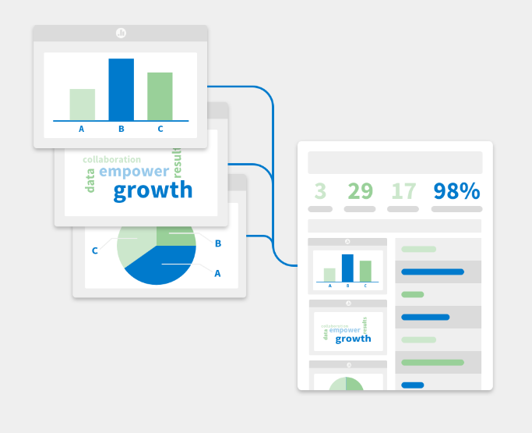
Options
Multiple choice
Scales/Ratings
1 word (Wordle)
Comment

Slide 58
How to Create a Poll on Polleverywhere

Slide 63
Calendly: Free online appointment scheduling software; syncs with Microsoft Outlook Calendar, including your UTRGV teaching and personal calendars.
Applications in the classroom:
Scheduling virtual office hours
Scheduling F2F office hours during busy times of the semester (required conferences, for example)
Calendly schedule syncs with UTRGV Outlook calendars for reminders.
Access:
The free version supports only one kind of meeting (meeting length, meeting title, single/multiple invitees) at a time.
There is an app form for smartphone use.
To create a Calendly account, click here.

Slide 64
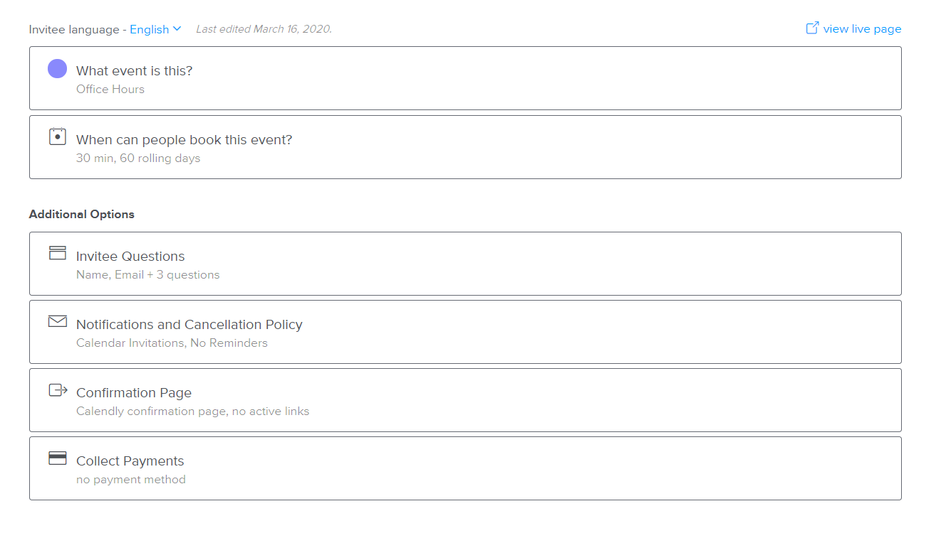

Slide 65
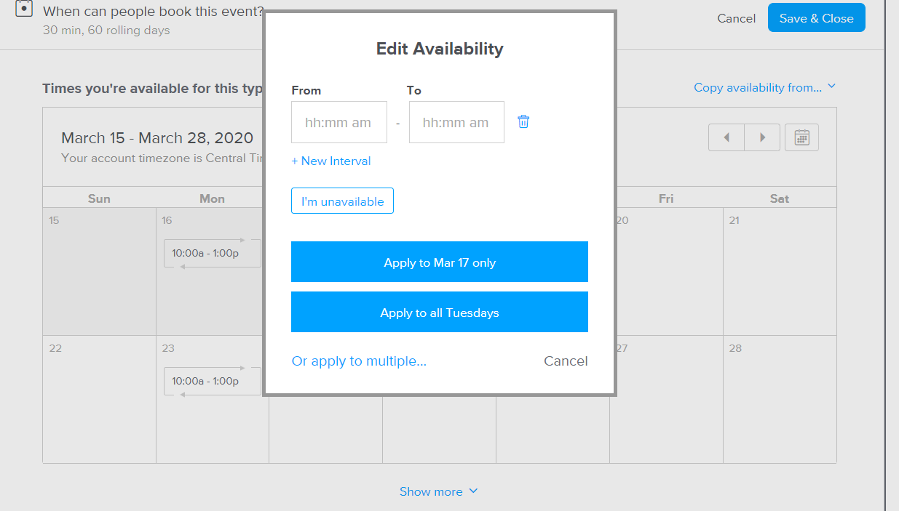

Slide 66
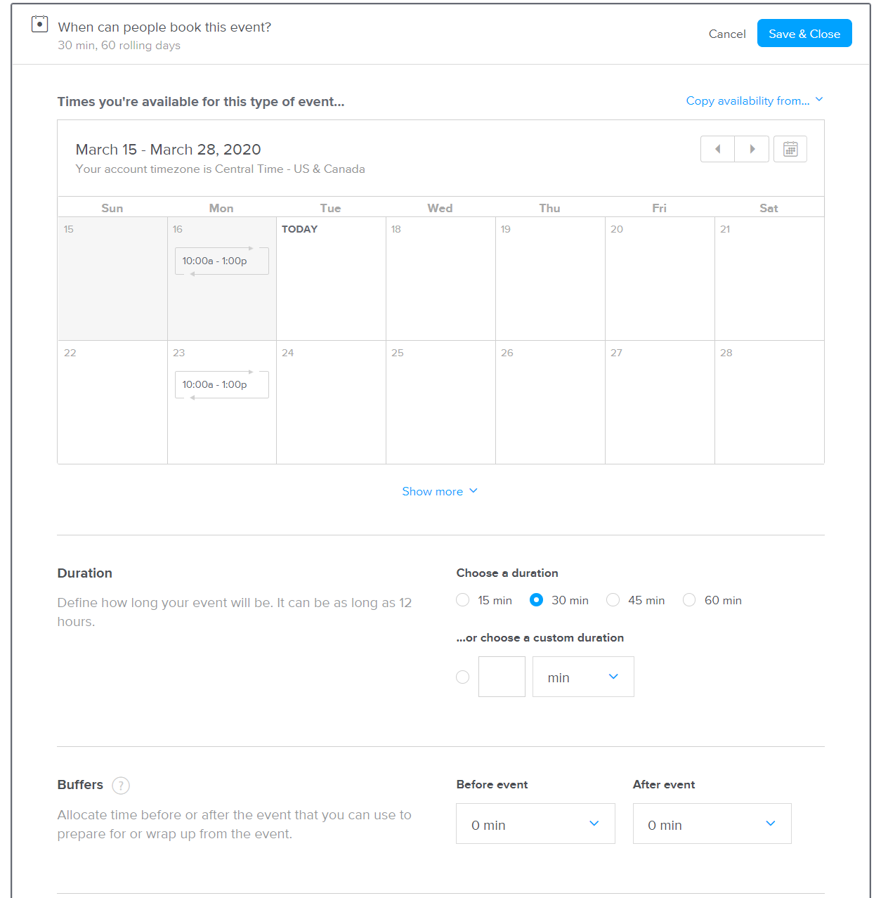

Slide 67
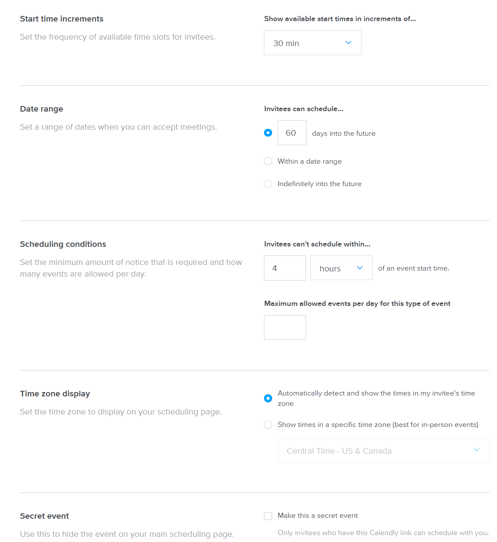

Slide 68
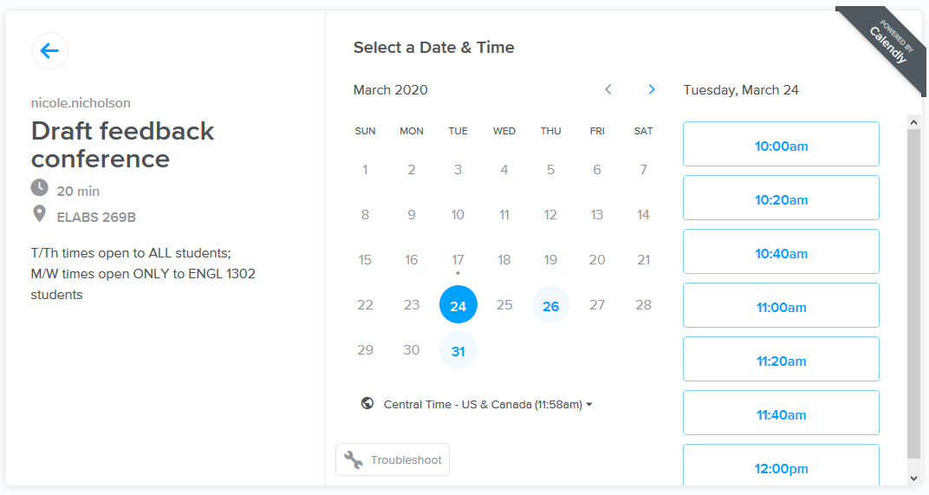
Sample scheduling page for office hours and conferences.

Slide 69
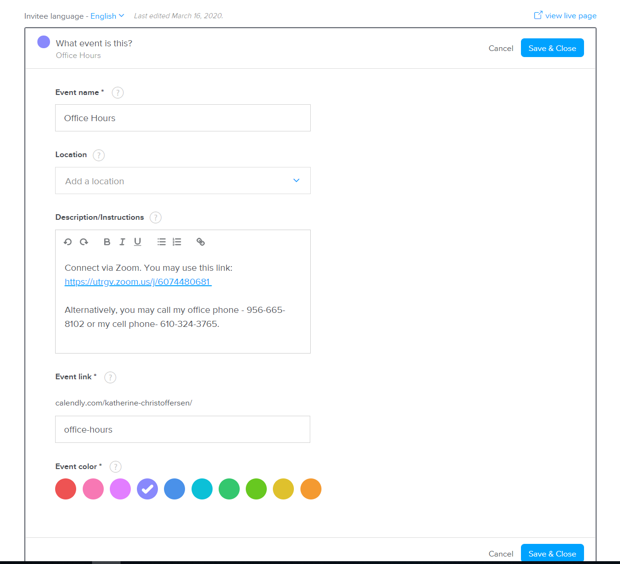

Slide 70
