Slide 1

2018

Slide 2
Financial aid updates
Jael Perez
Associate Director of Financial Aid

Slide 3


New FAFSA/TASFA Priority Deadline!
2018
Beginning with the 19-20 the FAFSA/TASFA Priority Deadline will be January 15!
UTRGV is changing it’s priority deadline to align with the new priority deadline set by the state of Texas!
This deadline is required for Texas Grant Priority Model

Slide 4
FAFSA/TASFA Updates

Slide 5
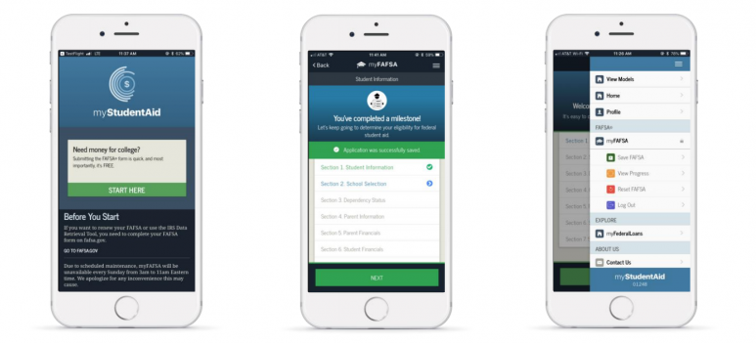
FAFSA Mobile App
On July 24, 2018 Federal Student Aid announced the launch of the new FAFSA mobile app: myStudentAid

Slide 6
myStudentAid App
myFAFSA: complete the FAFSA safely and securely from your mobile device
Profile: edit/manage an FSA ID
myFederalLoans: view federal student loan and aid history
Studentaid.gov: access FSA’s signature source of information on student financial aid products, processes and services
Contact Us: contact information for FSA’s contact centers

Slide 7
myFAFSA Features
The ability to begin, complete, and submit a new FAFSA form for the 2018–19 FAFSA processing cycle;
A customized experience based on whether they are a student, parent, or preparer. myFAFSA provides both guidance and assistance on how to answer the FAFSA questions, making the overall process more positive, engaging, and user-friendly; and
A secure channel with the same data protections as completing the FAFSA form through fafsa.gov.
A complete version of the mobile app is set to launch Oct. 1, in time for the beginning of the 2019-20 federal student aid cycle.

Slide 8

myFAFSA Drawbacks
Some of the current drawbacks of the myFAFSA app are:
You cannot submit a Renewal FAFSA
The IRS DRT Tool cannot be used on the mobile app
We do not have information at this time if these limitations are only temporary

Slide 9
FAFSA.GOV APPLICATION
The Free Application for Federal Student Aid (FAFSA) for 2019-20 year will be available on October 1st at www.fafsa.gov.
A student Must be a US Citizen or Lawful Permanent Resident in order to complete a FAFSA. DACA students are not eligible for Federal Student Aid, thus for the most part in Texas they should not be completing a FAFSA
Parents’ citizenship status is not relevant
Recommended Priority Deadline: January 15th
UTRGV Federal School Code: 003599

Slide 10
Changes on the 2018–19 FAFSA® Form
The 2018–19 FAFSA changes include the following:
The fafsa.gov website has an updated look with new colors and has been redesigned so that the site pages will fit the screen size and shape of any device, including desktop or laptop computers and mobile devices such as smartphones or tablets.
The "Help and Hints" display box has been replaced by "tool tips" that provide information about each FAFSA question.
While the number of questions on the FAFSA form remains the same, the questions are displayed in a more user-friendly way, with some now grouped in a different order to ease navigation through the site.

Slide 11
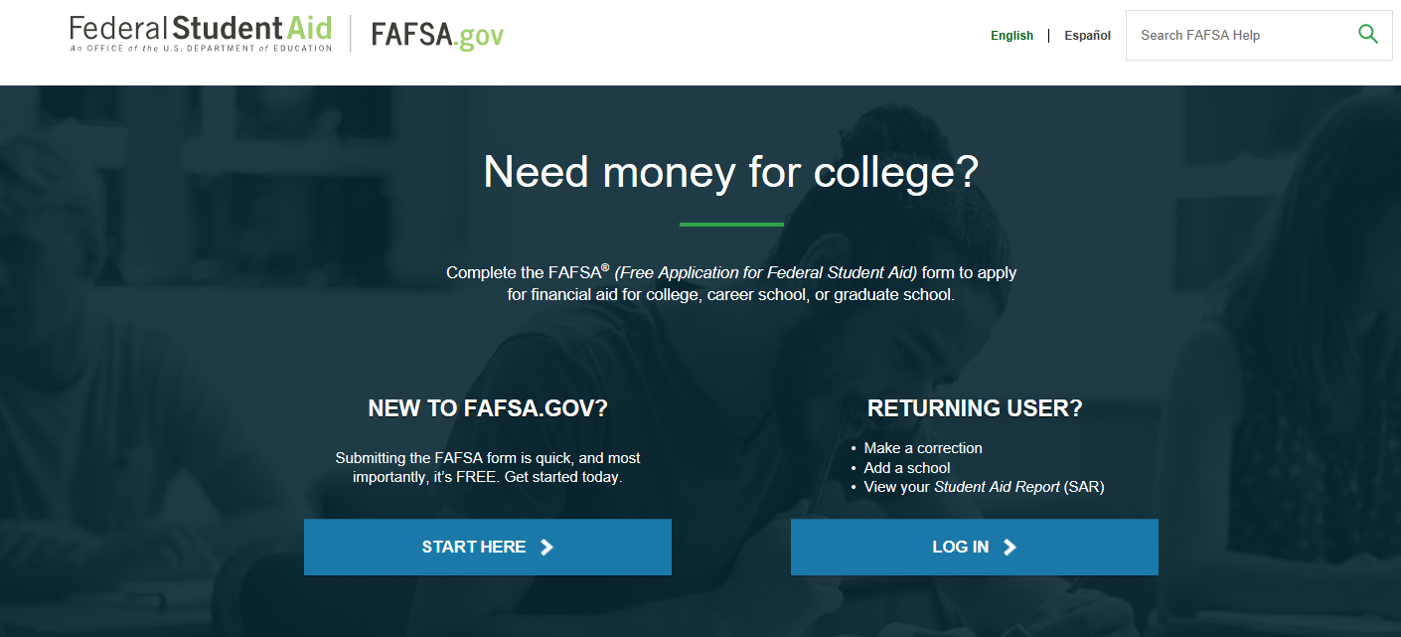

Slide 12
Information Needed
Parents and student (if applicable) need to have their tax return and W2’s from 2017 year in order to complete the FAFSA or use IRS Data Retrieval.
SSN number for student and parent (if applicable)
Permanent resident card for student (if applicable)
Other: Additional Financial Information and Untaxed Income information such as child support, veteran benefits, social security benefits, disability benefits.
FSA ID for student and parent (if applicable)

Slide 13
FSA ID Tips
Always create an FSA ID with an e-mail address (it’s the easiest way to retrieve if forgotten)
Student and parent must use a different e-mail address
Do not use a work or school e-mail. Use only a personal e-mail.
Student and/or parent should access the e-mail account (on a separate browser) before starting to create an FSA ID
Once FSA ID is created student/parent can validate e-mail immediately and this allows for their e-mail address to become the username for the FSA ID.
* If a parent does not have an SSN then he/she will sign the FAFSA using a signature page (do not use an ITIN for FSA ID)

Slide 14
IRS DATA RETRIEVAL
The IRS DRT will be available to use with the 2019–20 FAFSA on the web.
During the 2018-19 year additional security and privacy protections were added to address concerns that data from the tool could be used by identity thieves to file fraudulent tax returns.
The IRS DRT remains the fastest, most accurate way to input tax return information into the FAFSA

Slide 15
TASFA UPDATE

Slide 16
FAFSA OR TASFA
FAFSA: Federal student aid is only available to U.S citizens or legal permanent residents (number from permanent resident card required).
The TASFA is available for students applying at Texas public schools that are not U.S citizens or legal permanent residents, but that may be classified as Texas residents under SB 1528 law.
**Important**Students under Deferred Action for Childhood Arrivals (DACA) and meet the SB 1528 Law criteria should use the TASFA if applying for school accepting TASFA. Not a FAFSA. TASFA has a list of schools accepting TASFA.

Slide 17
Senate Bill Law 1528
Under Senate Bill Law 1528, a student that is not a U.S citizen or legal permanent resident can be considered a resident of Texas and be eligible to pay in-state tuition and to receive state financial aid. The requirements to qualify under this law are:
  Graduate from a Texas High School
  Have resided in Texas 36 months before graduating from High School
  Have resided in Texas 12 months prior to enrolling in a college or university
  Students that meet this criteria can complete a TASFA and they need to submit a Residency Affidavit to Admissions.

Slide 18
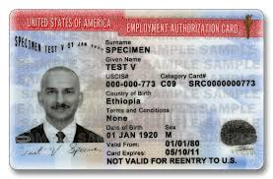

Deferred Action for Childhood Arrivals (DACA)
On June 15, 2012, the Secretary of Homeland Security announced that certain people who came to the United States as children and meet several guidelines may request consideration of deferred action for a period of two years, subject to renewal. This status protects individuals from deportation and provides work authorization and a Social Security number for work purposes. Deferred action does not provide lawful status or permanent residency.
Due to federal court orders, USCIS has resumed accepting requests to renew a grant of deferred action under DACA. USCIS is not accepting requests from individuals who have never before been granted deferred action under DACA
Students under DACA are still not eligible for federal aid, only state aid under the laws mentioned before. These students sometimes submit a FAFSA instead of a TASFA in error.

Slide 19
2019-2020 TASFA
New TASFA will become available on October 1, 2018.
Student must submit application in a timely manner, along with supporting information.
Due to limited state funding, the application must be submitted as soon as possible.
Available at
www.collegeforalltexans.com
www.aie.org
www.utrgv.edu/finaid
Recommended Priority Deadline: January 15th

Slide 20
TASFA 2019-20 Documents Needed
Parent(s) or student that did not file a 2017 Income Tax Return but worked, can submit a Notarized Statement of Income.
Parent(s) or student that filed a tax return in the U.S will need to submit a copy of the 2017 Return Transcript for disbursement but we will work with a copy of the 2017 tax return for awarding purposes. Return transcript can be requested at www.irs.gov under Get My Tax Record section.
Parent(s) that filed a foreign tax return, a copy will need to be provided
Selective Service Registration
All male students, ages 18 to 25, must register with the Selective Service System.
Students can register beginning 30 days before their 18th birthday
If student has a SSN, can register at www.sss.gov
If student does not have SSN, Form must be mailed to SSS Administration (must enter zeros in SSN fields).
A signed copy of the Selective Service Registration card or confirmation from SSS website must be provided to the Financial Aid Office.

Slide 21

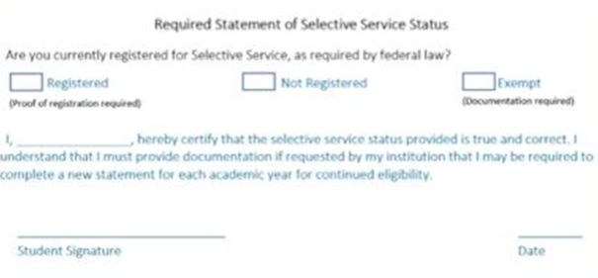
Required Statement of SSR Status

Slide 22
FAFSA/TASFA Reminders

Slide 23
Dependency
The student was born before January 1, 1996.
The student is married or separated (but not divorced) as of the date of the application. •
At the beginning of the 2019–2020 school year, the student will be enrolled in a master’s or doctoral degree program (such as MA, MBA, MD, JD, PhD, EdD, or graduate certificate, etc.).
The student is currently serving on active duty in the U.S. Armed Forces or is a National Guard or Reserves enlistee called into federal active duty for purposes other than training.
The student is a veteran of the U.S. Armed Forces (see the definition in the box on page 4).
The student has or will have one or more children who receive more than half of their support from him or her between July 1, 2019 and June 30, 2020.
The student has dependent(s) (other than children or spouse) who live with him or her and who receive more than half of their support from the student, now and through June 30, 2020. • At any time since the student turned age 13, both of the student’s parents were deceased, or the student was in foster care or was a dependent or ward of the court. •
As determined by a court in the student’s state of legal residence, the student is now, or was upon reaching the age of majority, an emancipated minor (that is, released from control by his or her parent or guardian).
As determined by a court in the student’s state of legal residence, the student is now, or was upon reaching the age of majority, in legal guardianship.
On or after July 1, 2018, the student was determined to be an unaccompanied youth who was homeless or was self-supporting and at risk of being homeless:
  by a high school or school district homeless liaison
  by the director of an emergency shelter or transitional housing program funded by the U.S. Department of Housing and Urban Development
  by a director of a runaway or homeless youth basic center or transitional living program
*A student that cannot check off at least one of these questions is required to provde parental data

Slide 24
Who is considered a parent for FAFSA/TASFA
For FAFSA/TASFA purposes parent refers to:
Biological parents
Adoptive parents
Step-parents-who is currently married to a living biological parent
For FAFSA/TASFA purposes a parent is not:
Foster parents
Legal guardians
Any family member who has not adopted the minor
A step-parent that is no longer married to biological parent or who is a widower of the biological parent
Note: It is important that student provides information for correct parent(s). If a student provides incorrect information can sometimes result in student owing thousands of dollars of financial aid. When in doubt please ask us!

Slide 25
FAFSA/TASFA Marital Status
FAFSA/TASFA Marital Status is as of the day the student completes the application. FAFSA/TASFA Marital Statuses cannot be updated after submission, they can only be corrected if they were reported incorrectly as of the day of FAFSA completion.
Student marital status options:
Single-if on the day you sign the FAFSA you are not married/remarried
Separated-if on the day you sign the FAFSA your divorced/separated and not living together
Married/Remarried-if on the day you sign the FAFSA you are married/remarried
Divorced or Widowed- on the day you sign the FAFSA you are married/remarried
Parent marital status options:
Married/Remarried
Never married
Divorced or Separated
Widowed
Unmarried and both legal parents living together

Slide 26
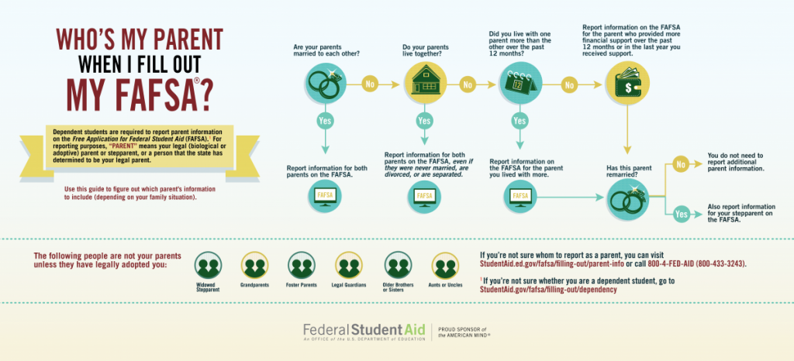

Slide 27
Special Circumstances
The information provided on the FAFSA or TASFA doesn’t always reflect accurately the family’s or student’s situation.
The family has unusually large medical bills or nursing home expenses that are not covered by insurance
The student or a parent lost his or her job or there has been a significant reduction in hours
The student has no contact with the parents and thus cannot provide parental information
The best thing you can do to help a student who has unusual circumstances is to help them fill out the FAFSA/TASFA as best as possible and inform student about contacting financial aid office of college he/she will be attending.

Slide 28
FAFSA Demo Site
The 2019-2020 Web Demonstration site will be available at https://fafsademo.test.ed.gov on September 30, 2018.The demonstration site can be used as a training tool for new staff.
You can access the demonstration site using eddemo as the User name and fafsatest as the Password.
The test site provides information and FSA IDs for test students.
Do not use real information on this site.

Slide 29
Common FAFSA Mistakes
Not answering High School Completion Status Question
Legal guardianship
Parent
Number of Family members
Number of Family members in College
Confusing parent information with student information
Entering information that doesn’t match the FSA ID information
Not providing required information

Slide 30
Verification updates

Slide 31
Verification Overview
Verification is the process by which a school confirms that the data reported on the FAFSA is accurate. Students selected for verification are requested to submit documentation that supports the information reported on the FAFSA.
Verification selection is done by the FAFSA using undisclosed algorithms; and some schools verify all students' FAFSA applications.
Also, schools are required to resolve any conflicting information, so a student can be selected for verification or requested to provide additional documents any time conflicting information is found either by what a student says, a document the student submits or a staff member noticing something on the file.

Slide 32
Verification Increase in 2018-2019
During the

Slide 33
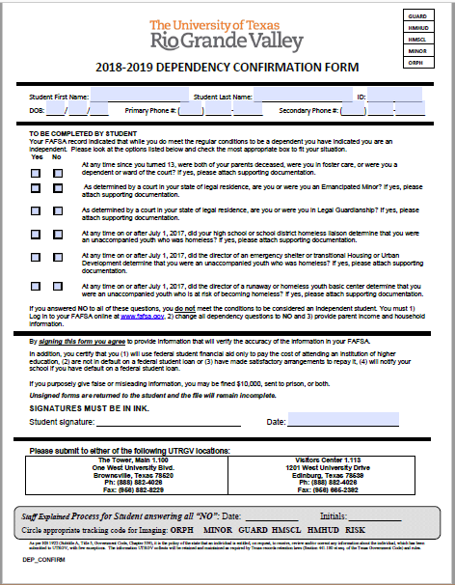
Dependency Confirmation Form
If the answer to ALL questions is No parent information is required
  The student should process a correction and update FAFSA with parent household, income tax data, and signatures
If the answer to at least 1 question is Yes parent information is NOT required
  The student should submit supporting documentation to the Financial Aid Office

Slide 34
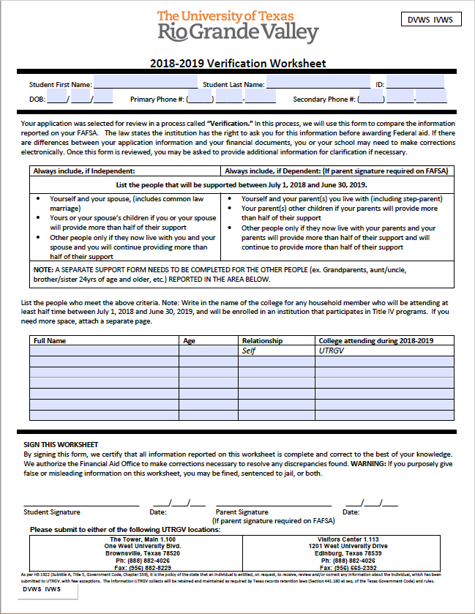
Verification Worksheet
Dependent Student
  Student
  Mother
  Father
  Siblings under 24
  All other household members will each require a support worksheet
Independent Student
  Student
  Spouse
  Children under 24
  All other household members will each require a support worksheet

Slide 35
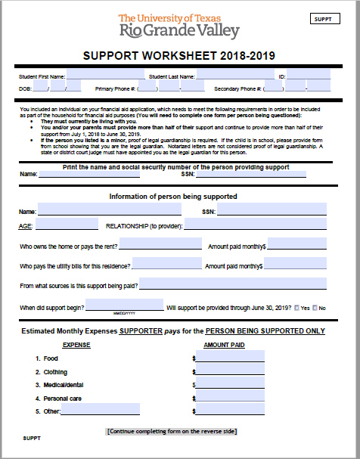
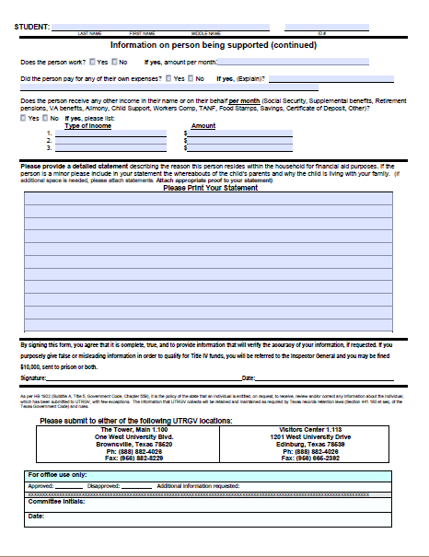
Support Worksheet
If the total amount from Page 1 is greater than the total amount from page 2 the person can be included in the household
Example
  Front Page Total = $750.00
    Food $300.00 + Clothing $100.00 + Mecical/Dental $250.00 + Personal Care $100.00.
  Back Page Total = $500.00
    Social Security check $250.00
  Included in household

Slide 36
UTRGV Non-Tax Filer Form: Dependent Student
For dependent students who did not file an Income Tax Return
  Copies of W2’s, or equivalent documents, for the year required if the student worked
A copy of the IRS Tax Return Transcript is required is required if the student filed an Income Tax Return
The IRS Verification of Non-filing Letter (IRSNFS) is NOT required

Slide 37
UTRGV Non-Tax Filer Form: Independent Student and Spouse
For each independent student, and spouse if applicable, who did not file an Income Tax Return
  Copies of W2’s, or equivalent documents, for the year required if the student worked
A copy of each of the IRS Tax Return Transcript is required if the student, and spouse if applicable, filed an Income Tax Return
The IRS Verification of Non-filing Letter (IRSNFS) IS required for each

Slide 38
UTRGV Non-Tax Filer Form: Parent(s) with SSN
For each parent(s) who did not file an Income Tax Return
  Copies of W2’s, or equivalent documents, for the year required if the parent(s) worked
A copy of each of the IRS Tax Return Transcript is required if the parent(s) filed an Income Tax Return
The IRS Verification of Non-filing Letter (IRSNFS) IS required for each parent

Slide 39
UTRGV Non-Tax Filer Form: Parent(s) without SSN/ITIN
For each parent(s) who did not file an Income Tax Return
  Copies of W2’s, or equivalent documents, for the year required if the parent(s) worked
A copy of each of the IRS Tax Return Transcript is required if the parent(s) filed an Income Tax Return
The IRS Verification of Non-filing Letter (IRSNFS) NOT required for

Slide 40
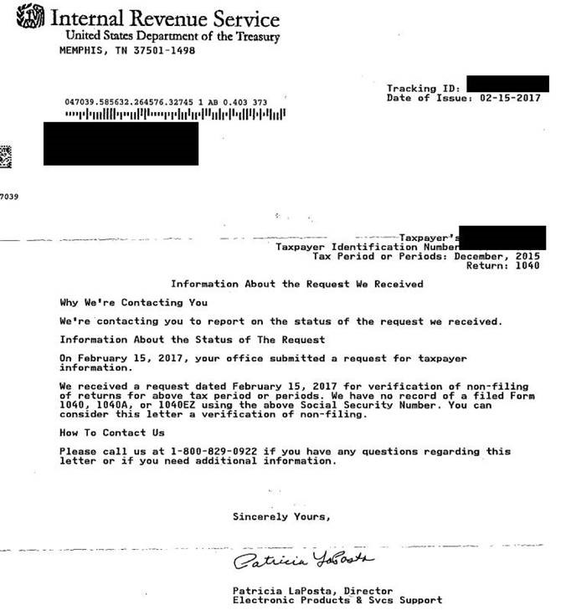
IRS Verification on Non-Filing Letter
Available at: https://www.irs.gov
  Follow the steps to Get Transcript ONLINE and select Verification of Nonfiling Letter, print it out.
Or IRS Form 4506-T
Required for each:
  Independent students
  Parent(s) with SSN’s
  Spouses
  **Not required for dependent students

Slide 41
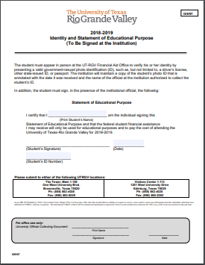
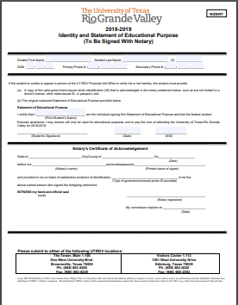
IDENTITY AND STATEMENT OF EDUCATIONAL PURPOSE
Statement of Educational Purpose
    Must be filled out in the presence of UTRGV staff, signed by UTRGV staff at time of submission
    Notarized Statement – filled out with a notary, identification used with notary must be submitted
Identity
  Valid/unexpired government-issued photo ID
High School Completion
  An official high school transcript must be submitted to the institution

Slide 42
IRS Flag 06
IRS Flag 06: The Parent or the Student initially used the IRS Data Retrieval Tool then another transaction was processed that called into question the use of the IRS retrieval.
  UTRGV staff review file to see what additional documentation, if any, is required. Additional documents are added.

Slide 43
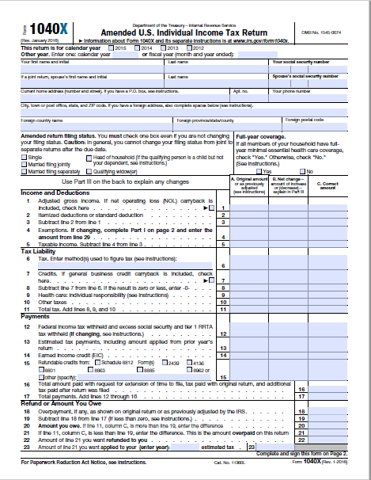
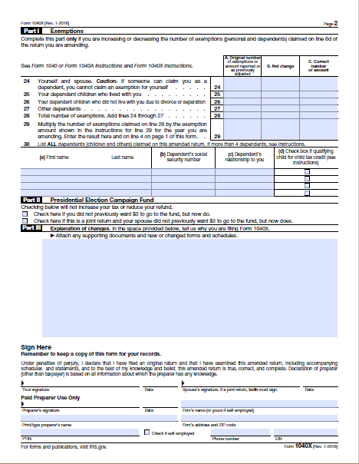
IRS Flag 07
IRS Flag 07: The Parent or the Student used the IRS Data Retrieval Tool to import their tax information from the IRS and the IRS determined they amended their Income Tax Return.
  A signed copy of the Amended Income Tax Return is required along with
  The new Tax Return Transcript (with amended information) and
  The printed original Tax Return Transcript

Slide 44
Comment Codes 400
For Parents of Dependent Students
  Parent is a tax filer (FAFSA Question 80) and the AGI retrieved from the IRS is zero, but the total income earned from work (FAFSA Questions 88 and 89) is greater than zero.
  The total of the Additional Financial Information fields reported on the FAFSA form (FAFSA Questions 93a-f) is greater than the AGI transferred from the IRS.
  Any item from the FAFSA list of Untaxed Income (FAFSA Questions 94a-i) is equal to or exceeds the AGI transferred from the IRS.
UTRGV staff review file to see what additional documentation, if any, is required. Additional documents are added.

Slide 45
Comment Codes 401
Not visible to student in ASSIST
For Dependent and Independent Students
  Student is a tax filer (FAFSA Question 32) and the AGI retrieved from the IRS is zero, but the total income earned from work (FAFSA Questions 39 and 40) is greater than zero.
  The total of the Additional Financial Information fields reported on the FAFSA form (FAFSA Questions 44a-f) is greater than the AGI transferred from the IRS.
  Any item from the FAFSA list of Untaxed Income (FAFSA Questions 45a-j) is equal to or exceeds the AGI transferred from the IRS.
UTRGV staff review file to see what additional documentation, if any, is required. Additional documents are added.

Slide 46
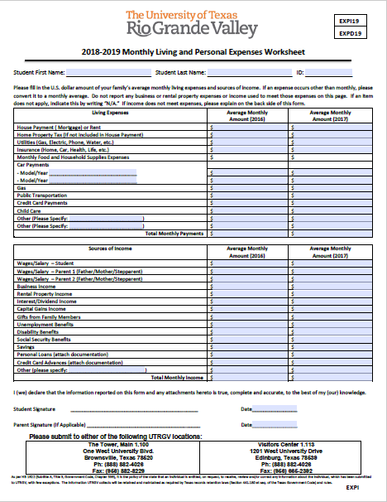
Student Monthly Income Worksheet
Required for students who:
  Have children or legal dependents
  Are dependent by age (less than 24)
  Are not married
  Report income less than $10,000.00

Slide 47
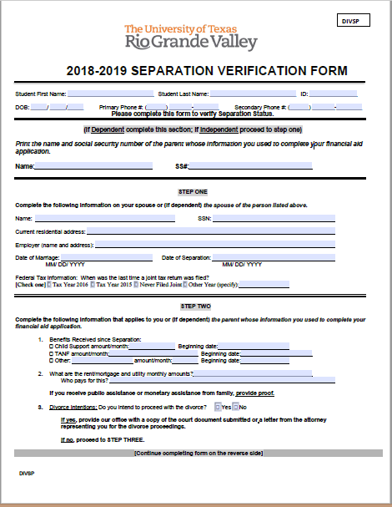
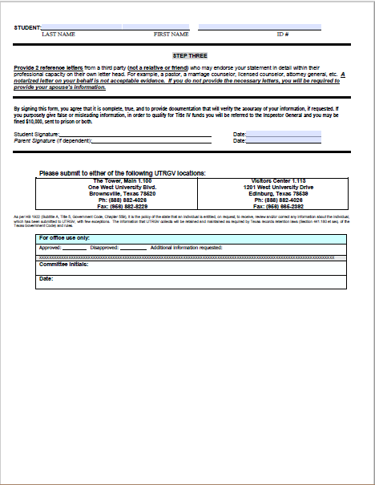
Separation Verification

Slide 48
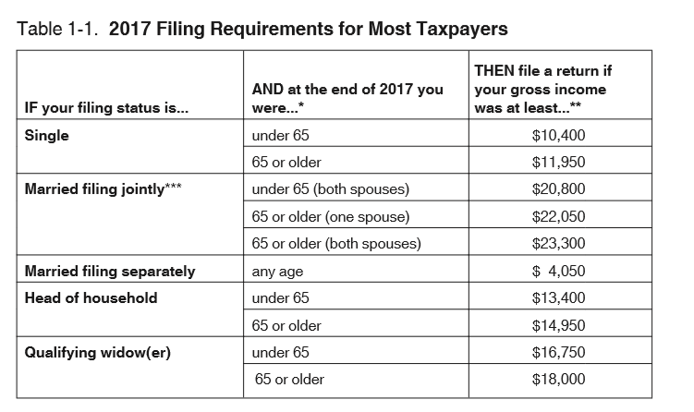
Tax Filing
In order to receive financial aid, individuals must follow IRS regulations and file a tax return if required and using appropriate filing status.

Slide 49
Tax Filing
Filing requirements: In order to receive federal or state aid, individuals must follow IRS regulations and file a tax return when required. FAFSA has built in logic that will give an error when a student or parent enters wages above the tax filing threshold and have not indicated that have filed or will file. If you encounter this you cannot proceed without changing to “will file.” On the TASFA these thresholds will be checked when the TASFA is reviewed.
Filing status for tax purposes-Determined by marital status as of the last day of the year (December 31).
  Single
  Head of Household
  Married filing joint return
  Married filing separate return-Need both tax returns

Slide 50
Tax Filing
Married taxpayers can usually only file as married filing separately or married filing jointly. Same sex parents are considered married for IRS purposes if married in a state where it is legal.
Exception: a married person can file as Head of Household when a U.S citizen or permanent resident is married to a non-permanent resident spouse and they have dependent children . The non-permanent resident spouse cannot file as Head of Household too! There can never be two Heads of Household for the same household.
Married spouses living apart due to temporary absences such as: illness, education, business, vacation, or military service are not considered separated
In the case of unmarried parents living together only one parent can file as Head of Household.
When in doubt use Interactive Tax Assistant www.irs.gov
FAFSA now asks for tax return filing status!
Following proper IRS regulations is mandated and incorrect information can often result not only in student owing thousands of dollars for financial aid received but also either student or parent owing thousands of dollars to IRS.

Slide 51
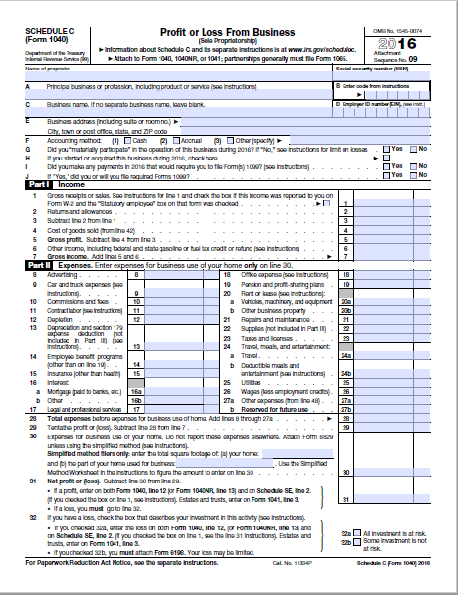
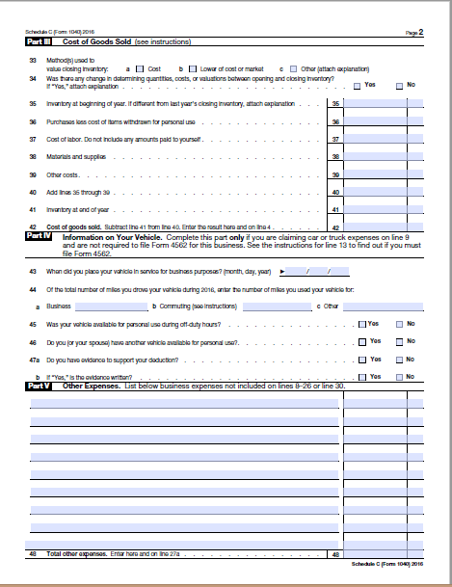
Schedule C
When a non-tax filer earns $400.00 or more in the United States they are generally required to file an Income Tax Return for the year.
Schedule C is used to determine if after expenses the Net Profit is equal to or greater than $400.00
  Net Profit >= $400.00: required to file
  Net Profit < $400.00: NOT required to file

Slide 52
Verification
Even though students are notified at point of FAFSA completion. Do not submit verification documents until requested by UTRGV
Systems may not be in place to begin collecting documents for new year and documents submitted could get lost.
All verification worksheets and documents will be found at https:// utrgv.edu/finaid for appropriate year.
Verification documents can be submitted via the document portal Document Central https://enrollment.utrgv.edu/DocumentCentral , via e-mail at finaid@utrgv.edu or in person at U Central or handed to a UTRGV representative visiting the campus. Please write student ID on any copies of documents submitted. Mailing forms is not recommended.
It’s important to check back after having submitted documents. Often more questions arise after initial submission and additional documents can be requested.

Slide 53
Application Deadlines
Financial aid funding is limited for many programs, so it’s important for students to submit their applications on time.
FAFSA priority deadline: January 15
TASFA state application deadline: January 15
UTRGV scholarship application deadline: December 1st
Summer notification priority deadline: February 15
FAFSA deadline for the current year: June 30*

Slide 54
UTRGV Institutional Programs

Slide 55
UTRGV Achieve
The UTRGV Achieve Program will cover a gap in tuition and fee expenses and $500 of book expenses per semester for the regular academic year (fall and spring) that is not being covered by other forms of gift aid (grants or scholarships), including Federal, State , private, and institutional aid.
Have a family income of $50,000 or less and demonstrate financial need as reported on the FAFSA/TASFA.
Be classified as a Texas Resident
Be enrolled for 15 hours or more per semester
Be enrolled as an undergraduate in a degree-seeking program towards a first Bachelors’ degree.
Entering Freshman with an ACT composite of 19, SAT composite of 900 or be in the top 10% of graduating class
Priority will be given to students that have filed the FAFSA/TASFA for the upcoming academic year by January 15th

Slide 56
UTRGV Assistance Scholarship
The scholarship is primarily intended to provide gift assistance to needy students currently receiving little or no gift aid. The maximum award amount is $2,250.
An entering freshman must:
have minimum ACT composite score of 20, or a SAT composite score of 950, or be in the top 10% of their high school graduating class.
Must be enrolled full-time
Must file the FAFSA/TASFA & demonstrate high financial need
Must not have TEXAS Grant
Must be a Texas resident
Must have Fall/Spring Pell under $3,000 ($1,500 per semester)

Slide 57

UTRGV Tuition Guarantee and Tuition Savings
UTRGV tuition uses guaranteed tuition plans for resident and non resident students. This means that tuition will not increase during the guarantee period. For example: a new entering freshman is guaranteed the same tuition rate for 4 years!
UTRGV in-state tuition is capped at 12 hours per semester. This means that additional courses taken above 12 hours are free. So, if a student enrolls in 15 hours, the extra class is free. If a student enrolls in 18 hours, the two extra classes are free.

Slide 58
Reminder!!
If a student is choosing to begin college during summer, he/she must complete the current year FAFSA (2018-2019) application before June 30.
If a student is applying to UTRGV and is not TSI clear. He/she will be required to attend during the summer so he/she will need to complete the current year FAFSA (2018-2019) application before June 30.
Best practice is to have any student that does not clear TSI on the first try and is attending UTRGV to complete a 2018-2019 FAFSA and then keep on trying to retest. There is no harm in completing a current year FAFSA and not needing it after the fact.
Many students in this situation missed the deadline to complete a current year FAFSA this summer!

Slide 59
2018 FAFSA/TASFA Super Saturday
This year’s FAFSA/TASFA Super Saturday will take place on:
October 13, 2018
9:00 AM to 2:00 PM
Visitor’s Center in Edinburg
The Tower in Brownsville

Slide 60
Resources
  For additional information, please visit:
  www.utrgv.edu/finaid
  www.utrgv.edu/scholarships
  www.utrgv.edu/askrio
  www.utrgv.edu/americorps
  www.studentaid.gov
  www.collegeforalltexans.com
  www.rgvfocus.org

Slide 61

UTRGV Financial Aid Office
www.utrgv.edu/finaid
www.utrgv.edu/askrio
FinAid@utrgv.edu
(888) 882 – 4026
Edinburg Location:
1st Floor Student Services Building (SSBL)
1201 West University Drive
Edinburg, Texas 78539
Brownsville Location:
The Tower, Main 1.100
1 West University Boulevard
Brownsville, Texas 78520
Hours:
8:00 – 5:00pm M, W, Th, 8:00 – 6:00pm Tu, 8:00 – 5:00pm F

Slide 62
Contact Information
Jael Perez
Associate Director of Financial Aid Operations and Community Liaison
956-665-2958 • jael.garcia@utrgv.edu
Brownsville • Edinburg • Harlingen

