Slide 2
Dara Newton
Associate Vice President for Strategic Enrollment

Slide 3
Andrea Yen
Director Undergraduate Recruitment

Slide 4
Office of Undergraduate Recruitment
Carlo Tamayo- Associate Director (Transfer)
Lacy Culpepper- Outreach Rep (STC)
Ruby Rodriguez- Outreach Rep (San Antonio)
Brenda Rodriguez- Coordinator
Krystal Marroquin- Coordinator

Slide 5
Academic Programs
New College Structure
School of Nursing
School of Social Work
College of Health Professions
New Department Structure
Sociology
Anthropology

Slide 6
Academic Programs
Statistics (BS)- College of Science
Sustainable Agriculture and Food Systems (BS)- College of Science
American Sign Language Interpretation (BS)- College of Health Professions
Fall 2020

Slide 7
UTRGV Accomplishments
Classified as Doctoral University- High Research Activity (R2)
Ranked 3rd among public universities in Texas that provide the best value
Best Colleges for Your Money 2019 rankings

Slide 8
UTRGV Accomplishments
Ranked 1st in Texas and 19th nationally with a 2019-20 price of attendance
Best Colleges for Your Money 2019 rankings
“First Class” of UTRGV graduated December 2018 and May 2019

Slide 9
Commitment to Improvement
Grand Openings
Brownsville: Interdisciplinary Academic Building
Edinburg: Interdisciplinary Engineering and Academic Building

Slide 10
Fall 2019 Enrollment
Total Enrollment – 29,463*
Freshman Enrollment – 4818*
Transfer Enrollment – 1830*
*Enrollment as of 9-4-2019, Unofficial

Slide 11
Upcoming Events
Discover UTRGV- New Fall Dates
Vaquero Academic Excellence Day (Invite Only)
Brownsville: Nov. 15
Edinburg: Oct. 14, Nov. 1
Transfer Tuesdays
Sept. 24, Oct. 22, Nov. 26
UTRGV Promise Night- Early Spring

Slide 12
Other Items
Counselor Packets
Counselor Website
Counselor Portal

Slide 13
Marybel Villasenor Garcia
Director Undergraduate Admissions

Slide 14
New for Fall 2020
Superscoring for SAT starting with applications for Fall 2020.
Highest score per section – all test dates matter!
Evidence-Based Reading and Writing | Math | Total Score | Test Date
400 | 350 | 750 | 8/1/2019
380 | 500 | 880 | 9/1/2019
400 | 500 | 900 | Superscore

Slide 15
How to Apply
Freshman Applicants
ApplyTexas (Domestic/International)
Essay (1 topic)
ACT/SAT scores
High School transcript or high school equivalency
Texas Private High School Certification form (if attended private HS in Texas)

Slide 16
How to Apply
International Applicants (additional requirements)
Foreign credential evaluation – FCSA/WES (if attended foreign high school)
English language proficiency – TOEFL/IELTS (if attended foreign high school)
$50 application fee (International applicants only)

Slide 17
How to Apply
Transfer Applicants
ApplyTexas (Domestic/International)
College Transcripts
$50 application fee (International applicants only)

Slide 18
Admissions - Reminders
High school seniors that choose to attend another college/university after graduation, are eligible to apply to UTRGV as Transfer students for a later term.
Transfer students must have an overall 2.0 GPA for admission and must submit transcripts from all college/universities attended.
If transfer student has less than 24 earned hours, student must also submit ACT/SAT scores and final high school transcript.

Slide 19
Admissions - Reminders
Applications for Fall 2020 available July 1st, 2019
Priority Deadline for Fall 2020: February 1st, 2020.
Essay and ACT/SAT scores needed for all Freshman applications, including top 10%.
Encourage students with Advanced Placement or International Baccalaureate scores to send them to UTRGV. Scores can be considered in holistic review.

Slide 20
Admissions - Reminders
Encourage students who have Dual Credit to send college transcript to UTRGV, credit can be considered in holistic review.
High school transcript must contain GPA, ranking (if applicable), junior year completed.
TREX transcripts preferred.

Slide 21
Admissions - Reminders
Non-TREX transcripts can be uploaded by counselor through counselor portal or by student through the student portal. https://enrollment.utrgv.edu/documentcentral
Needed for Enrollment:
Proof of TSI assessment and proof of vaccination against bacterial meningitis or exemptions are not considered during the admission decision process. These items are required as part of the enrollment process and are needed at time orientation/registration.

Slide 22
Communication to Students
Applicants will receive:
Email acknowledging application receipt
Email with UTRGV credentials (for first time applicants)
Emails and Letters about missing documents
Email and Letter about admission decision
Admitted students will also receive:
Emails to RSVP for New Student Orientation
Email about Texas Residency to qualify for In-State tuition (if applicable)
Email to submit final high school transcript

Slide 23
Admissions - Updates
New Director for Undergraduate Admissions:
Marybel Villasenor Garcia
marybel.villasenor@utrgv.edu
(956) 665-2957

Slide 24
UTRGV Student Stories

Slide 25
Kimberly Garcia
Promise Coordinator- Student Academic Success

Slide 26
Title Goes Here
The UTRGV Promise is OUR promise to
First Year Students that we will support them in their journey to graduate in four years.

Slide 27
This will save time and money.
We will work with to help them take advantage of experiences like internships, undergraduate research, and service learning.
We’ll even pay their tuition and fees if you follow the promise and don’t graduate in four years!

Slide 29
The Student Will:
Complete the required high impact educational practices identified in your College Promise Plan.
Visit your Promise Advisor at least twice a year.
Complete required Career Connection activities each year to link academic progress to career development.
Complete at least 30 academic hours each year (not including repeated or developmental courses)
Maintain a 2.5 GPA and earn no lower than the minimum course grade required for those courses with a minimum grade requirement
Complete the courses identified as critical on your College Promise Plan at the time indicated on the plan in order to stay on track.
Register for classes on your degree plan within the first 48 hours of registration eligibility for Fall and Spring semester registration. Notify your Promise Advisor no later than the study day of the current semester if unable to register for a required major course offered in the next semester.
Gain admission to their major by the beginning of the fall semester of your junior year if the major requires admission.
Maintain good standing with UTRGV including with the Financial Aid, Student Accounts, and Student Rights and Responsibilities offices.

Slide 30
UTRGV Will:
Maintain your same tuition and fee rates for the full four years of your undergraduate studies.
Make sure that you have access each semester to the courses you need to make progress in your major and to graduate in four years.
Provide high impact educational experiences to you during your undergraduate studies, such as access to academic internships, undergraduate research experiences, and writing-intensive courses.
Provide opportunities to connect with peers through study groups, volunteer activities, leadership activities, and student organization activities.
Provide supportive and accurate academic advising.
Provide opportunities for career exploration and preparation through the Career Center and through Career Connection activities designed for our Promise students.
If you are unable to graduate in four years despite meeting your obligations, the university will either make appropriate adjustments in your course requirements so that you can graduate in four years or will pay the tuition and fees for any coursework you are required to take beyond four years.

Slide 31
Colleges:
Robert C. Vackar College of Business and Entrepreneurship
College of Education and P-16 Integration (Bilingual, ESL, & Special Ed)
College Health Professions (Health & Rehabilitation Services)
College of Liberal Arts
College of Sciences

Slide 32
Fall 2020:
College of Engineering and Computer Science
College of Fine Arts
College of Nursing
College of Social Work

Slide 33
UTRGV.EDU/Promise

Slide 34
Promise@utrgv.edu (956)665-4021 utrgv.edu/promise

Slide 35
College Fair

Slide 36
Jesus Buitron
Scholarship Coordinator- Scholarship Office

Slide 37
Scholarship Team
Brenda Garcia
Director of Scholarships and Enrollment Communications
Phone: 956-665-2507
Email: brenda.garcia@utrgv.edu
Brenda Cowart
Assistant Director of Scholarships
Phone: 956-665-2935
Email: brenda.cowart@utrgv.edu
Ashley Resendez
Scholarship Coordinator
Phone: 956-665-3348
Email: ashley.resendez@utrgv.edu
Beatriz Guzman
Scholarship Coordinator
Phone: 956-665-3350
Email: beatriz.guzman@utrgv.edu
Jesus Buitron
Scholarship Coordinator
Phone: 956-665-2935
Email: jesus.buitron@utrgv.edu

Slide 38
Online Scholarship Application
www.utrgv.edu/ApplyScholarships
UTRGV Excellence Scholarship Application
Deadline: December 1, 2019
One-time award offer; must apply each year
VAMOS/UTRGV Endowed Scholarship
Deadline: February 15, 2020
4 year renewable, valued up to $10,000
Application becomes available the 1st week of October
Students must be admitted prior to
December 1st, 2019 to be considered for scholarships

Slide 39
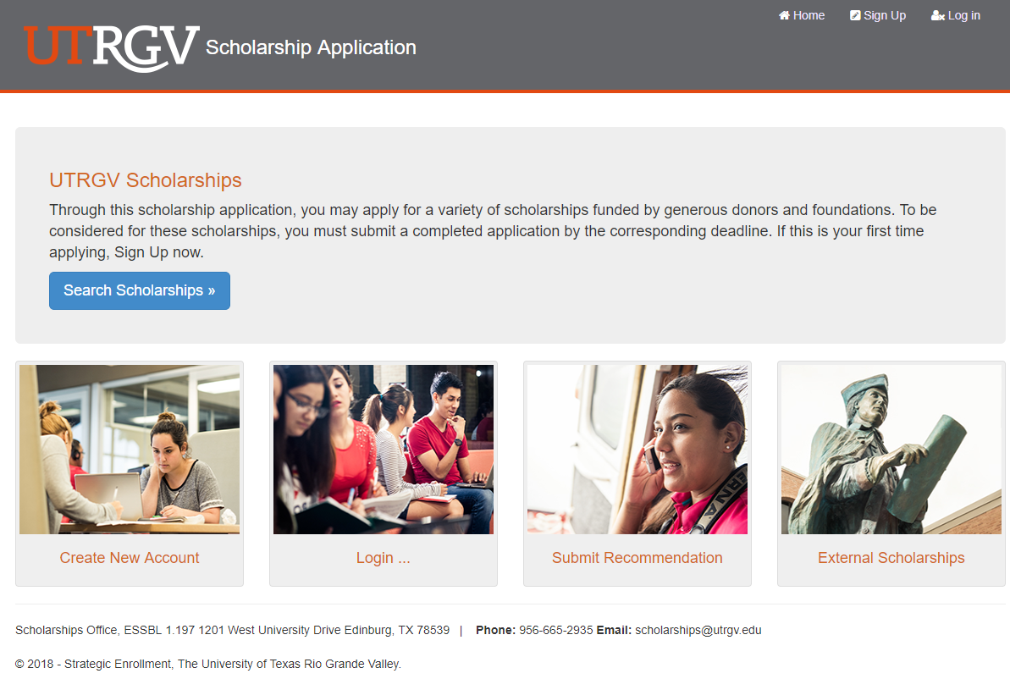
Online Scholarship Application
Body copy

Slide 40
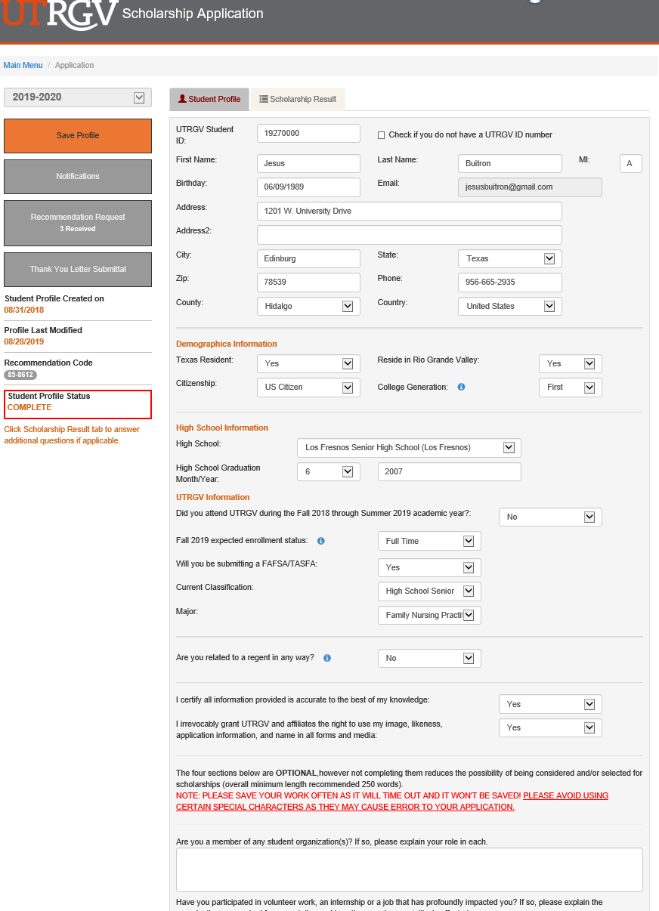

Slide 41
Merit Based Scholarships
Merit-based scholarships are awarded competitively and do not require the submission of a scholarship application. Instead, students are selected holistically based on their admissions application.
To be considered, students must be admitted to UTRGV by December 1, 2019.
Dual Enrollment students are required to submit their college transcript prior to December 1, 2019 in order to be considered for these scholarships.
Awards are offered on a first come first served basis until funds are exhausted

Slide 42
UTRGV Scholar Cohort Program
Program Description:
4-year renewable scholarship offered to new entering freshmen
To be considered, students must be admitted to UTRGV by December 1st, 2019.
UTRGV Presidential Scholarship – Valued up to $32,000
$8,000 per academic year ($4,000 Fall/Spring term)
UTRGV Meritorious Scholarship – Valued up to $20,000
$5,000 per academic year ($2,500 Fall/Spring term)
Awards are offered on a first come first served basis until funds are exhausted

Slide 43
UTRGV Gateway Scholarship
Program Description:
One-time scholarship offered to new entering freshmen
To be considered, students must be admitted to UTRGV by December 1st, 2019.
Award offer varies from $1,000 to $3,000
Awards are offered on a first come first served basis until funds are exhausted

Slide 44
UTRGV Housing Scholar Cohort Program
Program Description:
4-year renewable scholarship offered to new entering freshmen
For out of area students only
To be considered, students must be admitted to UTRGV by December 1st, 2019.
UTRGV Housing Scholarship - Valued up to $12,000
$3,000 per academic year ($1,500 Fall/Spring term)
Awards are offered on a first come first served basis until funds are exhausted

Slide 45
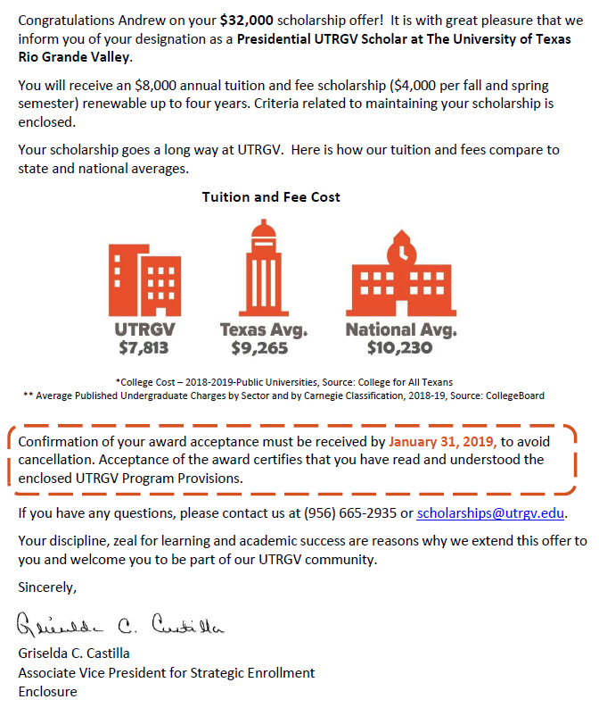

Slide 46
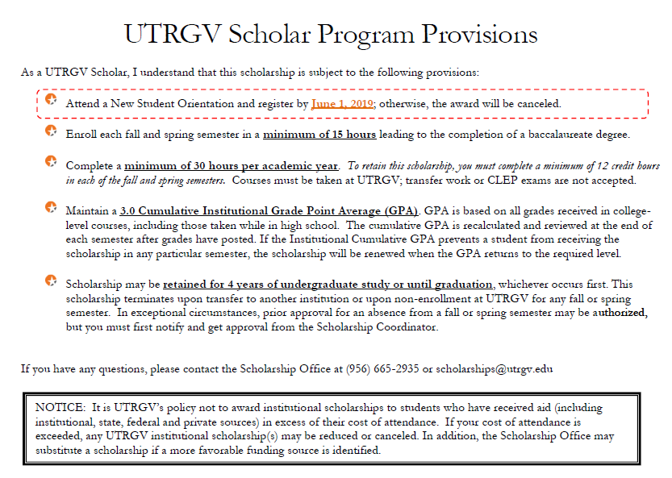

Slide 47
www.StarsScholarship.org
January 1st through March 31, 2020
Scholarship Criteria
Be a U.S. citizen or a legal permanent resident with a permanent resident card or passport stamped I-551.
Be a permanent resident (5 or more consecutive years) of and have a permanent South or West Texas address in one of our 30 counties.
Have earned/completed at least 12 undergraduate credit hours at a U.S. accredited college or university before applying for the scholarship.
Have a minimum college cumulative grade point average (GPA) of 2.7 on a 4.0 scale.
Have completed a high school diploma or its equivalent prior to the Fall of the new academic year.
Are enrolled in a U.S. accredited 2 yr. community college (enrolled part-time or full-time) in a degree-seeking program, or a 4yr. university undergraduate program (enrolled full-time) seeking a Bachelor's Degree, or a university graduate program (enrolled full-time) seeking a Master's, Law or Doctorate degree

Slide 48
www.TheDream.us
November 1st, 2019 through February 27, 2020
Application must be submitted online by the deadline. If selected, student will need to renew each year.
Valued up to $29,000 for tuition and fees
Eligibility Criteria
Have graduated or will graduate from high school by the end of the 2019-2020 academic year with a GPA of 2.5 or better on a 4.0 scale;
Are not enrolled in college at any time in the 2019-20 academic year (excluding enrollment in a high school pre-college or dual enrollment program);
Intend to enroll full-time in an associate’s or bachelor’s degree program at one of TheDream.US Partner Colleges no later than the Spring of 2021;
Are eligible for in-state tuition at the Partner College they wish to attend;
Have DACA or TPS or certify that you meet the immigration eligibility criteria set forth below;
You came to the United States before reaching their 16th birthday; and
Have significant unmet financial need.

Slide 49
The Excellence Scholarship application is only available from
October 1st,2019 through December 1st, 2019
Students must be admitted to UTRGV
prior to December 1st, 2019
Awards are offered on a first come first served basis until funds are exhausted

Slide 50
Questions?
For more information
Call us: 956.665.2935
Or email: scholarships@utrgv.edu
Visit our website: www.utrgv.edu/scholarships

Slide 51
Financial Aid Office

Slide 52
Financial Aid Updates
Jael Perez
Teresa Villarreal
UTRGV Financial Aid Office

Slide 53
FAFSA/TASFA Updates

Slide 54
FAFSA Mobile App

Slide 55
myStudentAid App
myFAFSA: complete the FAFSA safely and securely from your mobile device
Profile: edit/manage an FSA ID
myFederalLoans: view federal student loan and aid history
Studentaid.gov: access FSA’s signature source of information on student financial aid products, processes and services
Contact Us: contact information for FSA’s contact centers

Slide 56
myFAFSA Features
The ability to begin, complete, and submit a new FAFSA form for the 2020–2021 FAFSA processing cycle;
A customized experience based on whether they are a student, parent, or preparer. myFAFSA provides both guidance and assistance on how to answer the FAFSA questions, making the overall process more positive, engaging, and user-friendly; and
A secure channel with the same data protections as completing the FAFSA form through fafsa.gov.

Slide 57
FAFSA.GOV APPLICATION
The Free Application for Federal Student Aid (FAFSA) for 2020-21 year will be available on October 1st at www.fafsa.gov.
A student Must be a US Citizen or Lawful Permanent Resident in order to complete a FAFSA. DACA students are not eligible for Federal Student Aid, thus for the most part in Texas they should not be completing a FAFSA
Parents’ citizenship status is not relevant
Recommended Priority Deadline: January 15th
UTRGV Federal School Code: 003599

Slide 58
Information Needed
Parents and student (if applicable) need to have their tax return and W2’s from 2018 year in order to complete the FAFSA or use IRS Data Retrieval.
SSN number for student and parent (if applicable)
Permanent resident card for student (if applicable)
Other: Additional Financial Information and Untaxed Income information such as child support, veteran benefits, social security benefits, disability benefits.
FSA ID for student and parent (if applicable)

Slide 59
FSA ID Tips
Always create an FSA ID with an e-mail address (it’s the easiest way to retrieve if forgotten)
Student and parent must use a different e-mail address
Do not use a work or school e-mail. Use only a personal e-mail.
Student and/or parent should access the e-mail account (on a separate browser) before starting to create an FSA ID
Once FSA ID is created student/parent can validate e-mail immediately and this allows for their e-mail address to become the username for the FSA ID.
* If a parent does not have an SSN then he/she will sign the FAFSA using a signature page (do not use an ITIN for FSA ID)

Slide 60
IRS DATA RETRIEVAL
The IRS DRT will be available to use with the 2020–21 FAFSA on the web.
During the 2018-19 year additional security and privacy protections were added to address concerns that data from the tool could be used by identity thieves to file fraudulent tax returns.
The IRS DRT remains the fastest, most accurate way to input tax return information into the FAFSA

Slide 61
TASFA UPDATE

Slide 62
FAFSA OR TASFA
FAFSA: Federal student aid is only available to U.S citizens or legal permanent residents (number from permanent resident card required).
The TASFA is available for students applying at Texas public schools that are not U.S citizens or legal permanent residents, but that may be classified as Texas residents under SB 1528 law.
**Important**Students under Deferred Action for Childhood Arrivals (DACA) and meet the SB 1528 Law criteria should use the TASFA if applying for school accepting TASFA. Not a FAFSA. TASFA has a list of schools accepting TASFA.

Slide 63
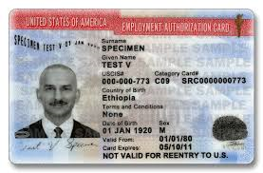
Deferred Action for Childhood Arrivals (DACA)
On June 15, 2012, the Secretary of Homeland Security announced that certain people who came to the United States as children and meet several guidelines may request consideration of deferred action for a period of two years, subject to renewal. This status protects individuals from deportation and provides work authorization and a Social Security number for work purposes. Deferred action does not provide lawful status or permanent residency.
Due to federal court orders, USCIS has resumed accepting requests to renew a grant of deferred action under DACA. USCIS is not accepting requests from individuals who have never before been granted deferred action under DACA.
Students under DACA are still not eligible for federal aid, only state aid under the laws mentioned before. These students sometimes submit a FAFSA instead of a TASFA in error.

Slide 64
2020-2021 TASFA
New TASFA will become available on October 1, 2019.
Student must submit application in a timely manner, along with supporting information.
Due to limited state funding, the application must be submitted as soon as possible.
Available at
www.collegeforalltexans.com
www.aie.org
www.utrgv.edu/finaid
Recommended Priority Deadline: January 15th

Slide 65
TASFA 2020-21 Document Needed
Parent(s) or student that did not file a 2018 Income Tax Return but worked, can submit a Notarized Statement of Income.
Parent(s) or student that filed a tax return in the U.S will need to submit a copy of the 2018 Return Transcript for disbursement, but we will work with a copy of the 2018 tax return for awarding purposes. Return transcript can be requested at www.irs.gov under Get My Tax Record section.
Parent(s) that filed a foreign tax return, a copy will need to be provided
Selective Service Registration
All male students, ages 18 to 25, must register with the Selective Service System.
Students can register beginning 30 days before their 18th birthday
If student has a SSN, can register at www.sss.gov
If student does not have SSN, Form must be mailed to SSS Administration (must enter zeros in SSN fields).
A signed copy of the Selective Service Registration card or confirmation from SSS website must be provided to the Financial Aid Office.

Slide 66
Required Statement of SSR Status

Slide 67
FAFSA/TASFA Reminders

Slide 68
Dependency
The student was born before January 1, 1997.
The student is married or separated (but not divorced) as of the date of the application. •
At the beginning of the 2020–2021 school year, the student will be enrolled in a master’s or doctoral degree program (such as MA, MBA, MD, JD, PhD, EdD, or graduate certificate, etc.).
The student is currently serving on active duty in the U.S. Armed Forces or is a National Guard or Reserves enlistee called into federal active duty for purposes other than training.
The student is a veteran of the U.S. Armed Forces (see the definition in the box on page 4).
The student has or will have one or more children who receive more than half of their support from him or her between July 1, 2020 and June 30, 2021.
The student has dependent(s) (other than children or spouse) who live with him or her and who receive more than half of their support from the student, now and through June 30, 2021.
At any time since the student turned age 13, both of the student’s parents were deceased, or the student was in foster care or was a dependent or ward of the court. •
As determined by a court in the student’s state of legal residence, the student is now, or was upon reaching the age of majority, an emancipated minor (that is, released from control by his or her parent or guardian).
As determined by a court in the student’s state of legal residence, the student is now, or was upon reaching the age of majority, in legal guardianship.
On or after July 1, 2019, the student was determined to be an unaccompanied youth who was homeless or was self-supporting and at risk of being homeless:
by a high school or school district homeless liaison
by the director of an emergency shelter or transitional housing program funded by the U.S. Department of Housing and Urban Development
by a director of a runaway or homeless youth basic center or transitional living program

Slide 69
Who is considered a parent for FAFSA/TASFA
For FAFSA/TASFA purposes parent refers to:
Biological parents
Adoptive parents
Step-parents-who is currently married to a living biological parent
For FAFSA/TASFA purposes a parent is not:
Foster parents
Legal guardians
Any family member who has not adopted the minor
A step-parent that is no longer married to biological parent or who is a widower of the biological parent
Note: It is important that student provides information for correct parent(s). If a student provides incorrect information can sometimes result in student owing thousands of dollars of financial aid. When in doubt please ask us!

Slide 70
FAFSA/TASFA Marital Status
FAFSA/TASFA Marital Status is as of the day the student completes the application. FAFSA/TASFA Marital Statuses cannot be updated after submission, they can only be corrected if they were reported incorrectly as of the day of FAFSA completion.
Student marital status options:
Single-if on the day you sign the FAFSA you are not married/remarried
Separated-if on the day you sign the FAFSA your divorced/separated and not living together
Married/Remarried-if on the day you sign the FAFSA you are married/remarried
Divorced or Widowed- on the day you sign the FAFSA you are married/remarried
Parent marital status options:
Married/Remarried
Never married
Divorced or Separated
Widowed

Slide 71
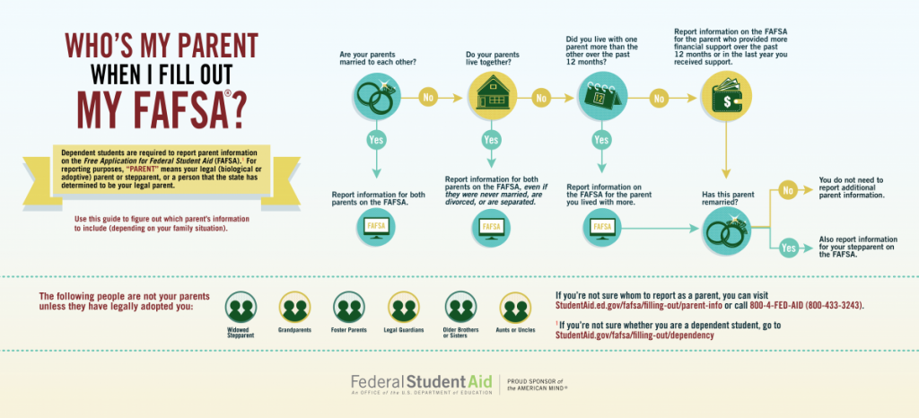

Slide 72
Special Circumstances
The information provided on the FAFSA or TASFA doesn’t always reflect accurately the family’s or student’s situation.
The family has unusually large medical bills or nursing home expenses that are not covered by insurance
The student or a parent lost his or her job or there has been a significant reduction in hours
The student has no contact with the parents and thus cannot provide parental information
The best thing you can do to help a student who has unusual circumstances is to help them fill out the FAFSA/TASFA as best as possible and inform student about contacting financial aid office of college he/she will be attending.

Slide 73
FAFSA Demo Site
The 2020-2021 Web Demonstration site will be available at https://fafsademo.test.ed.gov on September 30, 2019.The demonstration site can be used as a training tool for new staff.
You can access the demonstration site using eddemo as the Username and fafsatest as the Password.
The test site provides information and FSA IDs for test students.
Do not use real information on this site

Slide 74
Common FAFSA Mistakes
Not answering High School Completion Status Question
Legal guardianship
Parent
Number of Family members
Number of Family members in College
Confusing parent information with student information
Entering information that doesn’t match the FSA ID information
Not providing required information

Slide 75
Verification Updates

Slide 76
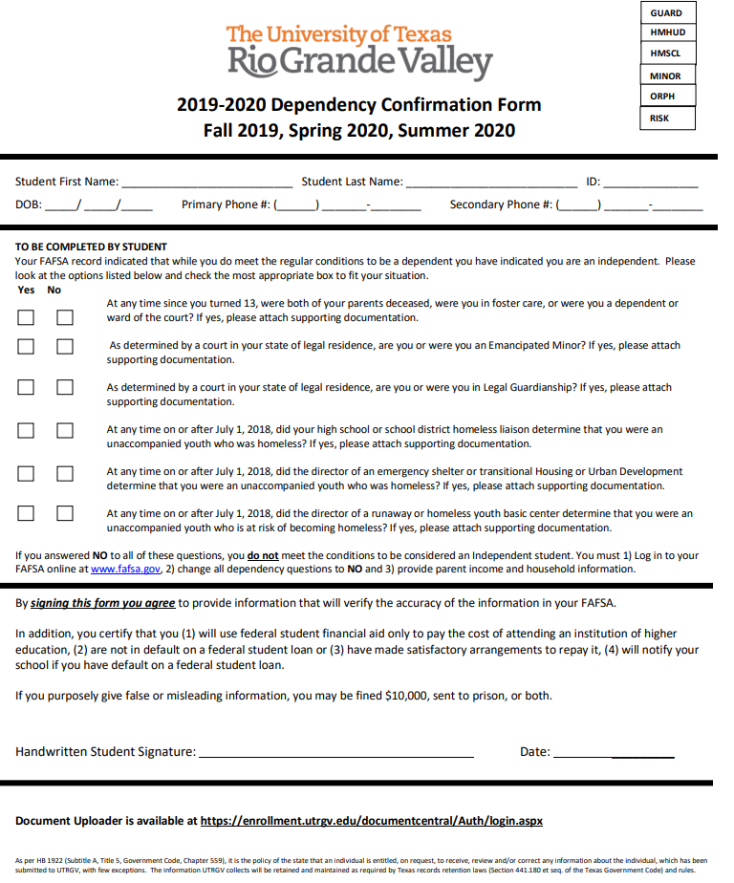
Dependency Confirmation Form
If the answer to ALL questions is No parent information is required
The student should process a correction and update FAFSA with parent household, income tax data, and signatures
If the answer to at least 1 question is Yes parent information is NOT required
The student should submit supporting documentation to the Financial Aid Office
Note: notarized letters are not acceptable, a court order, signed by the judge would be required.

Slide 77
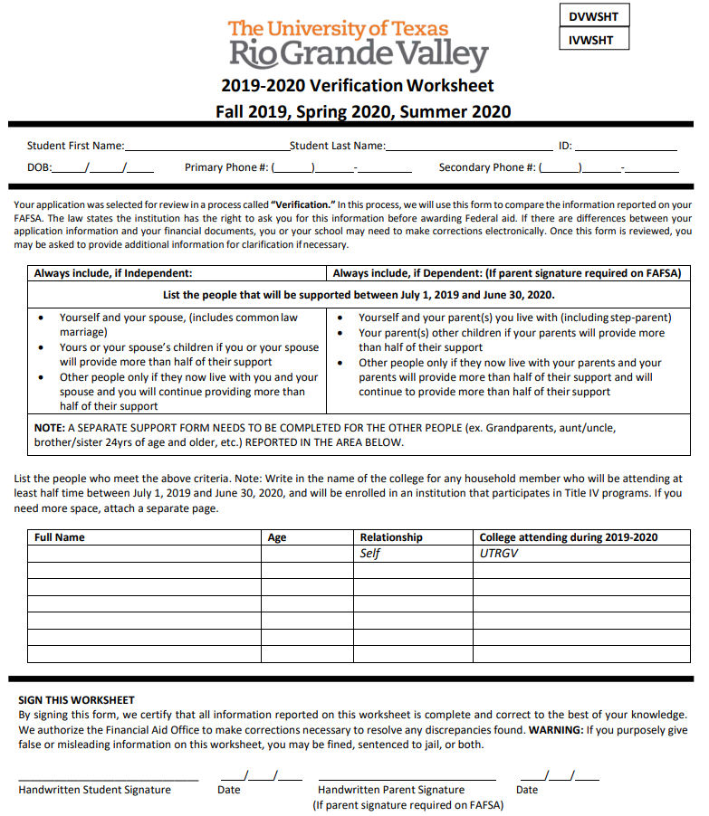
Verification Worksheet
Dependent Student
Student
Mother
Father
Siblings under 24
All other household members will each require a support worksheet
Independent Student
Student
Spouse
Children under 24
All other household members will each require a support worksheet

Slide 78
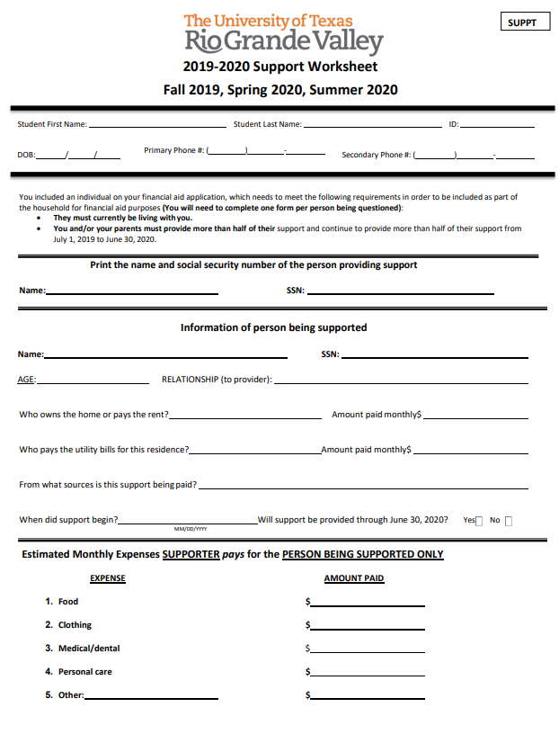
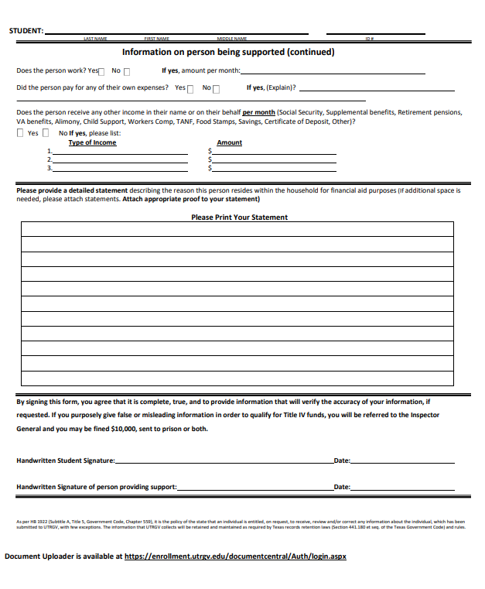
Support Worksheet
If the total amount from Page 1 is greater than the total amount from page 2 the person can be included in the household
Example
Front Page Total = $750.00
Food $300.00 + Clothing $100.00 + Mecical/Dental $250.00 + Personal Care $100.00.
Back Page Total = $500.00
Social Security check $250.00
Included in household

Slide 79
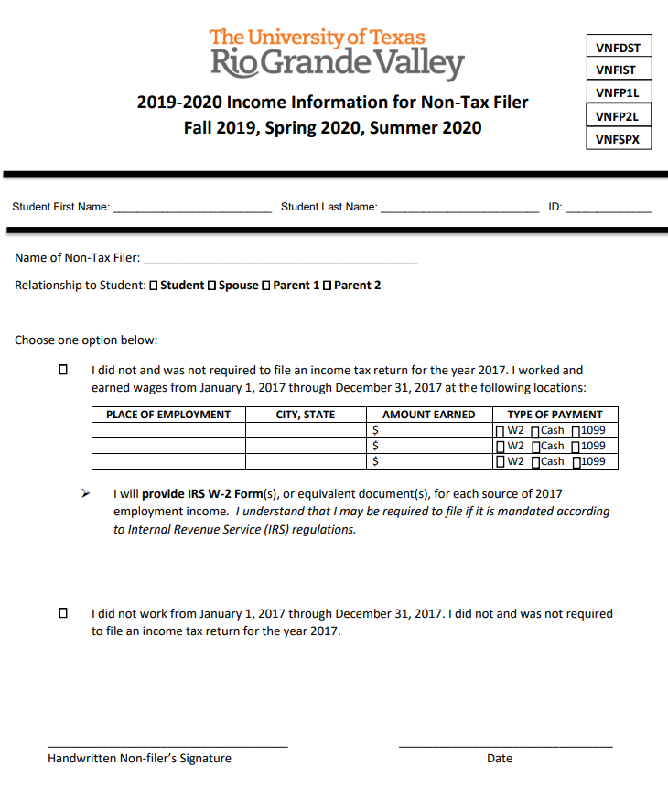
UTRGV Non-Tax Filer Form: Dependent Student
For dependent students who did not file an Income Tax Return
Copies of W2’s, or equivalent documents, for the year required if the student worked
A copy of the IRS Tax Return Transcript is required is required if the student filed an Income Tax Return
The IRS Verification of Non-filing Letter (IRSNFS) is NOT required

Slide 80
UTRGV Non-Tax Filer Form: Independent Student and Spouse
For each independent student, and spouse if applicable, who did not file an Income Tax Return
Copies of W2’s, or equivalent documents, for the year required if the student worked.
A copy of each of the IRS Tax Return Transcript is required if the student, and spouse if applicable, filed an Income Tax Return
The IRS Verification of Non-filing Letter (IRSNFS) or Verification of Non-filing Affidavit required for each

Slide 81
UTRGV Non-Tax Filer Form: Parent(s) with SSN
For each parent(s) who did not file an Income Tax Return
Copies of W2’s, or equivalent documents, for the year required if the parent(s) worked
A copy of each of the IRS Tax Return Transcript is required if the parent(s) filed an Income Tax Return
The IRS Verification of Non-filing Letter (IRSNFS) or Verification of Non-filing Affidavit required for each

Slide 82
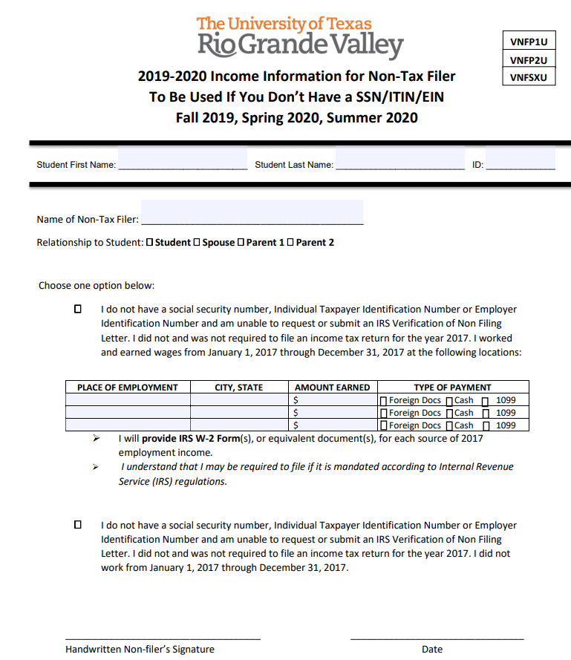
UTRGV Non-Tax Filer Form: Parent(s) without SSN/ITIN
For each parent(s) who did not file an Income Tax Return
Copies of W2’s, or equivalent documents (Hacienda, SAT documents, letter from employer on letterhead), for the year required if the parent(s) worked
A copy of each of the IRS Tax Return Transcript is required if the parent(s) filed an Income Tax Return

Slide 83
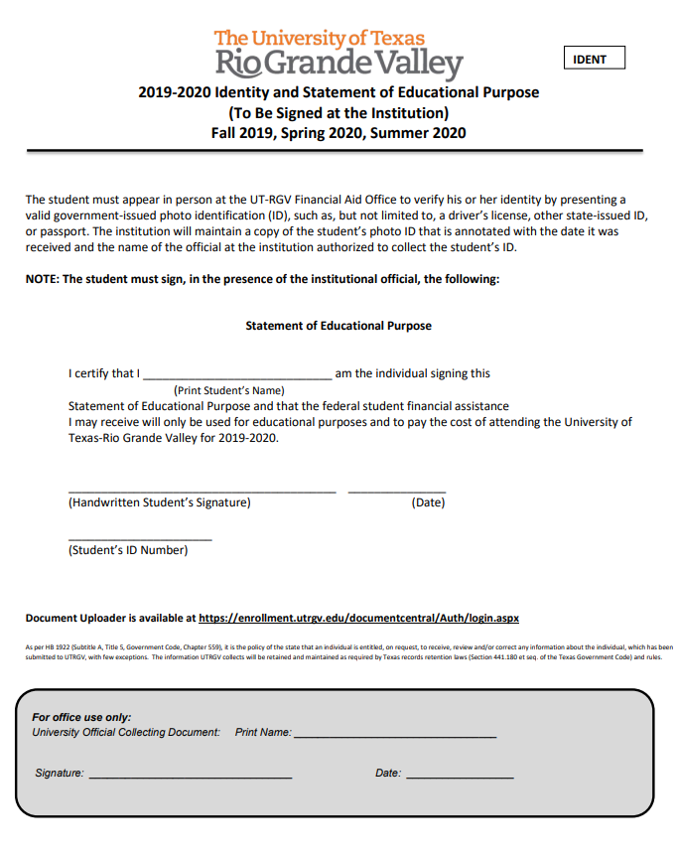
IDENTITY AND STATEMENT OF EDUCATIONAL PURPOSE
Statement of Educational Purpose
Must be filled out in the presence of UTRGV staff, signed by UTRGV staff at time of submission
Notarized Statement – filled out with a notary, identification used with notary must be submitted
Identity
Valid/unexpired government-issued photo ID
High School Completion
An official high school transcript must be submitted to the institution

Slide 84
IRS Flag 06
IRS Flag 06: The Parent or the Student initially used the IRS Data Retrieval Tool then another transaction was processed that called into question the use of the IRS retrieval.
UTRGV staff review file to see what additional documentation, if any, is required. Additional documents are added.

Slide 85
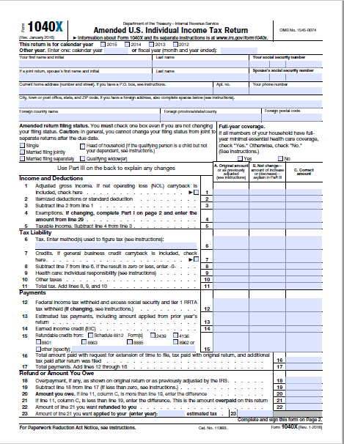
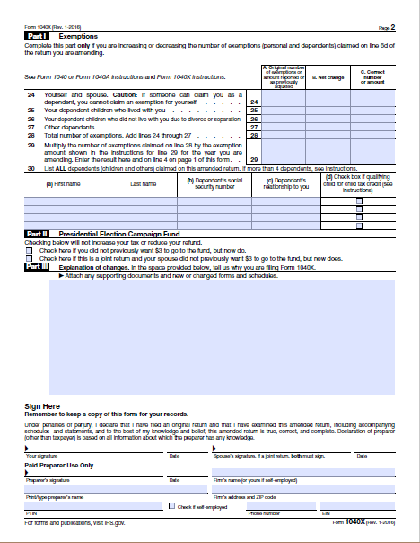
IRS Flag 07
IRS Flag 07: The Parent or the Student used the IRS Data Retrieval Tool to import their tax information from the IRS and the IRS determined they amended their Income Tax Return.
A signed copy of the Amended Income Tax Return is required along with
The new Tax Return Transcript (with amended information) and
The printed original Tax Return Transcript

Slide 86
Comment Codes 400
For Parents of Dependent Students
Parent is a tax filer (FAFSA Question 80) and the AGI retrieved from the IRS is zero, but the total income earned from work (FAFSA Questions 88 and 89) is greater than zero.
The total of the Additional Financial Information fields reported on the FAFSA form (FAFSA Questions 93a-f) is greater than the AGI transferred from the IRS.
Any item from the FAFSA list of Untaxed Income (FAFSA Questions 94a-i) is equal to or exceeds the AGI transferred from the IRS.
UTRGV staff review file to see what additional documentation, if any, is required. Additional documents are added.

Slide 87
Comment Codes 401
Not visible to student in ASSIST
For Dependent and Independent Students
Student is a tax filer (FAFSA Question 32) and the AGI retrieved from the IRS is zero, but the total income earned from work (FAFSA Questions 39 and 40) is greater than zero.
The total of the Additional Financial Information fields reported on the FAFSA form (FAFSA Questions 44a-f) is greater than the AGI transferred from the IRS.
Any item from the FAFSA list of Untaxed Income (FAFSA Questions 45a-j) is equal to or exceeds the AGI transferred from the IRS.
UTRGV staff review file to see what additional documentation, if any, is required. Additional documents are added.

Slide 88
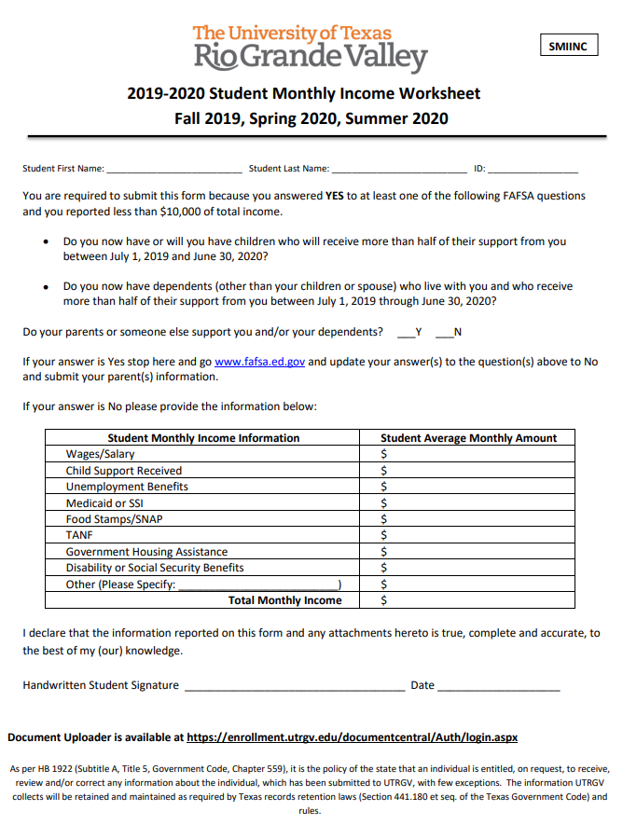
Student Monthly Income Worksheet
Required for students who:
Have children or legal dependents
Are dependent by age (less than 24)
Are not married
Report income less than $10,000.00

Slide 89
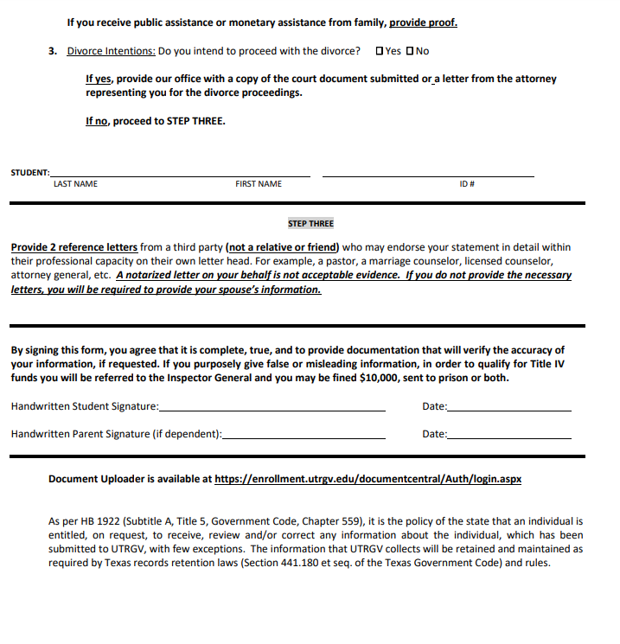
Separation Verification

Slide 90
Tax Filing
Filing requirements: In order to receive federal or state aid, individuals must follow IRS regulations and file a tax return when required. FAFSA has built in logic that will give an error when a student or parent enters wages above the tax filing threshold and have not indicated that have filed or will file. If you encounter this you cannot proceed without changing to “will file.” On the TASFA these thresholds will be checked when the TASFA is reviewed.
Filing status for tax purposes-Determined by marital status as of the last day of the year (December 31).
Single
Head of Household
Married filing joint return
Married filing separate return-Need both tax returns

Slide 91
Tax Filing
Married taxpayers can usually only file as married filing separately or married filing jointly. Same sex parents are considered married for IRS purposes if married in a state where it is legal.
Exception: a married person can file as Head of Household when a U.S citizen or permanent resident is married to a non-permanent resident spouse and they have dependent children . The non-permanent resident spouse cannot file as Head of Household too! There can never be two Heads of Household for the same household.
Married spouses living apart due to temporary absences such as: illness, education, business, vacation, or military service are not considered separated
In the case of unmarried parents living together only one parent can file as Head of Household.
When in doubt use Interactive Tax Assistant www.irs.gov
FAFSA now asks for tax return filing status!
Following proper IRS regulations is mandated and incorrect information can often result not only in student owing thousands of dollars for financial aid received but also either student or parent owing thousands of dollars to IRS.

Slide 92
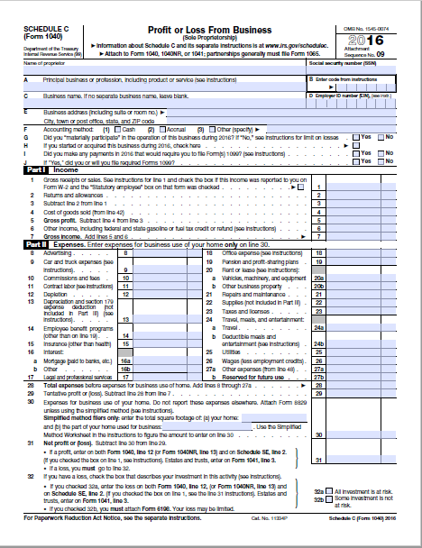
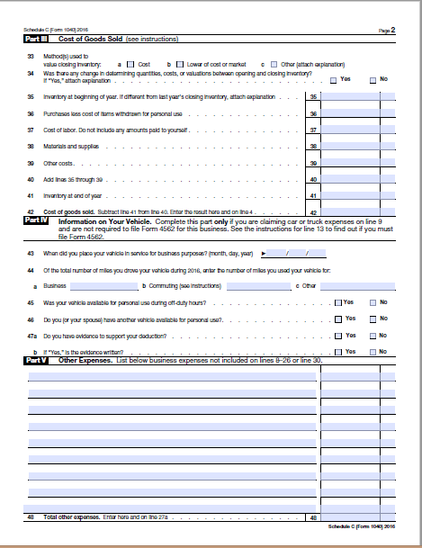
Schedule C
When a non-tax filer earns $400.00 or more (cash or self employment) in the United States, they are generally required to file an Income Tax Return for the year.
Schedule C is used to determine if after expenses the Net Profit is equal to or greater than $400.00
Net Profit >= $400.00: required to file
Net Profit < $400.00: NOT required to file

Slide 93
Verification
Even though students are notified at point of FAFSA completion. Do not submit verification documents until requested by UTRGV
Systems may not be in place to begin collecting documents for new year and documents submitted could get lost.
All verification worksheets and documents will be found at https:// utrgv.edu/finaid for appropriate year.
Verification documents can be submitted via the document portal Document Central https://enrollment.utrgv.edu/DocumentCentral , via e-mail at finaid@utrgv.edu or in person at U Central or handed to a UTRGV representative visiting the campus. Please write student ID on any copies of documents submitted. Mailing forms is not recommended.
It’s important to check back after having submitted documents. Often more questions arise after initial submission and additional documents can be requested.

Slide 94
Application Deadlines
Financial aid funding is limited for many programs, so it’s important for students to submit their applications on time.
FAFSA priority deadline: January 15
TASFA state application deadline: January 15
UTRGV scholarship application deadline: December 1
Summer notification priority deadline: February 15
FAFSA deadline for the current year: June 30*

Slide 95
UTRGV Institutional Programs

Slide 96
UTRGV Achieve
The UTRGV Achieve Program will cover a gap in tuition and fee expenses and $500 of book expenses per semester for the regular academic year (fall and spring) that is not being covered by other forms of gift aid (grants or scholarships), including Federal, State , private, and institutional aid.
Have a family income of $50,000 or less and demonstrate financial need as reported on the FAFSA/TASFA.
Be classified as a Texas Resident
Be enrolled for 15 hours or more per semester
Be enrolled as an undergraduate in a degree-seeking program towards a first Bachelors’ degree.
Entering Freshman with an ACT composite of 19, SAT composite of a 1010 or be in the top 10% of graduating class
Priority will be given to students that have filed the FAFSA/TASFA for the upcoming academic year by January 15th

Slide 97
UTRGV Assistance Scholarship
The scholarship is primarily intended to provide gift assistance to needy students currently receiving little or no gift aid. The maximum award amount is $2,250.
An entering freshman must:
have minimum ACT composite score of 20, or a SAT composite score of a 1010, or be in the top 10% of their high school graduating class.
Must be enrolled full-time
Must file the FAFSA/TASFA & demonstrate high financial need
Must not have TEXAS Grant
Must be a Texas resident
Must have Fall/Spring Pell under $3,000 ($1,500 per semester)

Slide 98
UTRGV Tuition Guarantee and Tuition Savings
UTRGV tuition uses guaranteed tuition plans for resident and non-resident students. This means that tuition will not increase during the guarantee period. For example: a new entering freshman is guaranteed the same tuition rate for 4 years!
UTRGV in-state tuition is capped at 12 hours per semester. This means that additional courses taken above 12 hours are free. So, if a student enrolls in 15 hours, the extra class is free. If a student enrolls in 18 hours, the two extra classes are free.

Slide 99
Reminder!!
If a student is choosing to begin college during summer, he/she must complete the current year FAFSA (2019-2020) application before June 30.
If a student is applying to UTRGV and is not TSI clear. He/she will be required to attend during the summer so he/she will need to complete the current year FAFSA (2019-2020) application before June 30.
Best practice is to have any student that does not clear TSI on the first try and is attending UTRGV to complete a 2019-2020 FAFSA and then keep on trying to retest. There is no harm in completing a current year FAFSA and not needing it after the fact.
Many students in this situation missed the deadline to complete a current year FAFSA this summer!

Slide 100
2019 FAFSA/TASFA Super Saturday
This year’s FAFSA/TASFA Super Saturday will take place on:
October 12, 2019
9:00 AM to 2:00 PM
Visitor’s Center in Edinburg
The Tower in Brownsville

Slide 101
Resources
For additional information, please visit:
www.utrgv.edu/finaid
www.utrgv.edu/scholarships
www.utrgv.edu/askrio
www.utrgv.edu/americorps
www.studentaid.gov
www.collegeforalltexans.com
www.rgvfocus.org

Slide 102
UTRGV Financial Aid Office
www.utrgv.edu/finaid
www.utrgv.edu/askrio
FinAid@utrgv.edu
(888) 882 – 4026
Edinburg Location: 1st Floor Student Services Building (SSBL) 1201 West University Drive Edinburg, Texas 78539 Brownsville Location: The Tower, Main 1.100 1 West University Boulevard Brownsville, Texas 78520 Hours: 8:00 – 5:00pm M, W, Th, 8:00 – 6:00pm Tu, 8:00 – 5:00pm F

Slide 103
Contact Information
Jael Perez
Associate Director of Financial Aid Operations and Community Liaison
956-665-2958 • jael.garcia@utrgv.edu
Brownsville • Edinburg • Harlingen

Slide 104
Dara Newton
Associate Vice President for Strategic Enrollment

