Slide 1


Ad Astra
Overview and Best Practices
Ad Astra Link: https://www.aaiscloud.com/UTXRioGrandeValley

Slide 2
Ad Astra
Ad Astra
  Scheduling software used by UTRGV to reserve rooms and spaces for academic and non-academic events.
    Trainings
    Exams
    Meetings
    Festivals
  Event requests are intended primary for UTRGV faculty, students, staff, and alumni. Outside corporations and organizations must be sponsored by a UTRGV department.
Request Access
  Submit a ticket to IT, see link below for instructions.
    https://www.utrgv.edu/esa/_files/documents/access-guides/tdx_guide_request_ad_astra_access.pdf
  Do not submit a request on behalf of another user. The requestor must submit their own ticket since Terms & Conditions are accepted at the time of submittal (including student employees).
  Turnaround time is 1 to 2 days, plan accordingly.
Event Scheduling Requirements
  All events require approval.
  Submit requests a minimum 1 week in advance.
  Last-minute or far in advanced requests may be reviewed, contact the appropriate scheduler.
Notes
  Academic Space Event Requests are scheduled until academic course scheduling and final exams are complete for the term. Any special circumstance may be reviewed.
  To request rooms for academic courses for the semester, submit an online Class Schedule Change Request (CSCR) form.

Slide 3
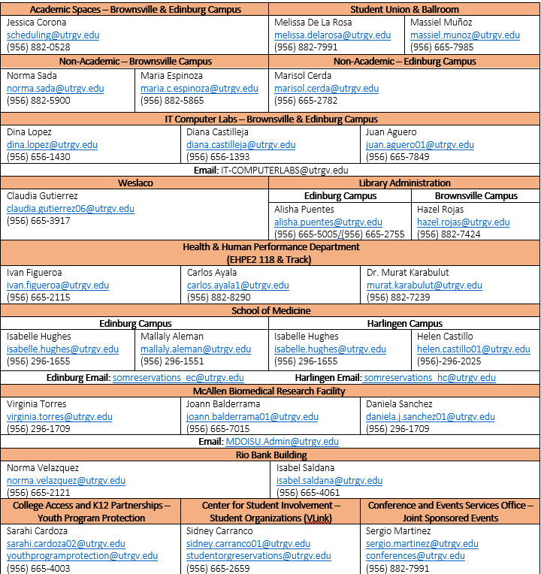
List of Schedulers and Approvers
*Prior approvals for certain rooms can be found on the room description details.

Slide 4
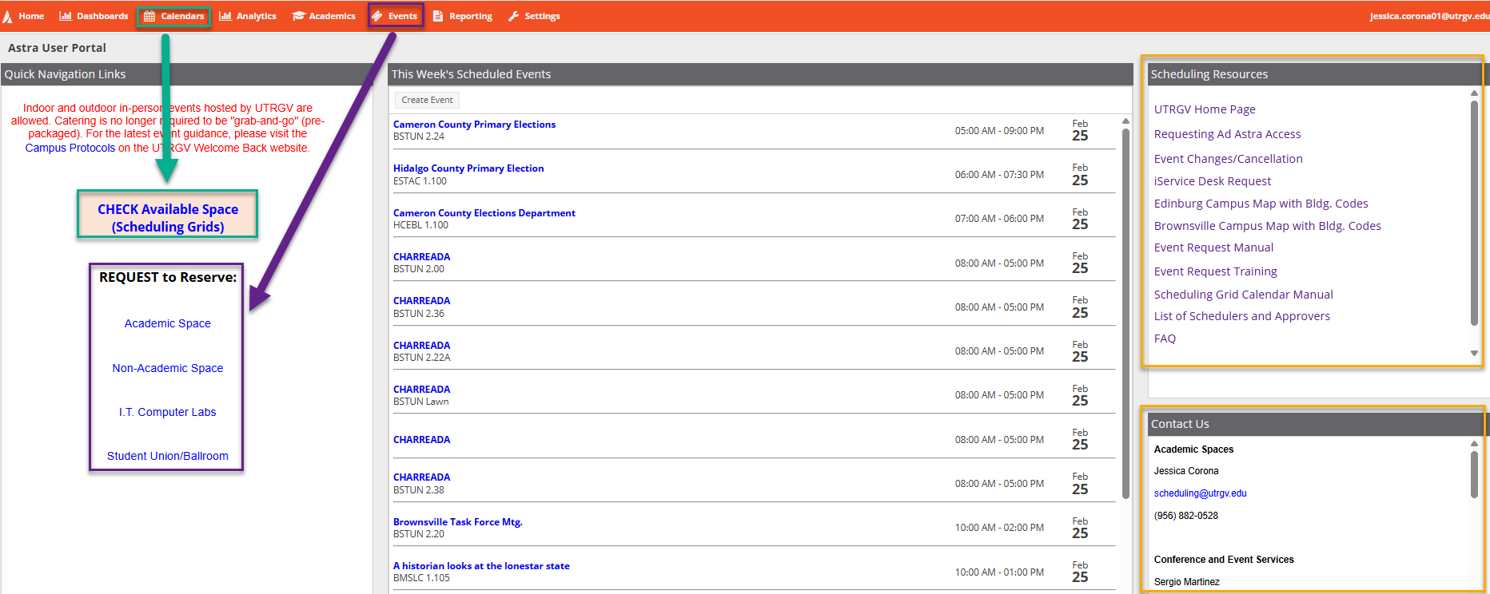
Ad Astra - Homepage
4

Slide 5
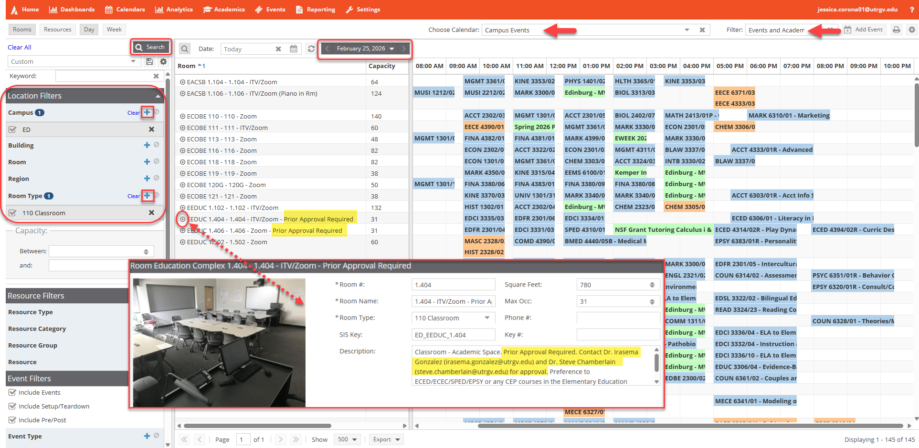
Step 1: Check Room Availability - Scheduling Grids
#2: Select Date
#4: Search
#1: Review Filters
#3: Apply Filters
ATTENTION:
If prior approval is required, contact the person listed. Once approved, forward approval to scheduling@utrgv.edu.
Include notes regarding approval under Event Description (Event Request).
#5: View Room Details
5

Slide 6
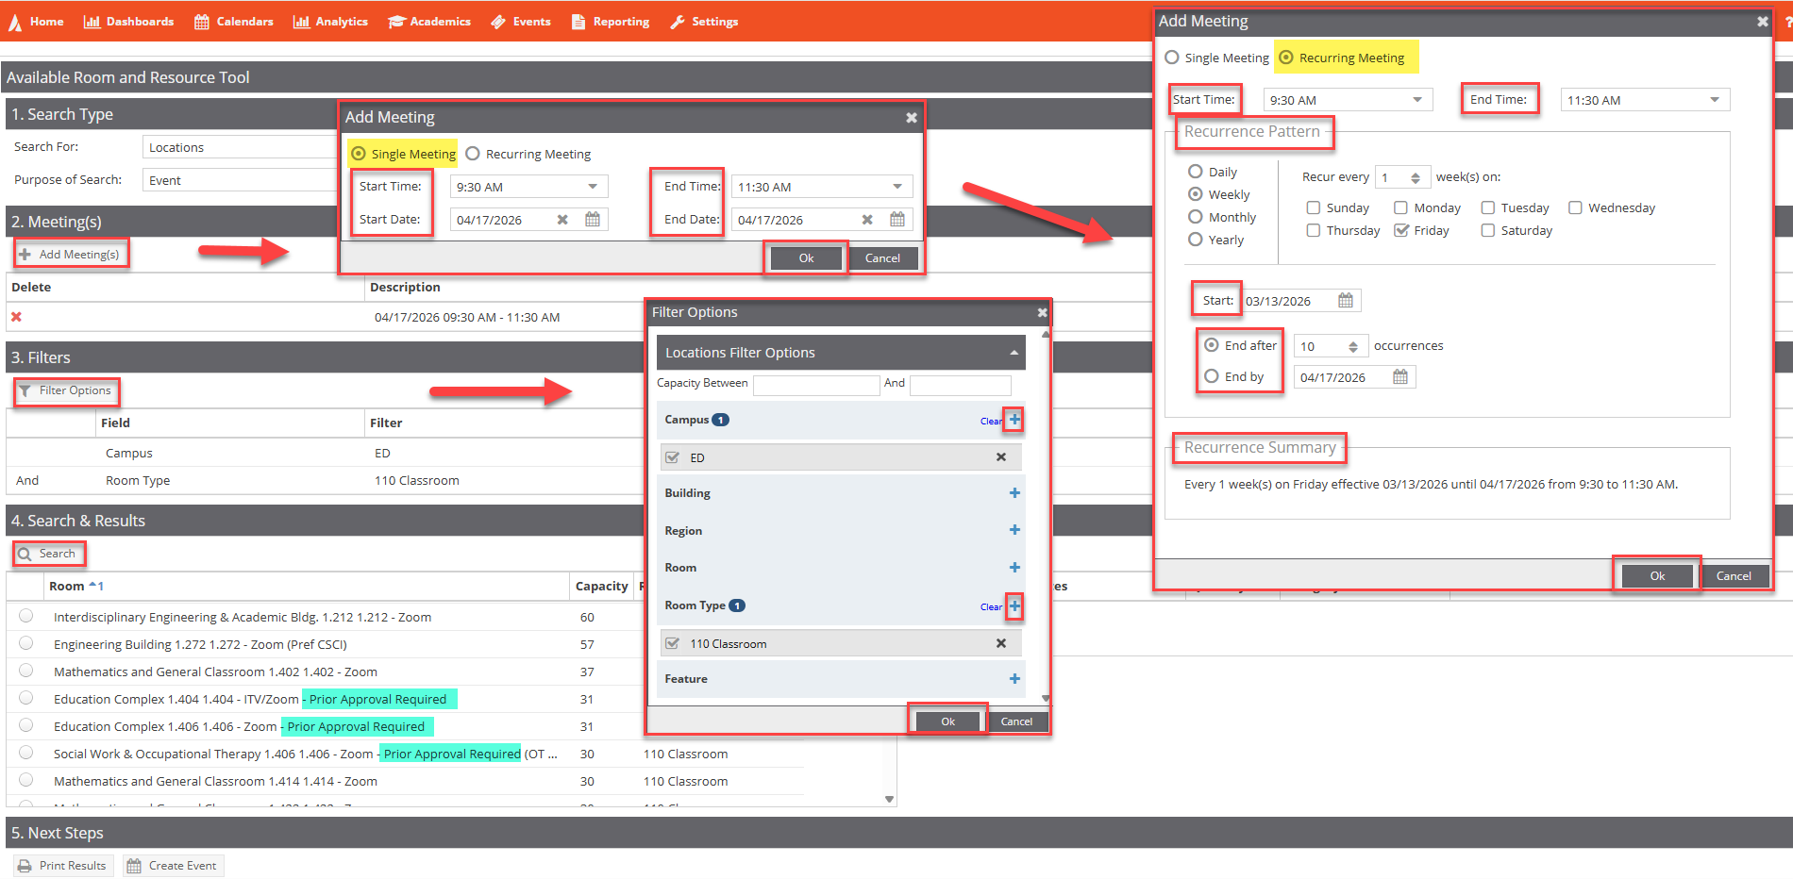
Step 1: Check Room Availability - Available Rooms
#1: Add Meeting
#2: Apply Filters
#3: Search
ATTENTION:
If prior approval is required, contact the person listed. Once approved, forward approval to scheduling@utrgv.edu.
Include notes regarding approval under Event Description (Event Request).

Slide 7
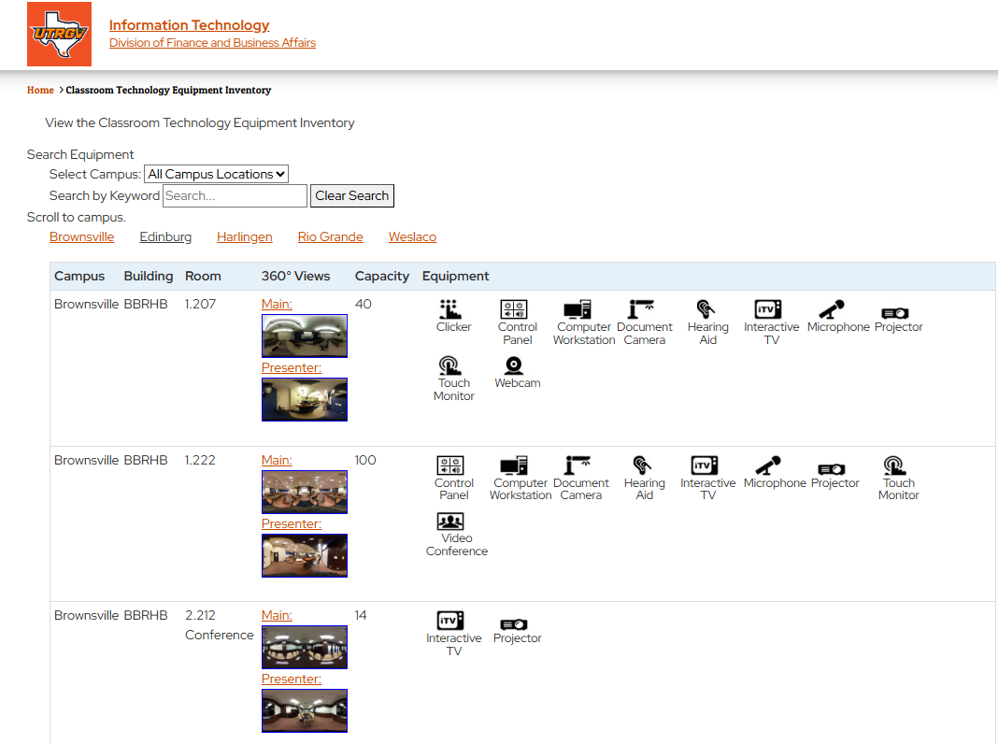
IT Resource: Classroom Technology Equipment Inventory
Link: https://www.utrgv.edu/it/technology-inventory/

Slide 8
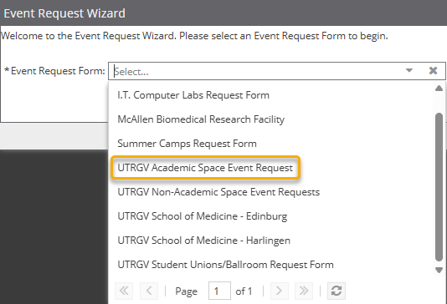

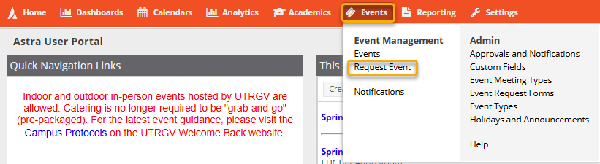
Step 2: Submit Event Request
Submit event request once items below are reviewed and cleared:
Reviewed Room Availability
Received approval for Prior Approval Room(s)
Youth Program Protection Cleared Event
Joint Sponsorship Application was Approved
I.T. Computer Labs Request: Computer Labs (IT Managed)
McAllen Biomedical Research Facility: MBMRF - School of Medicine
UTRGV Academic Spaces Event Request: Classrooms and Study Rooms (BRW & ED). *Unlocking Academic Spaces*
UTRGV Non-Academic Space Event Request: Lobbies, Conference Rooms, and Outdoor Spaces (BRW & ED). *Unlocking Buildings ONLY*
UTRGV School of Medicine – Edinburg: Medical Education and Team Based Learning Center.
UTRGV School of Medicine – Harlingen: Harlingen Clinical Education
UTRGV Student Unions/Ballroom Request: Student Union (BRW & ED), Chapel (ED), and University Center (ED).

Slide 9
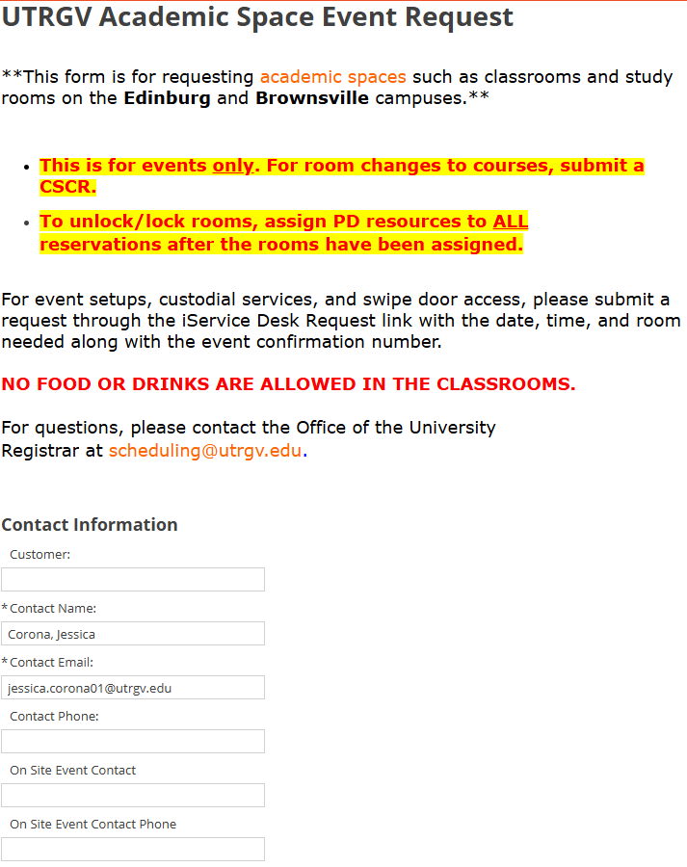
UTRGV Academic Space Event Request Form

Slide 10
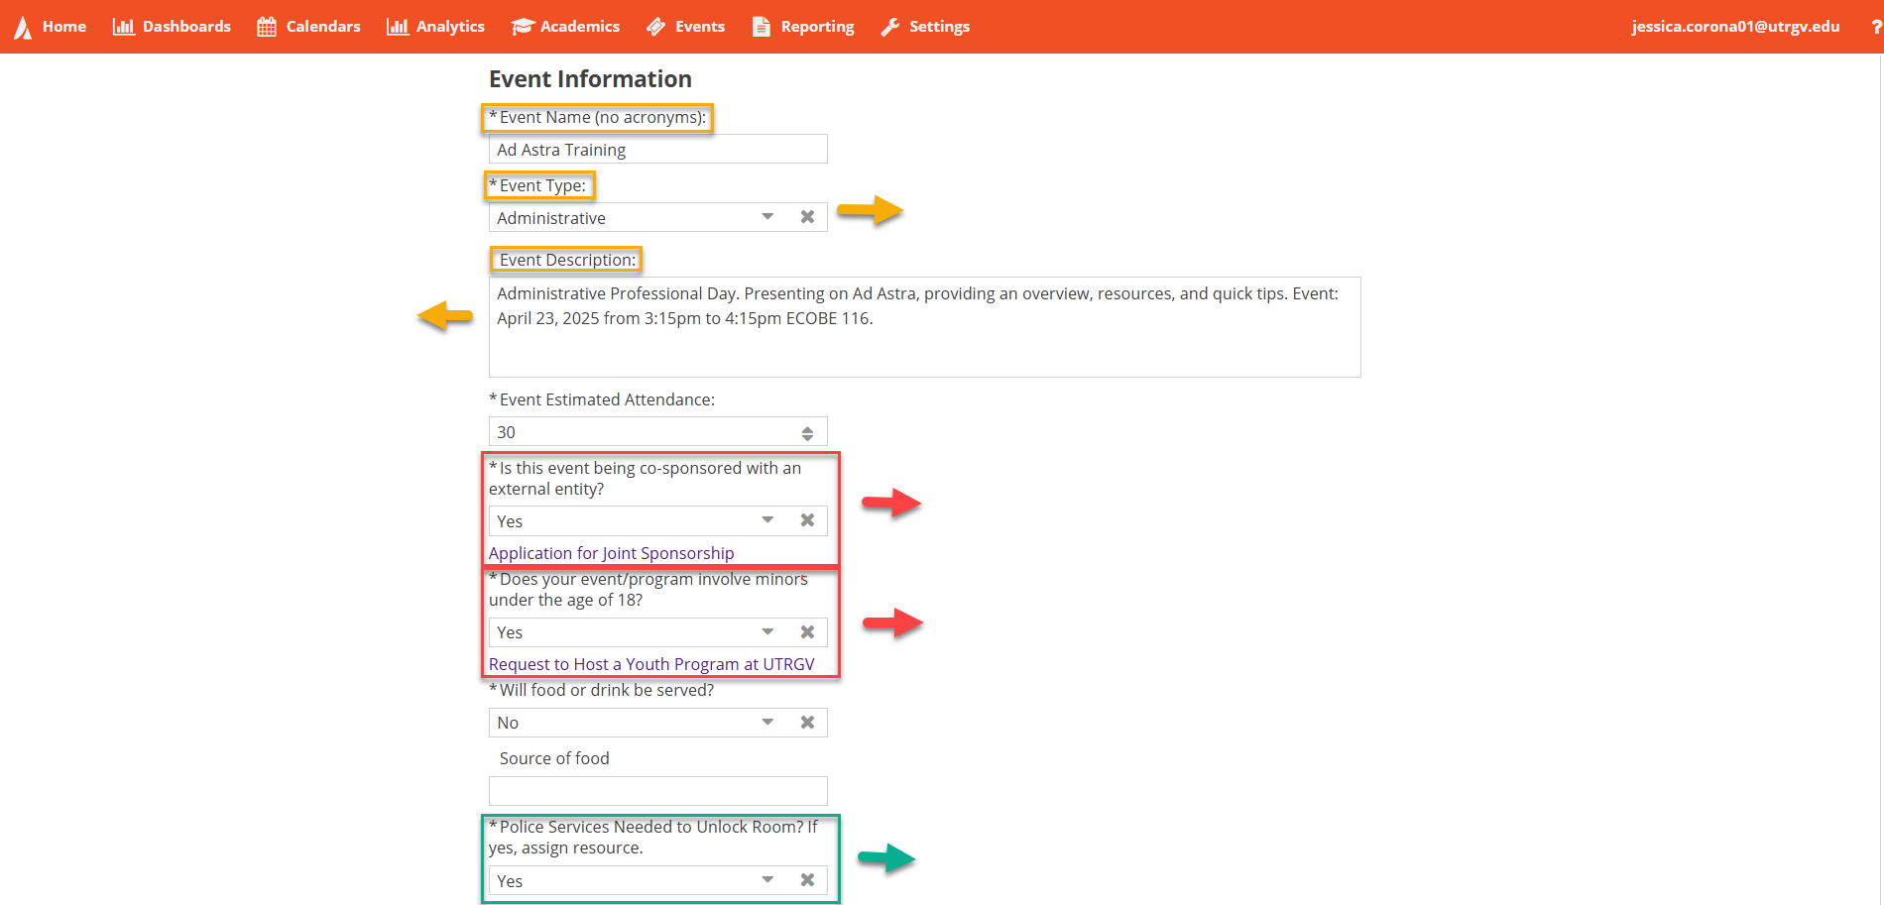
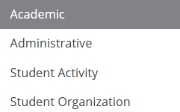
UTRGV Academic Space Event Request
Event Information
Approvals:
Joint Sponsorship
Youth Program Protection
Prior Approval (Rooms)
*Forward approvals to scheduling@utrgv.edu.
Once Joint Sponsorship Application is approved, we proceed with room reservation.
Once Youth Program Protection clears the event, we proceed with room reservation.
‘Yes’ does not automatically add PD resources to the reservation.
Assign PD resources after assigning room(s).

Slide 11

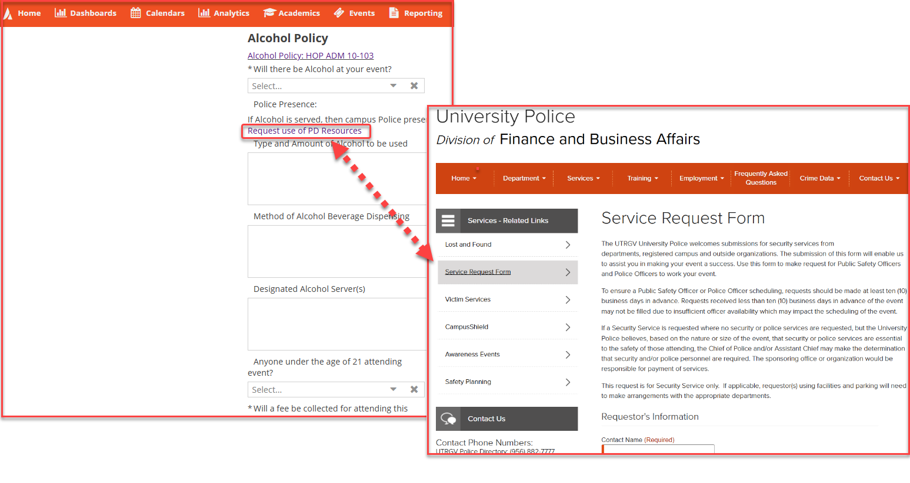

UTRGV Academic Space Event Request
Alcohol Policy
Campus Police presence is REQUIRED
Contact Phone Numbers:
UTRGV Police Directory: (956) 882-7777
UTRGV Campus Emergency: (956) 882-4911
Emergency: 911
Email: police@utrgv.edu
Edinburg Campus:
Police Station
501 N. Sugar Road,
Edinburg TX 78539
Brownsville/Harlingen Campus:
Police Station
2671 FJRM Ave.
Brownsville, TX 78520
Laredo Campus:
Police Station
1937 Bustamante St.
Laredo, TX 78041
Must be submitted at least 10 business days in advance.

Slide 12
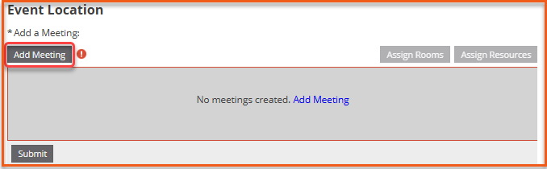
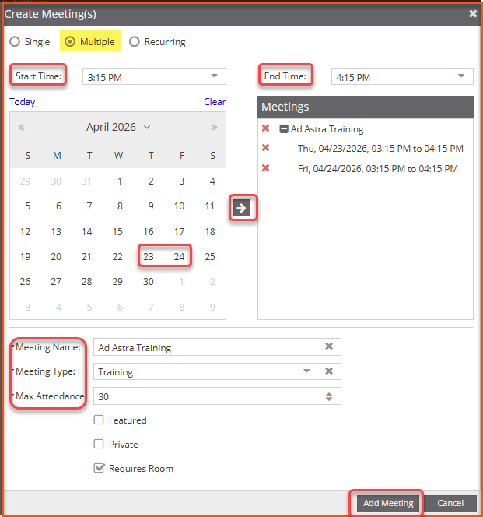

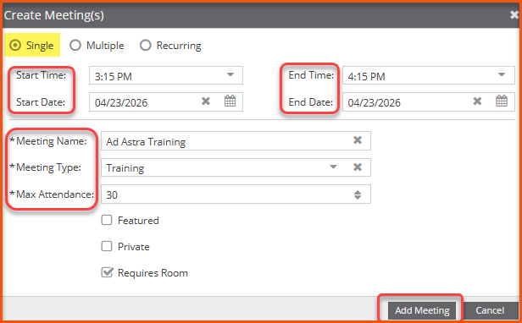

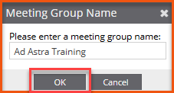

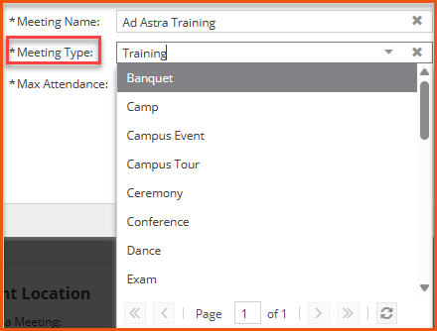
UTRGV Academic Space Event Request
Add Meeting
#1: Select Meeting
#1: Select Meeting
#2: Enter Times
#2: Enter Times & Date
#3: Add Meeting Information
#4: Click Arrow
Max Attendance:
List based on the space/room capacity.
#3: Select Dates
#4: Add Meeting
#5: Add Group Name & click OK
#6: Add Meeting Information
ATTENTION:
This information helps the system generate room availability based on what is entered.
Max Attendance:
List based on the space/room capacity.
#7: Add Meeting

Slide 13
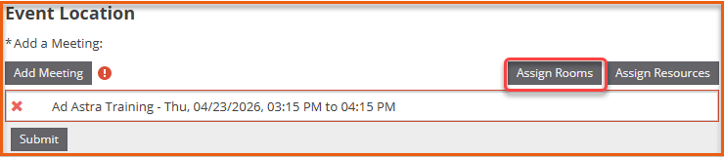
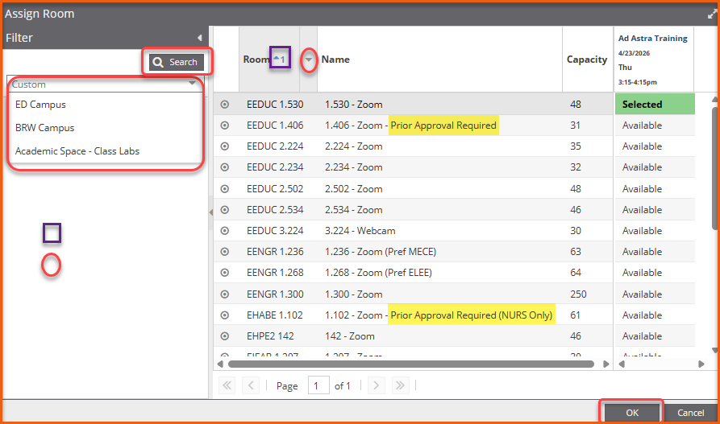
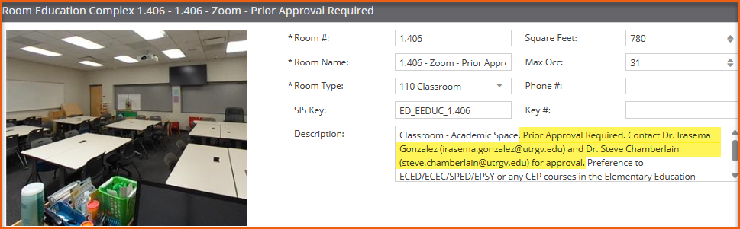
UTRGV Academic Space Event Request
Assign Rooms
#1: Assign Rooms
#3: Search
#4: Select Room(s)
ATTENTION:
If prior approval is required, contact the person listed. Once approved, forward approval to scheduling@utrgv.edu.
Include notes regarding approval under Event Description (Event Request).
#2: Apply Filters
Sory By
Add/Remove Columns
#5: Click OK

Slide 14
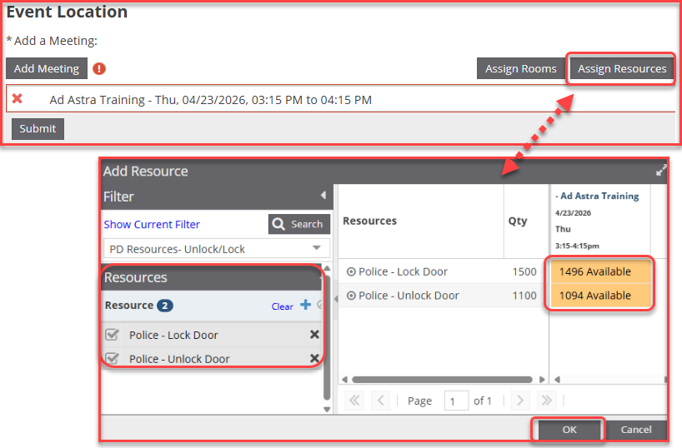

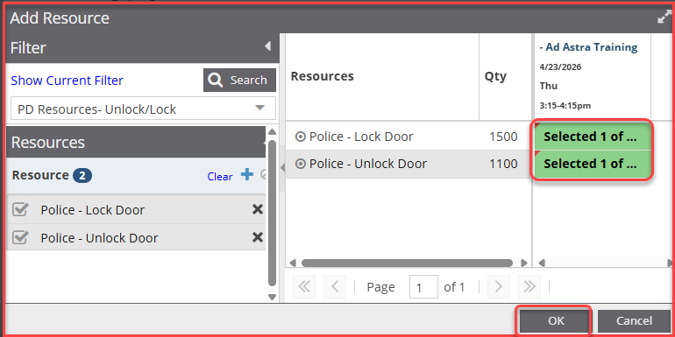

UTRGV Academic Space Event Request
Assign Resources (Police Resources: Unlock/Lock Doors)
#1: Assign Resources
For questions on Building/Room Door Contacts
Keyed Doors
UTRGV Police Communication
University Police
956-882-7777 2
police@utrgv.edu
Electronic Doors
Miguel Rivera
Security Systems Administrator
University Police
956-665-3647
Miguel.rivera@utrgv.edu
Alexander Lopez
Security Systems Technician II
University Police
Alexander.lopez@utrgv.edu
#3: No Resources
#2: Default Filters
ATTENTION:
Add PD resources to ALL events especially if your event is after hours and during the weekend.
University Police unlocks buildings and doors only if they are listed in Ad Astra.
Restrooms are unlocked/locked when there is an event scheduled in the building – No Reservation Needed.
#4: Type 1 in each cell. Must turn green.
#5: Click OK

Slide 15
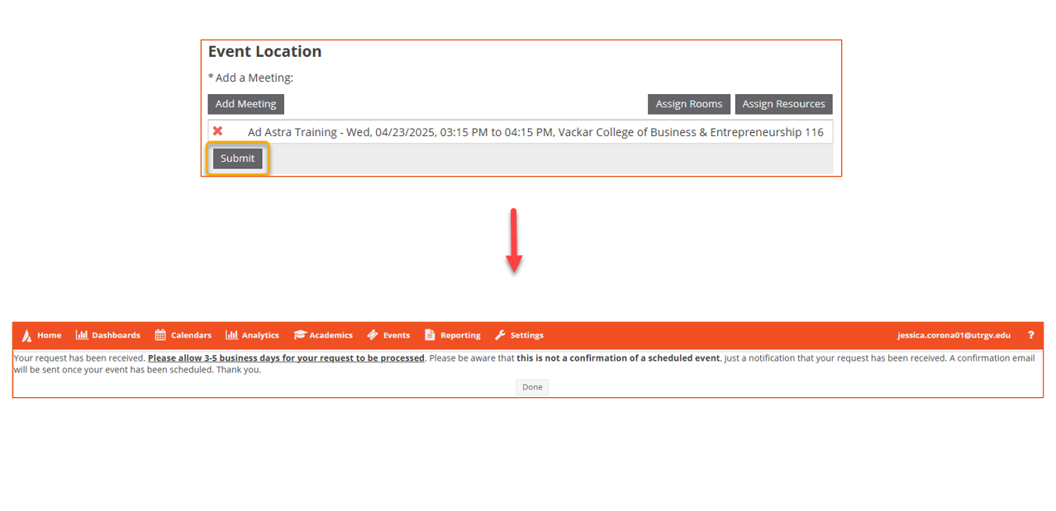
UTRGV Academic Space Event Request
Review and Submit

Slide 16
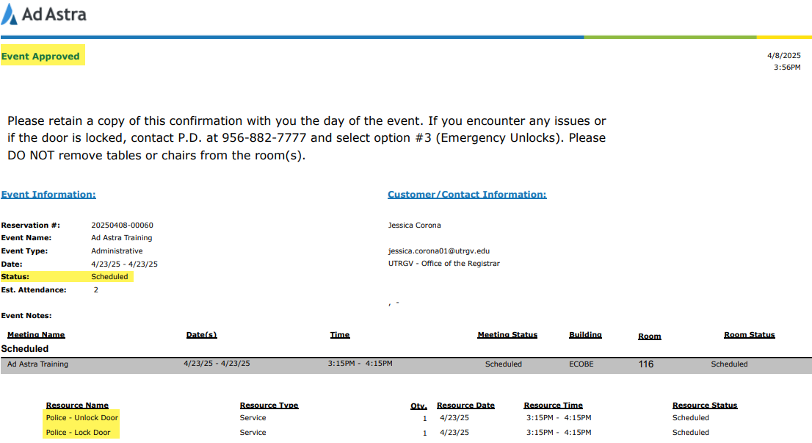
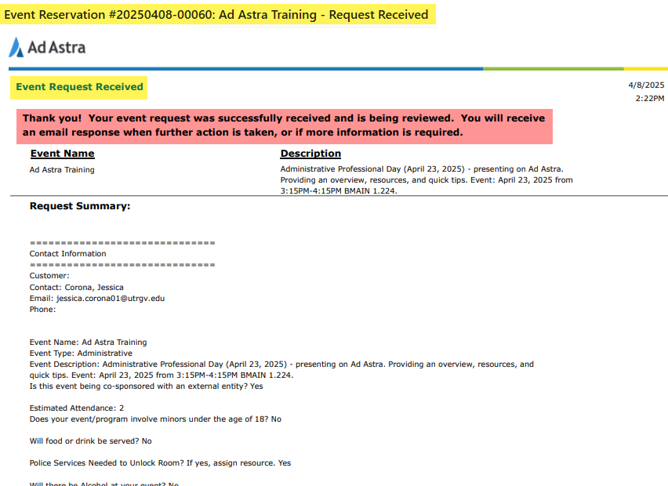
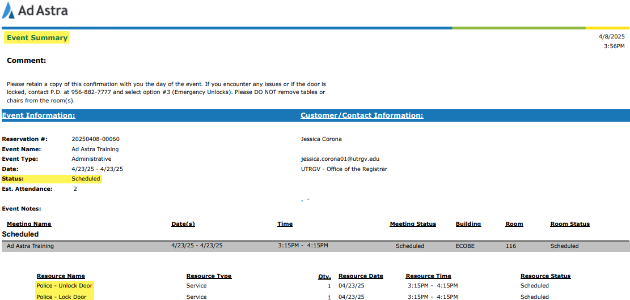
UTRGV Academic Space Event Request
Email Notifications: Event Request Received, Event Approved, and Event Summary

Slide 17
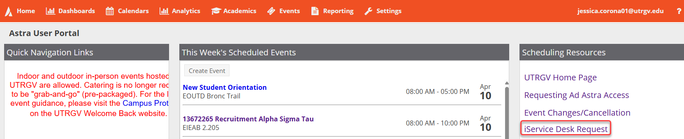
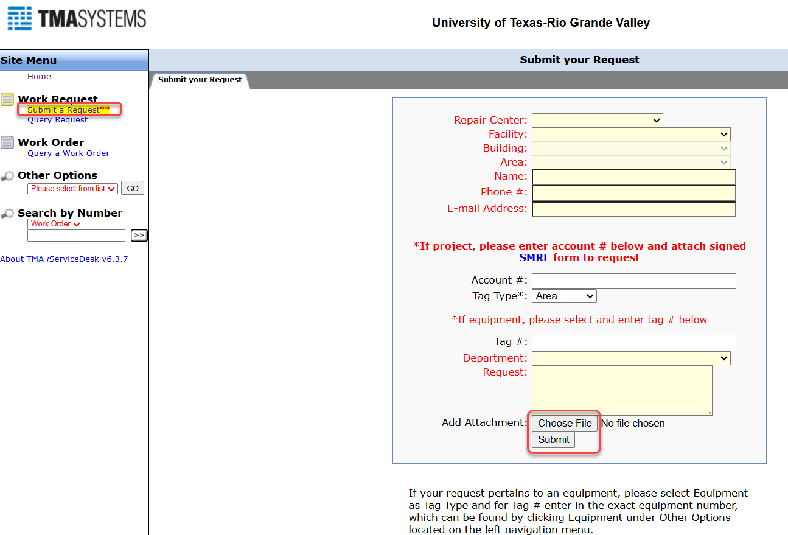
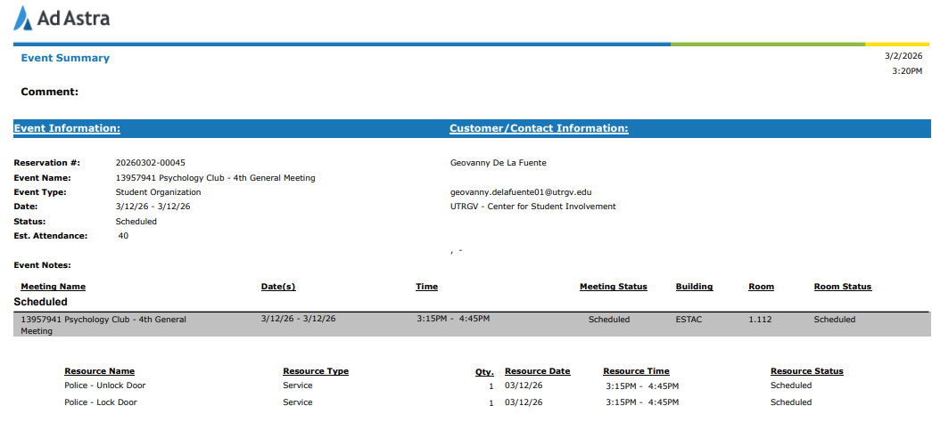

iService Desk Request
*Ad Astra and Facilities TMA/iService Desk are NOT linked*
#2: Submit a Request
#1: Click on Link
#3: Complete Form
A Work Request is required for ALL events that will need custodial services, room set-ups, etc. regardless of if the event is during business or after hours.
#4: Add Attachment
#5. Submit

Slide 18
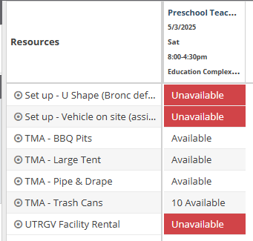
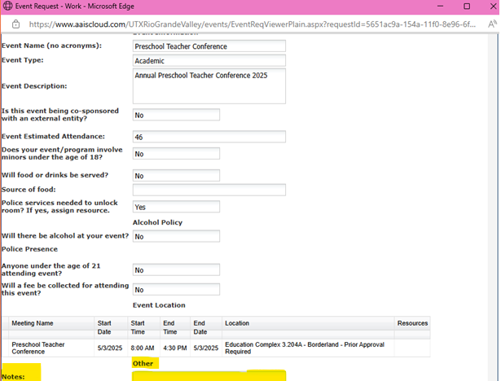
iService Desk Request – Cont.
*Ad Astra and Facilities TMA/iService Desk are NOT linked*
*Ad Astra is used to reserve the space; any other needs related to Facilities has to be requested through TMA link: https://facilities-isd.utrgv.edu/ for proper scheduling of services.
Adding the services to request tables, chairs, custodial services, etc. in Ad Astra (Resources) or under ‘Notes’, will not create the work request automatically, and it will not be taken into consideration.
If the space has standard setup/seating, submit the request for Custodial Services (even if no food is served) for after event clean up, this also includes restroom clean up.

Slide 19
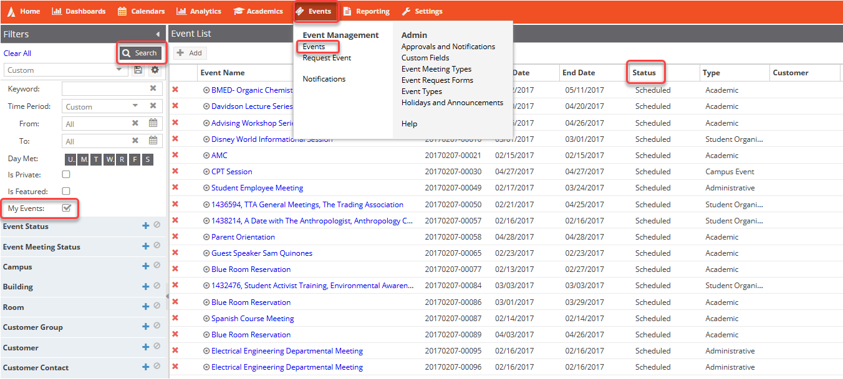
My Events
Review Event Status
#1: Events
#4. Search
#5: Review Status
#2: Select Events
#3: Click on ‘My Events’ box

Slide 20
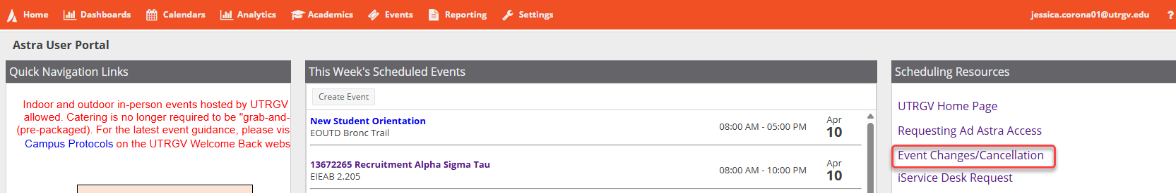
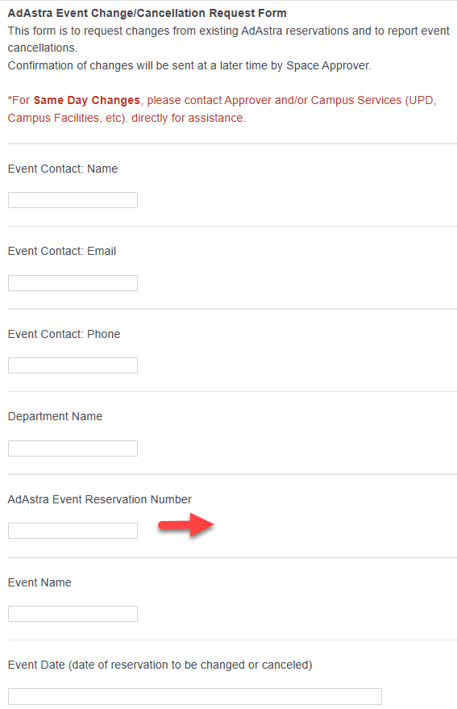
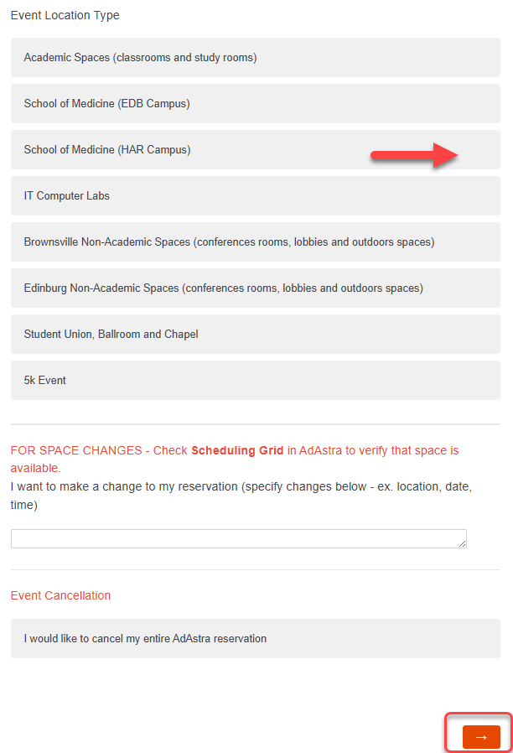
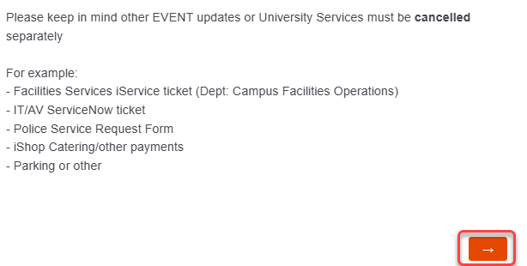


Event Changes/Cancellation Request Form
#2: Complete Form
#1: Click Link
Review your ‘Scheduled’ (Approved) reservation. Select the correct Event Location Type (based on the approved space).
#4: Review Information and then, Click Arrow to Continue
Located in all Ad Astra email notifications. (Ex:20250408-00060
#3: Click Arrow to Continue

Slide 21
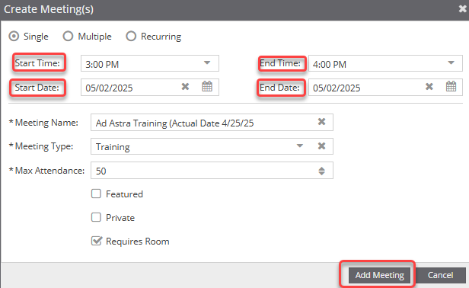
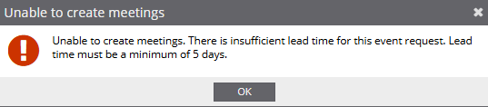
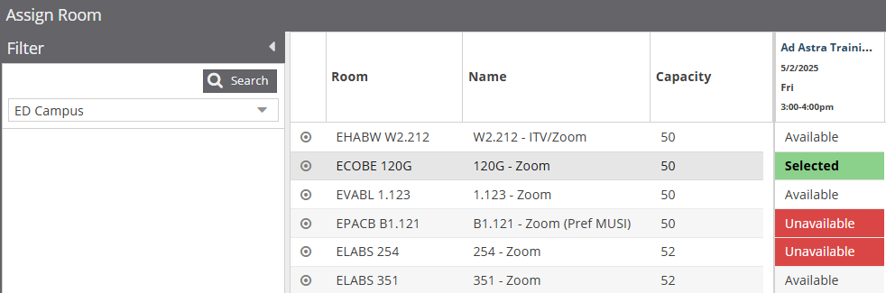
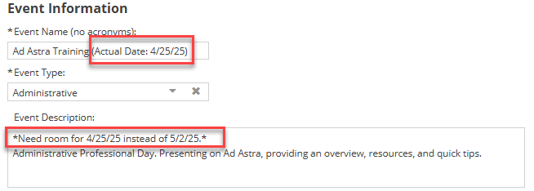
UTRGV Academic Space Event Request
Last - Minute Requests
Event Scheduling Requirements
Ad Astra allows to submit Academic Space Event Requests between the 5-day to 90-day timeframe only. Each form has their own timeframe, contact the appropriate scheduler for questions.
Last - Minute requests can be taken into consideration but are not guaranteed.
Request must be submitted via Ad Astra.
For any questions, please email us at scheduling@utrgv.edu.
#3: Enter Correct Times
#4: Future Date
#5: Add Meeting
#1: List Actual Date Next to Event Name
#6: Select Room
#2: Include Notes
Review room availability for Actual Date.
If room is not available for the Future Date, select any room and include notes under the Description field.
Example: “Selected ECOBE 120G but I need EPACB B1.121 instead. Room shows available for actual date.”

Slide 22


For any questions regarding Ad Astra or academic spaces, please contact the Office of the Registrar Scheduling Team at scheduling@utrgv.edu.
Leave positive recognition for UTRGV employees who demonstrate outstanding qualities & values using the Bravo Vaqueros link provided within your https://my.utrgv.edu account.

Slide 23
Frequently Asked Questions
Need access to Ad Astra?
  Submit a ticket to IT, see link below for instructions.
Submit event requests between the 5-day to 90-day timeframe (Academic Spaces). Requests outside this timeframe may be further reviewed, email scheduling@utrgv.edu. Each form has their own timeframe, contact the appropriate scheduler for questions.
Student employees are not allowed to submit an event request without approval from their supervisor. To grant access, please email scheduling@utrgv.edu.
Room requires prior approval?
  Contact the room approver (point of contact) to request approval (Review Room Details/Description).
  Once approved, forward approval to scheduling@utrgv.edu and submit event request (include notes under the Description field).
Event is being Co-Sponsored with an external entity?
  Submit the Joint Sponsorship Application. For questions contact conferences@utrgv.edu.
  Once approved, forward approval to scheduling@utrgv.edu and submit event request (include notes under the Description field).
Event involves minors under the age of 18 (Non-UTRGV students)?
  All youth programs are required to officially register on the Youth Programs Ideal-Logic website prior to the beginning of the program. For questions, contact youthprogramprotetction@utrgv.edu.
  Once approved, forward approval to scheduling@utrgv.edu and submit event request (include notes under the Description field).
Manually add Police Resources to unlock/lock doors to ALL reservation, especially if your event is after hours or during the weekend (REQUIRED).
A Work Request is required for ALL events that will need custodial services, room set-ups, etc. regardless of if the event is during business or after hours.
Please allow 3-5 business days for your event request to be processed.
To make changes or to cancel an existing reservation, please submit the Event Changes/Cancellation request for review and processing.

