Slide 1


Emergency
Tuition Loan (EML)

Slide 2
WHO CAN QUALIFY?
Students who are 18 years or older
  Students under 18 years of age must apply in person at the bursar’s office. a parent or legal guardian must be present, and Both parties are required to present a valid FORM OF Identification
Students registered in current term
Students with zero outstanding/past due debt with the university
Students who Have not received any financial aid disbursement for the same term
Students who HAVE NOT APPLIED FOR ANOTHER INSTITUTIONAL LOAN in the same term

Slide 3
Institutional Loans
Institutional Payment plans (ipp)
Emergency TuitIon loan (eml)
Terms available – fall, spring, summer I, summer ii & accelerated terms (7-WEEK PROGRAMS)
TO Apply – assist > my finances > emergency tuition loan request
Payment schedule:
  Emergency loan due date (see Website). Partial payments can be made after next business day from application
Charge – non-refundable 1% origination fee
  (OUTSTANDING TUITION AT THE TIME OF APPLICATION)
LATE charges - $10.00 TO $30.00 Late payment fee,
Other Charges - 23% internal collections & up to 30% external collections
More information including open period - Emergency Loans | UTRGV
Terms available – Fall & spring
TO Apply – Assist > My finances > Touchnet payment plan
Payment plan schedule:
  1st deadline – Day before Census date
  2nd deadline – 1st business day of Oct \ March
  3rd deadline – 1st business day of Nov \ April
  4th deadline – 1st business day of dec \ May
LATE Charge – non-refundable $30.00 processing fee
Other charges - $30.00 late fee per due installment
More information including open period - Institutional Payment Plans | UTRGV

Slide 4
other Type of Loans
Federal loans
private loans
managed by financial aid
Payment due – after graduation
Request – Assist > financial aid > award > year > award offer > accept awards
coverS – Student account balances, Institutional payment plans and emergency Tuition Loans
Credit – any left over money Will be DiSBursed to student
Contact office – finaid@utrgv.edu
managed by financial aid
Payment due – as per your LENDER schedule
Request – through SaLLIE mAe, SoFi, College avenue, brazos, earnest, mpower, etc.
Requirement – a cosigner (most of them)
coverS – Student account balances, Institutional payment plans and emergency Tuition Loans
Credit – any left over money Will be DiSBursed to student
Contact office – finaid@utrgv.edu

Slide 5
Eml – wHAT IT COVERS
coverS
DOES Not cover
Tuition fee
Student service fee
University service fee
Medical service fee
Intercollegiate Athletic Fee
Recreation fee
Student union fee
Origination fee
Differential tuition & lab fees
Orientation fees
Dorms and meals charges
Medical insurance charges
Late payment fees
Parking and citations
Clinic patient charges / Student health charges
Registration fees
Personal expenses

Slide 6
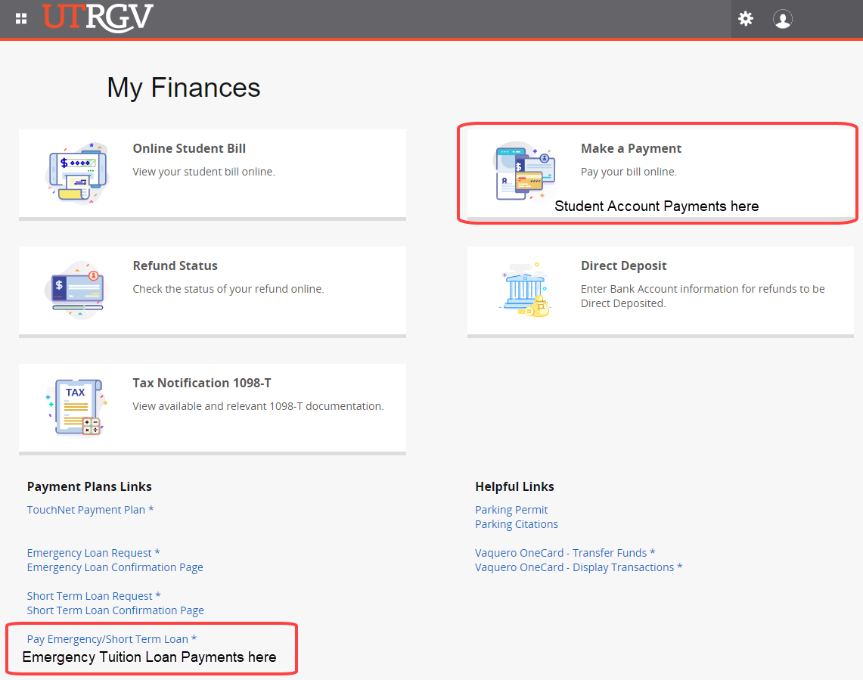
How to make a payment?
Online – ach or electronic check
Student account
Assist > my finances > make a payment > Select term
Emergency Tuition loan account
Assist > my finances > pay emergency loan > “pay bill”.
in person - Bursars office
Student account – cash, money order, check, & debit CARD
Emergency loan – cash, money order, & check.
Partial payments before due date are allowed without penalty
Payments may take 24 – 48 hours to reflect on your bill

Slide 7
What happens if your eml is not paid in full by due date
Students are liable for up to 3 late payment fees
Balance thresholds for late payment fee
1st late payment fee – 1-3 days after emergency loan due date
2nd late payment fee – 30 day past due
3rd late payment fee – 60 day past due
Less than $500 - $10.00 Late payment Fee​
between $500.00 and $1,000.00 - $20.00 Late payment Fee​
greater than $1,000.00 - $30.00 Late payment Fee
Additional fees for accounts that remain unpaid
23% internal collection charge – 90 days past due ​
Up to 30% collection charge – accounts assigned to external collections
Students are responsible for all costs associated with the collection of their account

Slide 8
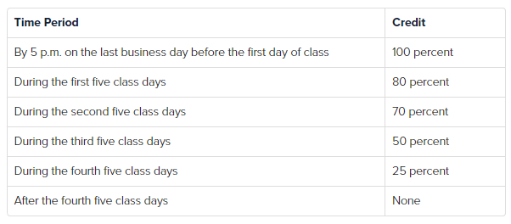
What happens if I drop/add my courseS
Partial drops
The emergency tuition loan will automatically adjust to student bill increases or decreases until the 20th day of class.
Contact the loanoffice@utrgv.edu if you intend to pay a student balance and payment was transferred to eml.
Complete withdrawal
According to:
section 54.006, Texas Education code
Visit the dropping/withdrawing website for more information
Dropping/Withdrawing | UTRGV

Slide 9
Consequences for outstanding accounts
The utrgv financial hold will be placed to all emergency tuition loans in default and may Prevent students from:
  viewing grades
  receiving diploma upon graduation
  Requesting a new institutional loan (emergency tuition loan or institutional payment plan)
utrgv is a state agency, a state hold will be placed on delinquent accounts possible preventing:
  Receiving financial aid refunds from other state institutions including other Texas universities
  Lottery ticket payment
  State employment reimbursements or payroll checks
  other miscellaneous source of payment handled by the state
Credit bureau reporting – outstanding balances may be reported to the 3 major credit bureau agencies
  Negatively impacts student credit score
  Affects real Estate purchase, personal loans, APPLYING FOR CREDIT CARDS, etc.

Slide 10
Can I request to extend my payment due date?
State universities cannot extend the initial due date.
As per utrgv Catalog UNDER Student bill and methods of payment:
“State universities cannot extend credit. Students are expected to meet financial obligations to UTRGV within the designated time allowed. Tuition and fees are payable at the time the bill statements are available through ASSIST. Students are not entitled to enter class or laboratory until all tuition and fees have been paid or the student has established a UTRGV Payment Plan”.

Slide 11
Testing your knowledge
Can students pay their Emergency loan outstanding balance in payments before the EML due date?
Yes, students can create their own payment plan to guarantee a Paid in Full account by the EML due date.
No, students need to wait until the EML due date to Pay in Full.

Slide 12
Testing your knowledge
How can students make sure that their Emergency Tuition Loan application paid for their student account balance?
The student received an emergency loan confirmation email.
The current student account has an outstanding balance, and the Emergency Tuition Loan office has not processed a payment.
The current student account has a zero balance, and the Emergency Tuition Loan paid for it.

Slide 13
Testing your knowledge
Who can I contact to find out if there is any available funds to pay for my Emergency Tuition Loan?
Assist > My Finances > Financial Aid > Year > Award Offer > Accept Awards.
Contact the finaid@utrgv.edu for more Federal Loan information.
Contact the scholarship@utrgv.edu for available scholarship information.
Contact the studentsuccess@utrgv.edu for available information.
Apply for a private loan at lenders such as Sallie Mae, Mpower, SoFi, College Avenue, Brazos, Earnest.

Slide 14
Testing your knowledge
What happens if the Emergency Tuition Loan account is not Paid in full by the EML due date?
Student may be charged up to $90.00 in late payment fees.
Student may be charged from 23% to 30% in collection charges.
Student credit score will be affected once the EML account is reported to major credit bureaus.
Student account will incur a state hold placed at the Texas Comptroller Office.
Student will not be able to request an institutional loan for any future semester or term.

Slide 15
Thank you
Student business services
emergency tuition loan office
loanoffice@utrgv.edu 956-665-2191
Sound Effect by Muzaproduction
Notes:
Catherine

