Slide 1


Touchnet Implementation

Slide 2
Bill & Payment
Student View

Slide 3
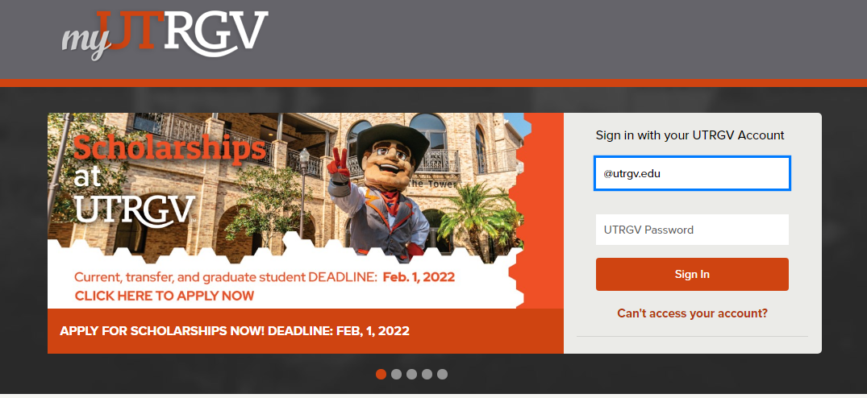
Log in Process:
Login through my.utrgv.edu by entering in your UTRGV credentials.
You will be prompted to myUTRGV homepage.

Slide 4
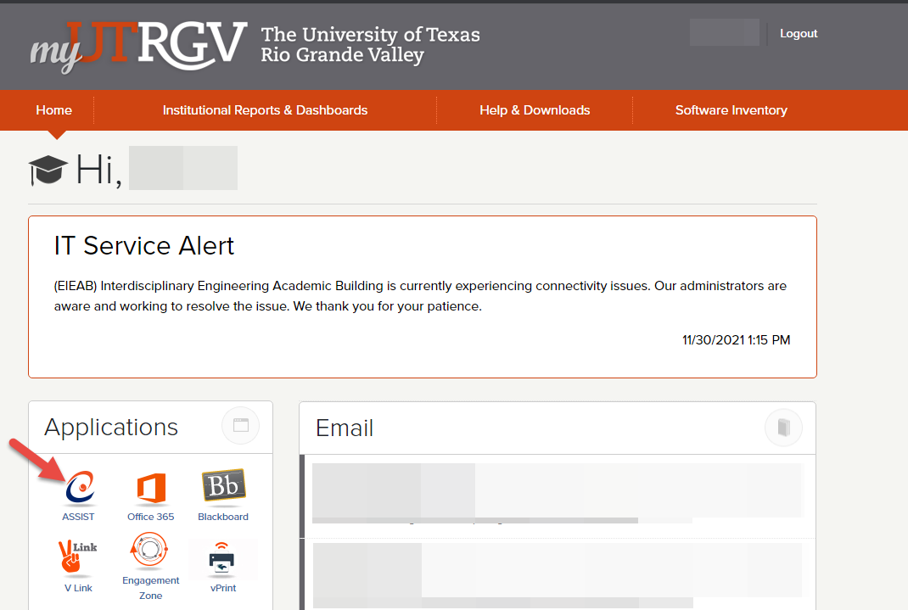
myUTRGV Homepage
From the list of applications, click on ASSIST.
You will be redirected to the Student Services homepage.

Slide 5
Pay Now Option – Student Services

Slide 6
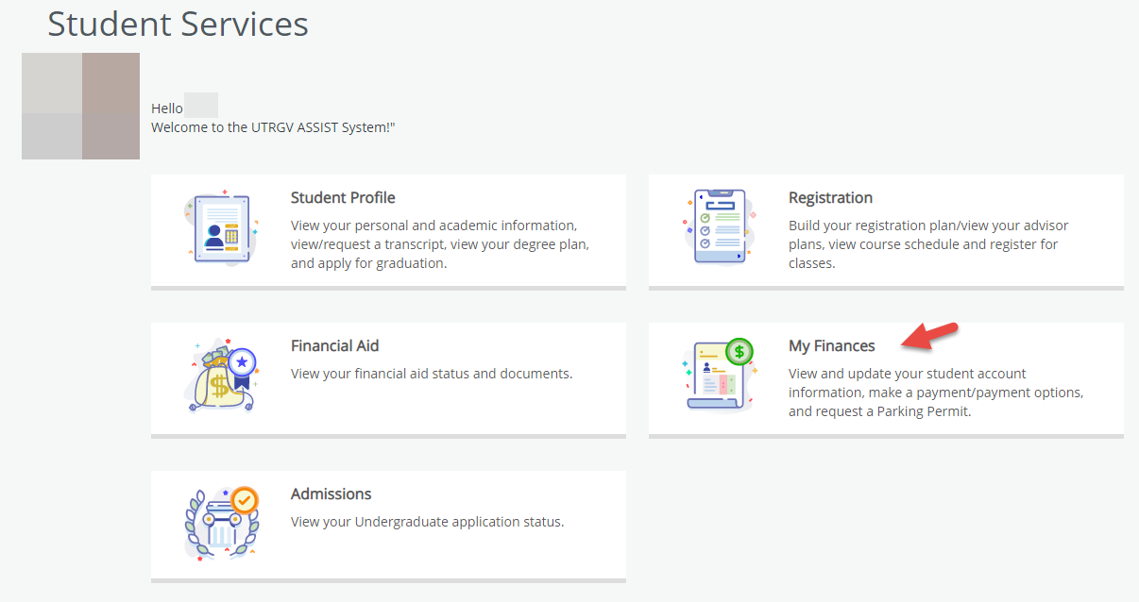
Student Services
Through the Student Services page, you will click on My Finances.
My Finances will provide the student account information and payment options.

Slide 7
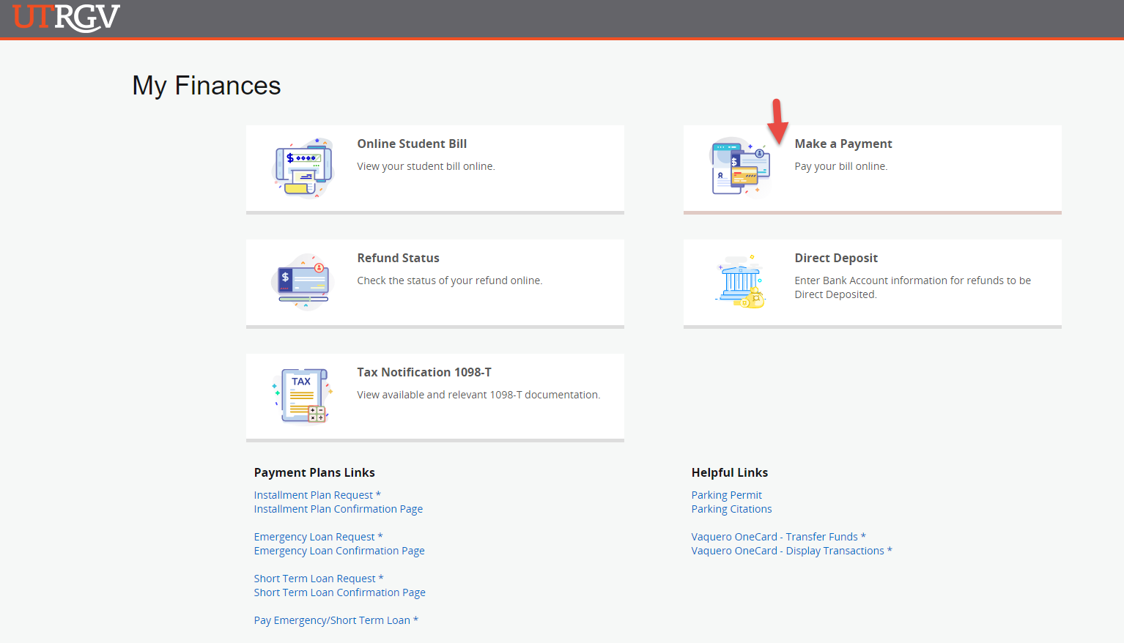
My Finances
On the My Finances homepage, click on Make a Payment.
The Make a Payment homepage will provide general payment information such as acceptable payment types, the credit card convenience fee and the Emergency Loan payments link.

Slide 8
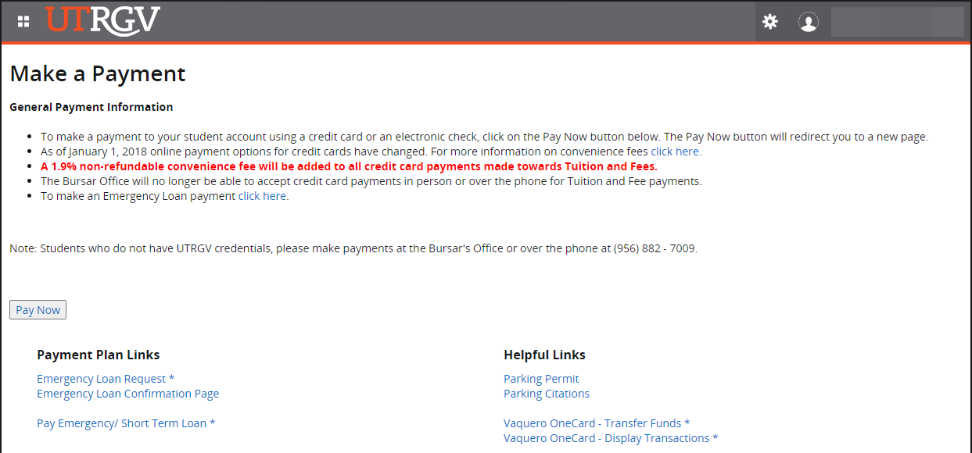
Make a Payment
On the Make a Payment homepage, click on the Pay Now option.
The Pay Now button will redirect students to the TouchNet Student View Homepage.

Slide 9
Pay Now Option – Online Student Bill

Slide 10
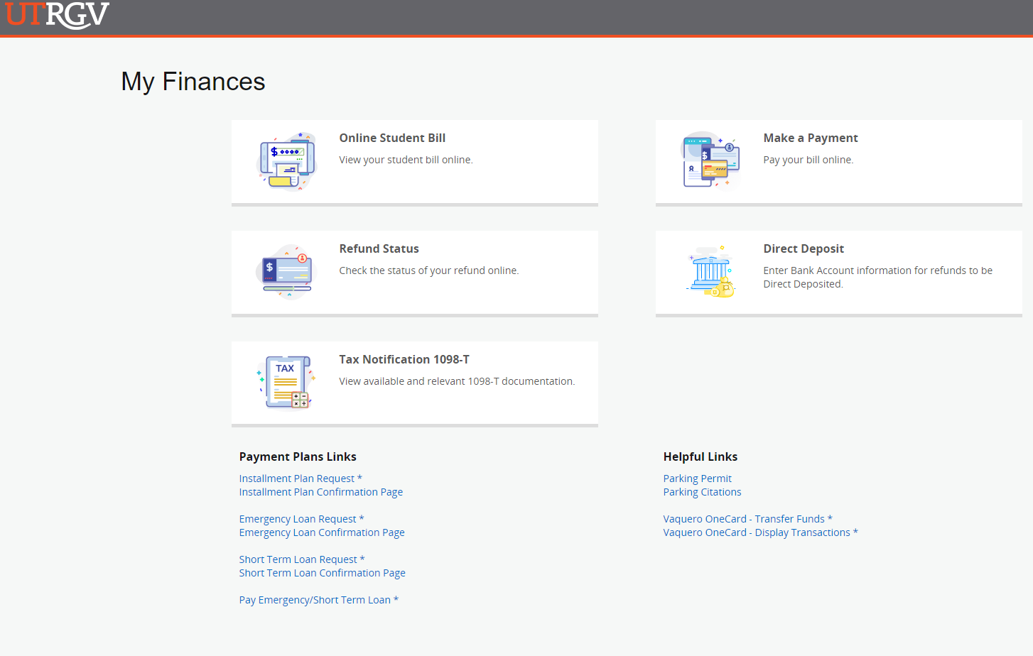
Online Student Bill
Students can also access the payment portal through their Online Student Bill.

Slide 11
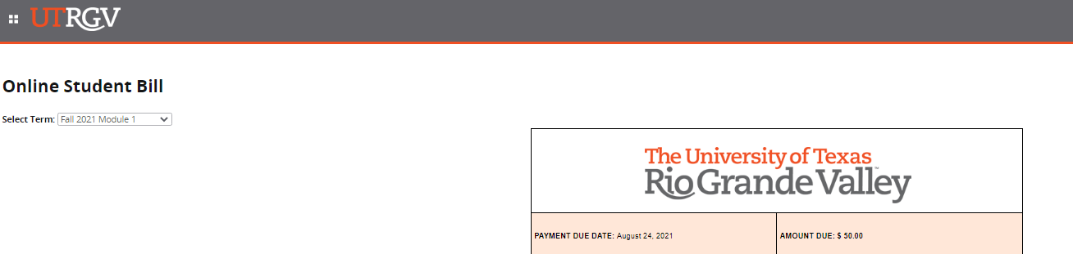
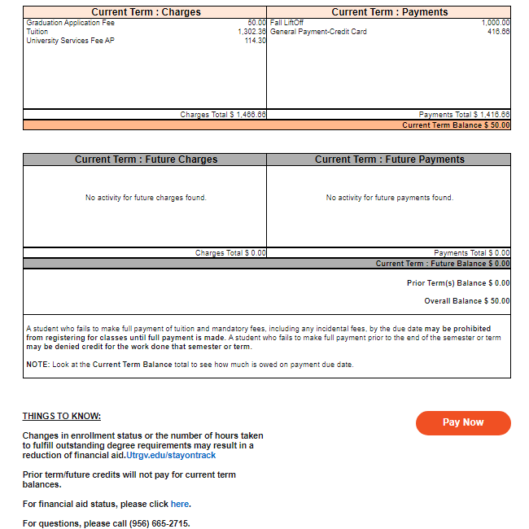
Online Student Bill
After scrolling selecting the term, scroll down to the bottom of the page and select the Pay Now button. This will lead students to the Make a Payment page.

Slide 12
Make a Payment
On the Make a Payment homepage, click on the Pay Now option.
The Pay Now button will redirect students to the TouchNet Student View Homepage.

Slide 13
Pay now button will redirect you to the TouchNet Student View site.
You will need to click on the “Make a Payment” tab in Touchnet Student View site.

Slide 14
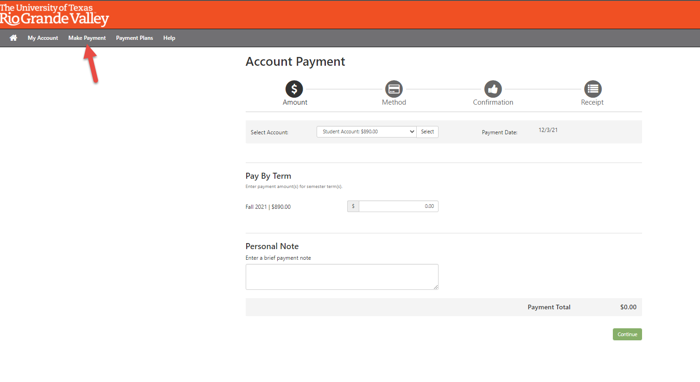
Make Payment

Slide 15
TouchNet Homepage

Slide 16
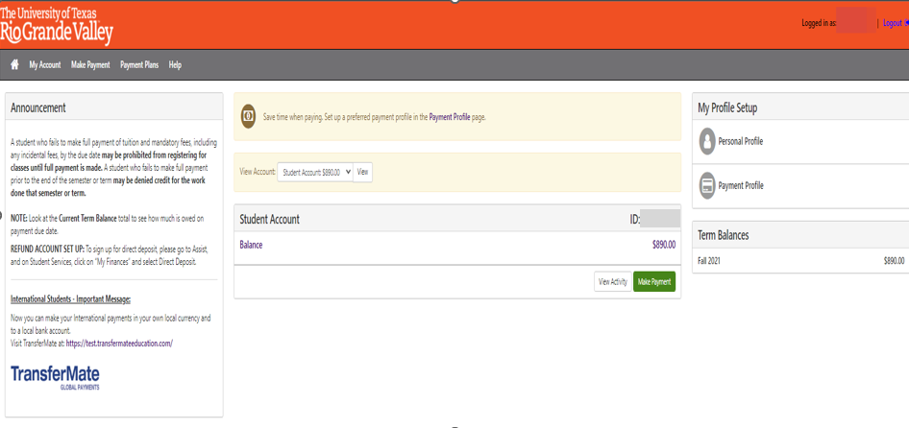
Homepage - Student View
Notes:
Here is the student’s view of the home page. It is user friendly and provides plenty of information to the student. On the left, there is an announcements pane that shows important information on outstanding balances and how such balances generate holds that affect future registration. In addition, the left pane provides information for International Students regarding TransferMate (our new international payments processor). On the right, the student has profile options for the student to personalize their account. The middle of the page shows the student account information and provides payment plans and line-item information.
The student can see an option to sign up for direct deposits for refunds. This may create confusion since we are not processing refunds through TouchNet at this time. A message on the home screen has been added to redirect the student to log in to Assist.
“To sign up for direct deposit, please go to Assist, and on Student Services, click on “My Finances” and select Direct Deposit”.

Slide 17
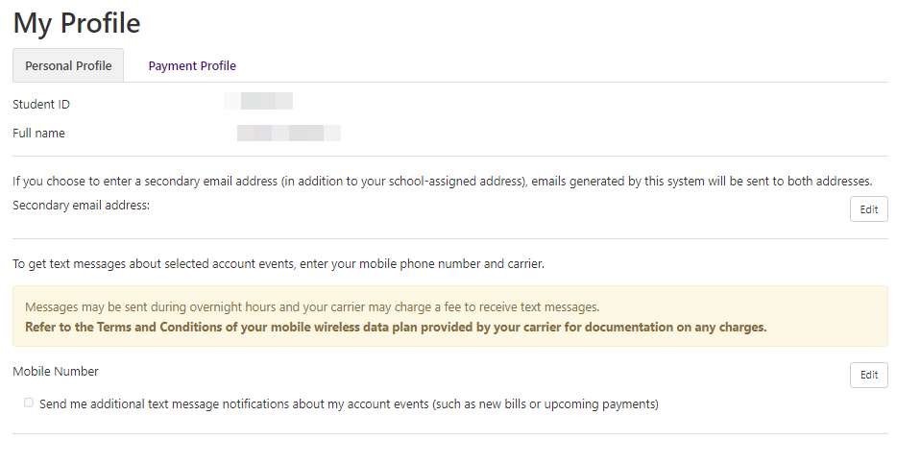
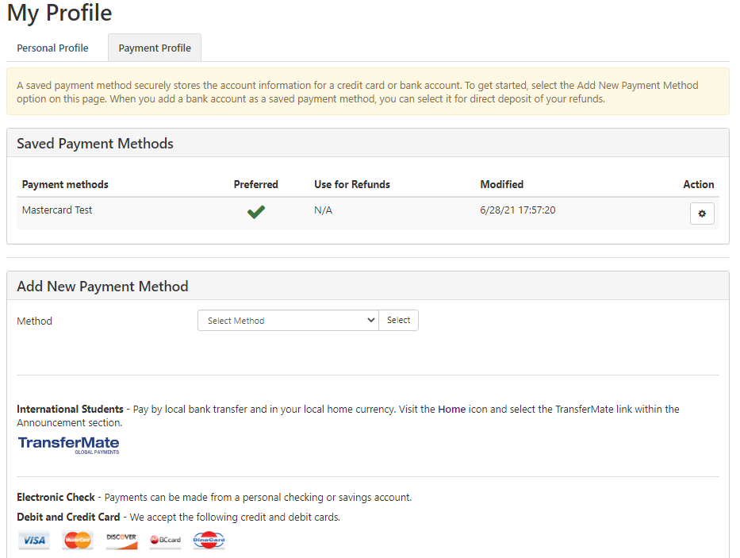
Student Profile
On the Student Profile page, students can save payment methods to their profile and can add secondary contact information.

Slide 18
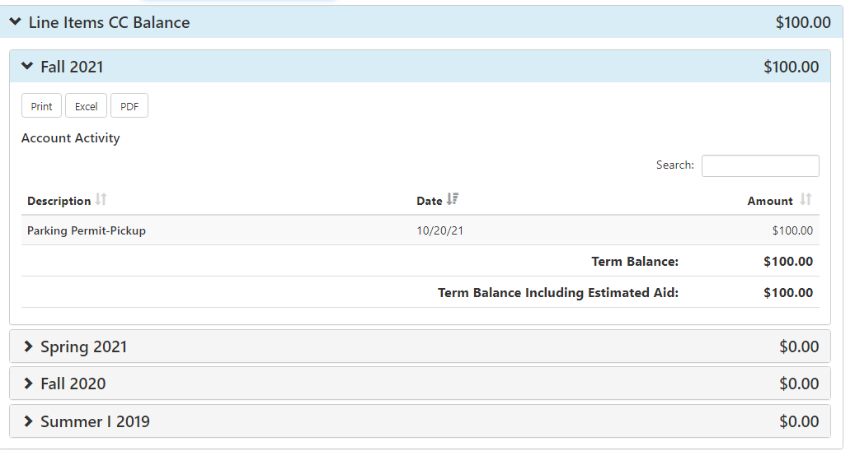
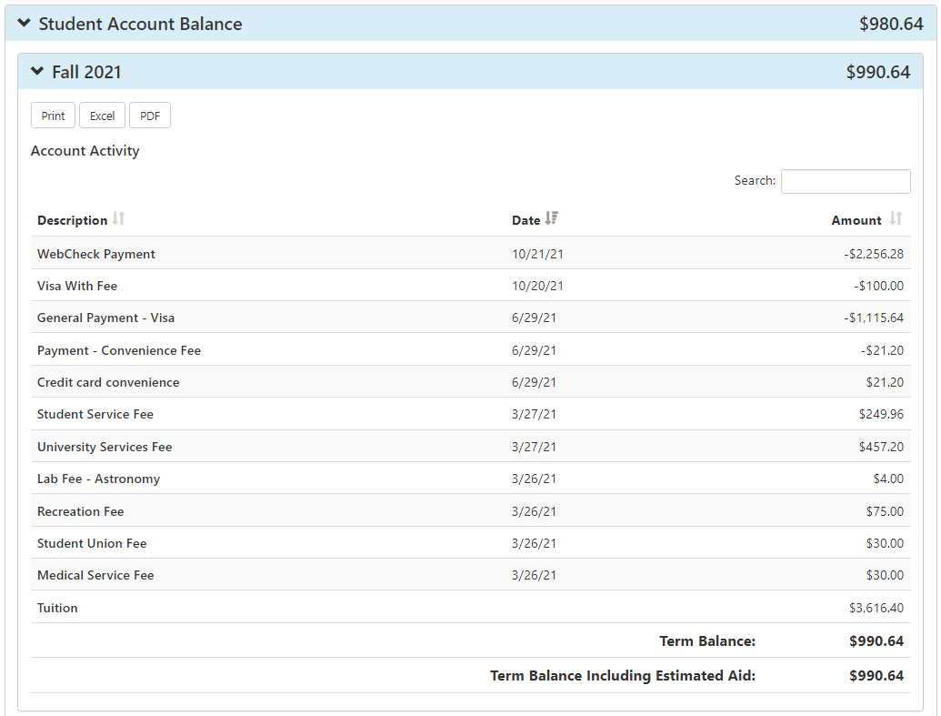
Account Activity
My Account Activity in TouchNet reflects the balances by line items, by line items with convenience fee, and by student account balances (Tuition and Mandatory Fees). Students can expand each balance by term. They can also expand each term to view tuition and fee descriptions.
Students will be receiving email notifications from noreply@utrgv.edu. Samples of notifications are payment confirmation, failed payment, payment plan enrollment, installment amount changes, payment plan installment reminder(s), late installment reminder(s), etc.

Slide 19
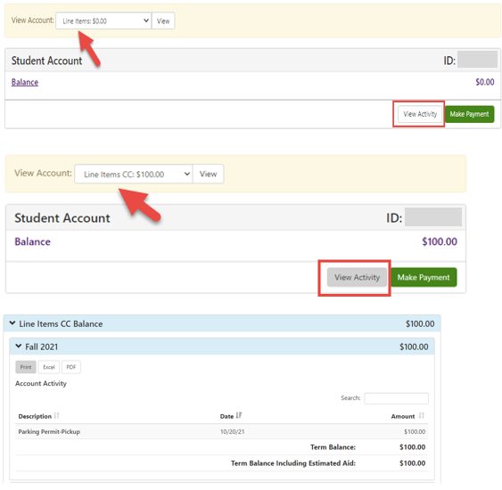
Line-Item Option & Real Time Payments
TouchNet will allow students to apply payments to specific charges in Banner:
    “Line Items”. Charges/fees listed here will not generate a credit card convenience fee (Ex. Bookstore charges, credit card chargebacks, parking tickets etc.)
    “Line Items CC”. Charges/fees listed here are subject to the Credit Card Convenience Fee (Ex. Parking permits, graduation application fee, Installment Fee, Dorm Room charges, etc.)
Online payments processed successfully through TouchNet will post to Banner in real-time.
Notes:
We will have “Line Items” that do not generate CCCF ( Bookstore charges, credit card chargebacks, parking tickets etc.)
“Line Items CC” are for those charges that will incur the CCCF ( Parking permits, graduation application fee, Installment Fee, Dorm Room charges, etc.)
Like “Other Fees” in Assist, line items will allow the student to apply payment to specific charge in Banner. These include parking permits, graduation application fees, and other non-tuition fees.

Slide 20
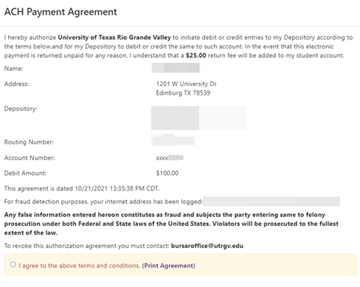
Payment Options
TouchNet offers students the following payment options: credit card & electronic checks. *Debit cards can be used but will be processed as credit & will incur a credit card convenience fee. Therefore, it is recommended for students that pay with a debit card to select the use the electronic check payment option.
International wires are also accepted and must be processed through TransferMate.
If a student has a saved payment method, the system will automatically populate the ACH payment agreement. This option is available for students that would like to pay with their checking account as an electronic check.
A convenience fee of 1.9% is charged to all online credit card payments towards Tuition and Fees.
Notes:
For students who want to pay with a Debit card we

Slide 21
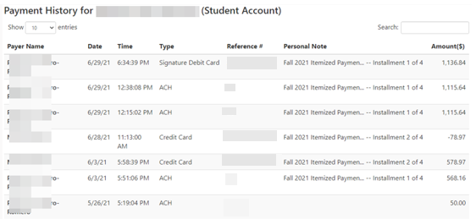
Payment History
Students have the option to view their payment history for TouchNet payments only. The student has the option to filter their history by line item or by student account, by payer and by payment type, and by date range.
Notes:
Scheduled payments were not enabled.
Students no longer have the option to add an authorized user for payments.

Slide 22
Payment Plan
Itemized Installment Plans

Slide 23
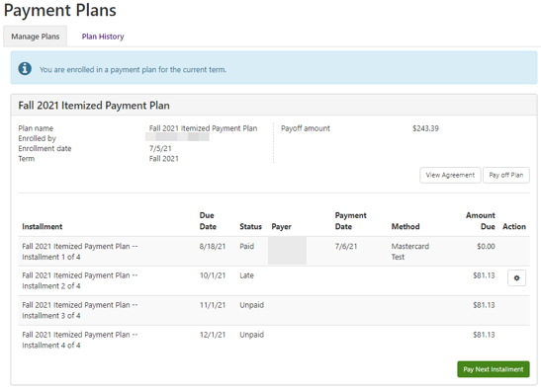
Itemized Payment Plan
Itemized payment plans can be created for Fall and Spring terms only. The plan consists of four payments; the first Installment will be paid by the term tuition due date and subsequent payments are due on the first business day of the month.
Notes:
- The option to request the payment plan will go Offline when the enrollment window ends.

Slide 24
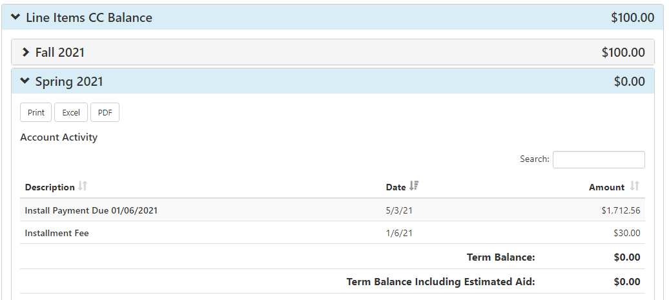
Installment Plan Processing & Late Payment Fee
The payment plan has a one time $30 processing fee. This is classified as a “Line-Item CC” and has been set as a post charge, meaning students can pay the fee later.
A late payment fee of $30 is imposed after 3 consecutive days of non-payment (including weekends) after the installment due date.
Notes:
It is important to remind students to pay the 1st Installment first and then proceed to make the payment towards the processing fee separate. This will allow for the fee to be allocated accordingly in Banner.
When payments are processed towards Installment Plan or Tuition, payments should be paid as a “Term” and not as “Line Item”.

Slide 25
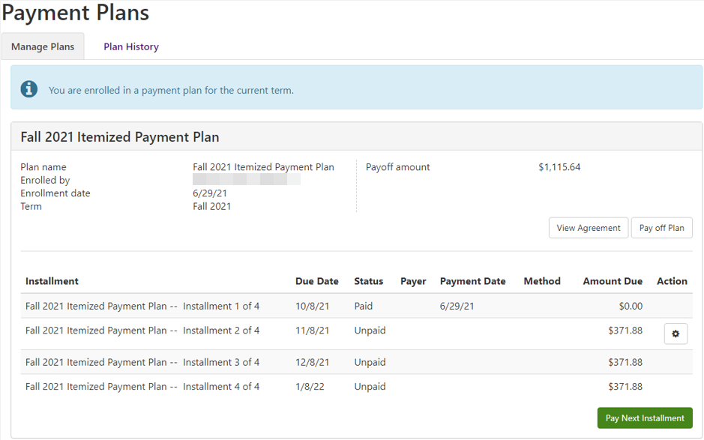
To Qualify
Must be registered for the current term.
Must be 18 years or older. *Minors must contact the Bursar’s Office directly as DB hold will be placed on their account and will prevent them from requesting the installment plan online.
Must not have prior term balances, including previous or active Emergency Loans.
Students pending the High Assurance Indicator will receive the HA hold that will prevent them from requesting the installment plan online. As soon as the two forms of ID’s have been verified and clearance has been provided, system will release their hold.

Slide 26
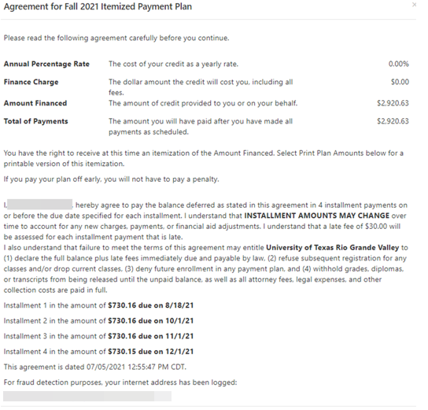
Payment Plan Agreement
The agreement states the terms and conditions for the Installment Plan. The agreement discloses that the amounts may change depending on adjustments made to their account. It also explicitly states the $30 late fee and penalties for not adhering to the agreement. If a student wishes to cancel the plan, they must contact the Bursar Office directly (each situation will be reviewed on a case-to-case basis).
Notes:
The agreement is very detailed and provides plenty of information for the student to understand.
Mention the $30 processing fee
Gives Bursar Office information to cancel agreement
Student must be over 18 to enroll, system still lets minors enroll so planning to add a hold
We decided not to enable authorized users in TouchNet since the payment plan agreement would generate under the guardian's name.

Slide 27
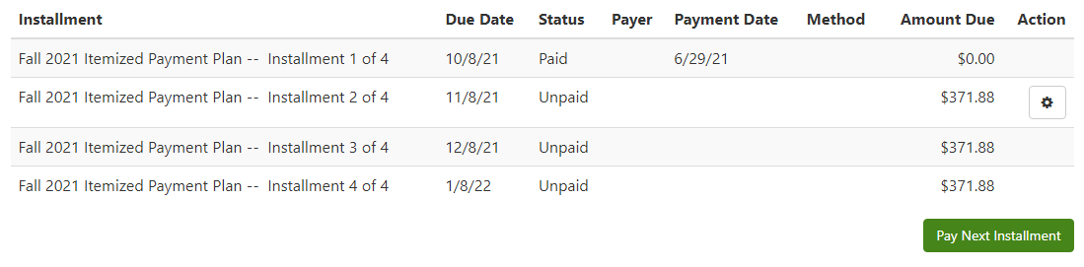
Payment Plan Description – Financial Aid
The Payment Plan is divided into four monthly payments.
If Financial Aid is applied to the account before the plan is requested, the plan is calculated for the remaining balance.
If Financial Aid is applied to the account after the plan is requested, the credits are applied towards future installments.

Slide 28
Payment Plan Description - Adjustments
If charges are added/dropped from the student account, the payment plan will recalculate with the new balance.
When Financial Aid is removed, the payment plan will recalculate the original balance. If a payment was made, it will be applied to the first installment.

Slide 29
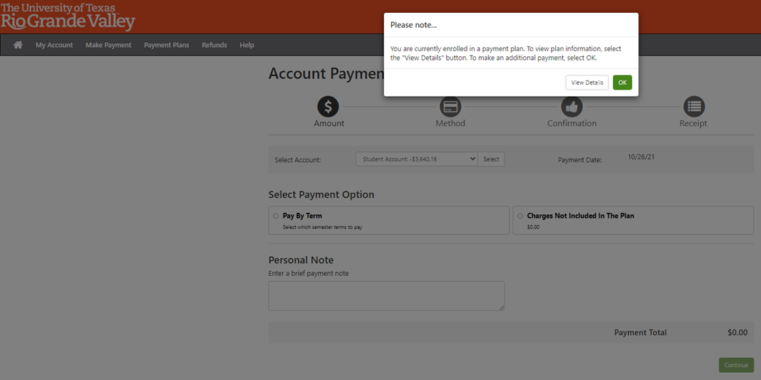
Payments
When enrolled in a payment plan and a student plans to make a general payment system should alert them that they currently have an active payment plan.

Slide 30
Questions ?
Contact Bursar Office:
Email: Bursaroffice@utrgv.edu
Phone: 956-665-2718 or 956-882-7090

