Slide 1

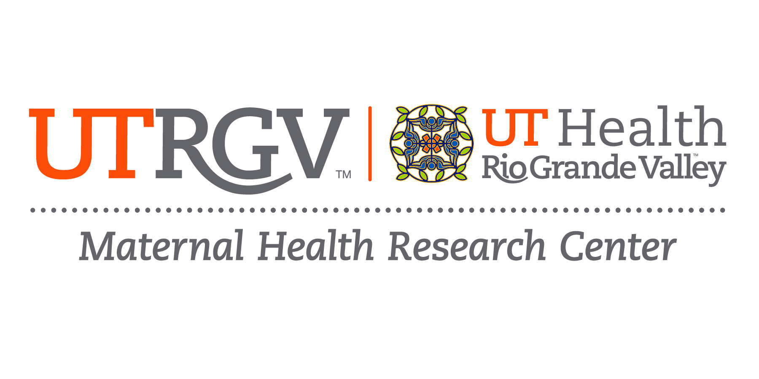
Notes:
I love this picture. It reminds me about science that says that communities where a lot of Hispanics live have better pregnancy outcomes like lower infant deaths and bigger babies at birth. It also reminds me that being Hispanic, bicultural and bilingual means better child social and cognitive development and access to high quality parenting. And did you know that in challenging times, if we were to pick up the phone and call our moms that 62% of us will find reassurance and connection? It’s beautiful!
At the same time, there is a lot we need to do to improve the health and well-being of Hispanic women, especially here in the Rio Grande Valley. And I’m here to talk to you about a new initiative that has been funded by the federal government for us to do that through research.

Slide 2

Mindful Mother Intervention
Designing and evaluating a promotora-led approach to increase psychological flexibility among women who are pregnant or within two years of delivery in community settings.
Promotoras(es) are best for this work because they are peers, trusted messengers, have cultural insight and possess the knowledge and tools to effectively link women to needed resources.
Psychological Flexibility is the superpower of mental health and well-being. It is a factor we can change to decrease a woman’s risk of depression and anxiety, improve her quality of life and lessen the impact of trauma experienced during childbirth and after delivery.
Notes:
Deepu George

Slide 3

Birth Stories Archive
Collecting and archiving birth stories or oral accounts of a person’s labor and delivery experience. Women living in the Rio Grande Valley detail the events, emotions and decisions made through the process.
Analyses of these data can tell us about factors that lead to or prevent adverse maternal health outcomes and help us identify gaps in services or resources that support mom and baby.
This type of research goes beyond the data and can help us improve patient-centered care, inform healthcare practices and policies. It provides valuable insights that can help promote positive outcomes and reduce maternal health disparities.
Notes:
Milena Melo

Slide 4

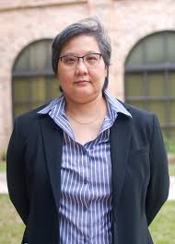
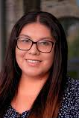
Environmental Hazards in
Border Region
Describe environmental hazards present in RGV region and examine the effect of environmental hazards inside the home, outside the home, and heat stress on general health in the region.
Analyses of these data can tell us about environmental factors present that are known to adversely impact maternal and child health.
This type of research can help us identify opportunities to improve maternal and child health in the region by addressing environmental factors.
Notes:
Choh, Urbina

Slide 5
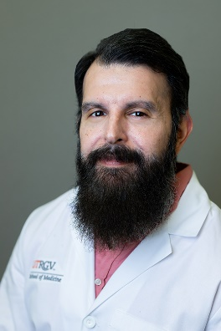
Human Breastmilk Exposome
Preliminary results from a rapid environmental health assessment (n=331) conducted in our region, where most respondents were female (77%) and between the ages of 18-39 (52%), showed frequent self-reported environmental hazards in homes and neighborhoods
Create institutional capacity to conduct proteomic and metabolomic analyses on human breastmilk samples to support future studies regionally and across the MHRC that aim to examine how environmental factors work synergistically to impact maternal health
This research will generate research hypotheses of the associations between components of breastmilk (e.g. environmental toxicants) and maternal and child health outcomes.
Notes:
Jacob Galan

Slide 6
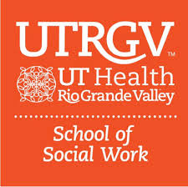



Community Engagement Alliance
CEAL is a research network that works with communities to identify promising engagement and outreach practices that communicate trustworthy, science-based information to communities experiencing differences in health outcomes.
Conversations Advancing Resilience and Empowerment (CARE) Intervention addresses inaccurate health related information to promote the adoption of healthy behaviors across four key topics: self-monitoring blood pressure, nutrition, physical activity and well-being.
This research will provide evidence-based information to address the high burden of chronic disease among women of reproductive age
Notes:
Luis Torres-Hostos
Leticia Villareal-Sosa
Rebecca Cole

Slide 7
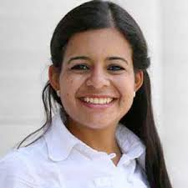
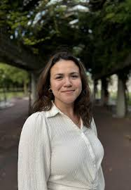



Psychological Sciences Research
The maternal health research center is training the next generation of maternal health researchers through a unique collaboration between our institute and Morgan State University.
Our fellows are studying how childhood maltreatment or unfair treatment in pregnancy increases posttraumatic stress responses and the relationship between parental self-efficacy and perceived stress among parents with children with autism.
This research will provide evidence-based information to design and evaluate interventions that can support parents of children with developmental delays living in under resourced areas as well as prevent violence and victimization among adolescents and emerging adults.
Notes:
Dr. Cecilia Montiel-Nava + Geohanna Noel
Dr. Ruby Charak + Maria Isabel Ramos

Slide 8
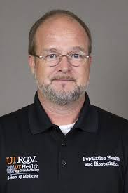
Preventing Congenital Syphilis
Provider and community education and outreach program to address rising rates of congenital syphilis in our region.
We provide continuing medical education for providers and train CHWs to educate community members about STI prevention, testing and treatment. We have UTHealth Connect on social media and formed regional task force in partnership with DSHS Region 11
This work is helping to increase awareness of the importance of sexual reproductive health among both men and women living in our region and the impact it can have on health across the lifecourse and on infant health.
Notes:
Cliff Clark

Slide 9

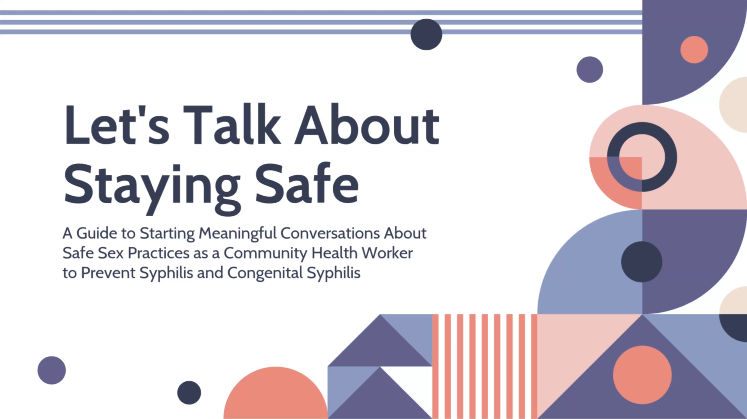
Preventing Congenital Syphilis

Slide 10
Questions?

Slide 11
References
The U.S. Maternal Vulnerability Index. Surgo Ventures. https://mvi.surgoventures.org.
McDonald, J.A., Mojarro, O., Sutton, P.D. et al. Adolescent Births in the Border Region: A Descriptive Analysis Based on US Hispanic and Mexican Birth Certificates. Matern Child Health J 19, 128–135 (2015). https://doi.org/10.1007/s10995-014-1503-2
Khan D, Hamilton B, Rossen LM, He Y, Wei R, Dienes E. Teen birth rates for age group 15–19 in the United States by county, 2003–2020. National Center for Health Statistics. 2022.
McDonald JA, Mojarro O, Sutton PD, Ventura SJ. A Binational Overview of Reproductive Health Outcomes Among US Hispanic and Mexican Women in the Border Region. Prev Chronic Dis 2013;10:130019. DOI: http://dx.doi.org/10.5888/pcd10.130019.

Slide 12
References
Khan SS, Vaughan AS, Harrington K, et al. US County–Level Variation in Preterm Birth Rates, 2007-2019. JAMA Netw Open. 2023;6(12):e2346864. doi:10.1001/jamanetworkopen.2023.46864
Regional Analysis of Maternal and Infant Health in Texas - Updated 6/6/18
MacDorman MF, Declercq E, Thoma ME. Trends in Texas maternal mortality by maternal age, race/ethnicity, and cause of death, 2006-2015. Birth. 2018 Jun;45(2):169-177. doi: 10.1111/birt.12330. Epub 2018 Jan 4. PMID: 29314209; PMCID: PMC5980674.
Texas Maternal Mortality and Morbidity Review Committee and Department of State Health Services Joint Biennial Report 2022

