Slide 1
4-year (De Novo) Protocol Submission
IBC Tick@Lab

Slide 2
Content:
Access to tick@lab
IBC/HBA De-Novo Protocol Submissions
Getting Started
Adding personnel
Application Sections
Attachments
Validating and Saving
Protocol Submission
Reviewer Feedback
Resubmitting a Protocol

Slide 3
Access to tick@lab

Slide 4
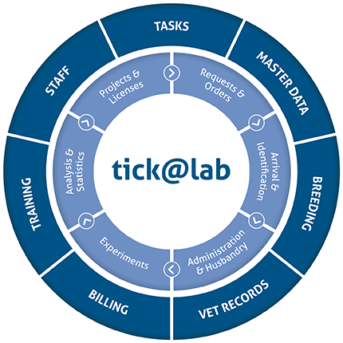

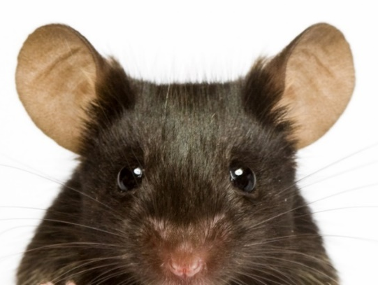

tick@lab URL
https://lar.utrgv.edu/tickatlab/default.aspx

Slide 5
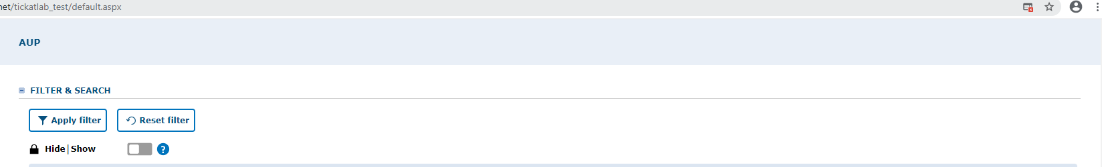

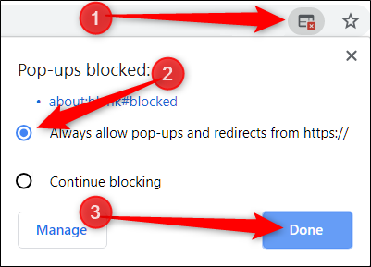
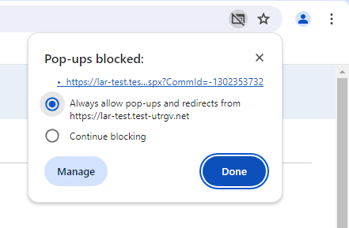
Allow Pop-Ups
Reminder: Allow Pop-ups to open new windows.
Follow the steps.

Slide 6
Access to Tick@Lab is not Automatic
If your personnel has never worked with tick@lab before, they’ll need to complete a web form to request access via IT.
Click HERE or on the link below for instructions on how to request tick@lab access:
Submitting your access request for tick@lab (utrgv.edu)
If you are unable to log-in please contact Amy Mutore or Monica Barrera for assistance at ibc@utrgv.edu, amy.mutore@utrgv.edu, or monica.barrera01@utrgv.edu.

Slide 7
IBC/HBA De-Novo Protocol Submissions
IBC/HBA Protocols must be re-submitted every 4 years for approval.
  This means re-submitting the entire protocol as a new submission
On tick@lab, the protocol can be duplicated, and a new protocol number will be assigned.
  Duplicating the protocol will allow for all the information on the original protocol to be copied over to the new draft document.
  Once duplicated, any additions/changes needed can be made to the protocol before submitting.

Slide 8
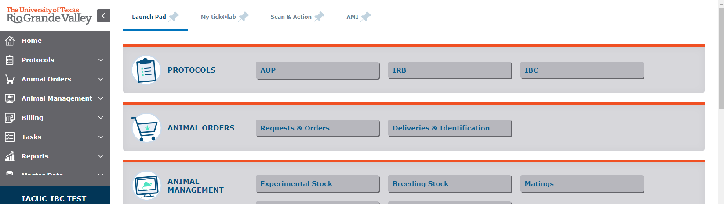
Getting Started
1. Click on “IBC”

Slide 9
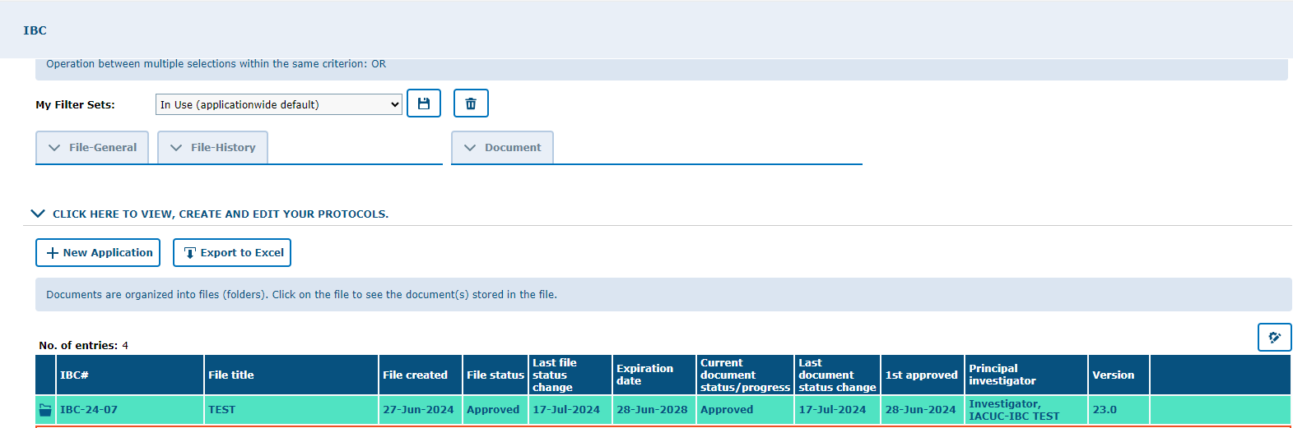
    To initiate a De-Novo protocol, go to the “In-Use” option under “My Filter Sets.” Then, right-click on your protocol and select “Duplicate File.”

Slide 10
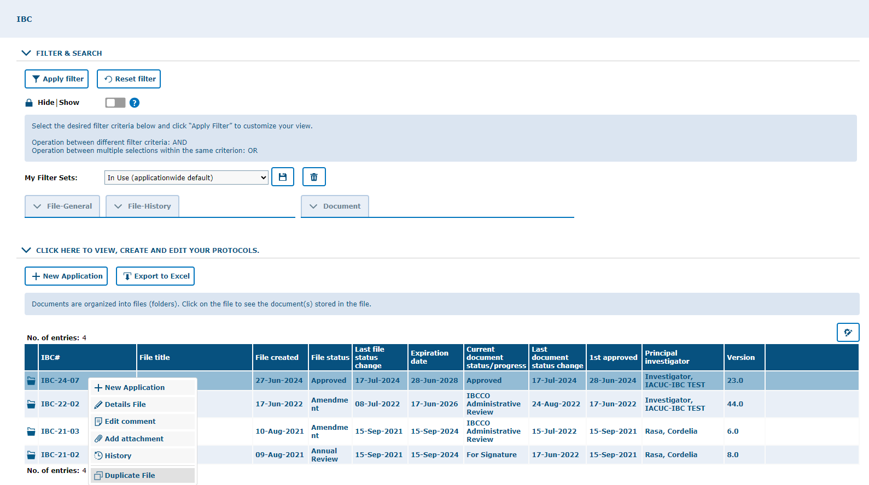

Slide 11
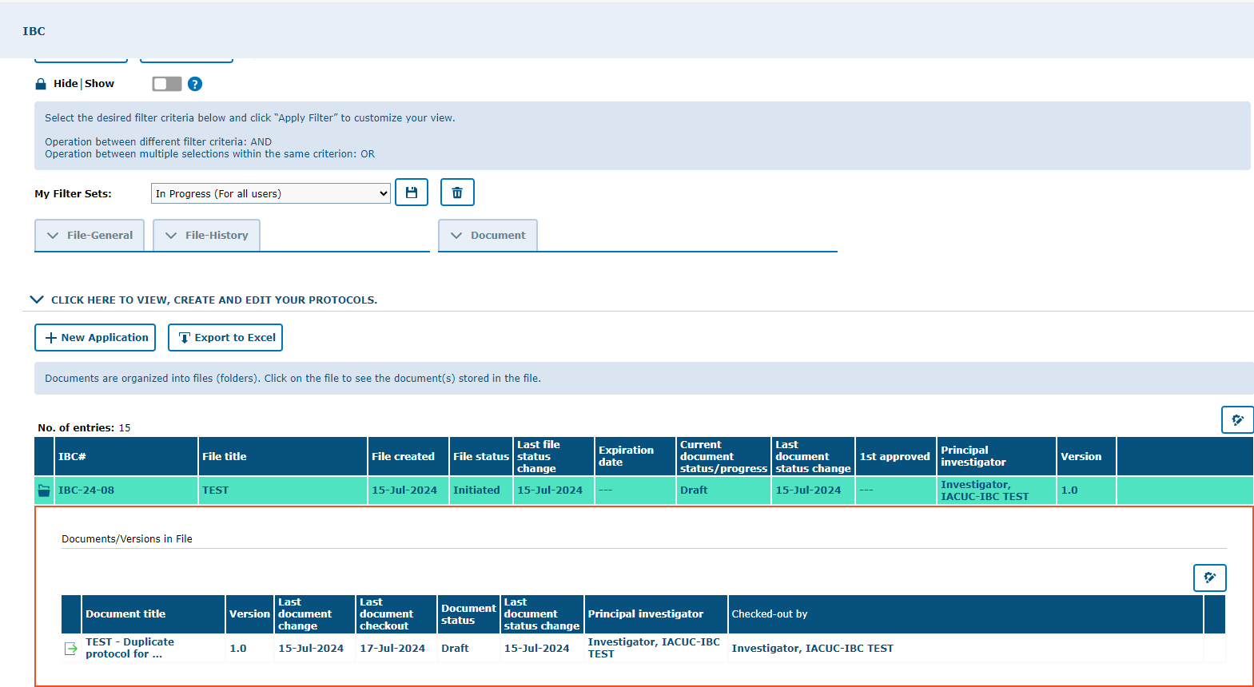
    The duplicated file will then appear under the “In Progress” option in “My Filter Sets.”

Slide 12
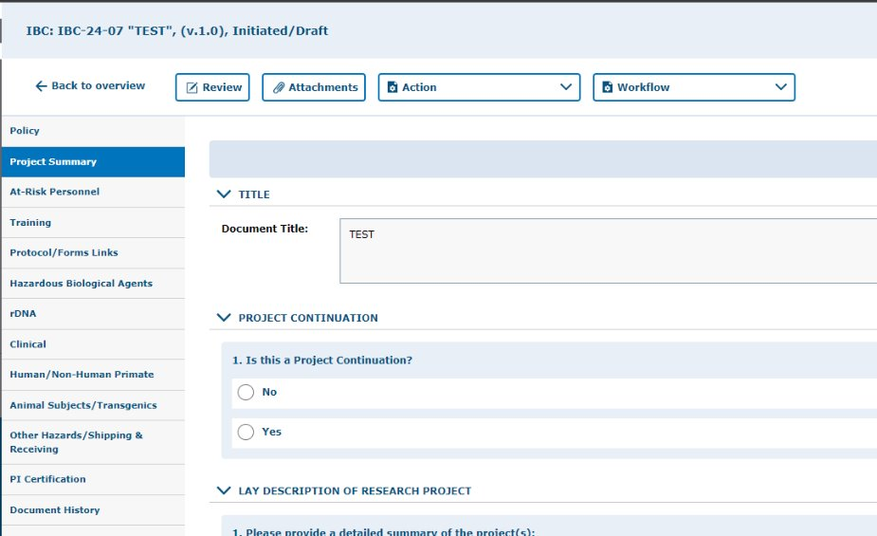
    Review your duplicated protocol by going through each tab to ensure all the information was copied.
    If any additions/changes need to be made, they can be made in this submission.
      i.e. if you’ll be using less animals this time around, change the number of animals for this submission.

Slide 13
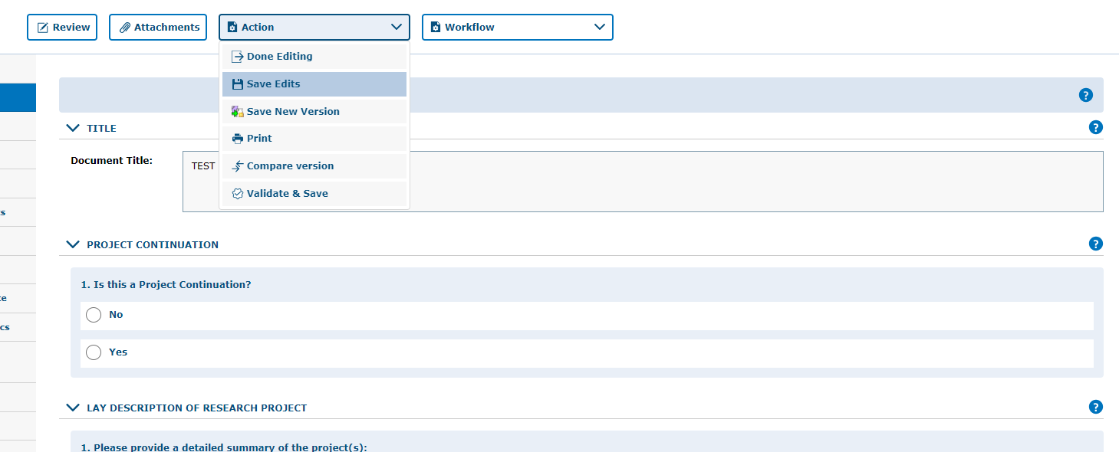

ALWAYS SAVE YOUR WORK!
Save Often. tick@lab does not save information automatically.
Make sure you save information after completing each tab.
Click on “Save Edits” under the “Action” button located in each tab
Note, that there are 4 ways to save forms:
  Done Editing: saves the file and checks the document in so that another person can check it out and edit it.
  Save Edits: saves the document and allows you to keep working on it.
  Save New Version: saves a separate and new version of the file (duplicate).
  Validate & Save: alerts you of any missing items in the protocol before saving.

Slide 14
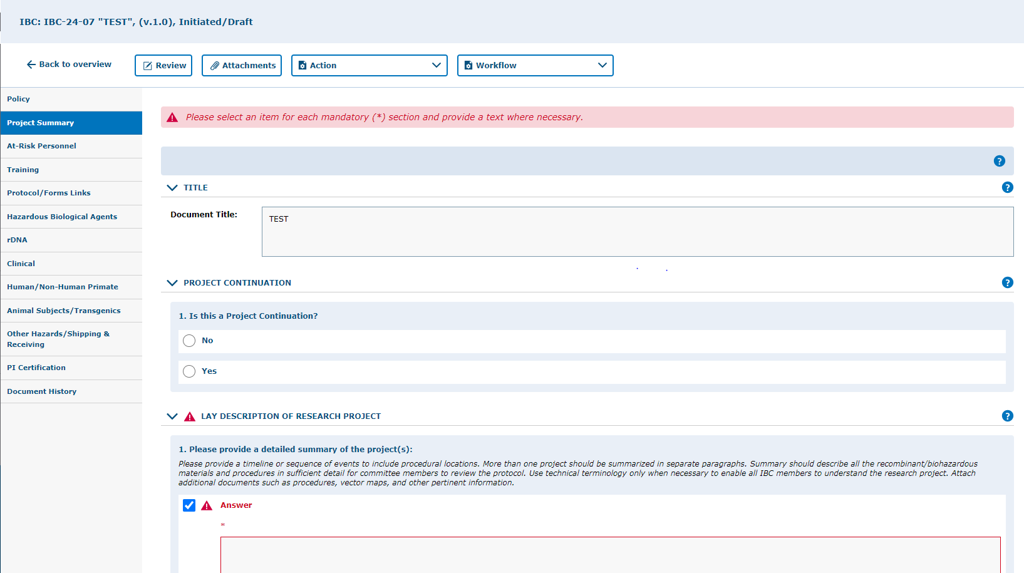
Example of error when there is missing information on a required field (s).

Slide 15
Adding Personnel
How to add project team members to protocol

Slide 16
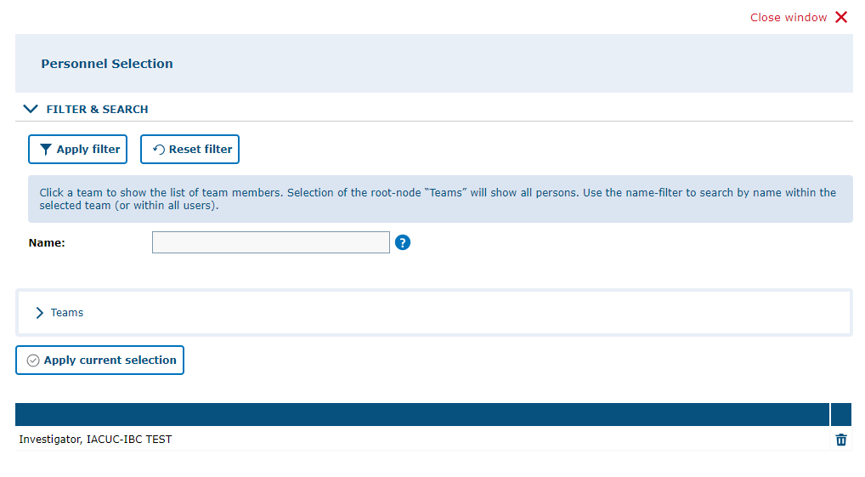
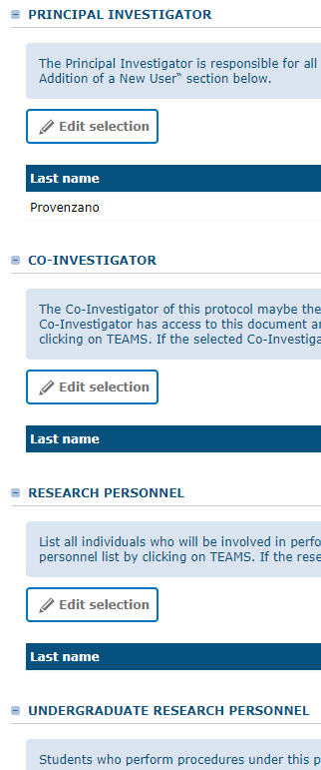
From the “At-Risk Personnel” Tab on the left, go into each of the questions and click “Edit selection” to
assign personnel as Co-Investigators, Key Personnel, Faculty Advisor and Reviewer and Signers
from the Pop-up window.
1.You can type the Name (first or last, or both) and click “Apply filter.” Or,
2.You can click on Teams and select from the list, then click on “Apply current selection”.
Note 1: You can add as many personnel as you want.
Note 2: If you cannot find a researcher from the list, there is a slight possibility that the researcher does not have access to tick@lab and will need to be manually added by ORC staff. Please contact Office Research Compliance (ORC) for assistance.

Slide 17
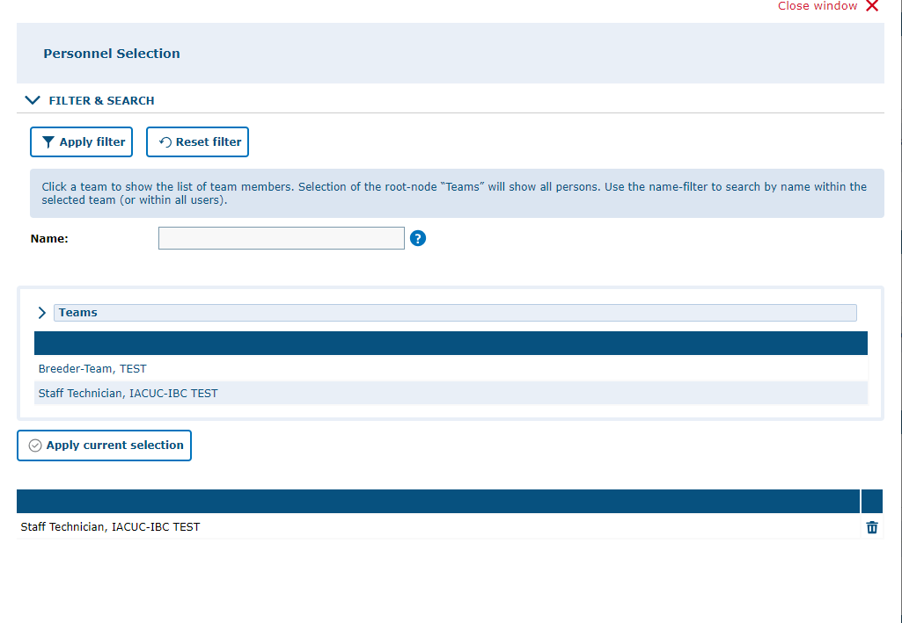
NOTE: To find personnel individuals, click on the word "Teams" to get the list.
You can also search for an individual's name using the fill-in field. Type in the name, then click on "Apply Filter."
Select the name of the person you are wanting to add. Their name will appear on the bottom. Then, click on "Apply Current selection" to add to the protocol. To add more than one individual, click on each name, then click on "Apply Current Selection' when done.

Slide 18
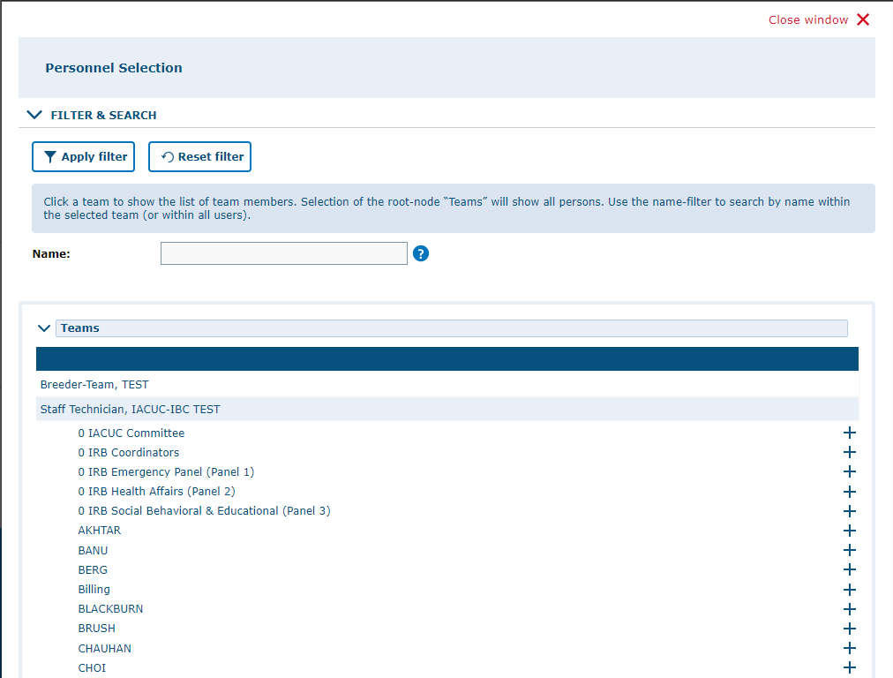
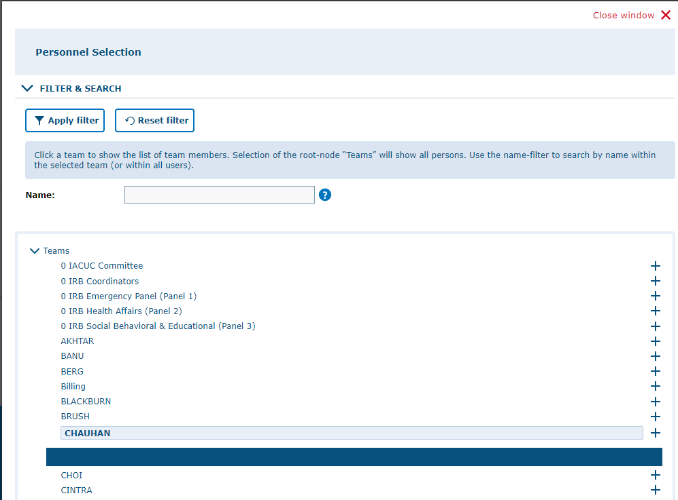
To add an entire team/group to a section, click on ">." When selected, the ">" turns to "v" and a list of PI teams will appear.
To view the members in the PI team, click on the PI name.
To add the team, click on the "+." The names will appear at the bottom.
Click on "Apply Current Selection" to add the personnel to the protocol.

Slide 19
Application Sections
Review and Answer the Different Sections of the Protocol

Slide 20
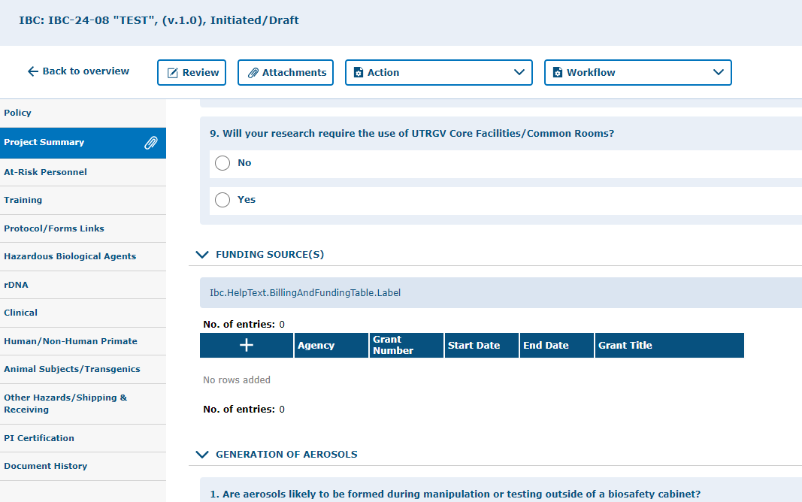
Update Funding
Under the “Project Summary” tab, be sure to update funding information for the protocol if it has changed since the last protocol submission/renewal.
Click on the “+” and fill out the funding information areas.

Slide 21
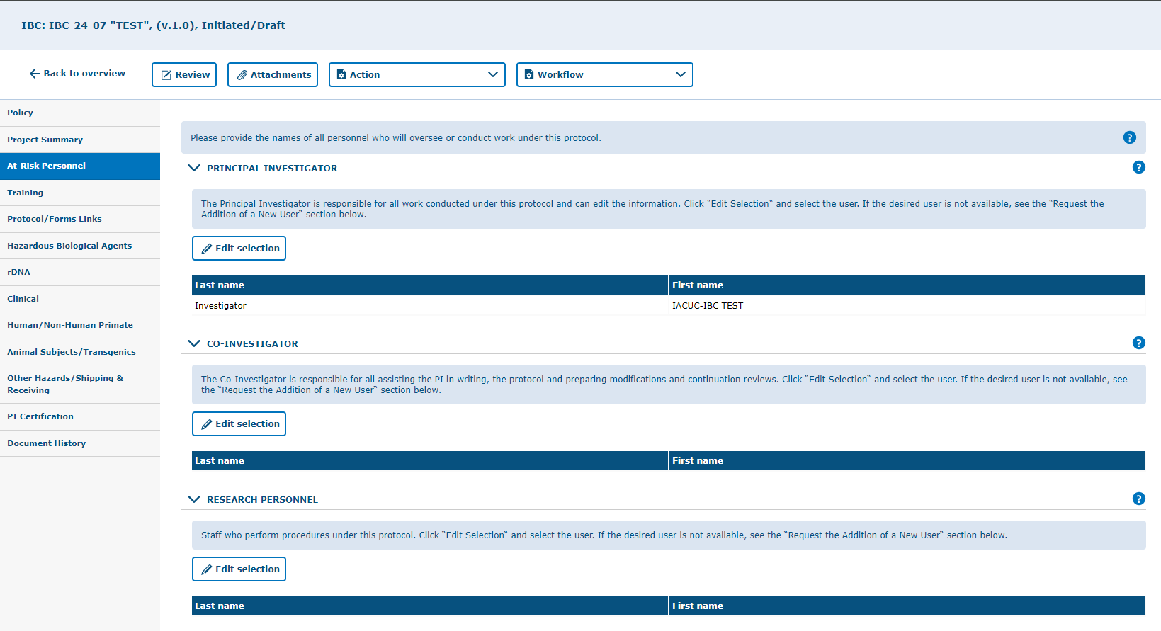
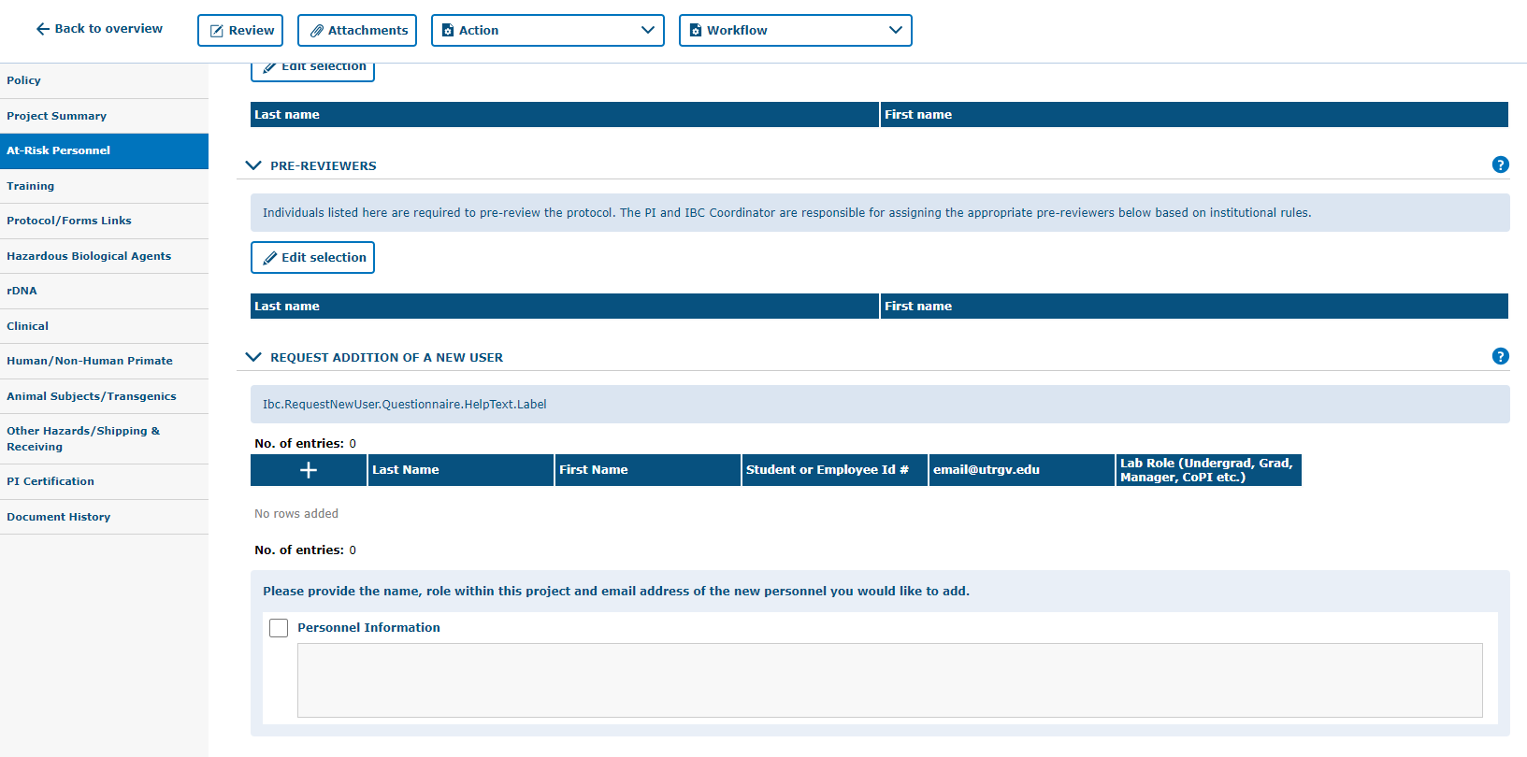
Click on “At-Risk Personnel” tab on left hand side, click on Edit Selection button to fill in/update information.
NOTE: Personnel listed at "Co-Investigator" will have the access to the entire protocol as the Principal Investigator and will be able to edit the protocol as well.
Under the Personnel tab, you will be able to add the individuals who will play a role in your IBC/HBA. Make sure to add them under the correct area (e.g., co-investigators, research personnel, or student research personnel). You can also add a peer reviewer. This will send the IBC/HBA to your colleague for review prior to sending the IBC/HBA to the IBC Coordinator. If a particular individual is not listed, add their name and role under the “Request Addition of a New User” section. DON’T FORGET TO SAVE!

Slide 22
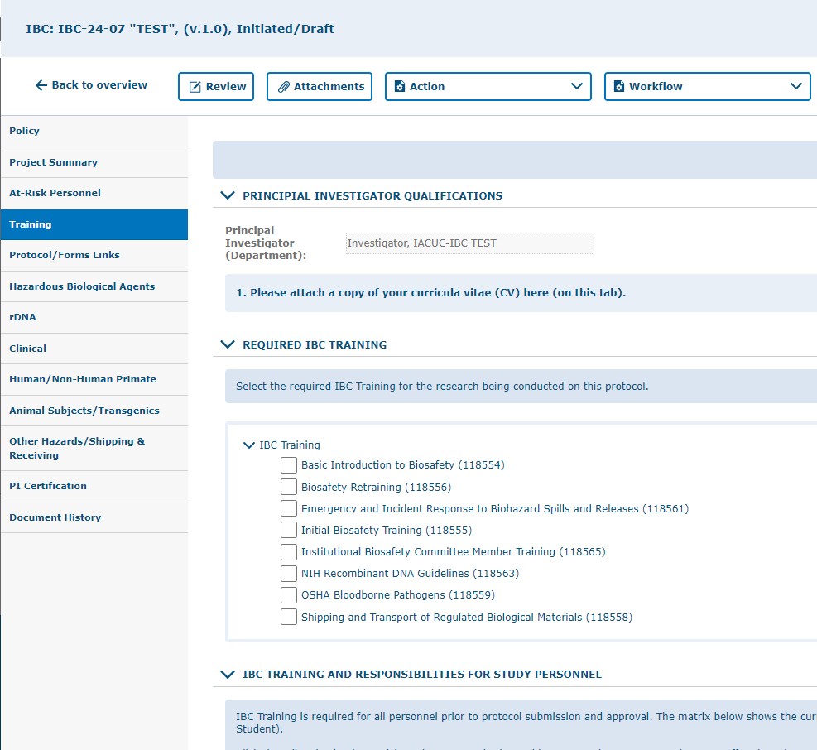
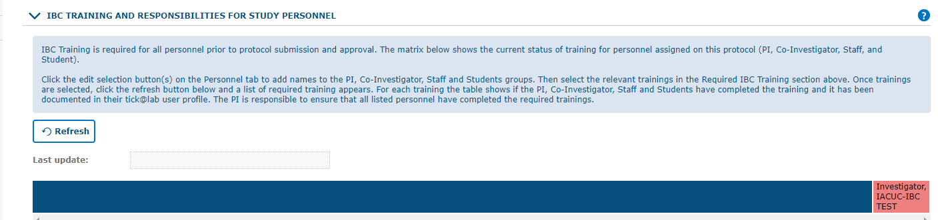
Click on “Training” tab.
MANDATORY for all involved in the IBC/HBA Protocol. Check with the IBC Office for more details on which trainings will be mandatory. Basic CITI Trainings and species-appropriate training must be completed for IBC/HBA approval. Click on the Refresh button to see which personnel is compliant or pending to complete the designated trainings. Remember to SAVE your work!

Slide 23
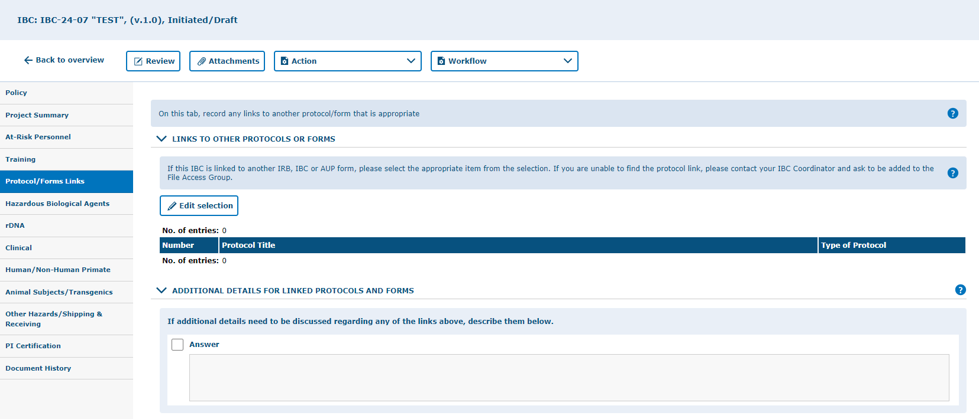
Click on “Protocol/Forms Links” tab.
Complete/update if applicable, direct your questions to the IBC Office. Remember to SAVE your work!

Slide 24
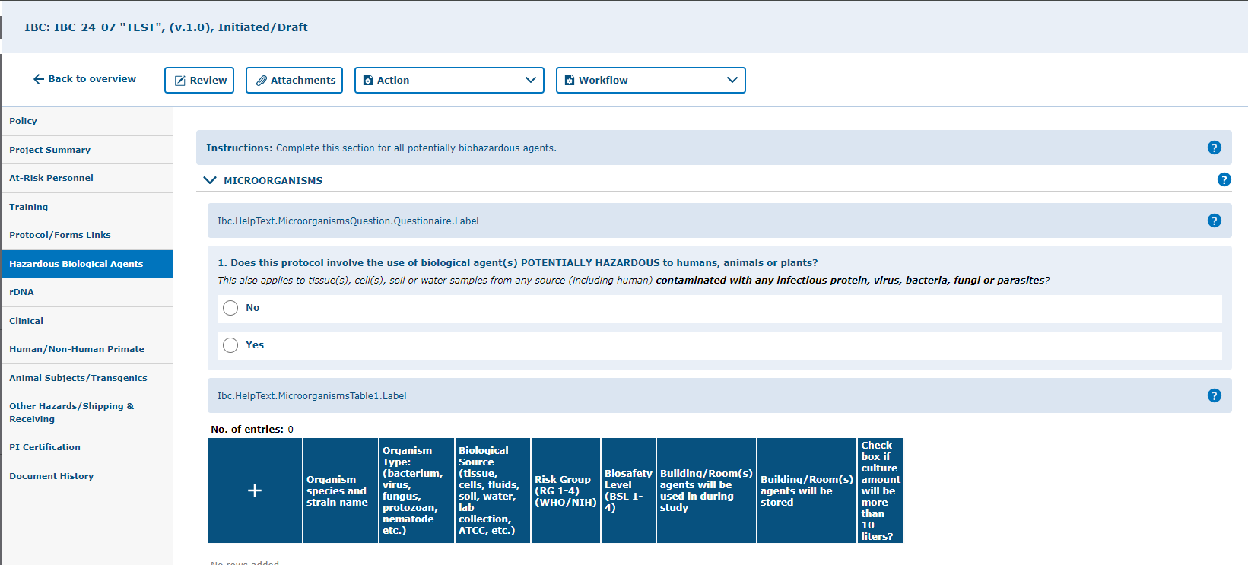
Click on “Hazardous Biological Agents” tab.
Complete/update this section if your protocol involves any potentially biohazardous agents. Remember to SAVE your work!

Slide 25
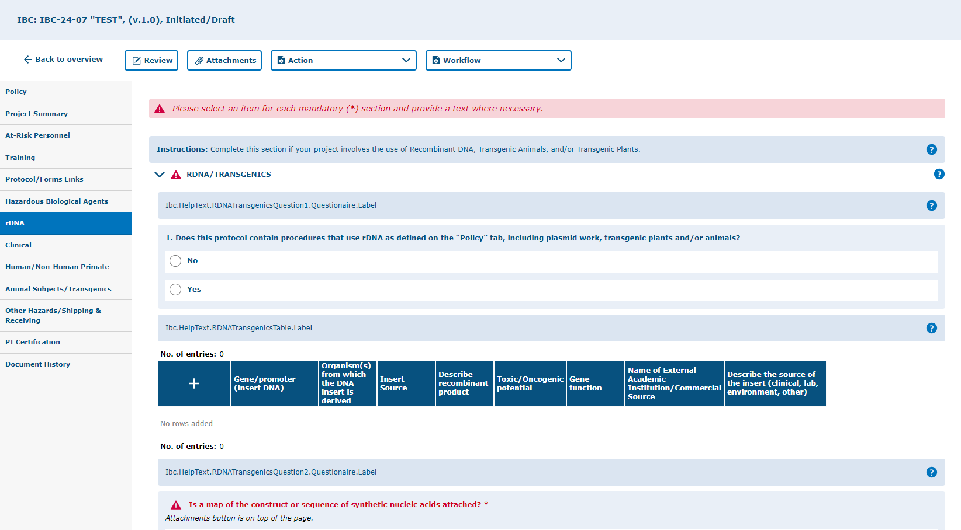
Click on the “rDNA” tab.
Complete/update the section in this tab if your project involves the use of Recombinant Nucleic Acids, Transgenic Animals, and/or Transgenic Plants. If you answer “yes” to number 1, the section will expand and show nested questions as well as tables that must be completed at the bottom of the page. Remember to SAVE your work!

Slide 26
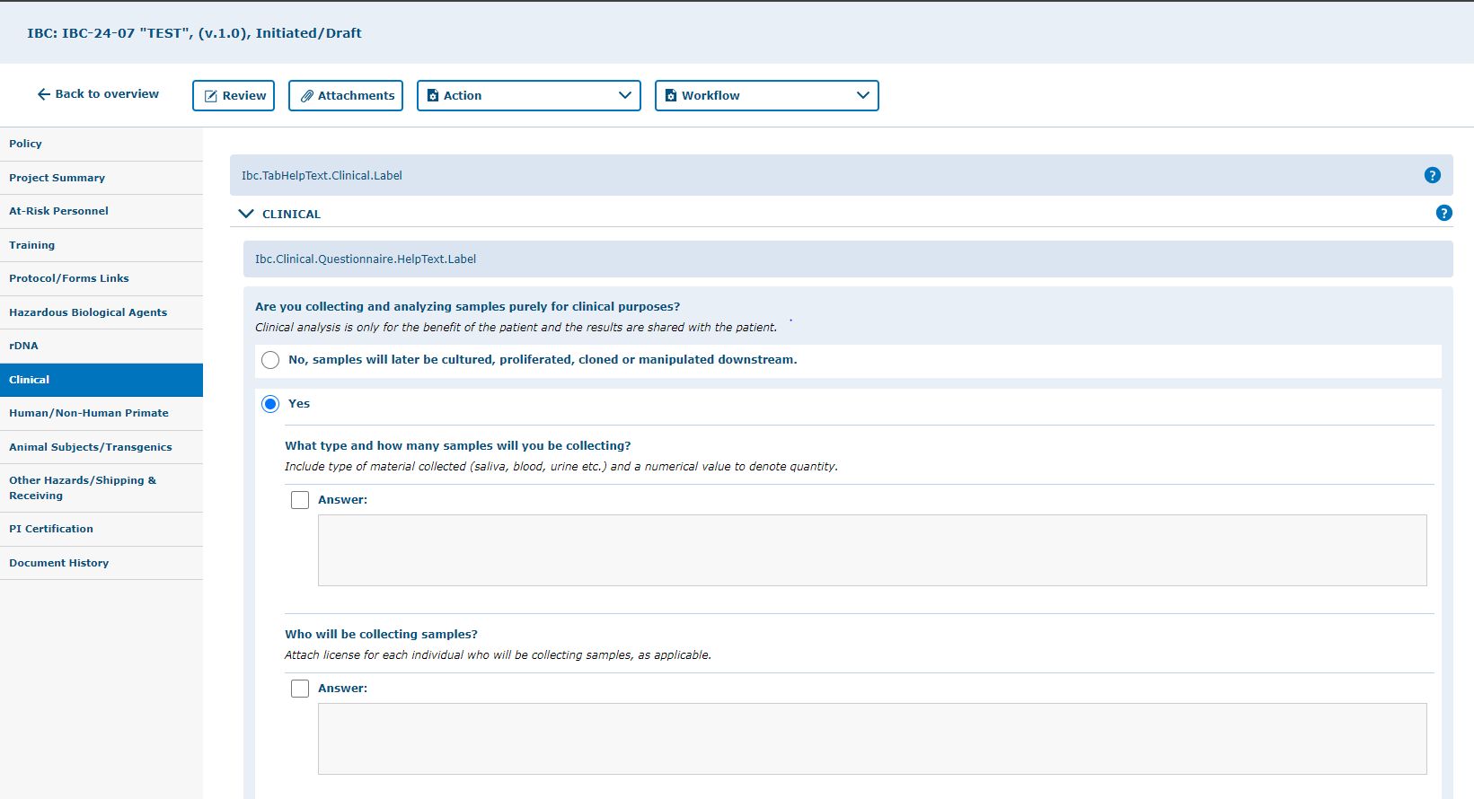
Click on the “Clinical” tab.
Complete/update this section if your protocol involves collecting and analyzing samples purely for clinical purposes. Answering “YES” will expand the section and show nested questions that must be completed if applicable. Note that human subjects research requires IRB approval. Remember to “SAVE” your work!

Slide 27
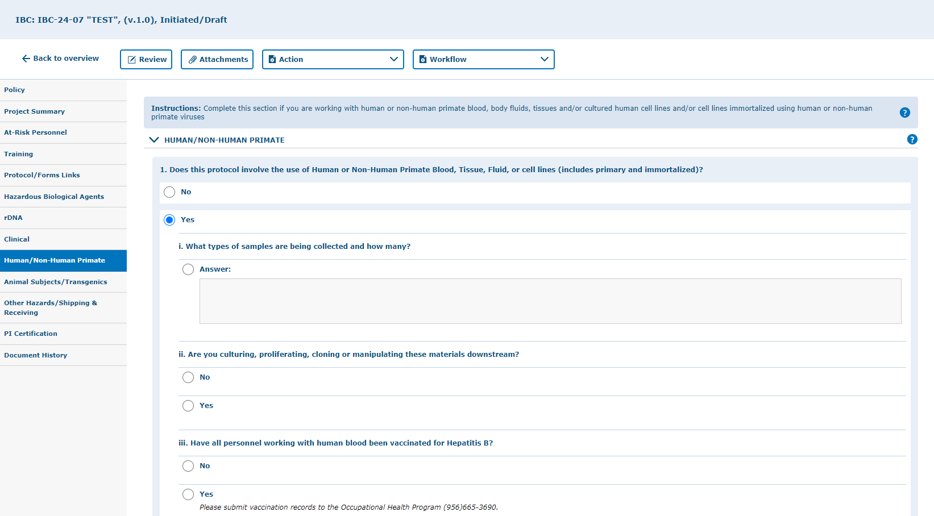
Click on “Human/Non-Human Primate” tab.
Complete/update this section if you are working with human or non-human primate blood, body fluids, tissues and/or cultured human cell lines and/or cell lines immortalized using human or non-human primate viruses. Answering “YES” will expand the section and show nested questions that must be completed if applicable. Note that corresponding approvals will be required if applicable prior to initiating any work (ex. IRB and AUP). Remember to SAVE your work!

Slide 28
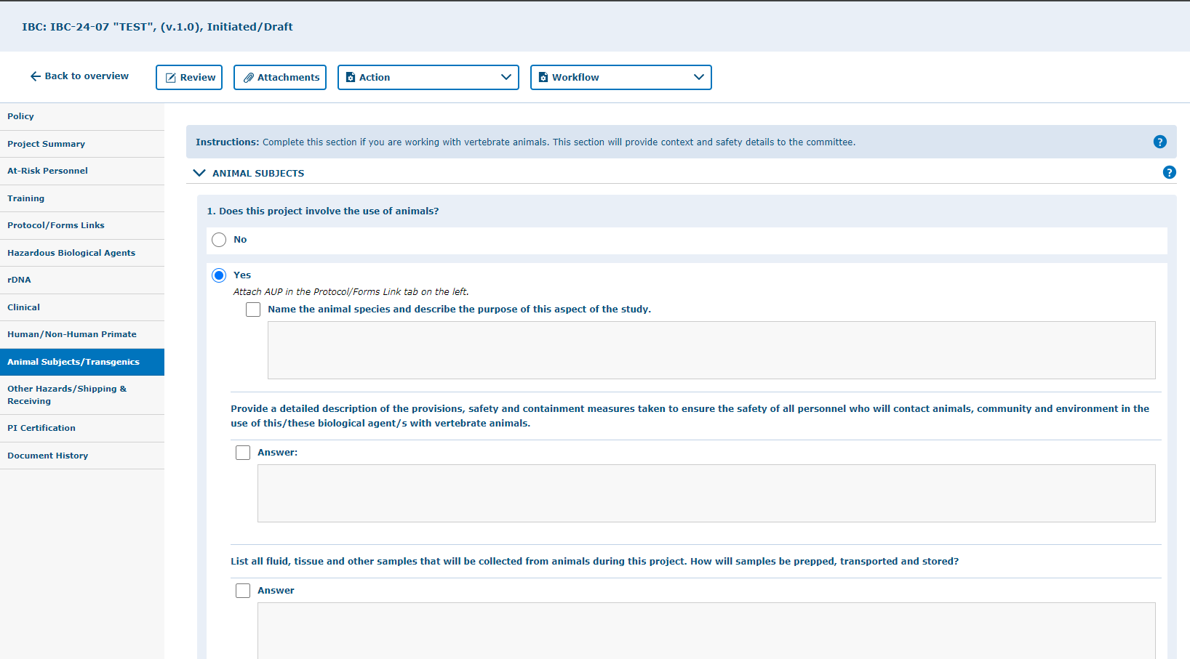
Click on “Animal Subjects/Transgenics ” tab.
Edit/update this tab and indicate if you are working with vertebrate animals. This section provides context and safety details to the committee. If you answer yes to number 1, the section will expand with more questions to complete. Note that animal work with vertebrate animals requires an approved Animal Use Protocol (AUP) prior to initiating any work. Remember to SAVE your work!

Slide 29
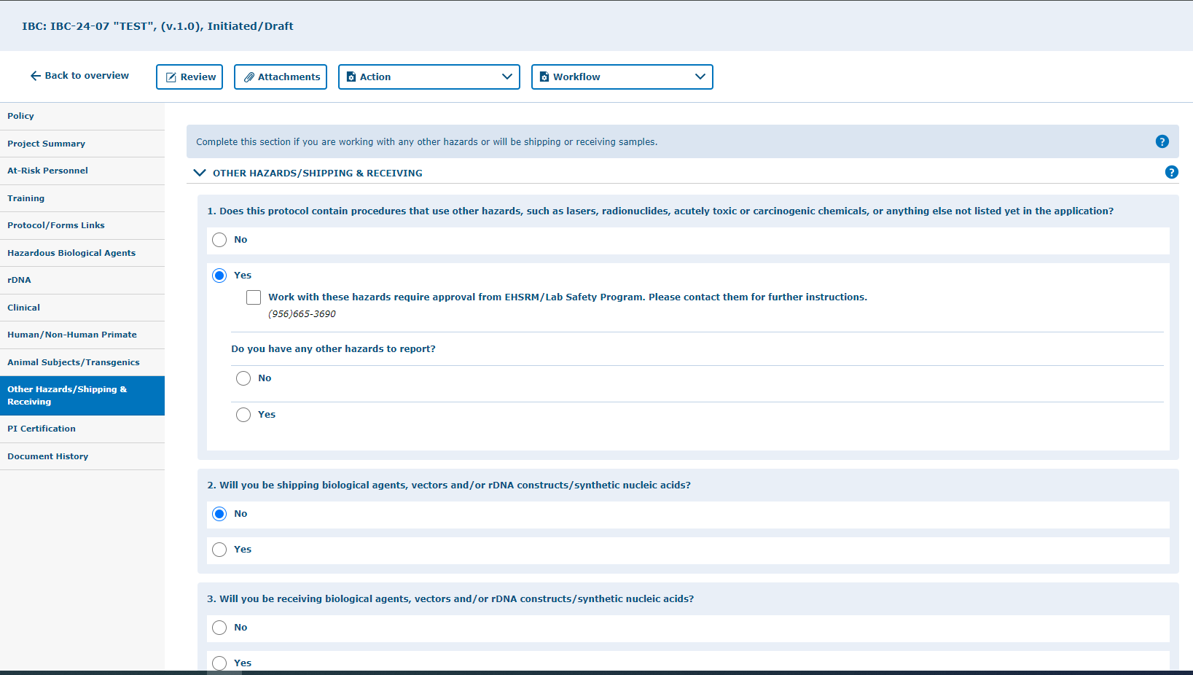
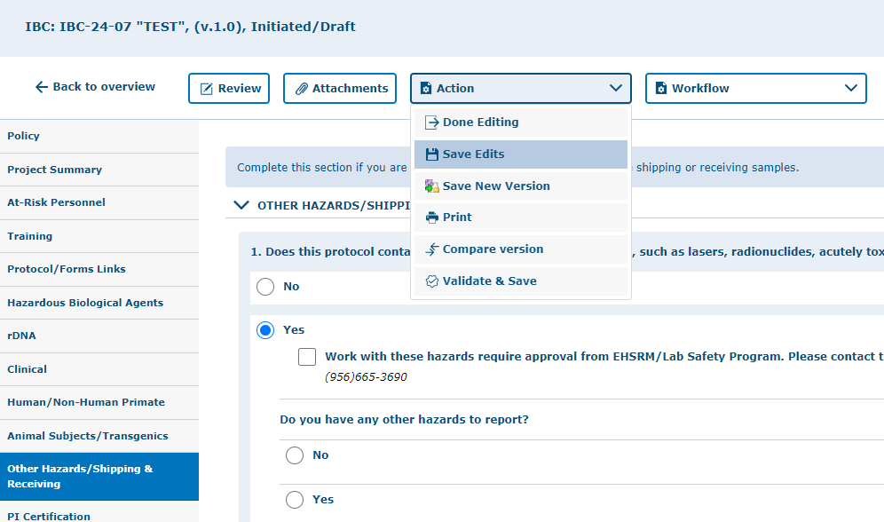
Click on “Other Hazards/Shipping & Receiving” tab.
Complete/update this section if you are working with any other hazards or will be shipping or receiving samples. If you answer yes to number 1, 2, and/or 3 the section will expand with more questions to complete. Remember to SAVE your work!

Slide 30
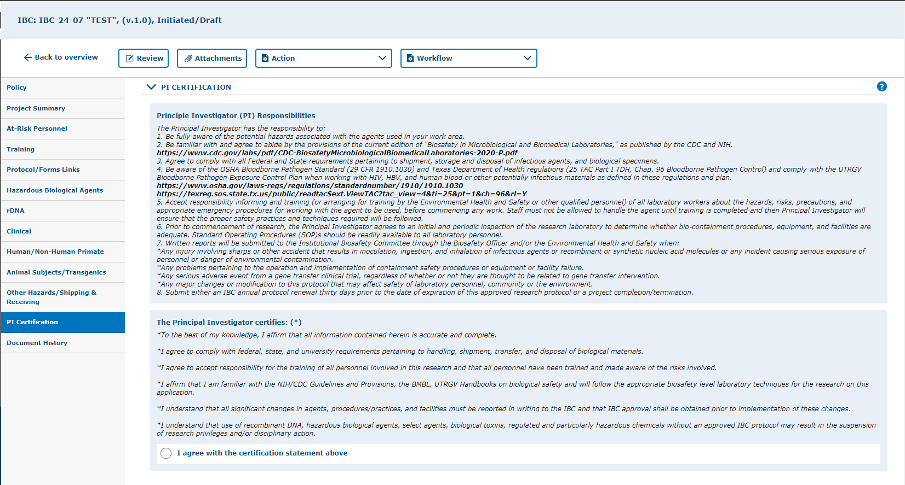
Click on “PI Certification”.
Select “I agree with the certification statement above.”
PI Certification: This is a mandatory field!

Slide 31
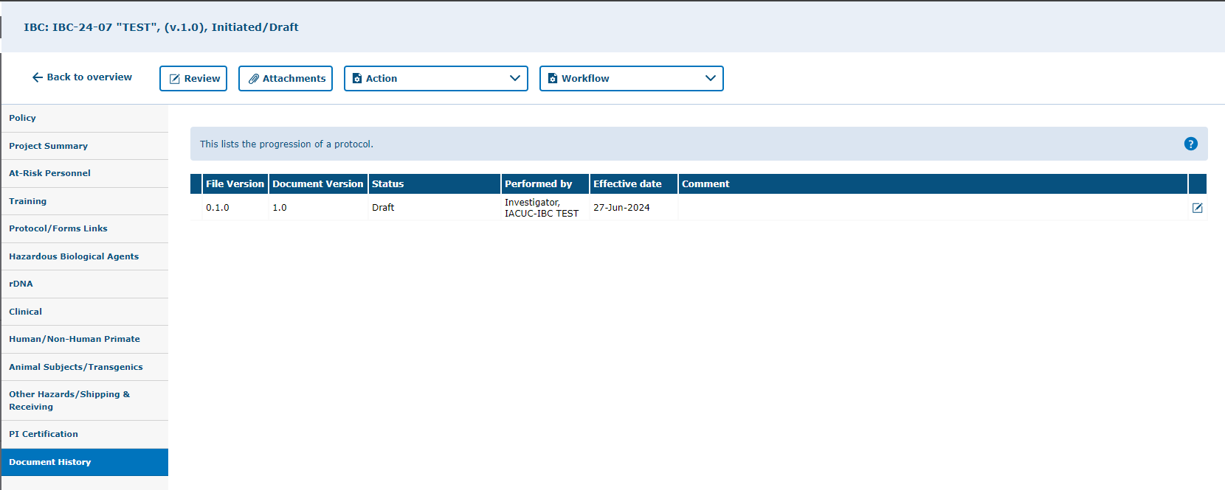
Click on “Document History” tab.
Check the status and any comments under this tab.

Slide 32
Attachments
How to add attachments to your protocol

Slide 33
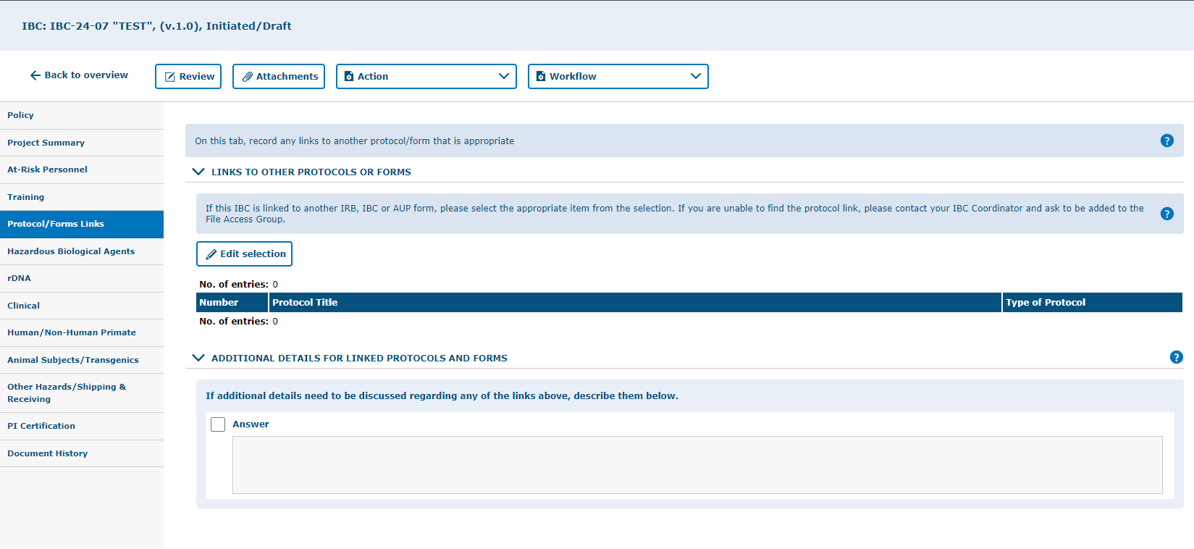
You can add attachments by using the “Attachments” button.
Include your attachments on their respective tabs. This is will facilitate the review process once you submit.
i.e. Attach any additional protocol form documents on the Protocol/Forms Link tab. Attach your appendix/addendum materials on the Project Summary tab.

Slide 34
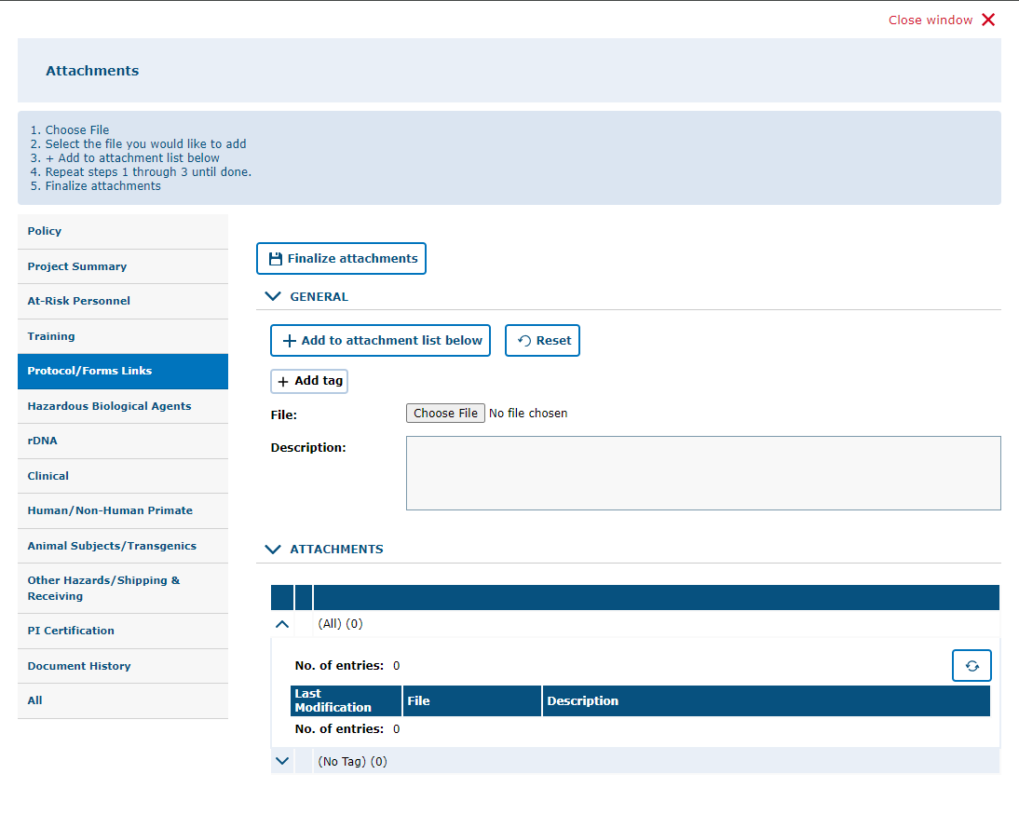
3. Click “Finalize Attachments”
2. After choosing the file, click on “Add to Attachment List Below.” For more than one file, click on “Choose File” then “Add to Attachment List Below” until all documents needed have been added, then click on “Finalize Attachments.”
1. Click on “Choose File” and upload file from computer or other devices. You can add a description of the attachment in the box.
4. Click on “All” to view all the application attachments.

Slide 35
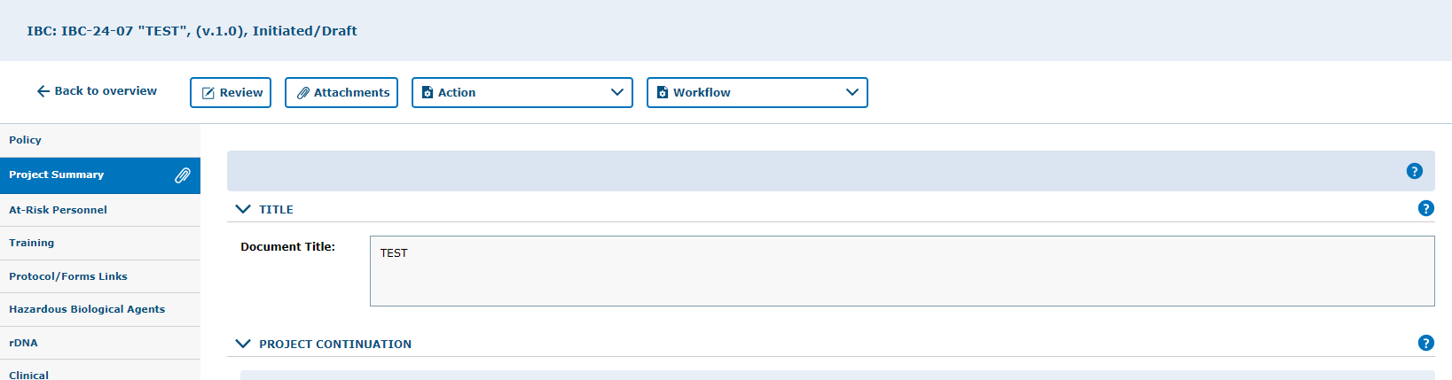
How to locate an attachment
Attachments are on the tab indicated by the paper clip icon.

Slide 36
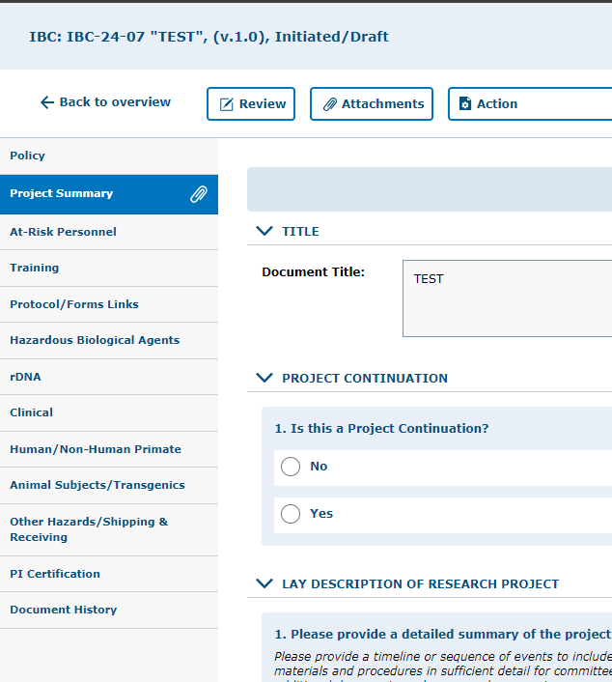
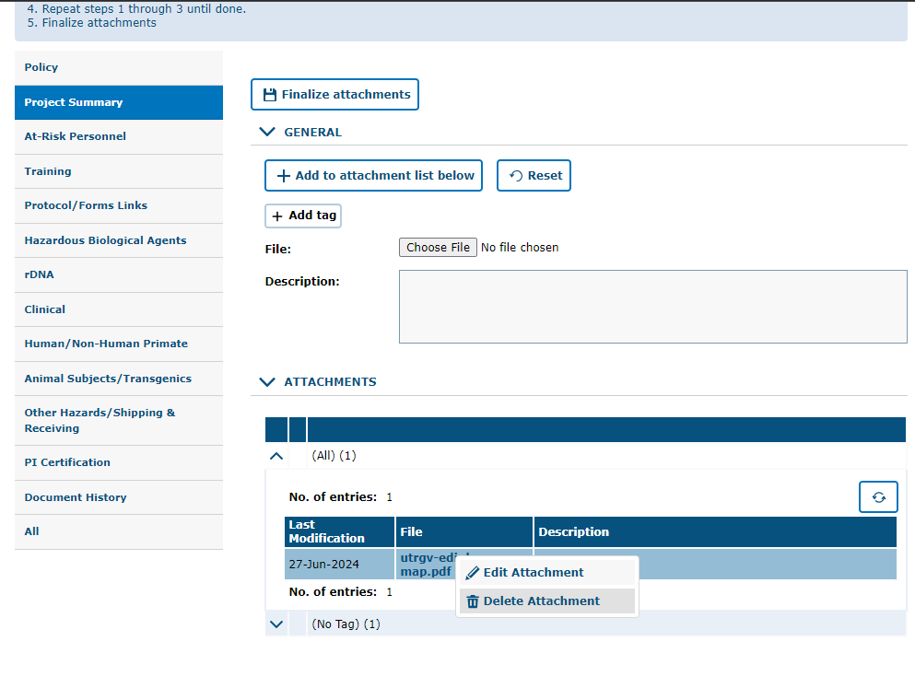
How to remove an attachment
You can remove attachments by:
Clicking on the “Attachments” button
Right-clicking on the attachment
Selecting “Delete Attachment”

Slide 37
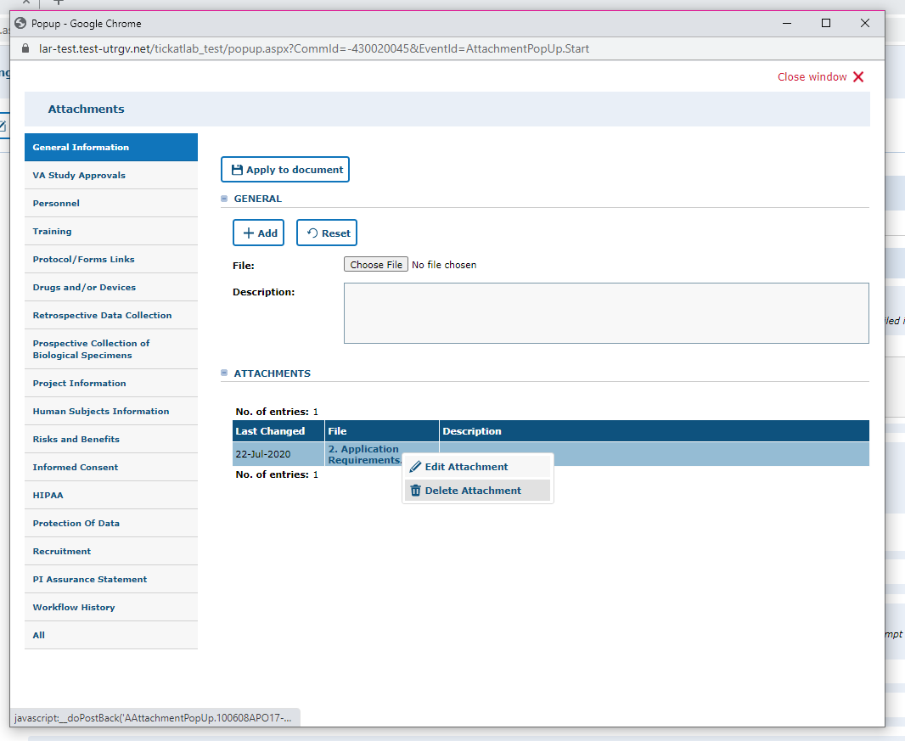
Note: by changing the workflow, the attachments will be locked and can no longer be deleted. i.e., while in draft mode and pre-review revision mode you may delete any attachments that you do not need. However, once you submit to the IBCCO Administrative Review, attachments will be locked.
Right click on top of the name of the file and select “Delete Attachment”

Slide 38
Validating and Saving

Slide 39
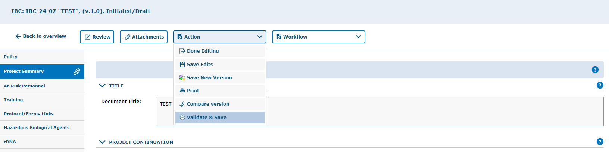
Once you have completed the application (Project Summary tab through the PI Certification tab), then it is recommended to Validate and Save your application
Mandatory questions are marked with (*) at the end of the questions
“Validate & Save” is a feature to check for any incomplete mandatory questions.

Slide 40
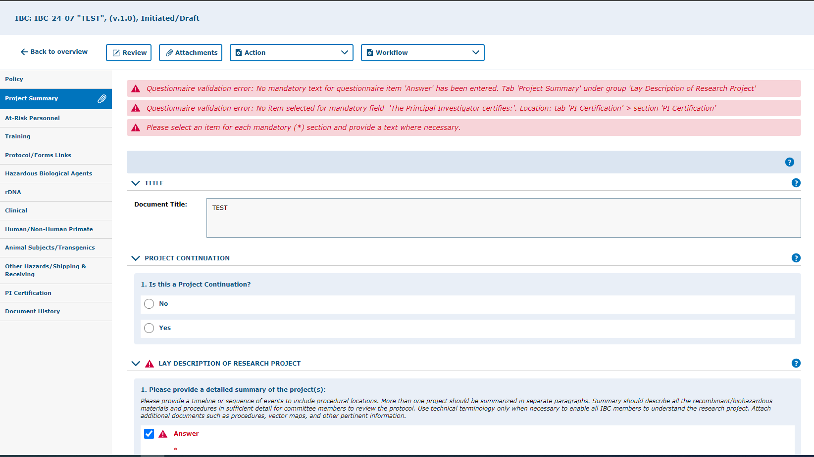
Application Validation
Pending Mandatory questions.

Slide 41
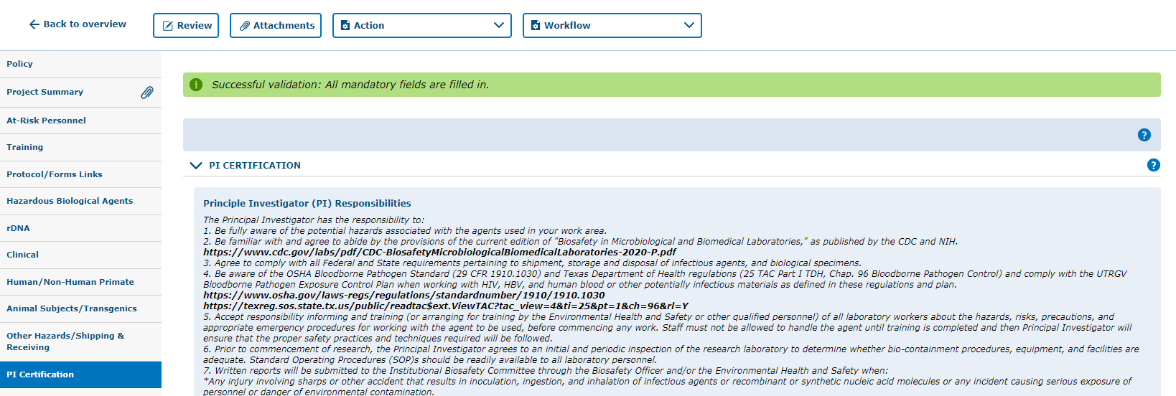
Application Validation
All required questions are answered and the protocol is ready for submission.

Slide 42
Protocol Submission

Slide 43
Remember to SAVE YOUR WORK!
Click on “Save Edits” under the “Action” button located in each tab
Prior to submitting the protocol, make sure you have saved the edits you have made.
Note, that there are 4 ways to save forms:
  Done Editing: saves the file and checks the document in so that another person can check it out and edit it.
  Save Edits: saves the document and allows you to keep working on it.
  Save New Version: saves a separate and new version of the file (duplicate).
  Validate & Save: alerts you of any missing items in the protocol before saving.

Slide 44
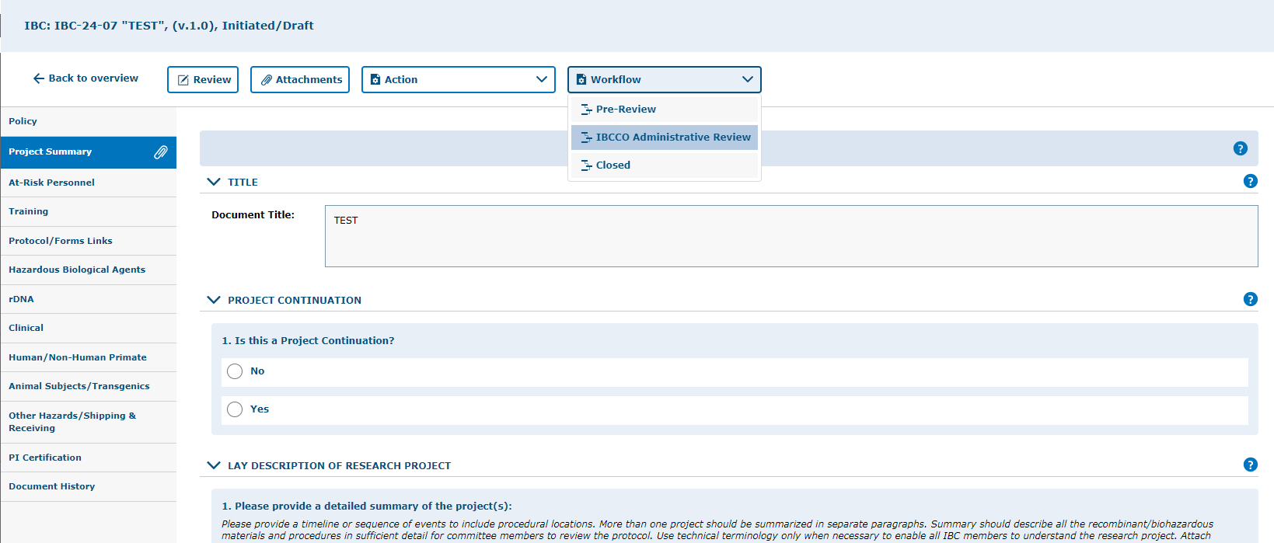
Click “Workflow” and select “IBCCO Administrative Review” from the list box.

Slide 45
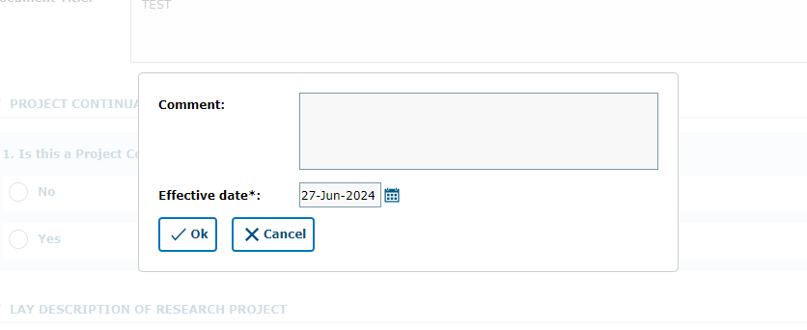
You may leave a comment inside the text box, then click “Ok”

Slide 46
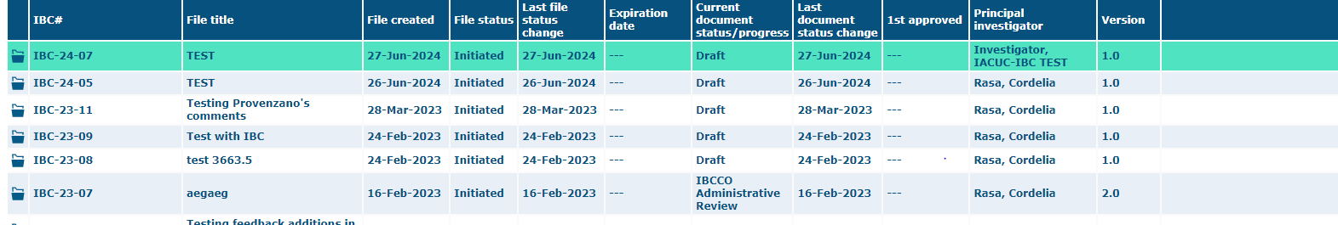
Confirm that the protocol was submitted by looking at the document status column. The status should read "IBBCO Administrative Review."

Slide 47
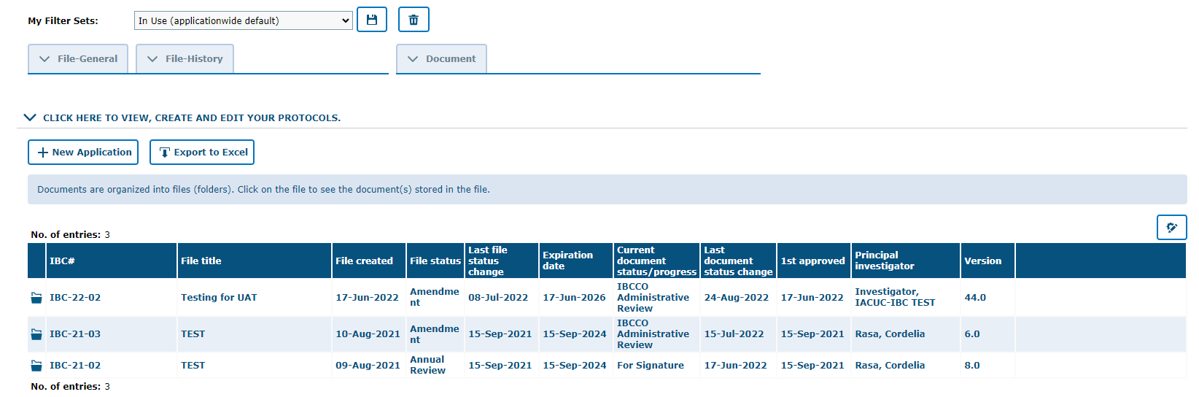
Your approved protocol will appear on the IBC tab ‘In Use (applicationwide default)’ filter
This status will say “APPROVED” once protocol is approved.
***Your project has been APPROVED***

Slide 48
Reviewer Feedback
How to find comments, questions, and concerns from the reviewer.

Slide 49
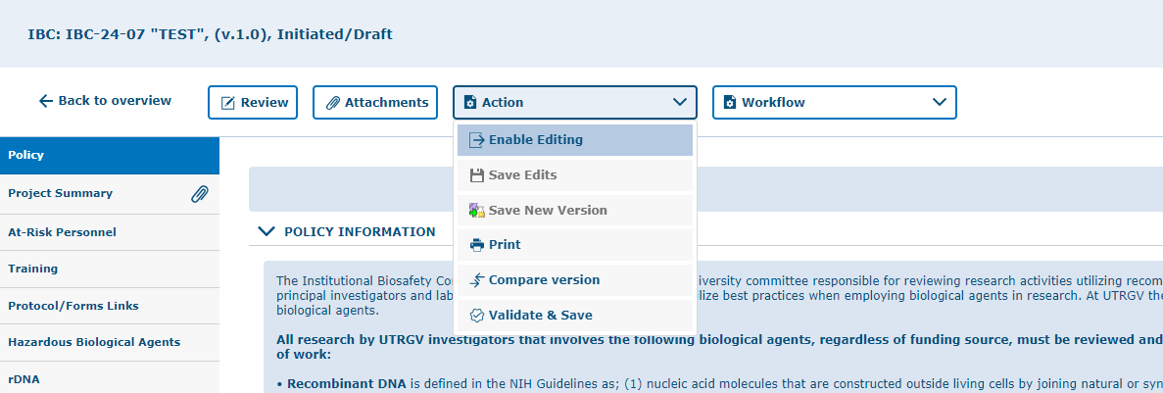
Enable the Document for Editing

Slide 50
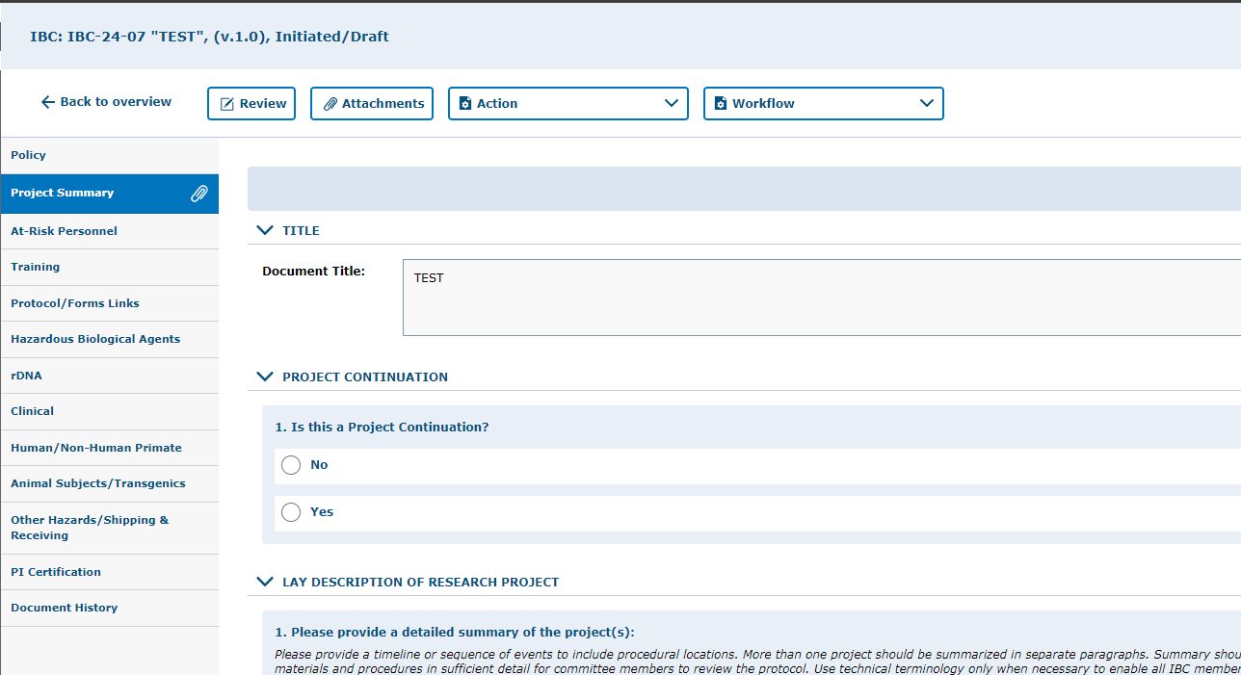
Once the document is in edit mode, all revisions can be viewed by using the review button.
Click on “Review” button to see all feedback from the reviewer.

Slide 51
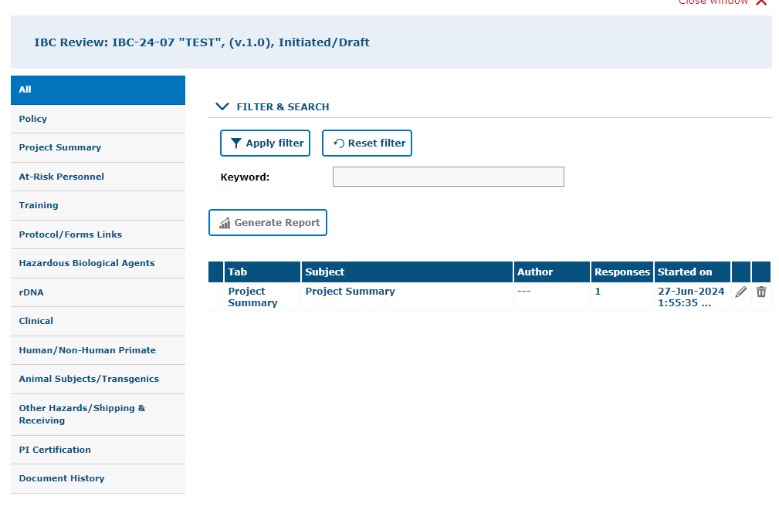
Click “All” to see the feedback left on all tabs at once, instead of moving from tab to tab.
To open the feedback items, click on the subject.
As illustrated above, you will find a list of items requested by reviewers for the entire protocol.
To respond to the feedback, click on each topic under the “Subject” column to open a response field.

Slide 52
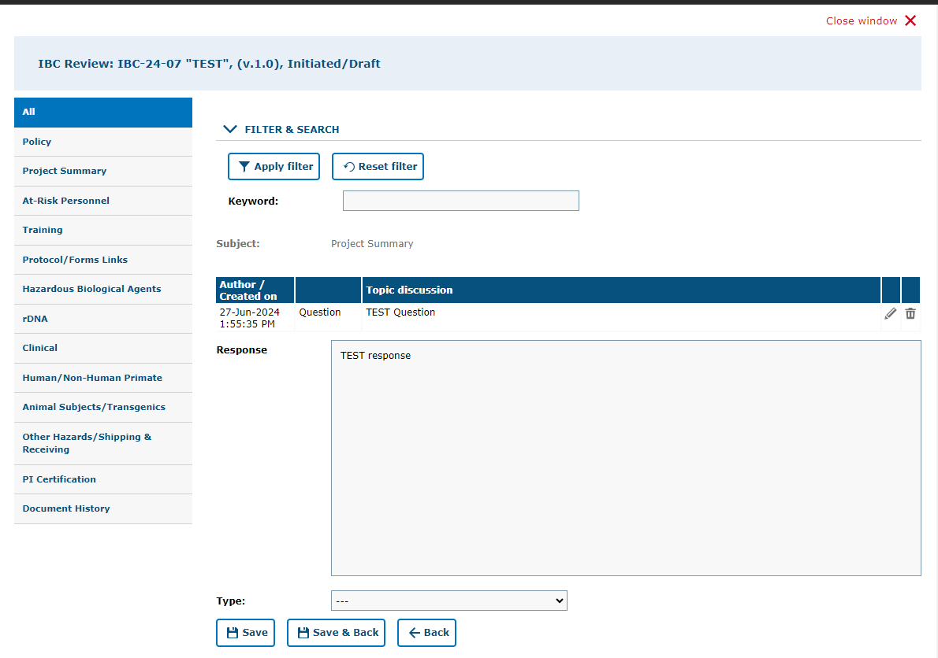
4. Click “Close Window”
1. Enter comment/answer in “Response” Text box.
3. Click “Save & Back”
2. Select “Response” here after entering your response in text box.
If a document needs to be uploaded as a response, you must go back to the “attachments” tab and upload the document in the respective section.

Slide 53
Resubmitting a Protocol
Submitting back to Workflow, after making required revisions

Slide 54
Remember to SAVE YOUR WORK!
Click on “Save Edits” under the “Action” button located in each tab
Prior to submitting the protocol, make sure you have saved the edits you have made.
Note, that there are 4 ways to save forms:
  Done Editing: saves the file and checks the document in so that another person can check it out and edit it.
  Save Edits: saves the document and allows you to keep working on it.
  Save New Version: saves a separate and new version of the file (duplicate).
  Validate & Save: alerts you of any missing items in the protocol before saving.

Slide 55
1. Click “Workflow” and select “IBCCO Administrative Review” from the list box.

Slide 56
2. You may leave a comment inside the text box, then click “Ok”

Slide 57
Confirm that the protocol was submitted by looking at the document status column. The status should read" IBBCO Administrative Review".

Slide 58
Your approved protocol will appear on the IBC tab ‘In Use (applicationwide default)’ filter
This status will say “APPROVED” once protocol is approved.
***Your project has been APPROVED***

Slide 59

Thank you !
Office of Research Compliance
Amy Mutore
IACUC/IBC Coordinator
(956)665-2889
amy.mutore@utrgv.edu
Monica Barrera
IACUC/IBC Specialist
(956)665-7873
monica.barrera01@utrgv.edu
Please contact Amy or Monica for assistance regarding submitting an IBC/HBA protocol. We are always happy to meet via Zoom or Teams to walk you through the process and answer any questions!

