Slide 1
Annual Review Submission
IBC Tick@Lab

Slide 2
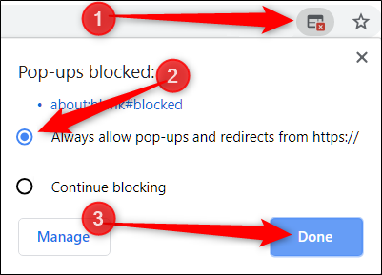
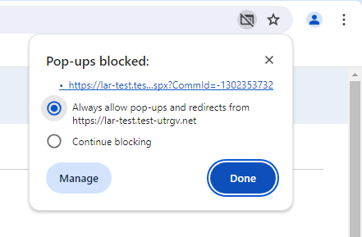
IMPORTANT NOTE:
    Follow the steps
Remember to allow pop-ups in your web browser.
If you do not allow pop-ups, the system will not work properly.

Slide 3
tick@lab URL
https://lar.utrgv.edu/tickatlab/default.aspx
Log in with your UTRGV Credentials

Slide 4
Access to tick@lab is not Automatic
If your personnel has never worked with tick@lab before, they’ll need to complete a web form to request access via IT.
Click HERE or on the link below for instructions on how to request Tick@Lab access:
Submitting your access request for tick@lab (utrgv.edu)
If you are unable to log-in please contact the Amy Mutore or Monica Barrera for assistance at ibc@utrgv.edu, amy.Mutore@utrgv.edu, or monica.barrera01@utrgv.edu.

Slide 5
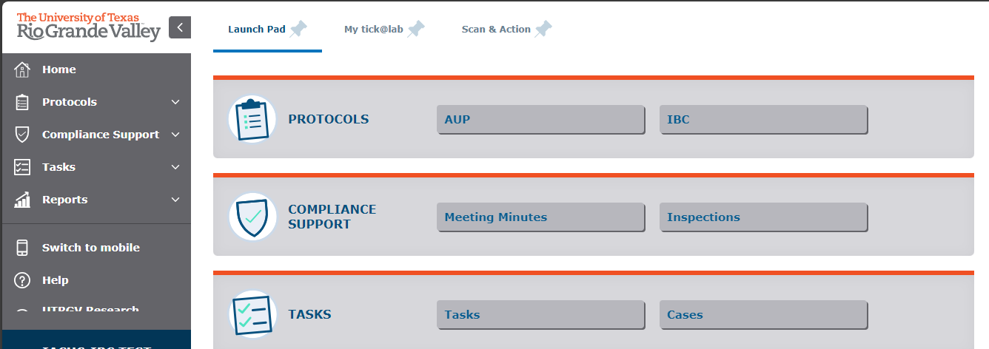
Getting Started
Click on “IBC”

Slide 6
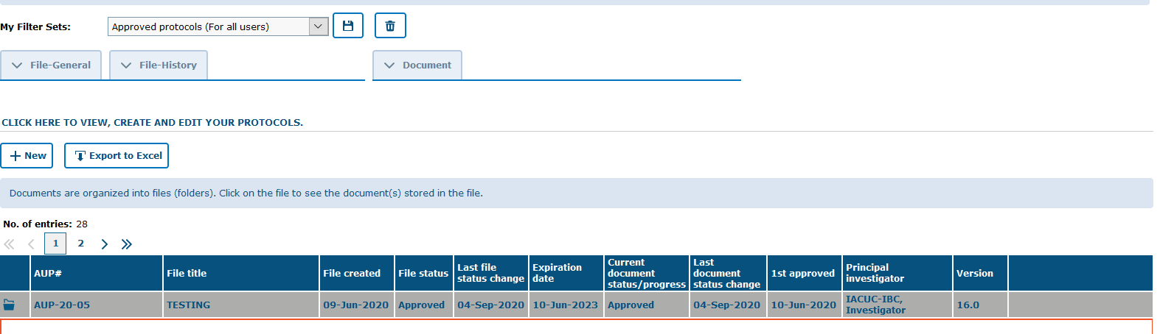

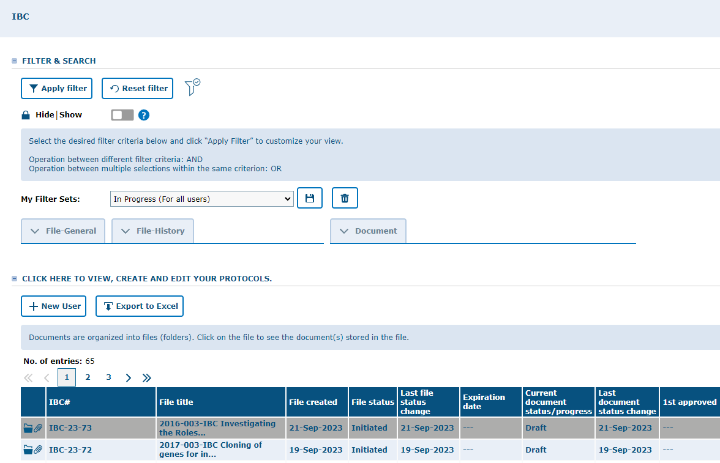
As the PI of the protocol, you will get an email approximately 90, 60 & 30 days before the scheduled expiration date and you will be notified that an Annual Review is required.
For this process you are going to access to your approved protocol by selecting “In Use” on My Filter Sets.
Click on any part of the projects' main information to expand your files.

Slide 7
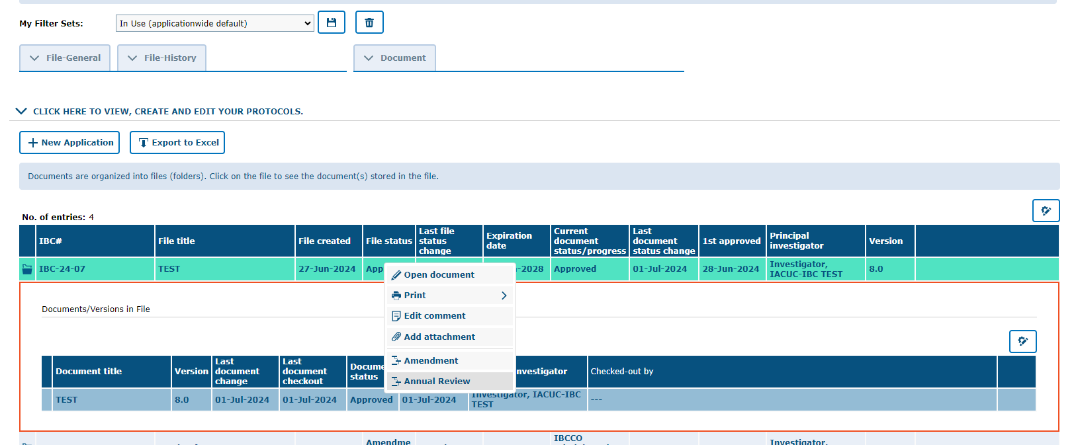
1.) Right click on document to see the context menu
2.) Select “Annual Review”

Slide 8
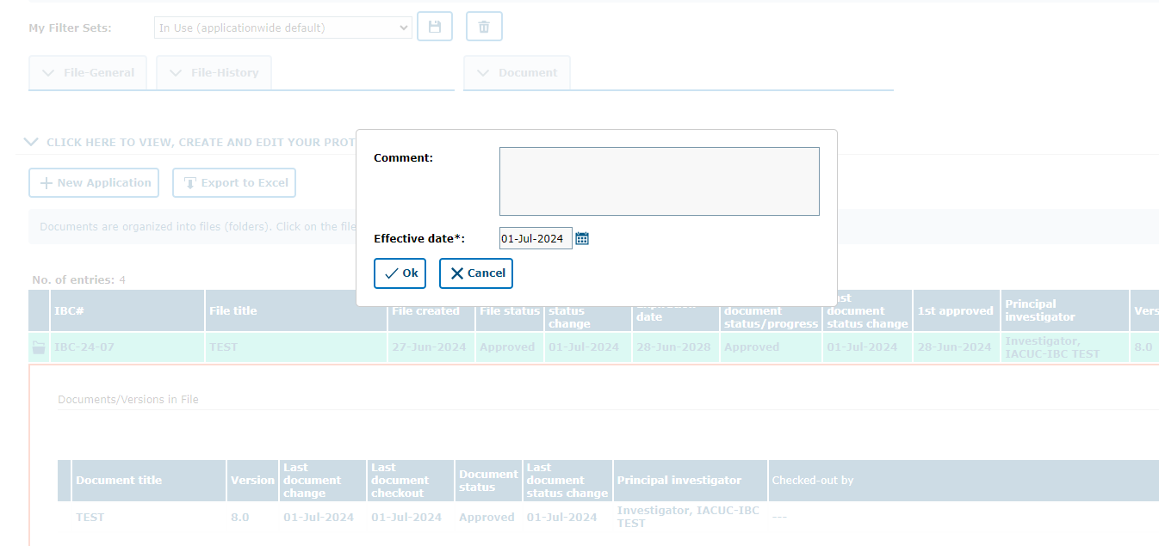
Include a comment indicating that you are submitting a continuation review for your project and click “Ok.”

Slide 9
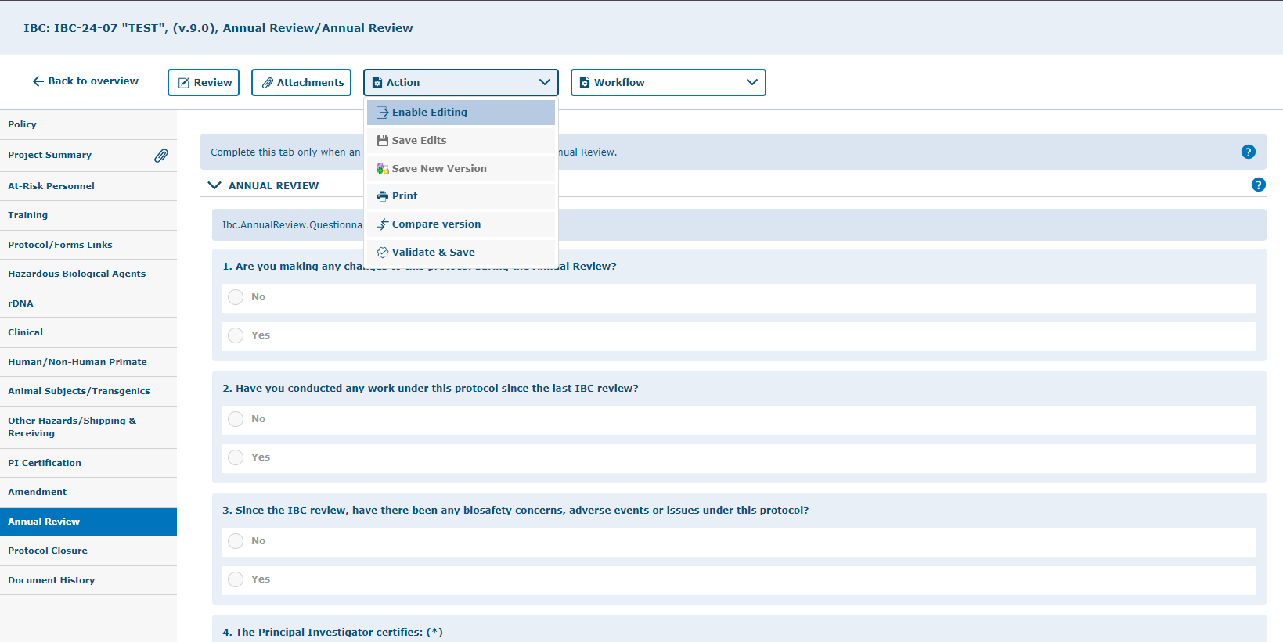
Select "Enable Editing" " from Action button.
Click on “Annual Review” tab and answer the questions.

Slide 10
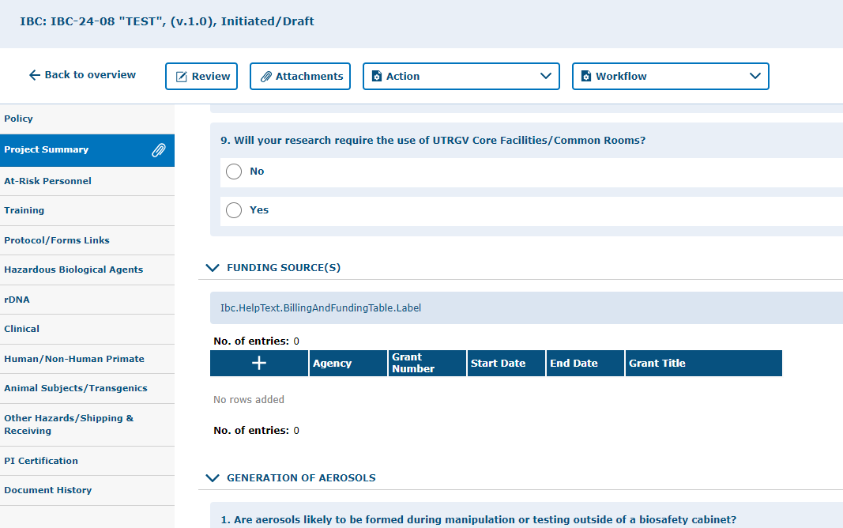
Update Funding
Under the “Project Summary” tab, be sure to update funding information for the protocol if it has changed since the last protocol submission/renewal.
Click on the “+” and fill out the funding information areas.

Slide 11
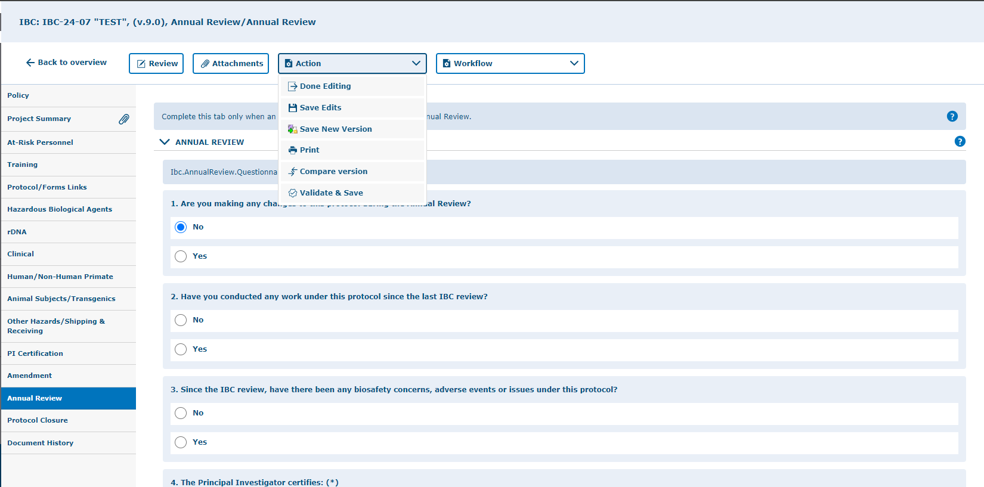
Save all changes. Remember you can save by clicking any of the “Action” buttons at any time
Note, you have 4 ways to save forms:
  Done Editing: saves the file and checks the document in so that another person can check it out and edit it.
  Save Edits: saves the document and allows you to keep working on it.
  Save New Version: saves a separate and new version of the file (duplicate).
  Validate & Save: alerts you of any missing items in the protocol before saving.

Slide 12
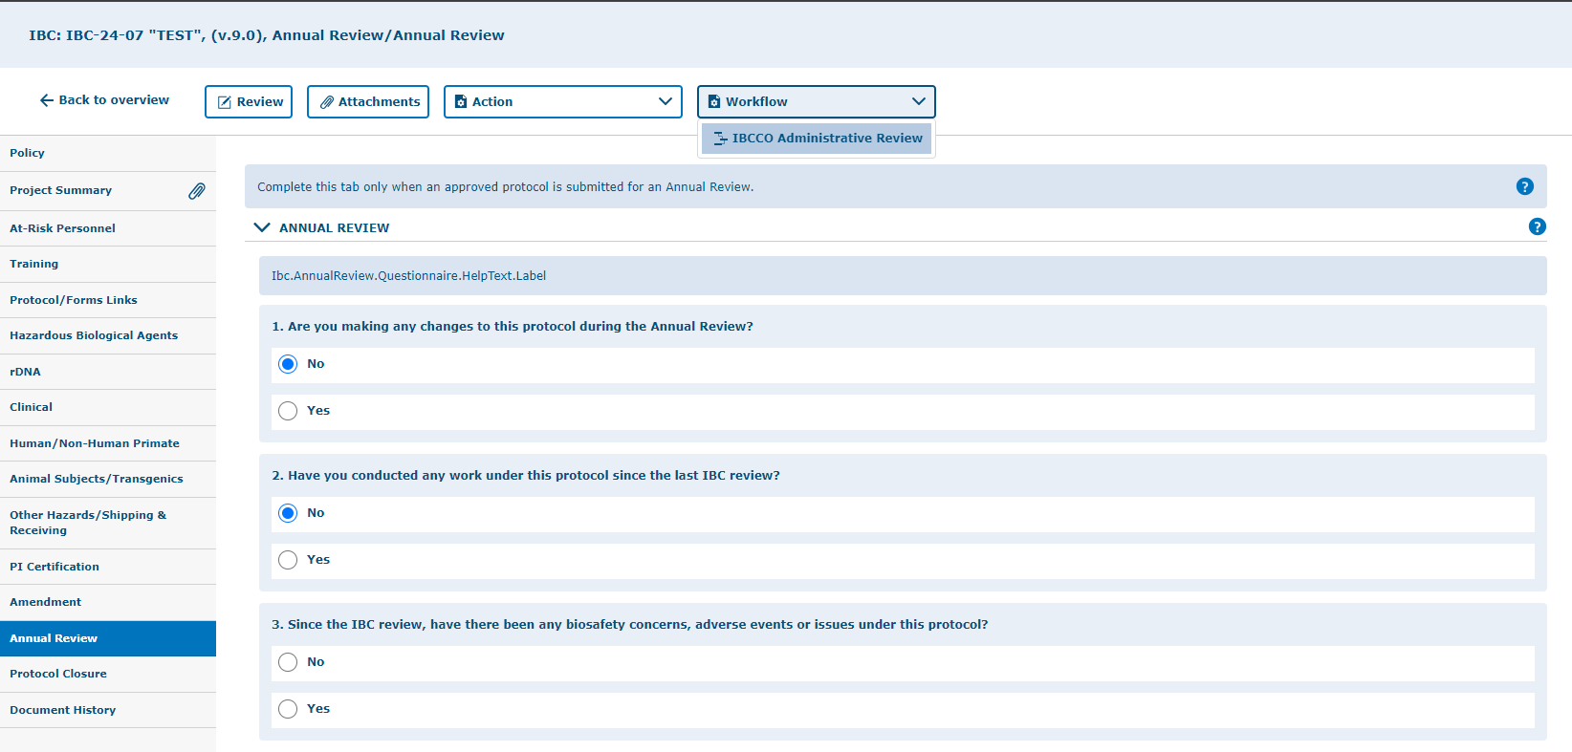
To submit an Annual Review to workflow. Click on “Workflow” and select “IBCCO Administrative Review.”

Slide 13
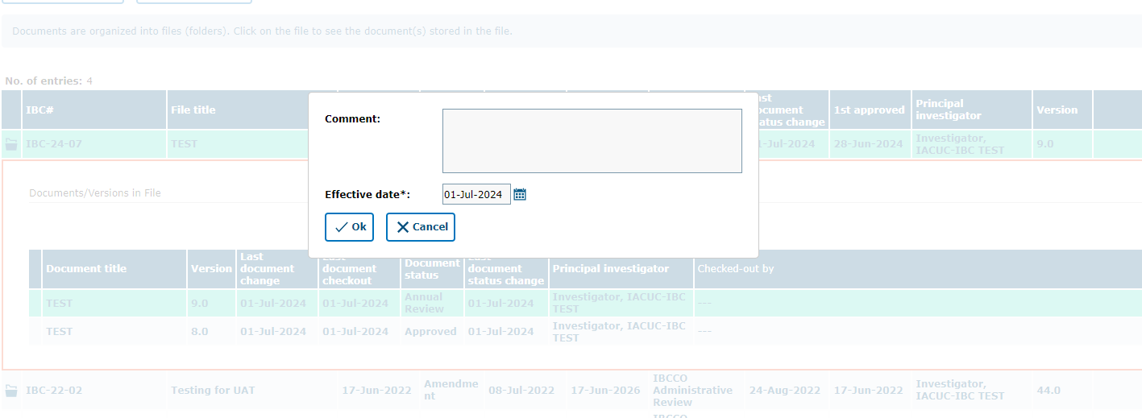
Leave a comment (e.g., submitting my annual review for this study) and click “Ok.”

Slide 14
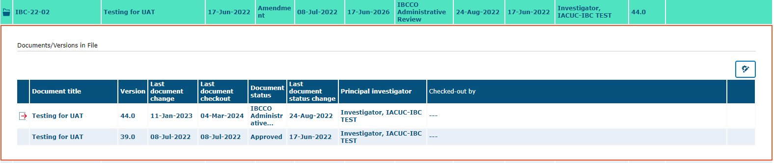
Your Annual Review has been submitted to workflow for IBCCO Review

Slide 15
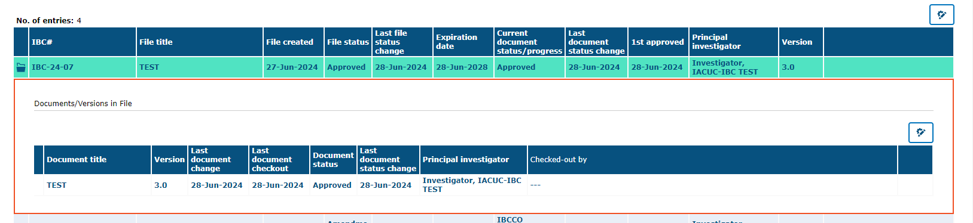
Once approved, your Annual Review will appear under the IBC “In Use” filter and will have an “Approved” document status/file status.

Slide 16
How to Revise a Submitted Annual Review
Returned to you for Revision

Slide 17
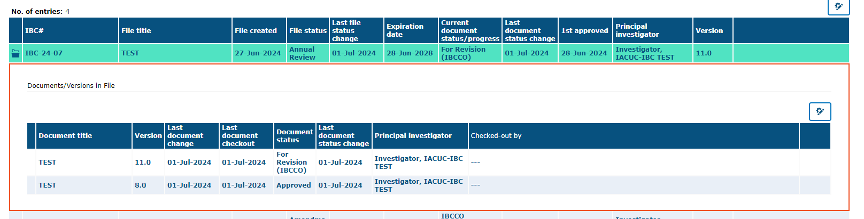
When submitted, your protocol will be reviewed. If anything is found to be missing or in need of editing, the questions/concerns will be entered in the protocol and will be sent back to you, the PI, for revisions.
If your annual review application is returned to complete required revisions:
You will receive an email that review comments have been placed in the protocol and the annual review needs to be revised.

Slide 18
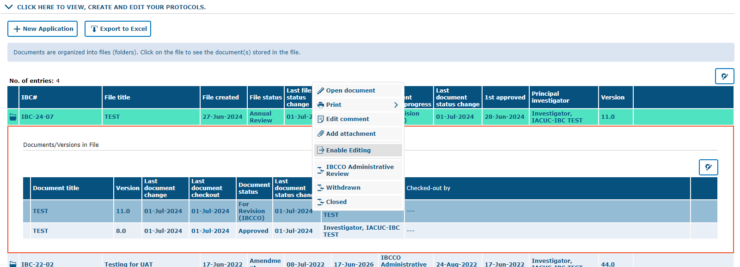
To make changes to a document in tick@lab, you need to Enable Editing" on the document first. During the time a document is being edited, no other person can access your document (Other team members, IBC, and/or committee members).
Right-click on the document and select “Enable Editing.”

Slide 19
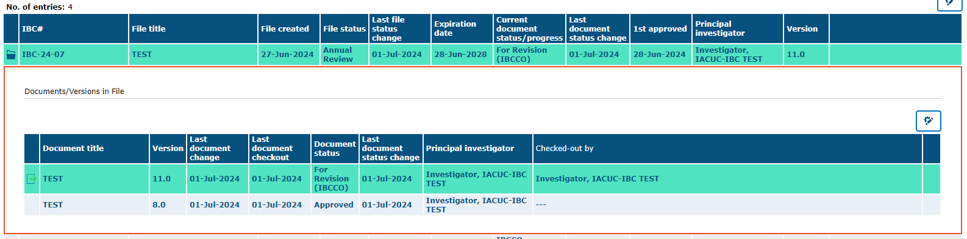
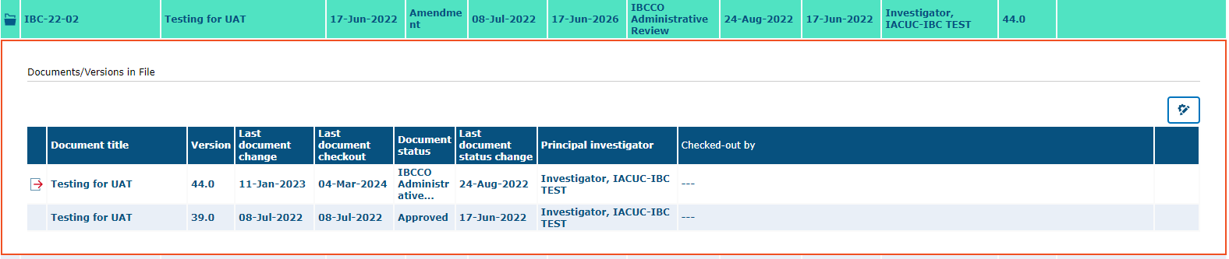
Remember, only one person at a time can work on an application.
Others can view in read-only mode, while the document is checked-out (being edited).
Green Arrow (operational mode): Means it is available to see and edit.
Red Arrow (read-only mode): Means someone is working on the document.

Slide 20
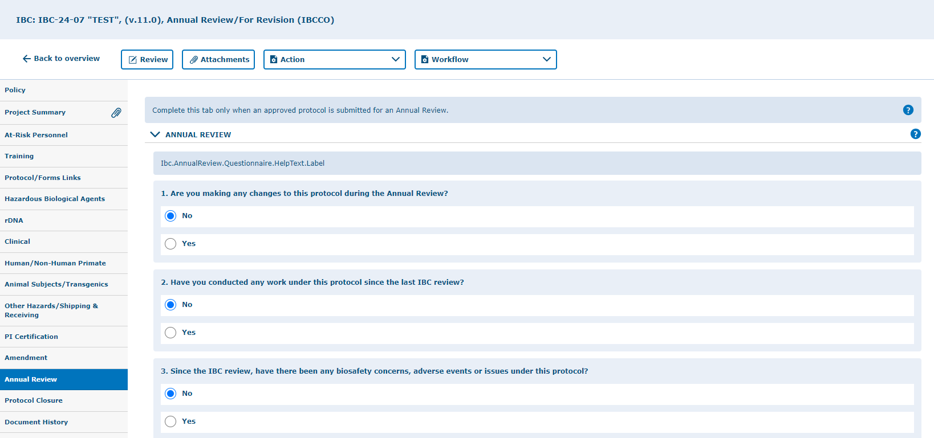
Once you have selected "Enable Editing" on the Annual Review application, then you can navigate all the revisions requested by using the “Review” button

Slide 21
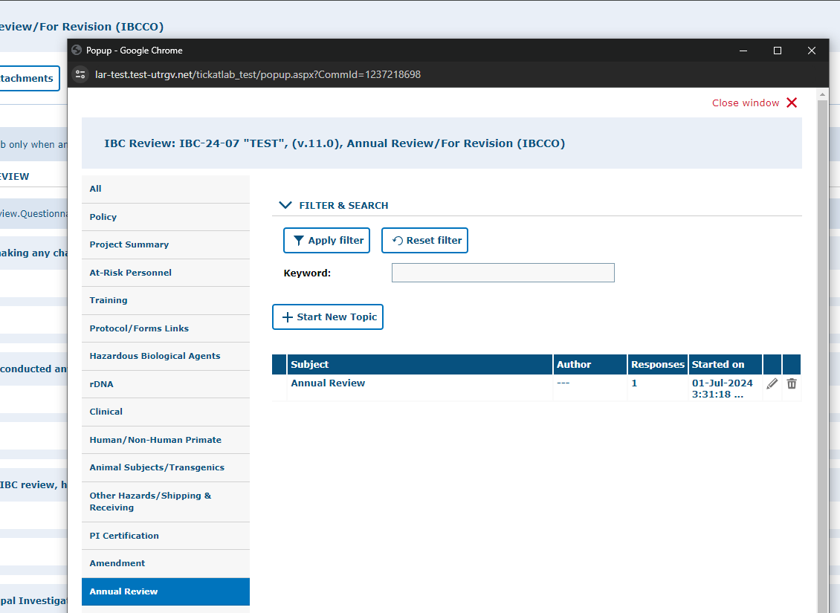
As illustrated in the red box, you will find a list of items requested by reviewers for the entire protocol.
To respond to the feedback, please click on each topic under the “Subject” column to expand a field and respond.
NOTE: these responses will also have to be revised within their respective areas in the protocol.
Click “All“ to see the feedback left on all tabs, instead of moving from tab to tab.
To open the feedback items, click on subject.

Slide 22
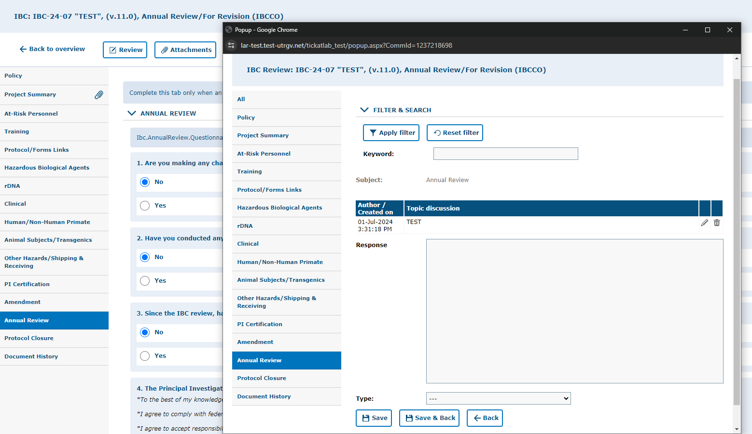
If a document must be uploaded as a response, you will need to go back to the “attachments” tab and upload the document in the respective section.
I.e., document related to a response regarding the Project Summary can be uploaded within the “Project Summary” tab.
1.) Enter comment/answer in “Response” text box.
2.) Select the type of response (Response, Question, Concern, etc.
3.) Click “Save & Back.”

Slide 23
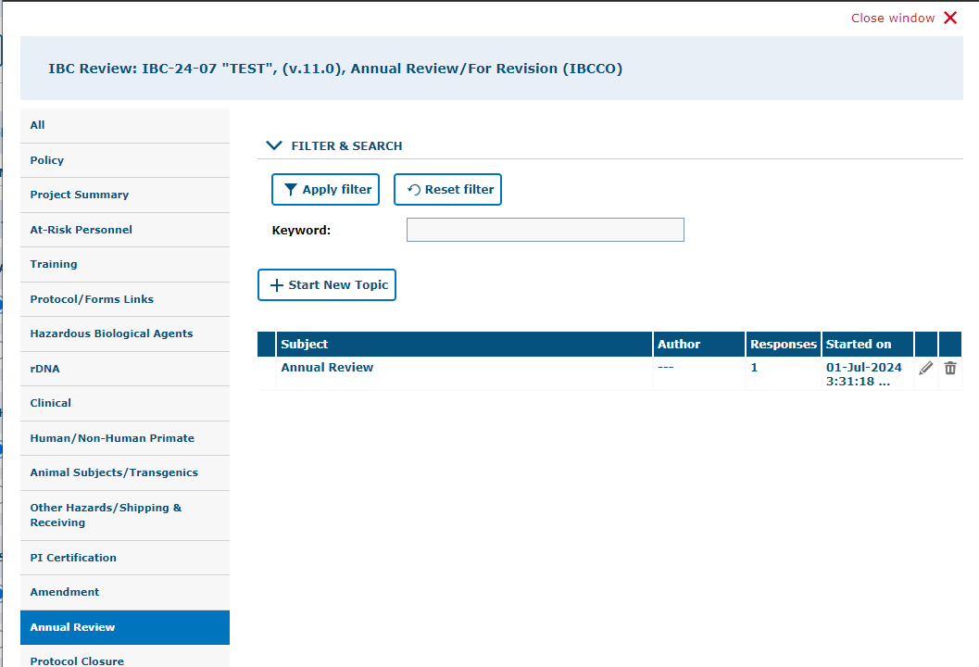
After reviewing and addressing all items, click “close window”.
Every time a researcher makes modification to a form a new version is activated in the system. The creation of versions allows the IBC Coordinator and Committee Members to streamline the review by conducting automatic comparisons among versions.

Slide 24
Resubmitting an Annual Review
Submitting back to Workflow, after making required revisions

Slide 25
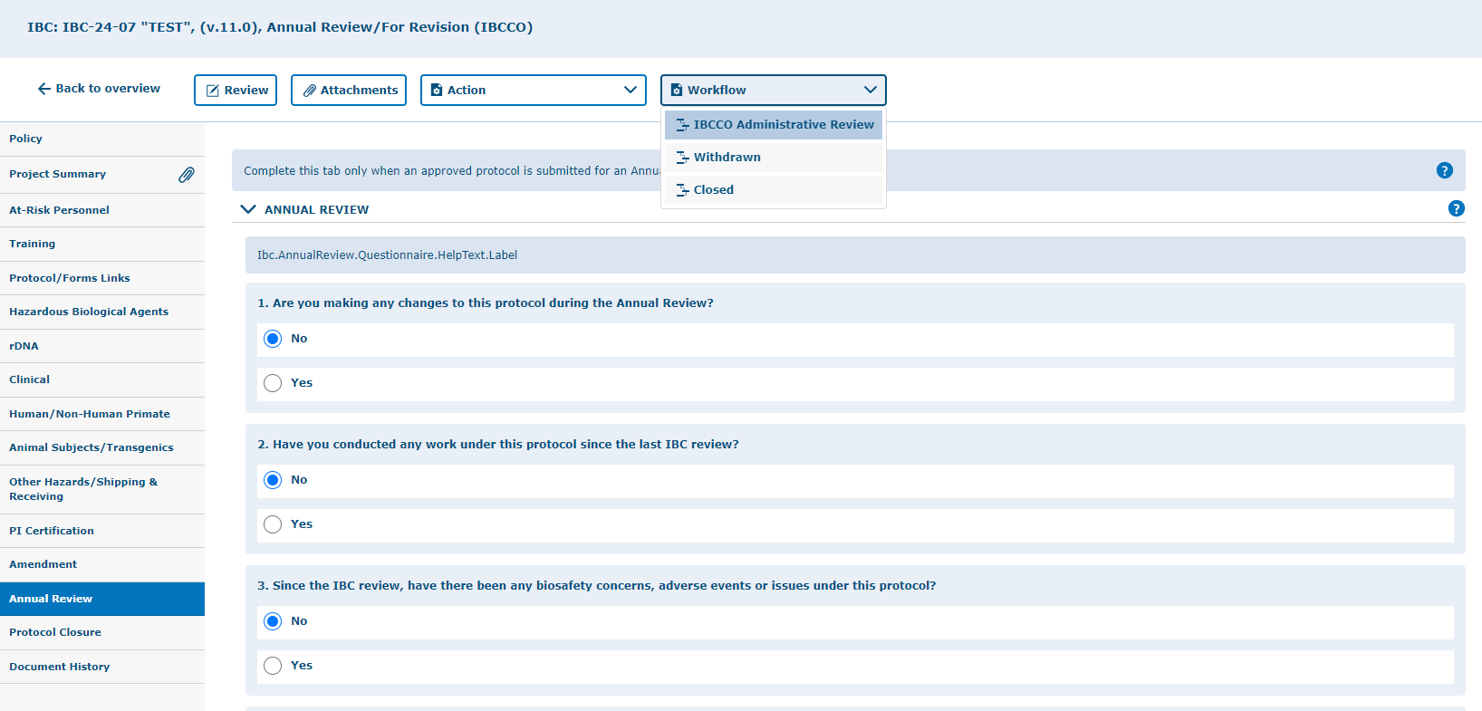
1.) Click on “Workflow” and select “IBCCO Administrative Review.”

Slide 26
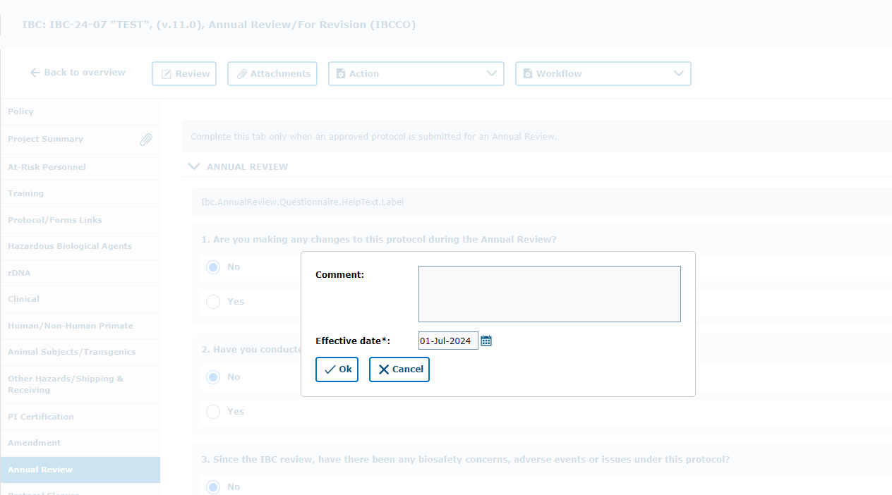
Adding a comment description in this box serves to communicate with the next Workflow user.
Write a comment inside the text box, after that click “Ok.”
Please use this box to communicate with the next Workflow user.

Slide 27
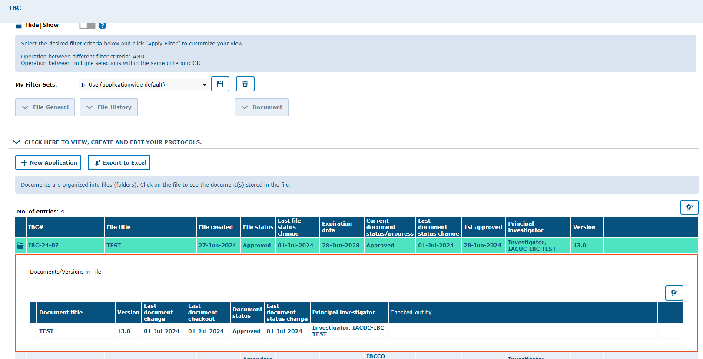
Once your revisions are completed and received, your submission will be re-reviewed. If your revisions are not sufficient or something was missed, the protocol will be returned to you for additional editing.
Once approved, you will receive an email notification and your Annual Review will disappear from the ‘In Progress (for all users)’ list.
Approved Projects are located under the “In Use” section on My Filter Sets.

Slide 28
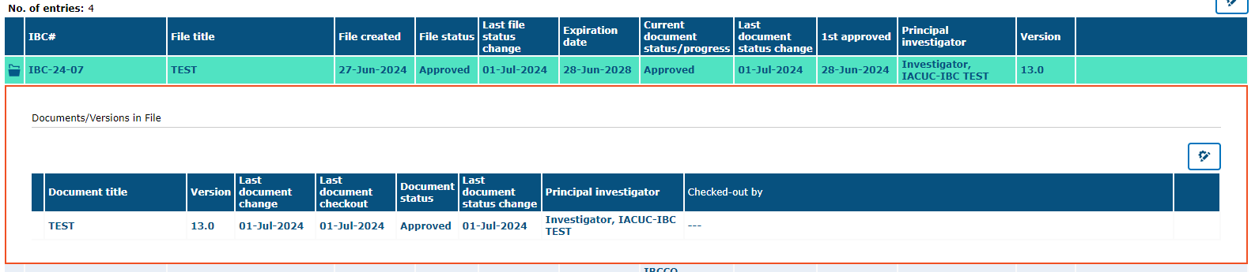
This is an example of how your approved Annual Review will look like on tick@lab, In Use filter
***Annual Review has been APPROVED***

Slide 29

Thank you !
Office of Research Compliance
Amy Mutore
IACUC/IBC Coordinator
(956)665-2889
amy.mutore@utrgv.edu
Monica Barrera
IACUC/IBC Specialist
(956)665-7873
monica.barrera01@utrgv.edu
Please contact Amy or Monica for assistance regarding submitting an IBC/HBA protocol. We are always happy to meet via Zoom or Teams to walk you through the process and answer any questions!

