Slide 1
Amendments (Modifications)-Adding/Removing Personnel
IBC Tick@Lab

Slide 2
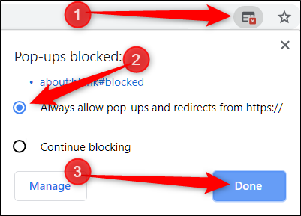
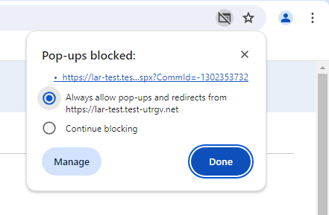
IMPORTANT NOTE:
    Follow the steps
Remember to allow pop-ups in your web browser.
If you do not allow pop-ups, the system will not work properly.

Slide 3
tick@lab URL
https://lar.utrgv.edu/tickatlab/default.aspx
Log in with your UTRGV Credentials

Slide 4
Access to tick@lab is not Automatic
If your personnel is new to working with the tick@lab system, they will need to complete an access request via IT.
Click HERE or on the link below for instructions on how to request tick@lab access:
Submitting your access request for tick@lab (utrgv.edu)
If you are unable to log-in please contact the Amy Mutore or Monica Barrera for assistance at ibc@utrgv.edu, amy.mutore@utrgv.edu, or monica.barrera01@utrgv.edu.

Slide 5
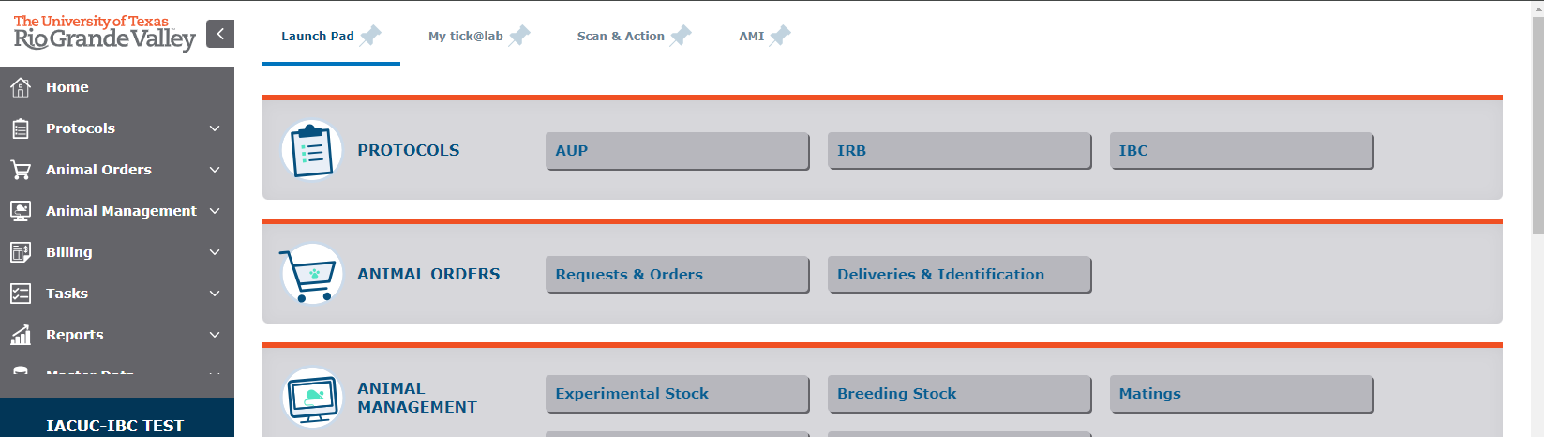
Getting Started
Click on “IBC”

Slide 6
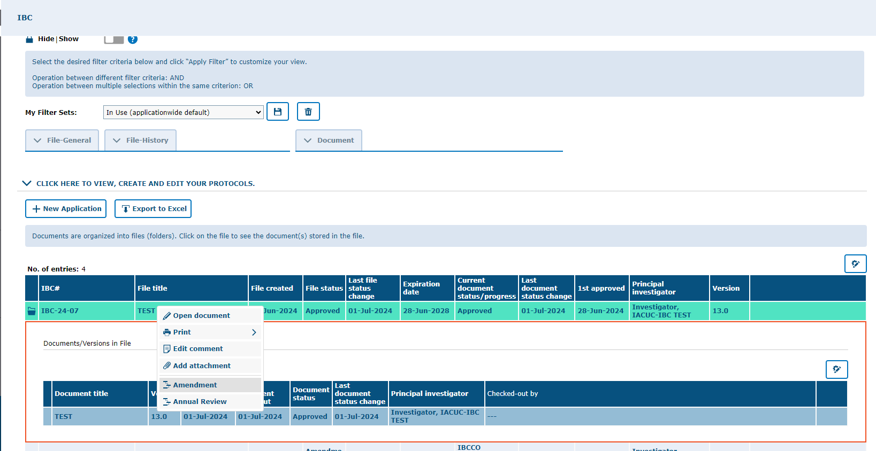
To add or remove personnel, an Amendment will need to be created and submitted.
Start by selecting and expanding your protocol, right-click on the latest version, and select “Amendment.”

Slide 7
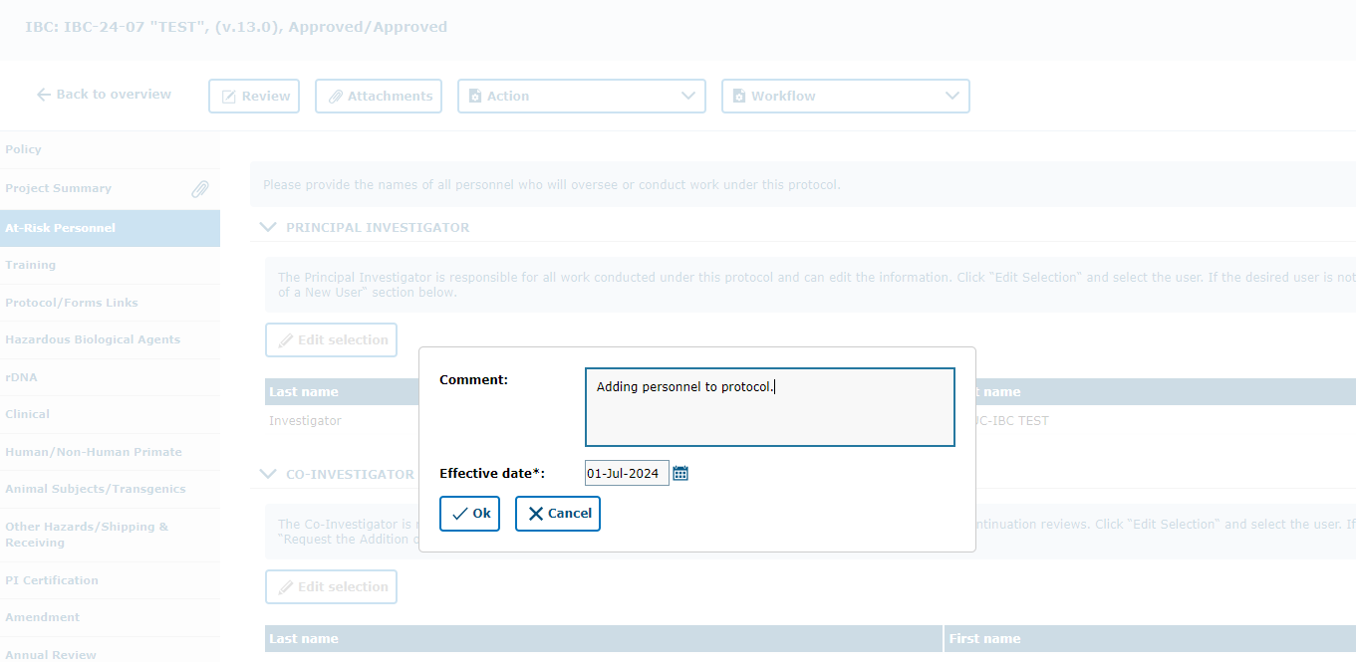
Provide a brief description of the amendment and click “Ok.”

Slide 8
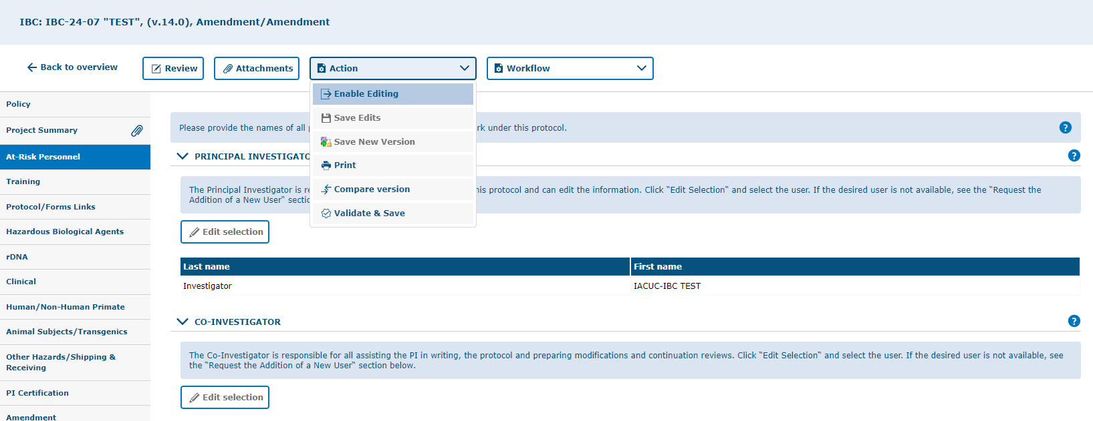
Click on the “At-Risk Personnel” tab, then select “Enable Editing” from the Action button.

Slide 9
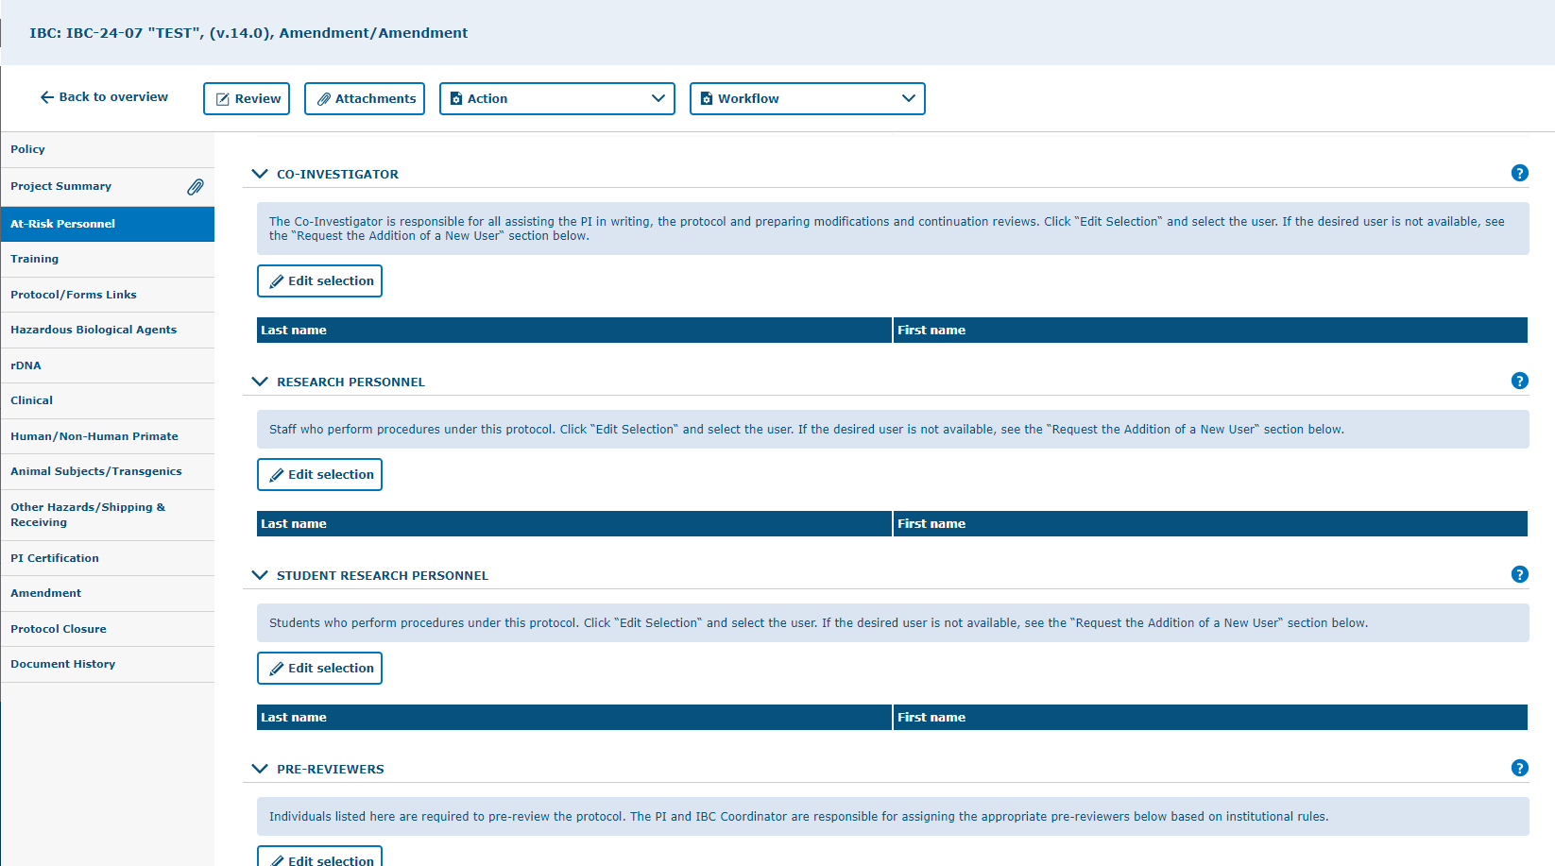
Click on the “Edit Selection” button in the section you wish to add personnel on. i.e. Research Personnel
NOTE:
Pre-Reviewers can be anyone you wish to have access to review your protocol before you submit to IBCCO.

Slide 10
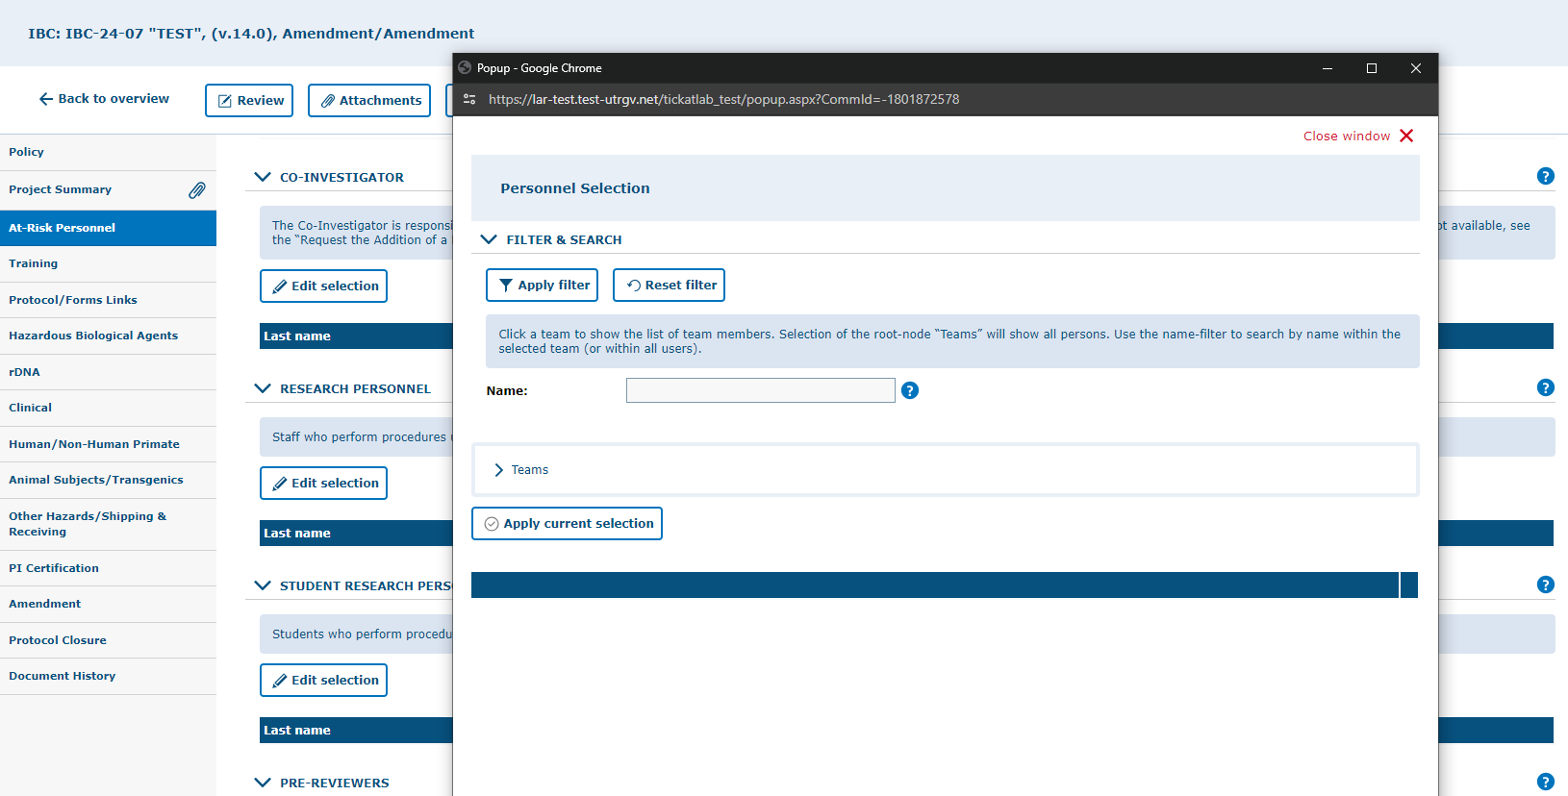
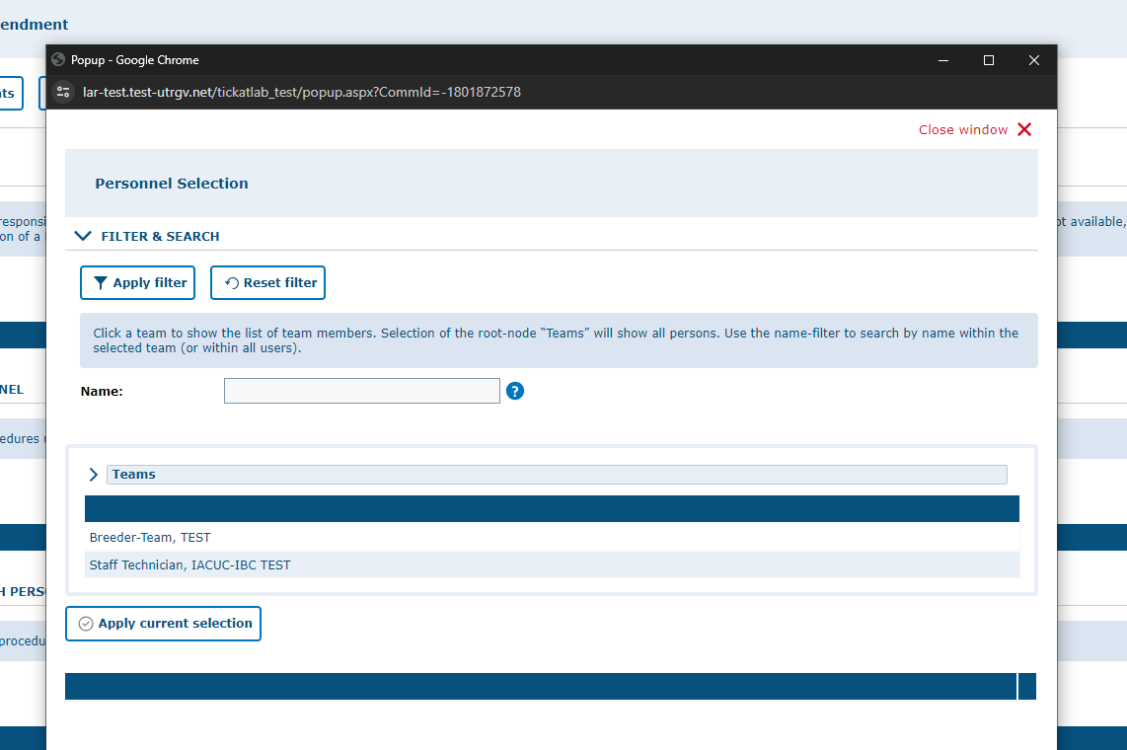
Once you click on “Edit Selection,” search for personnel by:
Searching for their name on the “Name” section, or
Clicking on the “Teams” word and selecting a name from the list that pops up
NOTE: Make sure to click on the word “Teams” and not the “>”; clicking on the “>” will show personnel names in teams/groups according to which PI they are listed under.

Slide 11
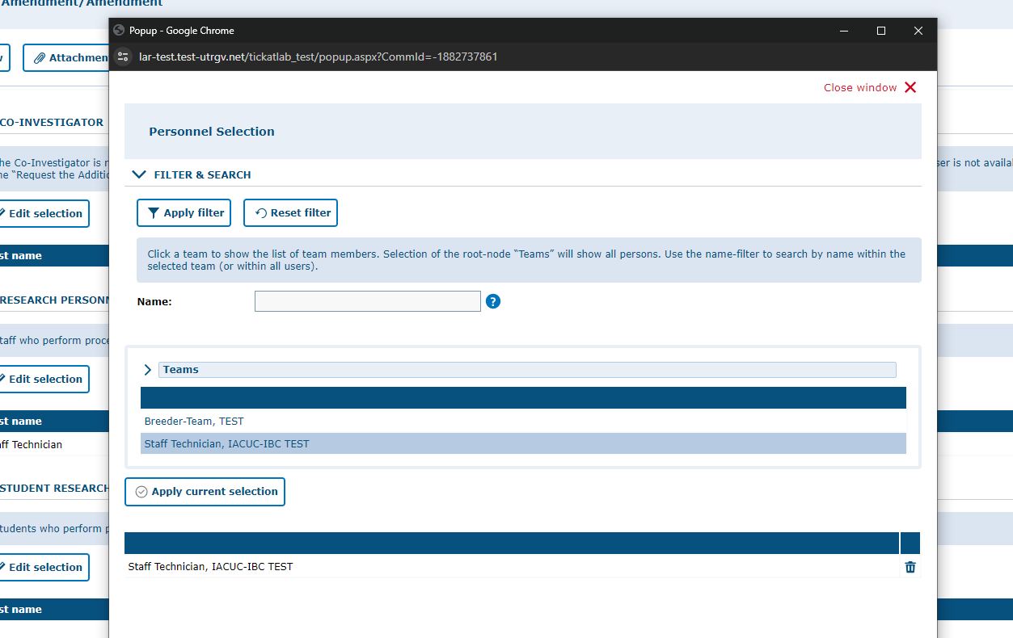
After you are done selecting personnel names from the list, click on “Apply Current Selection” to have them added to your protocol.
Then, click on “Close Window’ to close the pop-up window and ensure the changes are saved.

Slide 12
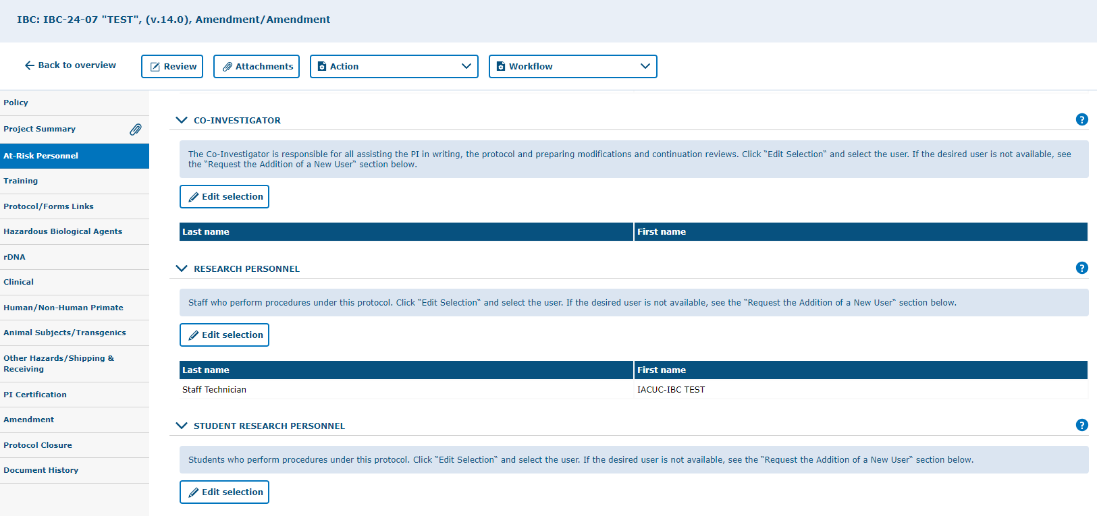
Added personnel will appear listed under the respective sections they were added to.

Slide 13
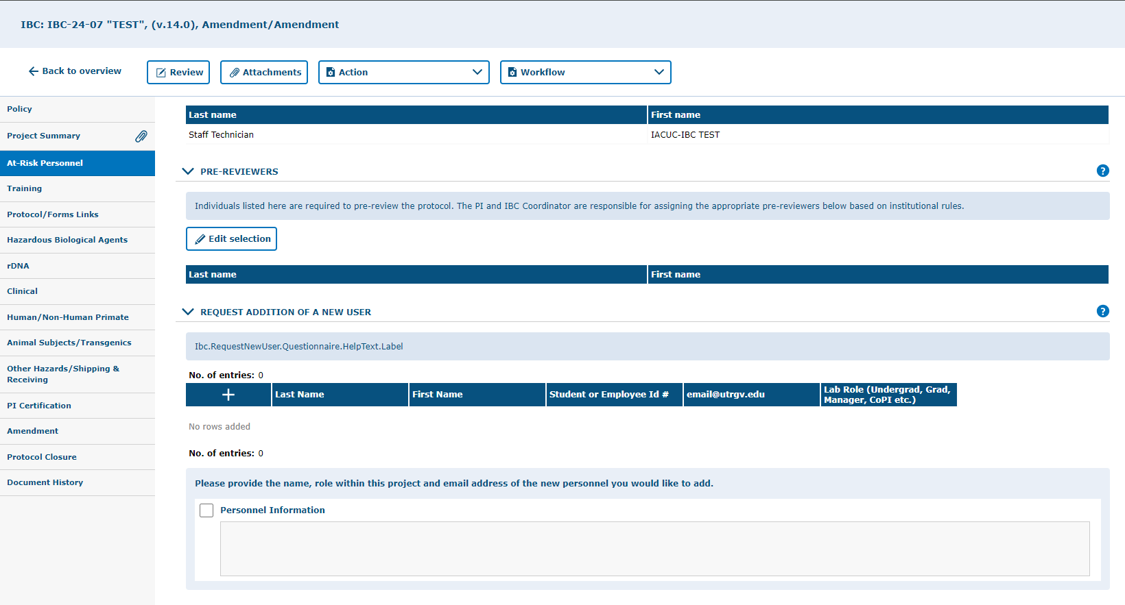
If the personnel you need to add is not on the list, please add their names under the “Request Addition of a New User” section table. This will enable IBC administrative staff to search for the personnel on tick@lab.
NOTE: If personnel does not have a tick@lab account, they will need to request access. Follow the link below for access request instructions:
Submitting your access request for tick@lab (utrgv.edu)

Slide 14
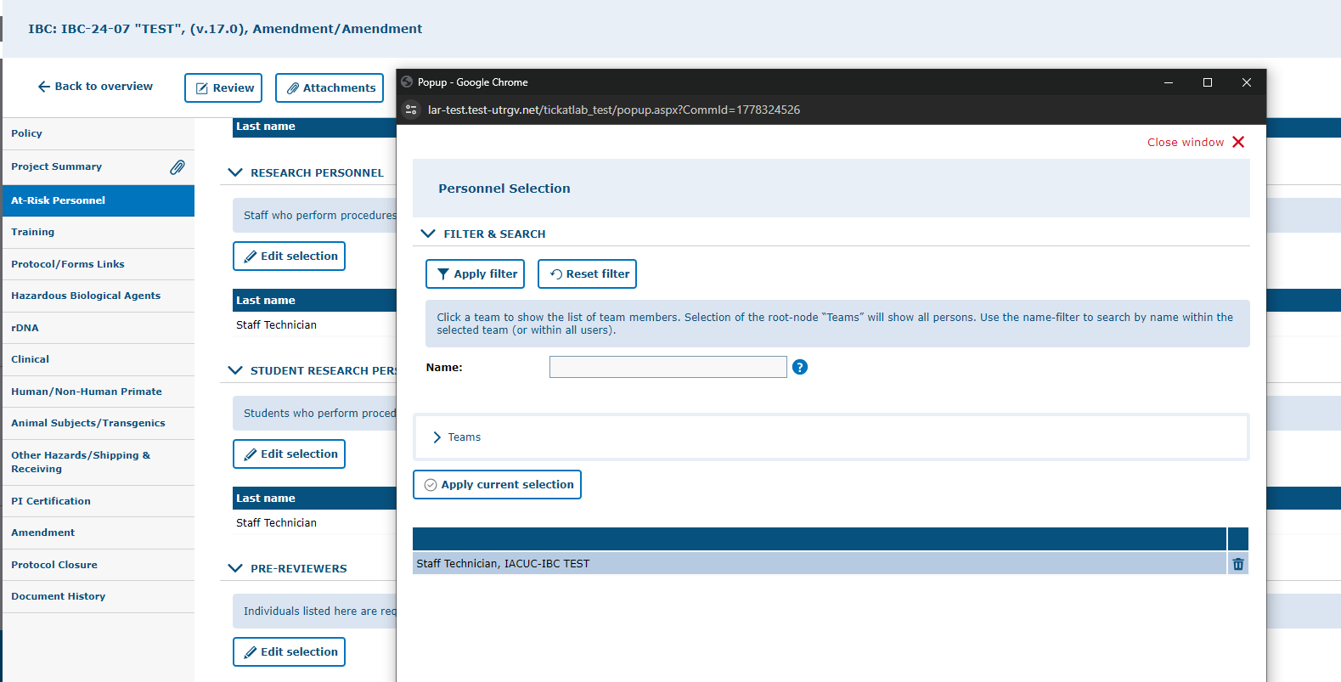
Deleting Personnel From Protocol
To delete personnel, click on “Edit Selection,” then click on the trash can icon next to the personnel name. Click on “Apply Selection” then “Close Window” to finalize the change.

Slide 15
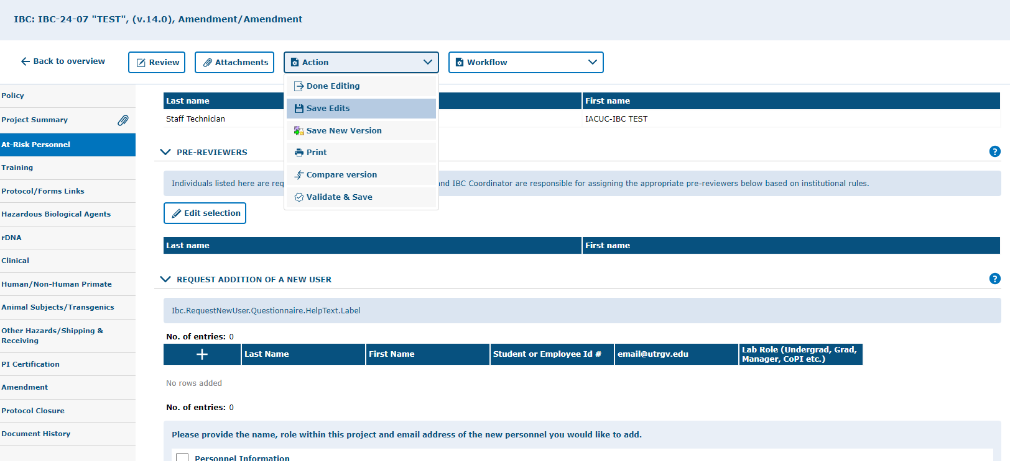
Remember to save after every change you make on the protocol to ensure your work does not erase. If you are done adding personnel, you can click on “Done Editing” and it will save as well as check the protocol back in.

Slide 16
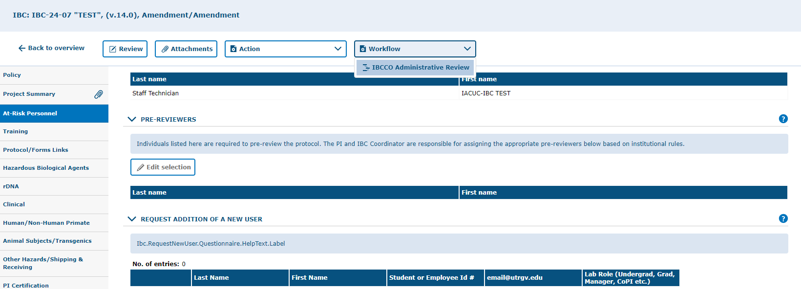
Once all changes have been made and saved, select “IBCCO Administrative Review” under the Workflow button. This will send the protocol to admin for review.

Slide 17
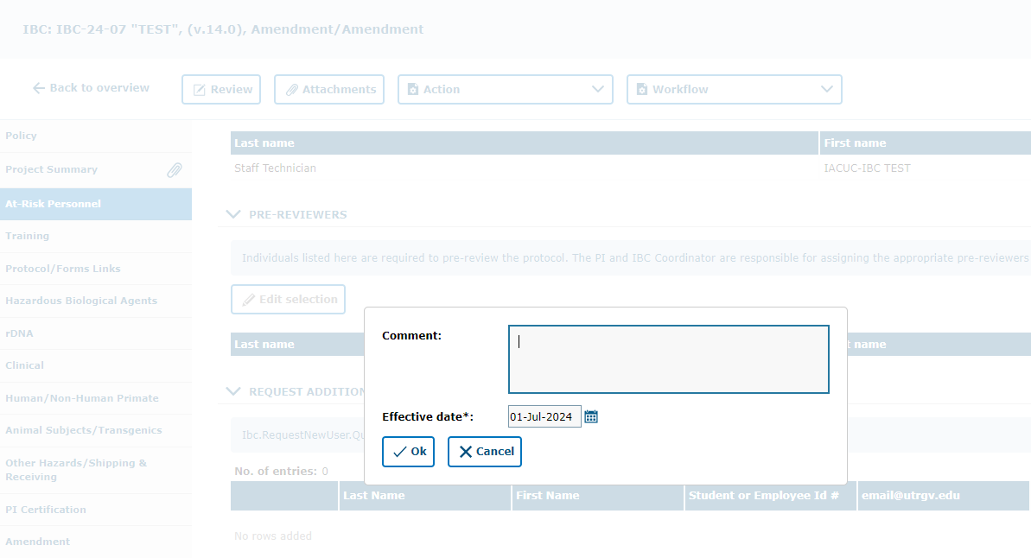
Add a comment specifying your additions. i.e. adding personnel.

Slide 18
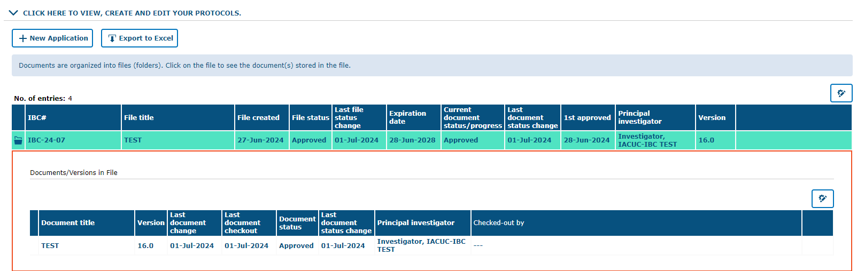
Once the additions have been reviewed and approved, the protocol will be “Approved” under Files Status.
Personnel additions will typically only require administrative review and approval. If there are any issues with adding any personnel, do not hesitate to contact the IBC administrative staff, we are happy to help!

Slide 19

Thank you !
Office of Research Compliance
Amy Mutore
IACUC/IBC Coordinator
(956)665-2889
amy.mutore@utrgv.edu
Monica Barrera
IACUC/IBC Specialist
(956)665-7873
monica.barrera01@utrgv.edu
Please contact Amy or Monica for assistance regarding submitting an IBC/HBA protocol. We are always happy to meet via Zoom or Teams to walk you through the process and answer any questions!

