Slide 1
Amendments (Modifications)
IBC tick@lab

Slide 2
Content:
Access to tick@lab
Getting Started
How to submit an amendment (modification request)
Attachments
Validating and Saving
How to revise a submitted amendment
Resubmitting an amendment

Slide 3
Access to tick@lab

Slide 4
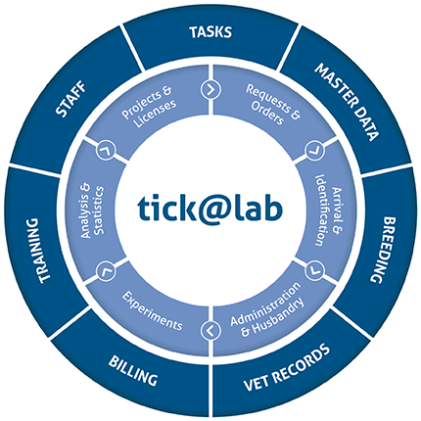

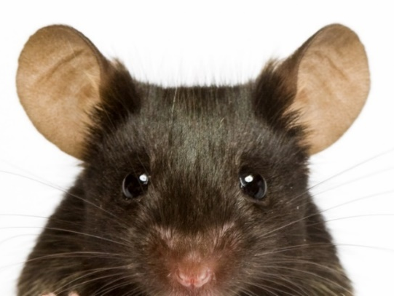

tick@lab URL
https://lar.utrgv.edu/tickatlab/default.aspx

Slide 5
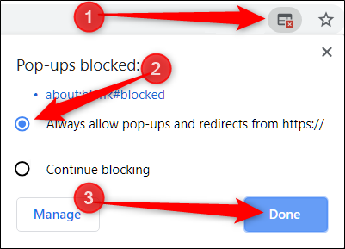
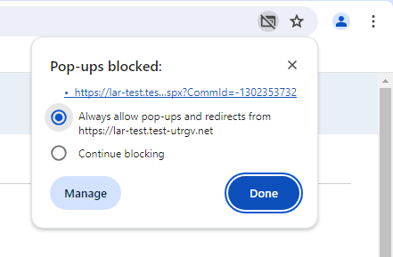
IMPORTANT NOTE:
    Follow the steps
Remember to allow pop-ups in your web browser.
If you do not allow pop-ups, the system will not work properly.

Slide 6
Access to tick@lab is not Automatic
If your personnel has never worked with tick@lab before, they’ll need to complete a web form to request access via IT.
Click HERE or on the link below for instructions on how to request Tick@Lab access:
Submitting your access request for tick@lab (utrgv.edu)
If you are unable to log-in please contact the Amy Mutore or Monica Barrera for assistance at ibc@utrgv.edu, amy.mutore@utrgv.edu, or monica.barrera01@utrgv.edu.

Slide 7
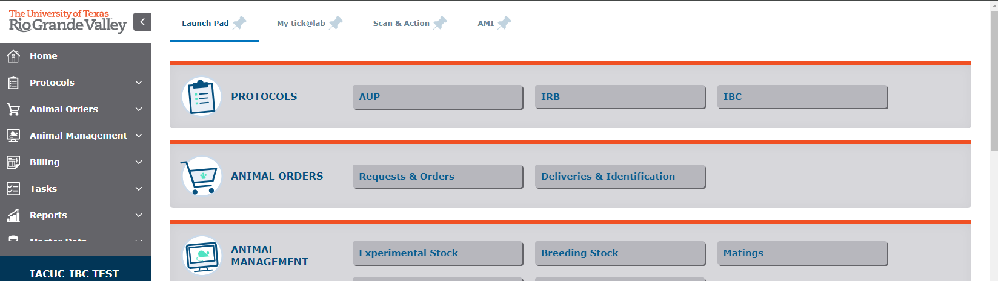
Getting Started
1. Click on “IBC”

Slide 8
How to Submit an Amendment (Modification) Request
Submission Steps

Slide 9
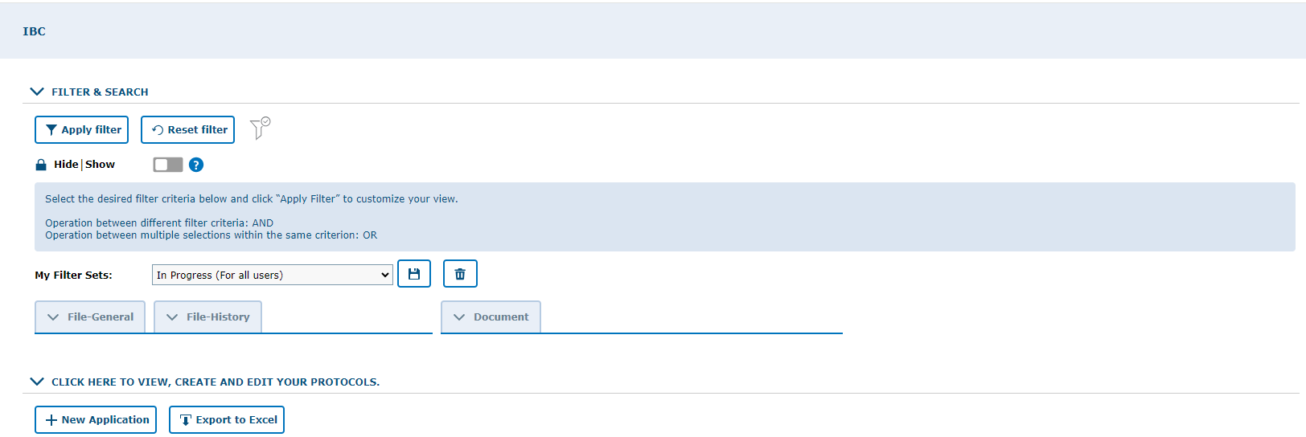
Make sure to work in the IBC tab
2. Make sure to select “In Progress (For all Users)”
3. Click to expand protocol lists

Slide 10
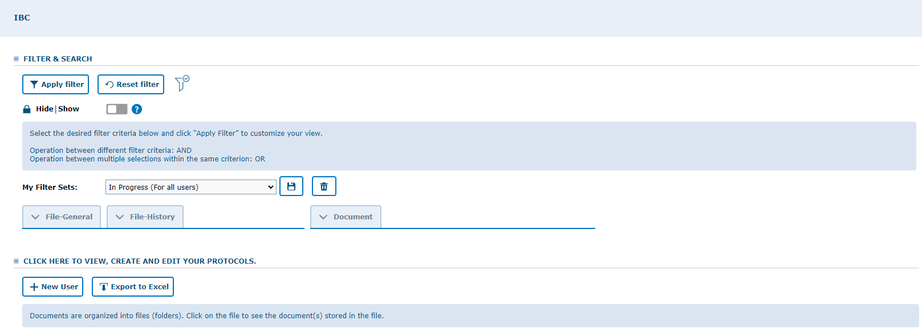
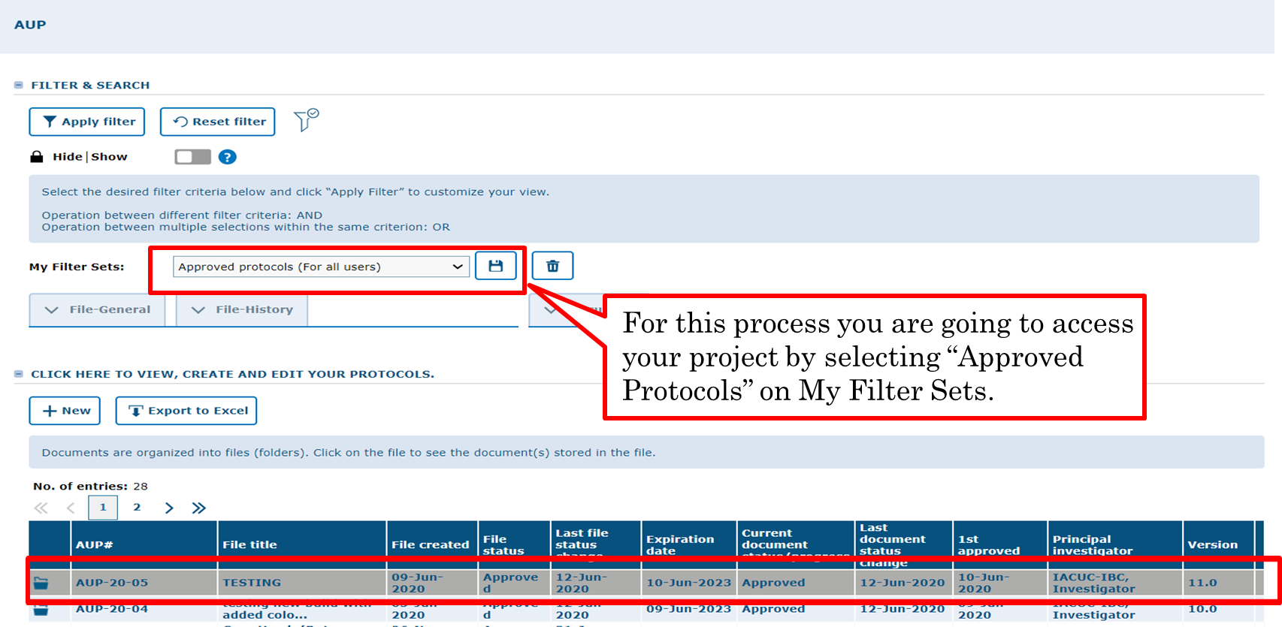

Note: The PI or Co-Investigators can amend (modify) an approved protocol.
Double click on any part of the main information to open Documents/Versions in the file.

Slide 11
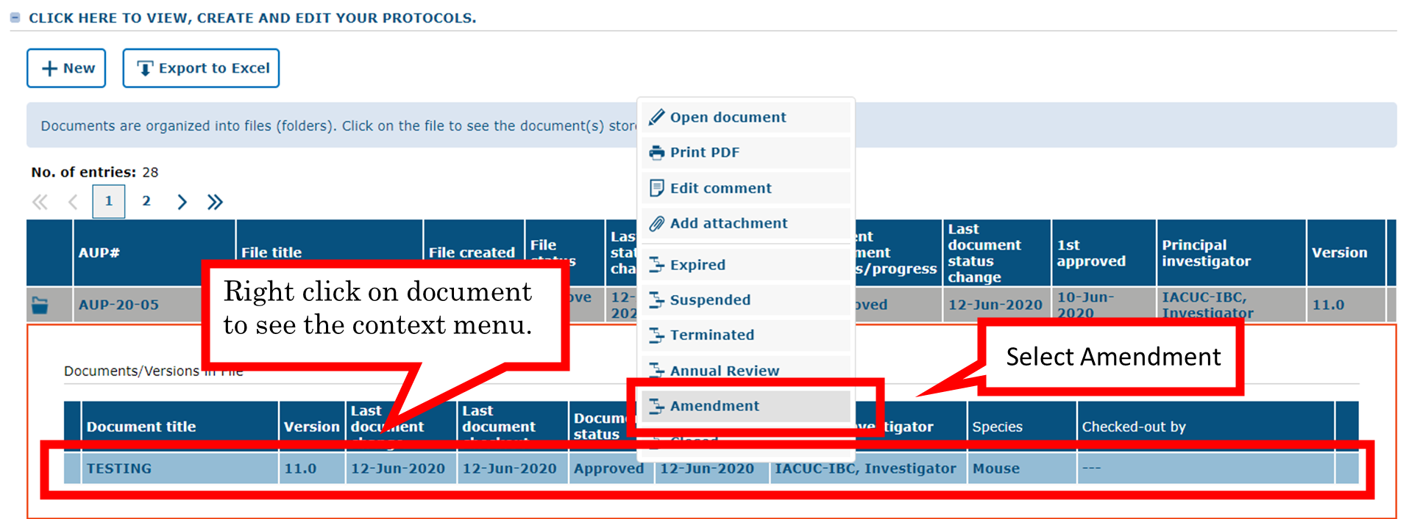
The file contains a collection of documents related to the same study protocol, including your approved version of the initial protocol.

Slide 12
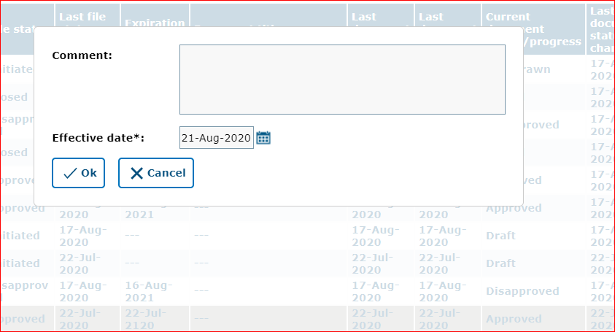
Provide a brief description of the amendment and click “Ok.”

Slide 13
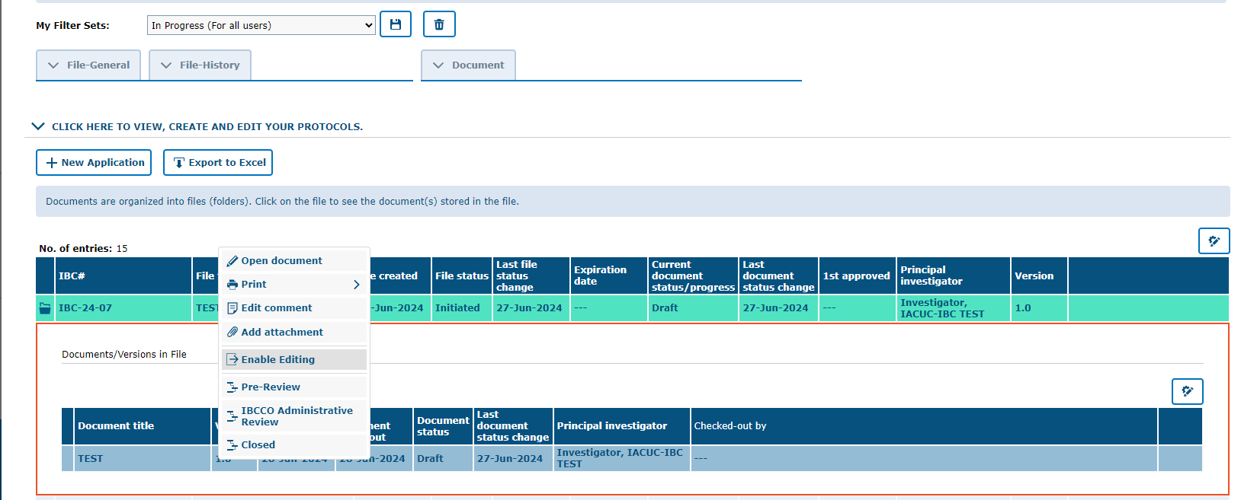
In this step you can see an additional document version is created (i.e. 1.0, 2.0, etc.).
Click on the amendment, the newest version, to open the document and begin to make changes.
To edit the Amendment then submit, you will need to right-click on the new version and select “Enable Editing.”

Slide 14
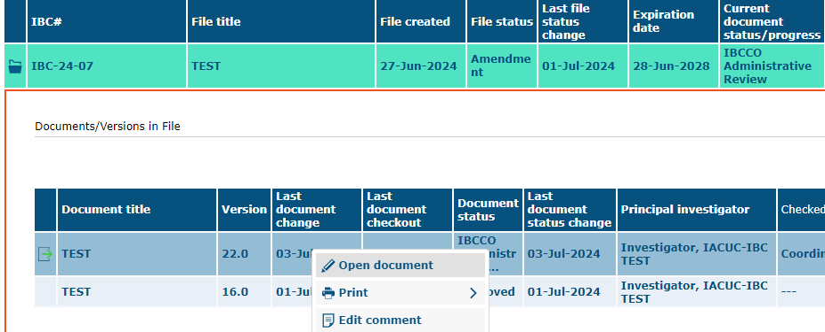
Include a comment briefly summarizing proposed changes (E.g., add personnel, or modify procedures, etc.) and click “Ok.”

Slide 15
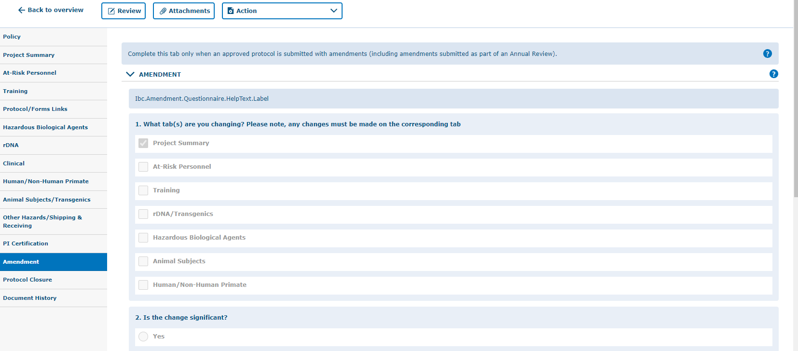
If your approved application was generated in tick@lab, you will see the original information you entered. If that is the case all you need to do is modify the text. If your approved protocol was processed originally on a PDF, your approved protocol will be uploaded into tick@lab as an attachment.
However, to process the amendment you will need to enter the proposed modification(s) into each of the tabs.

Slide 16
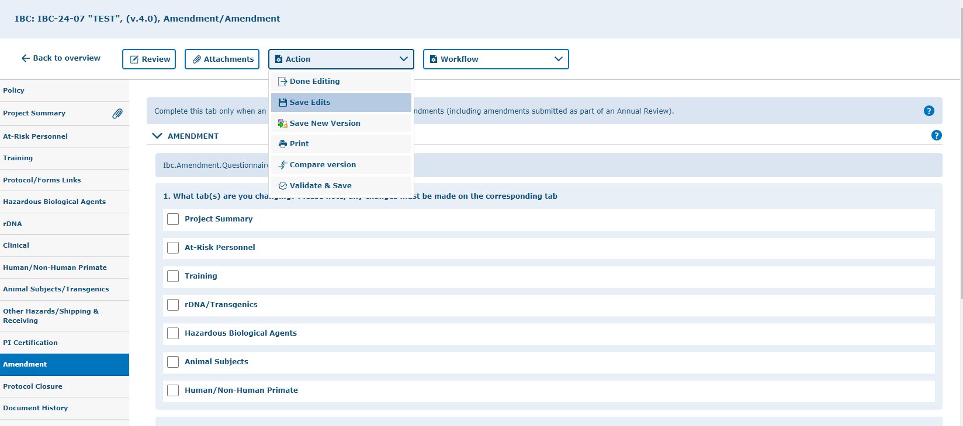
Save All The Changes
Remember, you can save by clicking any of the “Action” button options at any time. It is recommended this be done after every page to reduce the risk of losing information should the page refresh or the computer restart for any reason.
Note: there are 4 ways to save forms:
1.) Done Editing: Saves the file and checks the document in so that another person can check it out to edit.
2.) Save Edits: Saves the document and allows you to keep working on it.
3.) Save New Version: Saves a separate and new version of the file (duplicate).
4.) Validate & Save: alerts you of any missing items in the protocol before saving.

Slide 17
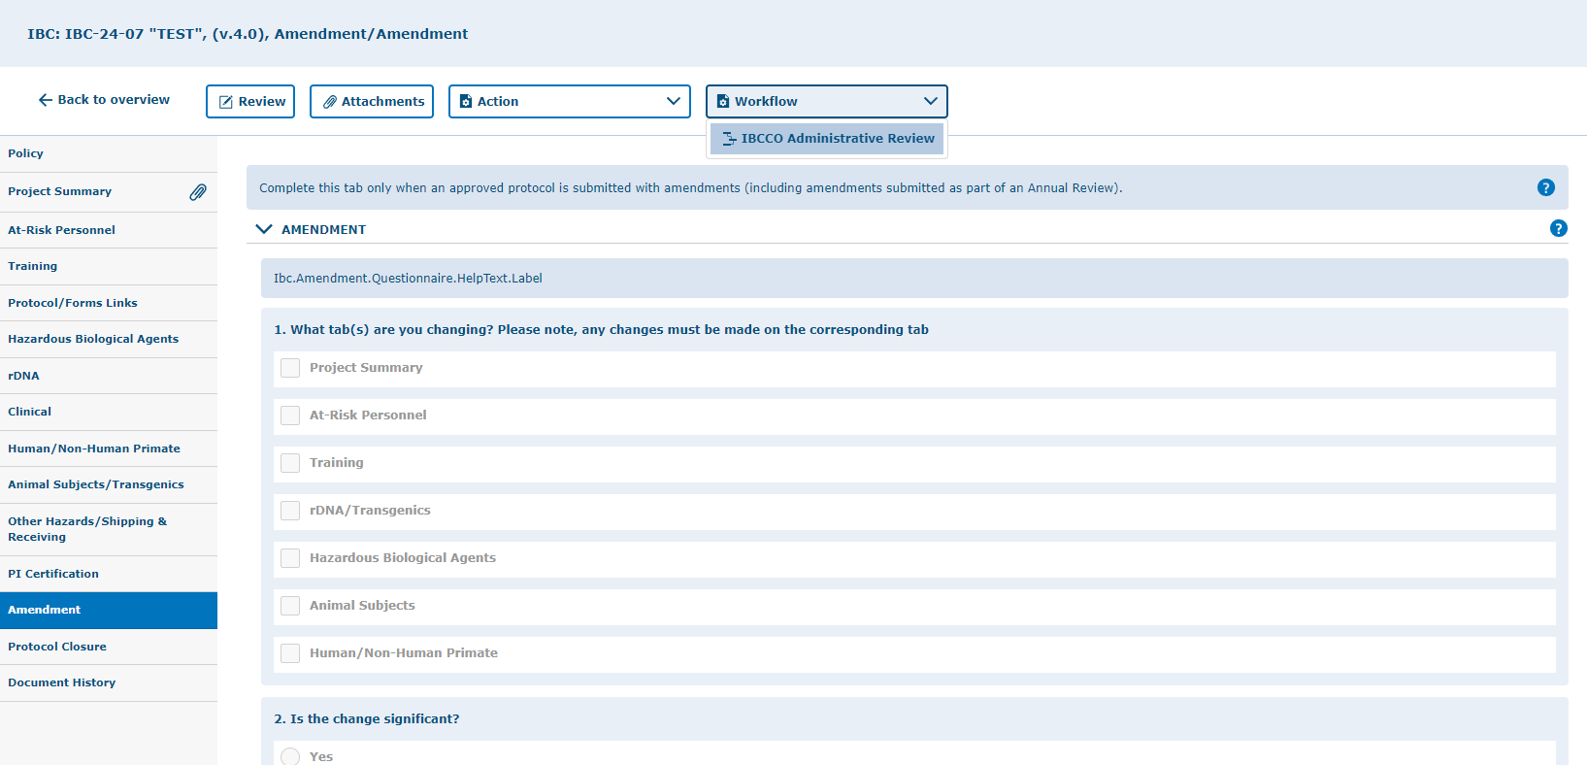
To submit a protocol amendment (modification) to the workflow:
Click on “workflow” and select “IBCCO Administrative Review.”

Slide 18
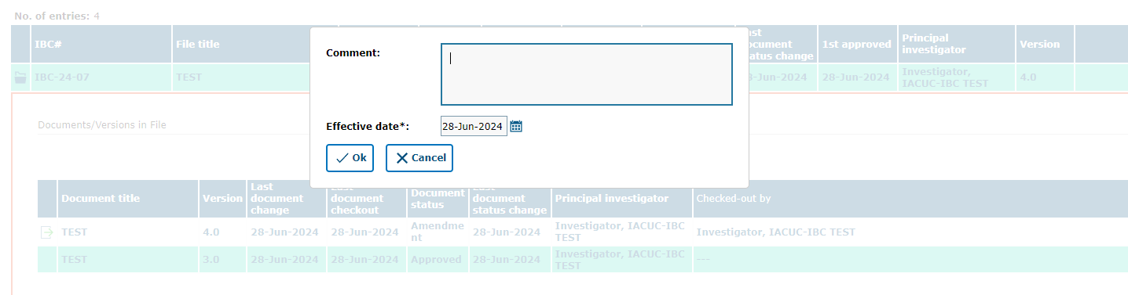
Include a comment briefly summarizing proposed changes (E.g., add personnel, or modify procedures, etc.) and click “Ok.”

Slide 19
Attachments
How to add attachments to your protocol

Slide 20
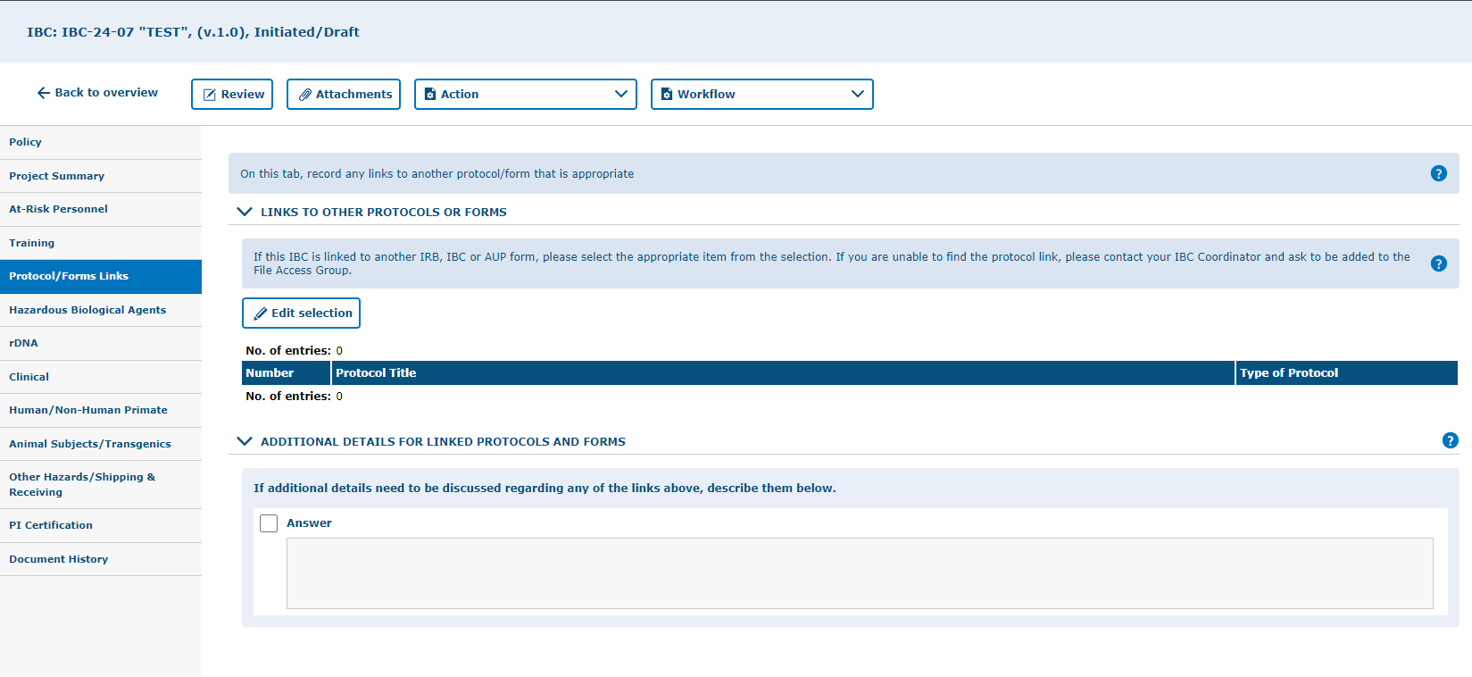
You can add attachments by using the “Attachments” button.
Include your attachments on their respective tabs. This is will facilitate the review process once you submit.
i.e. Attach any additional protocol form documents on the Protocol/Forms Link tab. Attach your appendix/addendum materials on the Project Summary tab.

Slide 21
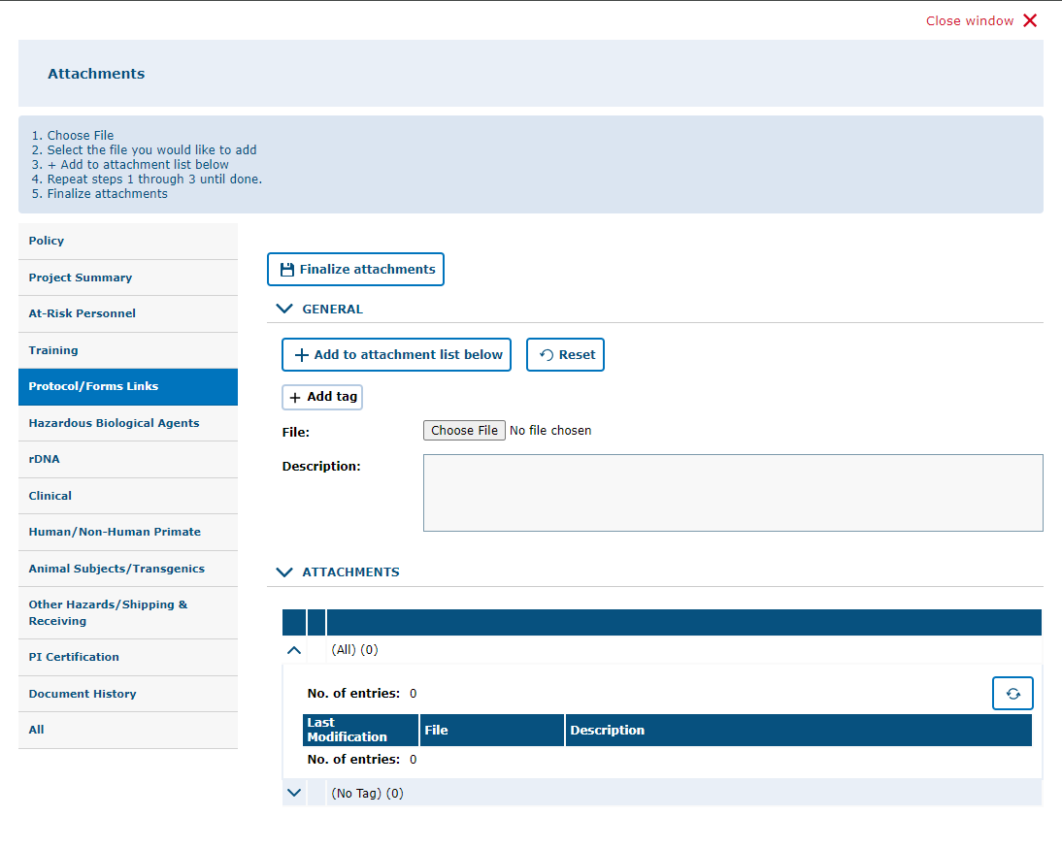
3. Click “Finalize Attachments”
2. After choosing the file, click on “Add to Attachment List Below.” For more than one file, click on “Choose File” then “Add to Attachment List Below” until all documents needed have been added, then click on “Finalize Attachments.”
1. Click on “Choose File” and upload file from computer or other devices. You can add a description of the attachment in the box.
4. Click on “All” to view all the application attachments.

Slide 22
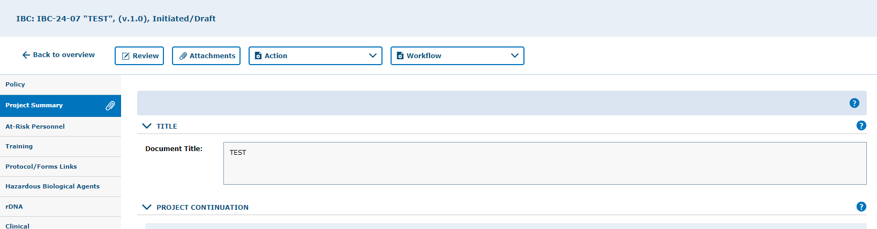
How to locate an attachment
Attachments are on the tab indicated by the paper clip icon.

Slide 23
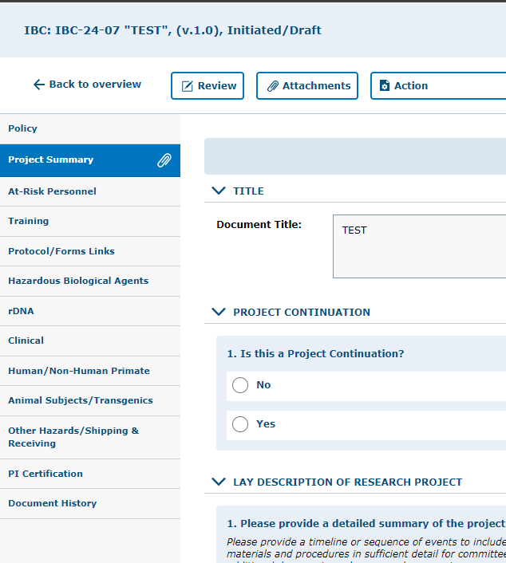
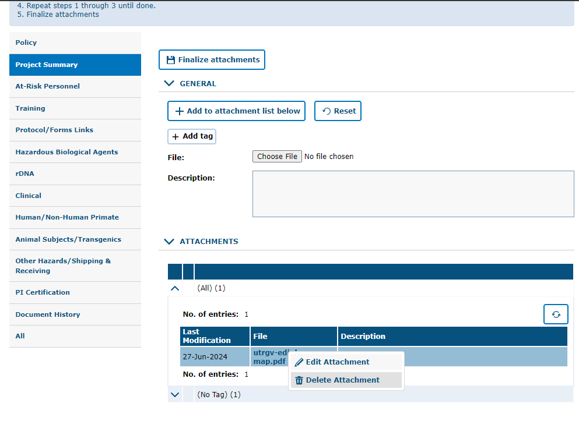
How to remove an attachment
You can remove attachments by:
Clicking on the “Attachments” button
Right-clicking on the attachment
Selecting “Delete Attachment”

Slide 24
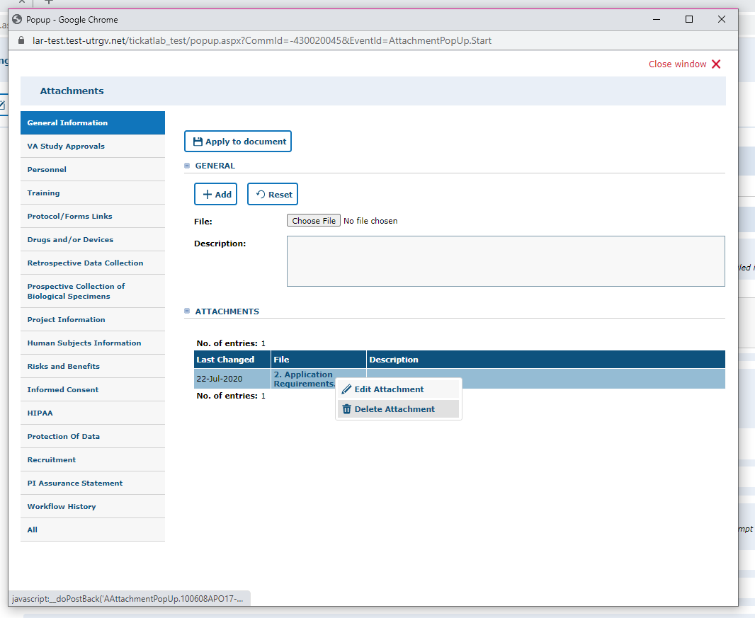
Note: by changing the workflow, the attachments will be locked and can no longer be deleted. i.e., while in draft mode and pre-review revision mode you may delete any attachments that you do not need. However, once you submit to the IBCCO Administrative Review, attachments will be locked.
Right click on top of the name of the file and select “Delete Attachment”

Slide 25
Validating and Saving

Slide 26
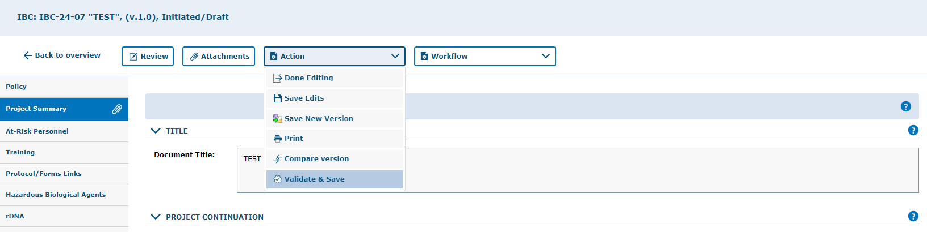
Once you have completed the application (Project Summary tab through the PI Certification tab), then it is recommended to Validate and Save your application
Mandatory questions are marked with (*) at the end of the questions
“Validate & Save” is a feature to check for any incomplete mandatory questions.

Slide 27
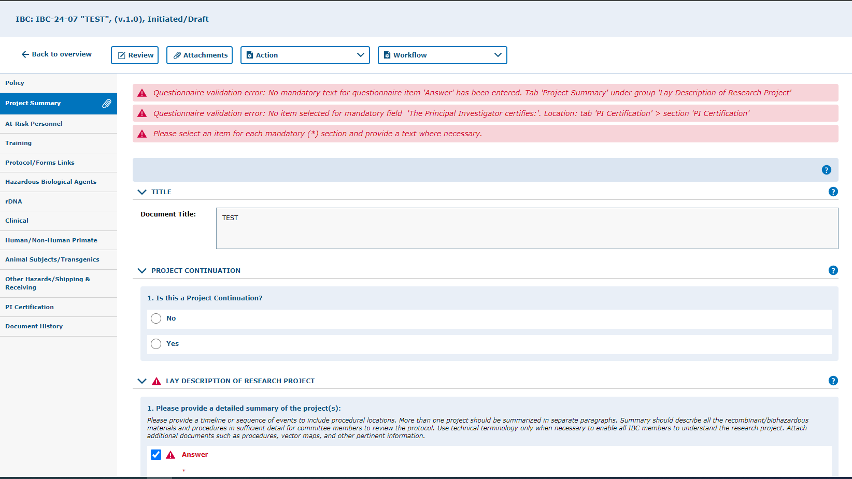
Application Validation
Pending Mandatory questions.

Slide 28
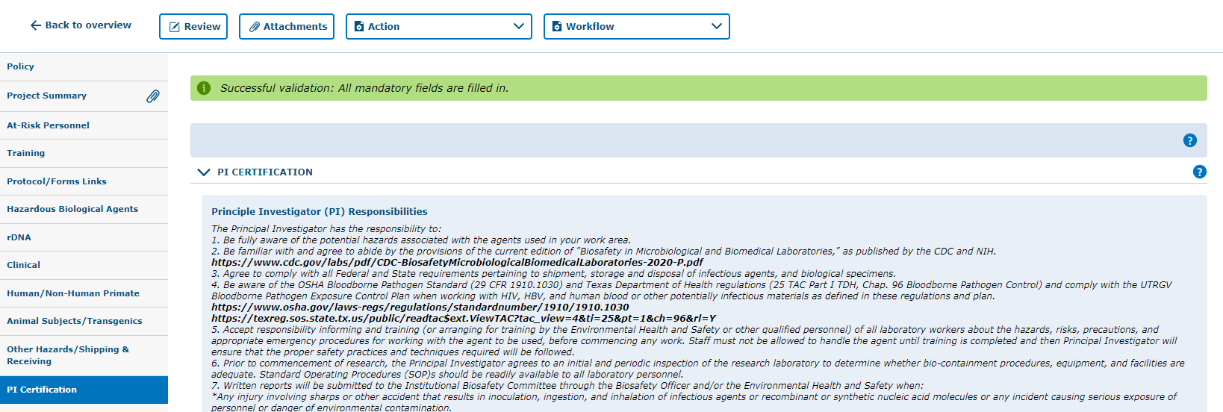
Application Validation
All required questions are answered and the protocol is ready for submission.

Slide 29
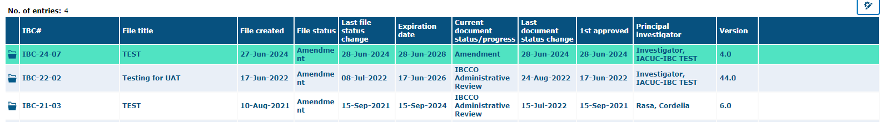
Once sent to IBCCO Administrative Review, the “Current document status/progress” will reflect that the protocol is under administrative review.
Note: Amendments (modifications) and Annual Reviews that have not been approved can be found on the “In Progress (for all users) filter in “My Filter Sets.”

Slide 30
How to Revise a Submitted Amendment
Returned to you for Revision

Slide 31
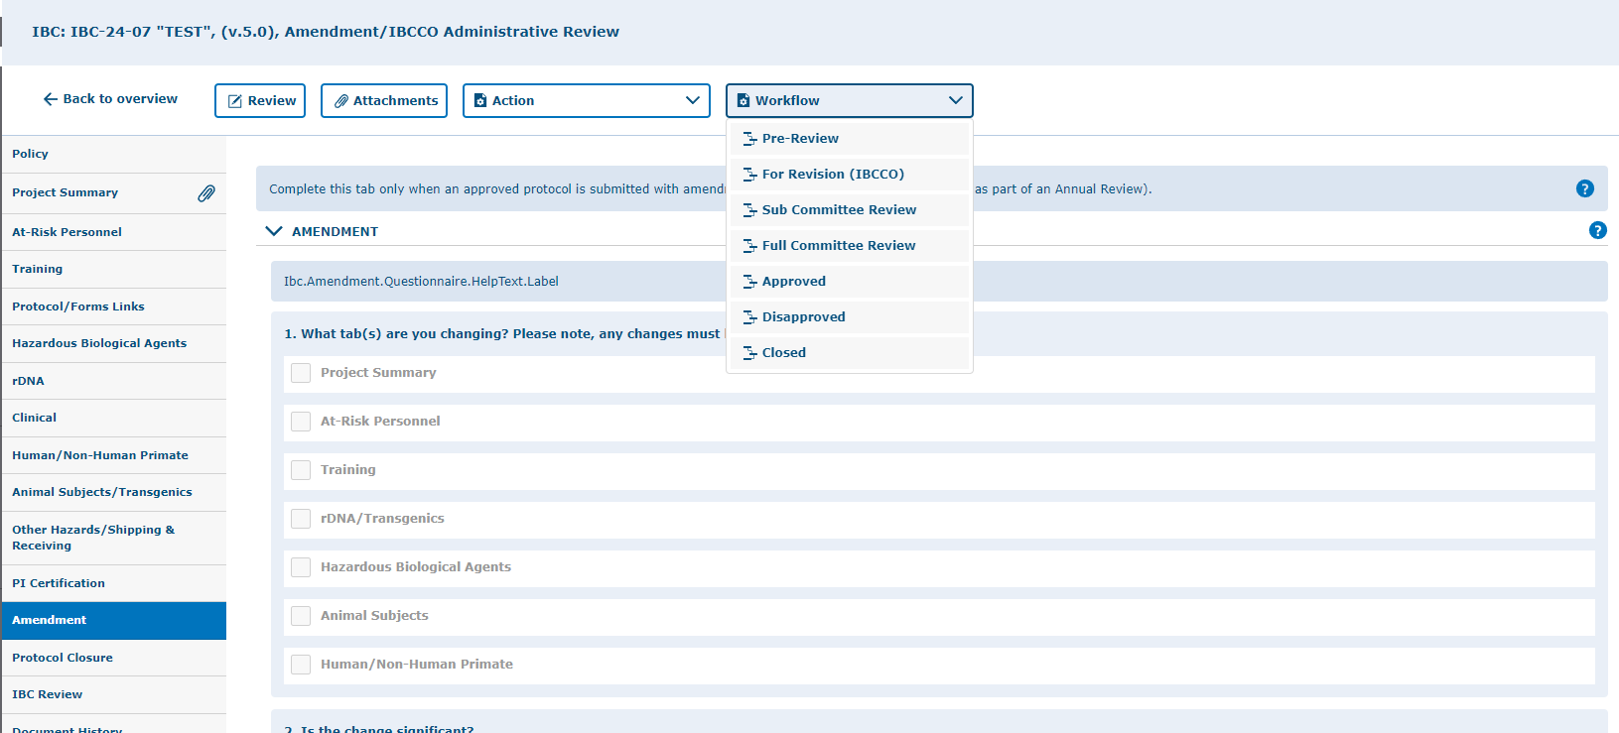
When submitted, your protocol will be reviewed. If anything is found to be missing or in need of editing, the questions/concerns will be entered in the protocol and will be sent back to you, the PI, for revisions.
If your amendment application is returned to complete required revisions:
You will receive an email that review comments have been placed in the protocol and the amendment needs to be revised.

Slide 32
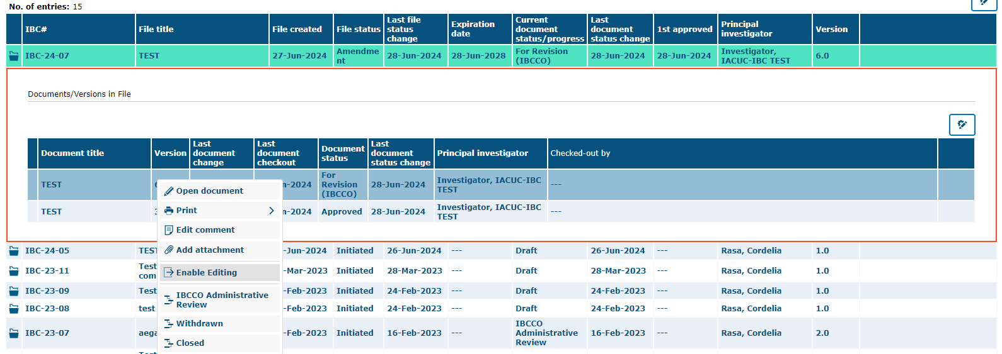
To make changes to a document in tick@lab, you need to enable the document for editing first. During the time a document is checked-out (being edited), no other person can access your document (Other team members, IBCCO, and/or Reviewer).
Right-click on the document and select “Enable Editing.”

Slide 33
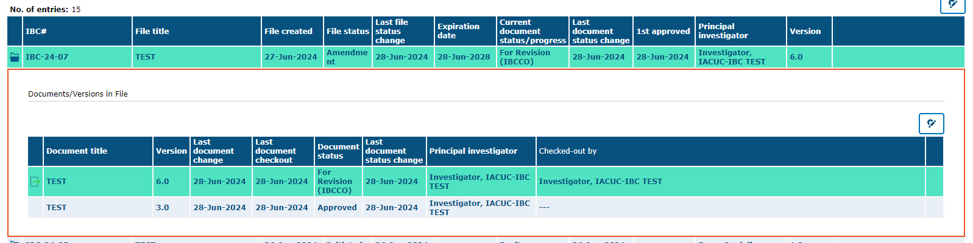
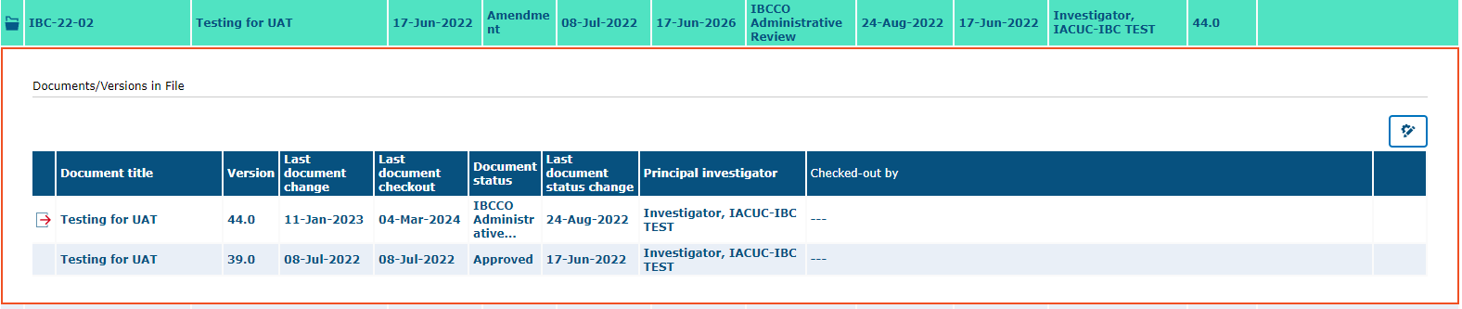
Remember, only one person at a time can work on an application.
Others can view in read-only mode, while the document is being edited.
Green Arrow (operational mode): Means it is available to see and edit.
Red Arrow (read-only mode): Means someone is working on the document.

Slide 34
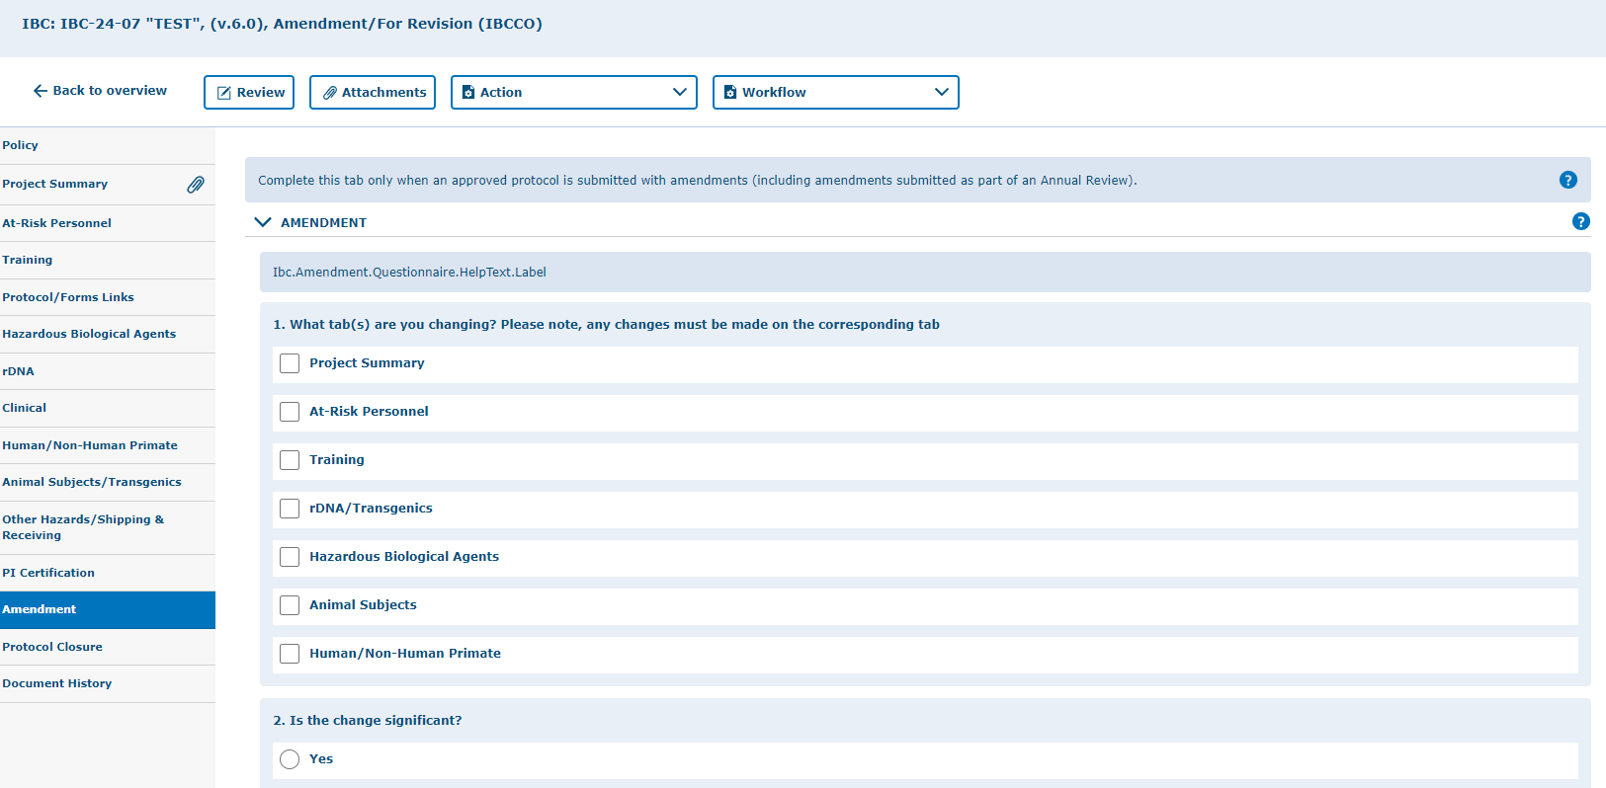
Once you have enabled the Amendment application for editing, then you can navigate all the revisions requested by using the “Review” button

Slide 35
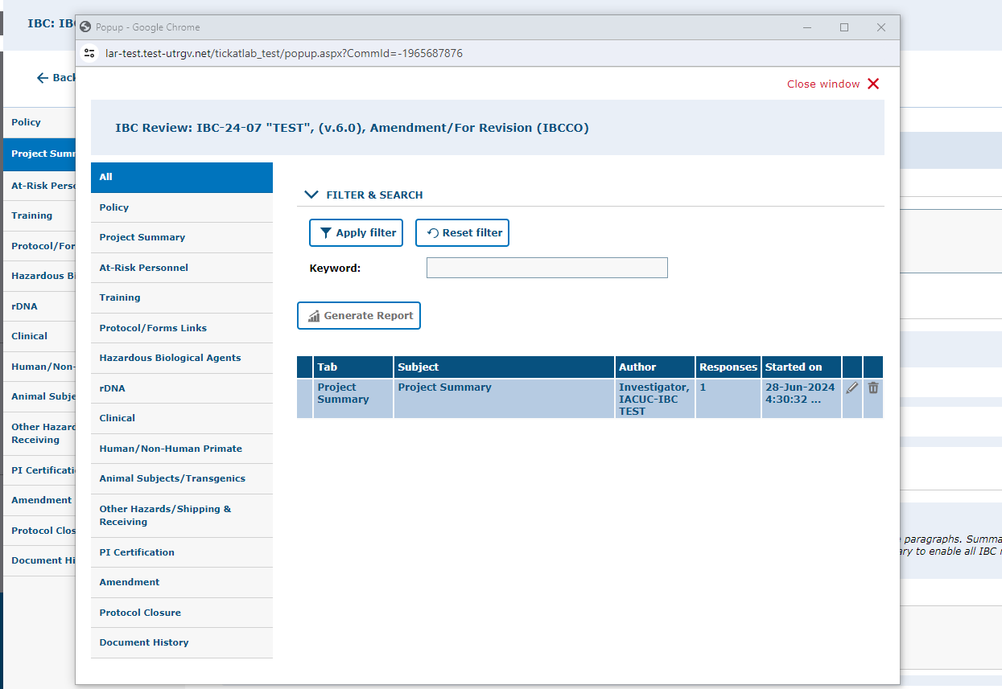
As illustrated in the red box, you will find a list of items requested by reviewers for the entire protocol.
To respond to the feedback, please click on each topic under the “Subject” column to expand a field and respond.
NOTE: these responses will also have to be revised within their respective areas within the protocol.

Slide 36
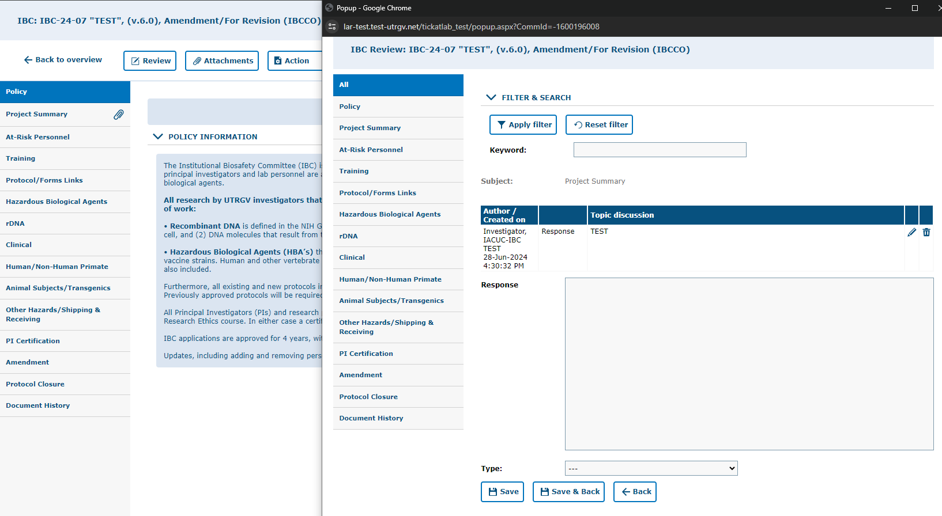
If a document must be uploaded as a response, you will need to go back to the “Attachments” tab and upload the document in the respective section.
i.e., document related to a response regarding the Project Summary can be uploaded within the “Project Summary” tab.
1.) Enter comment/answer in “Response” text box.
2.) Select the type of response (Response, Question, Concern, etc.
3.) Click “Save & Back.”

Slide 37
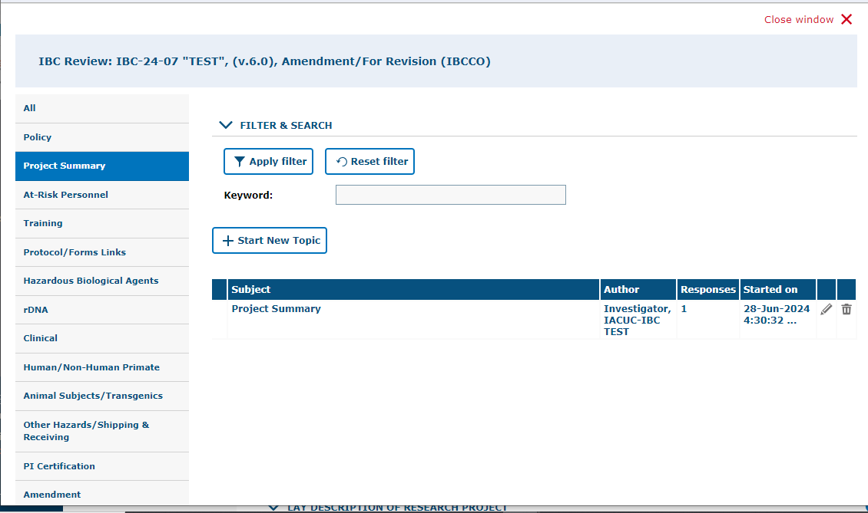
After reviewing and addressing all items, click “close window”.
Every time a researcher makes modification to a form a new version is activated in the system. The creation of versions allows the IBC Coordinator and Committee Members to streamline the review by conducting automatic comparisons among versions.

Slide 38
Resubmitting an Amendment
Submitting back to Workflow, after making required revisions

Slide 39
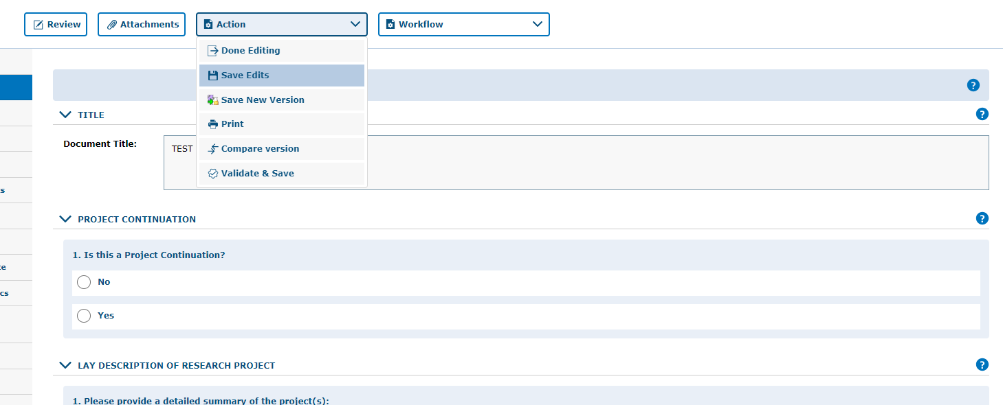

Remember to SAVE YOUR WORK!
Click on “Save Edits” under the “Action” button located in each tab
Prior to resubmitting the protocol, make sure you have saved the edits you have made.
Note, that there are 4 ways to save forms:
  Done Editing: saves the file and checks the document in so that another person can check it out and edit it.
  Save Edits: saves the document and allows you to keep working on it.
  Save New Version: saves a separate and new version of the file (duplicate).
  Validate & Save: alerts you of any missing items in the protocol before saving.

Slide 40
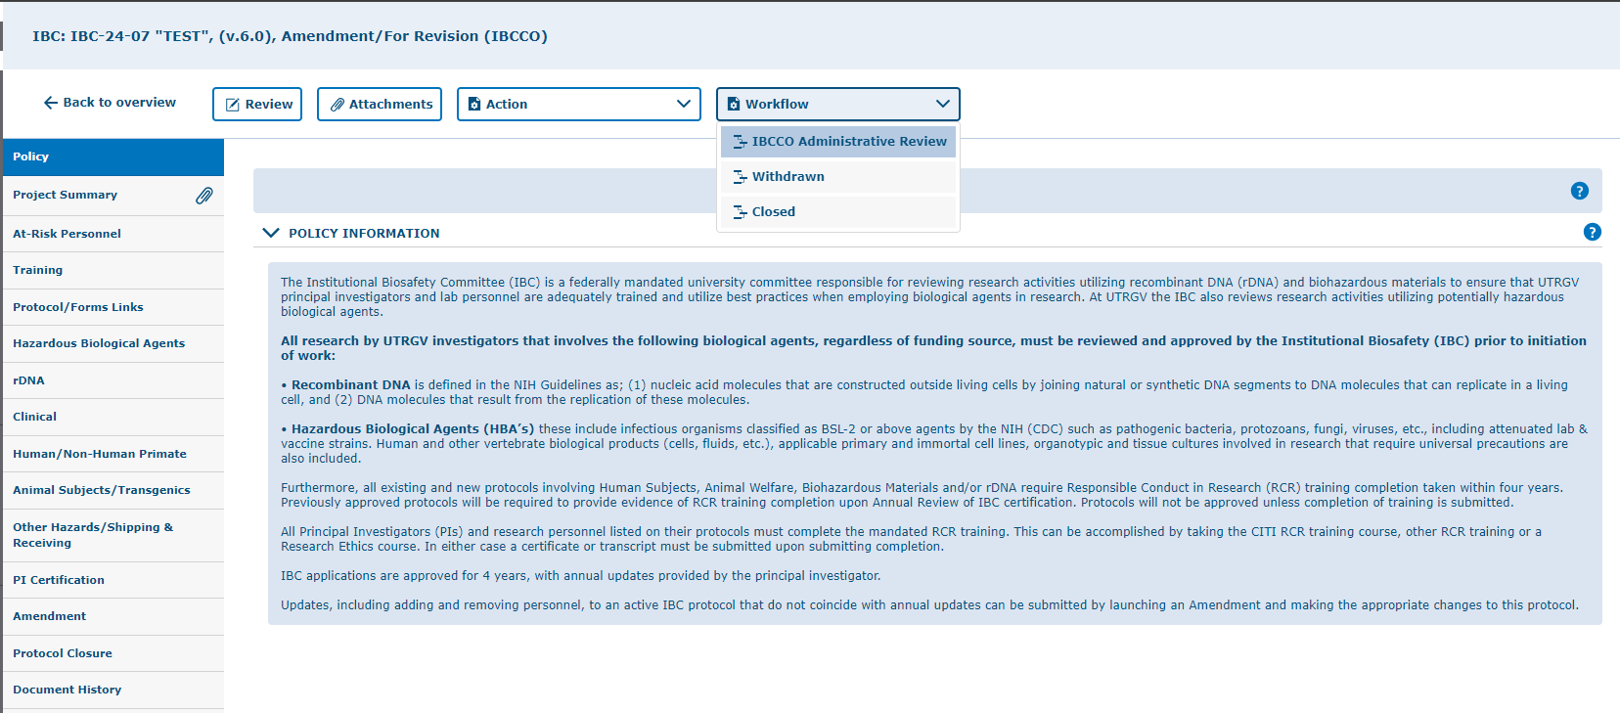
Click on “Workflow” and select “IBCCO Administrative Review.”

Slide 41
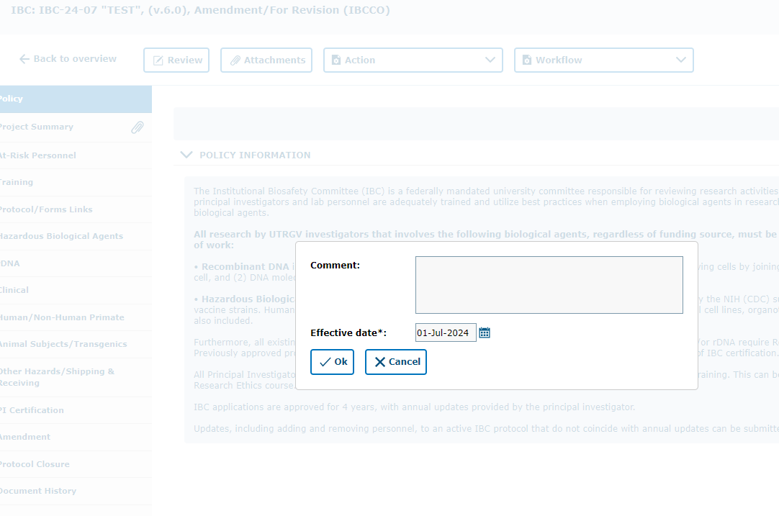
Adding a comment description in this box serves to communicate with the next Workflow user.
Write a comment inside the text box, and click “Ok”
Please use this box to communicate with the next Workflow user.

Slide 42
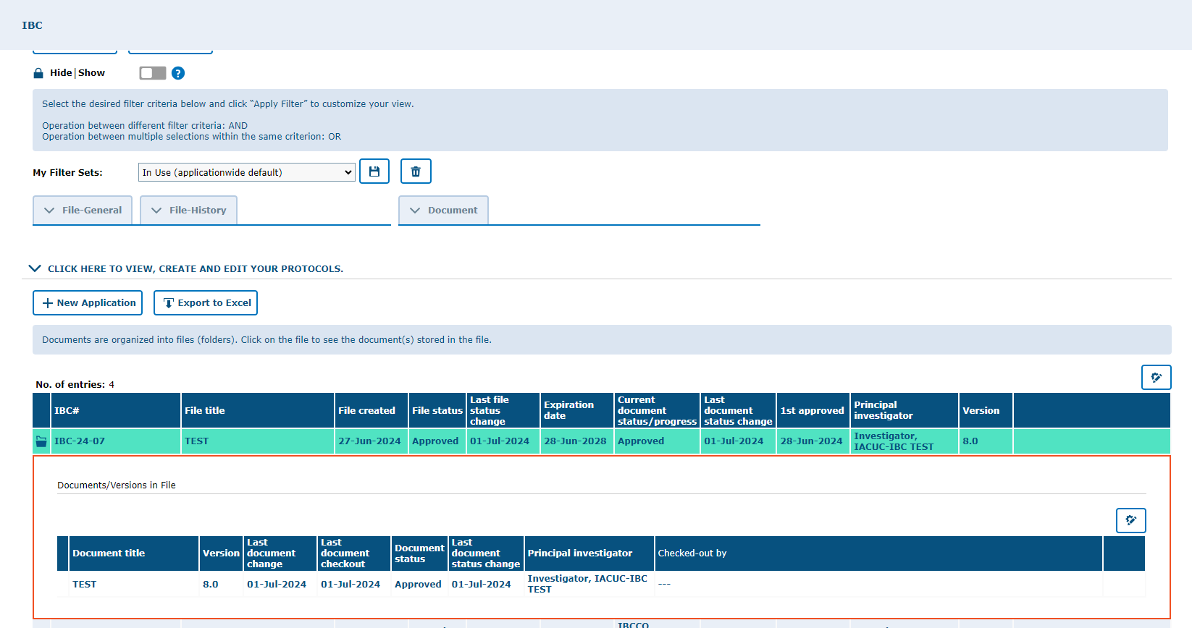
Once your revisions are completed and received, your submission will be re-reviewed. If your revisions are not sufficient or something was missed, the protocol will be returned to you for additional editing.
Once approved, you will receive an email notification and your amendment will disappear from the ‘In Progress (for all users)’ list.
Approved Projects are located under the “In Use” section on My Filter Sets.

Slide 43
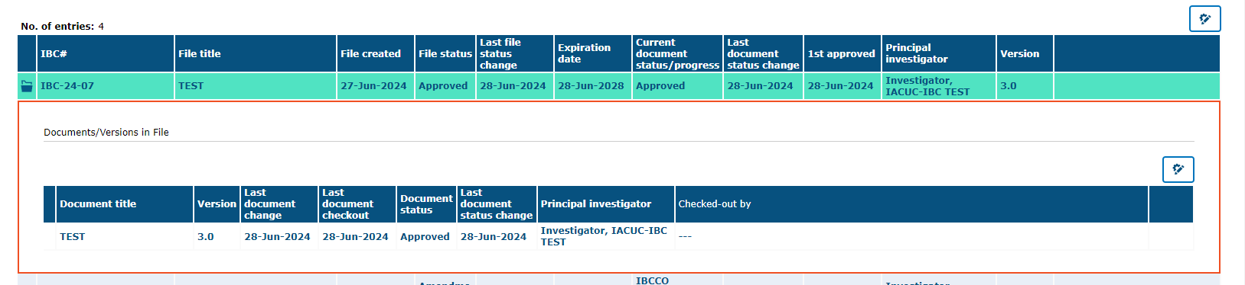
This is an example of how your approved amendment will look like on tick@lab, "In Use" filter
***Amendment has been APPROVED***

Slide 44

Thank you !
Office of Research Compliance
Amy Mutore
IACUC/IBC Coordinator
(956)665-2889
amy.mutore@utrgv.edu
Monica Barrera
IACUC/IBC Specialist
(956)665-7873
monica.barrera01@utrgv.edu
Please contact Amy or Monica for assistance regarding submitting an amendment to your protocol. We are always happy to meet via Zoom or Teams to walk you through the process and answer any questions!

