Slide 1
Committee Members
IBC Training
IBC Tick@LAb

Slide 2

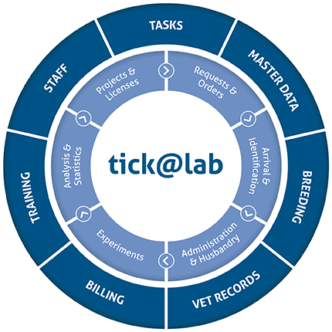
https://lar.utrgv.edu/tickatlab/default.aspx
tick@lab URL
Log in using your UTRGV credentials.

Slide 3
Access to tick@lab is not Automatic
If you are new to working with the tick@lab system, then you will need to complete an access request form via IT.
Click HERE or on the link below for instructions on how to request tick@lab access:
Submitting your access request for tick@lab (utrgv.edu)
If you are unable to log-in please contact the Amy Mutore or Monica Barrera for assistance at ibc@utrgv.edu, amy.mutore@utrgv.edu, or monica.barrera01@utrgv.edu.

Slide 4
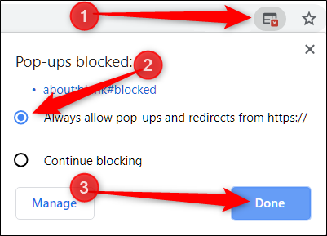
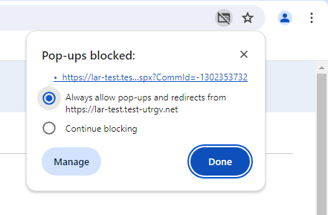
IMPORTANT NOTE:
    Follow the steps
Remember to allow pop-ups in your web browser.
If you do not allow pop-ups, the system will not work properly.

Slide 5
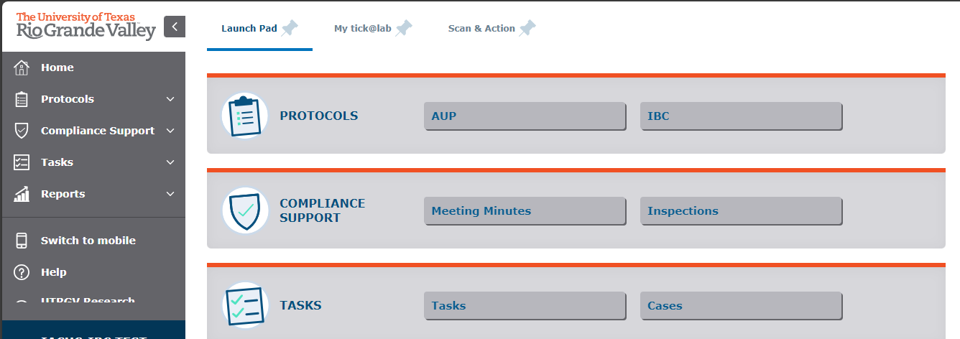
Getting Started
Click on “IBC”

Slide 6
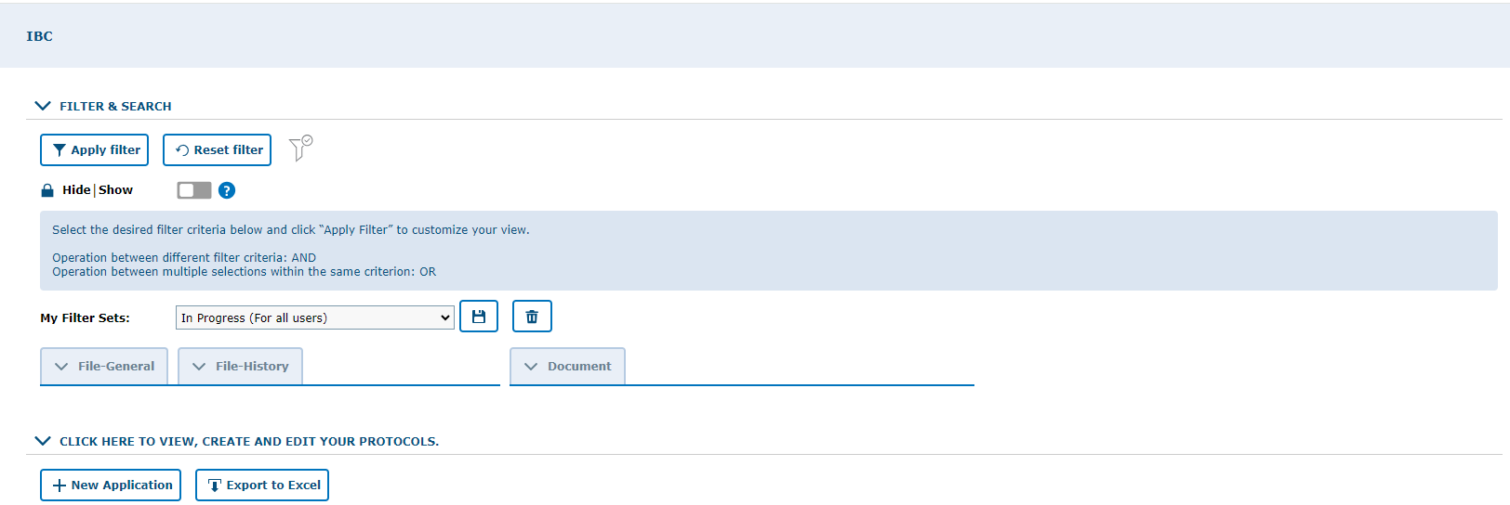
Make sure to work in the IBC tab
Make sure to select “In Progress (For all Users)”
Click to expand protocol lists

Slide 7
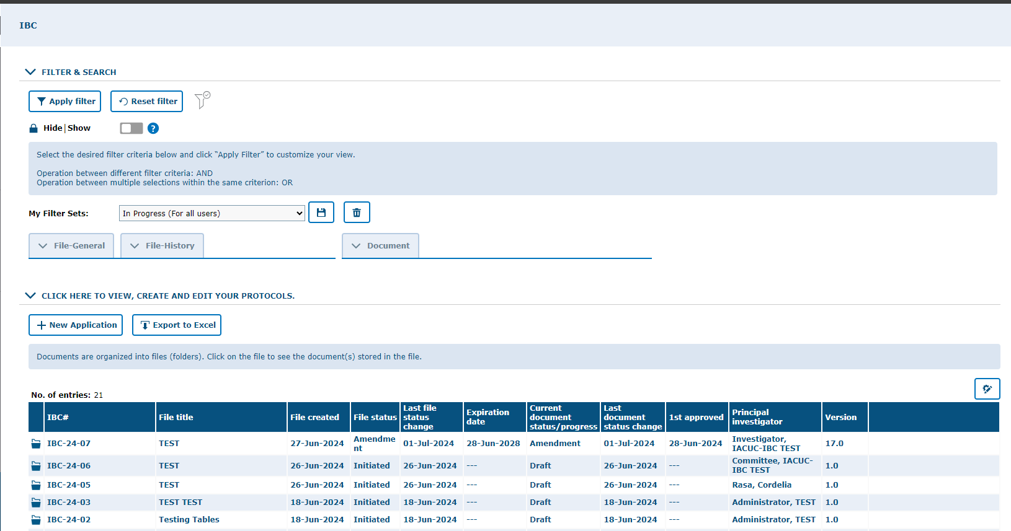
Scroll down to access the files in the protocol. Then, click on the designated protocol to review it.
List of IBC’s
“In Progress” protocols

Slide 8
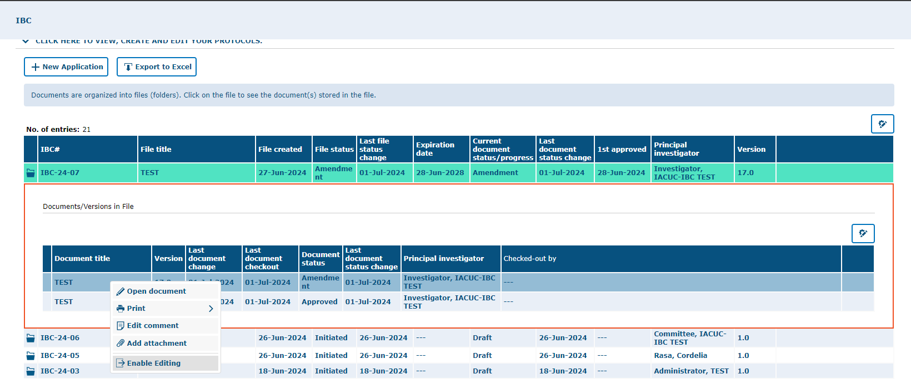
Right click on the protocol name and
select “Enable Editing”

Slide 9
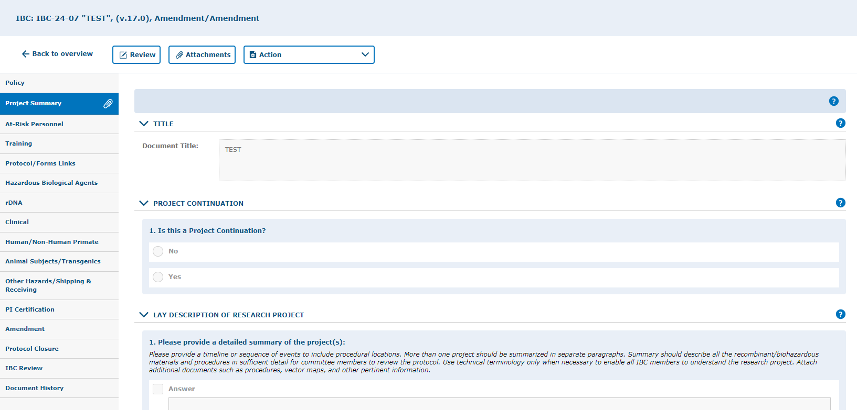
Reviewing a New (Initial) Protocol
*If you need assistance with any of the areas, please feel free to contact Amy or Monica at ibc@utrgv.edu.
Review each Tab

Slide 10
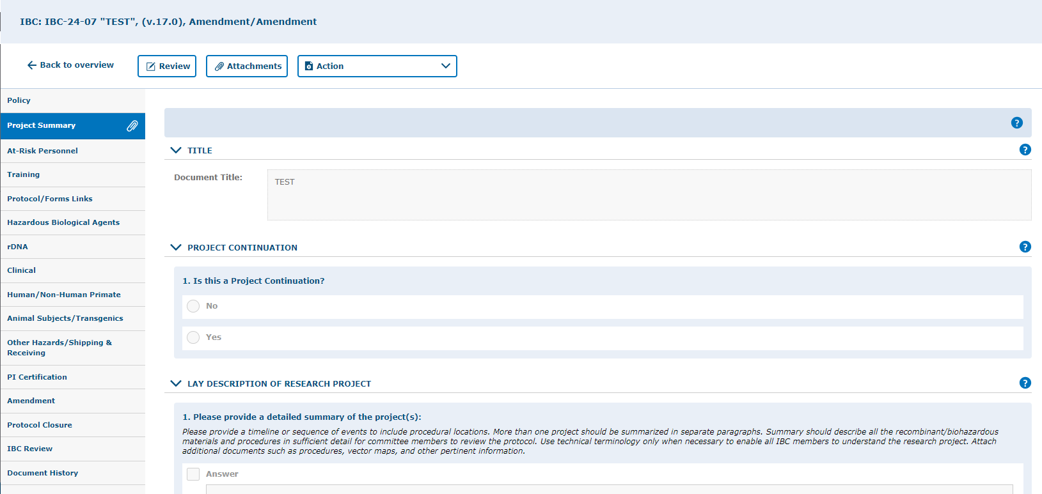
If you have any comments or concerns, you can add them in the review section.
Note: The review section will appear as a pop-up window. If you click on the “Review” button and nothing happens, the pop-up may have been blocked.

Slide 11
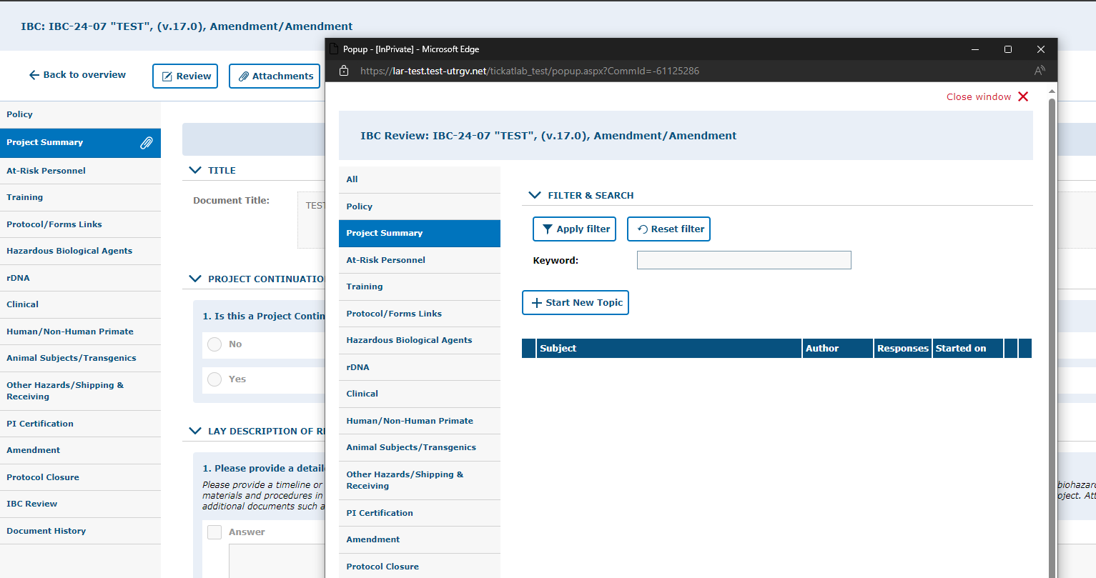
This is the pop-up you will see after clicking the Review button.
Click here to start a new comment.

Slide 12
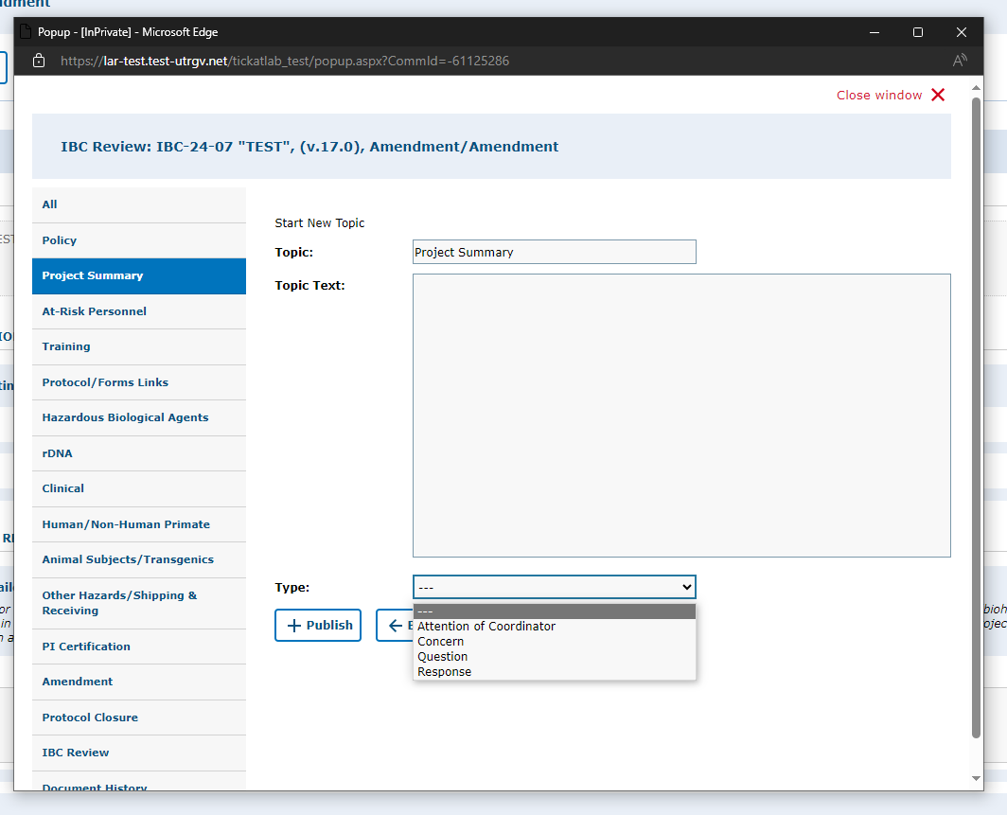
You can write questions, concerns, responses, and specific comments for each tab.
This will ensure the PI knows exactly where the revision is needed when they edit their protocol.
Write Text here

Slide 13
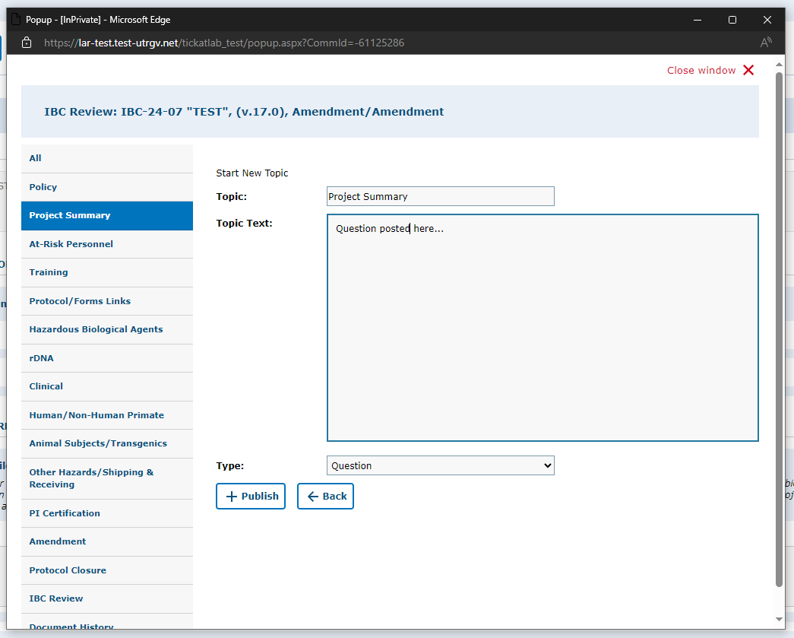
After writing your comments, questions or concerns, click “+Publish”.

Slide 14
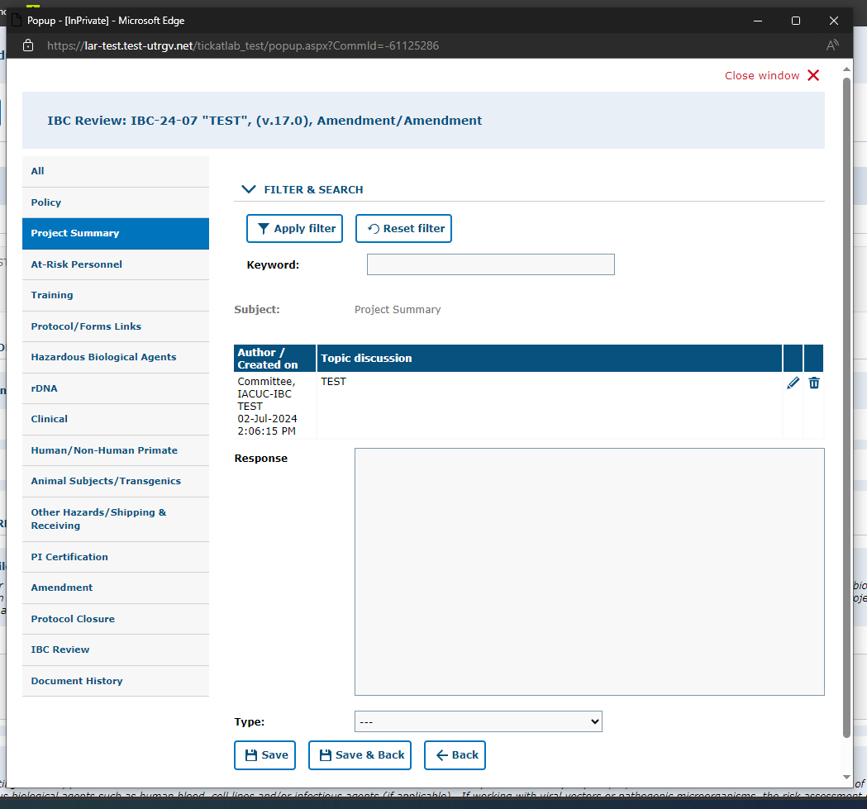
Make sure your comment has been posted and close the window.
Click on “Save and Back” if you wish to enter a question/comment on another tab.
If you find you need to add to your comment, click on the pencil icon to edit.

Slide 15
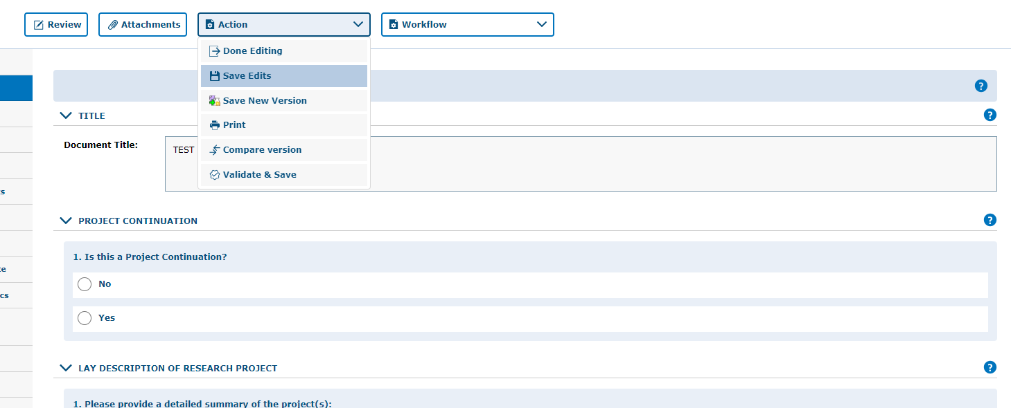
Once you’ve reviewed the protocol and entered any comments, be sure to save your work by selecting the “Action” button and clicking on either “Done Editing” or “Save Edits.”

Slide 16
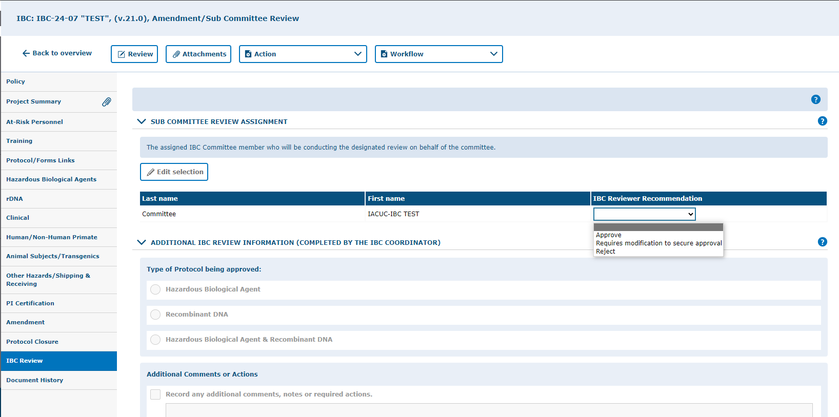
As a sub-committee reviewer, once you have reviewed the protocol, a protocol recommendation can be entered under “IBC Review Recommendation” within the IBC Review tab.
Admin. Note: This slide needs to be edited to contain the correct review process decided on by the committee
Options available:
-Approve
-Requires Modifications to Secure Approval, or
-Reject
Remember to click on “Save Edits” or “Done Editing” under the “Action” button to ensure your selections are saved.

Slide 17
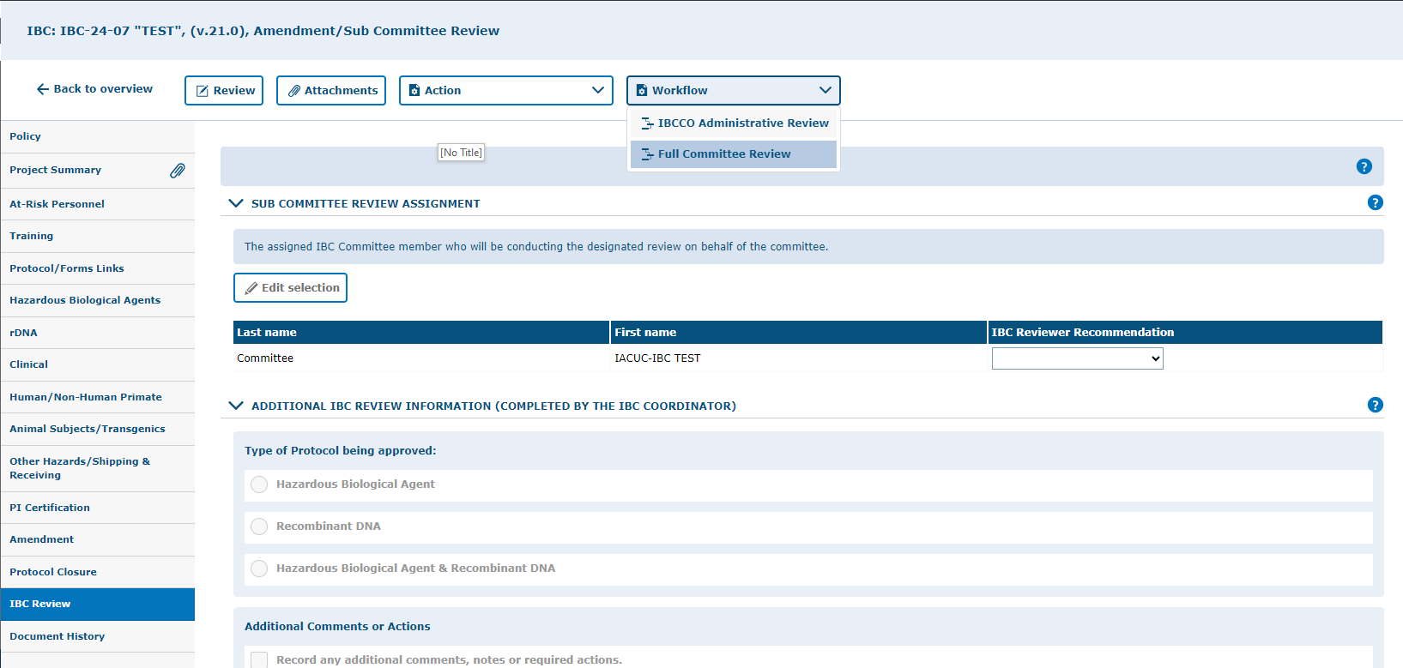
If you determine the protocol must be reviewed under Full Committee Review, you can choose that option under the “Workflow” button.
Otherwise, you can send it back to “IBCCO Administrative Review.”
Admin. Note: This slide needs to be edited to contain the correct review process decided on by the committee

Slide 18
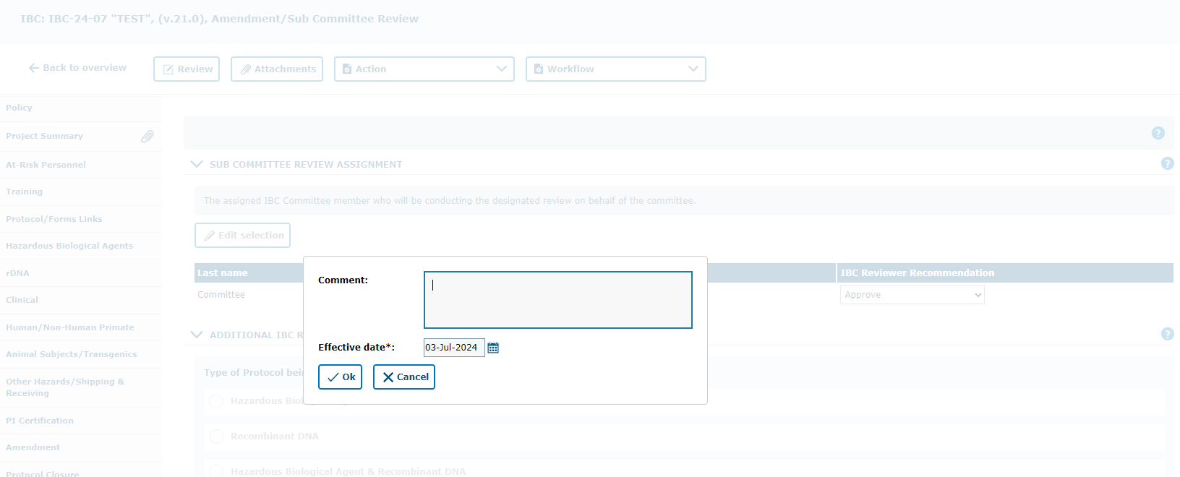
Enter a comment within the comment box.
This helps the IBCCO Admin. identify what the determination of the protocol has been.
Click “Ok” when done.

Slide 19
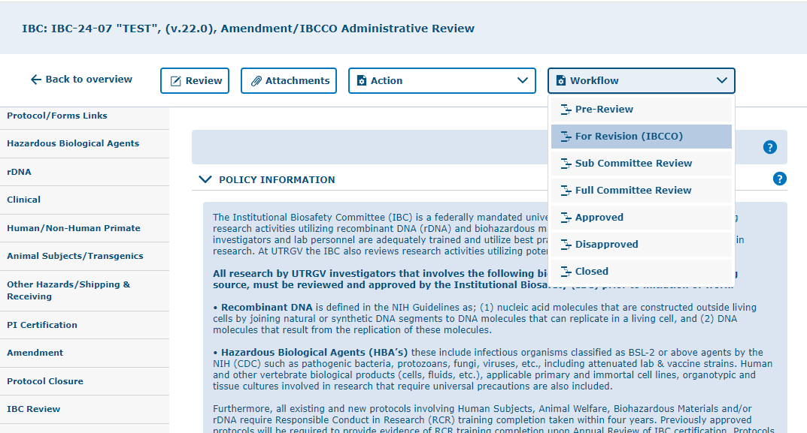
If revisions are required by the PI, the IBCCO Administrator will forward the protocol back to the PI for review.

Slide 20
Annual Reviews and Amendments
Reviewing for any submitted changes

Slide 21
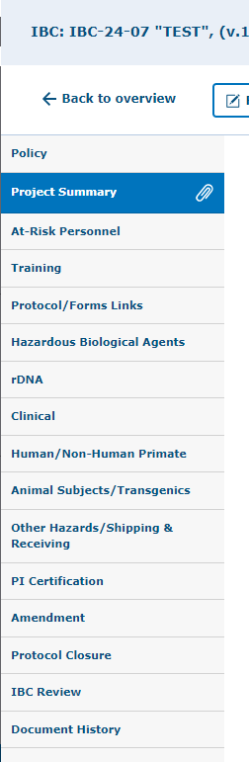
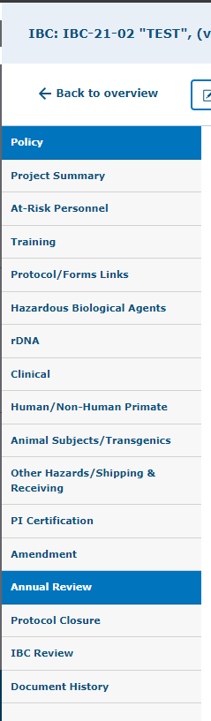
When reviewing a protocol in Amendment or Annual Review, please do the following:
If protocol is an Amendment, click on the “Amendment” tab and review the changes listed.
  Verify that changes mentioned in Amendment tab have been entered in their respective areas of the protocol. i.e. a change in procedure should be listed within the “Procedures” tab.
If protocol is an Annual Review, click on the “Annual Review” tab and review the information entered.
  If no changes are listed, then no further review will be needed. If changes were listed, verify the listed changes have been entered in their respective areas on the protocol.

Slide 22
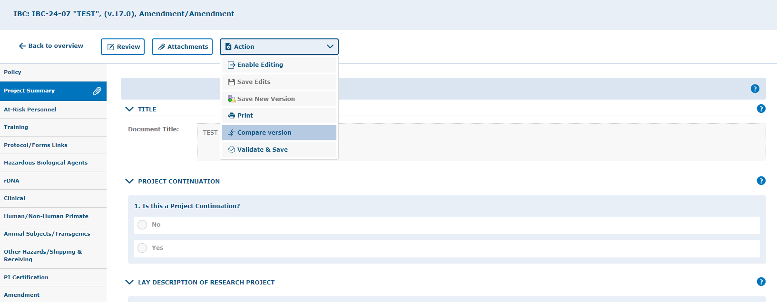
“Compare version”
Select this option to compare two versions of a document with each other.
Document can be compared to the most recent approved document to get a view of what changes, if any, have been made.
This feature is especially helpful when reviewing annual renewals and amendments.

Slide 23
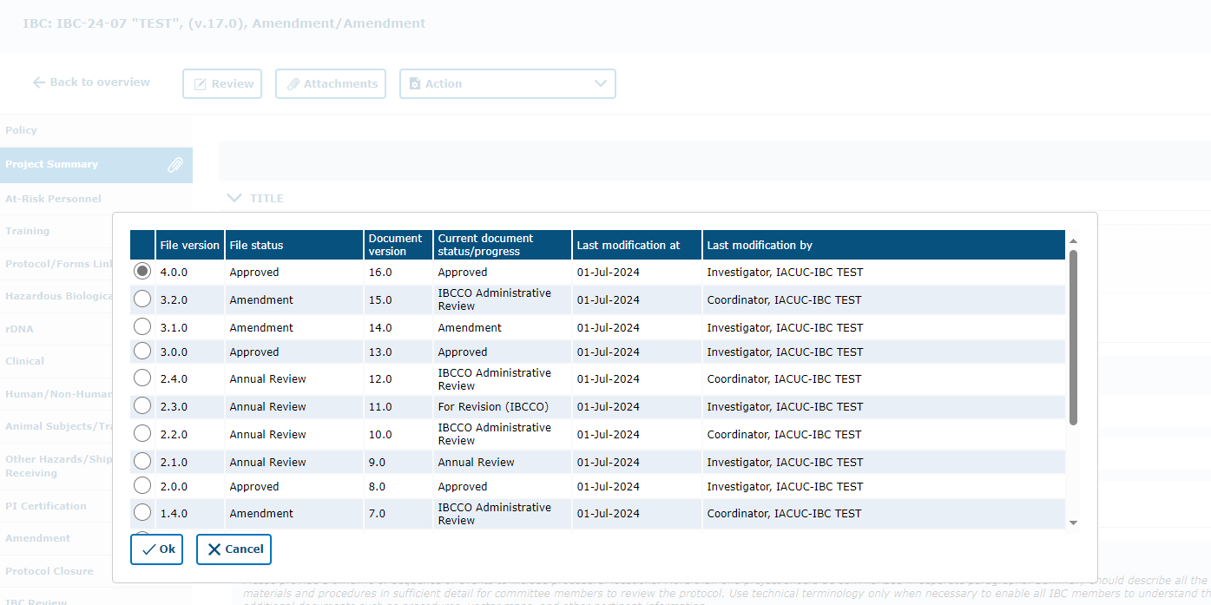
Select document version then Click “Ok” to start comparing.

Slide 24
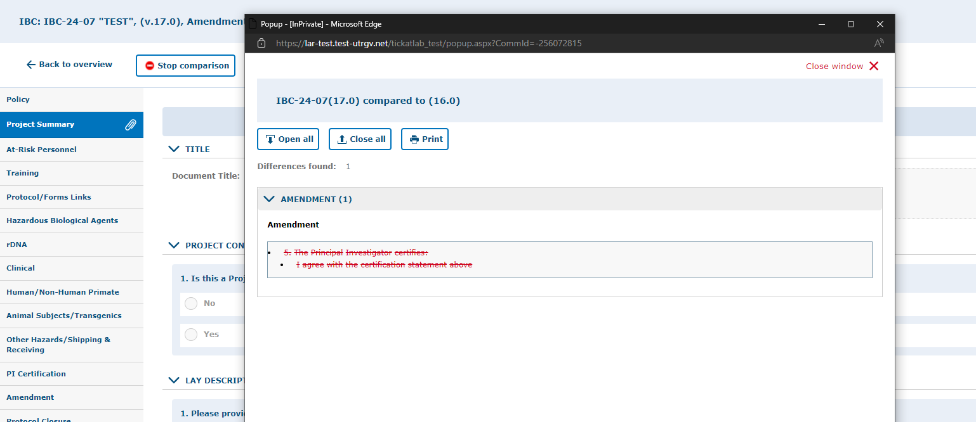
Once you are done viewing the changes, you can click on “Stop Comparison” to go back to the protocol.
A pop-up window will show the areas where changes have been made and will detail specifically what was changed. These changes should also be listed within the protocol.

Slide 25
As with Initial Protocol reviews, if you have any comments or concerns, you can add them in the review section by following the steps detailed on slides 11-14.

Slide 26
Once you have reviewed the protocol and entered any comments, remember to save all work by selecting the “Action” button and clicking on either “Done Editing” or “Save Edits.”

Slide 27
As a sub-committee reviewer, once you’ve reviewed the protocol, you can enter your recommendation under “IBC Review Recommendation” within the IBC Review tab.
Admin. Note: This slide needs to be edited to contain the correct review process decided on by the committee
You can select:
-Approve
-Requires Modifications to Secure Approval, or
-Reject
Remember to click on “Save Edits” or “Done Editing” under the “Action” button to ensure your selections are saved.

Slide 28
If you determine the changes detailed in the Annual Review or Amendment protocol must be reviewed under Full Committee Review, you can choose that option under the “Workflow” button.
Otherwise, you can send it back to “IBCCO Administrative Review.”
Admin. Note: This slide needs to be edited to contain the correct review process decided on by the committee

Slide 29
Enter a comment within the comment box.
This helps the IBCCO Admin. identify what the determination of the protocol has been.
Click “Ok” when done.

Slide 30
If revisions are required by the PI, the IBCCO Administrator will forward the protocol back to the PI for review.

Slide 31


Trainings
Trainings required by PIs and all listed research personnel will be verified by IBC Administrative personnel.

Slide 32
Thank you !
Office of Research Compliance
Amy Mutore
IACUC/IBC Coordinator
(956)665-2889
amy.mutore@utrgv.edu
Monica Barrera
IACUC/IBC Specialist
(956)665-7873
monica.barrera01@utrgv.edu
Please contact Amy or Monica for assistance in reviewing protocols. We are always happy to meet via Zoom or Teams to walk you through the process and answer any questions!

