Slide 1
Submission of IBC/HBA Protocols
IBC Tick@LAb

Slide 2
Content:
Access to tick@lab
Starting your protocol
Adding personnel
Application Sections
Attachments
Validating and Saving
Reviewer Feedback
Resubmitting a Protocol

Slide 3
Access to tick@lab

Slide 4
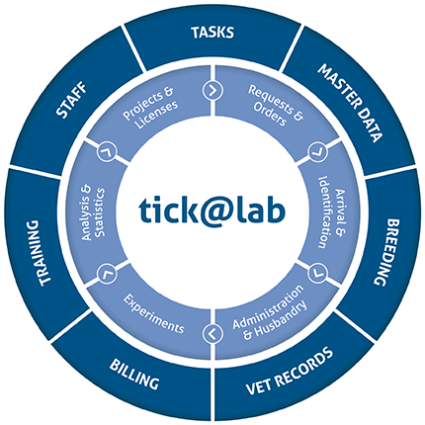

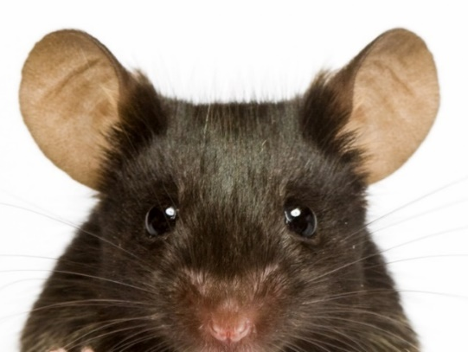

tick@lab URL
https://lar.utrgv.edu/tickatlab/default.aspx

Slide 5
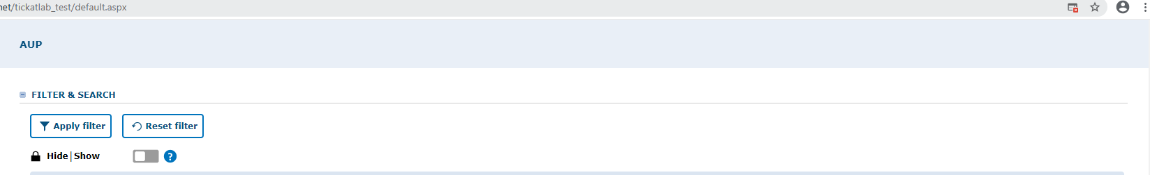

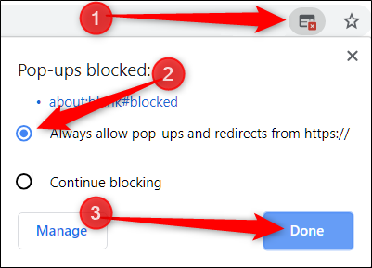
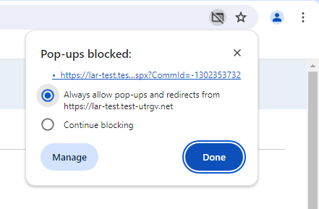
Allow Pop-Ups
Reminder: Allow Pop-ups to open new windows.
Follow the steps.

Slide 6
Access to tick@lab is not Automatic
If you are new to working with the tick@lab system, then you will need to complete an access request form via IT.
Click HERE or on the link below for instructions on how to request tick@lab access:
Submitting your access request for tick@lab (utrgv.edu)
If you are unable to log-in please contact Amy Mutore or Monica Barrera for assistance at ibc@utrgv.edu, amy.mutore@utrgv.edu, or monica.barrera01@utrgv.edu.

Slide 7
Starting your protocol

Slide 8
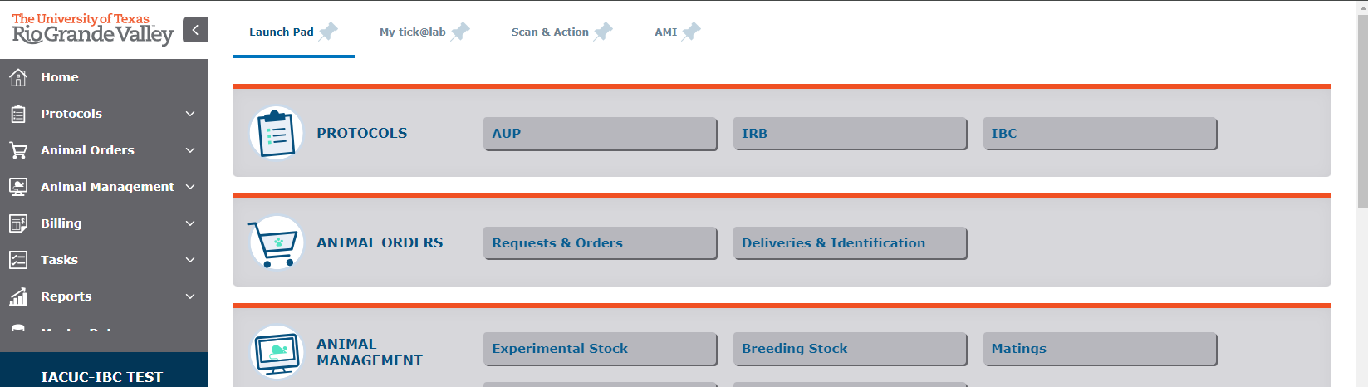
Getting Started
1. Click on “IBC”

Slide 9
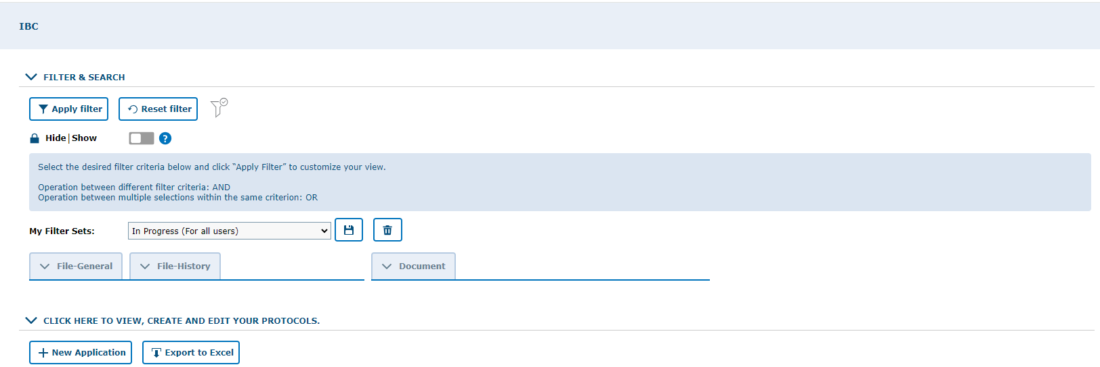
Make sure to work in the IBC tab
2. Make sure to select “In Progress (For all Users)”
3. Click to expand protocol lists

Slide 10
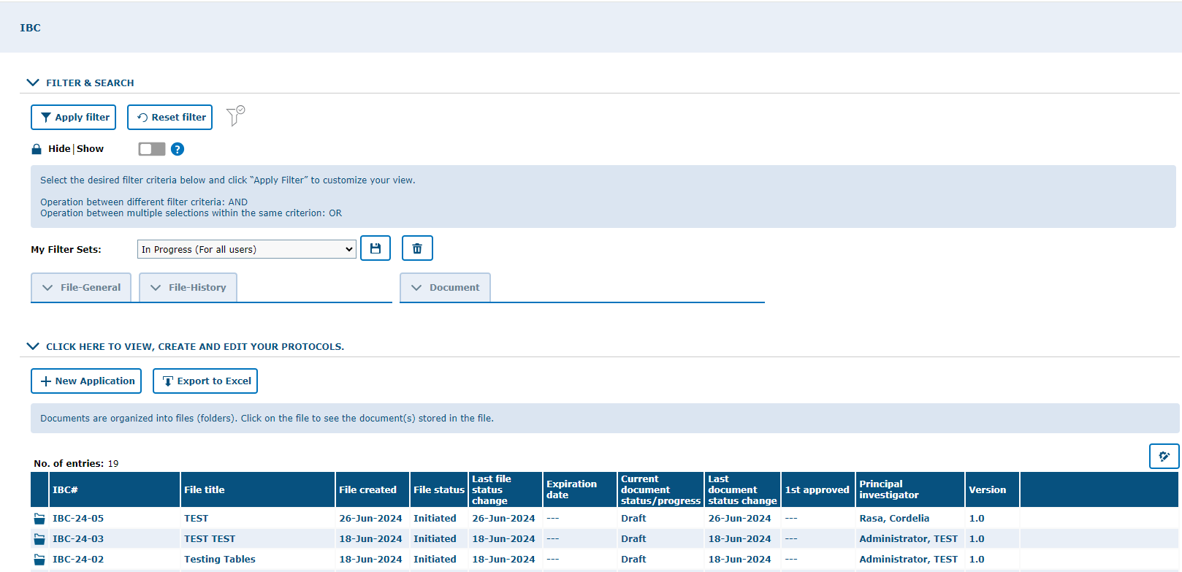
Creating a New Application
4. Click on “New Application”

Slide 11
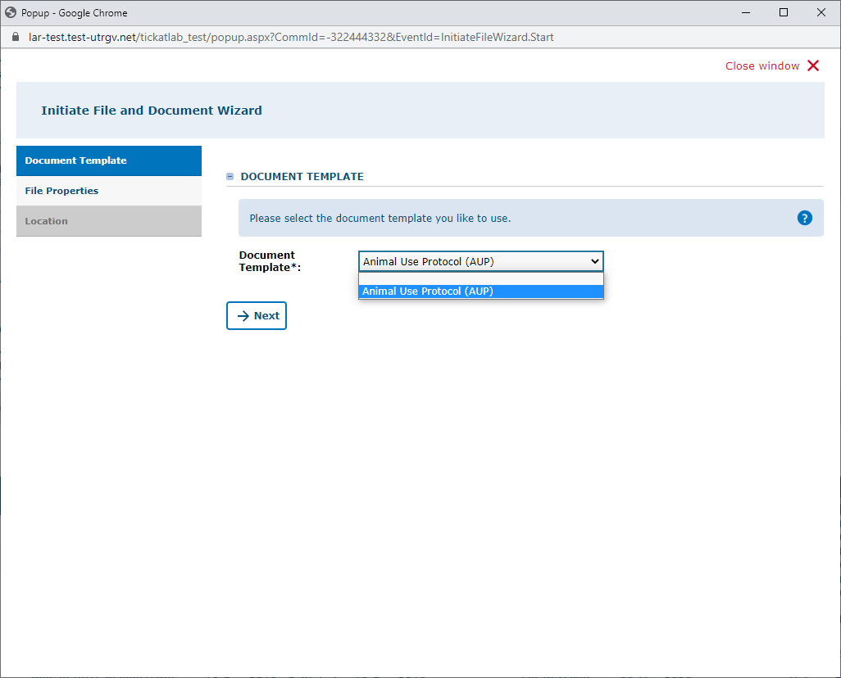
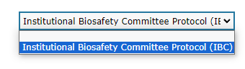
5. Select IBC protocol on the document template option
6. Click “Next”

Slide 12
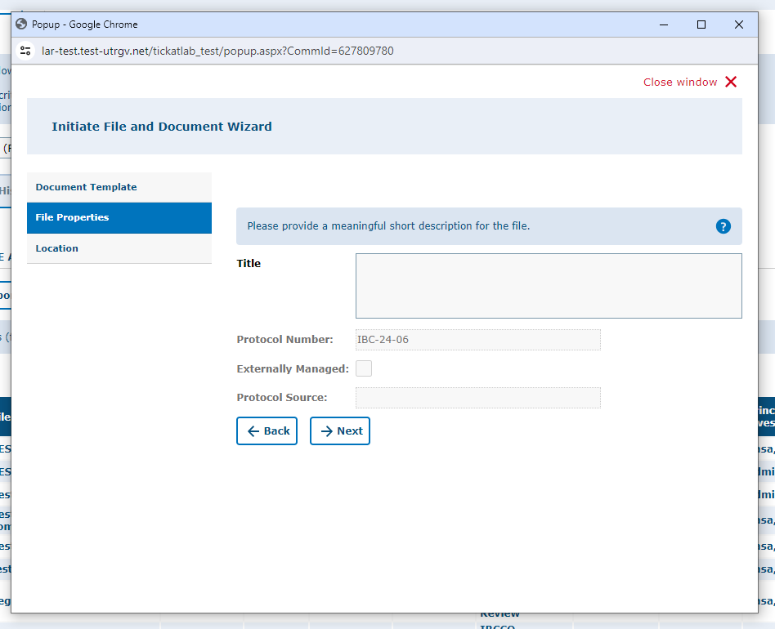
7. Click inside the box to title your IBC/HBA protocol
8. Click “Next”
NOTE: The protocol number will generate automatically.

Slide 13
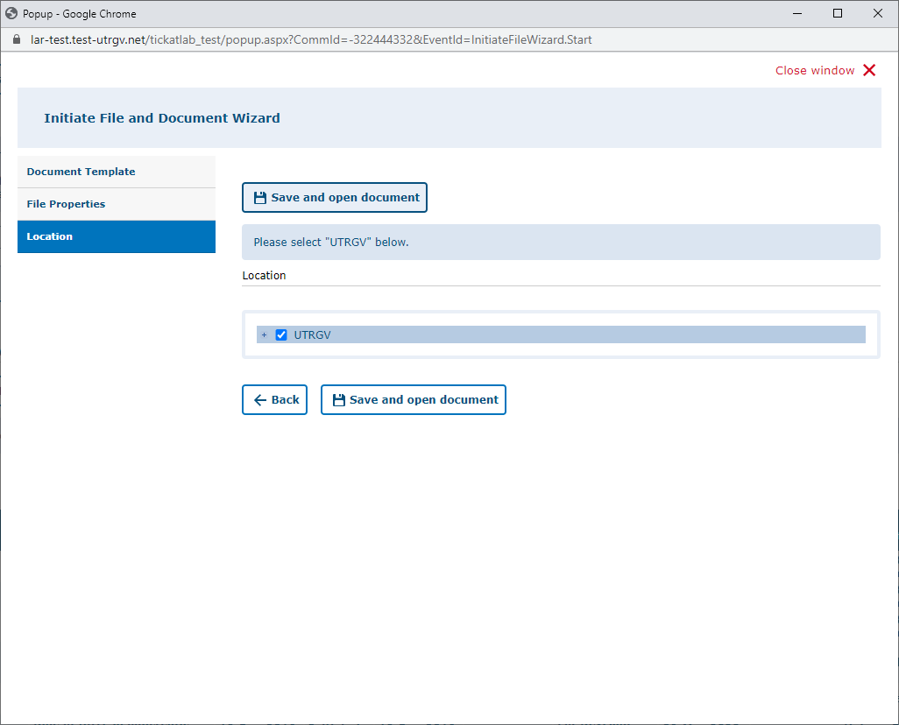
9. Select “UTRGV”
10. Click “Save and open document”

Slide 14
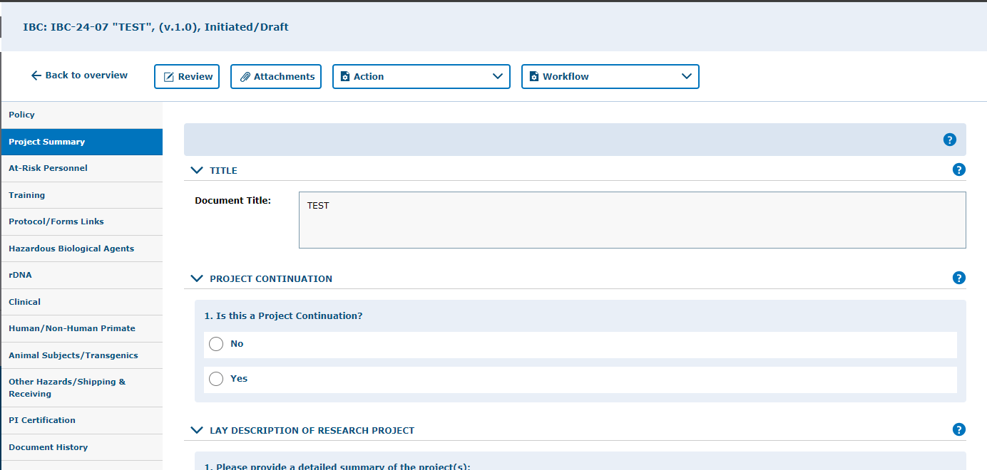
Note:
11. Click on “Project Summary” Tab
There are several tabs on the left side. These need to be reviewed and have each applicable field completed. Please note that some fields will be mandatory; tick@lab will not let the IBC/HBA be submitted if these are missing.

Slide 15
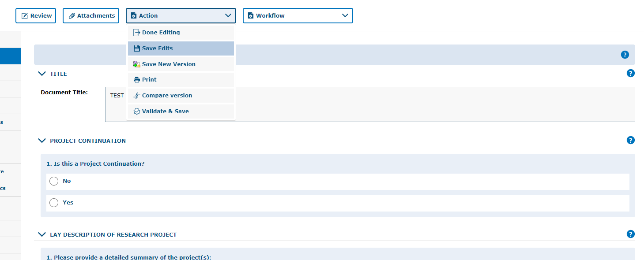

ALWAYS SAVE YOUR WORK!
Save Often, tick@lab does not save information automatically.
Make sure you save information after completing each tab.
12. Click on “Save Edits” under the “Action” button located in each tab
Note, that there are 4 ways to save forms:
  Done Editing: saves the file and checks the document in so that another person can check it out and edit it.
  Save Edits: saves the document and allows you to keep working on it.
  Save New Version: saves a separate and new version of the file (duplicate).
  Validate & Save: alerts you of any missing items in the protocol before saving.

Slide 16
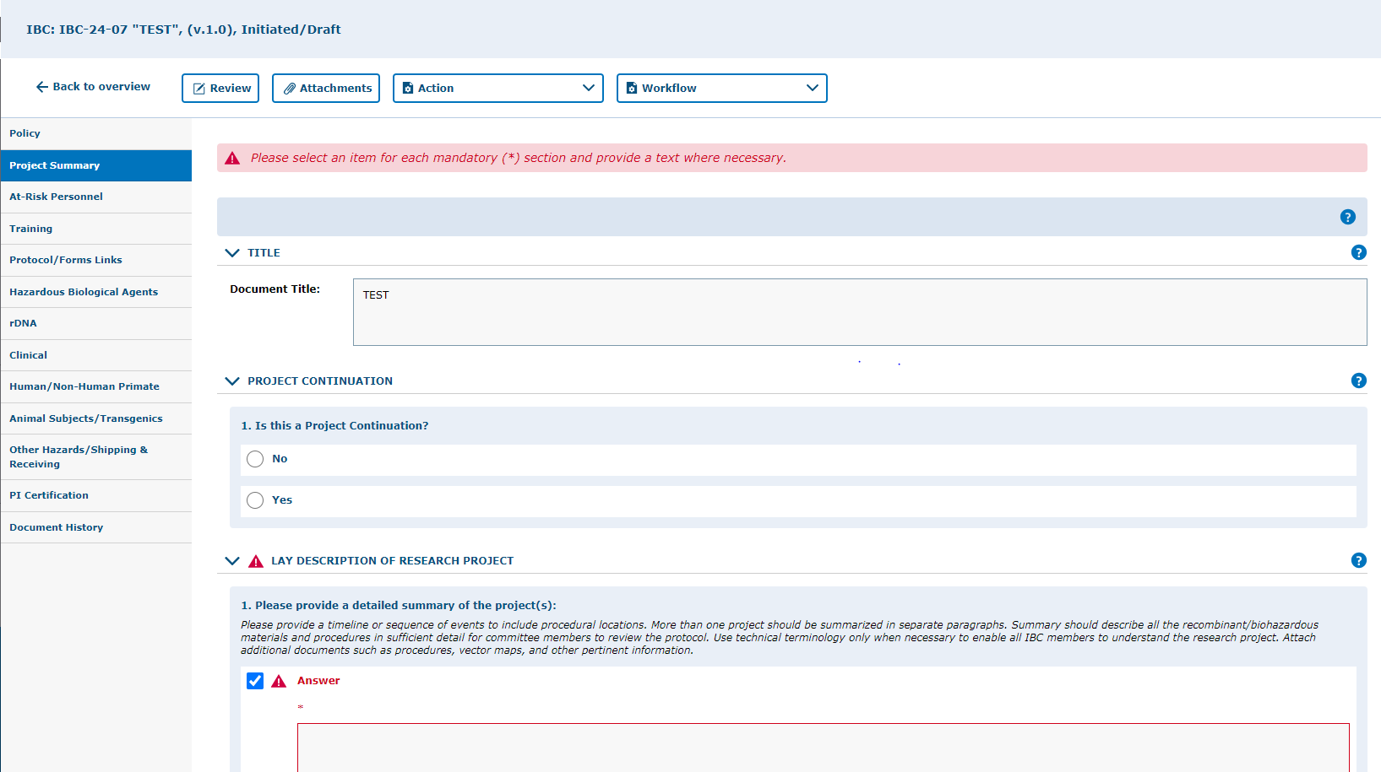
Example of error when there is missing information on a required field (s).

Slide 17
Adding Personnel
How to add project team members to protocol

Slide 18
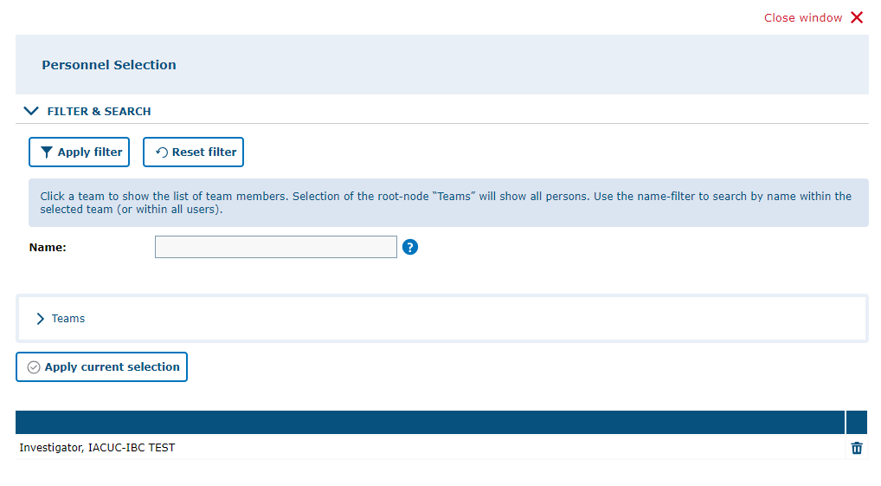
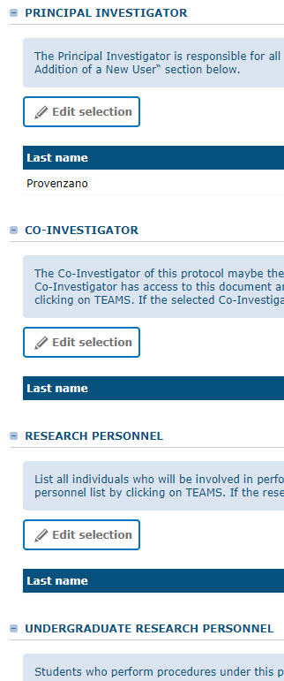
From the “At-Risk Personnel” Tab on the left, go into each of the questions and click “Edit selection” to
assign personnel as Co-Investigators, Key Personnel, Faculty Advisor and Reviewer and Signers
from the Pop-up window.
You can type the Name (first or last, or both) and click “Apply filter.” Or,
You can click on Teams and select from the list, then click on “Apply current selection”.
Note 1: You can add as many personnel as you want.
Note 2: If you cannot find a researcher from the list, there is a slight possibility that the researcher does not have access to tick@lab and will need to be manually added by Office of Research Compliance (ORC) staff. Please contact Office Research Compliance for assistance.

Slide 19
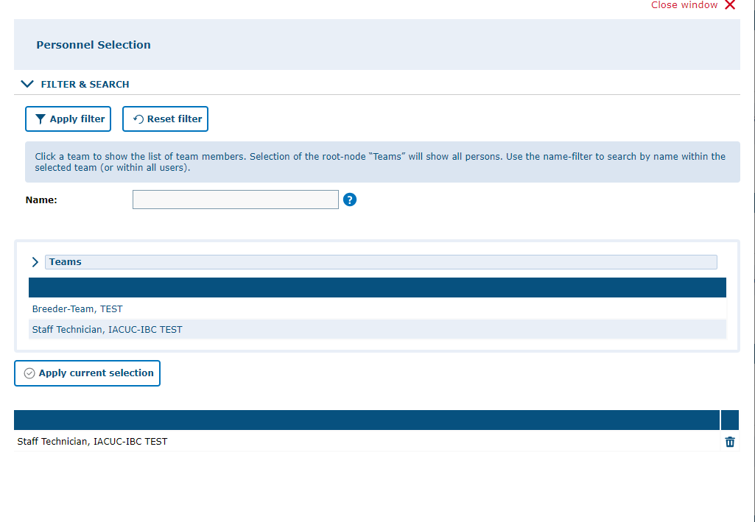
NOTE: To find personnel individuals, click on the word "Teams" to get the list.
You can also search for an individual's name using the fill-in field. Type in the name, then click on "Apply Filter."
Select the name of the person you are wanting to add. Their name will appear on the bottom. Then, click on "Apply Current selection" to add to the protocol. To add more than one individual, click on each name, then click on "Apply Current Selection' when done.

Slide 20
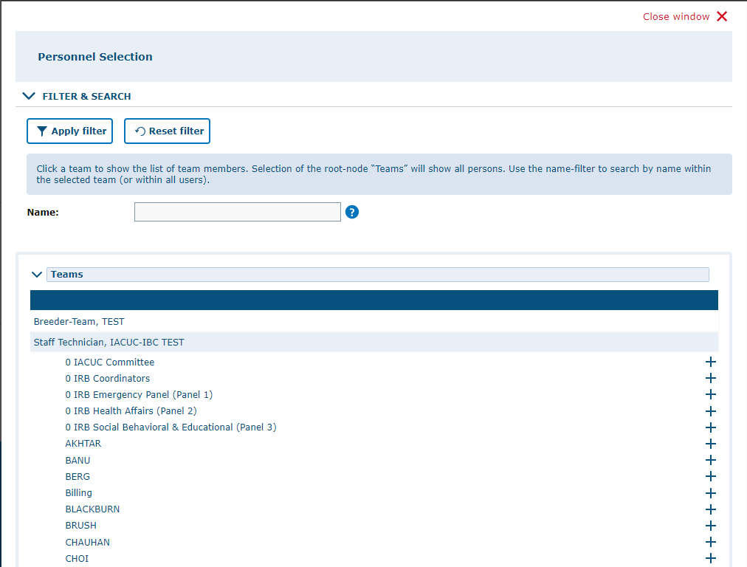
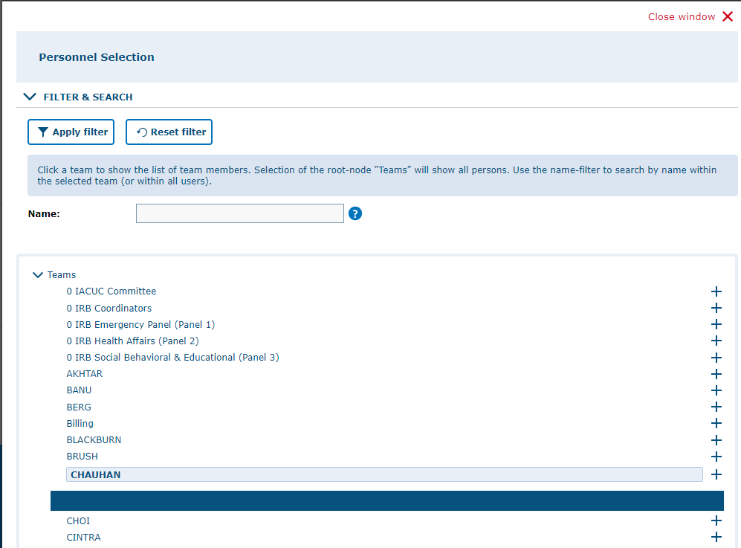
To add an entire team/group to a section, click on ">." When selected, the ">" turns to "v" and a list of PI teams will appear.
To view the members in the PI team, click on the PI name. i.e., to view Dr. PI's team, click on Dr. PI's name.
To add the team, click on the "+." The names will appear at the bottom.
Click on "Apply Current Selection" to add the personnel to the protocol.

Slide 21
Application Sections
Review and Answer the Different Sections of the Protocol

Slide 22
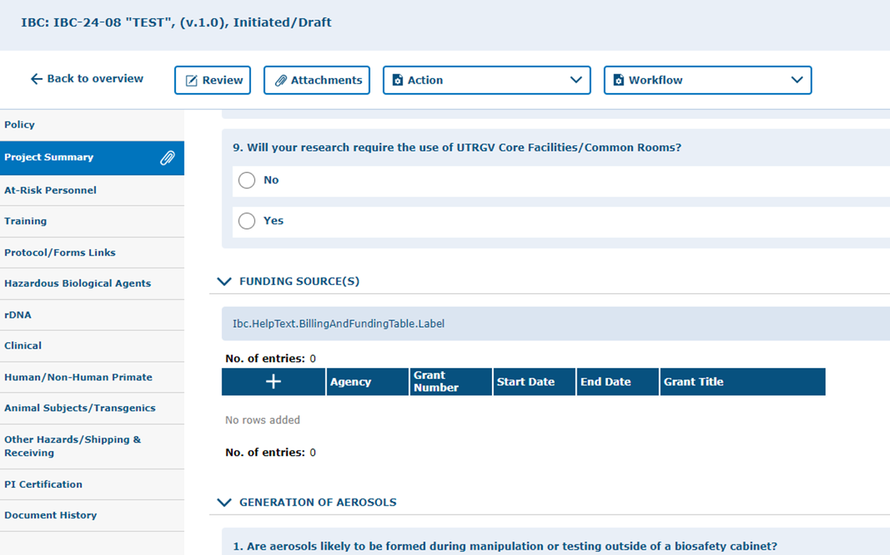

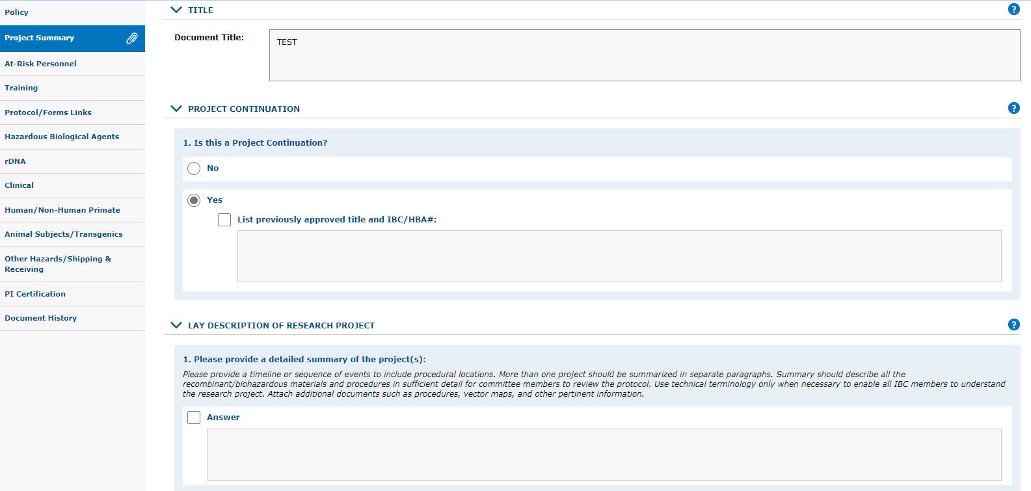
Click on “Project Summary” tab on left hand side, click on Edit Selection button to fill in information.
Click on the “+” and fill out the funding information areas.
Complete all applicable areas under the Project Summary page.
Be sure to provide a lay description that is as clear and as easily understandable as possible.
Enter funding source(s) is known.
Certain sections will expand with more questions if the answer to the initial question is "yes."

Slide 23
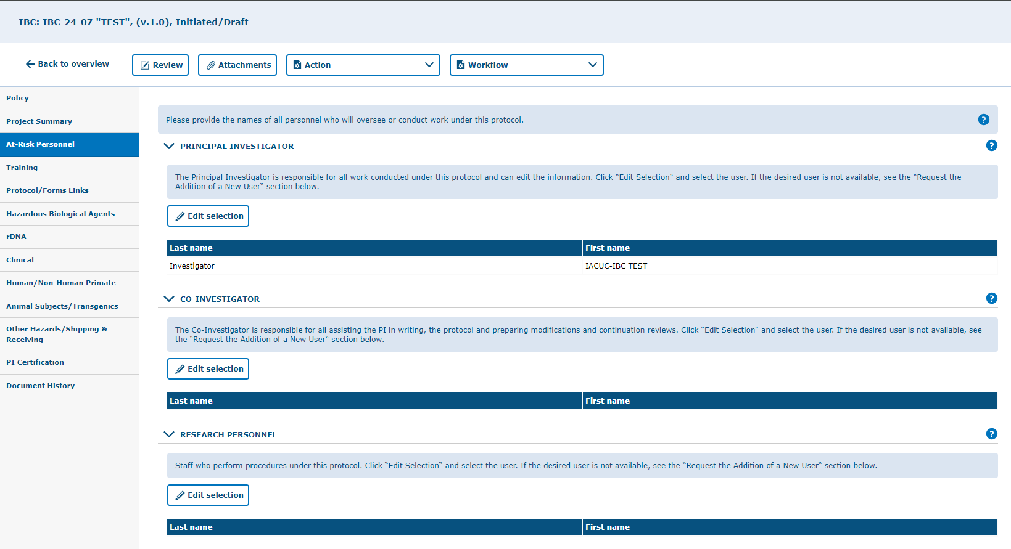
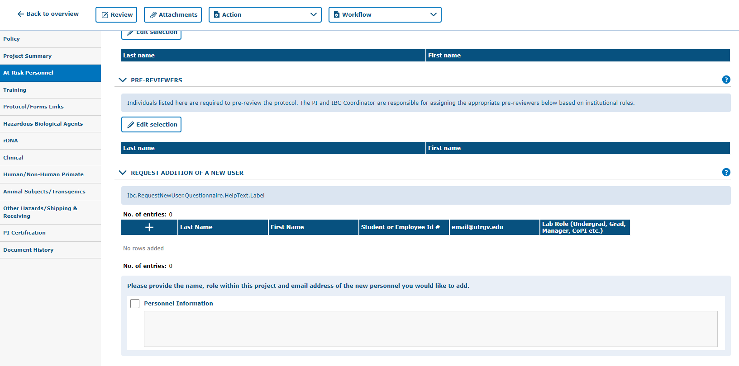
Click on “At-Risk Personnel” tab.
NOTE: Personnel listed at "Co-Investigator" will have the access to the entire protocol as the Principal Investigator and will be able to edit the protocol as well.
Under the Personnel tab, you will be able to add the individuals who will play a role in your IBC/HBA. Make sure to add them under the correct area (e.g., co-investigators, research personnel, or student research personnel). You can also add a peer reviewer. This will send the IBC/HBA to your colleague for review prior to sending the IBC/HBA to the IBC Coordinator. If a particular individual is not listed, add their name and role under the “Request Addition of a New User” section. DON’T FORGET TO SAVE!

Slide 24
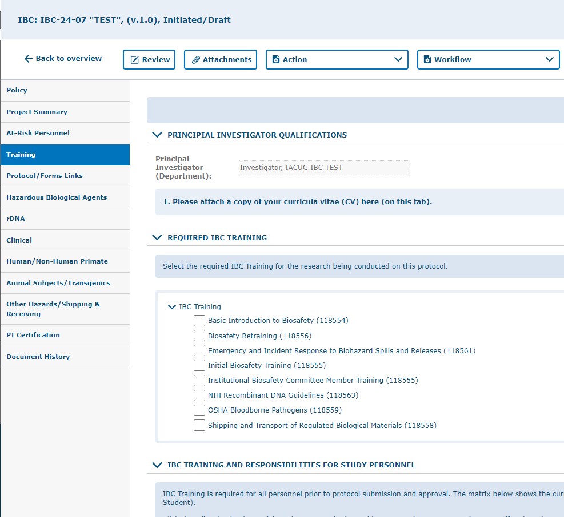
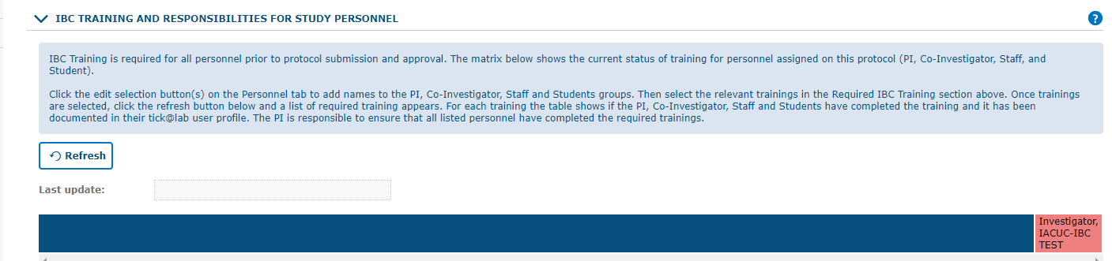
Click on “Training” tab.
MANDATORY for all involved in the IBC/HBA Protocol. Check with the IBC Office for more details on which trainings will be mandatory. Basic CITI Trainings and species-appropriate training must be completed for IBC/HBA approval. Click on the Refresh button to see which personnel is compliant or pending to complete the designated trainings. Remember to SAVE your work!

Slide 25
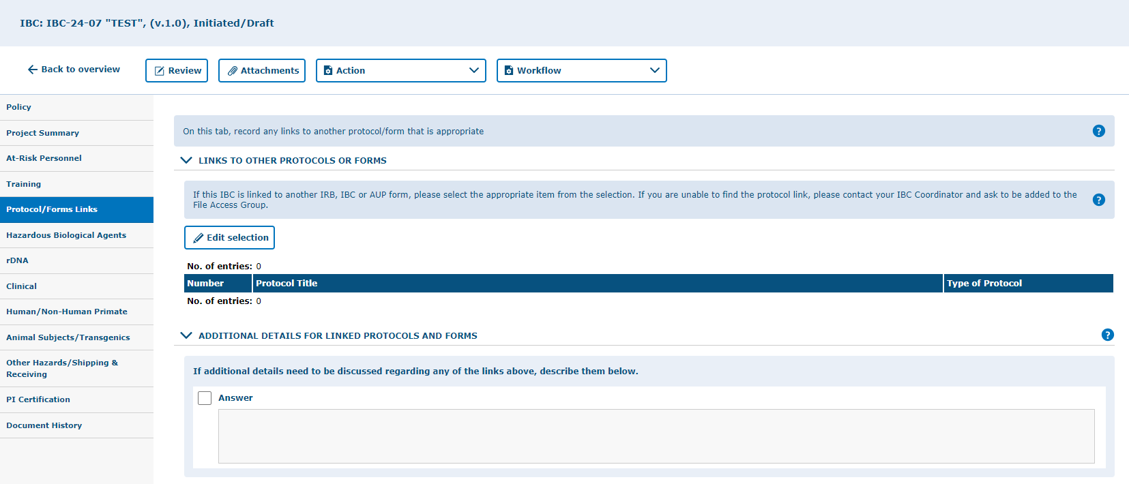
Click on “Protocol/Forms Links” tab.
Complete if applicable, direct your questions to the IBC Office. Remember to SAVE your work!

Slide 26
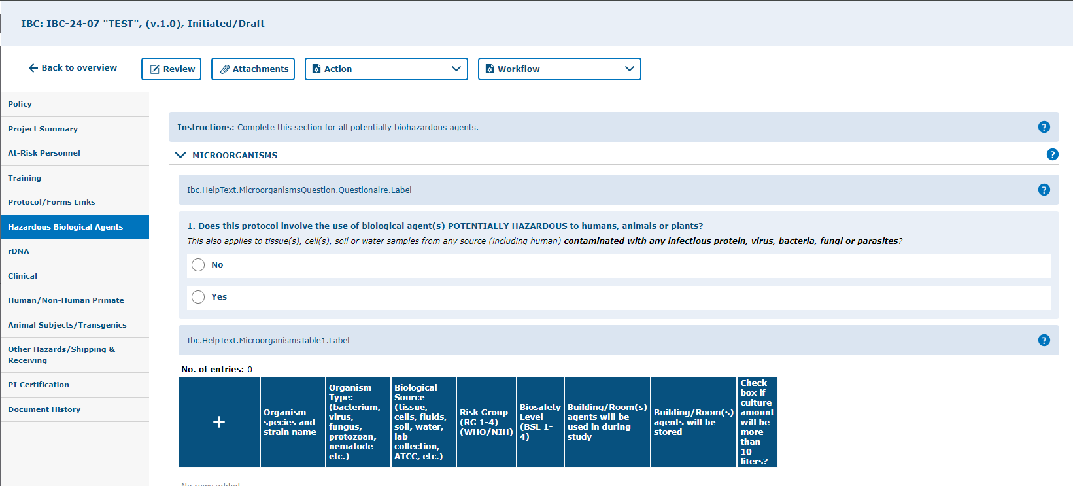
Click on “Hazardous Biological Agents” tab.
Complete this section if your protocol involves any potentially biohazardous agents. Remember to SAVE your work!

Slide 27
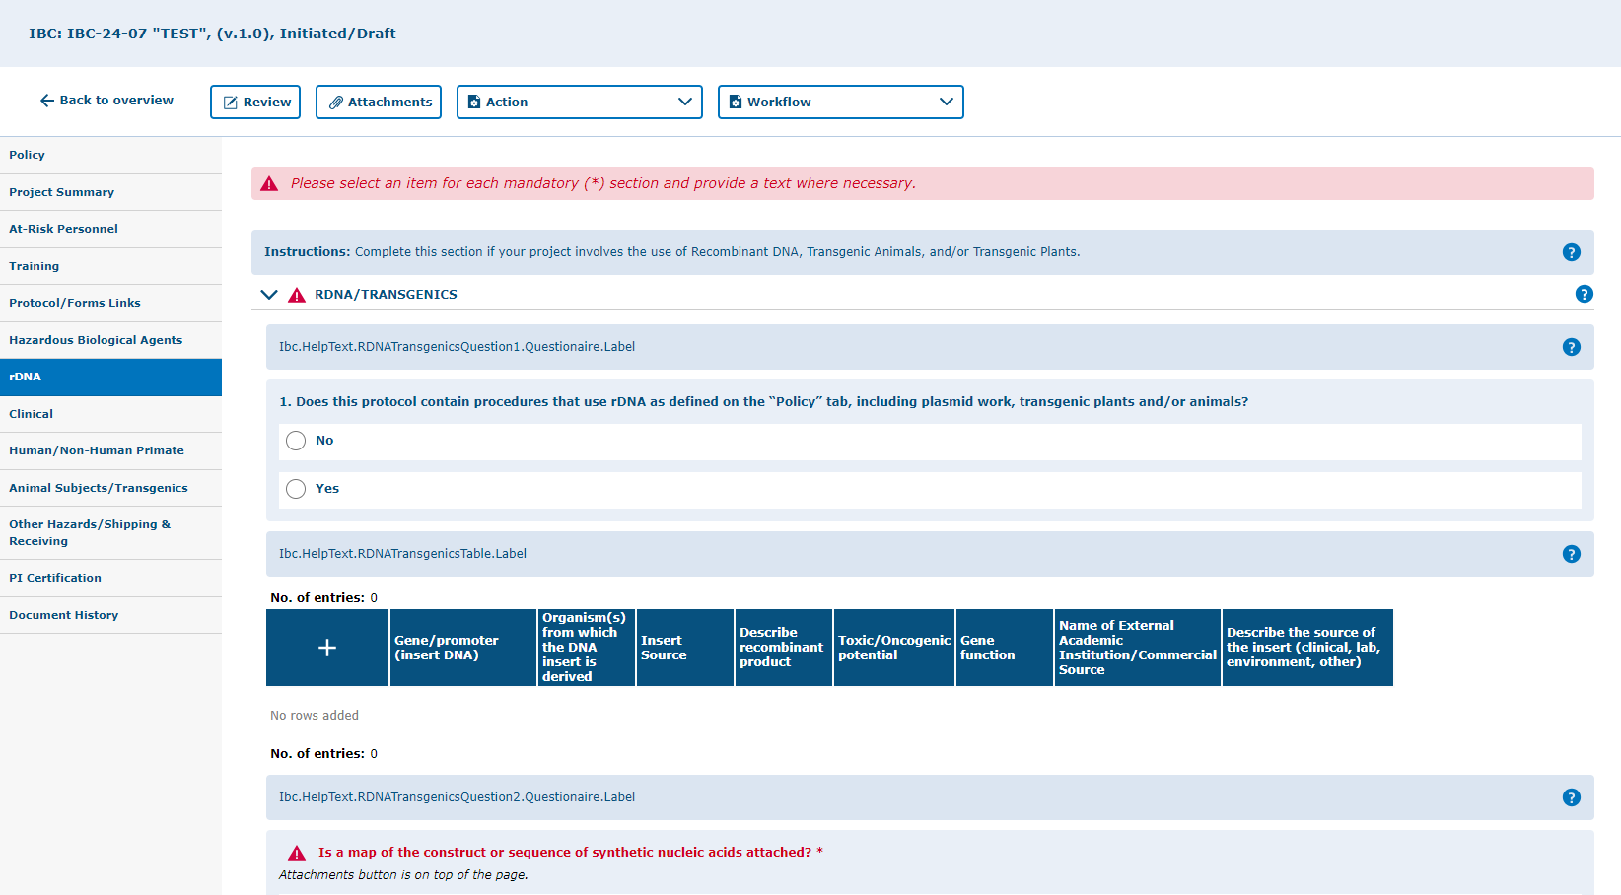
Click on the “rDNA” tab.
Complete the section in this tab if your project involves the use of Recombinant Nucleic Acids, Transgenic Animals, and/or Transgenic Plants. If you answer “yes” to number 1, the section will expand and show nested questions as well as tables that must be completed at the bottom of the page. Remember to SAVE your work!

Slide 28
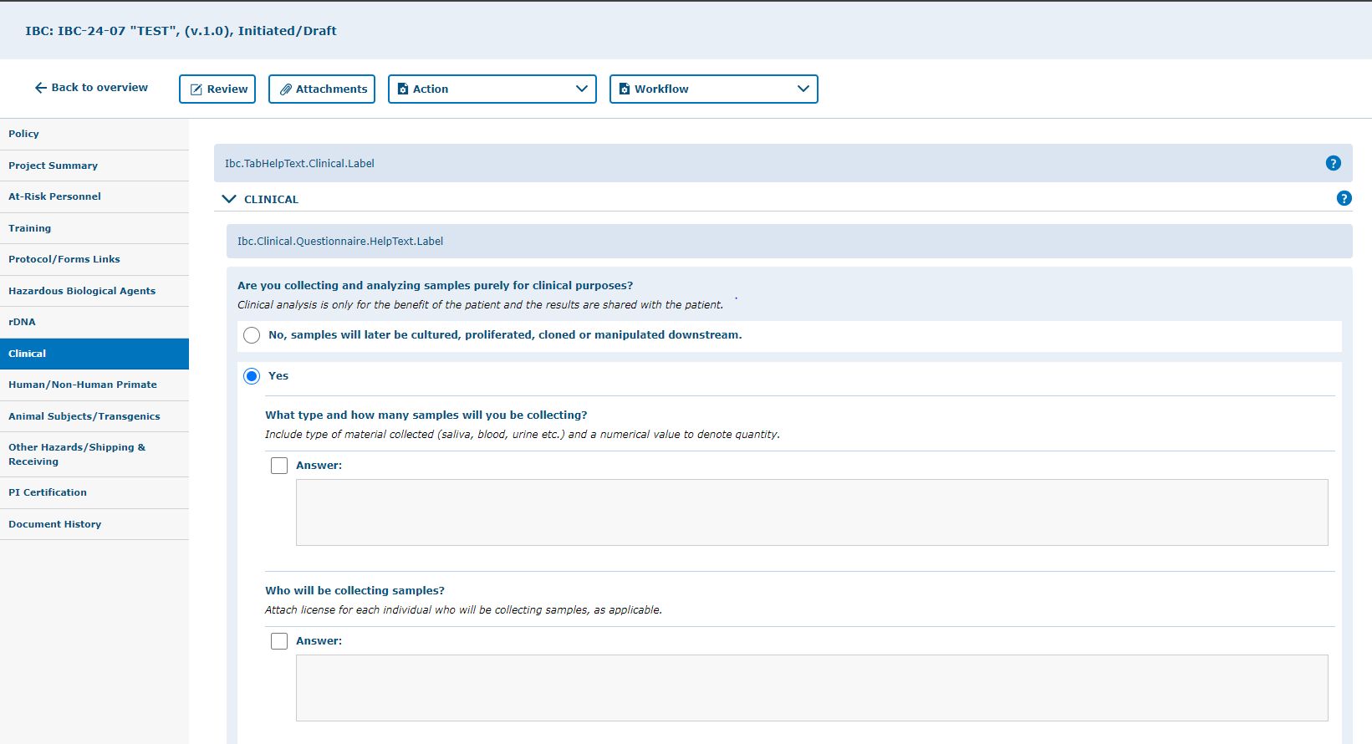
Click on the “Clinical” tab.
Complete this section if your protocol involves collecting and analyzing samples purely for clinical purposes. Answering “YES” will expand the section and show nested questions that must be completed if applicable. Note that human subjects research requires IRB approval. Remember to “SAVE” your work!

Slide 29
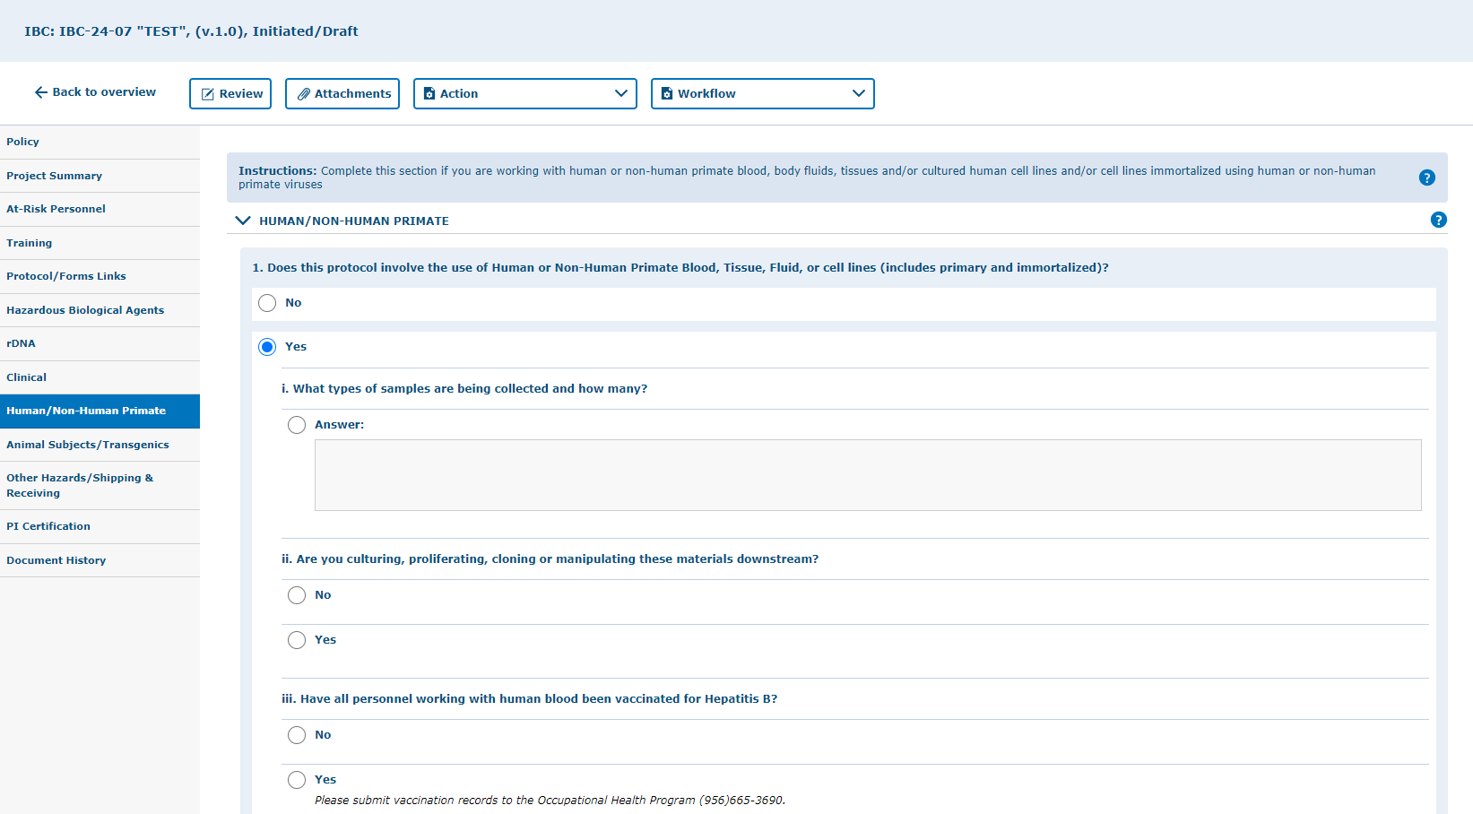
Click on “Human/Non-Human Primate” tab.
Complete this section if you are working with human or non-human primate blood, body fluids, tissues and/or cultured human cell lines and/or cell lines immortalized using human or non-human primate viruses. Answering “YES” will expand the section and show nested questions that must be completed if applicable. Note that corresponding approvals will be required if applicable prior to initiating any work (ex. IRB and AUP). Remember to SAVE your work!

Slide 30
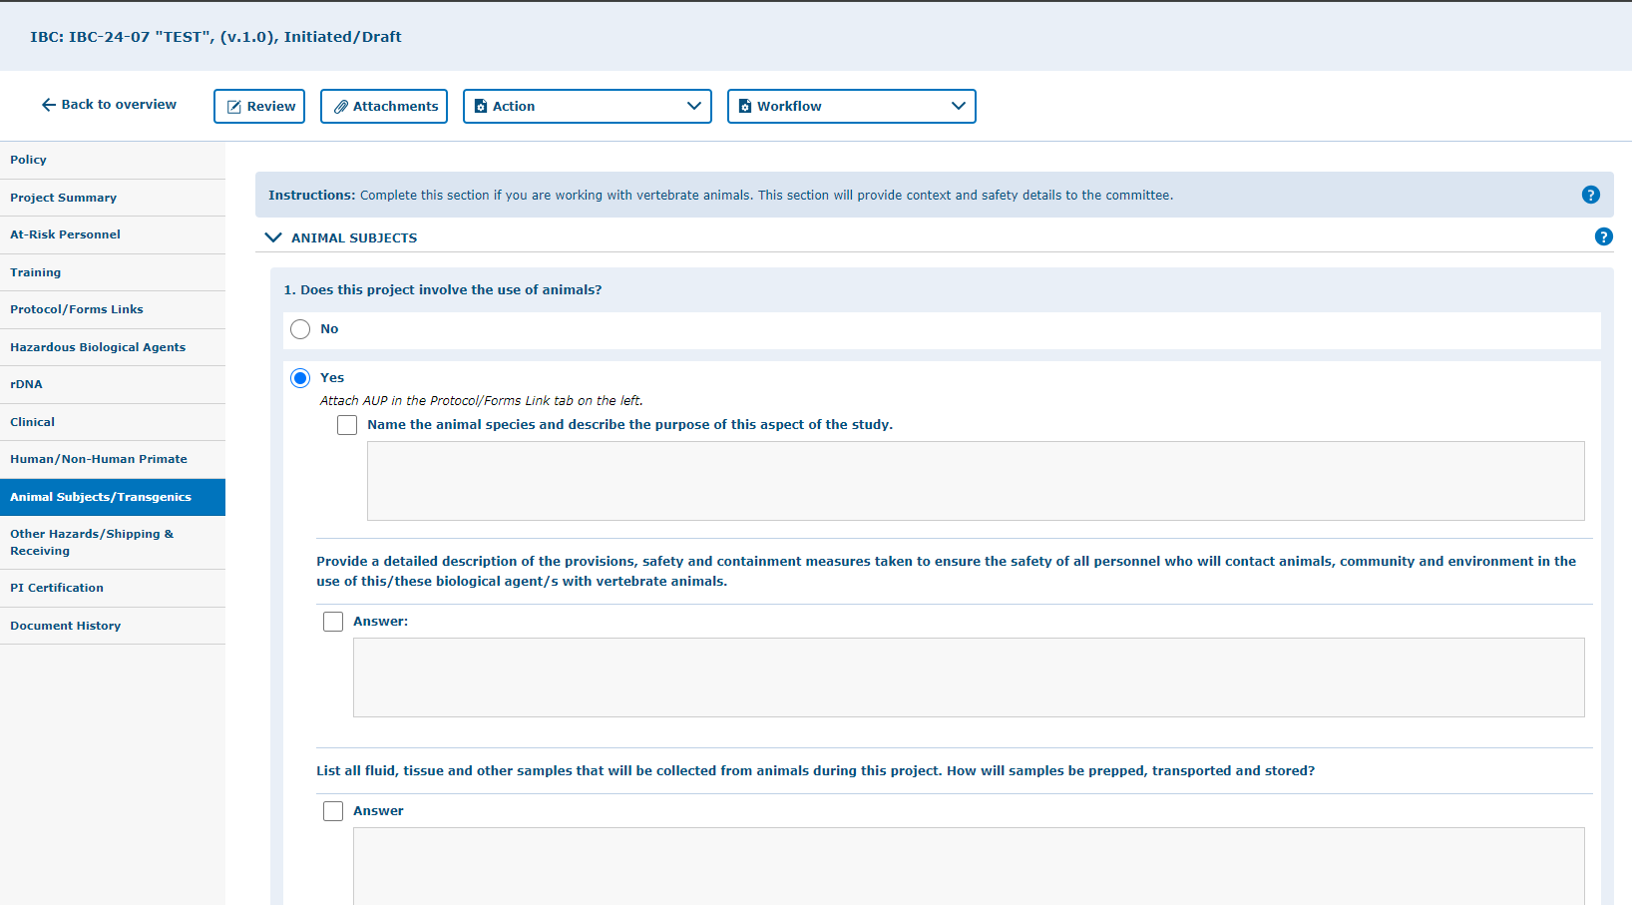
Click on “Animal Subjects/Transgenics ” tab.
In this tab you can indicate if you are working with vertebrate animals. This section provides context and safety details to the committee. If you answer yes to number 1, the section will expand with more questions to complete. Note that animal work with vertebrate animals requires an approved Animal Use Protocol (AUP) prior to initiating any work. Remember to SAVE your work!

Slide 31
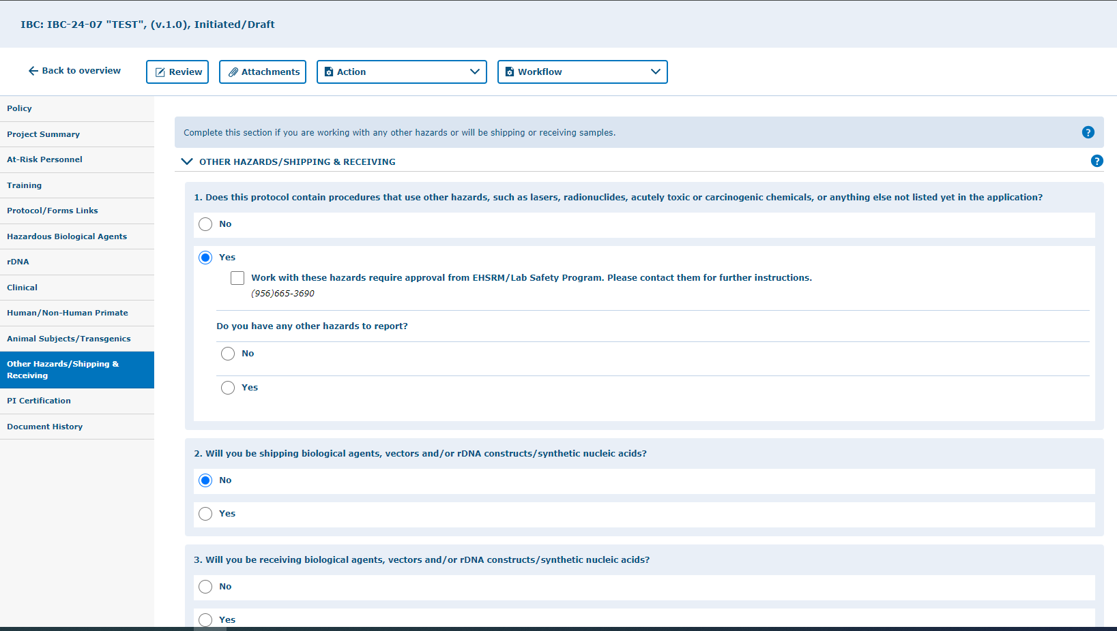
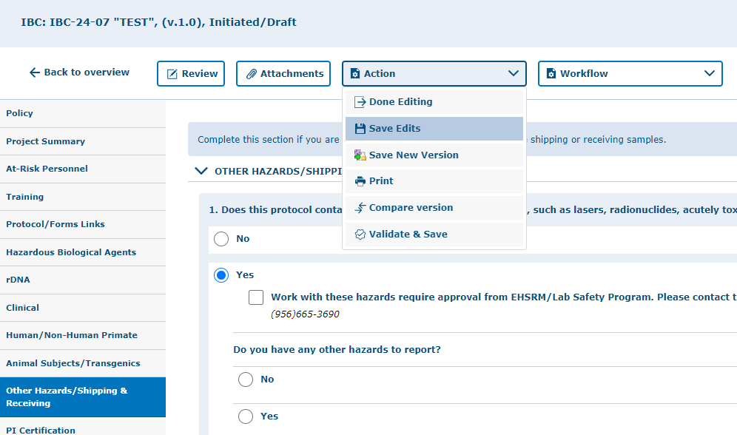
Click on “Other Hazards/Shipping & Receiving” tab.
Complete this section if you are working with any other hazards or will be shipping or receiving samples. If you answer yes to number 1, 2, and/or 3 the section will expand with more questions to complete. Remember to SAVE your work!

Slide 32
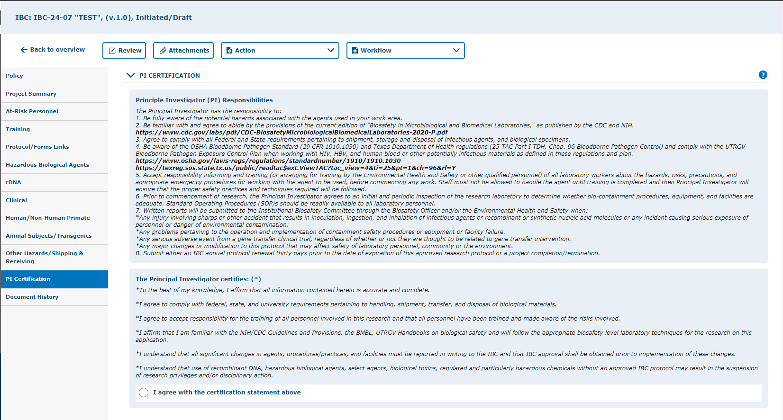
Click on “PI Certification”.
Select “I agree with the certification statement above.”
PI Certification: This is a mandatory field!

Slide 33
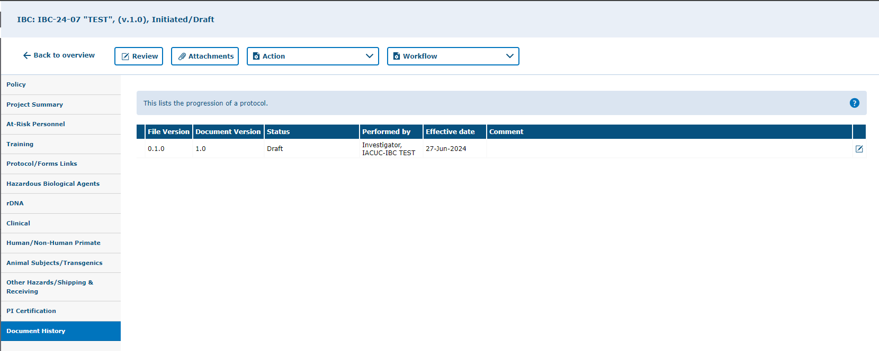
Click on “Document History” tab.
Check the status and any comments under this tab.

Slide 34
Attachments
How to add attachments to your protocol

Slide 35
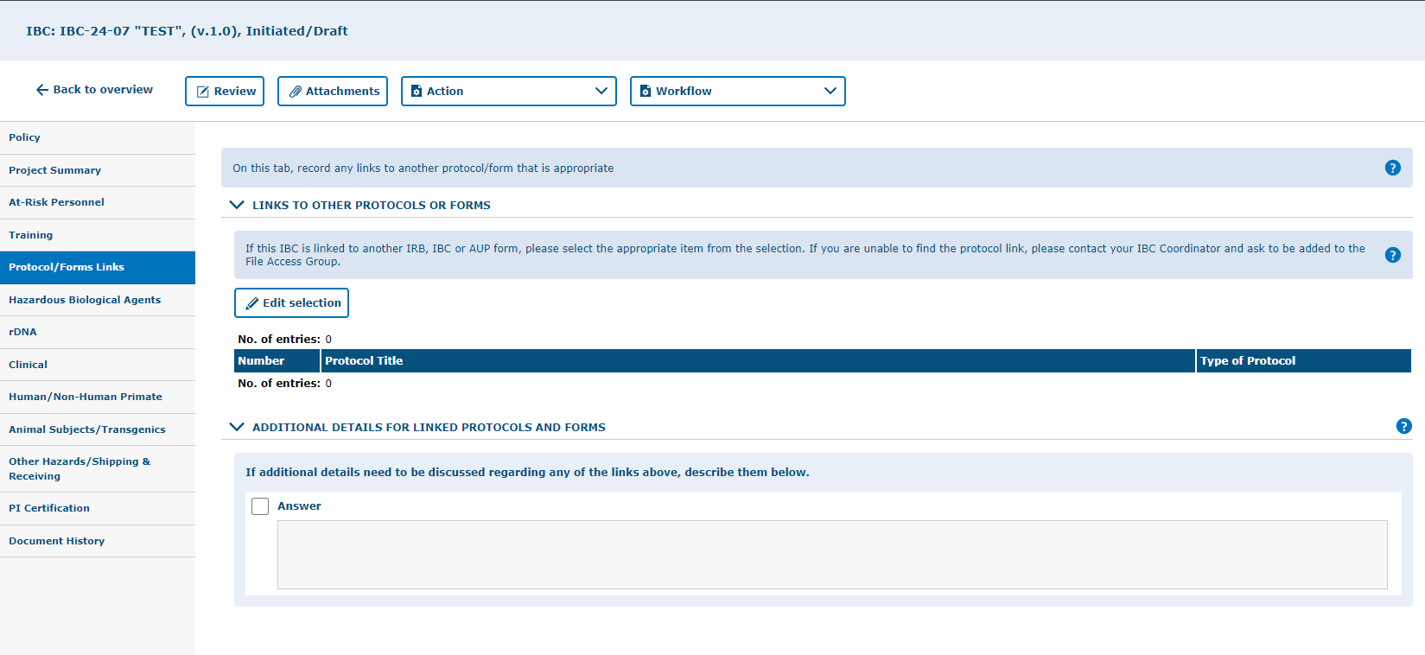
You can add attachments by using the “Attachments” button.
Include your attachments on their respective tabs. This is will facilitate the review process once you submit.
i.e. Attach any additional protocol form documents on the Protocol/Forms Link tab. Attach your appendix/addendum materials on the Project Summary tab.

Slide 36
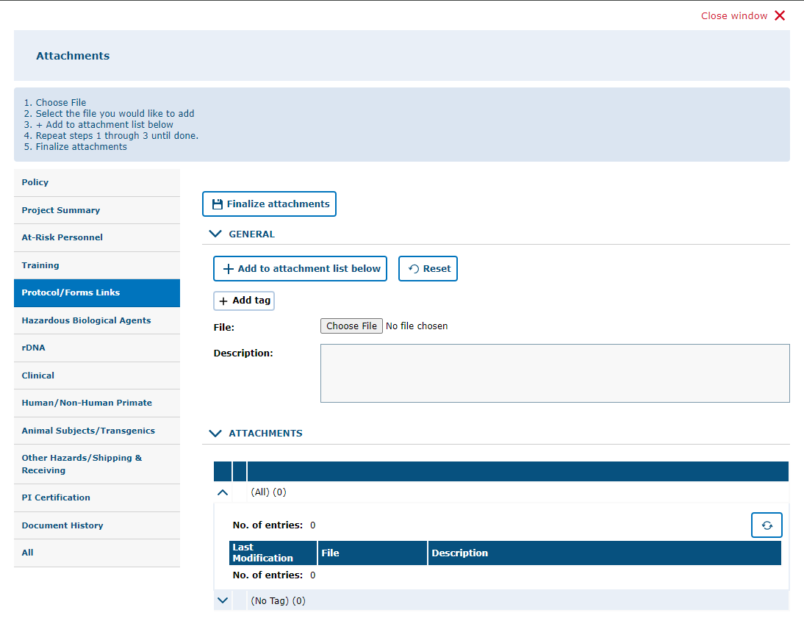
3. Click “Finalize Attachments”
2. After choosing the file, click on “Add to Attachment List Below.” For more than one file, click on “Choose File” then “Add to Attachment List Below” until all documents needed have been added, then click on “Finalize Attachments.”
1. Click on “Choose File” and upload file from computer or other devices. You can add a description of the attachment in the box.
4. Click on “All” to view all the application attachments.

Slide 37
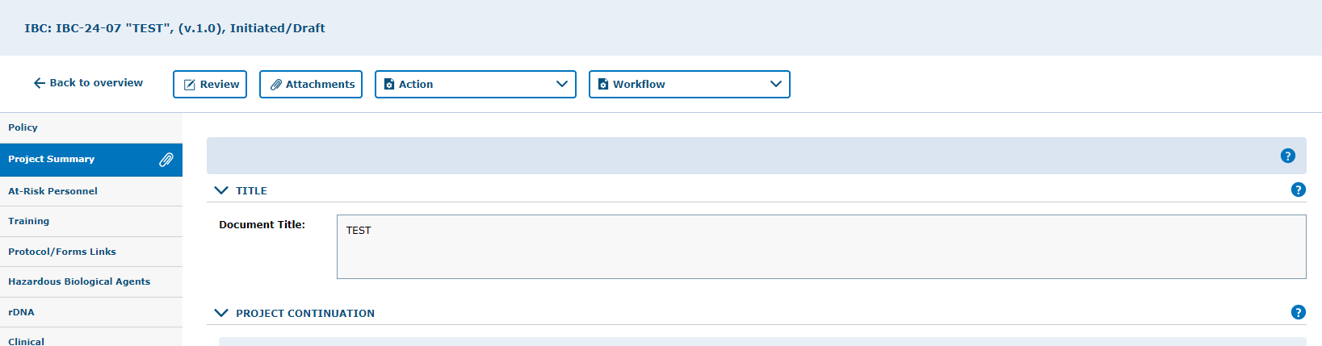
How to locate an attachment
Attachments are on the tab indicated by the paper clip icon.

Slide 38
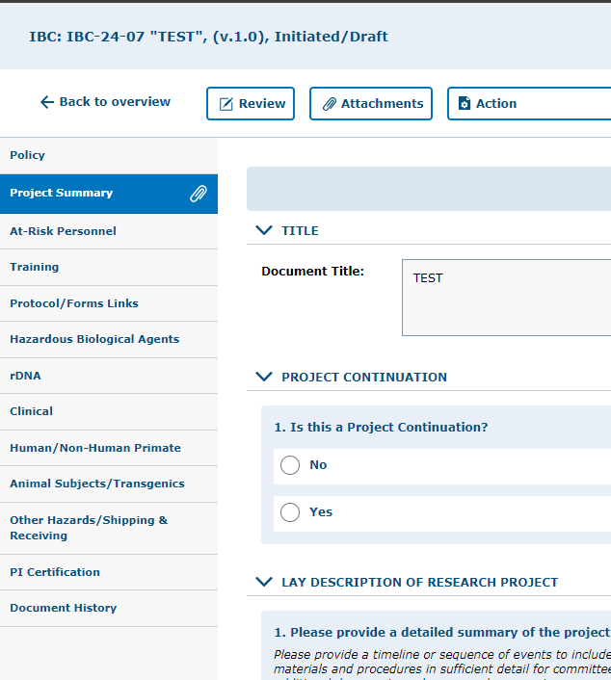
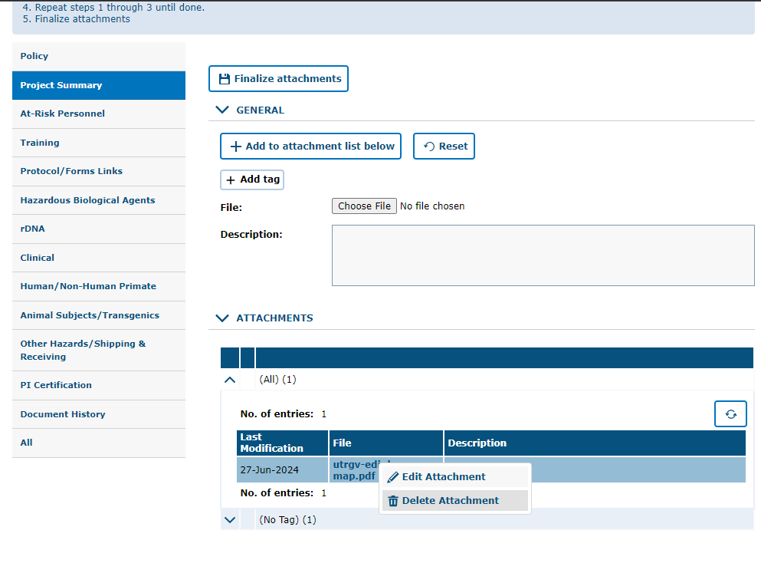
How to remove an attachment
You can remove attachments by:
Clicking on the “Attachments” button
Right-clicking on the attachment
Selecting “Delete Attachment”

Slide 39
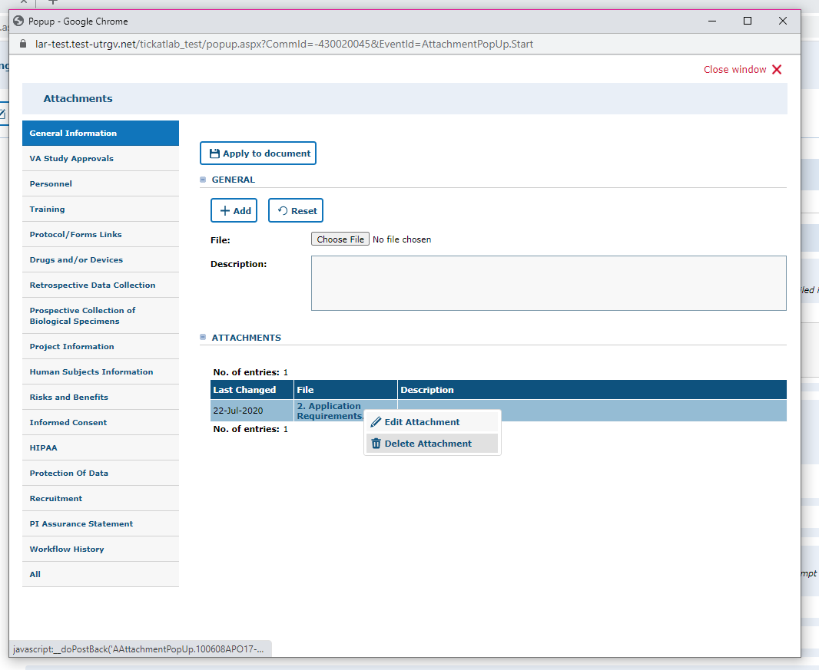
Note: by changing the workflow, the attachments will be locked and can no longer be deleted. i.e., while in draft mode and pre-review revision mode you may delete any attachments that you do not need. However, once you submit to the IBCCO Administrative Review, attachments will be locked.
Right click on top of the name of the file and select “Delete Attachment”

Slide 40
Validating and Saving

Slide 41
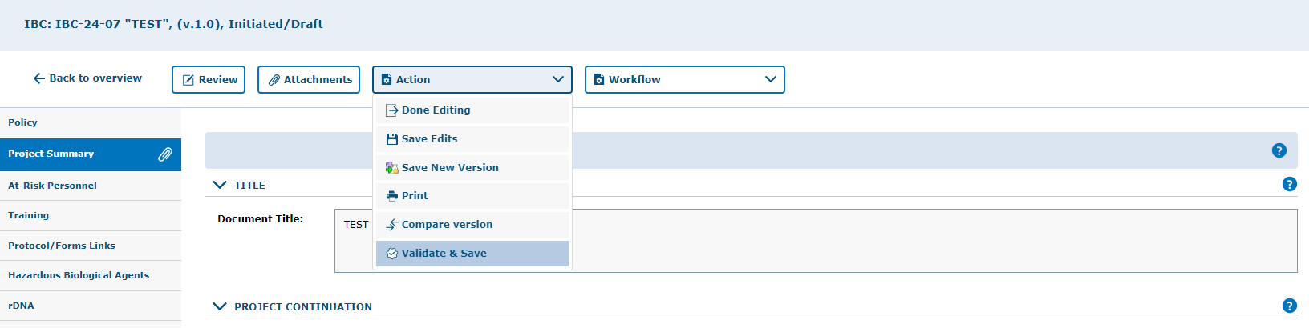
Once you have completed the application (Project Summary tab through the PI Certification tab), then it is recommended to Validate and Save your application
Mandatory questions are marked with (*) at the end of the questions
“Validate & Save” is a feature to check for any incomplete mandatory questions.

Slide 42
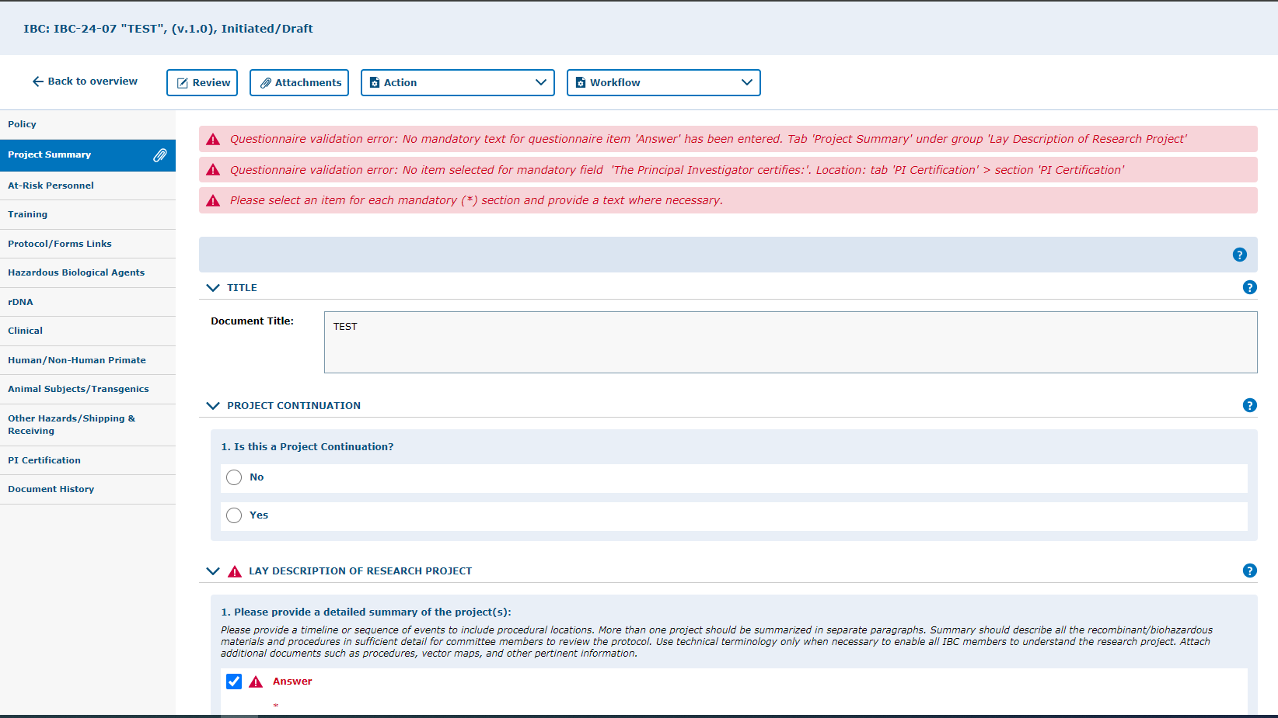
Application Validation
Pending Mandatory questions.

Slide 43
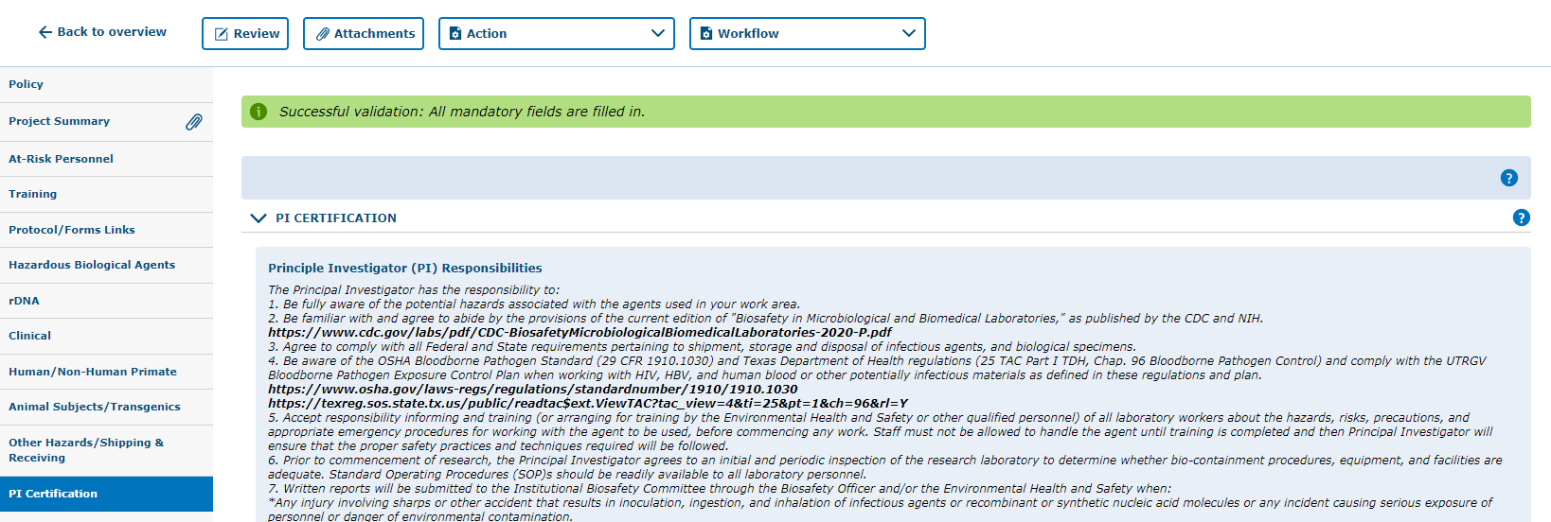
Application Validation
All required questions are answered and the protocol is ready for submission.

Slide 44
Protocol Submission

Slide 45
Remember to SAVE YOUR WORK!
Click on “Save Edits” under the “Action” button located in each tab
Prior to submitting the protocol, make sure you have saved the edits you have made.
Note, that there are 4 ways to save forms:
  Done Editing: saves the file and checks the document in so that another person can check it out and edit it.
  Save Edits: saves the document and allows you to keep working on it.
  Save New Version: saves a separate and new version of the file (duplicate).
  Validate & Save: alerts you of any missing items in the protocol before saving.

Slide 46
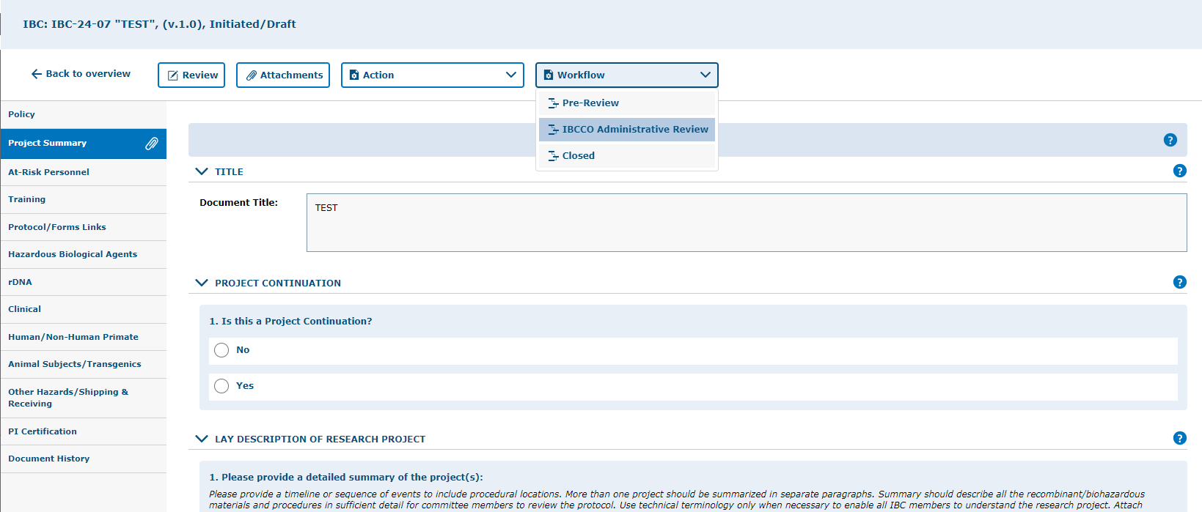
1. Click “Workflow” and select “IBCCO Administrative Review” from the list box.

Slide 47
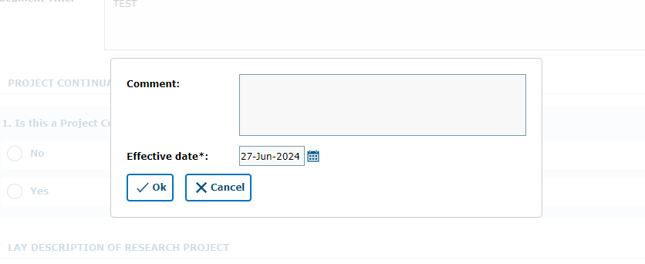
You may leave a comment inside the text box, then click “Ok”

Slide 48
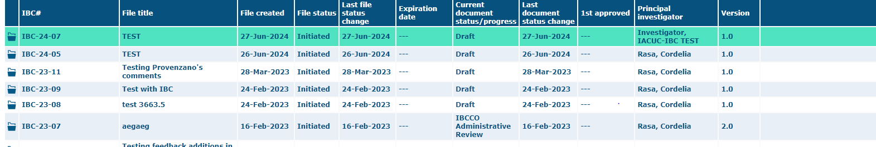
Confirm that the protocol was submitted by looking at the document status column. The status should read "IBBCO Administrative Review."

Slide 49
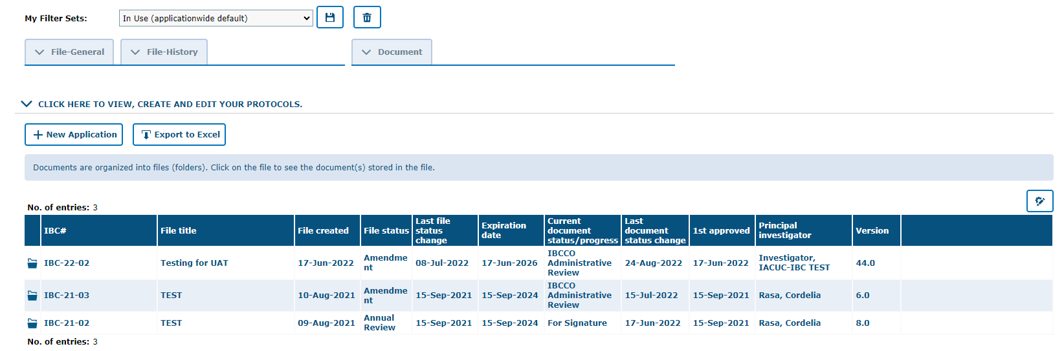
Your approved protocol will appear on the IBC tab ‘In Use (applicationwide default)’ filter
This status will say “APPROVED” once protocol is approved.
***Your project has been APPROVED***

Slide 50
Reviewer Feedback
How to find comments, questions, and concerns from the reviewer.

Slide 51
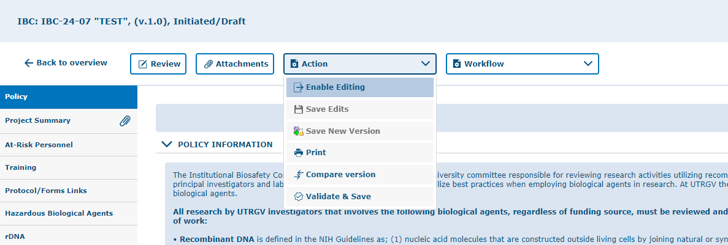

Enable the Document for Editing

Slide 52

Once the document is in edit mode, all revisions can be viewed by using the review button.
Click on “Review” button to see all feedback from the reviewer.

Slide 53

Click “All” to see the feedback left on all tabs at once, instead of moving from tab to tab.
To open the feedback items click on the subject
As illustrated in the red box above, you will find a list of items requested by reviewers for the entire protocol.
To respond to the feedback, please click on each topic under the “Subject” column to open a response field.

Slide 54

4. Click “Close Window”
1. Enter comment/answer in “Response” Text box.
3. Click “Save & Back”
2. Select “Response” here after entering your response in text box.
If a document needs to be uploaded as a response, you must go back to the “attachments” tab and upload the document in the respective section.

Slide 55
Resubmitting a Protocol
Submitting back to Workflow, after making required revisions

Slide 56
Remember to SAVE YOUR WORK!
Click on “Save Edits” under the “Action” button located in each tab
Prior to submitting the protocol, make sure you have saved the edits you have made.
Note, that there are 4 ways to save forms:
  Done Editing: saves the file and checks the document in so that another person can check it out and edit it.
  Save Edits: saves the document and allows you to keep working on it.
  Save New Version: saves a separate and new version of the file (duplicate).
  Validate & Save: alerts you of any missing items in the protocol before saving.

Slide 57
1. Click “Workflow” and select “IBCCO Administrative Review” from the list box.

Slide 58
2. You may leave a comment inside the text box, then click “Ok”

Slide 59
Confirm that the protocol was submitted by looking at the document status column. The status should read" IBBCO Administrative Review".

Slide 60
Your approved protocol will appear on the IBC tab ‘In Use (applicationwide default)’ filter
This status will say “APPROVED” once protocol is approved.
***Your project has been APPROVED***

Slide 61

Thank you !
Office of Research Compliance
Amy Mutore
IACUC/IBC Coordinator
(956)665-2889
amy.mutore@utrgv.edu
Monica Barrera
IACUC/IBC Specialist
(956)665-7873
monica.barrera01@utrgv.edu
Please contact Amy or Monica for assistance regarding submitting an IBC/HBA protocol. We are always happy to meet via Zoom or Teams to walk you through the process and answer any questions!

