Slide 1

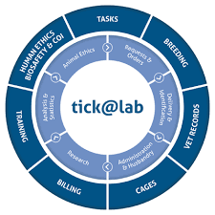
tick@lab
A guide for investigators & research personnel

Slide 2


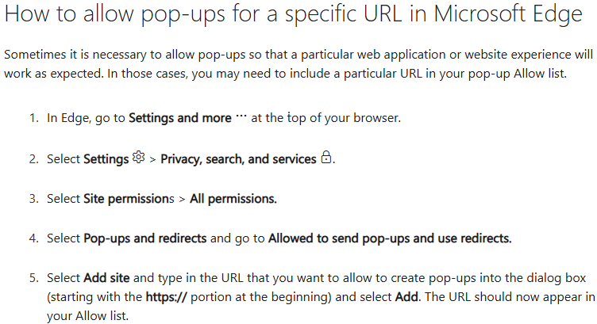
What is Tick@lab?
1. If you are using Chrome, go to the Open Applications Menu, top right corner
2. Click on Settings > Privacy & Security Tab > Site settings> Pop-ups & redirects > select the check box that says, “Sites can send pop-ups and use redirects.”
3. Refresh your webpage, and the pop-up blocker should be disabled.
1. If you are using Firefox, go to the Open Applications Menu, top right corner
2. Click on Settings > Privacy & Security Tab > deselect the check box that says, “Block pop-up windows”
3. Refresh your webpage and the pop-up blocker should be disabled.
Electronic system that allows LAR staff and Researchers to submit and manage animal use protocols, order animals, capture data for breeding, and animals used in studies.
Make sure your browser does not have the Popup Blocker on; disable this setting and always allow the pop-ups when using tick@lab.
To log on, use the following link: https://lar.utrgv.edu/tickatlab/default.aspx
Use your UTRGV Credentials as your login.

Slide 3
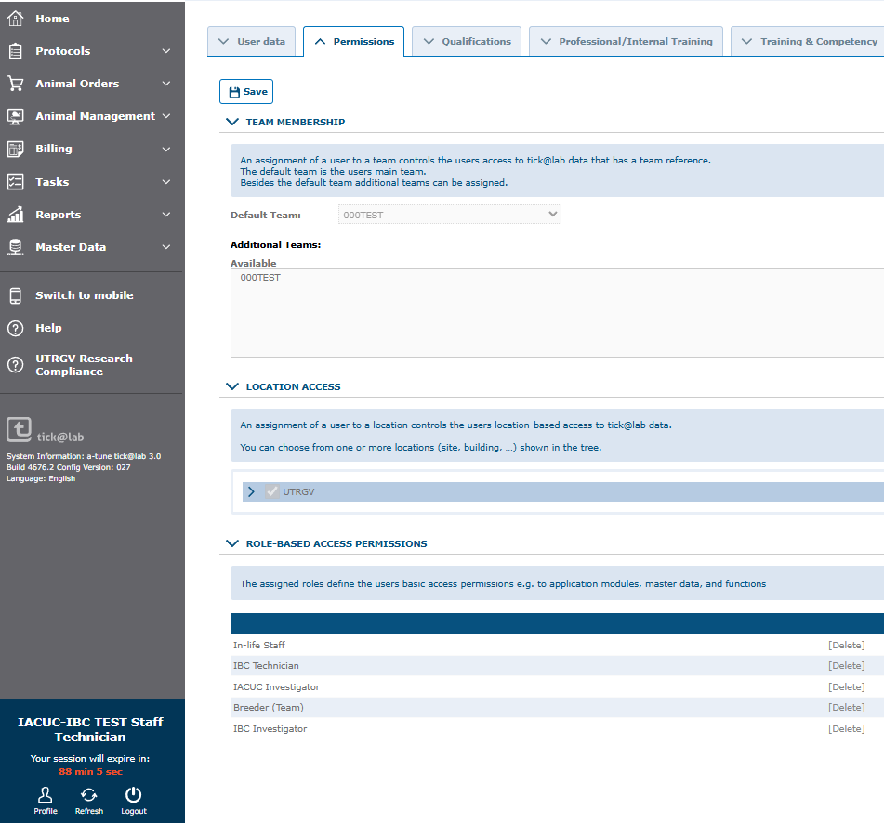
What is my role in tick@lab?
Your role may be different from that of the main investigators and even other research staff in your lab.
Research Staff (non-students) can submit animal order requests and enter/update data for animals in the system.
Go to Profile to review your role(s) and Team.
Default Team →User Data tab
Roles → Permissions Tab

Slide 4
Table of Contents
Animal orders……………….5
Request training…………..14
Enter weights……………….21

Slide 5
Animal Ordering

Slide 6
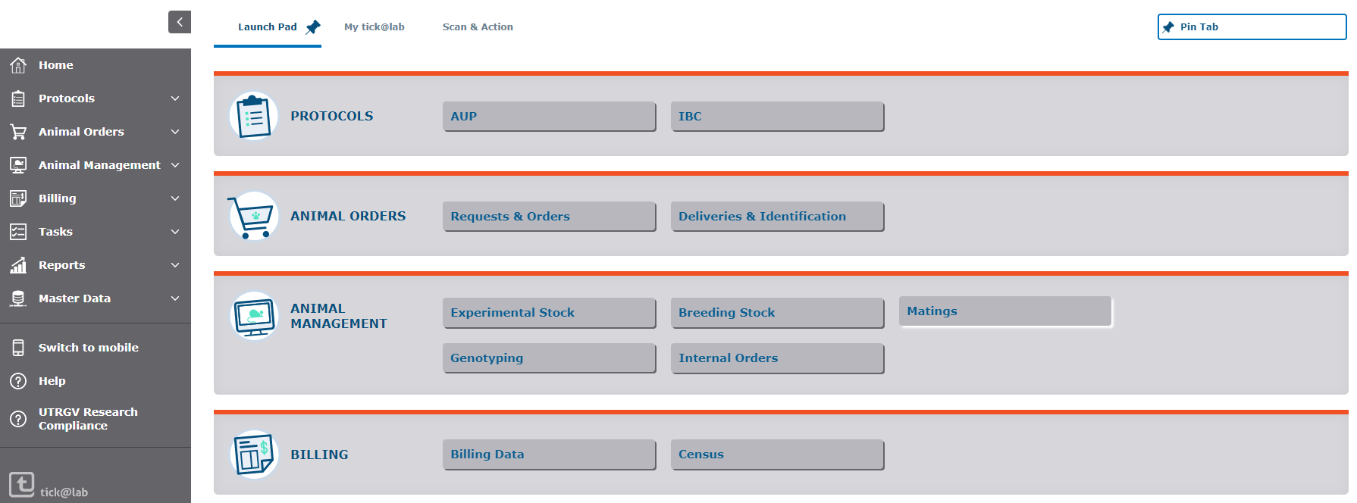
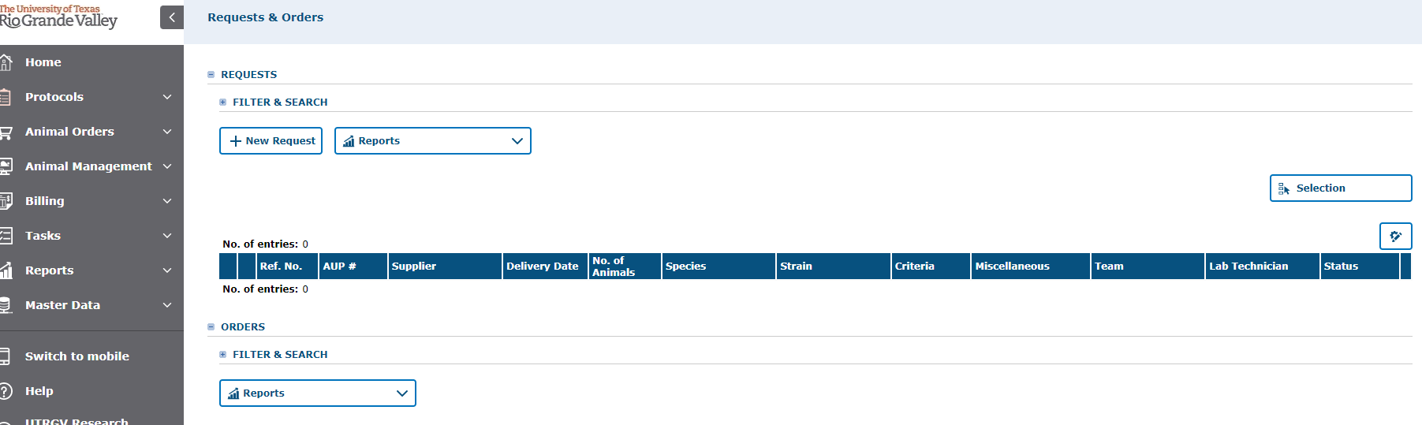
How do I order Animals?
Only Principal Investigators (PI) and designated Research Staff may place orders against an active/approved animal use protocol.
Click on the Requests & Orders tab to access this section.
Then click on New Request to start your animal order
Click on ‘New Request” to start your order

Slide 7
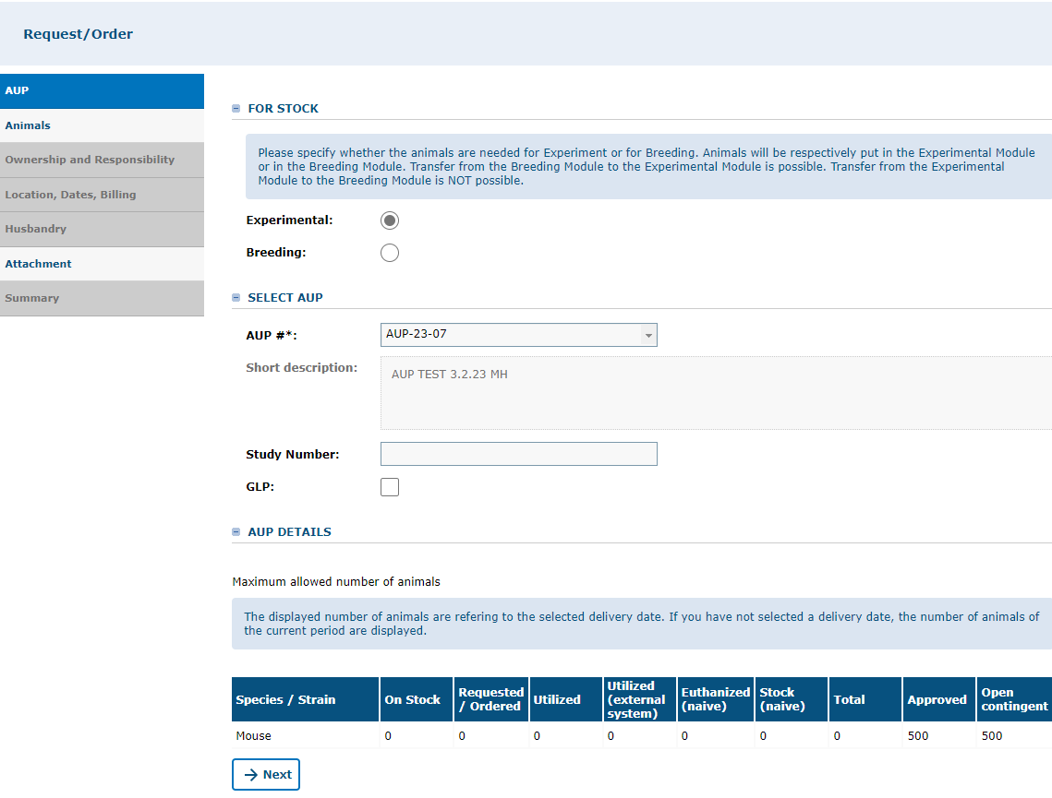
AUP Tab
AUP Tab:
Specify if the animals you need are for Experimental or Breeding.
Select the AUP you want to order animals from.
Study Number and GLP may be left blank, optional.
The AUP Details will provide a summary of how many animals (per species) you currently have, how many have been ordered, and how many were approved.

Slide 8
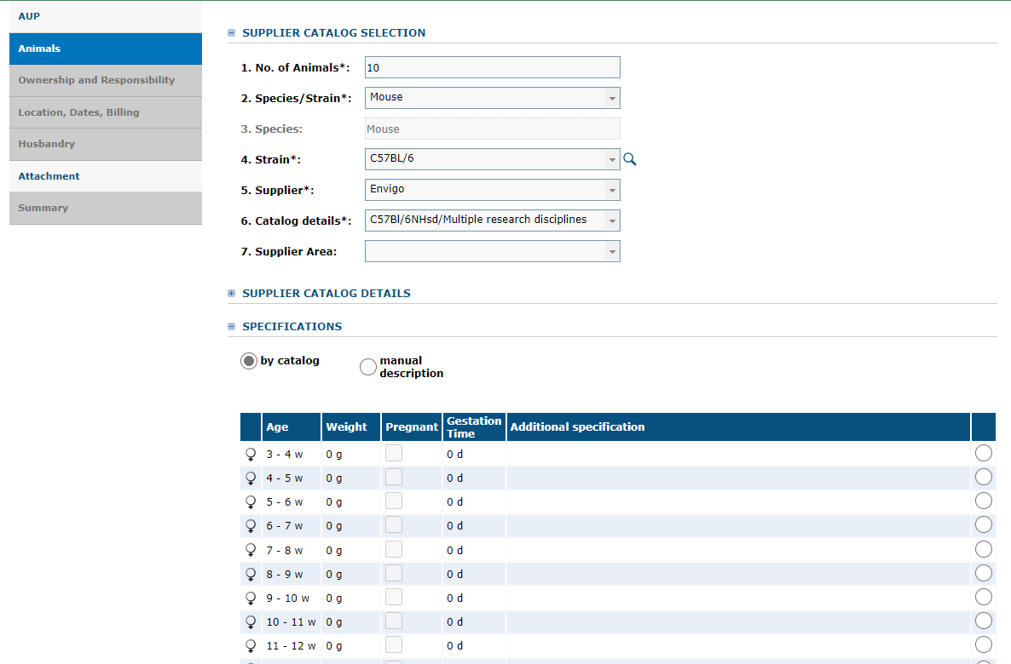
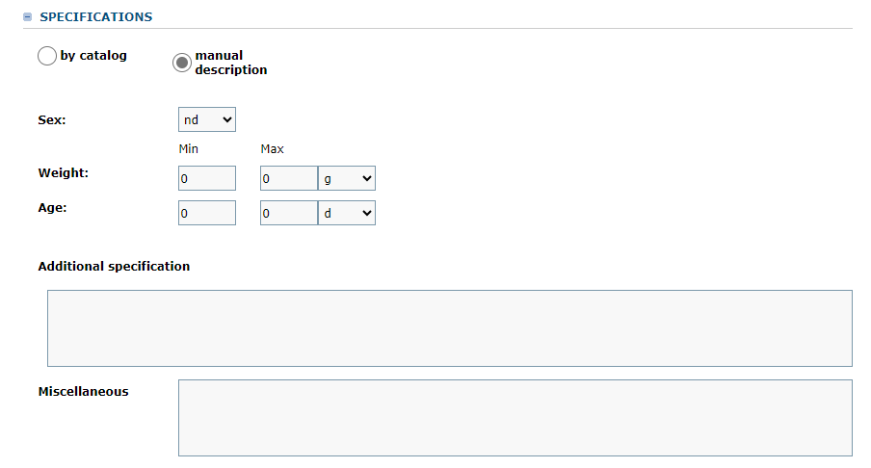
Animal Tab
Complete the Supplier Catalog Section.
If the supplier you want to order from is not listed, contact Laboratory Animal Resources (956-665-2067 or at animalresources@utrgv.edu)
Choose the animal criteria from the available catalog
Animal Tab
Or select “manual description” to specify your criteria.
Age
Weight
How many males and females

Slide 9
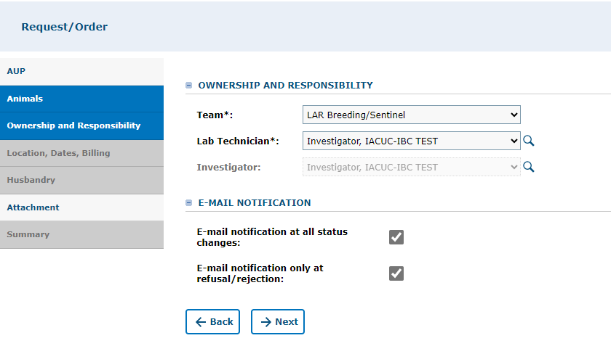
Ownership & Responsibility Tab
Select the Team (by PI) for whom you are placing the order.
Cost Center will always be DEFAULT
Lab Technician: Select the PI or research personnel in charge of the animal. Do NOT SELECT ANY STUDENTS!
Email Notifications: Check off the boxes if you wish to receive notifications regarding your animal order request.

Slide 10
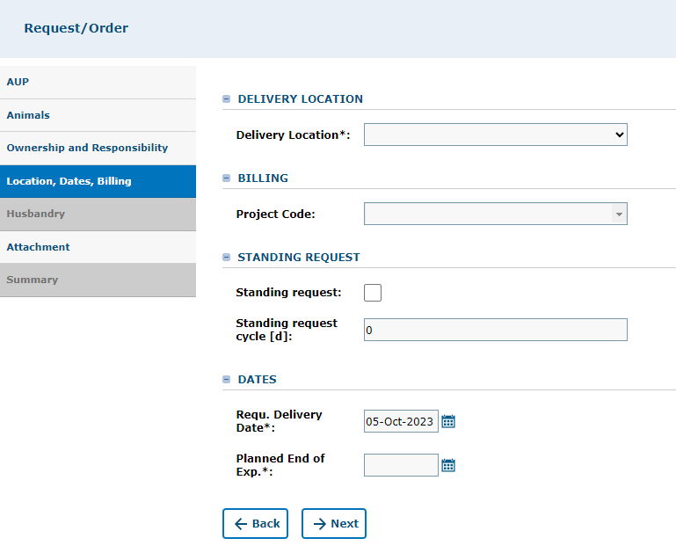
Location, Dates, Billing Tab
Indicate the delivery location: Edinburg, McAllen, Brownsville, or South Padre Island
Billing: Select the PI listed on the Protocol you are placing the order against.
Standing Request: Leave Blank- standing requests for animal orders are not allowed
Dates: Requested Delivery Date should be listed as 10 business days from the date of the request.
For example, you submit the request on Monday, Feb. 10, 2020, and the Requested Delivery date should be listed as Monday, Feb. 24, 2020. The timeframe is to provide Procurement and Financial Teams time to collect quotes, submit requisitions, and obtain necessary approvals.
Planned end of experiment date: This field indicates the date the study will end or animal(s) will be sacrificed.

Slide 11
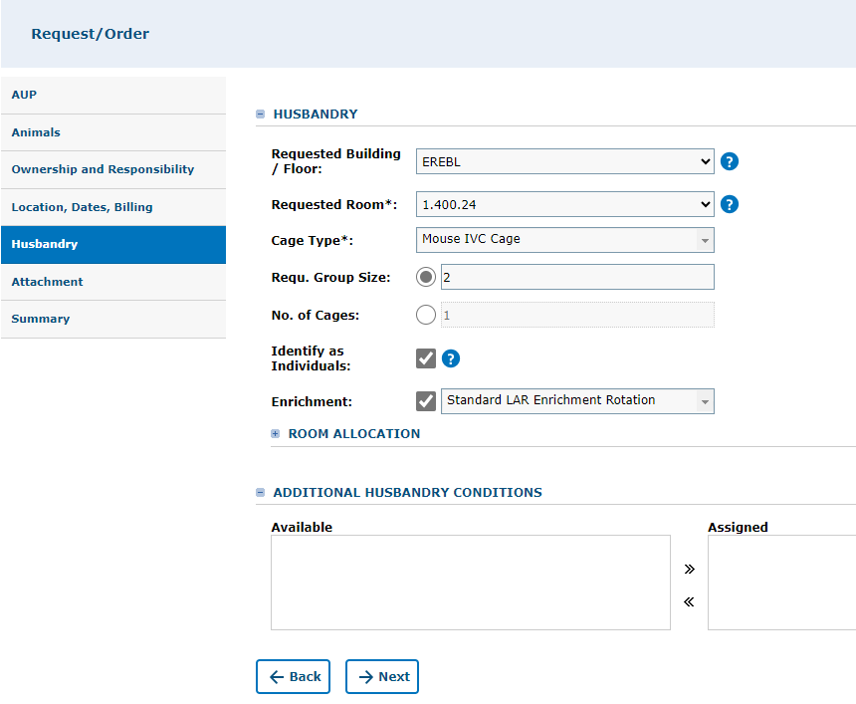
Husbandry Tab
Enter the LAR housing information. If you are not sure of the building or room number, please contact LAR (665-2067 or 665-6436).
Indicate the cage type (Contact LAR if you are not sure what cage type is suitable for your animal). The selected cage type will drive your per diem rate.
Indicate the group size or if animals need to be housed individually (group size would be 1).
Enrichment: If your animals cannot have any enrichment, please indicate “No Enrichment.” Otherwise, it will be defaulted to the Standard LAR Enrichment Rotation.

Slide 12
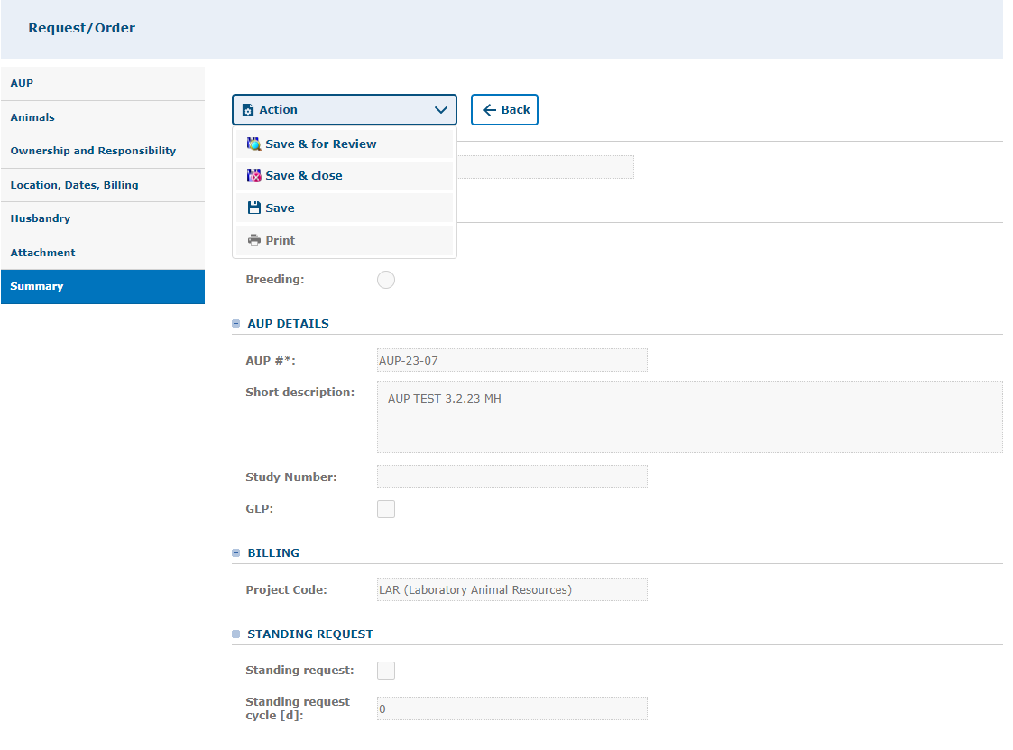
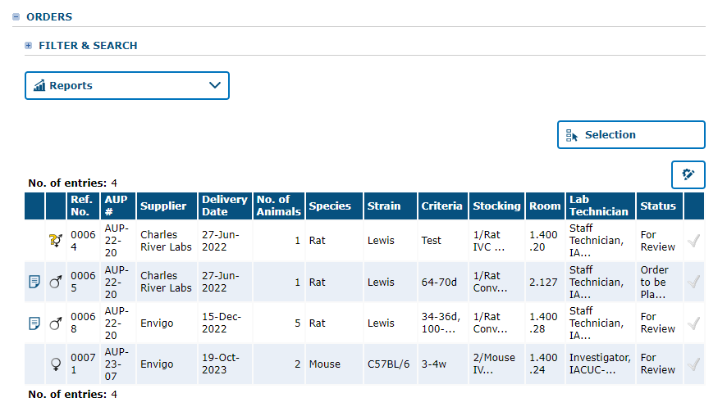
Summary Tab
Review the Summary of your Order and ensure that all the information entered is correct.
If everything is good to go, Go to the Action button and select Save & for Review. This will automatically send the request to LAR.
A reference number will be generated for your order and appear under “Orders”- This will be routed to LAR to finalize the order in iShop.

Slide 13
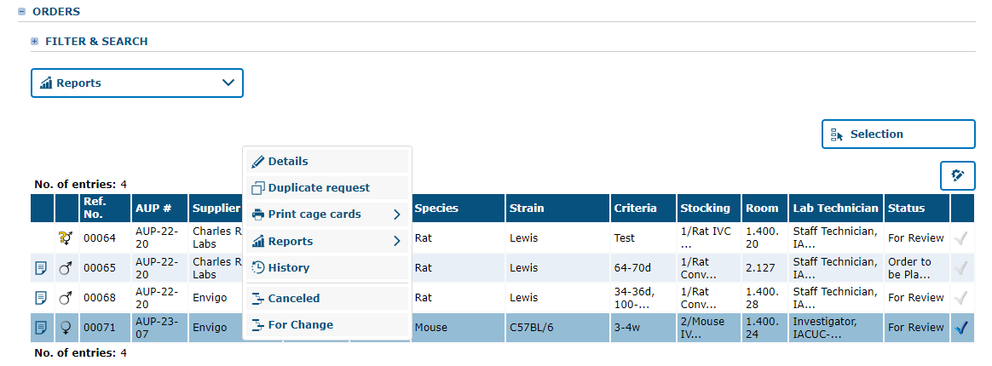
Making Changes To An Existing Order Request
Select the order with the reference number you want to change or cancel by clicking on the check mark, on the far-right side of the entries table.
Right-click and select “For Change” or “Canceled”
Selecting “For Change” will allow you to make changes to your order. Type in the comment section the reasoning for change.
Once you save the changes, close the window (pop-up) and right click again on the request. Select “For Review” to send the request to LAR to process in iShop.

Slide 14
Request Training

Slide 15
LAR’s Training Schedule
Every Tuesday between 10:30 am – 3:30 pm
Every Friday between 10:30 am - 3:30 pm

Slide 16
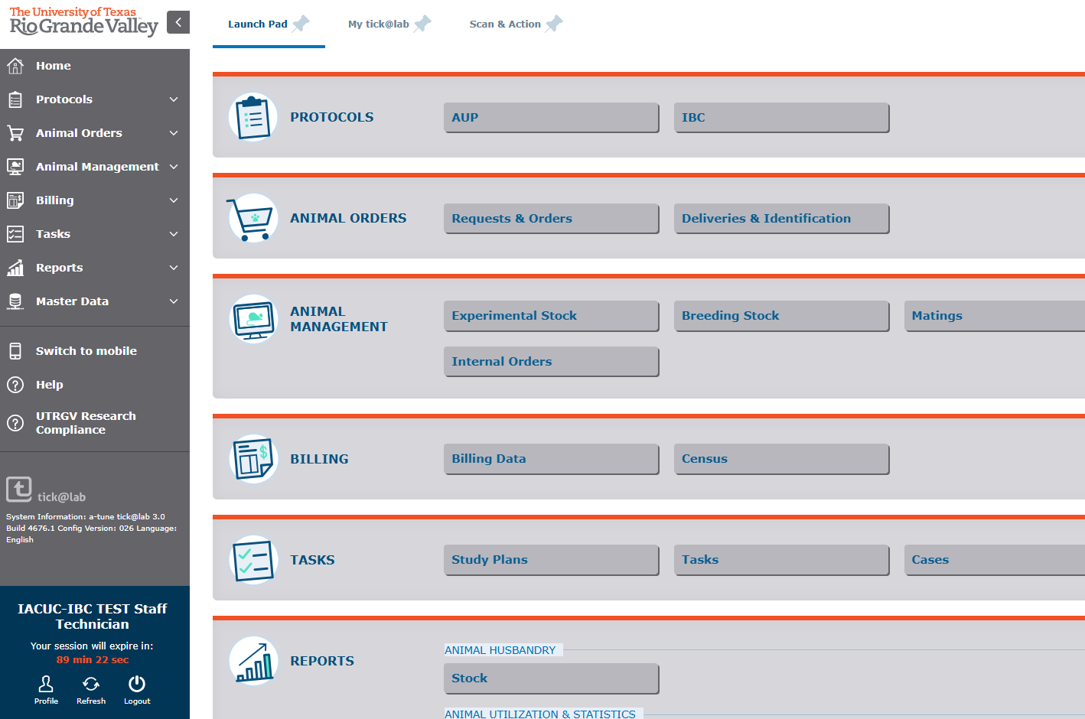
TICK@LAB DASHBOARD
1. On the home page, click on “Profile” in the bottom left corner.

Slide 17
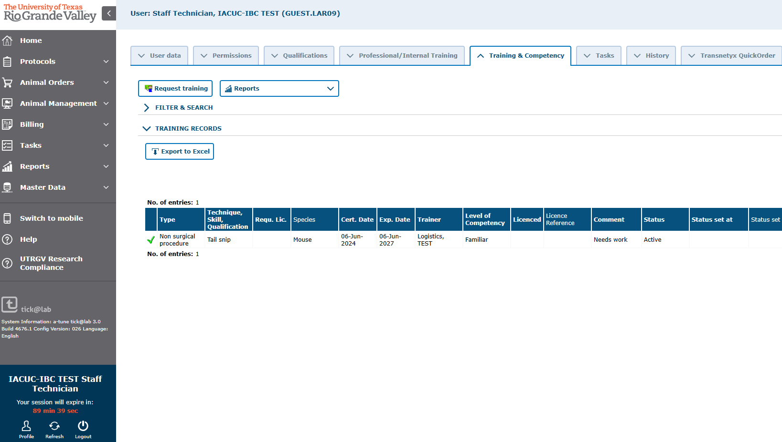
TRAINING & COMPETENCY → Request Training
1. After clicking on the profile button, click on the “ Training & Competency ” tab.
2. Then click on the “Request Training.” A pop-up window will appear.

Slide 18
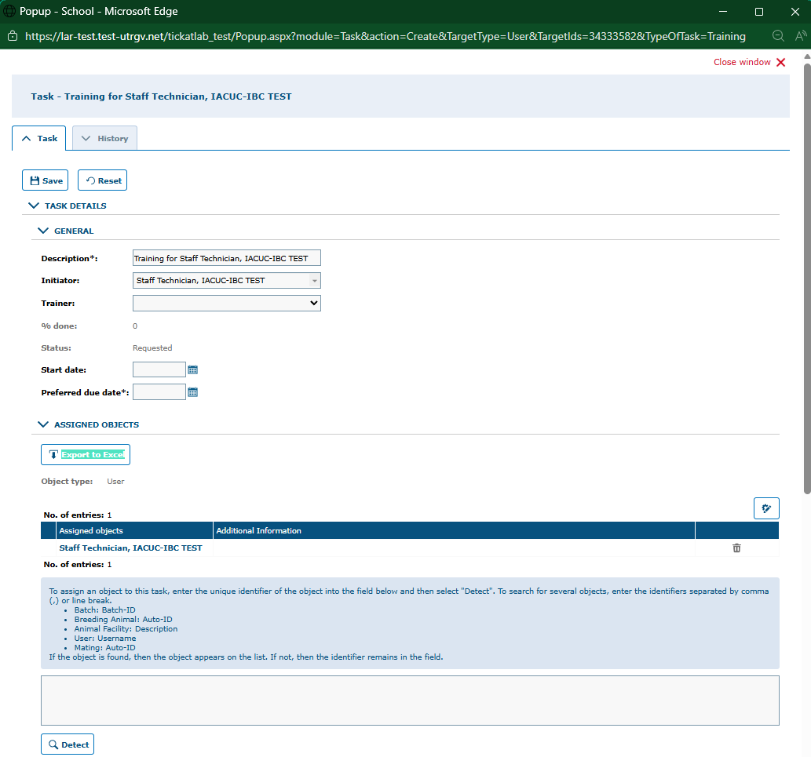
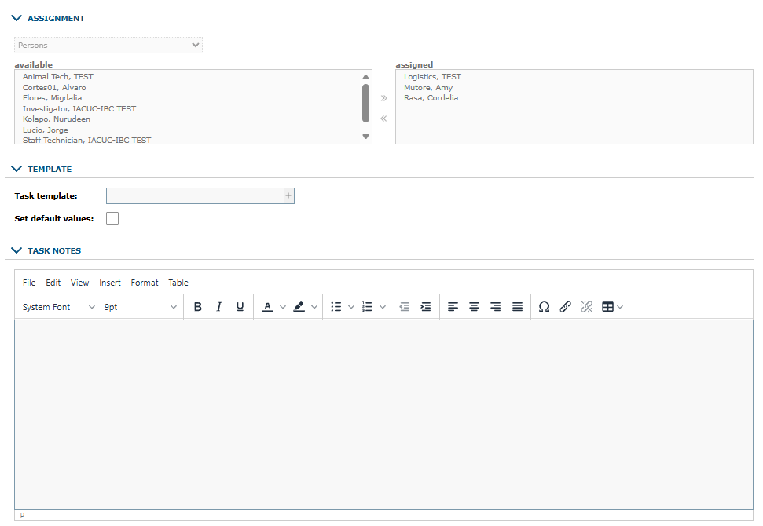

TRAINING & COMPETENCY, Request Training contin.
4. Assigned training coordinators will automatically be pre-filled.
1. A pre-filled Training Task Description will appear.
2. You can select the trainer in the drop- down if you know the trainer’s name.
3. The requester will automatically see their name under assigned objects.
5. Under task notes, please type in the type of training you are requesting and what AUP it falls under.
Notes:
*** need to add the “You can find LAR’s training list on the next page”

Slide 19
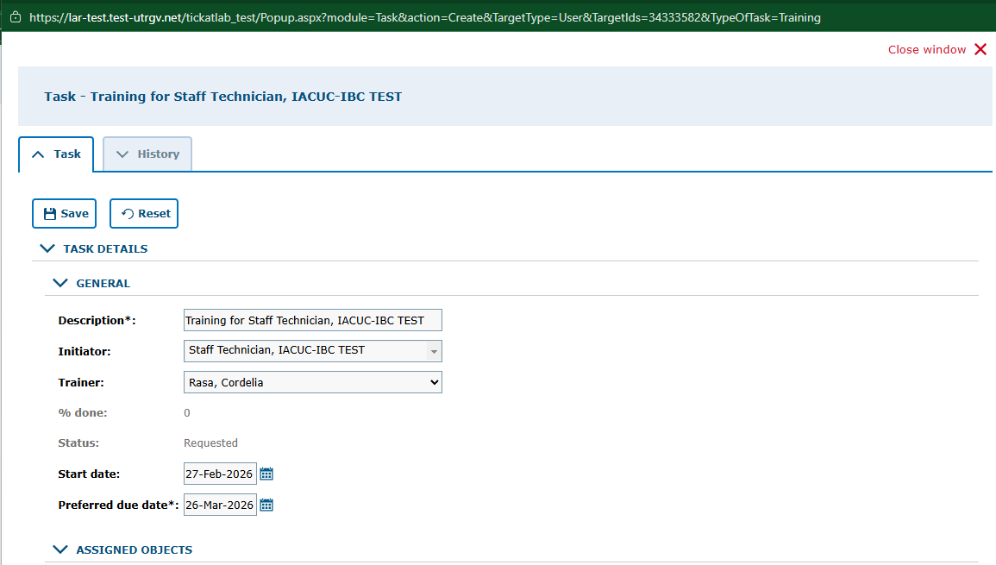
TRAINING & COMPETENCY → Request Training- final step
After completing all required fields, go back to the top of the pop-up window.
Click “Save” and then click on “close window”.
A Designated Trainer will contact you to schedule the training.

Slide 20
Entering Initial weights

Slide 21
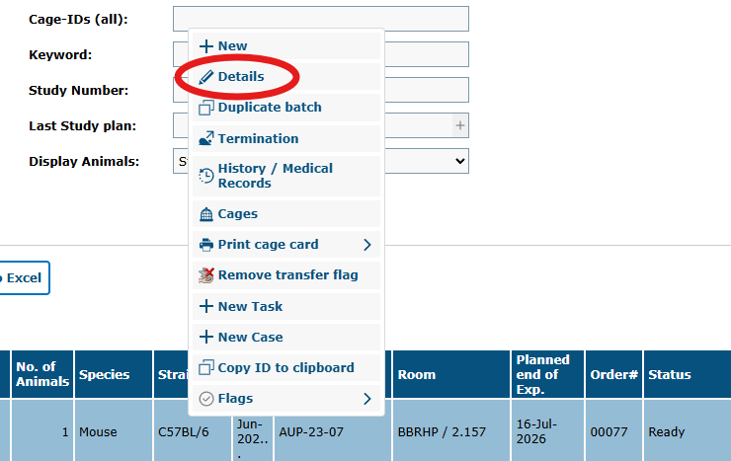
Select Animal and then Details

Slide 22
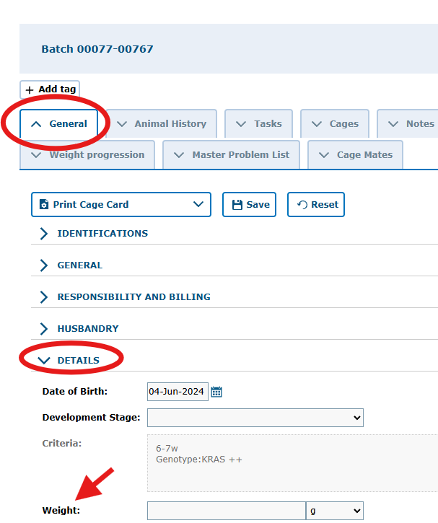
In the General tab, go to details section and enter the weight and click Save.

Slide 23
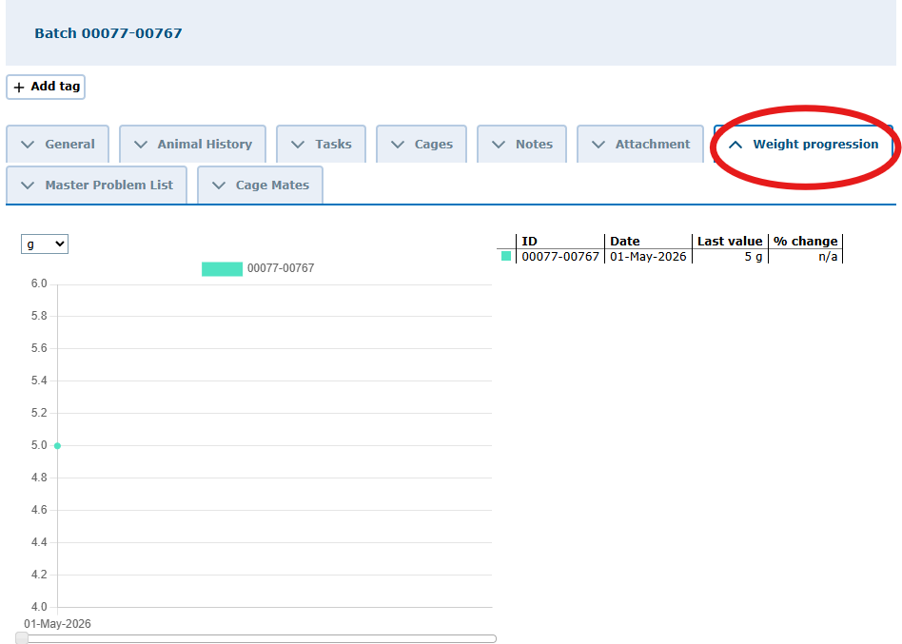
The weight changes will be shown in the Weight progression tab

Slide 24
To Practice, use the TRAINING ENVIRONMENT!
TRAINING ENVIRONMENT
For real-time use, use Production
https://lar-test.test-utrgv.net/tickatlab_test/default.aspx
CONTACT THE LAR OFFICE TO RETRIEVE YOUR UNIQUE ID.
LAR Office: 956-665-2067
Email: animalresources@utrgv.edu
https://lar.utrgv.edu/tickatlab
Login: UTRGV EMAIL
PASSWORD: UTRGV PASSWORD

