Slide 1
Accessing SciENcv
Research Enhancement

Slide 2
What is SciENvc?
Science Experts Network Curriculum Vitae - Is a tool that creates professional profiles and NIH & NSF Support documentation.
Why SciENvc?
  Free online tool through NCBI
  Easily create multiple Biosketches for different funding agencies and research projects.
  Compiles the formatting for you – Time saver and generates the PDF for you
  Ability to designate a delegate who can assist in accessing and modifying your Biosketch
  Easily import from ORCID or My Bibliography
Link: https://www.ncbi.nlm.nih.gov/sciencv/
Page: 1

Slide 3
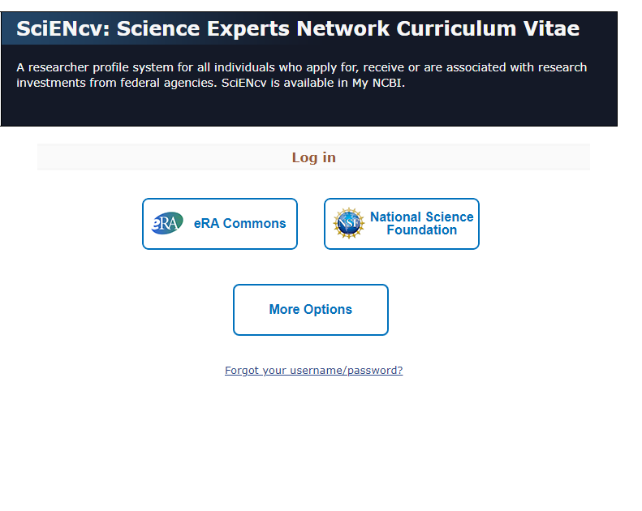
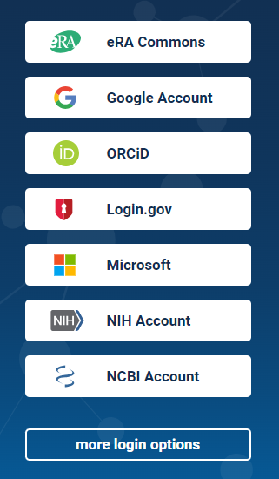
Accessing SciENcv
Go to: SciENcv
Click the “More Options” button.
Once again select “More login Option”
1
2
Page: 2

Slide 4
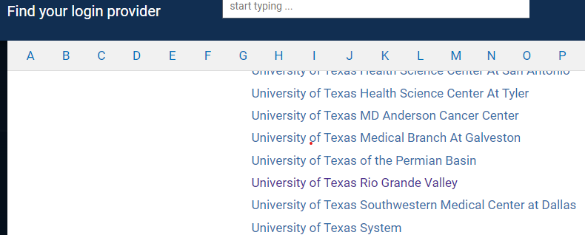
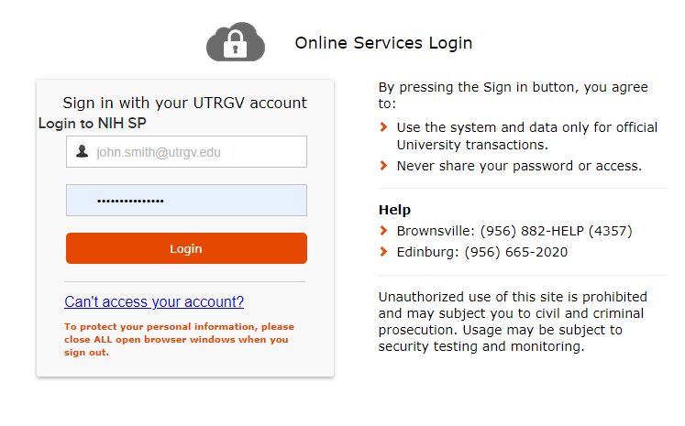
Accessing SciENcv
Find “University of Texas Rio Grande Valley”
Continue with your login credentials
1
2
Page: 3

Slide 5
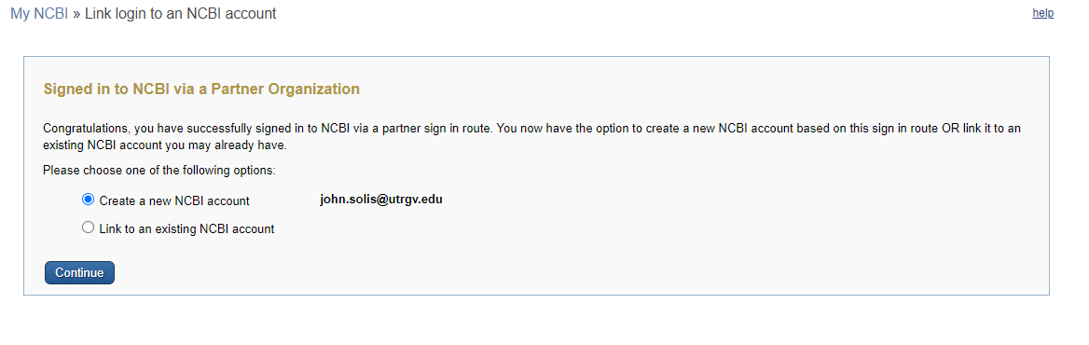
Accessing SciENcv
Create or Link a NCBI Account.
  For this tutorial we will create a new account
1
Page: 4

Slide 6
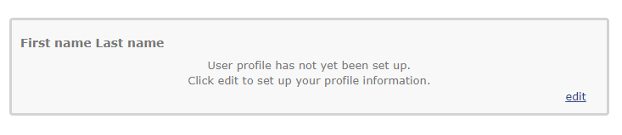
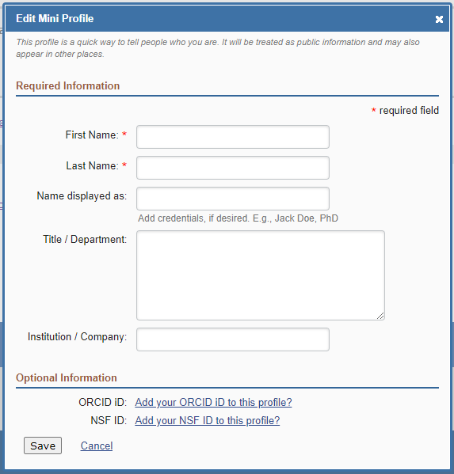
Setting up Profile on SciENcv
Select the edit button
Fill out the required fields
Fill out the optional fields including linking your ORCiD and NSF ID
1
2
Page: 5

Slide 7
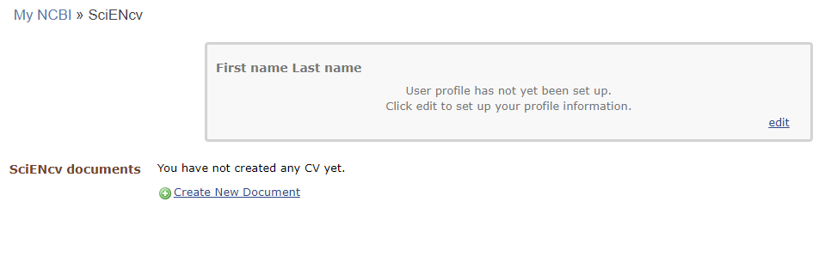
Creating Biosketch
You can create a new Biosketch from scratch or import from ORCiD. For this tutorial we will create a new document
Click “Create New Document.”
1
Page: 6

Slide 8
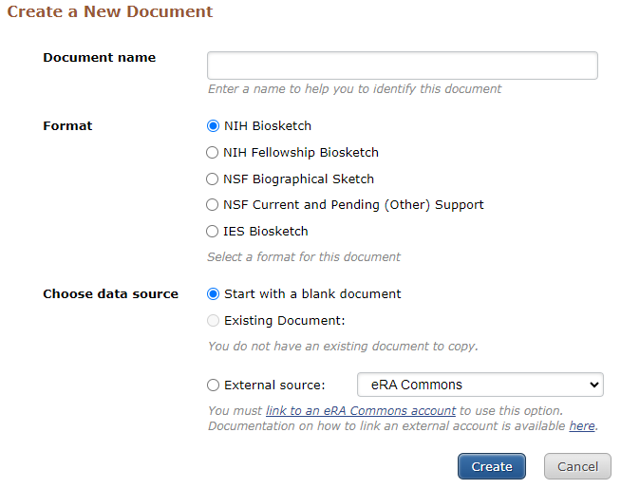
Creating Biosketch
1
In the text box, enter a name for this specific biosketch.
For the format, choose the agency you are submitting too.
  Note: the required biosketch sections differ between the NIH and NSF so you will need to create separate biosketches for these funding agencies.
For the data source, choose “Start with a blank document.”
Click “Create.”
2
3
Page: 7

Slide 9
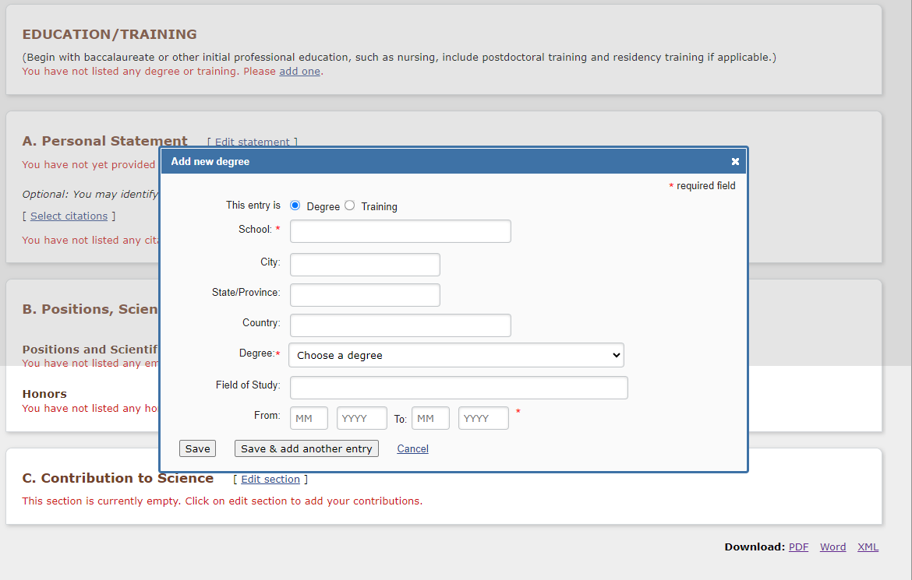
Creating Biosketch - Education
1
Select add one in the Education/Training section
Fill out the required fields and click Save or Save & add another entry to continue adding your educations merits
2
3
4
Page: 8

Slide 10
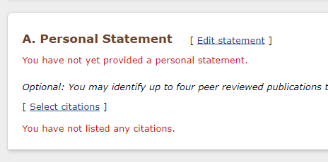
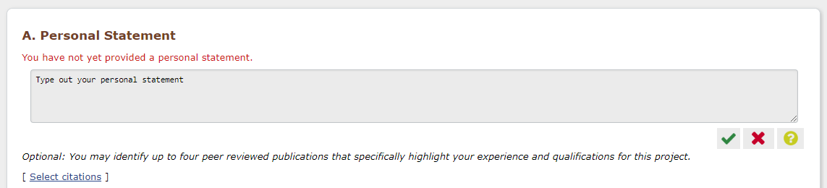
Creating Biosketch – Personal Statement
1
Select “Edit statement”
Type out your personal statement
Click on the green check box to save your personal statement
2
3
Page: 9

Slide 11
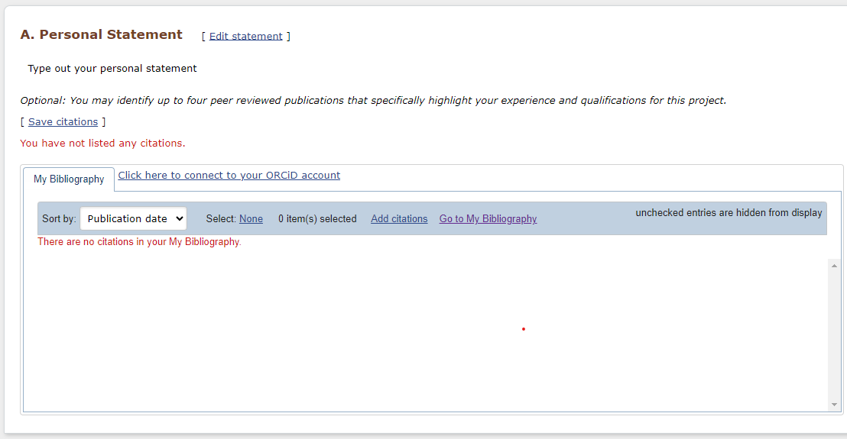
Creating Biosketch – Adding Citations
Select “Select Citations”
From the list select the citations you want to add to your Personal Statement.
If no citations appear click on “Go to My Bibliography” button.
1
2
3
Page: 10

Slide 12
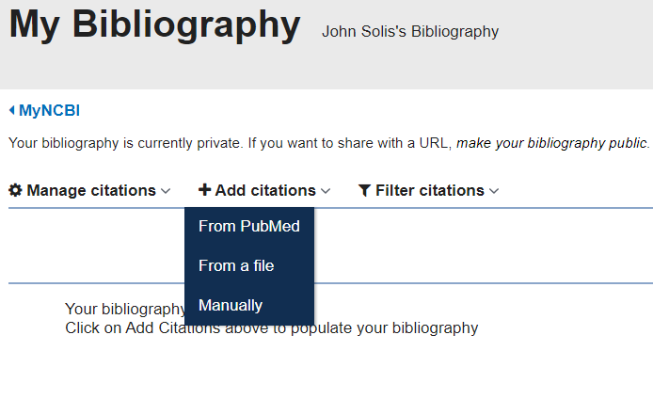
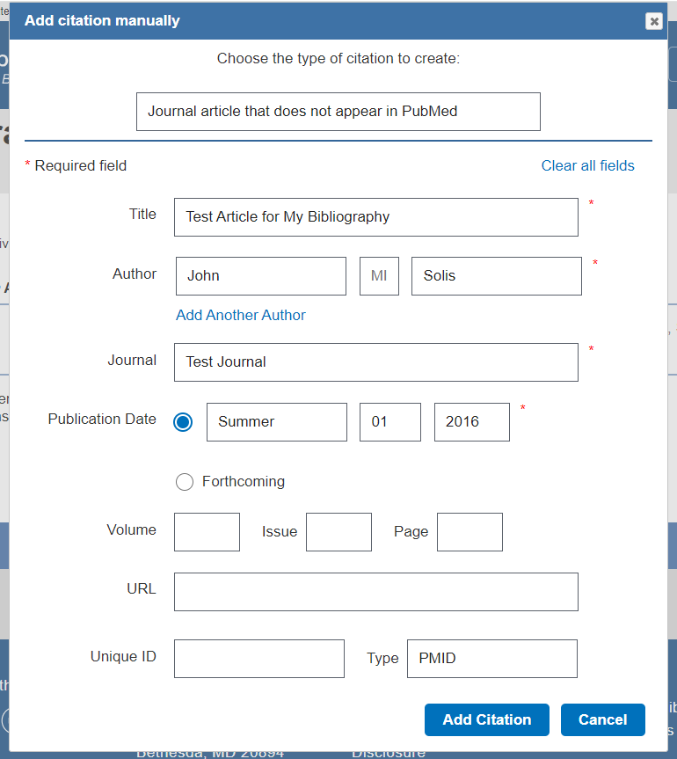
Creating Biosketch – Adding Citations
Select “+ Add citations”
Click on Manually
Fill out the required fields in the citation and click on the Add Citation button
Continue adding your other citations
1
3
2
4
Page: 11

Slide 13
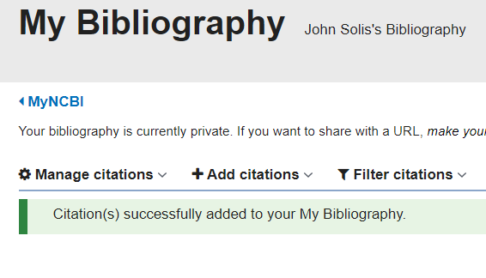
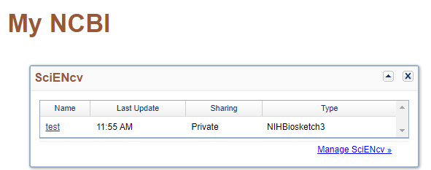
Creating Biosketch – Adding Citations
1
To return to your Biosketch click on “MyNCBI”
On your dashboard look for the SciENcv section and select the Biosketch you want to edit.
2
3
Page: 12

Slide 14
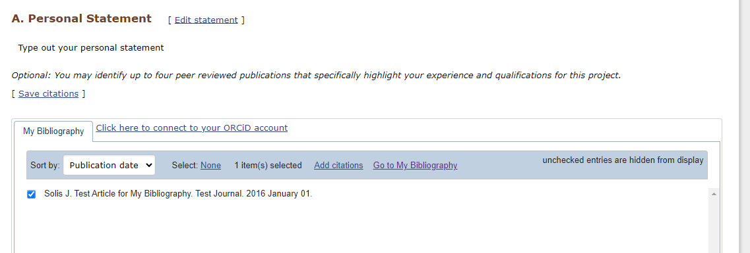
Creating Biosketch – Adding Citations
Under Personal Statement click on Select citations
You will see your Citations you created under My Bibliography. Select the ones you want to add to your Biosketch and click on “Save citations”
2
1
Page: 13

Slide 15
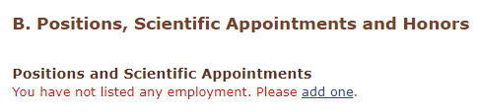
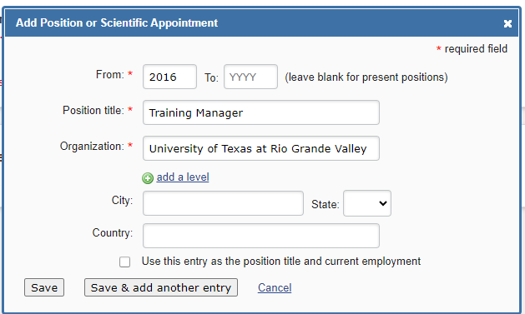
Creating Biosketch – Positions, Scientific Appointments and Honors
Under Positions and Scientific Appointments click on “Add one”
Fill out the required fields and click on “Save”
1
2
3
Page: 14

Slide 16
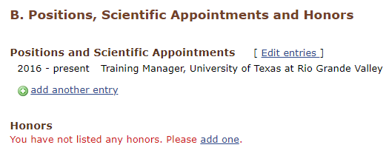
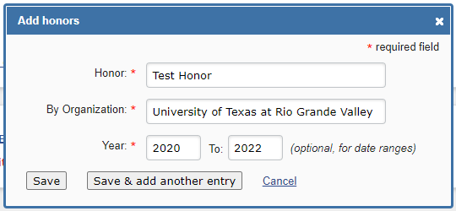
Creating Biosketch – Honors
Under Honors click on “Add one”
Fill out the required fields and click on “Save”
1
2
3
Page: 15

Slide 17
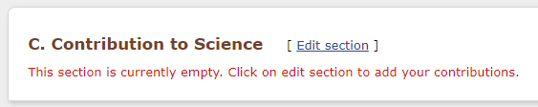
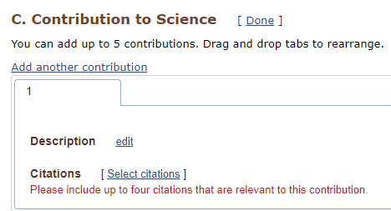
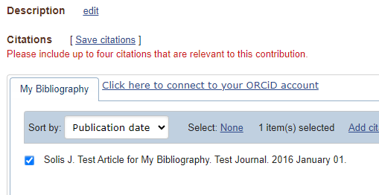
Creating Biosketch – Contribution to Science
1
Under Contribution to Science click on “Edit section”
Click on “Select citations”
Select the citations you want to add and click on “Save citations”
2
4
3
Page: 16

Slide 18
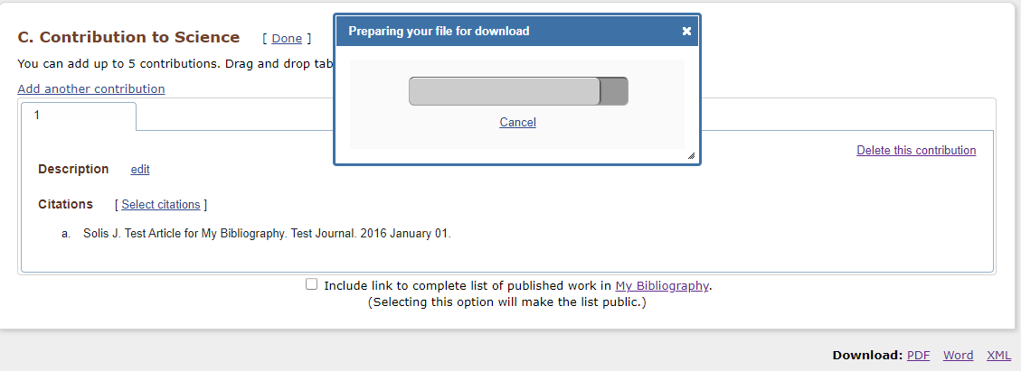
Creating Biosketch – Downloading Biosketch
On the bottom right-hand section of the page, you can select the format you want to download your Biosketch
Once you select the format the system will automatically start the download.
2
1
Page: 17

Slide 19
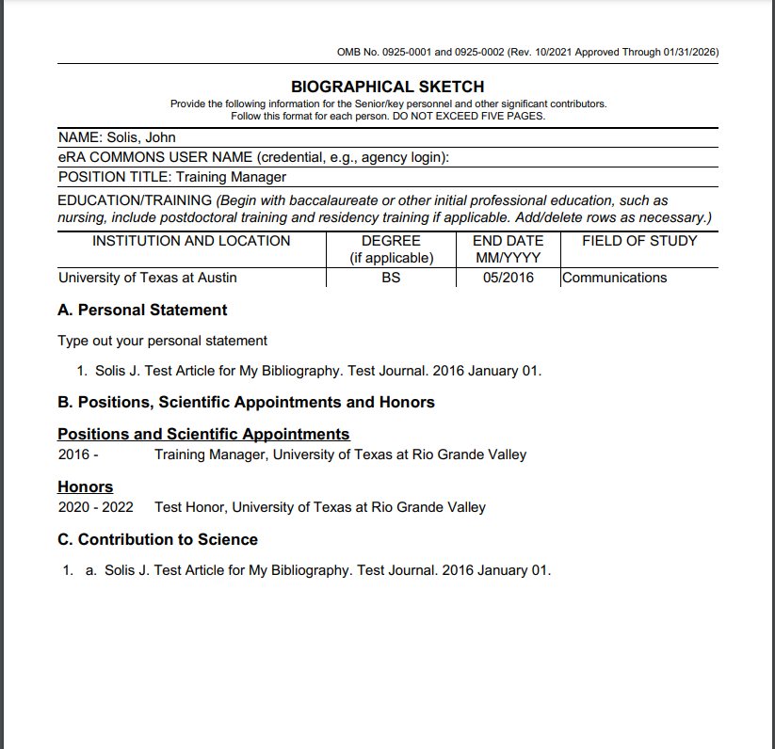
Creating Biosketch – Downloading Biosketch
1
This is how your Biographical Sketch is going to look like.
Page: 18

Slide 20
Glossary
eRA Commons - online resource for accessing and sharing administrative information throughout entire grant life cycle.
My Bibliography - online resource for storing citations, especially from PubMed. When linked to eRA Commons, can determine Public Access Policy compliance.
My NCBI account - saves user information and NCBI database preferences; includes access to My Bibliography and SciENcv.
ORCID - A unique, persistent identifier (PID) for individuals to use as they engage in research, scholarship, and innovation activities.
Page: 19

