Slide 1
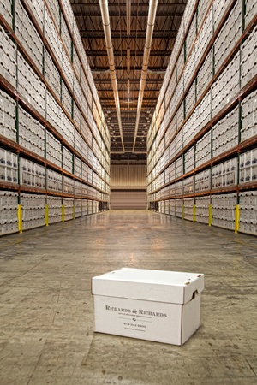
Records Management

Slide 2
The following forms are samples of Texas State Library and Archives Commission. Implementing the use of these forms not only will abide by regulations set by TSLAC, but will also benefit our department in the following ways:
  Will give accuracy to what UT System requires.
  Will make our jobs more efficient and organized due to the fact that format of forms is user friendly and self explanatory.
  And for ease of access all forms are/can be found on our web site for our use.

Slide 3
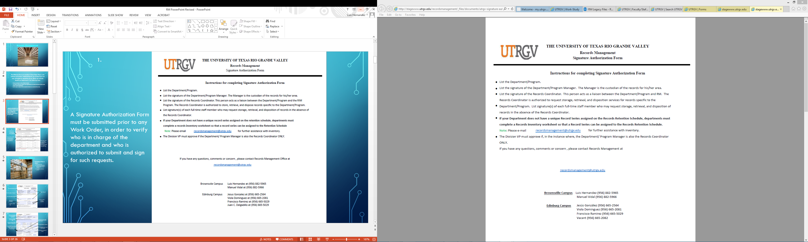
Page1.
A Signature Authorization Form must be submitted prior to any Work Order, in order to verify who is in charge of the department and who is authorized to submit and sign for such requests.

Slide 4
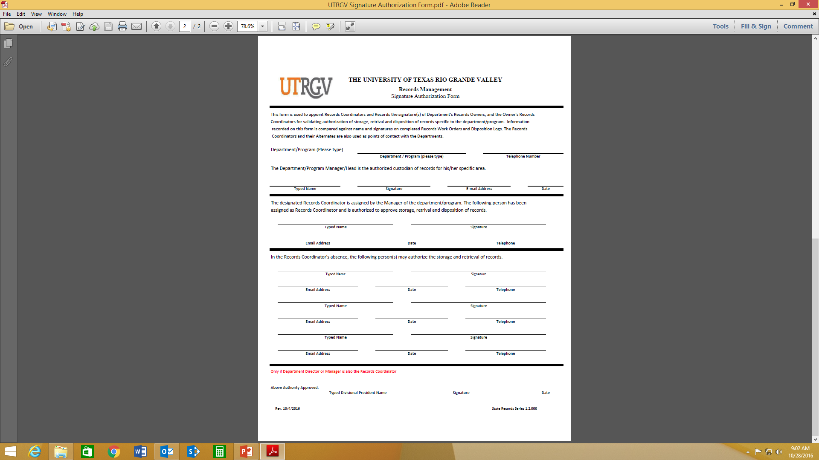
Page2.
First Section is filled out and signed by Dept. Manager/Director
Second section is filled out by Designated Records Coordinator assigned by Dept. Manager/Director
Third section is just in case Records Coordinator is not present and another person (Full Time employee) is authorized to sign

Slide 5
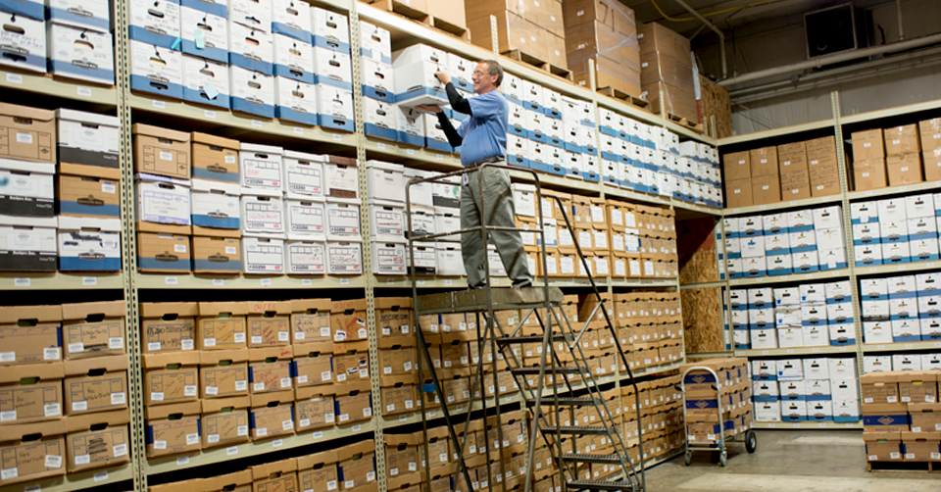
Storage Of Files
For Storage of Files we require
  One Work order.
  One Inventory Worksheet per box(worksheet contains brief description of box contents).

Slide 6
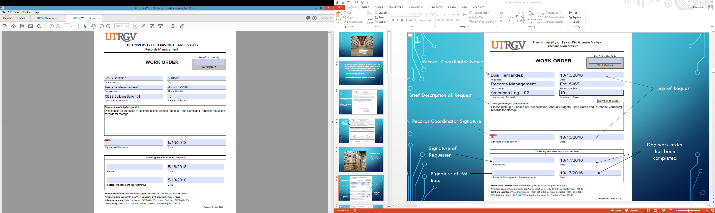
Work Order
1.
Records Coordinator Name
Day of Request
Brief Description of Request
Records Coordinator Signature
Day work order has been completed
Signature of Requester
Signature of RM Rep.

Slide 7
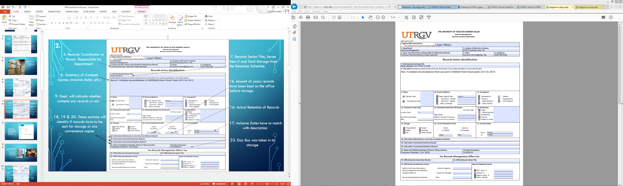
2.
4. Records Coordinator or Person Responsible for Department
7. Records Series Title and Series Item #.
5. Summary of Contents (names, inclusive dates ,etc.)
16. Amount of years records have been kept on the office before storage
9. Dept. will indicate whether contents are records or not
16. Actual Retention of Records
18, 19 & 20. These sections will identify if records have to be sent for storage or are convenience copies
17. Inclusive Dates have to match with description
23. Day Box was taken in to storage

Slide 8
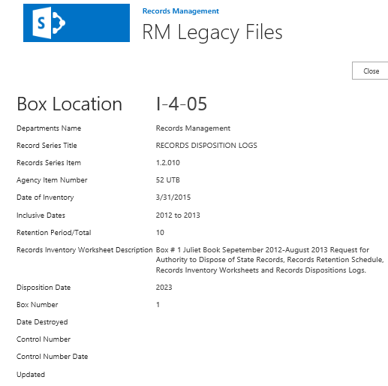
Example of label
All the information on label should match information on Inventory Worksheet and Retention Schedule (Created by RM for Internal Departmental use only)

Slide 9
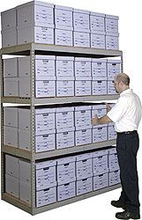

Box Retrieval
If any Department should need to retrieve a box for any reason we require:
  One Work Order
  Records Inventory Worksheet or any additional details pertaining to what they are looking for so that we can locate and fulfill their request as quickly as possible.

Slide 10
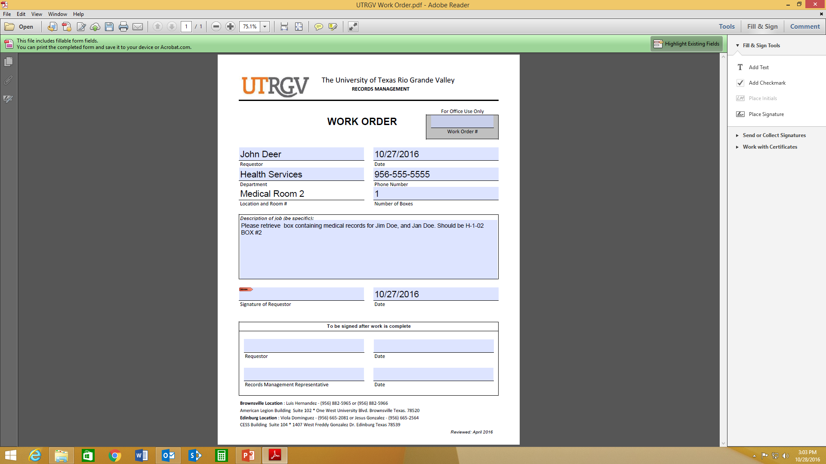
1.
Records Coordinator or Person Responsible for Department
Day of Request
Description of what needs to be retrieved (the more details the better)
Records Coordinator Signature
Signature of Requester and RM Rep
(will be signed once dept. is finished looking at records)
Day work order has been completed

Slide 11
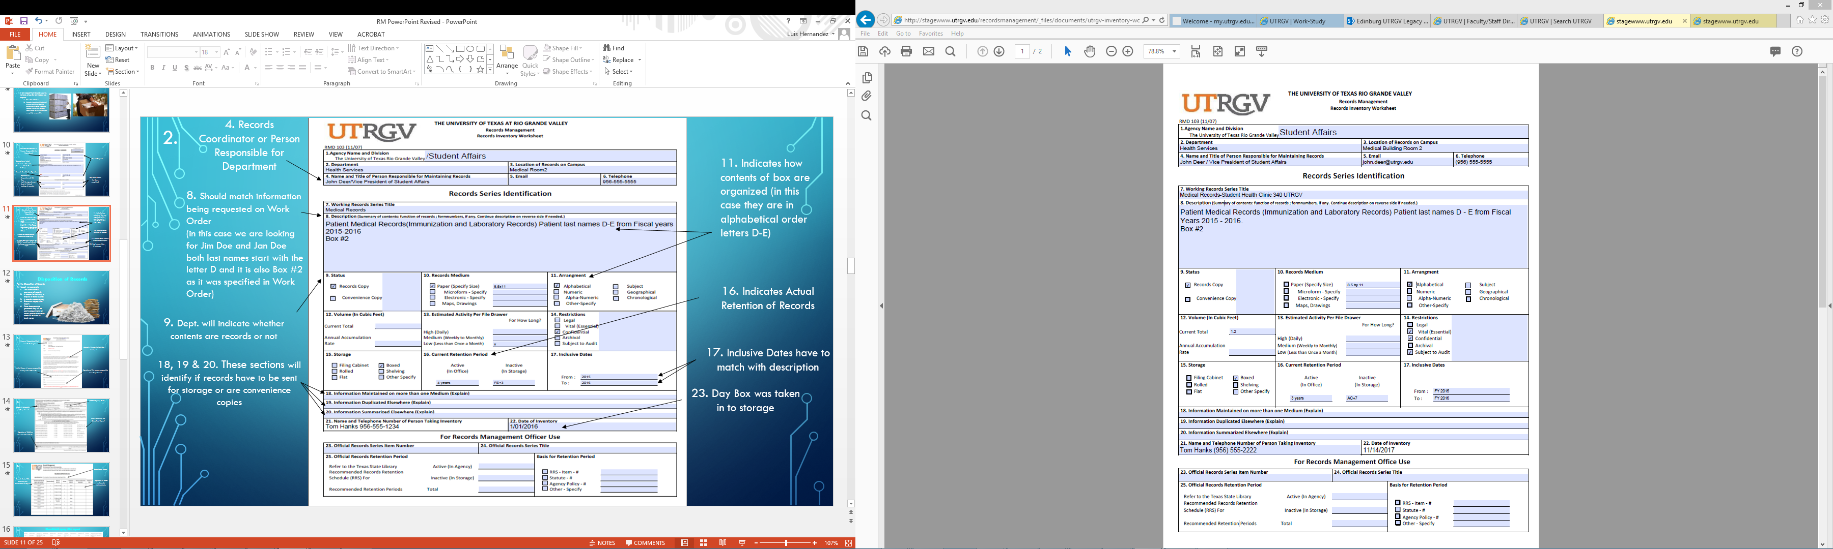
4. Records Coordinator or Person Responsible for Department
2.
11. Indicates how contents of box are organized (in this case they are in alphabetical order letters D-E)
8. Should match information being requested on Work Order
(in this case we are looking for Jim Doe and Jan Doe both last names start with the letter D and it is also Box #2 as it was specified in Work Order)
16. Indicates Actual Retention of Records
9. Dept. will indicate whether contents are records or not
17. Inclusive Dates have to match with description
18, 19 & 20. These sections will identify if records have to be sent for storage or are convenience copies
23. Day Box was taken in to storage

Slide 12

Disposition of Records
For the Disposition of Records (In-House) we generate
  One Memo for the Destruction of Records
  A Request for Authority to Dispose of State Records
  A Records Disposition Log
  SharePoint Legacy Files Report.
  Once documents are generated they will be sent to departments for review prior to destruction in case of an Audit or legal matter.

Slide 13
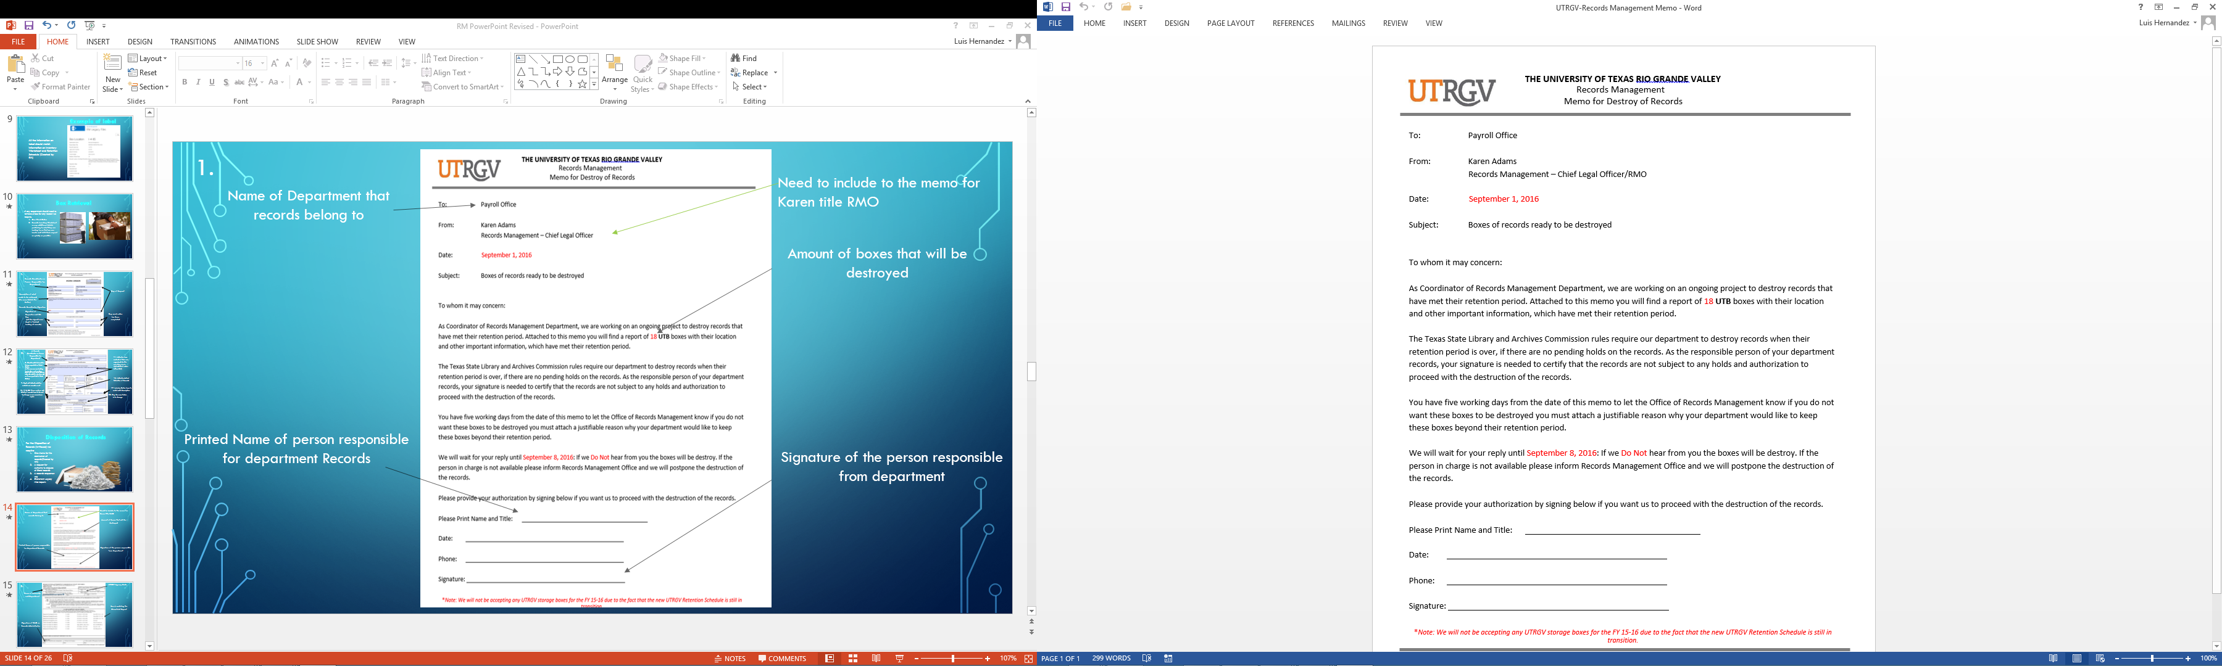
1.
Name of Department that records belong to
Amount of boxes that will be destroyed
Printed Name of person responsible for department Records
Signature of the person responsible from department

Slide 14
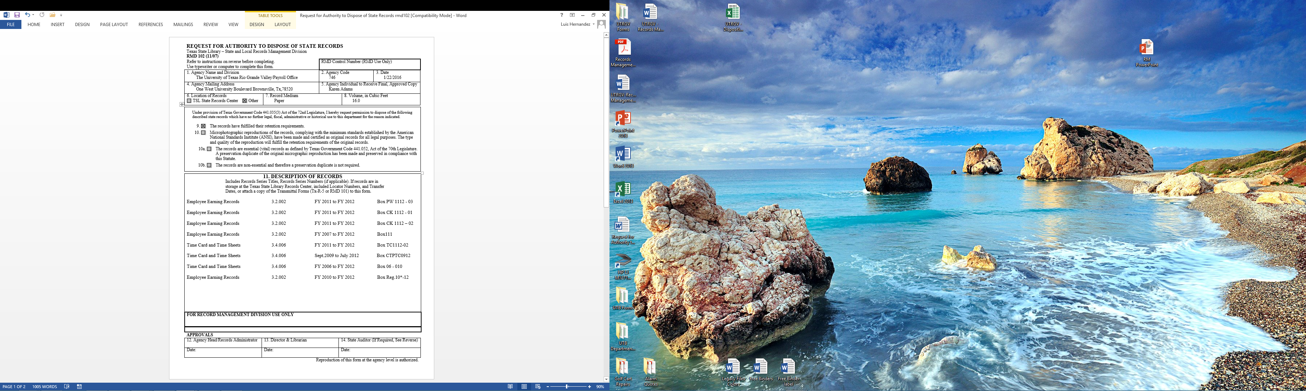
2.
UTRGV Agency Code
Name of University and Department
Box # matching the SharePoint Report
Signature of RMO or Records Administrator

Slide 15
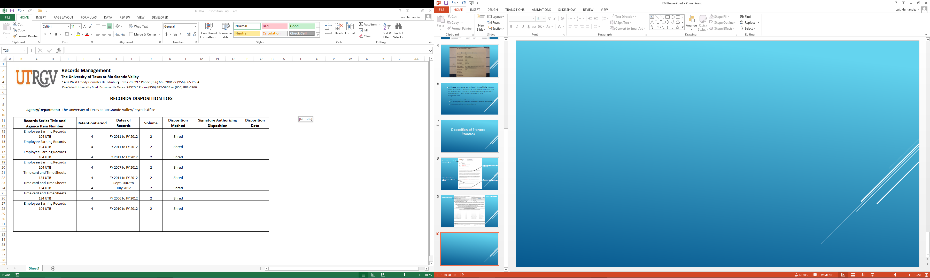
3.
Department Name
Records Series Title Matching the information on Report
Signature of RMO or Records Administrator

Slide 16
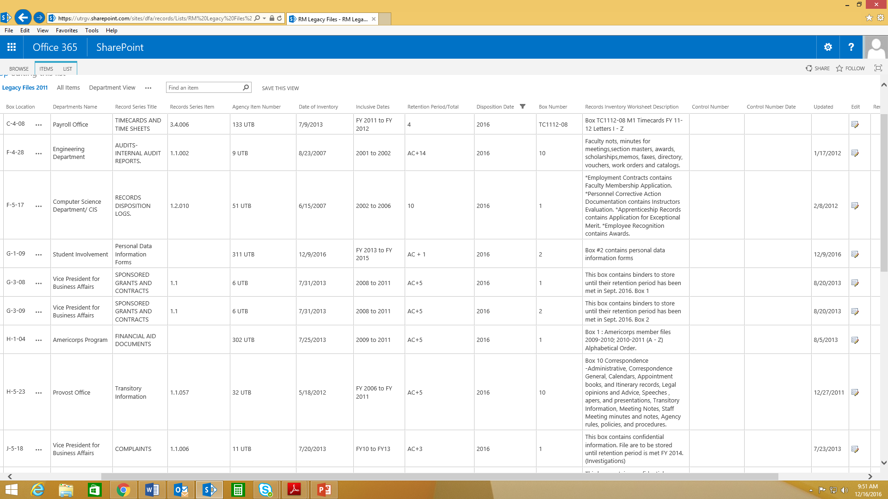
4.
SharePoint Legacy files report

Slide 17


Disposition of Records
For the Disposition of Records (Pick-up for Disposition) we require
  One Work Order
  One Departmental Destruction Form

Slide 18
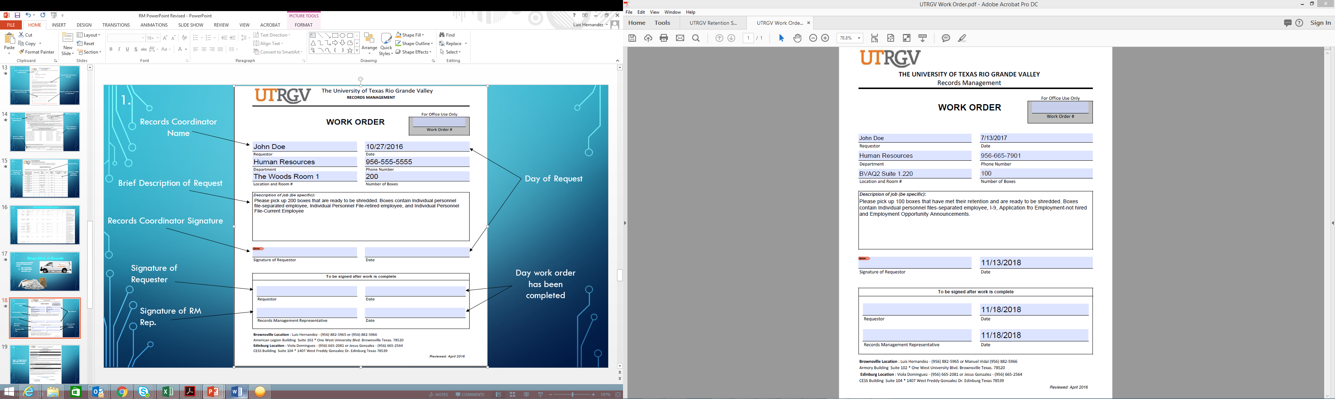
1.
Records Coordinator Name
Brief Description of Request
Day of Request
Records Coordinator Signature
Signature of Requester
Day work order has been completed
Signature of RM Rep.

Slide 19
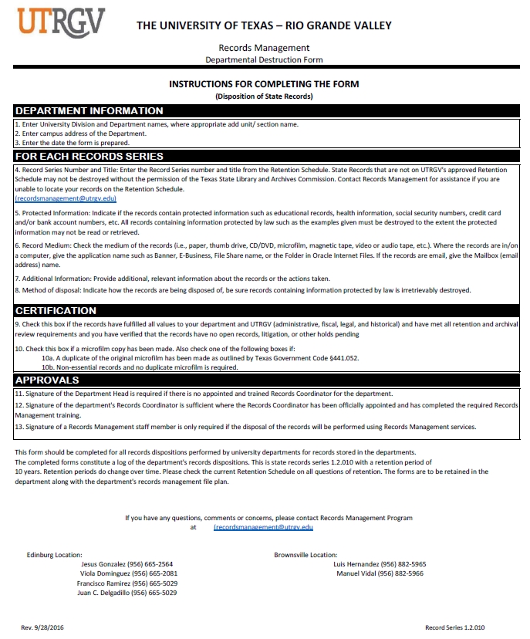
2.
Page 1 of Departmental Destruction Form shows how to fill out page 2.

Slide 20
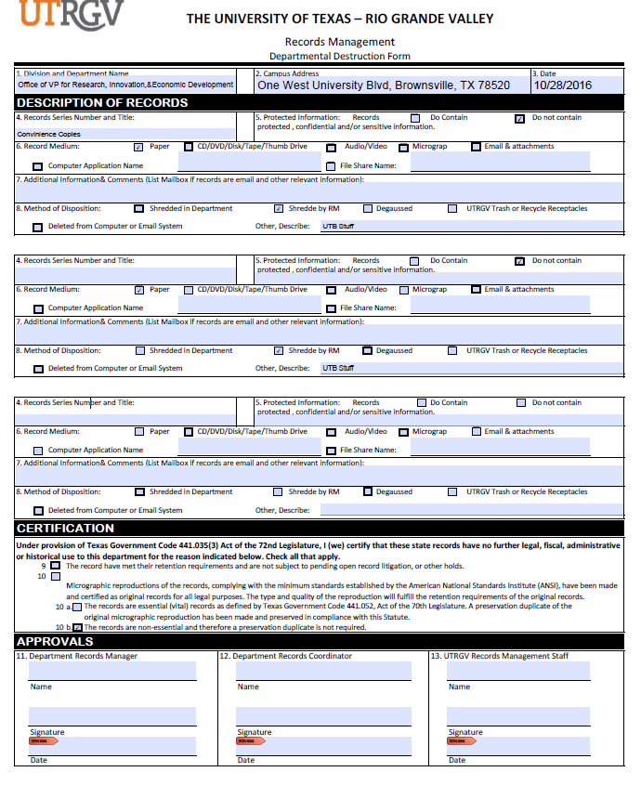
Page 2.
5. Indicates if box contains sensitive information or not
4. Indicates if files to be destroyed are convenience copies or other type of records base on the retention
6. Indicates the type of file to be destroyed
8. Indicates how files are to be disposed of
9-10 b. Please indicate the reason files are to be destroyed, and check off any that apply
11&12. Require printed name and signature of person in charge of records for their Dept.
13. Will be signed by RM Rep.

Slide 21
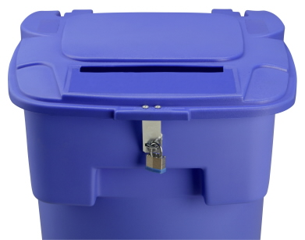
Disposition of Bin Contents
For Disposition of Bin Contents we require:
  One Work Order
  Security Container Agreement
  Departmental Destruction Form

Slide 22
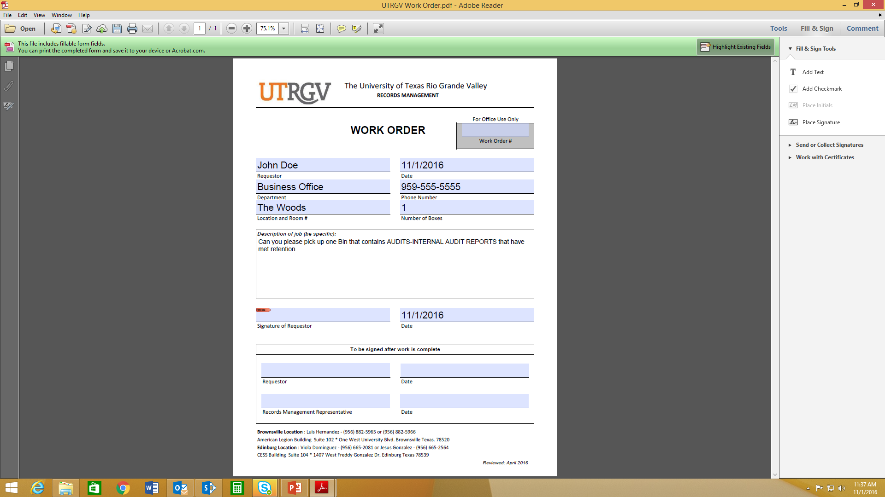
1.
Records Coordinator Name
Brief Description of Request
Day of Request
Records Coordinator Signature
Signature of Requester
Day work order has been completed
Signature of RM Rep.

Slide 23
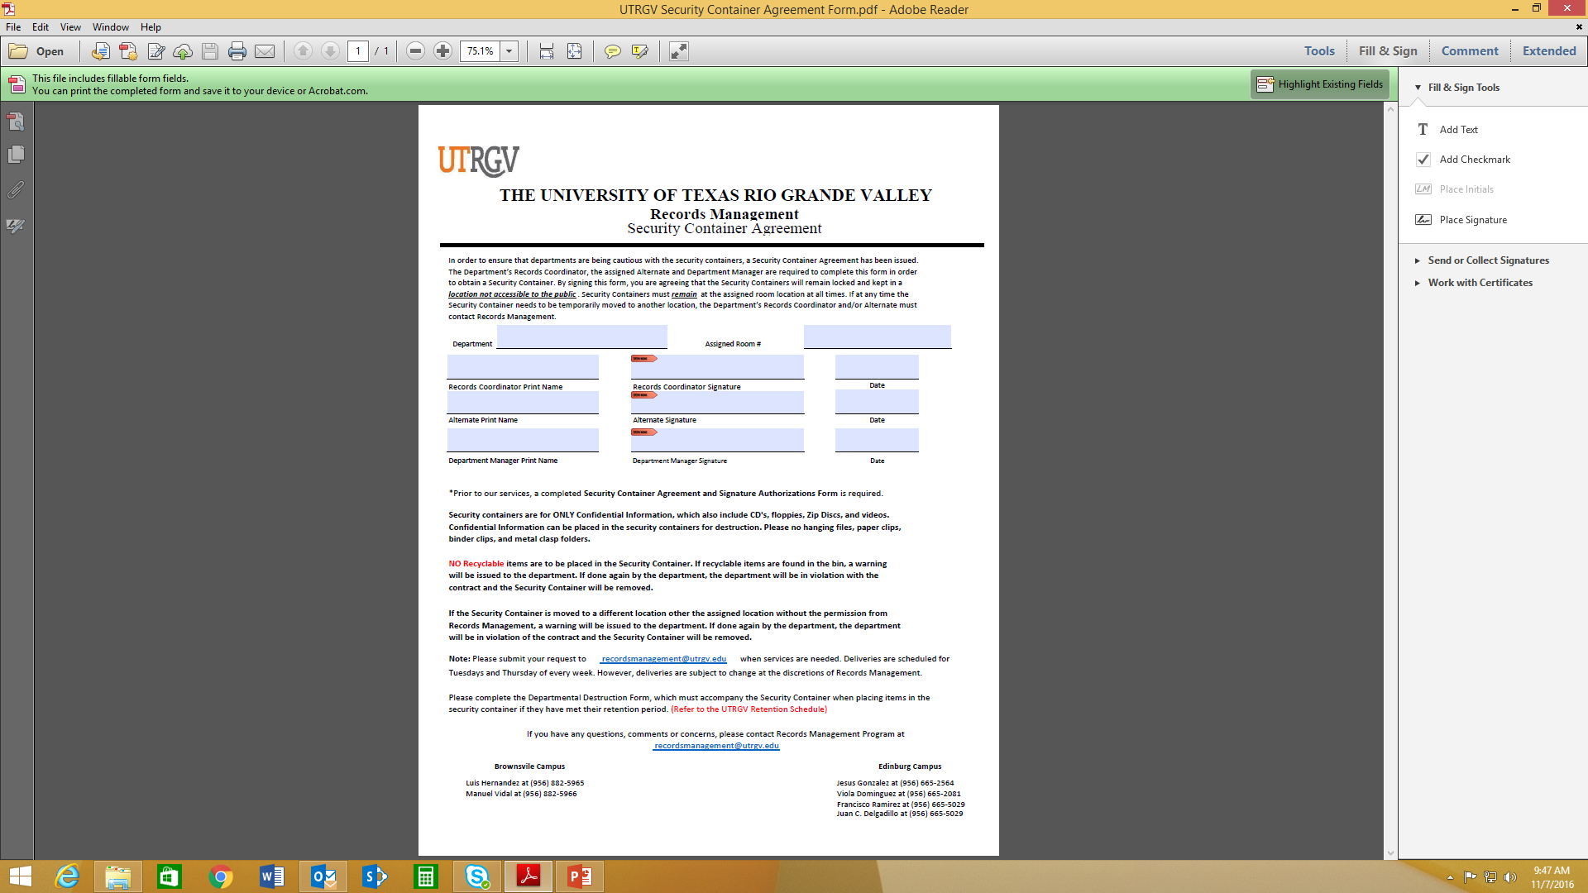
2.
Department Name
Printed Name and Signature of Records Coordinator
Location
In case Records Coordinator is not present, an Alternate person can sign the Agreement
Printed Name and Signature of Department Manager

Slide 24
3.
Page 1 of Departmental Destruction Form shows how to fill out page 2.

Slide 25
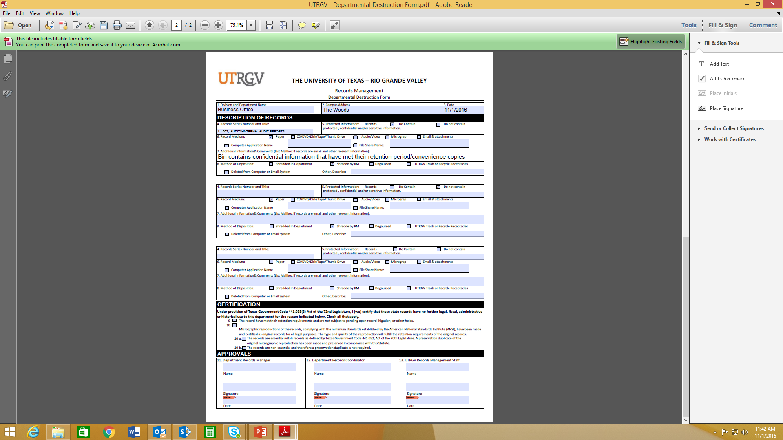
5. Indicates if box contains sensitive information or not
4. Indicates if files to be destroyed are convenience copies or other type of records
6. Indicates the type of file to be destroyed
These sections are filled out if there other types of documents included in Bin
8. Indicates how files are to be disposed of
9-10 b. Please indicate the reason files are to be destroyed, and check off any that apply.
11&12. Require printed name and signature of person in charge of records for their Dept.
13. Will be signed by RM Rep.

Slide 26
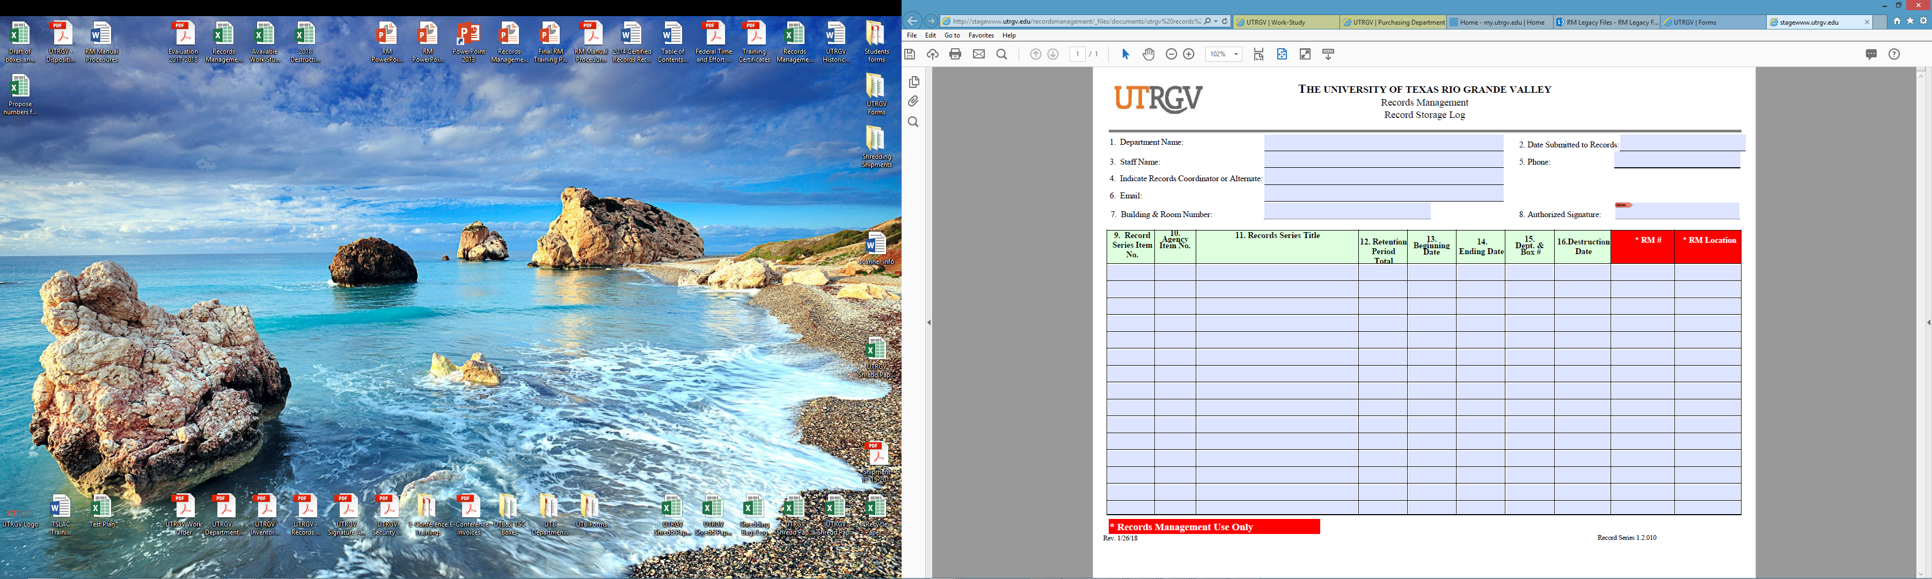
Optional for departmental use

