Slide 1
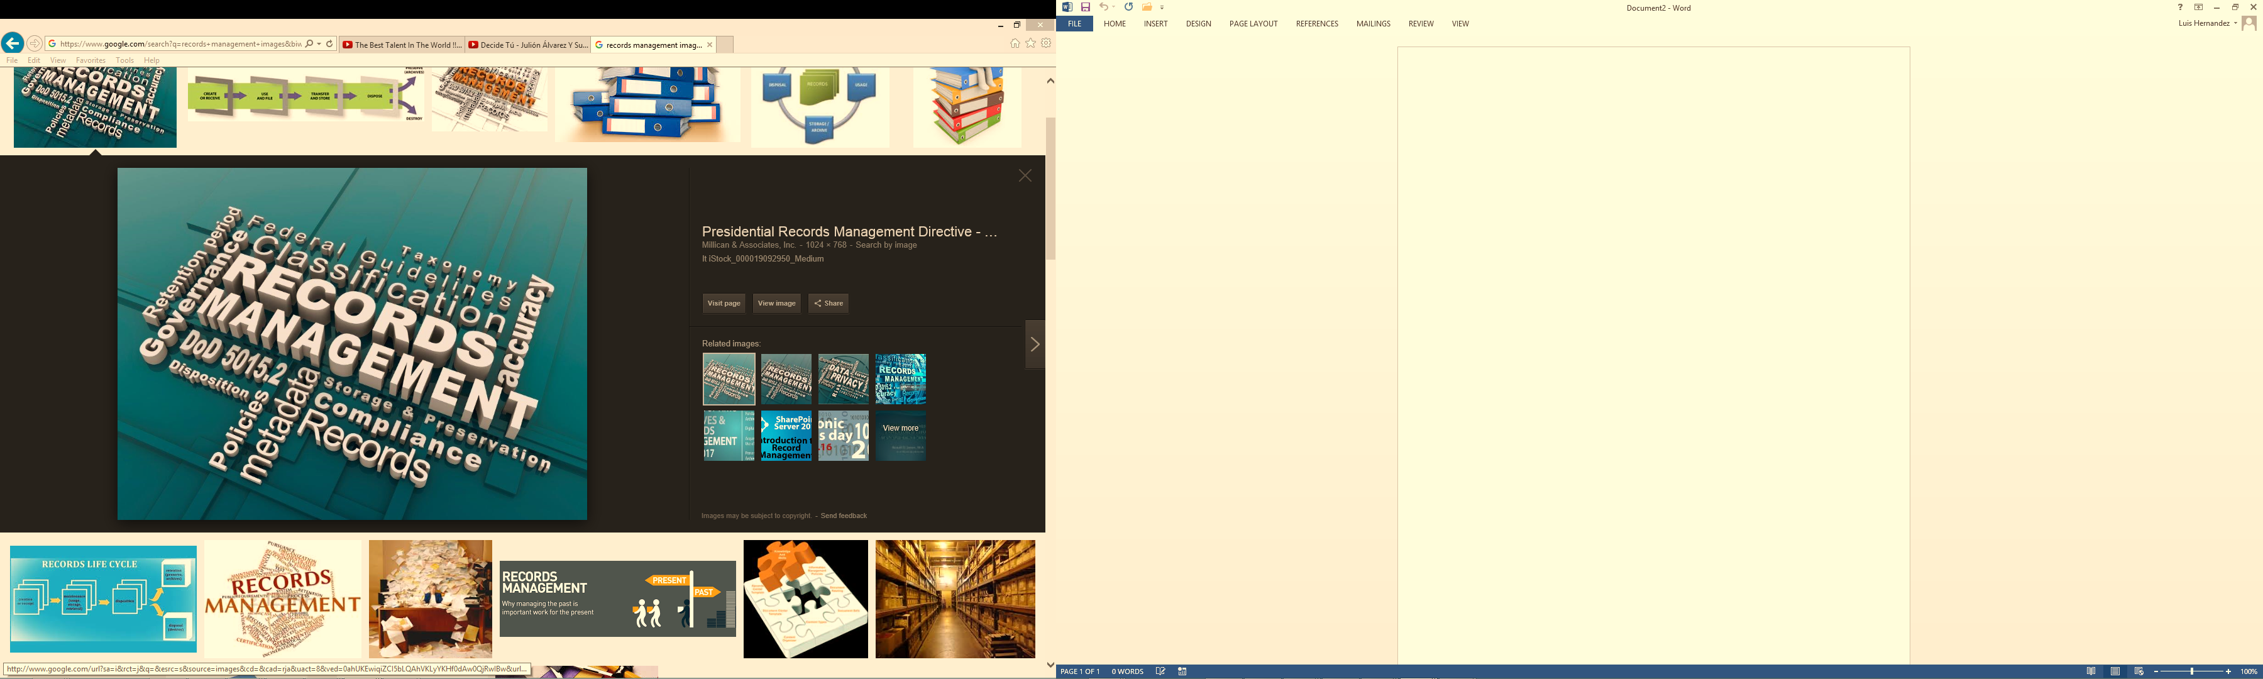
Training for Records Coordinators and Managers
The University of Texas Rio Grande Valley

Slide 2
Topics Covered
Records Management Basics
Definition of Records
Records Retention Schedule
What is a Record?
Storage of Records
Destruction of Records
Strategies & Best Practices
Questions?

Slide 3

What is Records Management?
The application of management techniques to the creation, use, maintenance, retention, preservation and destruction of state records for the purpose of complying with Texas Statutes and other laws, Texas State Library & Archives Commission rules, UT System and UTRGV policies, as well as improving the efficiency and quality of recordkeeping to benefit the overall operations of UTRGV as a University.

Slide 4
Introduction
Records Management Program
Filing & Storage
Retention
Inventory
Electronic Records
Management Content
Records Management
Destruction
Security
Litigation Files
Archives
Vital Records

Slide 5


Records Management Basics
Breakdown of Records Management Department
Determine what is a record
Determine what are Convenience Copies
Emails and how to handle them
Electronic Records
RM Tools
Who is ready to jump into the Records Management System?

Slide 6
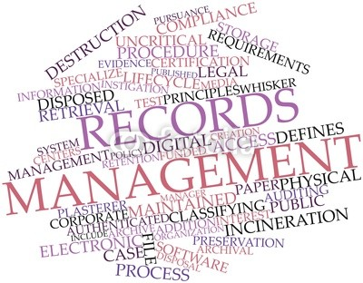
Records Management
Records Management Officer (RMO):
Responsible for coordination of all records management efforts at UTRGV communicates with TSLAC entity and serves as agency subject matter expert.
Records Management Coordinators (RMC):
One or more individuals designated by every Department as responsible for the coordination of records management efforts within that Department or Division.
Duties include the following:
Conducting Annual Audits
Submission of Storage Requests
Submission of Disposition Requests
Submission of Proposed Amendments (Adding Records Series Title, etc.)
Understanding & Applying RM Manual policies
Understanding & Applying RM Retention Policies as they relate to Records

Slide 7
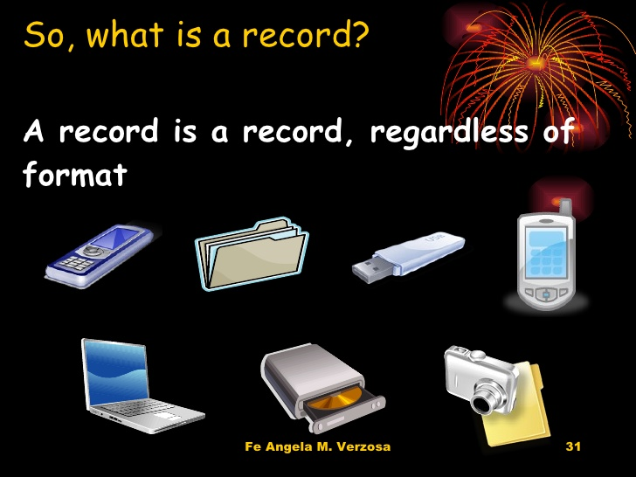
What is a Record
“Any written, photographic, machine-readable, or other recorded information created or received on behalf of a state agency or an elected official that documents activities in the conduct of state business or use of public resources.”
[ ADM 10-102 Records Management & Retention ]

Slide 8


How to determine what IS a record?
What is a record?
What is not a record?
A state record is a physical piece of paper or data stored electronically that documents activities in the conduct of University business.
State records are NOT a convenience copy, blank form, personal document (do not relate to UTRGV business) or draft versions of a document.

Slide 9
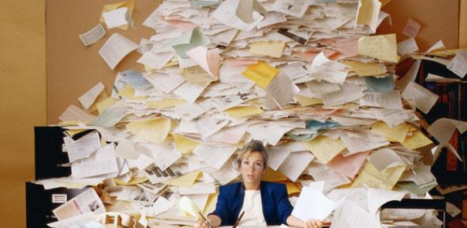
What is a convenience copy?
A “convenience” copy is a duplicate of the official record used for reference purposes. Convenience copies should be destroyed when no longer useful and should never be kept longer than the official record.
CAUTION! Care must be taken in determining whether a duplicate record is really a convenience copy, or if two or more copies might be official records for different reasons. It is possible for the same document to be in two departments and be a record copy because they serve a different function in each department.

Slide 10

Understanding E-Mail
3 important things
you must remember:
An e-mail can be a record – it is a medium (or format) that a record can be stored in.
You are responsible for determining whether the content in an email is a record and needs to be saved according to the Records Retention Schedule.
You will not find a line item on the RRS for emails.

Slide 11

E-mails Not Considered Records:
Spam: not a record according to Records Management standards.
CC’s / BCC’s: same as a paper convenience copy, you are not the record custodian.
Unsolicited email: vendors, non-work-related e-mail from coworkers, news articles.
Personal email: no relevance to UTRGV business.

Slide 12

Electronic Records or E-Records
E-Records are state records that are stored electronically. (Servers, email archives and databases, etc.)
Once you make a paper state record electronic (by scanning, etc.), the paper record can be destroyed (by following the requirements on the Records Retention Schedule) and the electronic copy becomes the official record.
Electronic records (soft copies) must follow the retention schedule the same way paper records (hard copies) do.

Slide 13

Records Retention Schedule
“Keeping our Coordinators in a row”
The Texas State Library and Archives Commission (TSLAC) is responsible for the State’s Records Retention Schedule and certifies all state agencies.
The University Records Retention Schedule aligns with the State Records Retention Schedule but also includes records series items that are specific to UTRGV. It is an official document that must be followed. Failure to comply with the UTRGV creates risks for the University and its employees.

Slide 14

What is the purpose of the UTRGV RRS?
Comply with state and federal laws and regulations
Define retention requirements for University staff
Provide guidance on proper management of UTRGV records
Identify, protect and secure vital records
Identify archival records

Slide 15
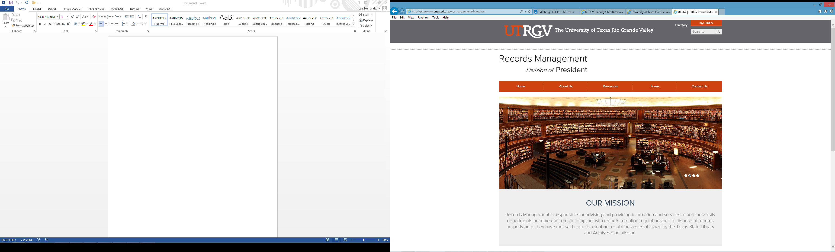
Where do I find the UTRGV Records Retention Schedule?
The UTRGV Records Retention Schedule (RRS) can be found on the Records Management website under resources.
http://www.utrgv.edu/recordsmanagement

Slide 16

How do I read the RRS?
The schedule is broken down into 13 fields, but we will focus on 8 key fields:
  Agency Item Number (3)
  Record Series Item Number (4)
  Record Series Title (5)
  Description (6)
  Retention Period (8)
  Archival Code (requires review by the State Archivist) (10)
  Remarks (11)
  Legal Citations (12)

Slide 17
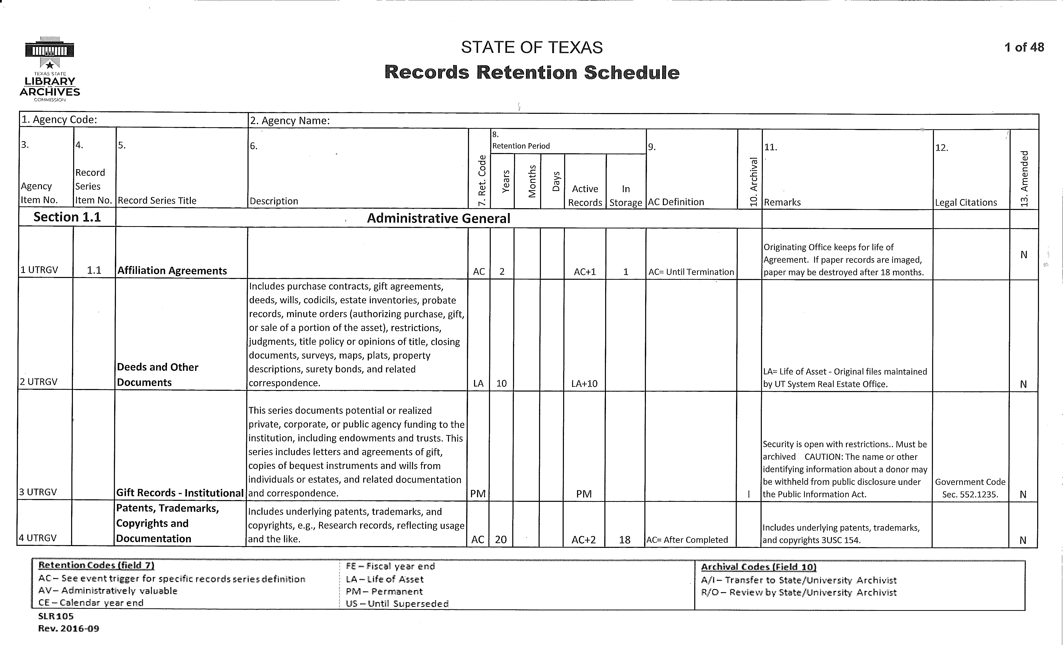

Slide 18
What do the Retention Codes mean?
AC – After closed, settled, expired, completed, terminated
AV – As long as administratively valuable
CE – Calendar year end (December 31st)
FE – Fiscal year end (August 31st)
LA – Life of the asset
PM – Permanent
US – Until superseded (replaced by updated version)
Number of months or years

Slide 19

Who is the holder of the record?
The person who owns the “final” record is the official owner. If that’s not you, you have a copy or a draft.
Examples:
HR is the record custodian for an I-9’s
Finance & Finance is the record custodian for Travel Vouchers
Financial Aid is the record custodian for Student Records
RM is the custodian of all records once they been sent to storage
Notes:
Travel Vouchers, Cell Phone Bills, General Manual, Record Retention Schedule

Slide 20
Other things to know about the Records Retention Schedule
The UTRGV Records Retention Schedule will be recertified (updated) every 4 years with TSLAC.
Amendments may be submitted within those 4 years through Records Management with TSLAC approval if a change to the RRS needs to be done.
To dispose of something that is not currently on the RRS, a form (RDM 102) must be filled out requesting disposition from TSLAC through Records Management. Contact the Records Management for more information on submissions.

Slide 21

Destruction Of Records

Slide 22

I don’t need this record anymore; can I shred it any time I feel like it?

Slide 23

You must be aware of several things before you destroy an official document.
  Ask yourself these questions:
  Is this document a record on the Record Retention Schedule?
  Does the record exist at another UTRGV department or does the department own this document?
  Has it met or exceeded its retention period that is listed on the Records Retention Schedule?

Slide 24
Caution! Don’t dispose records on “Holds”
Even if a record meets retention requirements it may not be disposed if any litigation, claim, negotiation, audit, public information request, administrative review, or other action involving the record is initiated, impending, or imminent until the completion of the action and the resolution of all issues that arise from it.

Slide 25
Storage of Records
There are many ways to store records, both physical and electronic. Please always adhere to your UTRGV RRS for methods of storage always.
If you come across documents that require either permanent or long-term storage at UTRGV Records Retention Schedule, please contact the Records Management for assistance.
If records require to be Archived/Archival review, please contact Records Management also.

Slide 26

Strategies and Best Practices
Conduct an annual audit of hard copy files and e-records
Discard of duplicates, transitory information
Create folders/subfolders and arrange records into alphabetical order or logical groups
Assign storage areas and organize by business function
Make sure you know
where your records are!

Slide 27
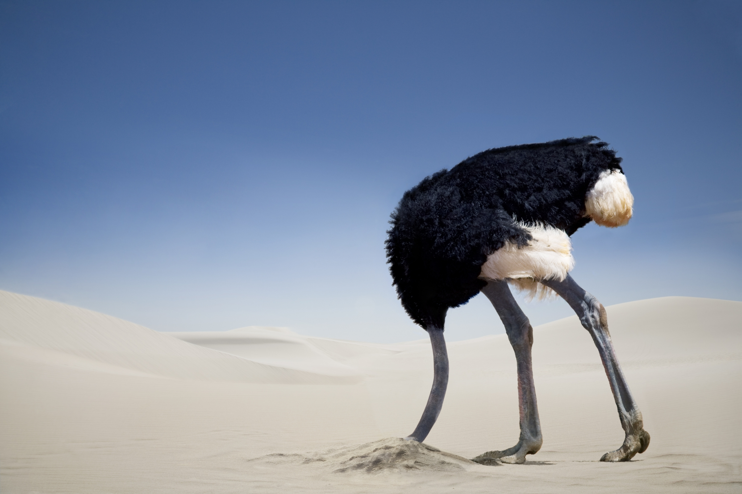
Questions?
Don’t just put your head under ground…
Call the Records Management if you have questions, concerns or issues that you are facing in your new role as a Records Manager or Records Coordinator for your Department or Division.

Slide 28

Contact Information:
recordsmanagement@utrgv.edu
Edinburg Office
Jesus Gonzalez jesus.gonzalez@utrgv.edu
(956) 665-2564 or (956) 665-2081
Francisco Ramirez francisco.ramirez@utrgv.edu
(956) 665-5029
Andrew Gandy andrew.gandy01@utrgv.edu
(956) 665-2081
Brownsville Office
Luis Hernandez luis.hernandez@utrgv.edu
(956) 882-5965
Rodrigo Candaudap rodrigo.candaudap01@utrgv.edu
(956) 882-5966

