Slide 1
Day 1
Magnetic Levitation Train Systems
Railway Safety

Slide 2
Introductions and Assign Students to Groups
  Set up Groups:
    Groups must come up with a Team Name
      Each member must be assigned one of these four roles:
        Lead Engineer(Oversees and helps with every single aspect of the project)
        Mechanical Engineers (Oversees Rails, Motors, and Sensors)
        Electrical Engineer (Software) (Programming and Functions of robot)
        Manufacturing Engineer(Oversees and Leads the building process)

Slide 3
Activity 1
Chalkboard Sentences
Objectives:
Access prior knowledge of students pertaining to railway safety
Formulate a sentence about railway safety. Each team member will only add one word to the sentence. Team members are not allowed to talk to each other.

Slide 4
Vocabulary for the Day
Force - Push or pull between two objects
Mass - Amount of matter in an object
Acceleration - increase in the rate or speed of something
Velocity - the speed of something in a given direction
Magnetic force - Attraction or repulsion that happens between electrically charged particles that are in motion.

Slide 5
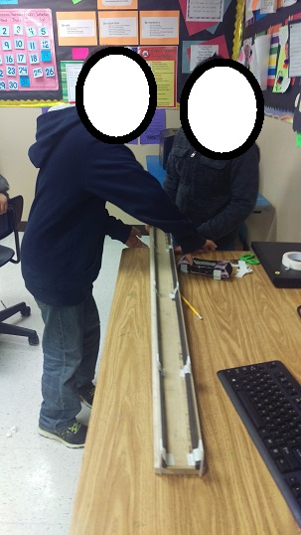
Activity 2
Mag-Lev Design, Incline, Speed
Show a video on Mag-Lev Train: Magnetic Levitation Train Video
Build Mag-Lev track
    Place each wood base on a flat surface.
    Slide the Plexiglas side rails into each side slotted groove.
    Lay magnetic strips so that it is flush against the Plexiglas side rail.
    Set up magnets on the car so that same poles of magnets face each other.

Slide 6
Activity 2
Allow some flexibility in this lesson, but make sure students understand to change only one element of their design at a time (height, magnets, color, etc.)
Construct four different inclines: 10°, 20°, 30°, and 40° and use five washers only (these represent five “passengers”)
Record in the data table the distance traveled and the elapsed time

Slide 7
Instructional Resources - Videos
https://www.youtube.com/watch?v=mn34mnnDnKU
https://www.youtube.com/watch?v=LEHR8YQNm_Q
https://www.youtube.com/watch?v=NYVMlmL0BPQ
http://studyjams.scholastic.com/studyjams/jams/science/forces-and-motion/inertia.htm (video not in file, need to copy and paste link)
http://studyjams.scholastic.com/studyjams/jams/science/forces-and-motion/acceleration.htm (video not in file, need to copy and paste link)

Slide 8
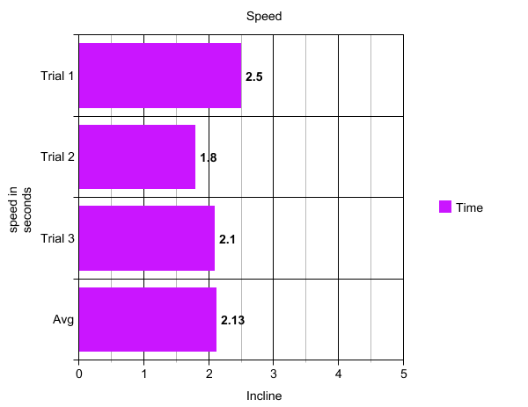
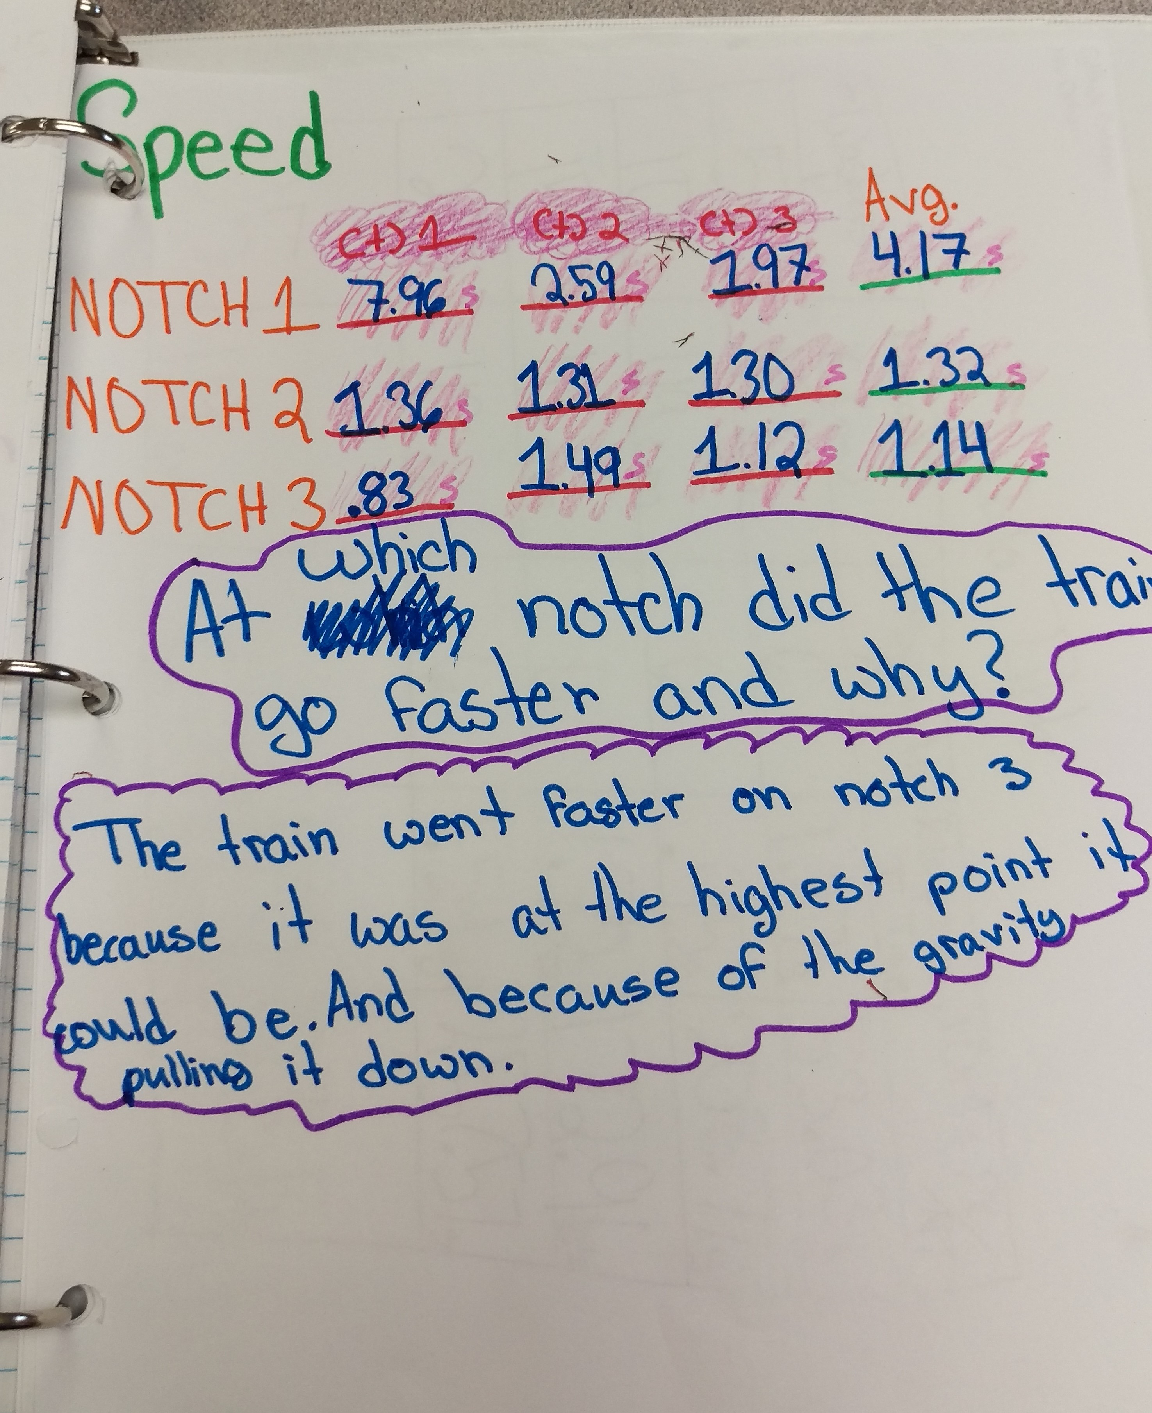
Example

Slide 9
Activity 3: Mass, Force, Acceleration
Review what was learned regarding speed and inertia.
Discuss speed, acceleration, and deceleration.
Using their findings, student groups should decide on the best incline.
Have students add washers (representing passengers) to their train car.
Measure the distance traveled and time elapsed.
Repeat process adding five washers at a time.

Slide 10

Discussion
How do external forces affect an object that is moving?
How many people can you get to stay on the maglev?
Write your results on a data table. 3 trials and calculate average.
How does this relate to Newton’s 1st Law? Newton’s 2nd Law?

Slide 11

Question Stems
What criteria would you use to assess …?
What data was used to evaluate …?
What would you suggest …?
What would happen if …?

Slide 12

Closure Activity
Explain your findings to the class. (Results and Conclusion)

Slide 13

Figure of Merit

Slide 14
Calculations
Calculate the Figure of Merit (FOM) for each trial.
Explain that the FOM is used to determine the best design as it takes mass, distance, time, and the number of passengers into account. The higher the FOM, the better the design FOM= 𝑷∙𝑿/𝑵∙𝑻
Where P = # of washers, X = distance traveled in cm, N = # of magnets, and T = elapsed time in seconds.

Slide 15
Discussion
Facilitate student understanding of the relationship between force, mass, and acceleration with some questions
For example:
  What happens to the distance traveled as the mass increases?
  What happens to the elapsed time when the mass increases?
  What happens to the acceleration as the mass increases?

Slide 16
Activity 4: Number of Magnets
Have students change the number of magnets of their car.
Calculate acceleration by measuring force and mass.
Record data on in the table provided

Slide 17
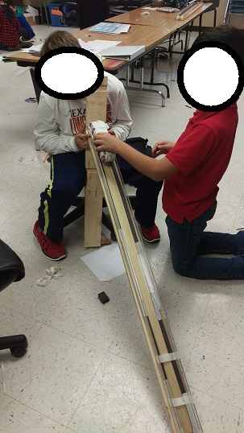
Activity 5: PTC Positive Train Control

Slide 18
Instructional Resources
https://www.youtube.com/watch?v=-VwHxCdn1Bk
https://www.youtube.com/watch?v=n6ATetoOhU4
https://www.youtube.com/watch?v=sRcv-I4zJWg
https://www.youtube.com/watch?v=9v6AfvKyFKQ

Slide 19
Instructional Resources
http://www.metrolinktrains.com/agency/page/title/ptc
https://www.fra.dot.gov/Page/P0621
http://www.progressiverailroading.com/ptc/article/Class-I-railroads-rate-the-state-of-positive-train-control--35442

Slide 20

Discussion
What is the importance of positive train control?
Have students explain one thing they learned about railway safety today.
Play video – Newton’s Laws (https://www.youtube.com/watch?v=mn34mnnDnKU).
Relate actvities to Newton’s 1st, 2nd, and 3rd laws.

Slide 21
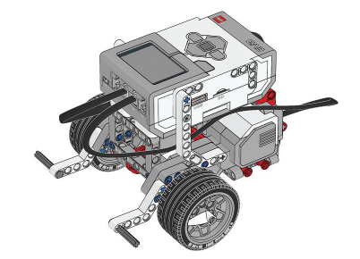
Day 2
Activity 1: Building Basic Bot
Use manual (provided with robot kit) and follow step by step procedure to building the basic bot.

Slide 22
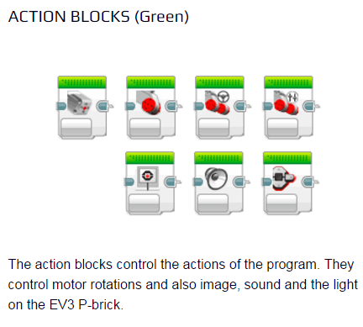
Activity 2
Basic Programming

Slide 23
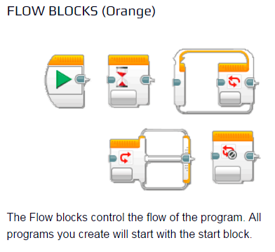
Basic Programming

Slide 24
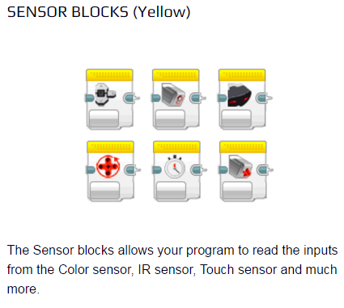
Basic Programming

Slide 25
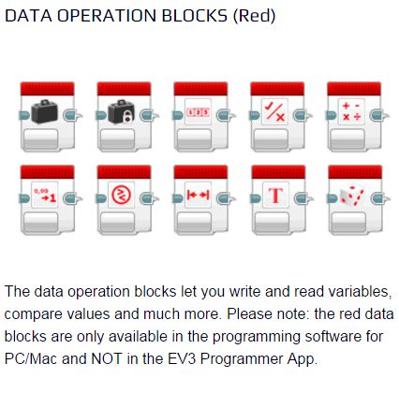
Basic Programming

Slide 26
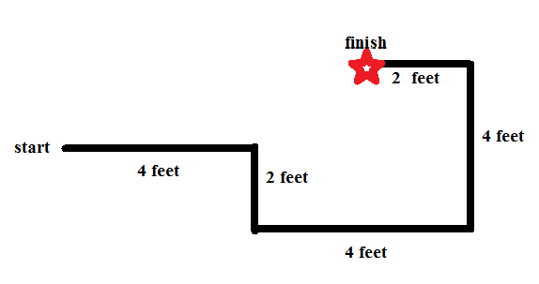
Activity 3: Program Your Robot

Slide 27
Programming Basic Movements
Use your curious nature and find out what happens when you input different settings on your action blocks
Once comfortable, try to follow the instructor’s challenge path to see who comes closest.

Slide 28
Day 3
Light Sensor

Slide 29
Activity 4
Use problem solving skills to create, run, and test programs created to control a robot.
Plan a route through an obstacle course that is efficient and obeys all traffic and railroad safety signs and signals.
Use the color sensor and the touch sensor to build a robot that can follow a line, and use the touch sensor as a guide to achieve specific commands.

Slide 30
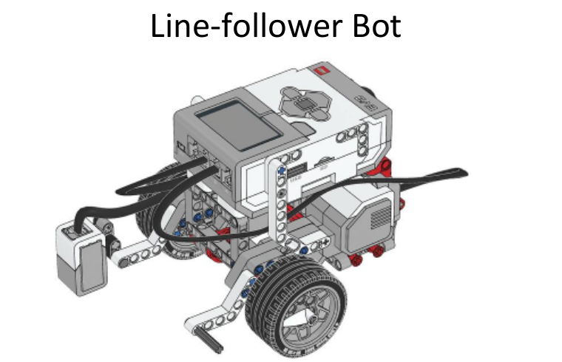
Objective:
Use problem solving skills to create, test, and run programs created to control a robot
A small change in design from the basic bot
Requires slightly more complex programming

Slide 31
Lesson Flow:
Explain to students that they are going to use the color sensor to teach their robot to obey safety signs and signals
Show students a video of the “Line Follow” and “Smooth Follow” programs on YouTube
https://www.youtube.com/watch?v=ODAGVeeDagk
Have students test their program after the addition of each block to make sure each command is programmed correctly

Slide 32
Line Follower
Notes: In this program, everything is inside a loop. The color sensor is set to measure reflected light intensity; the math blocks are set to advanced; the upper variable blocks are set to write numeric (default); the lower variable blocks are set to read numeric; and the move tank block is set to on. On the formula spaces, the formula is (a-b)*c.
Programing Video

Slide 33
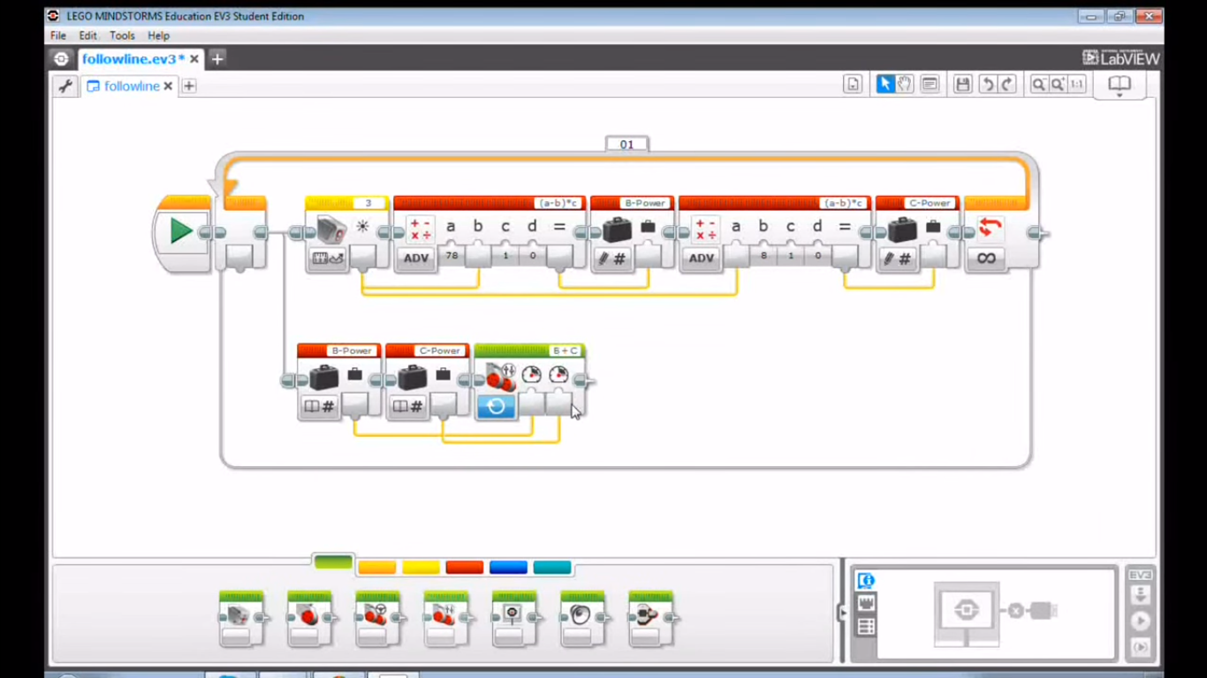
Line Follower Programming

Slide 34
Activity 5
Be a Safe Driver
Lesson Overview: Students will program their robot to follow traffic signals
  Objectives:
  Recognize and interpret traffic signs and signals.
  Recognize and interpret railway safety signs and signals
  Plan a route through an obstacle course that is efficient and obeys all traffic and railroad safety signs and signals.

Slide 35
Being a Safe Driver
Name and count the number of signs on the road they see every day when driving with their parents. What is safe driving?
What are the “do’s and do nots” of the road?
The basic traffic signs and laws: stopping at a stop sign, slowing down at a yellow light, slowing down in a school zone, and stopping when the gates are down at a railroad crossing

Slide 36
Building and Programming Safe Bot
Today you will learn to use the color sensor. The color sensor should be positioned at a right angle, approximately 1 cm from the surface of the test path
Your Safe bot needs to keep going at a green light, slow down at a yellow light, and stop at a red light
The Color Sensor Programing is. A switch block is placed inside a loop, and set to measure color.

Slide 37
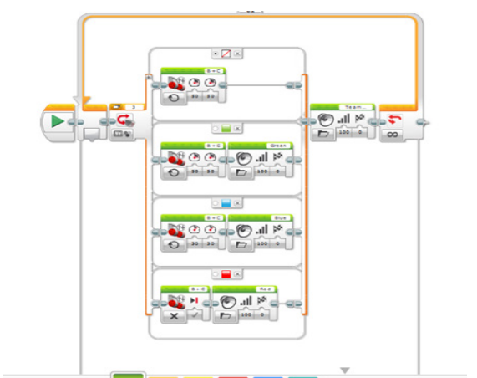
Programming
Note: A switch block is dragged inside a loop and set to measure color.
Then, actions are dragged into each color.
The no color tab is selected as default, and the default action is selected

Slide 38
Activity 6
Build And Program The Fork Lift
Lesson Overview: Students will use their knowledge and the medium motor to program their robot to move a Lego crate from point A to point B.

Slide 39
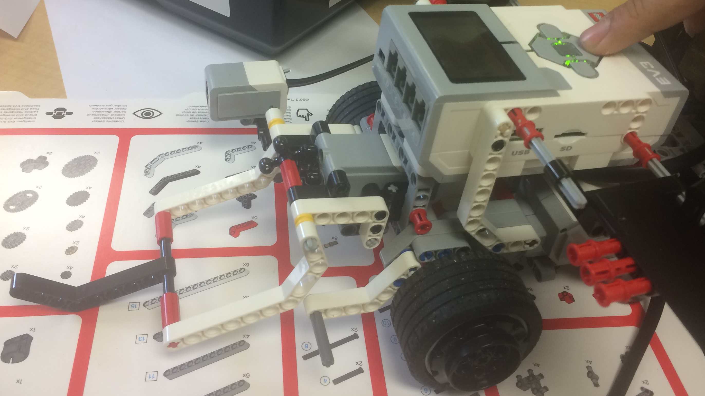
Objective
Use problem solving skills to create, test, and
run programs created to control a robot
A small change in design from the basic box hauler in instructions.
Requires slightly more complex
assembling

Slide 40
Lesson Flow
Explain to students that they are going to use the medium motor to lift a Lego crate, and move it to a designed location
Have students test their program after the addition of each block to make sure each command is programmed correctly

Slide 41
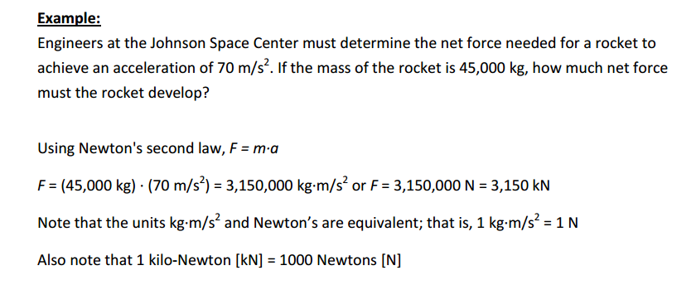
Newton’s Second Law of Motion

Slide 42
Power
Power is the rate at which work can be done, or how fast work can be done
Work is the force acting over a distance to move an object
Work = Force x distance
Power = Work/time

Slide 43
Day 4
Challenge

Slide 44
Challenge
Derailment Clean-up
Use problem solving skills to create, test, and
run programs created to control a robot
Create an original derailment theory using appropriate terms from the Railway Safety modules
Two part challenge in which students have to control a robot designed to reduce travel time to a derailment, and program the robot to clean up the derailment autonomously

Slide 45
Resources
Railway Safety Modules
Gear Assembly Video
Differential
Worm Gear
Control EV3 Using Cell Phone
Bluetooth Using Two Robots

