Slide 1
THE BEAUTIFUL LANDSCAPE OFFERED BY NATURE SITES - THE EDINBURG SCENIC WETLANDS AND WORLD BIRDING CENTER IN PERSPECTIVE
A presentation by Kofi Nketia Ackaah-Gyasi

Slide 2
Description
The first of nine birding centers to be opened, in March 2003, across the Rio Grande Valley.
It lies in the heart of South Texas, located in Edinburg, Texas, at the north-west area of the Edinburg Municipal Park.
The site houses about forty acres of birding and nature site including two miles of walking trails, three acres of butterfly gardens, and numerous ponds.
The center opens six days a week, from Monday through to Saturday.
Of the over 900 bird species that can be seen in the U.S, a little over 525 species have been recorded in the Rio Grande Valley, and of this number, about 296 species have been recorded at the site since 2003.
At the feeding centers in the site, one can enjoy the view of birds up close such as the plain chachalaca, the green jay, the great kiskadee, the clay colored thrush, the tropical kingbird, the buff-bellied hummingbird and the inca dove.

Slide 3
Description
About 140 species of butterflies have been documented in the birding center, including the majestic monarch, the Mexican bluewing, and the bordered patch.
The large ponds provide bird view of its inhabitants such as the egrets and other aforementioned pond animals.
The small ponds also provide drinking water to other birds and a means to get a cool shower on a hot sunny day in South Texas.
Each year, over 2,500 students spend 3 to 4 hours investigating wetlands.
The community garden serves as an educational demonstration garden and an actual community garden.
It also houses a native plant nursery where they grow native plants to plant in the garden and on site.
There is also the feathered nest, the gift shop of the center, which provides many nature books, educational toys, and home and garden décor.

Slide 4
History
It is the first world birding center to be opened in the Lower Rio Grande Valley, in March 2003.
It is was built by the City of Edinburg through a collective source of government funding: federal, state and local municipal founding.
Estimated cost of for the construction of the site and gardens is a total of about a million dollars.
Prior to the city of Edinburg owning the land, it was farm fields, so the wetlands are actually man-made holding ponds.These ponds were made for flood control.
The ponds are also tied to canals which bring in effluent water.

Slide 5
Mission
To educate people about the environmental necessity, economic value and natural beauty of local wetlands.
The center was created to help conserve native habitats for birds and other wildlife across the region, to promote ecotourism, and to help increase the understanding of the region’s vital natural resources through education and outreach.
Protecting native habitat and increasing the understanding of birds and wildlife.
With respect to the wetlands their mission includes educating the public about the importance of wetland habitat in an ecosystem for the protection of birds and education of residents about this important habitat.

Slide 6
Contributions
“We are the premiere in environmental education” (Oliva).
Since 2004, they have had all the fifth graders in Edinburg come out for a three-hour wetland field trip.
The center has helped make a difference in is the number of locals who are aware of and utilize an outdoor environment as recreation, and have joined the permanent staff and volunteers at the center.
“We are part of a larger system, not only of birding centers but of nature sites, that is growing young naturalists in the community, which is the best thing in the world to me” (Oliva).
As COVID lessens, and restrictions ease, the center will be engaging in many outreach events which they could really use the help of volunteers.

Slide 7
Goals/ Future plans
Infrastructural development – Marisa, the manager, intends on making the ground site more open and accessible. As part of this vision, the center is changing the dragonfly pond deck.
Climate change definitely has more detrimental impacts to the vegetative habitats than to humans. She said “The big freeze that occurred about two months ago killed off a whole lot of vegetation. Before the winter storm, in sometime last fall, there was a severe hurricane which destroyed about 15% of the vegetation. It took months to get many of the trees back on their feet”.
Having experienced these traumatizing events of climate change, Marisa plans on finding out the various ways and means of managing the habitats in the event of a similar situation reoccurring.
How do we change our management of the habitats?, “What do we need to do?”, “How do we make sure that we continue to be resilient and that we create systems to protect the habitats, in order to make sure that the habitat is available for wildlife?”.

Slide 8
Goals/ Future plans
We are looking at creating artificial housing structures, and finding ways of making sure that animals are resilient through climate change.” (Oliva).
With regard to the public, Marisa has ideas of making the grounds. They are trying to reach out to different audiences by having environmental education programs and activities that reach different groups of people.
Marisa said that “people must not only come visit the things that are local, taking Hidalgo County for instance, but they must explore all these natural sites around them. You don’t even have to know what species or what butterfly or bird, all you have to know is that this is a habitat and we can take parts and pieces of and put them in our backyard to create a safe and hopefully more resilient area for our wildlife to come.” (Oliva).
Marisa would also love to see a nature preschool, and some other incredible structures that attract people to the center. She said that “I have big dreams, but I don’t want to put them on record.”.

Slide 9
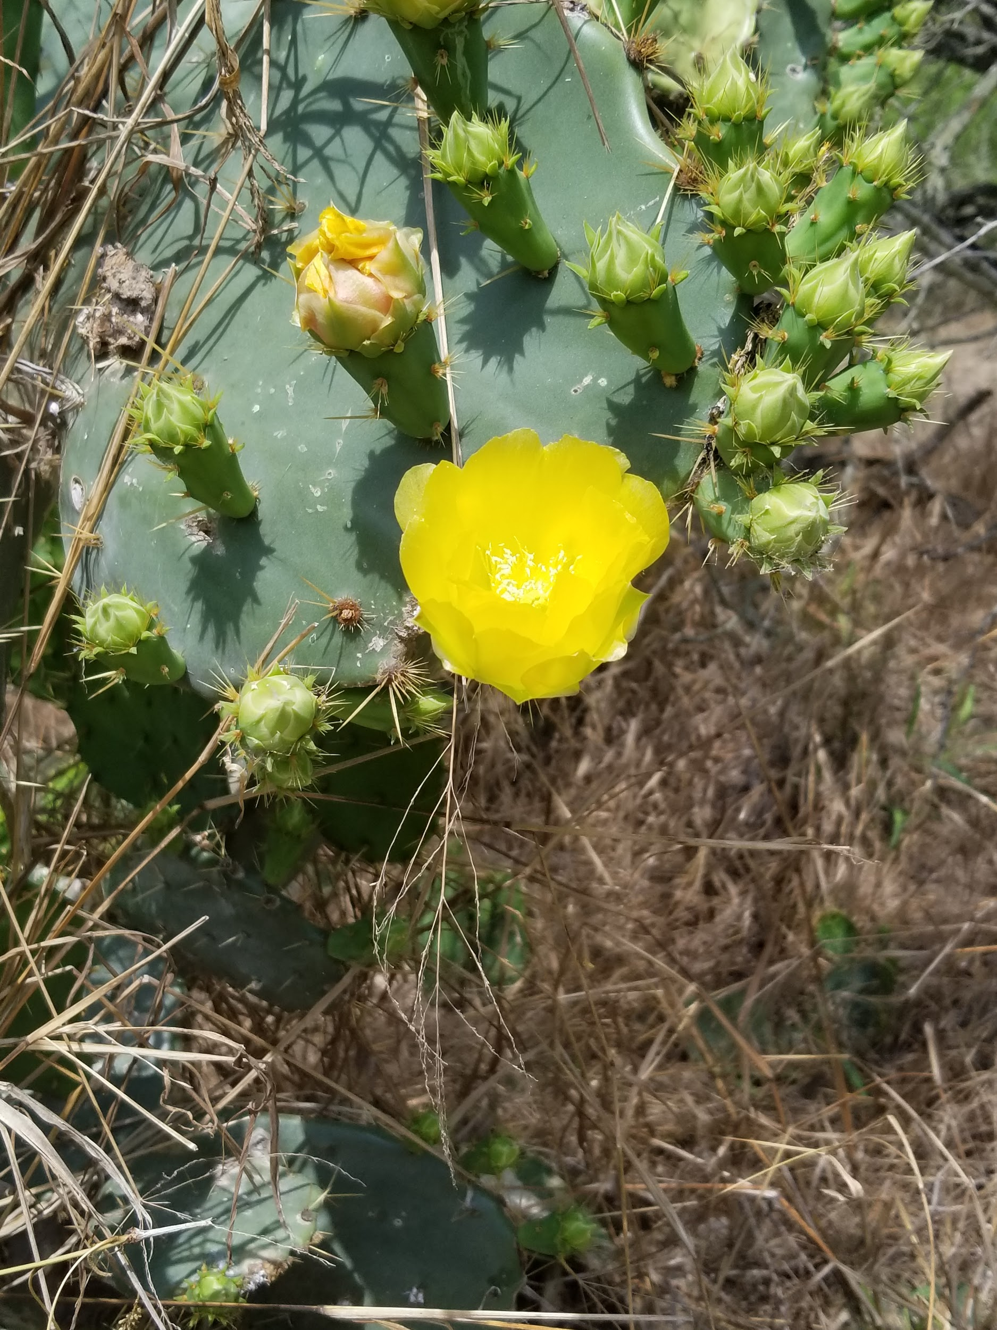
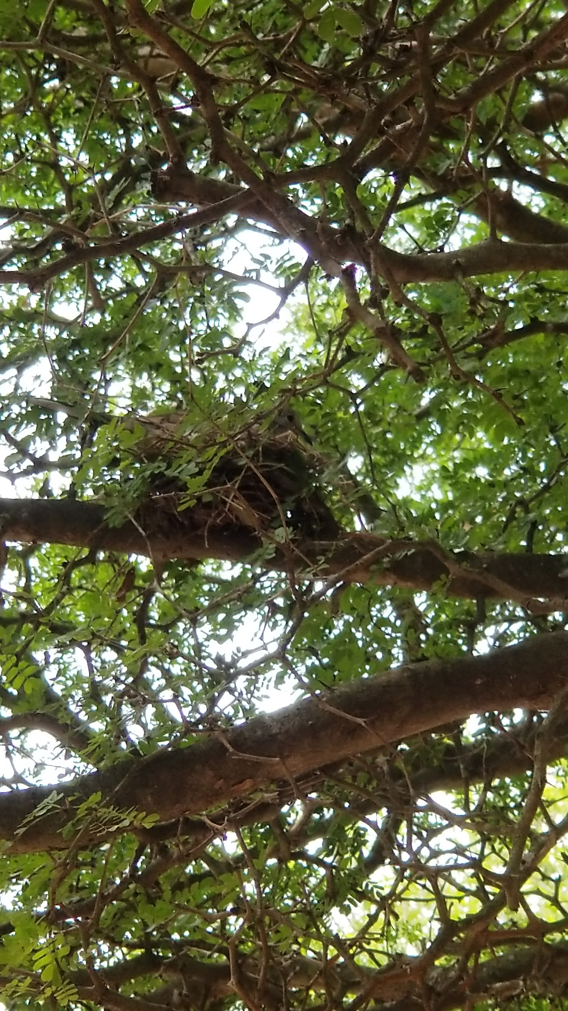
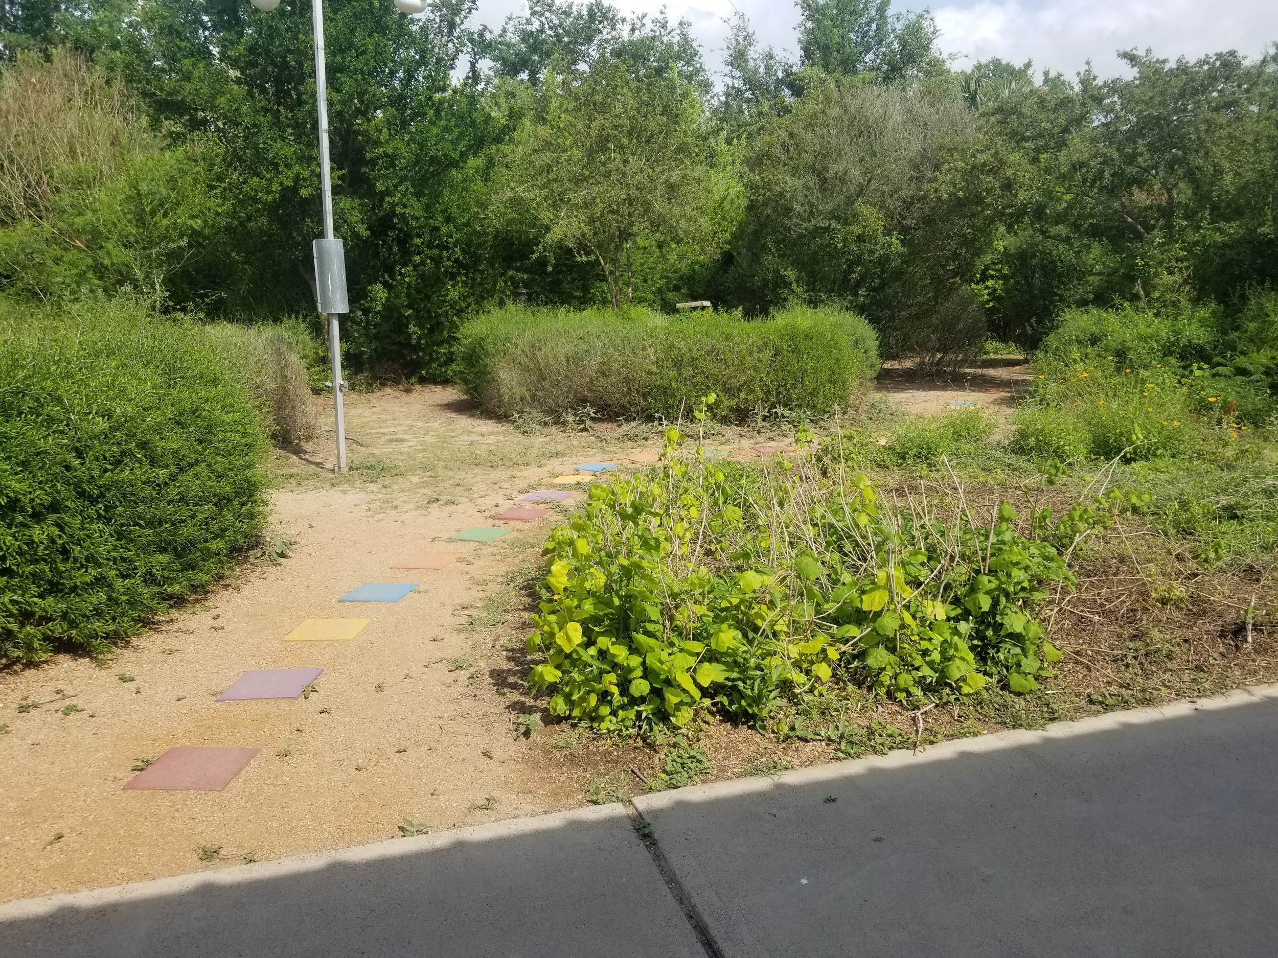
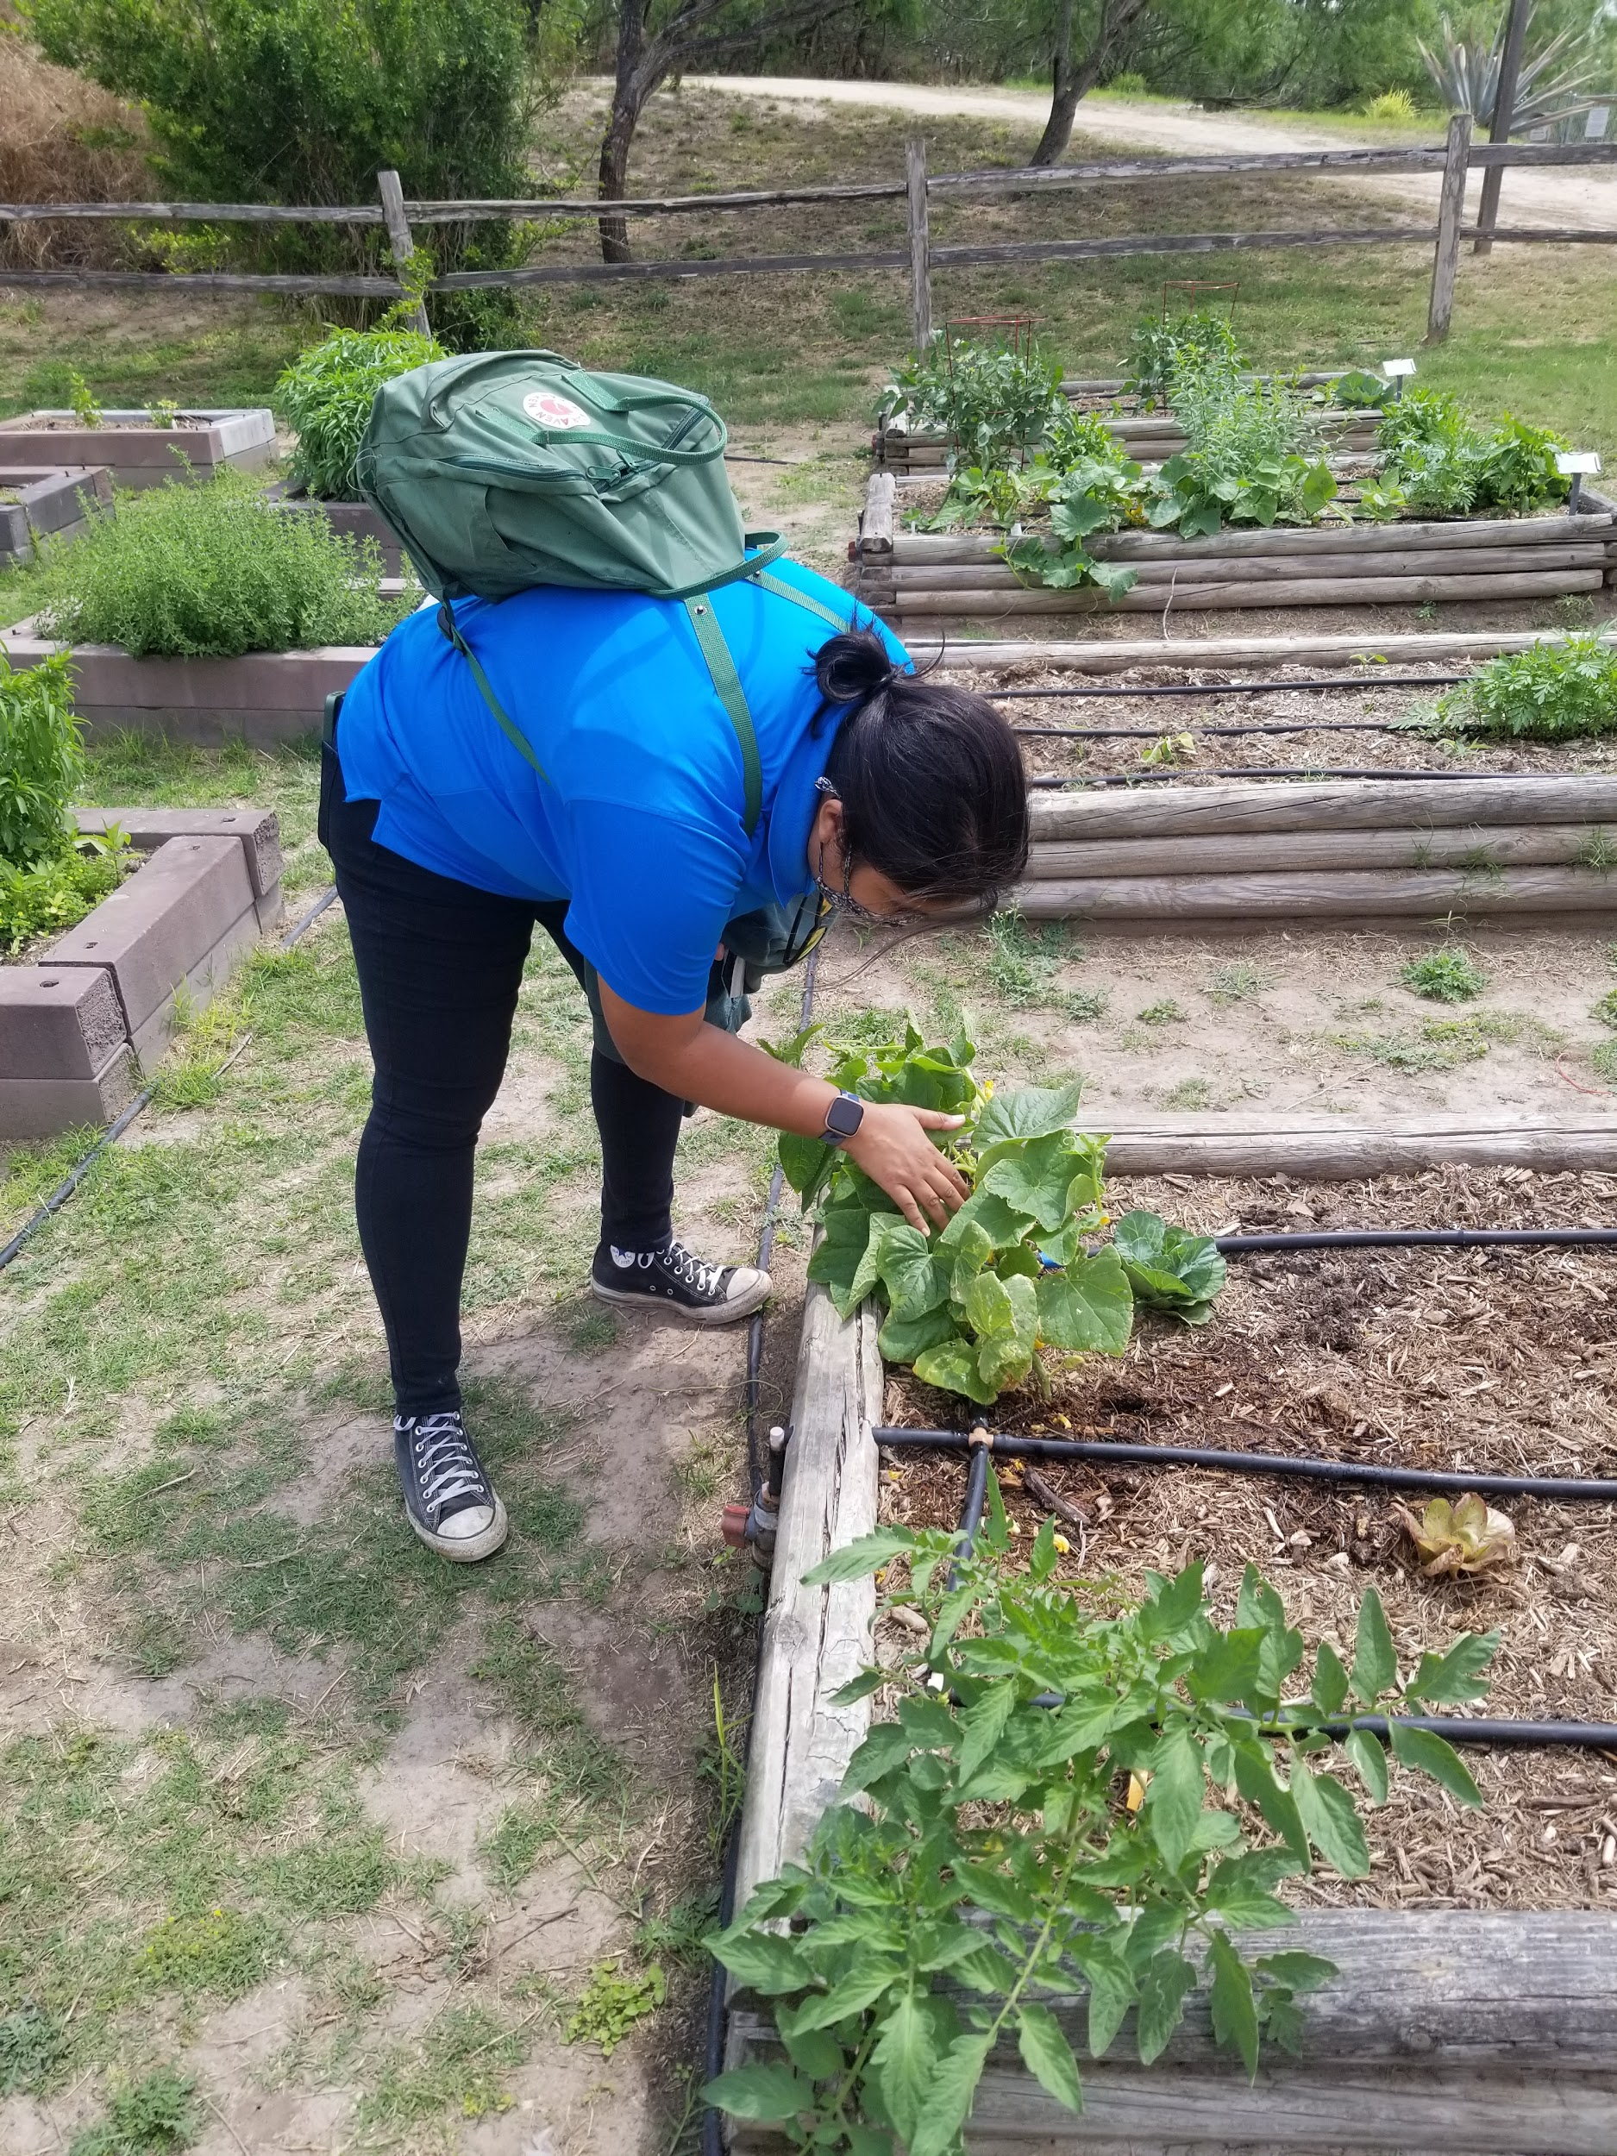
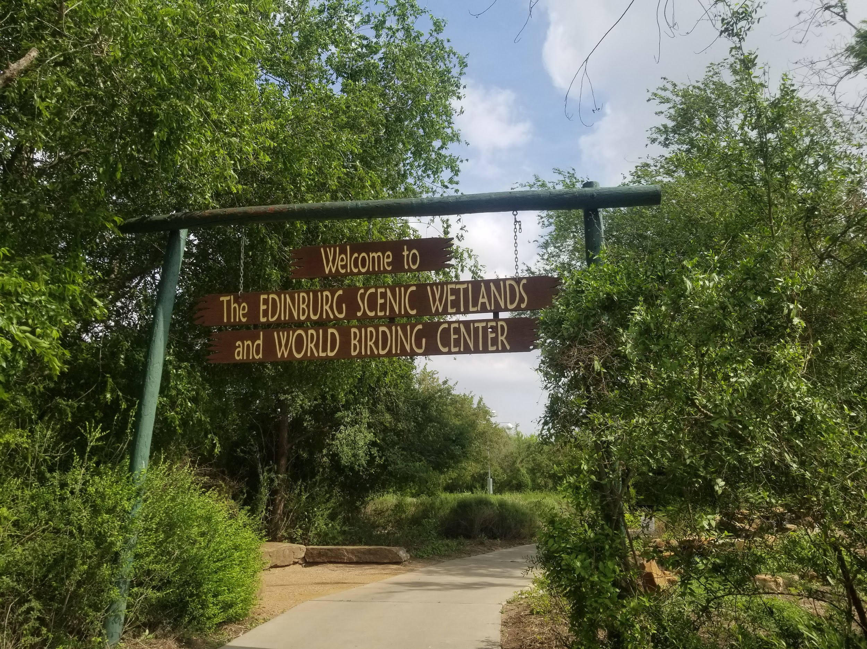
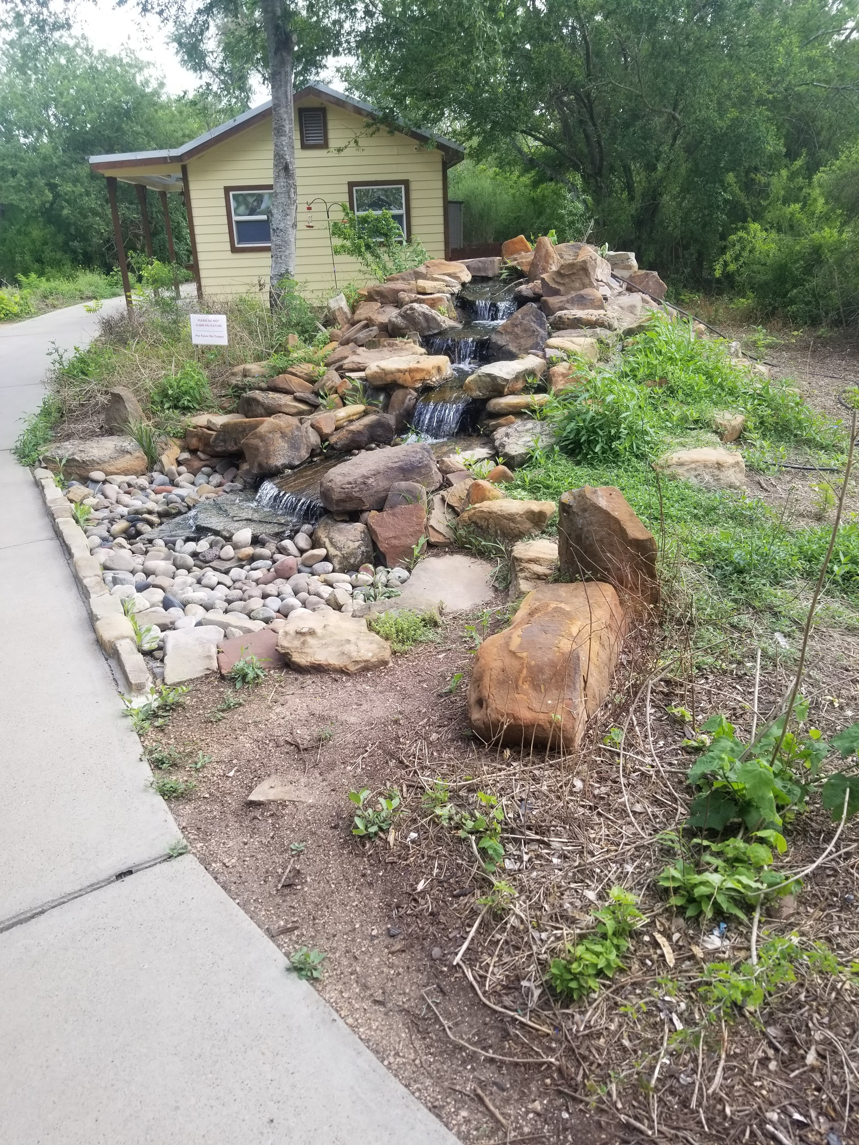
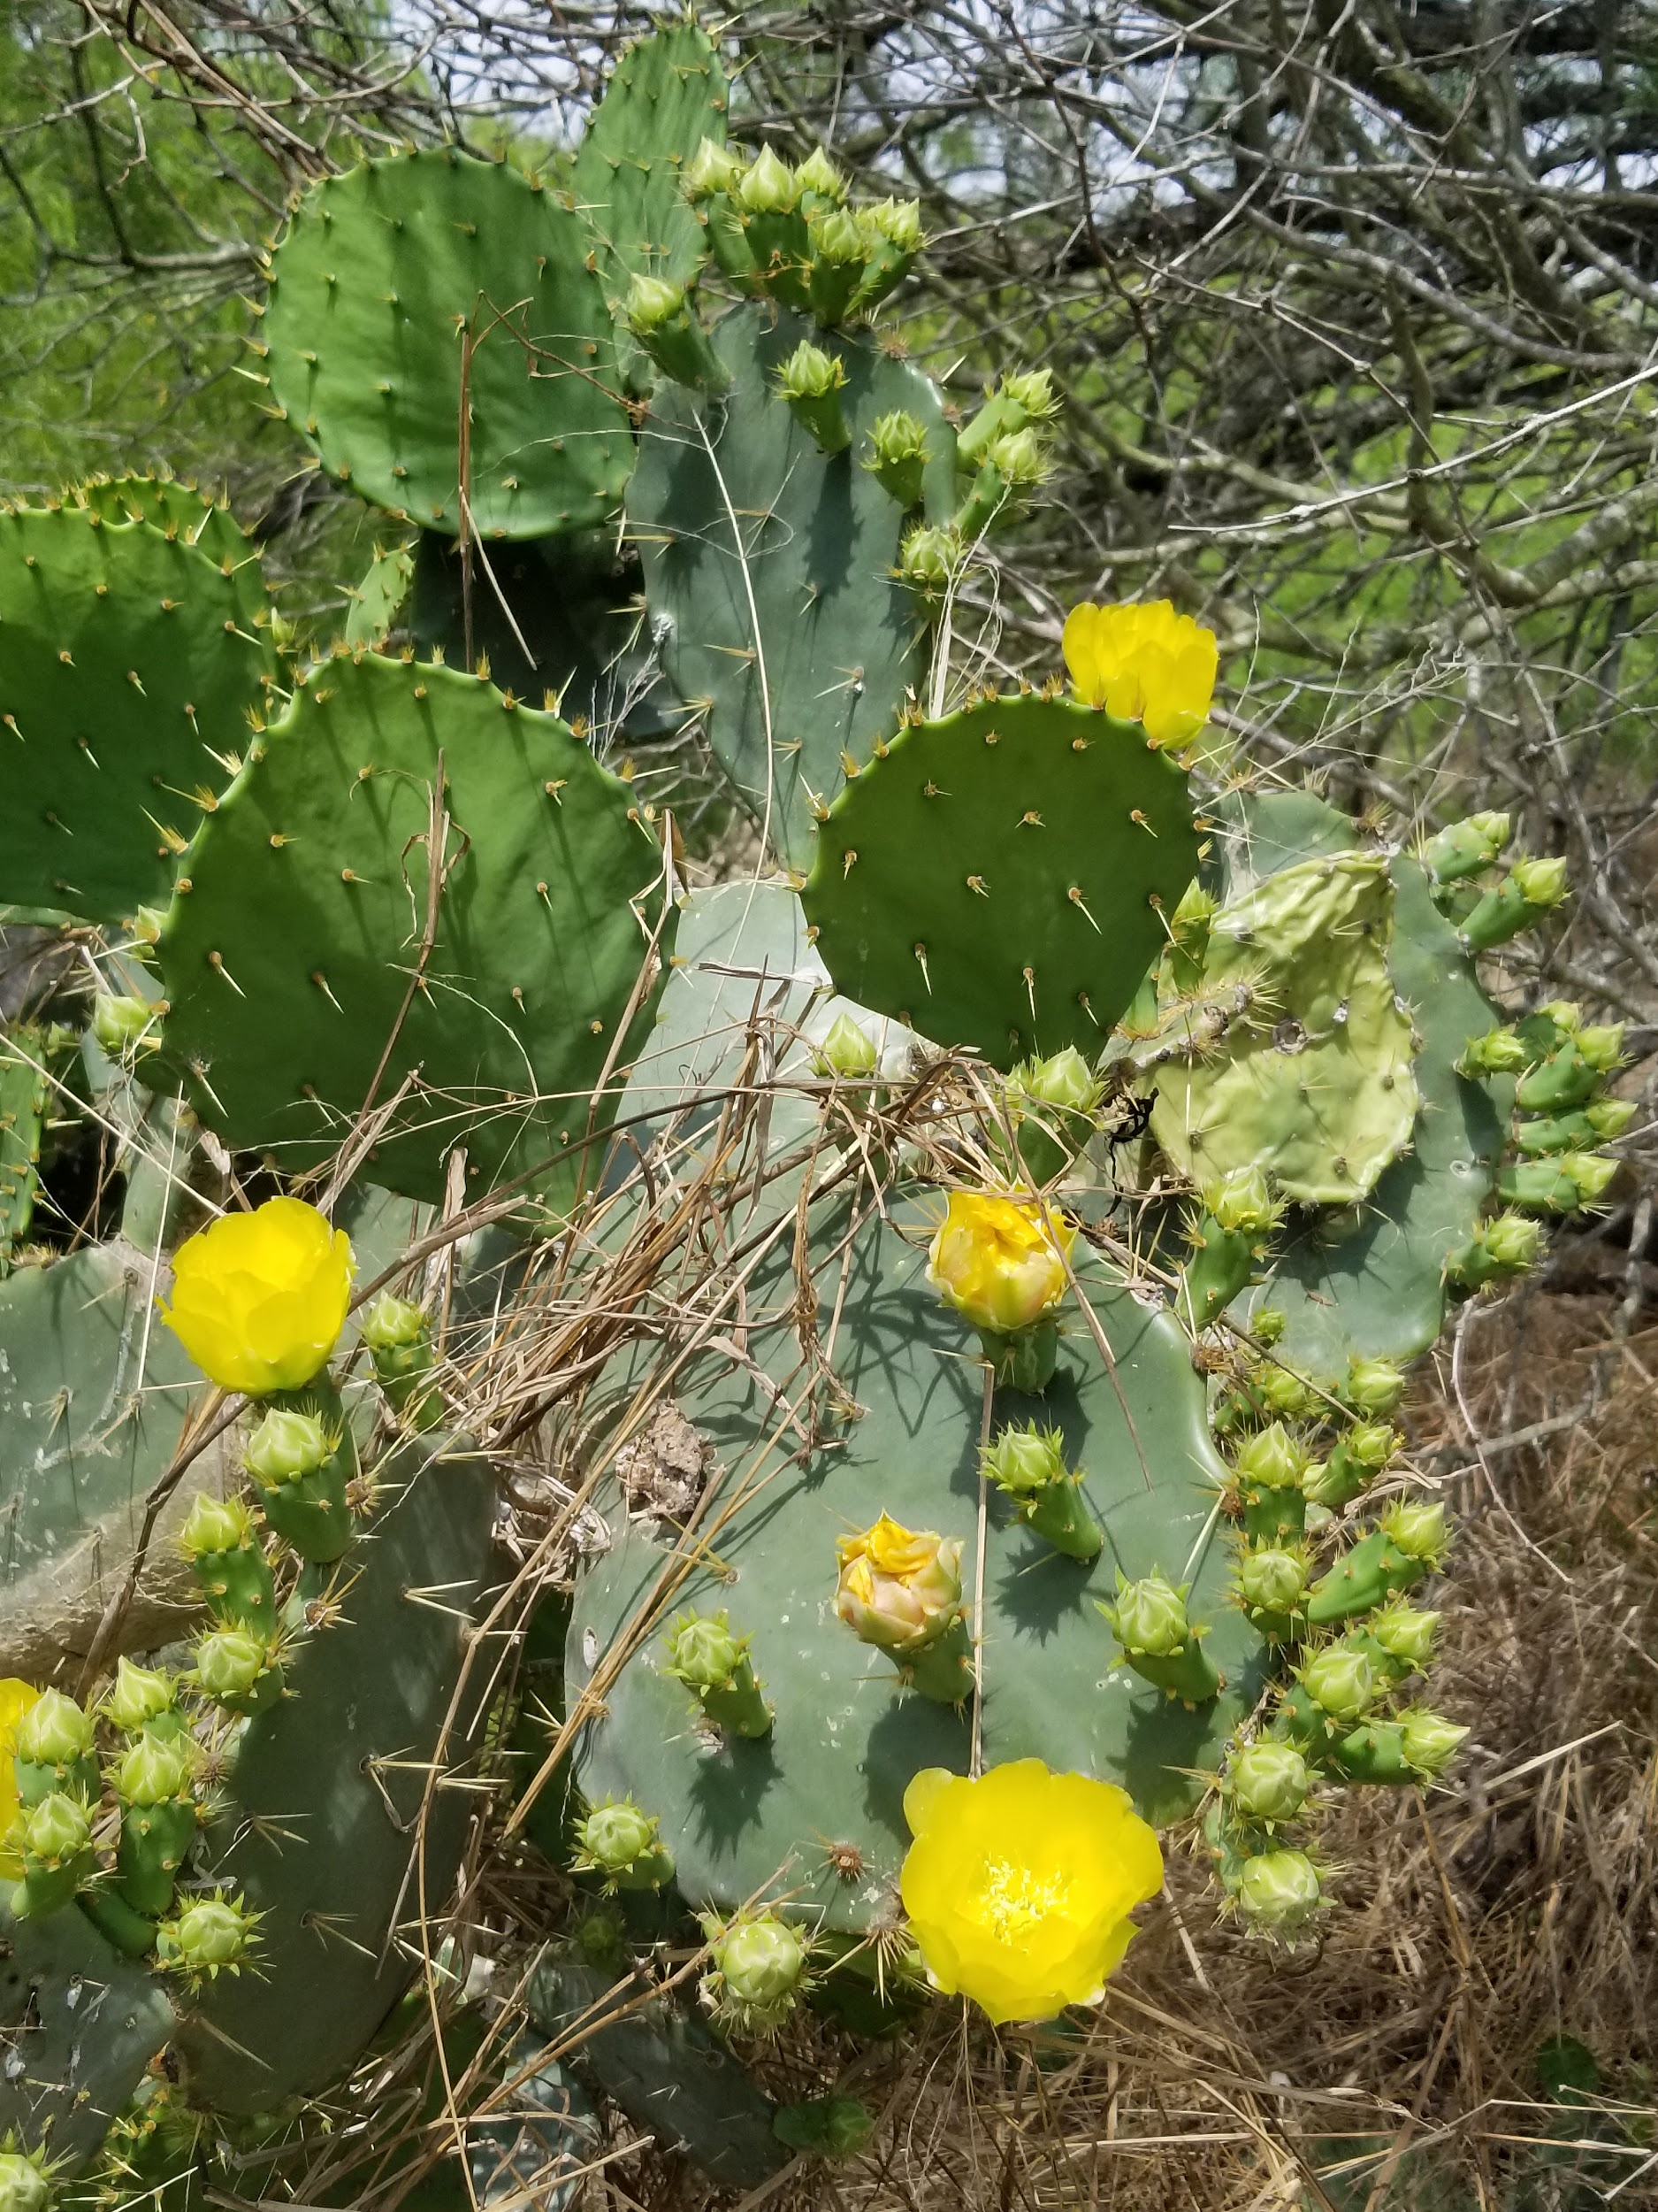
My Visit

Slide 10

Slideshow

Slide 11
THE END
THANK YOU FOR YOUR TIME.

