Slide 1

Exercising and why is it worth it
Cesar Tineo

Slide 2
Definition:
Exercise is physical activity that enhances health and fitness. The term exercise encompasses healthful activities from the gentle, like walking or lifting light dumbbells, to the strenuous, like marathon running, speed swimming, or martial arts training.

Slide 3

What I think it is
It is a way to free your mind and relax. It is more than just working out; it brings out a hunger for wanting more. After a while it becomes a lifestyle and you become part of a culture.

Slide 4





Slide 5
Why people exercise
A broken heart.
Want to change their lives.
To try something new.
Don’t like what they see in the mirror.
To keep focused.
Were born into it.

Slide 6
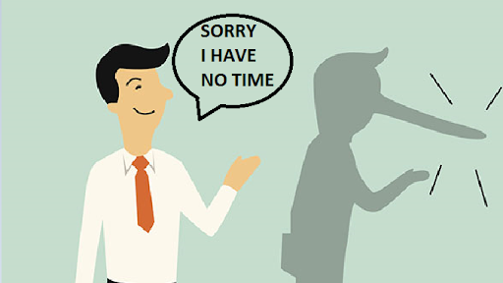
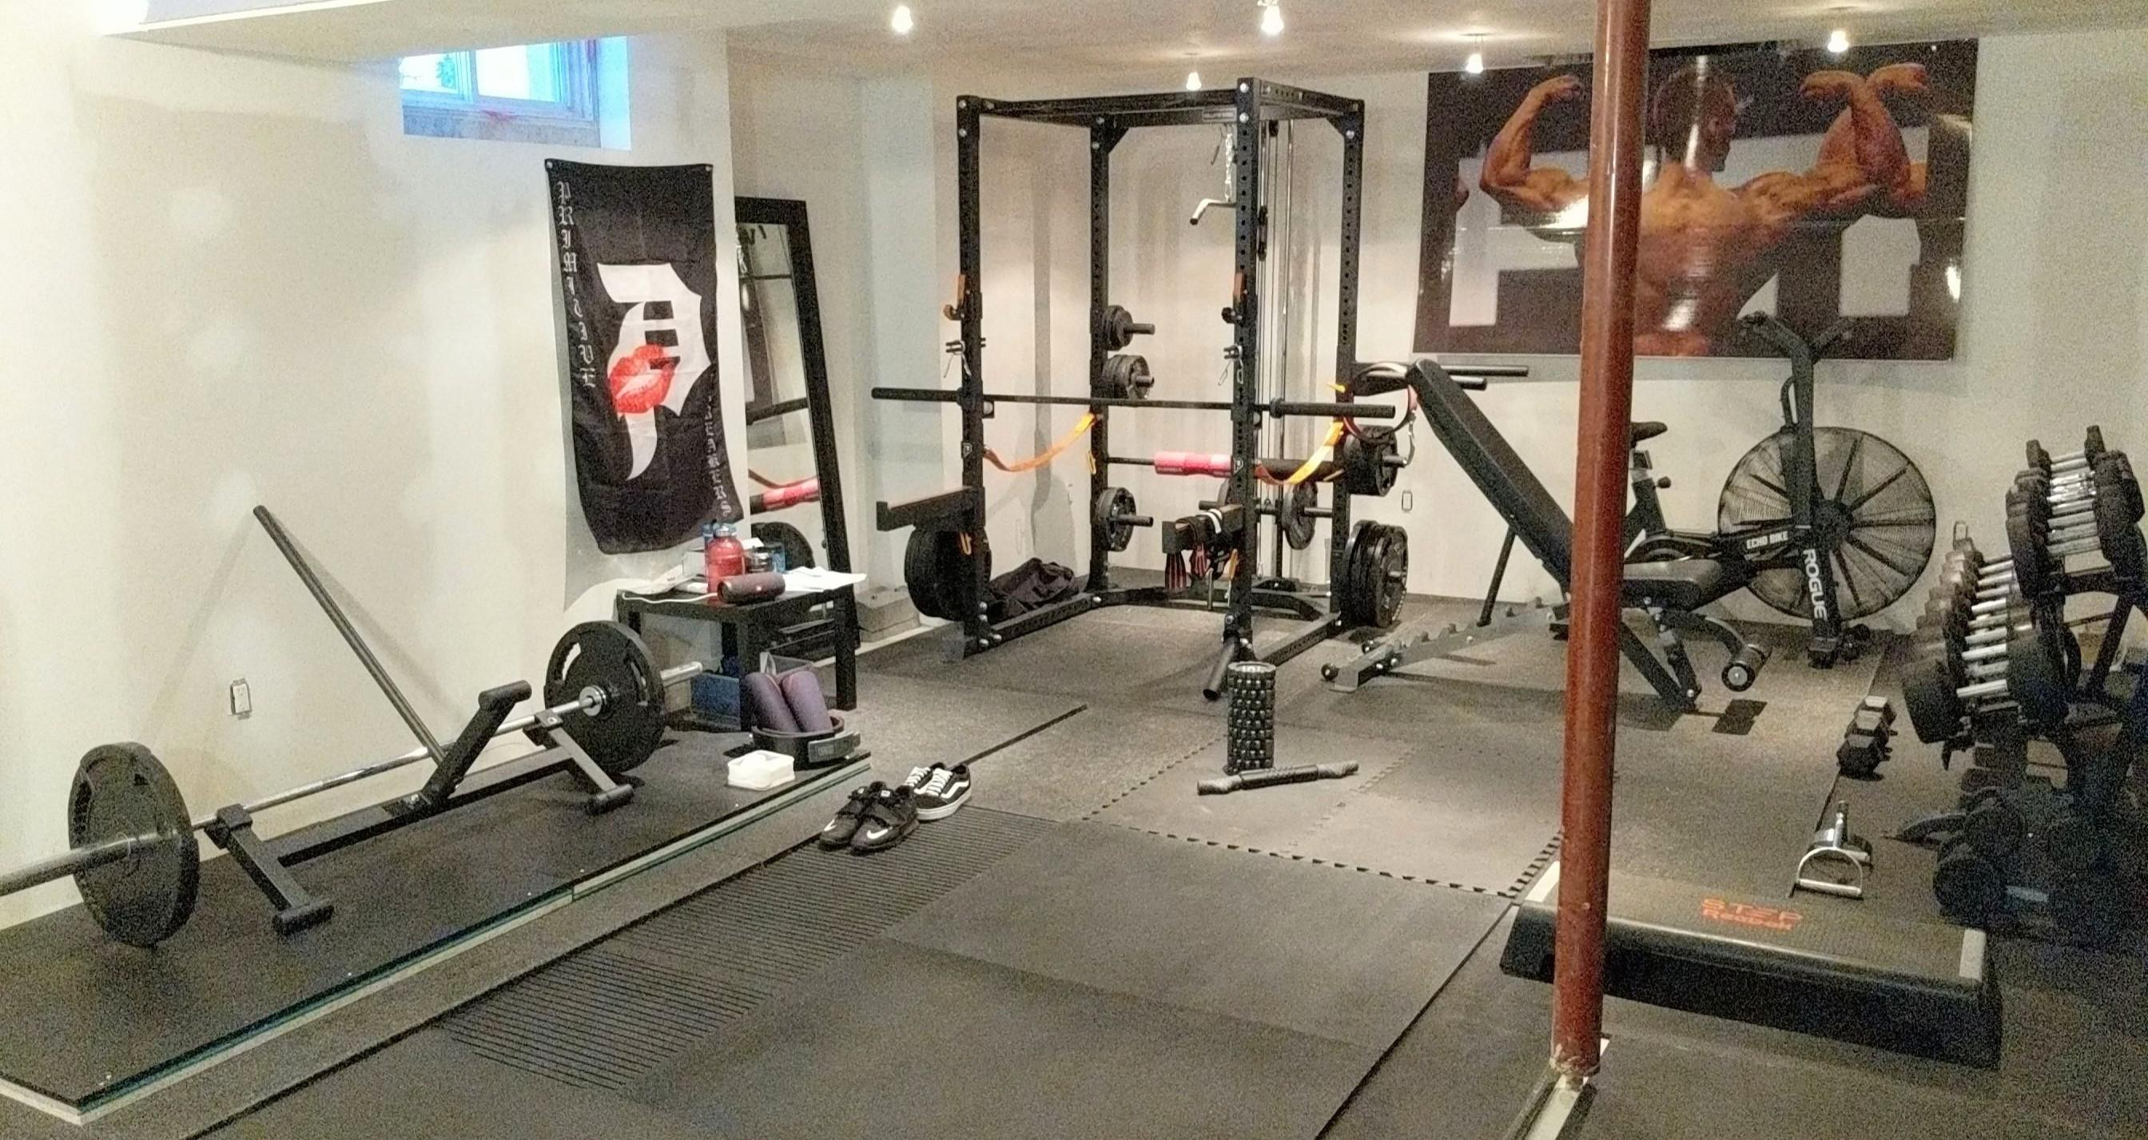

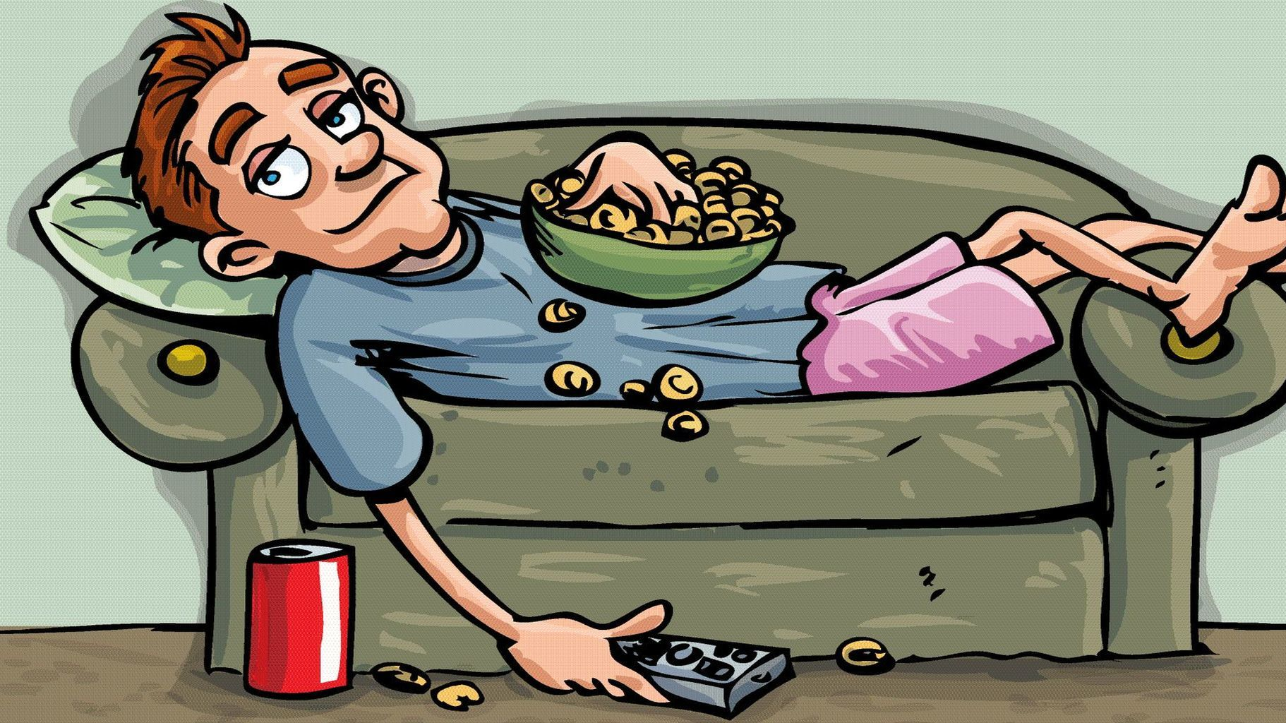
The Excuses
“I don’t have time”
“I don’t have the equipment.”
“I can’t afford a gym membership.”
“I am lazy.”
“My nail hurts.”

Slide 7

MOTIVATION

Slide 8
SOME SOLUTIONS
Set short-term, attainable goals for yourself so you will quickly see results and success.
Find workouts that suit your interests and lifestyle.
If you are easily bored, change your workout frequently and vary the exercises you do to help avoid redundancy which leads to boredom.
Work with a personal trainer who can help design a program that best meets your needs and will give you results.
You can workout anywhere.

Slide 9
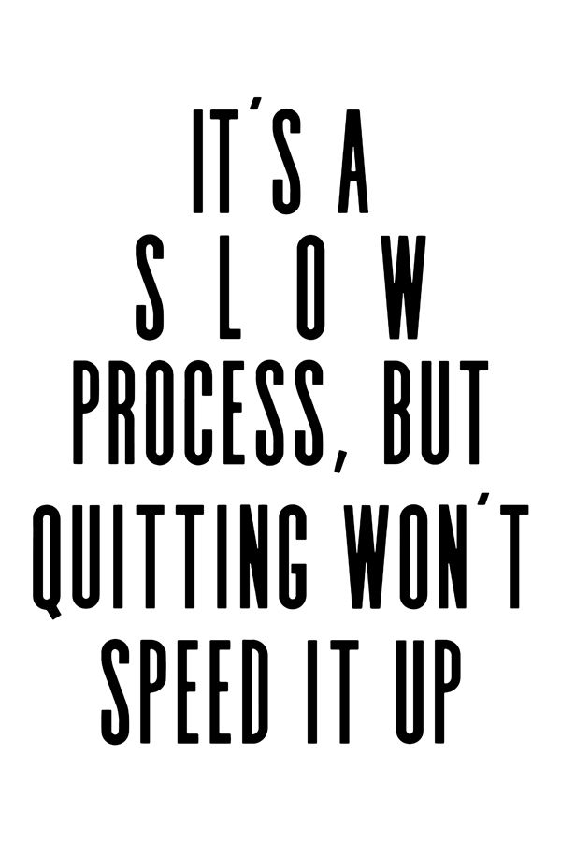

Slide 10
SO WHAT ARE YOU WAITING FOR?

