Slide 1
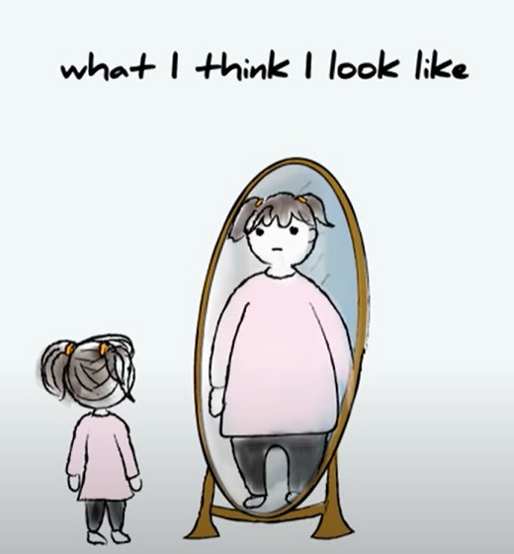
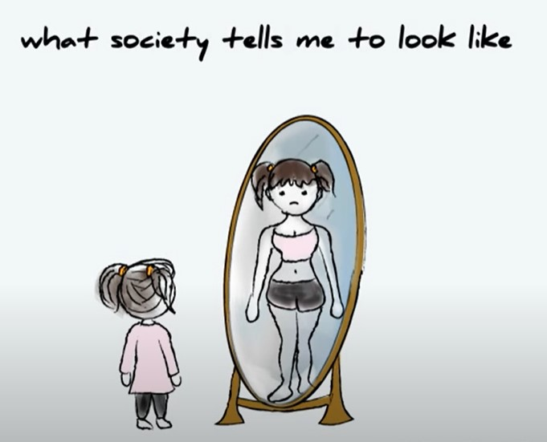
What is body image dissatisfaction, and how does our culture impact what our body ideal is?
For biological males and females

Slide 2
Body image is how we see ourselves, whether it’s in the mirror, how we think our friends and family see us, or our perception of how our community and culture sees us
While not a new topic, trends have developed recently that affect men as much as women, regardless of gender identity or sexual orientation

Slide 3
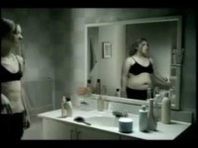
Example of effects fashion and entertainment have on body ideal and body dissatisfaction/body dysmorphia

Slide 4
Body ideal, on the other hand, is how we envision we should look or desire to look, such as slender and tone, or muscular and ripped, or taller/bigger/thinner/more handsome/more pretty…you get the picture
Popular movie stars and music artists, sports figures and fashion models, as well as social media sites deeply impact how we craft body ideal

Slide 5
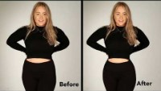
Example of effects that social media, photography and photoshop have on body ideal and body dissatisfaction/body dysmorphia

Slide 6
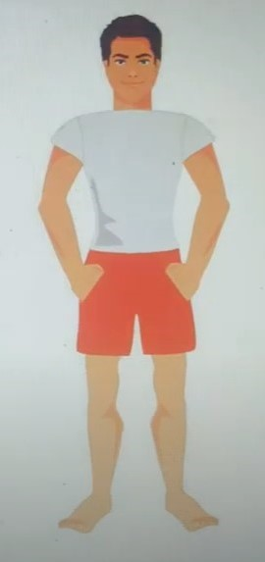
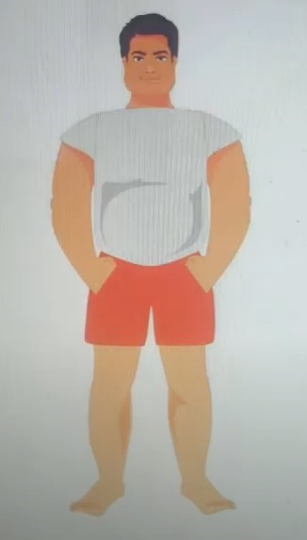
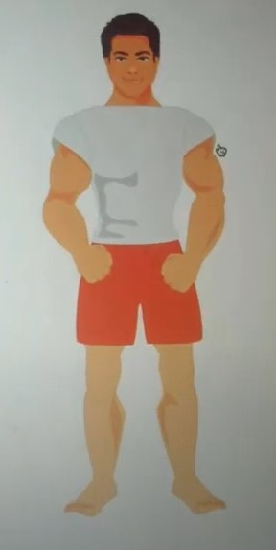
While in the past, culture-in-advertising has prioritized females, but since 2010, a dramatic increase in male-targeted campaigns show prevalence
How I think I look how I look in the mirror how I am “supposed to” look

Slide 7
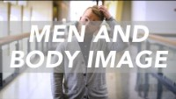
Example of effects current culture has on body ideal and body dissatisfaction/body dysmorphia

Slide 8
The greater the frequency of exposure to certain types of body ideal examples, the more they become normalized, then internalized, and from there we may tell ourselves how far away we are from “where we should be”….
Think of Abercrombie & fitch or calvin klein ads, or every marvel/DC movie in the last decade, and recognize how we’ve been bombarded by imagery

Slide 9
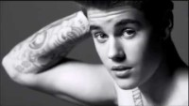
Example of effects movies and magazines have on body ideal and body dissatisfaction/body dysmorphia

Slide 10
After reviewing several academic, peer-reviewed journals studying body image disturbances across race, gender, sexual preference and biological spectrums, I still felt a closer look into how culture impacted our body ideal and body image was necessary to add to the academic conversation
I took a survey of 17 adults from 18-60, both bio male and bio female, straight and gay, black/white/Hispanic/Asian and mixed races

Slide 11
Interesting results and takeaways
Only half of those surveyed were happy with their current body image.
Despite only half showing body satisfaction, over 70% said they were close to their body ideal
88% felt comfortable discussing their body image issues with friends/family/peers.
78% believed that social media directly impacted their own body image and body ideal, but the bulk of those surveyed fell into the category under 5o years of age, and 66% under the age of 40
Both females and males were impacted by social media, entertainment and fashion in crafting their body ideal, nearly 50/50 with a slight tilt towards females, regardless of race/gender identity/sexual preference

Slide 12
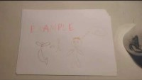
summary of effects social media has on body dissatisfaction and closing thoughts

Slide 13
Thank you for your attention & interest
https://youngminds.org.uk
https://adaa.org/understanding-anxiety/body-dysmorphic-disorder/treatment
https://www.selahhouse.com/eating-disorder-treatment-programs/body-dysmorphic-disorder-treatment-center/
https://houstonocdprogram.org/body-dysmorphic-disorder/

