Slide 1
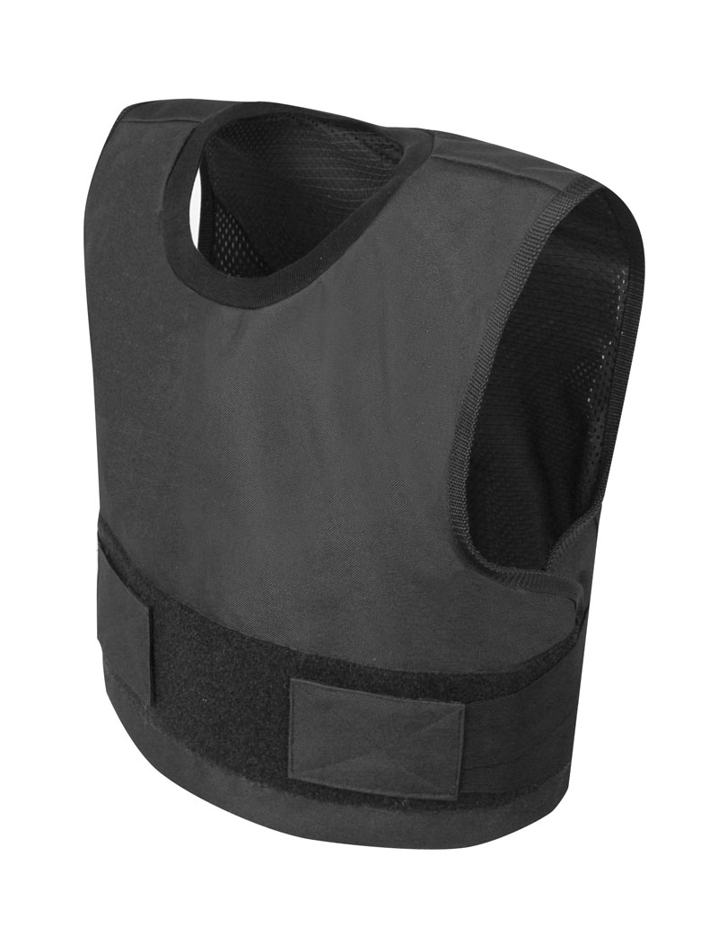
Light Flexible Bulletproof Vest
Faculty Advisor: Dr. Ortega
Course Advisor: Dr. Sarkar
Group:
Michael J Zapata
Alejandro Gomez
Eliel Martinez
Eric Canales

Slide 2
Problem
Bulletproof vests are not comfortable
Bulletproof vests are heavy (20-30 lbs)
Last year’s design did not perform as well as market Bulletproof vests

Slide 3
Market Status
Total Body Armor Industry revenue : 279 million
(Year 2015)
57 Business (Year 2015)
Top Companies (U.S.A.)
Point Blank Enterprises Inc. owned 26.2% in 2014
Ceradyne Inc. owned 19.2%
Average Bulletproof Vest Cost : $600

Slide 4
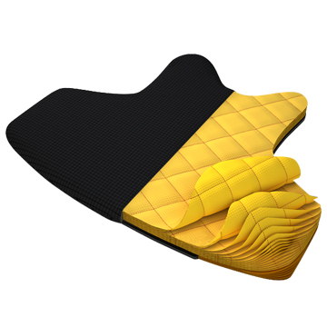
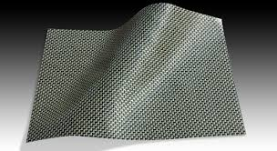
Solutions
Ventilated Bulletproof vest
Use strong flexible materials
Use flexible materials that stiffen on impact
Spectra 1000
Kevlar KM2

Slide 5
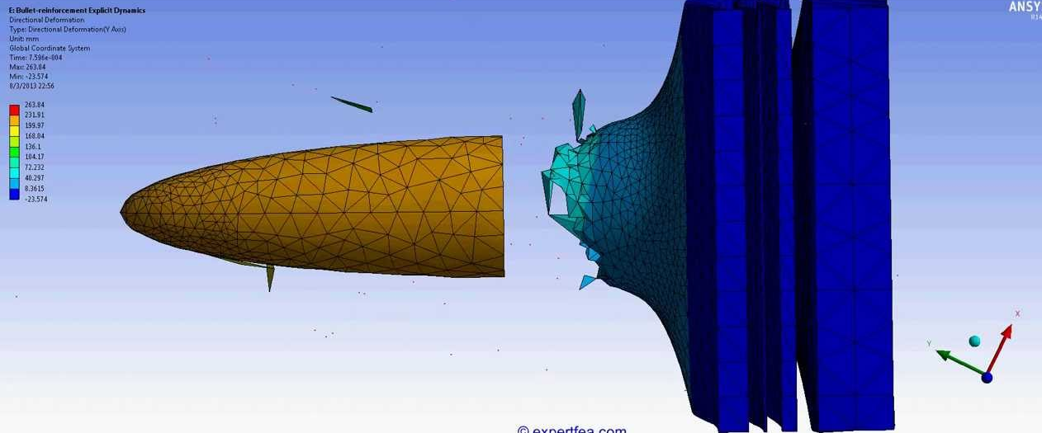
Approach
Simulate vest reactions after bullet impact using Finite Element Analysis Software
Choose appropriate materials that can satisfy our solutions by analyzing their properties
Setting up a controlled environment
Real life testing

Slide 6
Impact
This Bulletproof vest design will allow the user to feel more agile and at a more comfortable body temperature
Decrease blunt force trauma that an individual may experience

Slide 7
References

