Slide 1
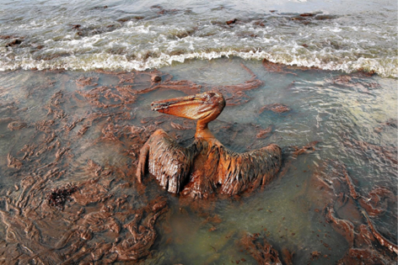
Problem Statement
Current methods for oil spill cleanup are inefficient and expensive
Equipment/operational costs
Operating time is slow
Environmental hazards associated
Low/no recyclability

Slide 2
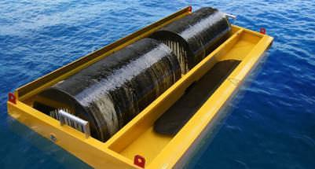
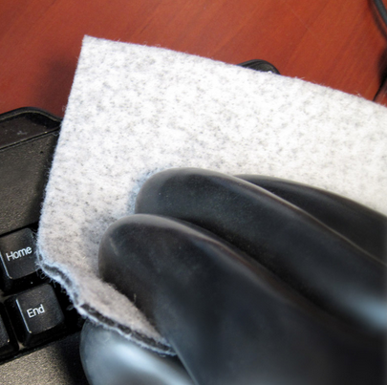
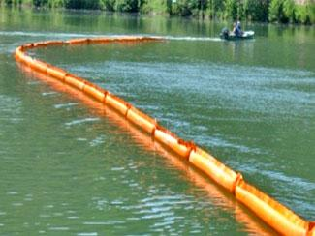
Background Research: Existing Solutions
Drum Skimmer
Sorbent
Inflatable Boom
Dispersant
Notes:
What do we know about nanofibers? What’s the advantage?
Pore size (2-10 nm)
Absorption capacity [for engine oil] = 39 (~40x weight)
Membrane thickness (~100 micron)
Oil uptake rate (~0.75 – 1.5 g oil/sec) or (293 g oil/sec for a 1x1 meter mat)

Slide 3
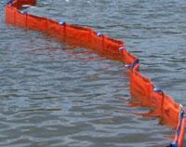
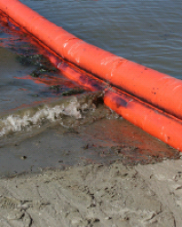
Background Research: Boom
Controlling the spread of oil preventing further pollution
There are several types of booms
Fence
Round or Curtain
Non-rigid or inflatable
All boom types are affected by water conditions
Notes:
http://www2.epa.gov/emergency-response/booms
http://response.restoration.noaa.gov/oil-and-chemical-spills/oil-spills/spill-containment-methods.html

Slide 4
Background Research: Dispersants
Chemical compounds that break down oil thereby
decreases the chance the oil reaches the shoreline.
allows the oil to sink to ocean floor

Slide 5
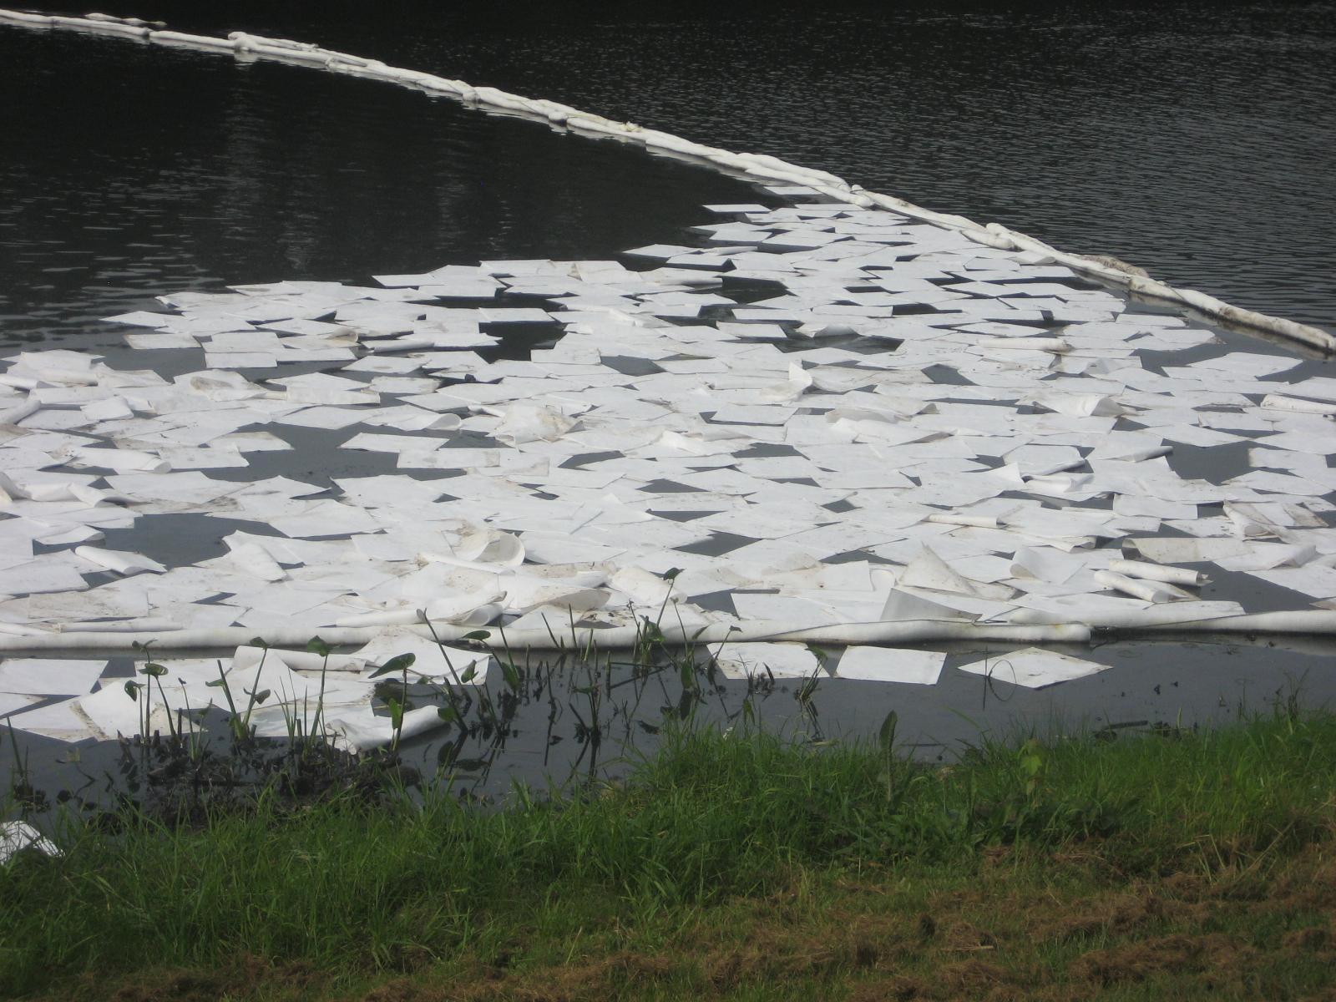
Background Research: Sorbents
Using absorption or adsorption to recover oil
3 types of sorbents
Natural organic
Natural Inorganic
Synthetic
Many sorbents are not reuseable
Notes:
Used for small spills
http://www2.epa.gov/emergency-response/sorbents
http://www.scientificamerican.com/article/sorbent-science-cleaning-oil-spills/
http://www.eoearth.org/view/article/158385/

Slide 6
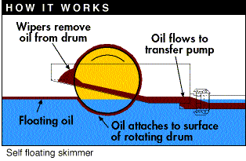
Background: Drum Skimmer
Oil adheres to the surface to the drum which is then scraped off
Oil can be placed into a reservoir or pumped out
Skimmers can take in water along with oil
Notes:
http://www.erosionpollution.com/oil-drum-skimmers.html
http://www.popularmechanics.com/technology/gadgets/a15666/santa-barbara-oil-spill-skimmers-and-booms/

Slide 7
Background Research: Existing Solutions
Design
Selection
Drum Skimmer
Sorbent
Inflatable Boom
Dispersant
Notes:
What do we know about nanofibers? What’s the advantage?
Pore size (2-10 nm)
Absorption capacity [for engine oil] = 39 (~40x weight)
Membrane thickness (~100 micron)
Oil uptake rate (~0.75 – 1.5 g oil/sec) or (293 g oil/sec for a 1x1 meter mat)

Slide 8
Major Competitors:
Sorbents:
Ultra Tech International
Oil Solutions International
PIG Corp
Dispersants
Nalco Environmental Solutions LLC
NEOS Company Limited
U.S. Polychemical Corp.
Skimmers
Versatech
GEI Works
Elastec
Booms
Grainger Industrial
ACME Environmental
Canadyne Technologies, Inc.

Slide 9
Competitive Product Summary
Product Name | Company | Location | Cost | Capacity
Ultra-Oil Blanket® | UltraTech Intl. | Shoreline | $84.00/ sheet | 0.84 gal/m^2
PIG® Oil Absorbent Mat Pad | New Pig | Industrial | $79.00/100 sheets | 1.1 gal/m^2
E-013 Sorbent Blanket | Clean Caribbean | Ocean,shore,river | $745/7 rolls | N/A
Offshore Boom | Clean Caribbean | Open ocean | $46250 | N/A
Disc Skimmer DBD5 | Desmi | River, near shore | $30000 | 30GPM
Drum/Brush Skimmer RBS-5 | Aquaguard | River, near shore | $34000 | 50GPM
Drum Skimmer TDS136 | Elastec | Open ocean | $41000 | 70GPM
Corexit 9500 | Nalco | Open ocean | $0.55/gal | N/A
Notes:
1. Actual size: 10’ x 5’, capacity: 3.9 gal
2. Actual size: 15’’ x 20’’, capacity: 28.16 oz per sheet, comes with 100 sheets
3. Actual size: 50’ x 9’’, water-filled boom
4. Actual size: 50 – 100’
5.

Slide 10
Market Research
Approximately $3.5 billion to double within the next 5-7 years¹
Similar technology:
Woolspill™
Nonwoven wool cloths
Fibertect™
Nonwoven cotton or activated carbon wipes
Carbon nanotube sponges*
Expanded/spongy graphene*
*researchers have scalability issues, $100/g.
1. "Nonwoven Filter Media Market Analysis By Technology (Spunbond, Meltblown, Wetlaid), By Application (Transportation, Water Filtration, HVAC, Food & Beverages, Healthcare, Manufacturing, Advanced Technology, Hydrocarbon Processing) and Segment Forecasts To 2022." Grandview Research. N.p., n.d. Web. 16 Sept. 2015.

Slide 11
Summary
Oil spills are major environmental disasters
Current products are costly, inefficient, and wasteful
Nanofiber tech. used to produce exceptional oil cleanup
Nereides
-Forcespinning™ for fast production
-Combines skimmer and sorbent tech.
-Carbon nanofiber membrane reusable
-99% oil to water collection capacity
-Ability to recycle oil

Slide 12
References
"Nonwoven Filter Media Market Analysis By Technology (Spunbond, Meltblown, Wetlaid), By Application (Transportation, Water Filtration, HVAC, Food & Beverages, Healthcare, Manufacturing, Advanced Technology, Hydrocarbon Processing) and Segment Forecasts To 2022." Grandview Research. N.p., n.d. Web. 5 Sept. 2015.
"EPA." Sorbents. N.p., n.d. Web. 5 Sep. 2015, image.http://www2.epa.gov/emergency-response/sorbents
"EPA." Booms. Accessed December 5, 2015. http://www2.epa.gov/emergency-response/booms
"How Do Oil Drum Skimmers Work?" How Do Oil Drum Skimmers Work? N.p., n.d. Web. 5 Sep. 2015,image.http://www.erosionpollution.com/oil-drum-skimmers.html
"The Frantic First Steps to Contain an Oil Spill." Popular Mechanics. N.p., 21 May 2015. Web. 12 Sep. 2015,image.http://www.popularmechanics.com/technology/gadgets/a15666/santa-barbara-oil-spill-skimmers-and-booms/
Gui, Xuchun, Hongbian Liu, Kunlin Wang, Jinquan Wei, Yi Jia, Zhen Liu, Lili Fan, Anyuan Cao, Hongwei Zhu, and Dehai Wu. "Recyclable Carbon Nanotube Sponges for Oil Absorption." Recyclable Carbon Nanotube Sponges for Oil Absorption. N.p., n.d. Web. 12 Sept. 2015.
"24" Inflatable Oil Containment Boom for PROTECTED PORTS." Enviro USA. N.p., Sept. 2015. Web. 16 Nov. 2015,image.http://www.enviro-usa.com/24-inch-inflatable-oil-containment-boom-for-protected-ports/
"California Mounts Ambitious Effort to Fill Chemical Gaps." — Environmental Health News. N.p., Sept 2015. Web. 16 Nov. 2015,image.http://www.environmentalhealthnews.org/ehs/news/chemical-clearinghouse
"Sorbent Science: Cleaning Oil Spills." Scientific American Global RSS. N.p., Web. Sept. 2015,image.http://www.scientificamerican.com/article/sorbent-science-cleaning-oil-spills/
"Oil Spill Control Technologies." Oil Spill Control Technologies. N.p., Sept. 2015. Web. Sept. 2015,image.http://www.eoearth.org/view/article/158385/
Li, Peng, Ying Qiao, Lili Zhao, Dahu Yao, Haixiang Sun, Yingfei Hou, Shuo Li, and Qi Li. "Electrospun PS/PAN Fibers with Improved Mechanical Property for Removal of Oil from Water." Marine Pollution Bulletin 93.1-2 (2015): 75-80. Web. Sep. 2015.

Slide 13
References cont’d
Teas, Ch, S. Kalligeros, F. Zanikos, S. Stournas, E. Lois, and Gyu-Hyun Anastopoulous. "Investigation of the Effectiveness of Absorbent Materials in Oil Spills Clean up." Investigation of the Effectiveness of Absorbent Materials in Oil Spills Clean up. National Technical University of Athens, Sept. 2015. Web. 16 Nov. 2015.
"Spill Containment Methods | Response.restoration.noaa.gov."Spill Containment Methods Response.restoration.noaa.gov. Web. 5 Dec. 2015.
Raza, Aikifa, Jianlong Ge, Yang Si, Jianyong Yu, Gang Sun, and Bin Ding. "Applications of Electrospun Nanofibers in Oil Spill Cleanup." (n.d.): n. pag. - Springer. Web. Sept. 2015.
"Robot Check." Robot Check. N.p., Oct. 2015. Web. 16 Nov. 2015,image.http://www.amazon.com/gp/product/B00O7IHVIA/ref=s9_hps_bw_g263_i4
Sarkar, Kamal, Carlos Gomez, Steve Zambrano, Michael Ramirez, Eugenio De Hoyos, Horacio Vasquez, and Karen Lozano. "Electrospinning to Forcespinning™." MaterialsToday 13.11 (2010): 12-14. Web. Sept. 2015.
Fox, Robert W., Robert W. Fox, Philip J. Pritchard, and Alan T. McDonald. Fox and McDonald's Introduction to Fluid Mechanics. Hoboken, NJ: John Wiley & Sons, 2011. Print.
Juvinall, Robert C., and Kurt M. Marshek. Fundamentals of Machine Component Design. New York: Wiley, 2000. Print.
"Sea Surface Temperature (SST) Contour Charts." - Office of Satellite and Product Operations. N.p., n.d. Web. Nov. 2015.http://www.ospo.noaa.gov/data/sst/contour/global_small.cf.gif
"Ironton Oil Extractor Pump 12V DC, 60 Watts, 3L/Min. Flow Rate." Ironton Oil Extractor Pump 12V DC, 60 Watts, 3L/Min. Flow Rate. N.p., Sept. 2015. Web.16 Nov. 2015,image.http://www.northerntool.com/shop/tools/product_200596412_200596412
“SLA-6V2 Battery”, 6 Volt, 2 Ah Sealed Lead Acid Battery. Sept 2015. Web. 16 Nov. 2015,image.http://www.batterymart.com/p-6v-2ah-sealed-lead-acid-battery.html
“HOSSEN® Mini 12V DC 60 RPM.” High Torque Gear Box Electric Motor. Sept 2015. Web. 16 Nov vvvv2015.http://www.ebay.com/itm/HOSSEN-Mini-12V-DC-60-RPM-High-Torque-Gear-Box-Electric-Motor-/381041878505

