Slide 1
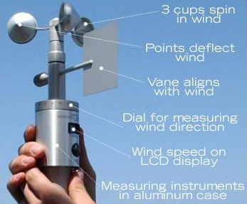
Portable Anemometer for HVAC
Faculty Advisor: Dr. Park, Mr. Villarreal & Mr. Sanchez
Group: Eleazar Salinas, Jose Gonzalez, Giovanny Barajas, Jose Villarreal, and Ryan Cortes

Slide 2
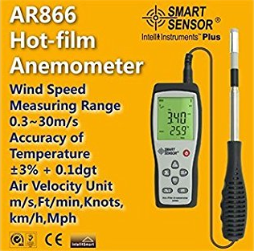
Problem Statement
We are trying to create a more affordable anemometer for engineers, technicians, HVAC personal, and energy control.
Expensive hand-held Hot-Film units
Vane type anemometers are ineffective at low air speeds
Not specific to HVAC Systems
Many moving parts on Vane type units.
Rotating fan anemometer left
Hot-film anemometer right

Slide 3
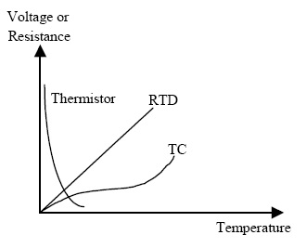
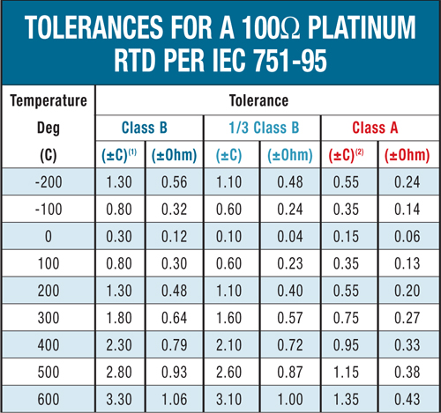
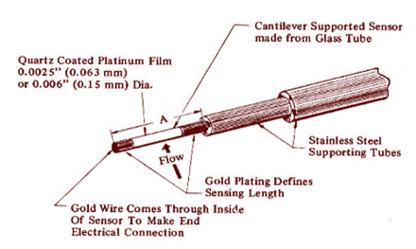
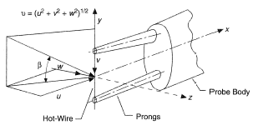

Slide 4
Approach
Market Research
Competitive Product Research
Component Research
Develop Heat Transfer Equation
Design Wheatstone Bridge Circuit
Program Heat Transfer Equations Into Micro controller
Design Exterior Casing

Slide 5
Market Status
Leading Markets
North America
United States
Canada
Mexico
Europe
Germany
United Kingdom
Italy
France
Asia Pacific
China
Japan
S. Korea
Taiwan
India
South America
Brazil
Argentina
6

Slide 6
Market Status Cont.
Leading Competitors
Siemens AG (Germany)
Kusam-Meco (India)
Fortive Corporation (U.S.A.)
OMEGA Engineering(U.S.A.)
Thermo Fisher Scientific Inc. (U.S.A.)
CEM Corporation (U.S.A.)
Teledyne Technologies Inc. (U.S.A.)
Horiba Ltd. (Japan)
Servomex (U.K.)
Vaisala (Finland)
7

Slide 7
Market Impact
This market is expected to grown tremendously through 2025
We believe we would be very competitive with our product. Estimation of product capture around 20%-35%
Cost Efficiency
Made in the U.S.A.
8

Slide 8
Market Impact Cont.
Kanomax (India)
TSI ( U.S.A)
OMEGA Engineering (U.S.A)
Thermo Fisher Scientific Inc. (U.S.A)
9

Slide 9
Competitive Products
Name | Model | Type | Manufacturer | Unit Price
Anemometer w/Real Time Data Logger | HHF-SD1 | Hot Wire | Omega Engineering | $510.00
Anemometer w/Real Time Data Logger | HHF-SD2 | Vane | Omega Engineering | $425.00
Ventilation Meter | 9565 | Hot Wire | Velocicalc | $1,089.00
Anemometer | 6036-CE | Hot Wire | Kanomax | $1,580.00
Air Velocity Meter | AVM410 | Hot Wire | Alnor | $598.50
Balometer | 6200D | Vent | TSI Alnor | $1,471.50
10

Slide 10
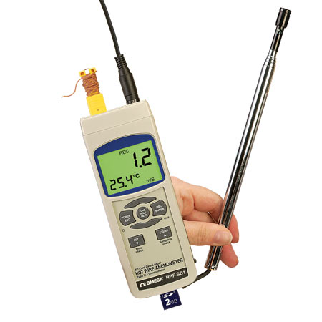
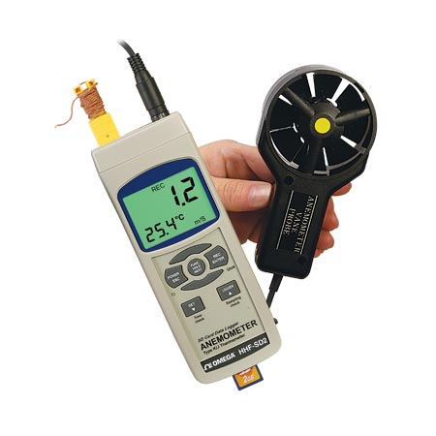
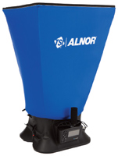
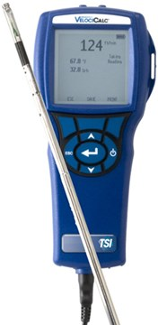
Competitive Products Cont.
11

Slide 11
Competitive Products Cont.
Name | Website | Dimensions (LxWxH) | Price (Dollars) | Key Feature
TSI | TSI.com | 3.8 in. x 8.3 in. x 2.1 in. | 2245.50 | Hot-Wire
Omega | Omega.com | (6.14in x 2.36in x 1.29in) | 179 | Fan
Kanomax | Kanomax.com | 3.4inx7.4inx1.6in | 1580 | Hot-Wire
Fisher | Fisher.com | 7in x 3in x 1.25 in. in | 577 | Hot-Wire
12

Slide 12
Competitive Products Cont.
Company | Model /Id # | Cost | Key Features
TSI | 9565 | 2245.50 | Large graphic display Multiple data logging formats
Omega | HHF81 | 179 | 1) Simultaneous readings of air velocity's and temperature 2) Standard type k thermocouple SMP
Kanomax | 6036 | 1580 | Data logging function capacity up to 1500 Highly visible black-lit-display
Fisher | 06-667-73 | 577 | 1) Accuracy ± 1% full scale plus 1 digit 2) Display temp in C̊ or F
13

Slide 13
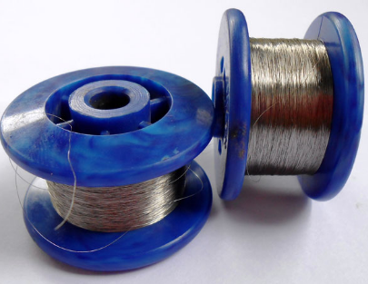
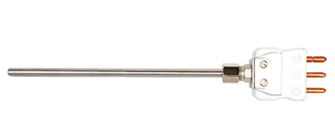
Proposed Solution
Design and engineer hot film anemometer
Understand the relationship between air velocity, heat transfer of the wire, and voltage signal.
Cost Effective design.
Minimize the need for moving parts by integrating “Hot Film System”.
Use more economically sound materials.
14

Slide 14
Goals ,Objectives , & Constraints
Goal : Specifically develop and design an economical, portable, and accurate anemometer with in allotted budget and time frame.
Objective: Combine knowledge of Heat Transfer, Electrical Circuits and computer programming to produce a portable handheld anemometer.
Constraints: 9 months to finish final product, extended purchase order lead time, testing and balancing.
15

Slide 15
Thank you!
62

