Slide 1

The UTRGV ISO Office contact information
www.utrgv.edu/is
is@utrgv.edu
Notes:
Introduction
What is our purpose? It is to provide support to the University in achieving its goals by ensuring the security, integrity, confidentiality, and availability of informational resources.
Our office adheres to different policies and best practices such as…(TAC 202, UTS 165, UTRGV AUP)

Slide 2
Policy Reviews
UTS 165
UTRGV AUP
TAC 202
Acceptable Use Policy for users and computers accessing UTRGV information resources as defined by UTS 165
It is the policy of The UT System to protect Information Resources based on Risk against accidental or unauthorized access, disclosure, modification, or destruction and assure the availability, confidentiality, and integrity of these resources.
Stablish information Security Standards for Institutions of Higher Education
States the rules for: Responsibilities of the Institution Head, Information Security Officer, and Staff.
Notes:
The university is required to follow various policies and procedures including:
Texas Administrative Code: TAC 202 Subchapter C
State requirement for state agencies and Higher Education; Responsibilities (Institutional Head, IS Officer, Staff)
UTS 165 Standards
Set by the UT Systems, this is how we manage the Information Security Program for each institution.
Ensure adherence to TAC 202 and provides additional safeguards for UT System Information Resources which fall under the UT umbrella.
Local at UTRGV is the Acceptable Use Policy
List of acceptable user policies regulating the use of System Information Resources at UTRGV. If you have questions, please reach out.
--You will find the links to these policies in our website www.utrgv.edu/is/resources/policies

Slide 3
Standards that protect
FERPA
HIPAA
PCI-DSS
Student Records
Health Records
Credit Cards Records
Notes:
Some additional laws and regulations that are followed by UTRGV are as follows.
FERPA (Family Educational Rights and Privacy) – Protects the privacy of student’s educational records .
HIPAA (Health Insurance Portability and Accountability Act) - Protects sensitive patient health information.
Industry Standards
PCI-DSS (Payment Card Industry Data Security Standards) – Accepted set of policies and procedures intended to optimize the security of credit, debit card transactions on campus and protect cardholders against misuse of their personal information.

Slide 4

Make sure you know how to report an Information Security Incident.
Information Security Office
www.utrgv.edu/is
1201 W. University Dr.
Edinburg, TX
(956)665-7823
is@utrgv.edu
Police Department
www.utrgv.edu/police
Notes:
In order to better protect your information, please make sure to know how to report an Information Security Incident.
Some incidents that will require you to inform the PD as well include the loss of computer (personal or work) with university data and involving your UTRGV credentials.

Slide 5

Most common forms of Attacks
Phishing Emails
Notes:
Always good to look for Red Flags.

Slide 6
Phishing Emails
Phishing Email – Is an online scam that targets consumers by sending out e-mails that appear to be from a known or trusted user.
Notes:
These scams can come in many forms such as voice messages, text messages and, the most common, email messages.

Slide 7
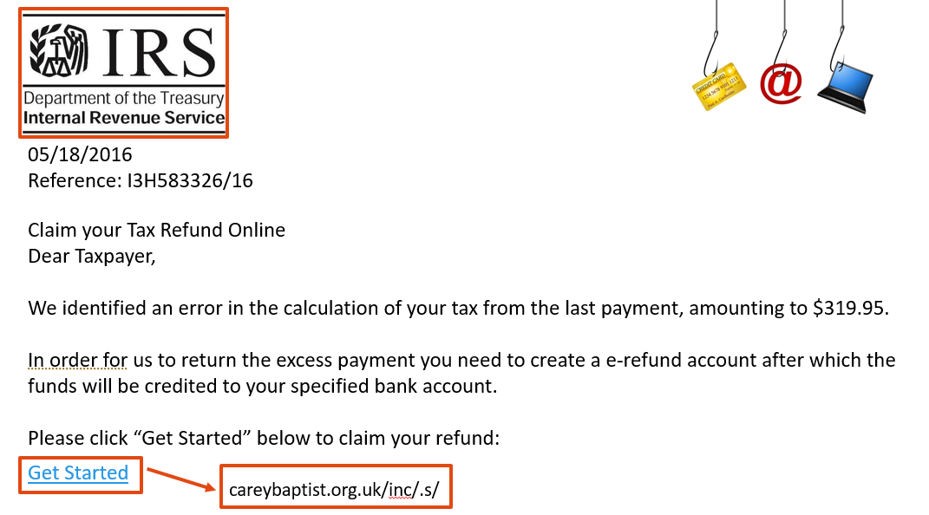
Phishing Email Example
Notes:
PHISHING EMAILS
Please note the official source, IRS with logo
Note the sense of urgency to the email.
Hover the mouse over the link, but DO NOT click the link!
Now observe the actual link you would be taken to!
We have technical controls in place to help block these types of emails
For every 1 of these that comes through there are about 10 to 15 thousand that gets blocked

Slide 8
Spotting Phishing Email
Urgent call to action or threats.
First time or infrequent sender.
Generic greeting.
Mismatched email domains.
Suspicious links or unexpected attachments.
For UTRGV email, always look for the “External Mail” tag.
Notes:
Urgent call to action or threats.
First time or infrequent sender.
Generic greeting.
Mismatched email domains. (as shown before)
Suspicious links or unexpected attachments. DO NOT Click on links.
For UTRGV email, always look for the “External Mail” tag.

Slide 9
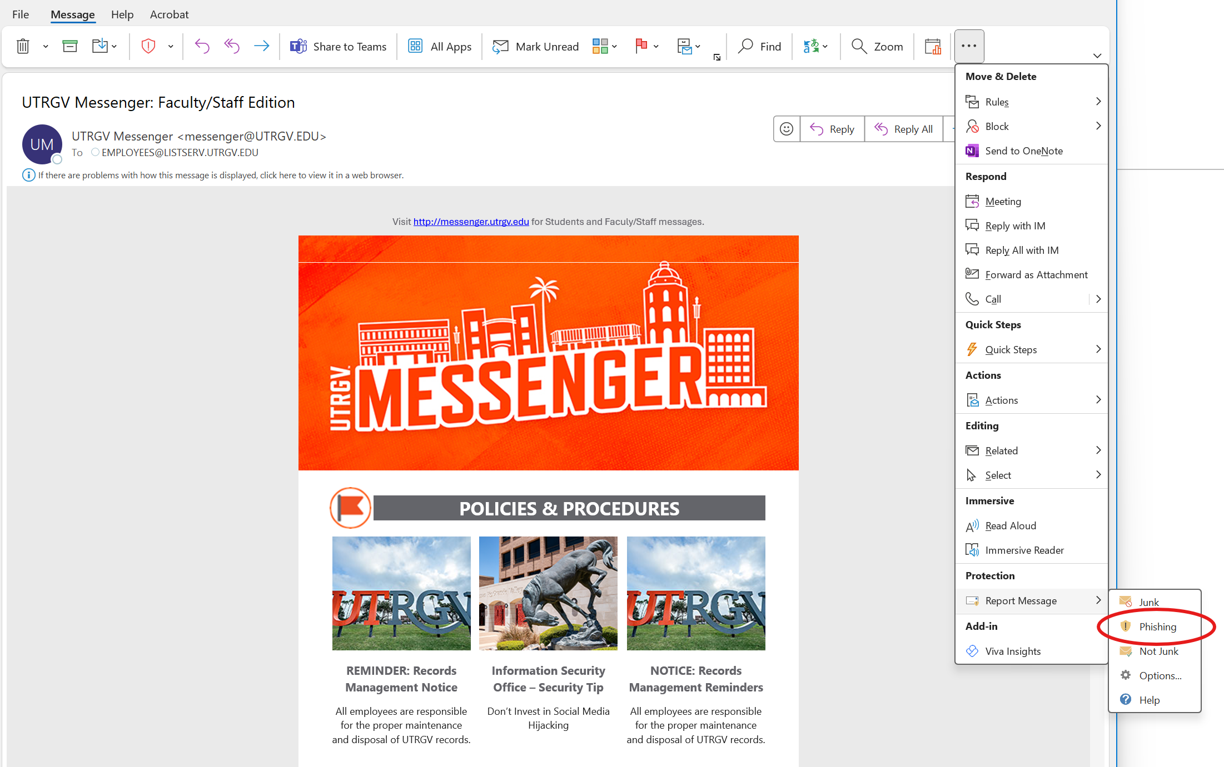
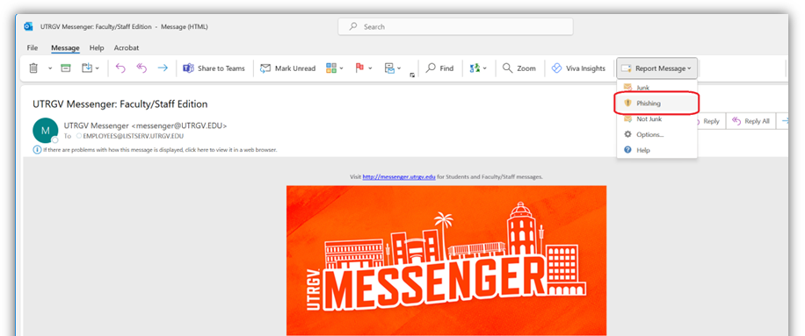
Reporting a Phishing Email
Notes:
For investigation.

Slide 10
Other ways to Report Phishing
If you receive an email that you suspect may be a phishing message:
Forward email to itdns@utrgv.edu
Article - Report a Phishing Email Usi... (utrgv.edu)
Notes:
You can also forward the email to itdns@utrgv.edu and DNS team will research it for you. Once you have been notified the email is safe, you can find it in the Deleted folder of your email.
There is also an article in the knowledge base (IT Support Center) to help you report a phishing email.

Slide 11
Smishing
Smishing– phishing via text message/SMS
While phishing emails remain the most common form of attach, other methods are becoming more frequent.
Notes:
Please note that UTRGV IT Services or Information Security will never ask for your password or MFA verification code via phone call, email, or text message.

Slide 12
The following is a real example of a recent smishing attack. If you obtained this type of text, we highly recommend resetting your UTRGV password. You can do this by contacting the UTRGV Helpdesk at 956-665-2020 or by visiting the UTRGV Password Reset Page at https://myaccount.utrgv.edu/.Taking this step will help ensure the security of your account.
Notes:
It’s always important to stay alert, but now more than ever, we must be proactive in protecting ourselves from cyber threats.

Slide 13
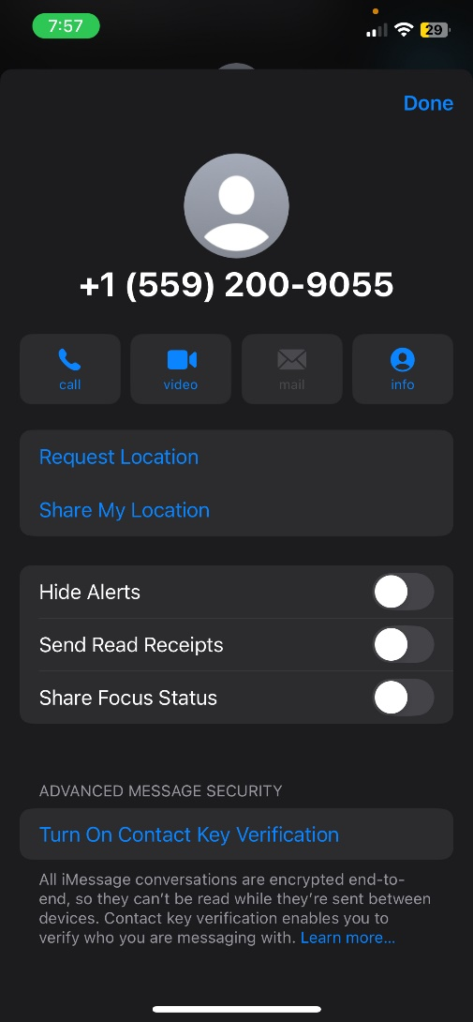
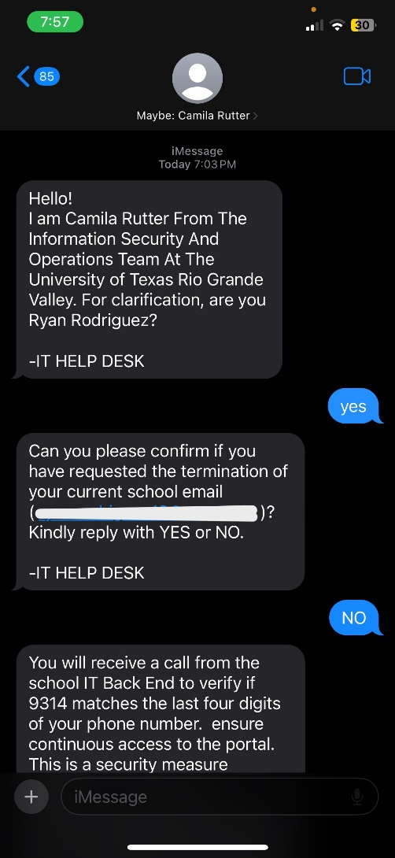
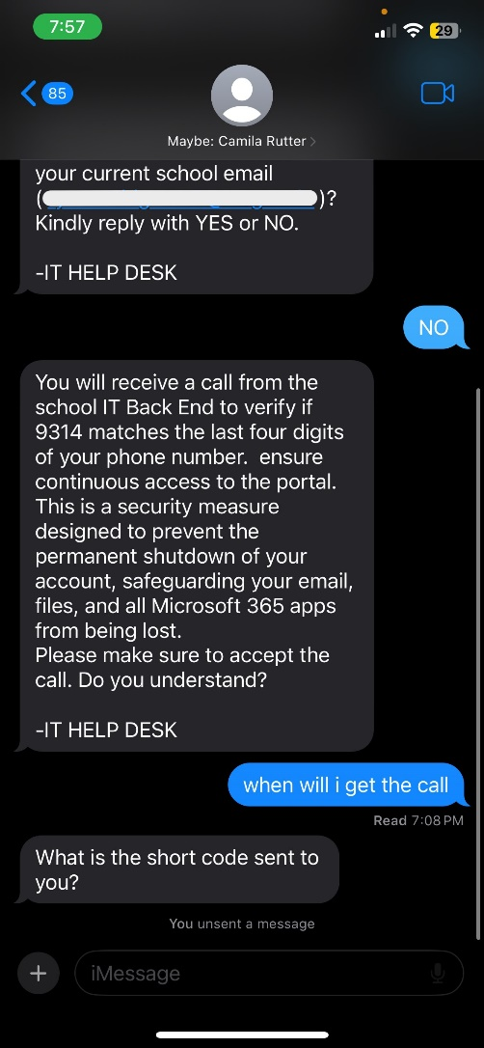
Please block the number shown in the screenshot below. Please note that cybercriminals may rotate numbers as part of their evolving tactics. This exact number has been used in three reported attacks.
Notes:
It's essential to be cautious and protect your credentials at all times.

Slide 14
Where can I Store University Data?
Devices and Services that are:
University Approved
Encrypted Personal Devices
Compliant with UTRGV security standards
Notes:
Where you store your data must be approved by university policy and state law.
OneDrive is an approved source to store university data.
If you use your personal devices to store any kind of University data, the personal device must be encrypted.
https://www.utrgv.edu/is/_files/documents/data-storage-guide.pdf

Slide 15

Protecting data at rest?
Transformation of data into a form that conceals the data’s original meaning to prevent it from being known or used.
Encryption is especially important if you are trying to send sensitive information that other people should not be able to access.
Remember that encryption does not protects you from virus/malware. Encryption protects you from unintended disclosure due to loss or theft.
Encryption
Notes:
As stated in the UTRGV AUP Any computer that stores University protected data, such as PII and FERPA data, must be encrypted
If an encrypted computer gets stolen that data is protected.
Yes, this means your personal computer!
All University owned computers, laptops and tablets must be encrypted
Even if they don’t currently have protected data stored in them. Remember encrypted does not protect against virus or malware.
Always be sure your computer firewalls are up to date.

Slide 16

Protecting data in motion
Because email messages are sent over the internet and might be intercepted by an attacker, it is important to add an additional layer of security to sensitive information.
To send an encrypted email, include [secure] tag at the beginning of the subject field of your email.
Example: Subject: [secure] Monthly Report
In addition, LiquidFiles has been implemented at UTRGV for sending and receiving protected information.
Article - Encrypt and Decrypt Email (utrgv.edu)
Notes:
If you can password protect the file, do it!
But send the password using a different channel!
How to open an encrypted email
Save and open the attachment in the email. Follow the instructions to sign in with a Microsoft or Office 365 account. If you do not have a Microsoft account (Hotmail or Live account) or Office 365 account, follow the instructions to obtain a one-time passcode to view the message. A passcode will be emailed to you and it will be valid for 15 minutes.
LiquidFiles uses modern HTML 5 methods for sending files, seamlessly splitting large files in 100MB blocks when uploading. This is an extra layer of security.

Slide 17

What is Liquid Files?
Liquid files will be used for securely sharing protected information that cannot be shared by other means such as email attachments or online shares. Examples of protected information are documents containing FERPA information, HIPAA, and Social Security Numbers.
How do I access Liquid Files?
You can get access to the software to send and request files by accessing the application URL https://securetransfer.utrgv.edu and entering your UTRGV credentials.
You can also access LiquidFiles through the my.utrgv.edu portal by clicking on the LiquidFiles icon:

Slide 18

Computers connecting to
Information Resources
Requirements
Required Configuration and Security Software
Data Backups
Users' responsibility
Where to get help with University owned computer problems
Only to approved sources
IT Service Desk (665-2020 or 882-2020)
OS & OS patches must be up to date.
Notes:
Some of these requirements are handled by IT Services automatically
Backups are the responsibility of the user and should only be stored in approved sources (e.g. Hardware encrypted or Business One Drive)
The university now backs up some of your local computer files to OneDrive.
If you have any questions, please contact the IT Service Desk.
Always be sure your updates are up to date.

Slide 19



Get IT approved before you buy.
Get I.T.
BEFORE YOU
Instructions can be found here https://support.utrgv.edu/TDClient/1849/Portal/Requests/ServiceDet?ID=42650
Notes:
It is a requirement by UTRGV that any software or service must be approved for purchasing by IT, IS, & Accessibility for compliance. This also includes no cost contracts such as Free cloud services or open-source software.
All Cloud vendors must go through a cloud vendor assessment as mandated by Texas State Policy knows as Texas-Ramp.
Anything that you need to purchase, needs to be through iShop. There is a workflow that is followed for proper approvals prior to purchasing.
Some people purchase computer equipment outside iShop (which is not recommended) because if your purchase does not meet the expected requirements and is not approved for purchase, the re-imbursement will not be approved.

Slide 20
Passwords
Why are passwords important?
  They provide validation
  They allow access and authorization
  They protect our data/information
Your password allows access to:
  Email
  Student records (FERPA)
  Network access (Wired and WiFi)
  Confidential Files / Research papers (IP)
  Employee Data
  (Your SSN, Direct Deposit, Contact Info, Home Address)
Notes:
Passwords provide basic authorization to your UTRGV profile.
Make sure you protect the confidentiality of your password.
Per UT System Policy…..next slide

Slide 21
Passwords (Cont’d)
Five(5) recommended password guidelines:
  You Shall Choose a password wisely
  You Will Never Write It Down
    NEVER!
  You Will Never Share It With Anyone
    Not even your supervisor, IT, or Security (ISO)
  You Will Change It Often
    At least once per year
  You Will Be Mindful of Where You Use It!
    Be careful of fake websites that are made to look real
Notes:
Things to remember when choosing a password:
Consider a catch phrase or lyrics to a song, something that you will remember without having to write it down.
You will never be asked by anyone in the institution for your password.
More modern authentication methods use additional layers of security to protect your account…..next slide

Slide 22

Reminder
It is a policy violation to use UTRGV passwords in non-UTRGV systems.
  Facebook
  Gmail
  Twitter
  This also includes 3rd party services in use by UTRGV but that are not maintained by UTRGV.
  Consider utilizing a password manager (Example: Dashlane & Keeper).
Notes:
Quick reminder, do not use the same password for different places.
If you have many passwords, you can use a password manager to keep track of your passwords.
Research which fits you best.

Slide 23

KnowBe4 Training
Knowbe4 is used for multiple employee trainings including:
  Acceptable Use Policy (AUP)
  Information Security Annual Training
  FERPA
  Sexual Harassment
Keeps track of training status
myUTRGV Portal
Notes:
This is a training platform. You will receive emails notifying you of what training needs to be completed.

Slide 24


Information Security Office,
www.utrgv.edu/is
is@utrgv.edu
Notes:
You will have an annual Information Security training as a reminder for many of the items we discussed.
Any Questions?

