Slide 1
On-Campus Supervisor Training

Slide 2
Access JobX & TimesheetX
UTRGVJobX & TimesheetX Site: https://utrgv.studentemployment.ngwebsolutions.com/

Slide 3
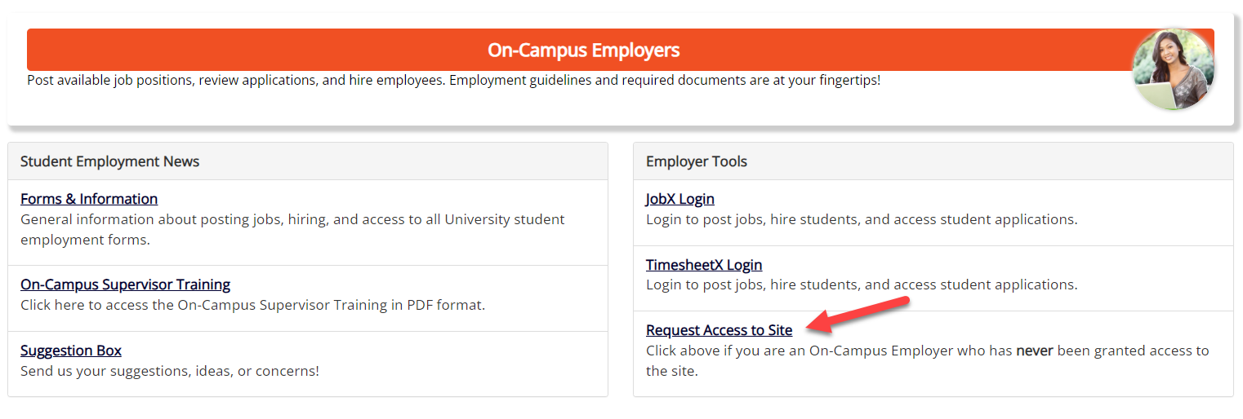
On-Campus Employer Request Login
Click the ‘Request Access to Site’ link if you are not already a student employment supervisor.
If you are a supervisor, your school has already provided you access to the site.

Slide 4
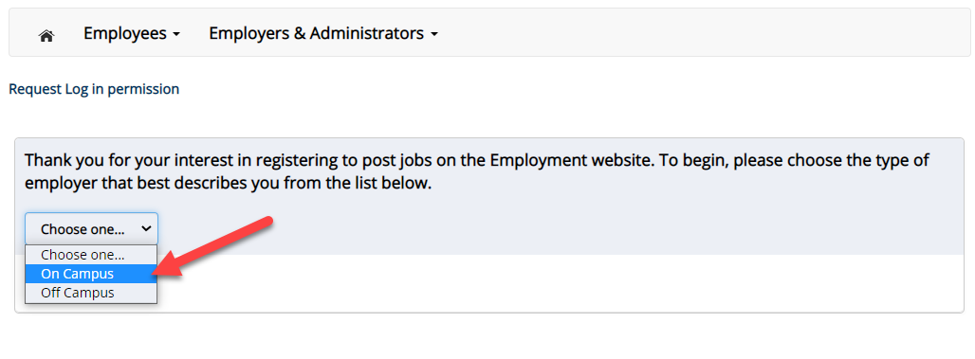
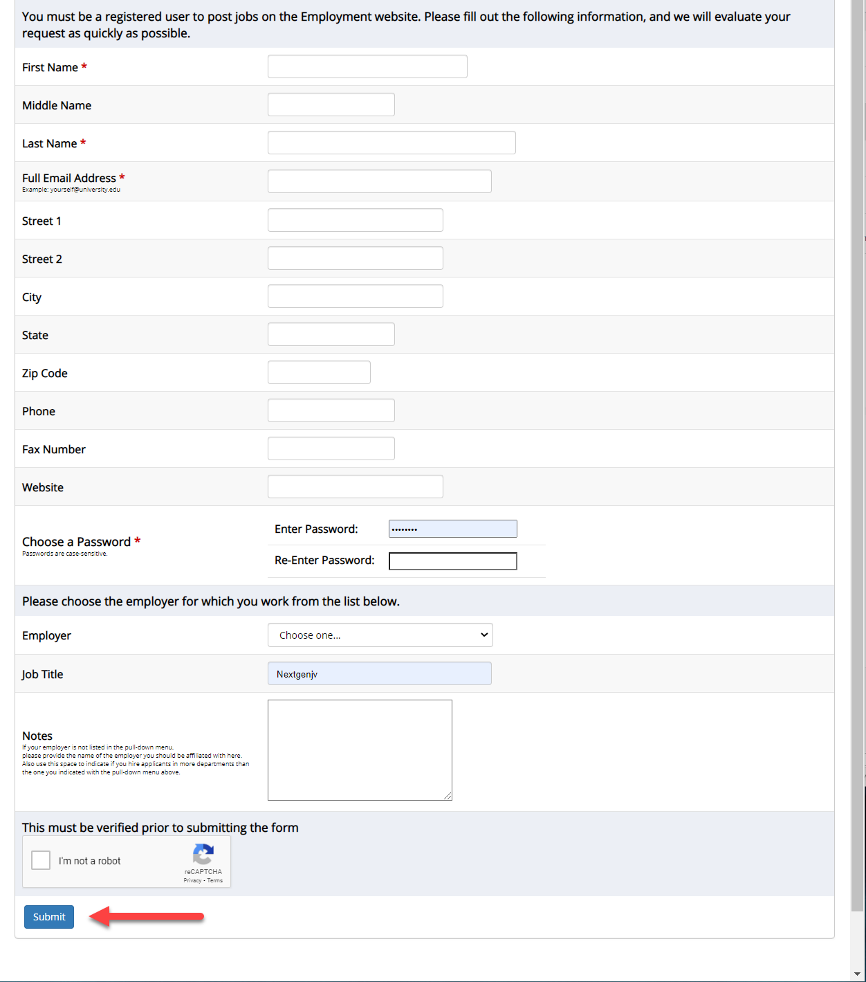
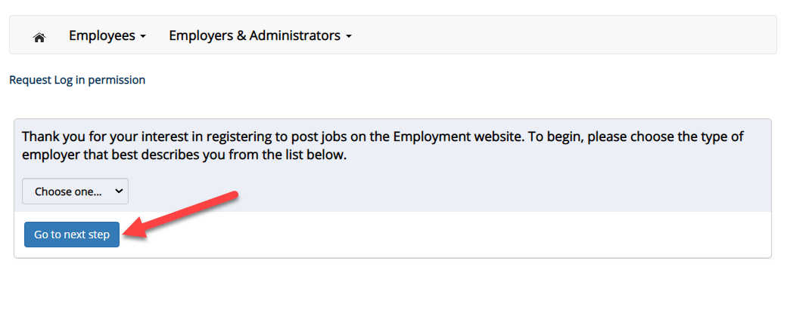
On-Campus Employer Request Login
Select ‘On-Campus’ from the dropdown menu.
Then click ‘Go to next step’ button to proceed to the form.
Complete Request Login Form.
Then click ‘Submit’ button to submit your request for an approved login.
You should receive an email once access has been granted.

Slide 5
Job Postings

Slide 6
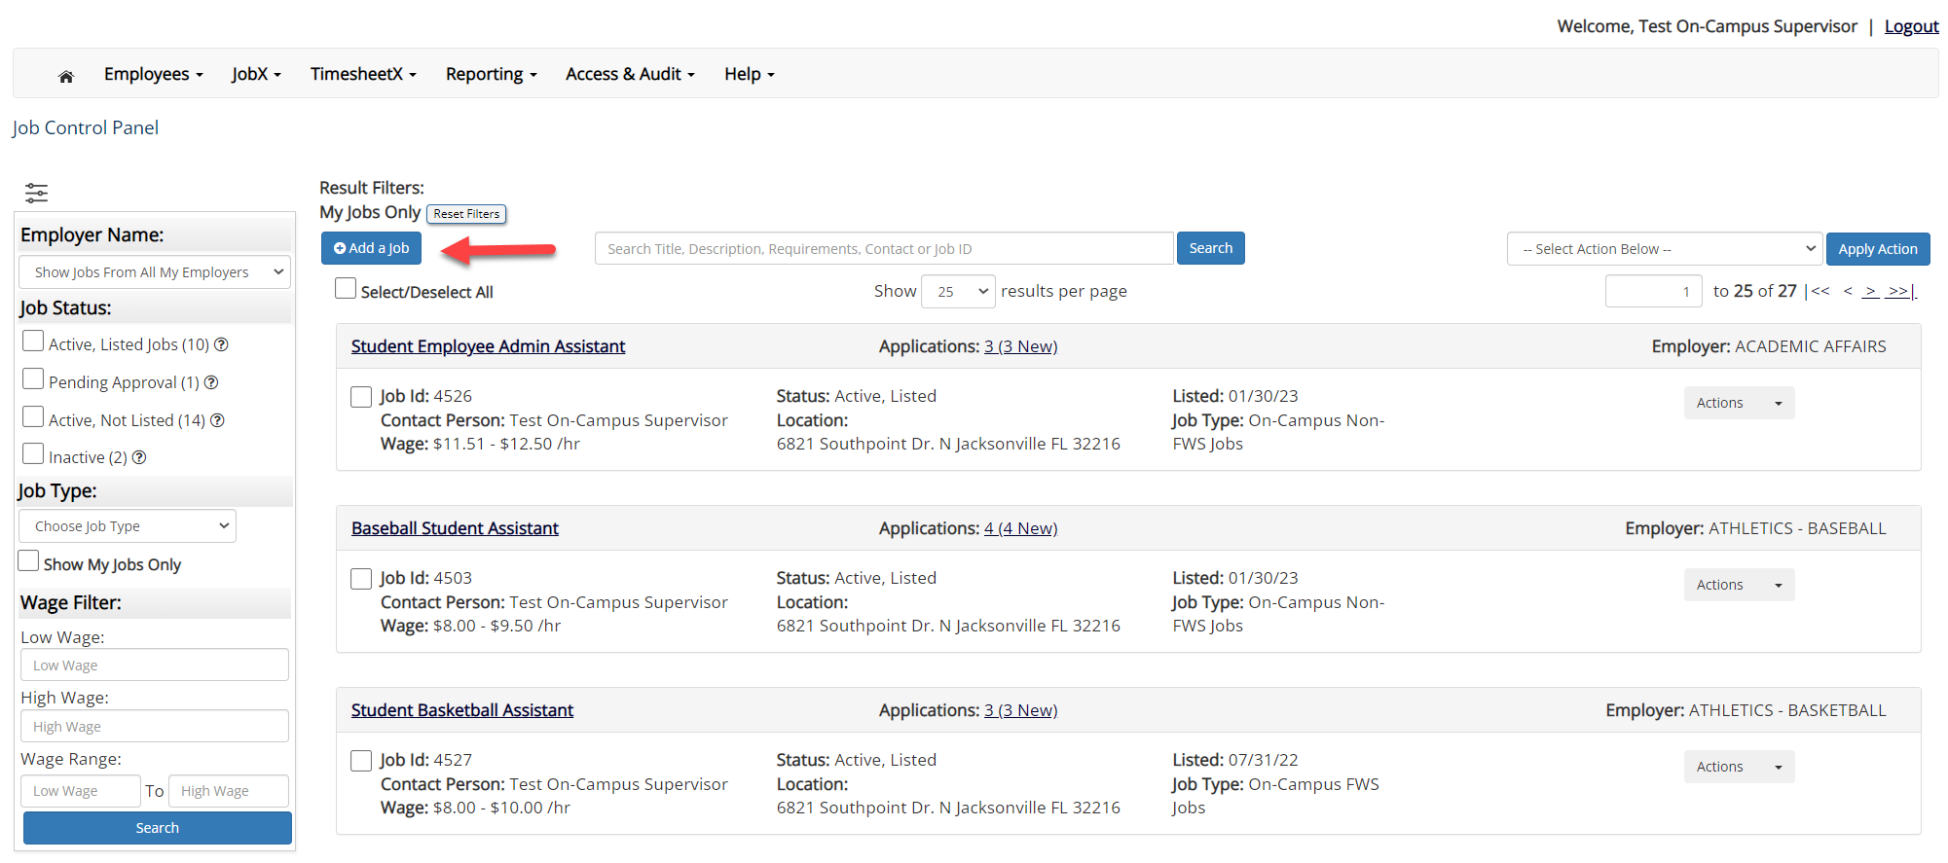
Create a Job Posting – Add a Job
On the Job Control Panel, click ‘Add a Job’ button to start the process to create an on-campus job.

Slide 7
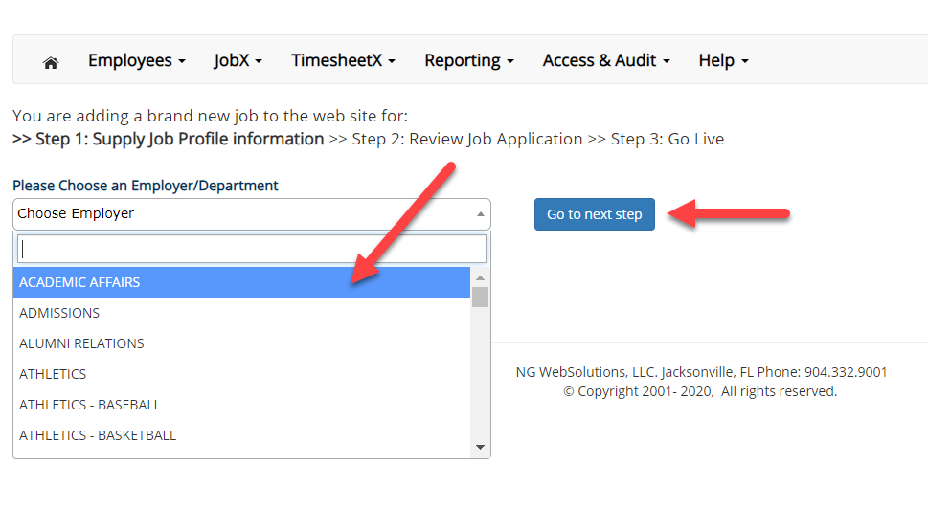
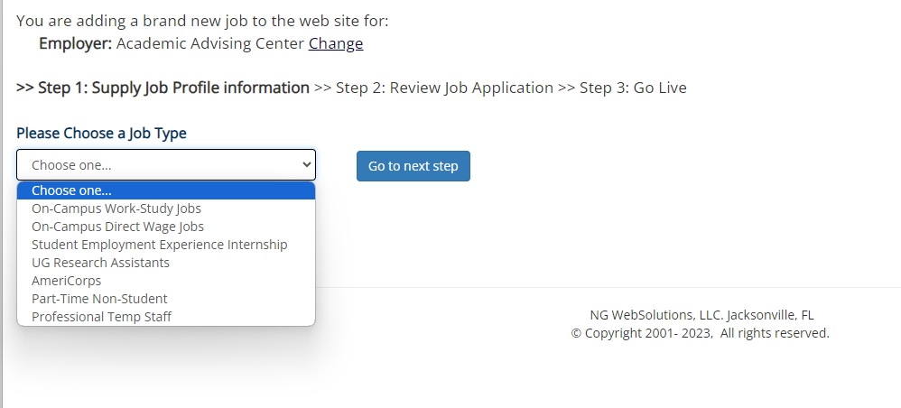
Create a Job Posting
Department:
If you have posting permissions for more than one department, Select the department for which you want to post a job from the ‘Employer/Department Name’ drop down list.
Next click ‘Go to next step’ button to proceed.
Note: If you only have permissions to post for one department, please proceed to the next slide.
Job type:
If you have posting permissions for more than one job type, you will select the job type for which you want to post a job from the ‘Job Type’ drop down list.
Then click ‘Go to next step’ to proceed.

Slide 8
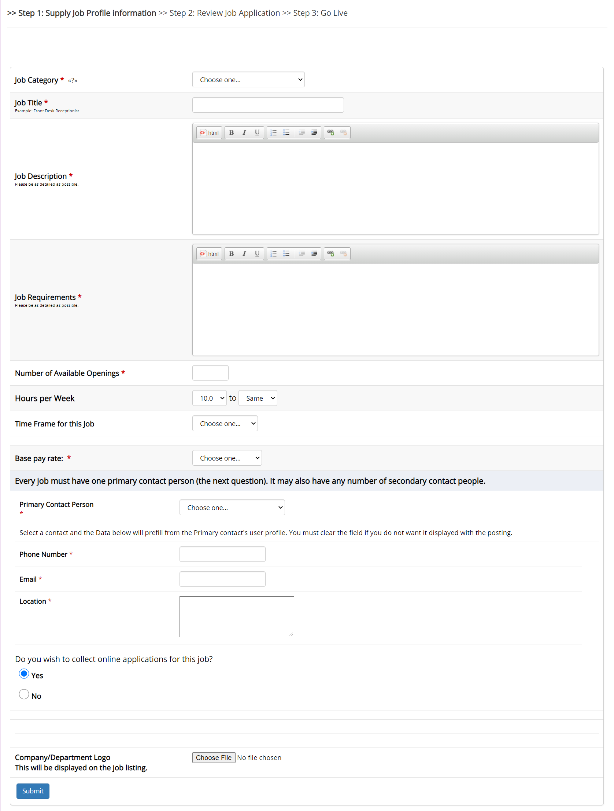
Create a Job Posting – Complete Job Posting Template
Complete the Job Posting Template.
The Job Posting Template may vary depending on the job type selected.
Fields denoted with a red * are required fields.
Lastly, click ‘Submit’ to continue the next steps in the process.

Slide 9
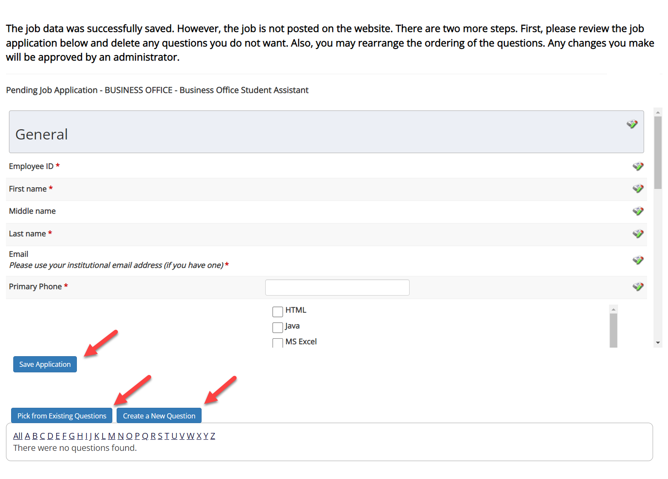
Create a Job Posting – Review Default Application
To ensure you find the most qualified candidate for your job, you may add job specific questions to the institutional default application questions.
Your site administrator must approve these job specific questions.
To add job specific questions to your institutional default application, at the bottom of the page you may use the customized tool, see next slide for additional information.

Slide 10
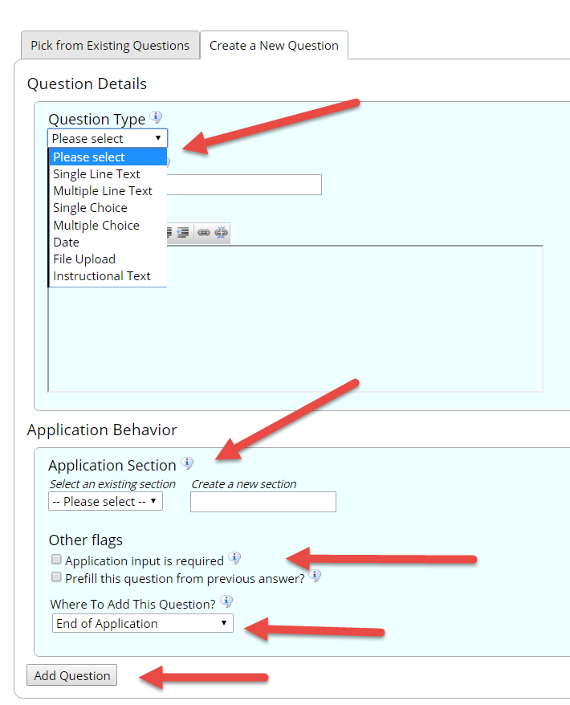
Create a Job Posting – Add Customized Questions
To add a question, select a question type from the 'Question Type' dropdown (e.g., Single Line, Multiple Line, Single Choice, Multiple Choice, Date, File Upload, or Instructional Text)
Use an abbreviated name for the question you’ll be adding for retrieval purposes in the “Pick from Existing Questions” library. Please Note: This will not be presented to the applicant.
The Question Label is what the applicant will see. Use the text and HTML editor for a professional look
You can add to an existing general section or create a custom section by entering its name in "Create a new section." Subsequent questions in this section can be added by selecting it from the dropdown.
You can place any new question exactly where you want it by selecting the desired location in the “Where to Add this Question” drop down list.
When you are completed adding a question, click the “Add Question” button. Lastly, to save the application, please click the “Save Application” button.
Please note: All job specific questions you add to your institutional default application will be reviewed and approved by Student Employment.
The Online Help contains more details instructions for adding questions.

Slide 11
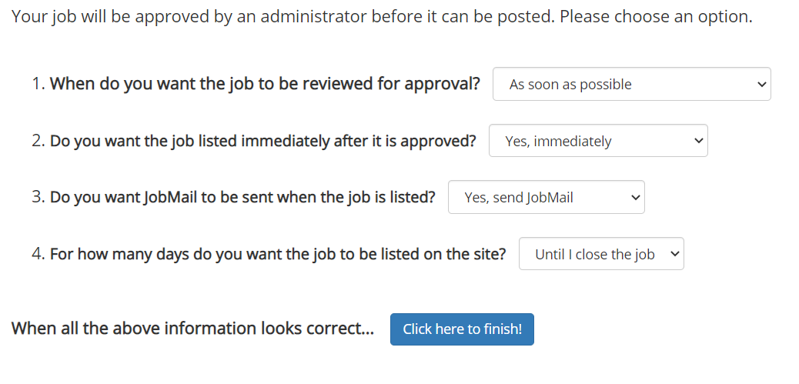
Create a Job Posting – Finalize Job Posting
When do you want the job to be reviewed for approval?
Select ‘As soon as possible’ from the list if you want the job to be reviewed for approval immediately.
Select ‘Later – I need to review it myself first’ if you wish to review the job further before approval. The job will be placed in Active, Not Listed until you are ready for approval.
Do you want the job listed immediately after it is approved?
Select ‘Yes, immediately’ from the list if you wish upon approval for the job status to be Active, Listed.
Select ‘No, put it in inactive for me’ from the list if you wish upon approval for the job status to be Inactive.
Select ‘No, put it in Active, Not Listed for me’ from the list if you wish upon approval for the job status to be Active, Not Listed.
3. For how many days do you want the job to be listed on the site?
If you want the job to be posted until you close the job, select ‘Until I close the job.’
If you want to designate a specific period of time the job should be posted, select the applicable duration from the drop-down list.
Click the “Click here to Finish!” button.
Your job will be submitted to the Student Employment Office for review/approval.

Slide 12
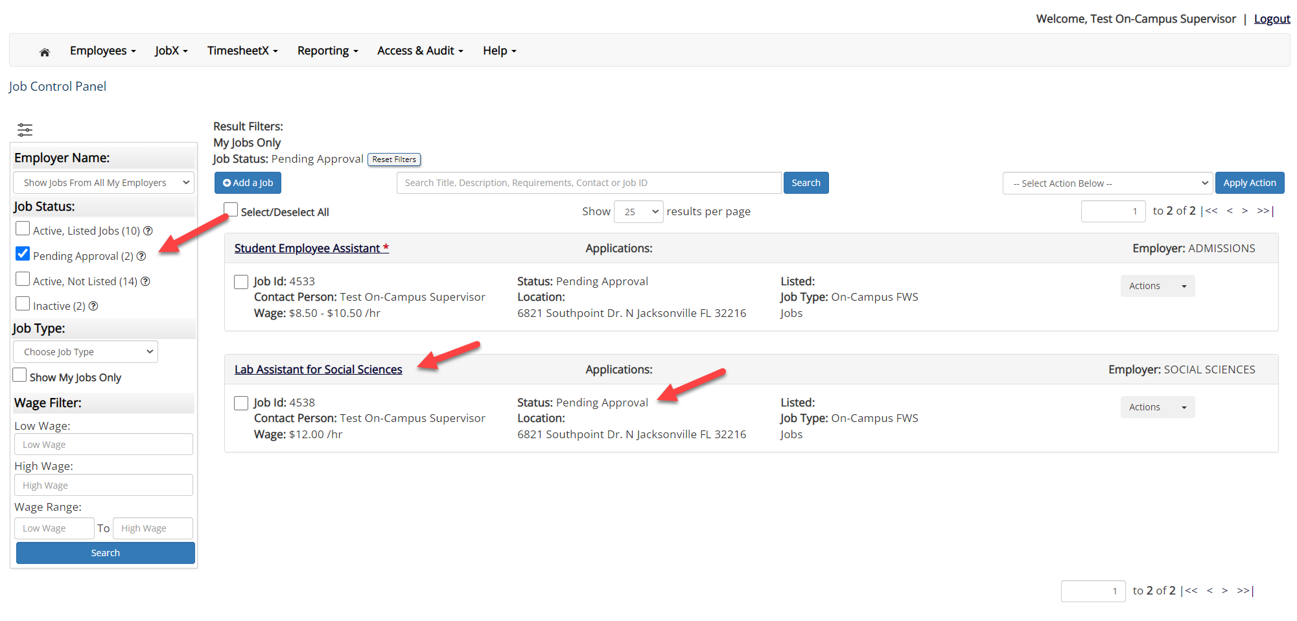
Create a Job Posting – Pending Approval
You may either print your job details or click ‘Return to your control panel’ to view and/or manage your jobs further.
If you choose to return to the control panel, the job you just added can be located in the ‘Pending Approval’ queue.

Slide 13
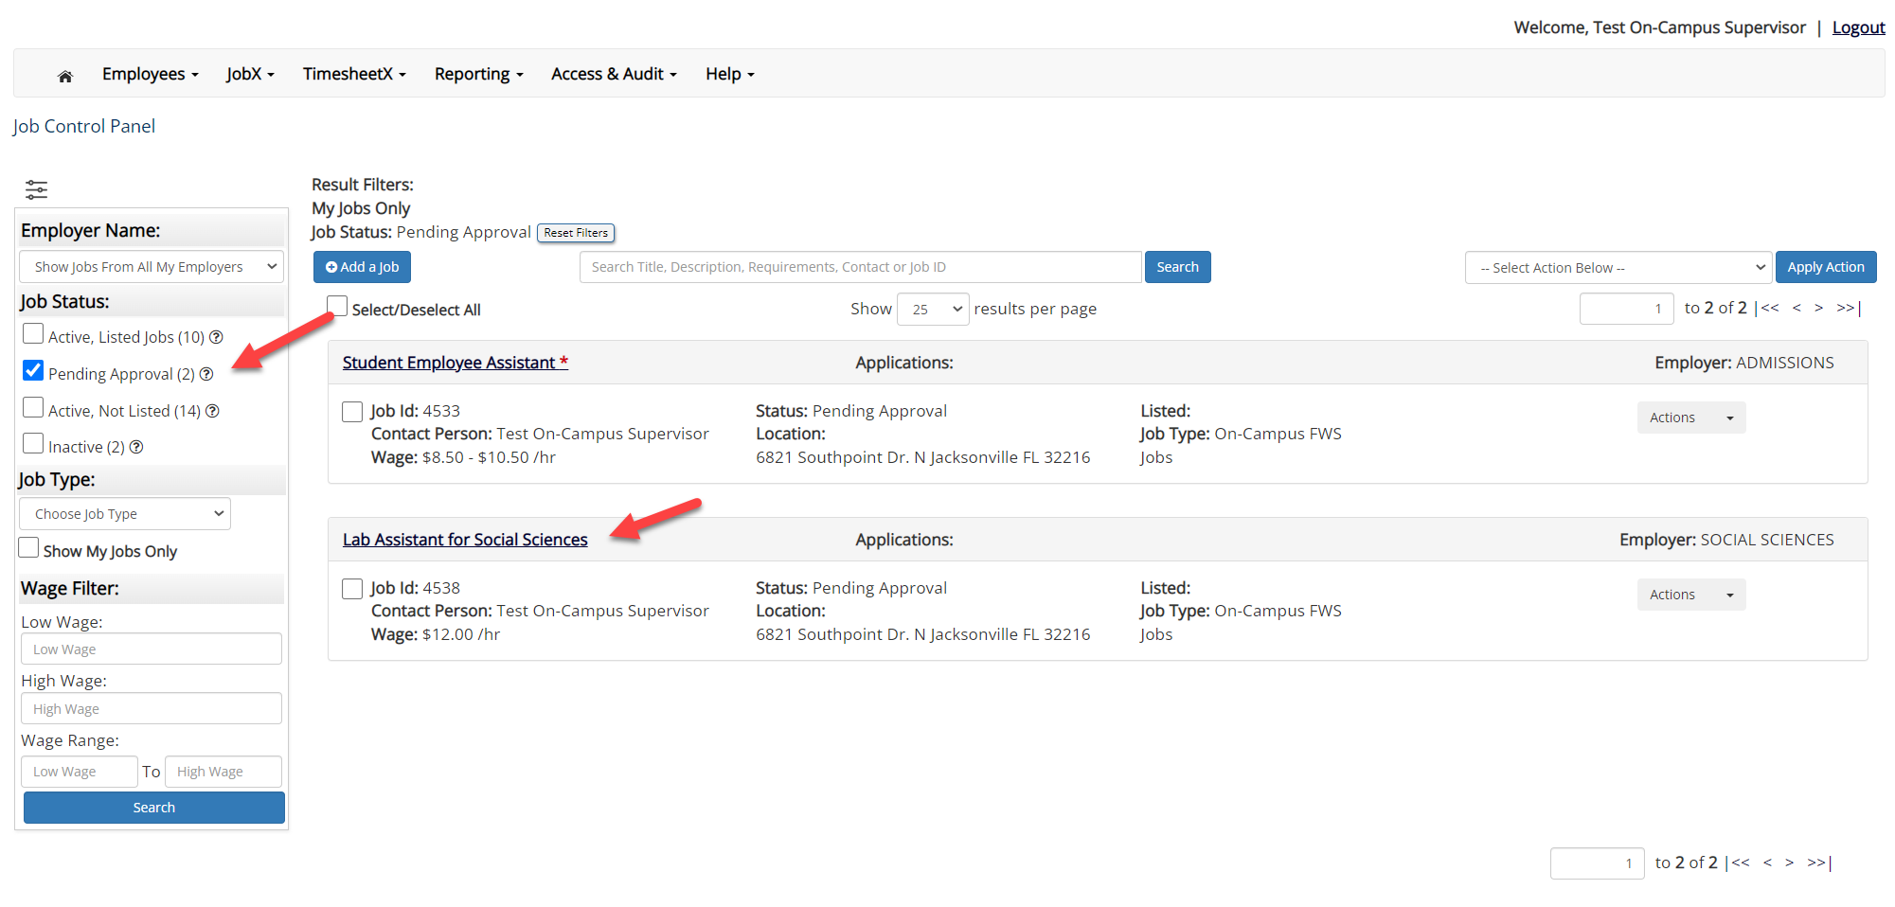
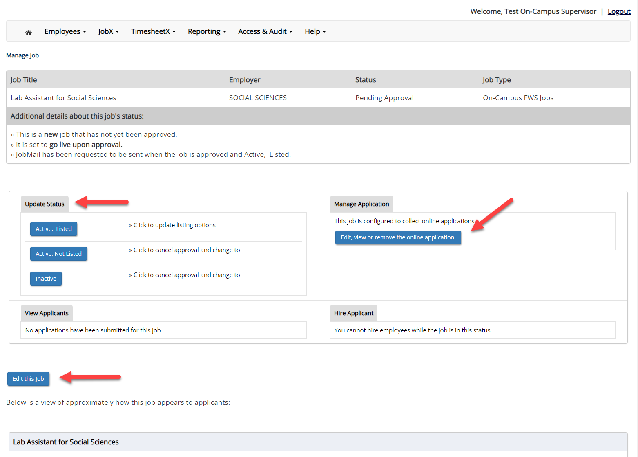
Edit a Job Posting
You may view the job and/or application details or request the job status be changed by simply clicking on the Job Title link.
To edit the job, click ‘Edit this Job’ button on the ‘Manage Job’ page.
To edit the application tied to your job, click ‘Edit or View the Online Application’.

Slide 14
Review & Hire Applicant(s)

Slide 15
Job Posting Approved - Next Steps
Manage Applications
Interview and Selection
Hire Applicant
Decline Application

Slide 16
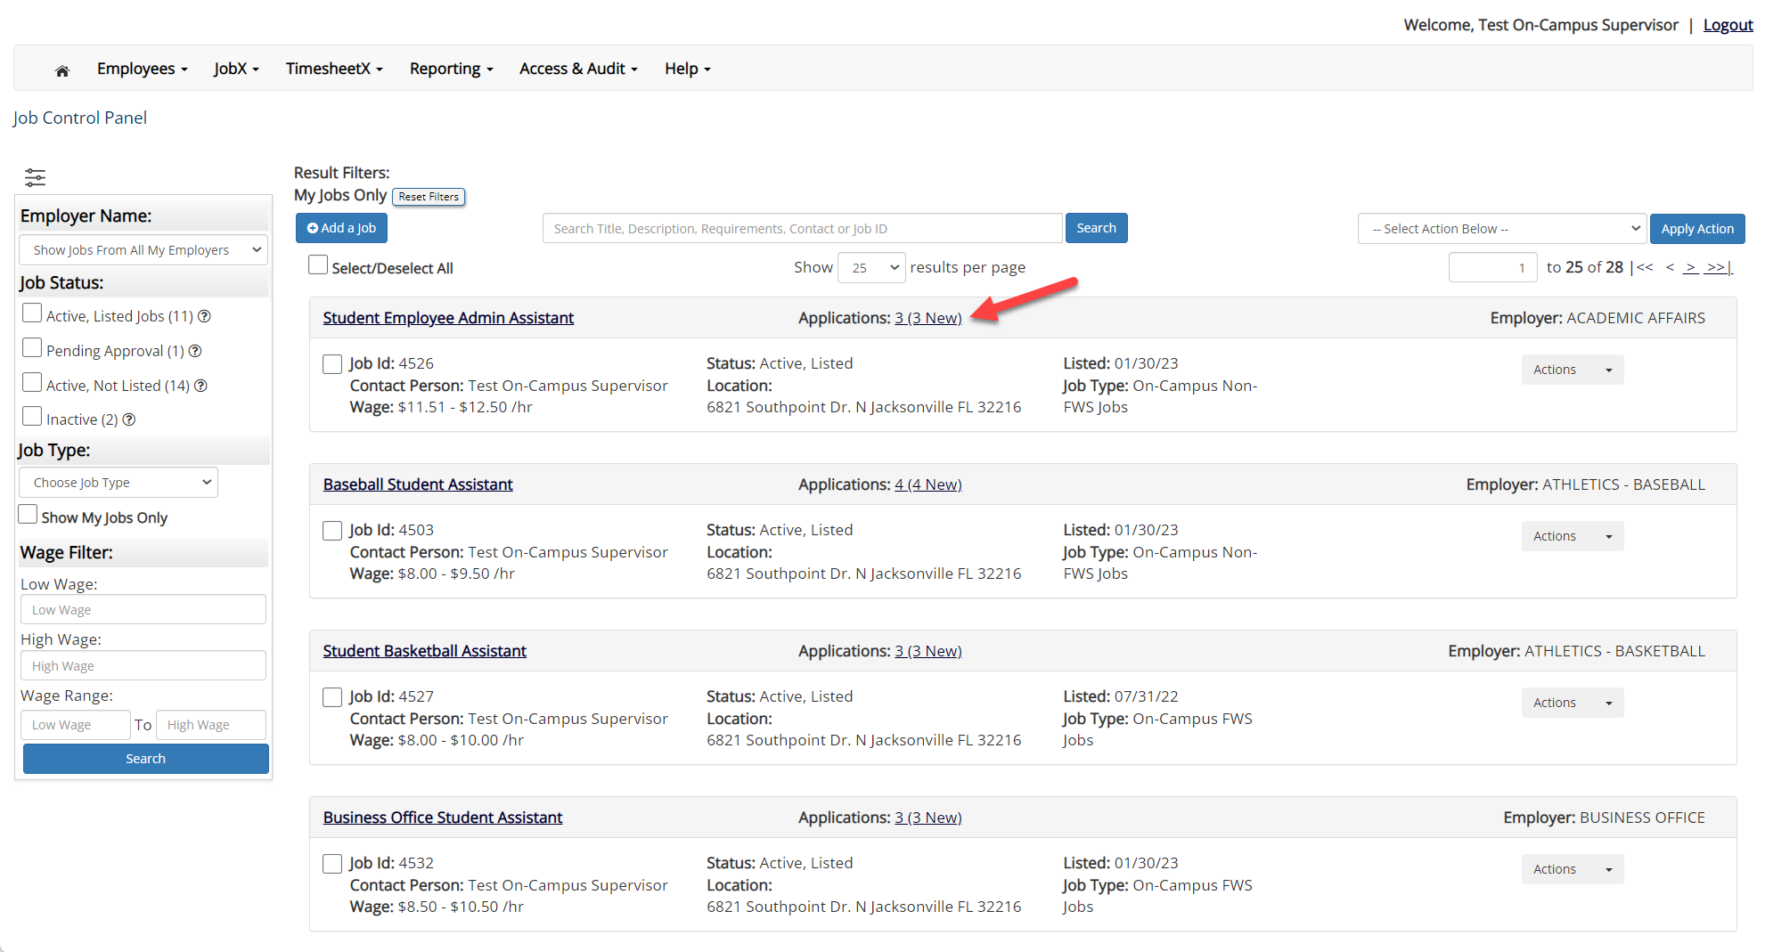
Manage Applications
You may hire an online applicant by clicking the ‘Applications’ link next to the job title or ‘Hire Applicant’ from the action drop down menu.

Slide 17
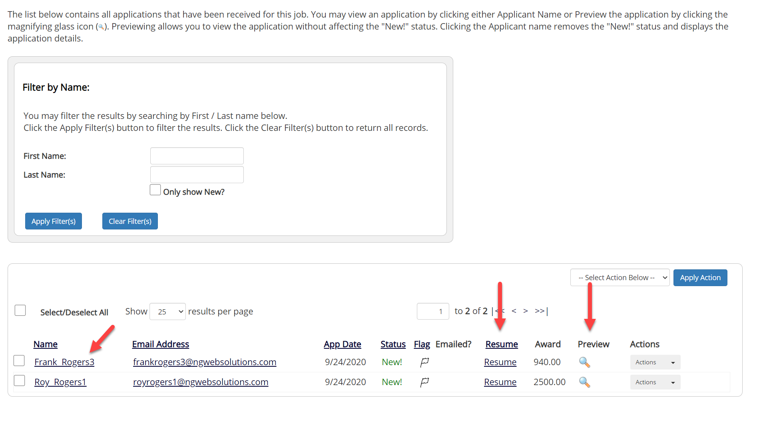
Manage Applications
Click the Applicants Name link to view the application in a full screen view.
Click the magnifying glass next to the student’s name to get a quick view format of the application.
If the student has provided a resume, click on the “Resume” link next to their name.

Slide 18
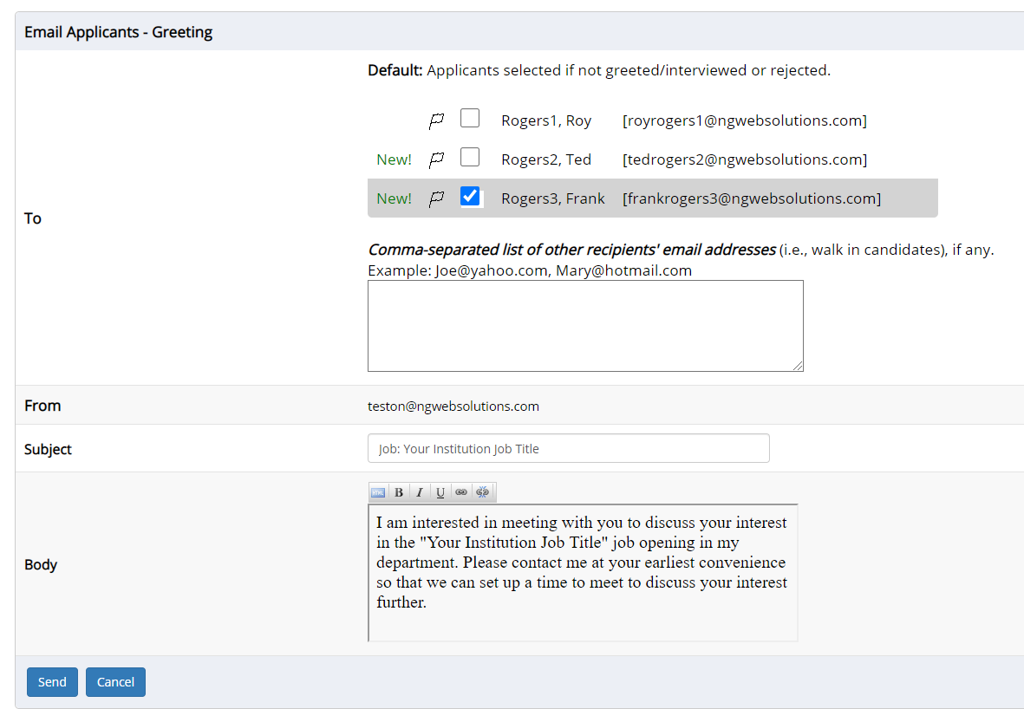
Schedule an Interview
This feature is utilized to set up interviews for one or more applicants. If you don’t wish to interview an applicant, please be sure the box next to that candidate is not checked.
You may change the text in the body of the e-mail or add additional email recipients in the ‘To’ box, then click on the “Send” button.
If you select more than one student to interview, individual e-mails will be sent to each student selected. If you don’t wish to interview an applicant, please be sure the box next to that candidate is not checked.
You may change the text in the body of the e-mail or add other email recipients in the ‘To’ box, then click on the “Send” button.
Important Note: Do NOT use this function for informing applicants you are not interested in hiring them and the job has been filled. For that purpose, you can utilize the integrated ‘Send Rejection Email(s)’ function reviewed in a future slide.

Slide 19
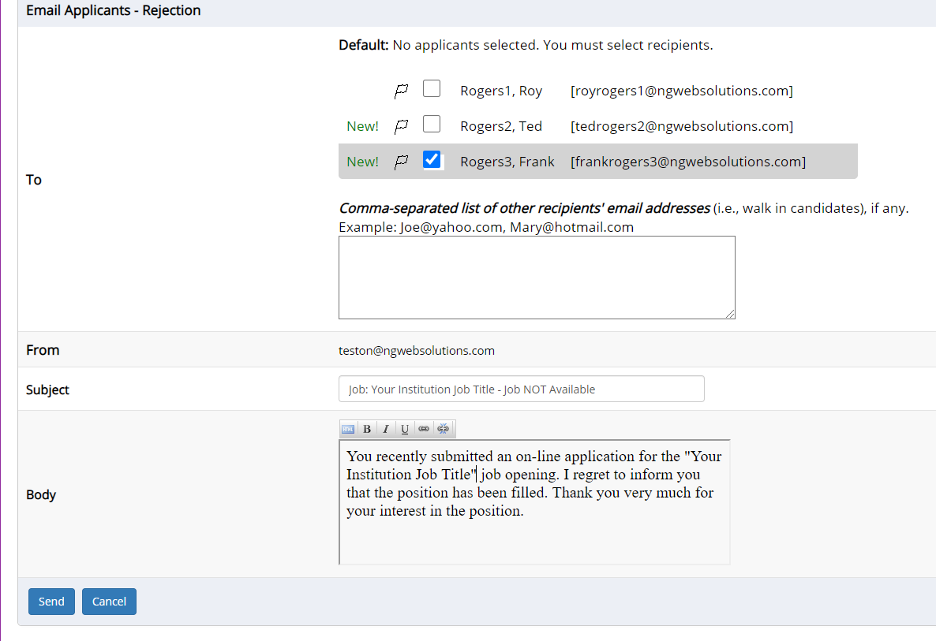
Notify applicant(s) they were NOT Selected
Click the box next to one or more applicants you would like to send a rejection email.
Next, select the ‘Send Reject Email’ action.
Finally click, ‘Apply Action’
If you select more than one student to reject, individual e-mails will be sent to each student selected. If you don’t wish to reject an applicant, please be sure the box next to that candidate is not checked.
You may change the text in the body of the e-mail or add other email recipients in the ‘To’ box, then click on the “Send” button.

Slide 20
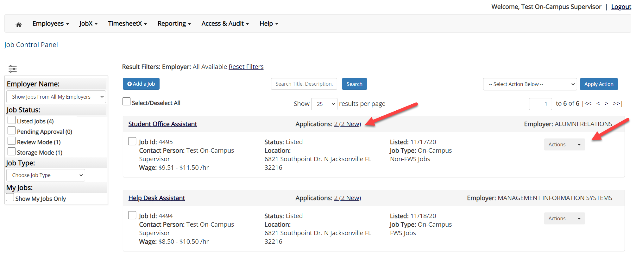
Hire an Applicant – Select Applicant
To hire an applicant, click on the ‘Applications’ link or select ‘Hire Applicant’ from the action drop down menu. This is also used to hire or rehire an applicant that did not submit an application.

Slide 21
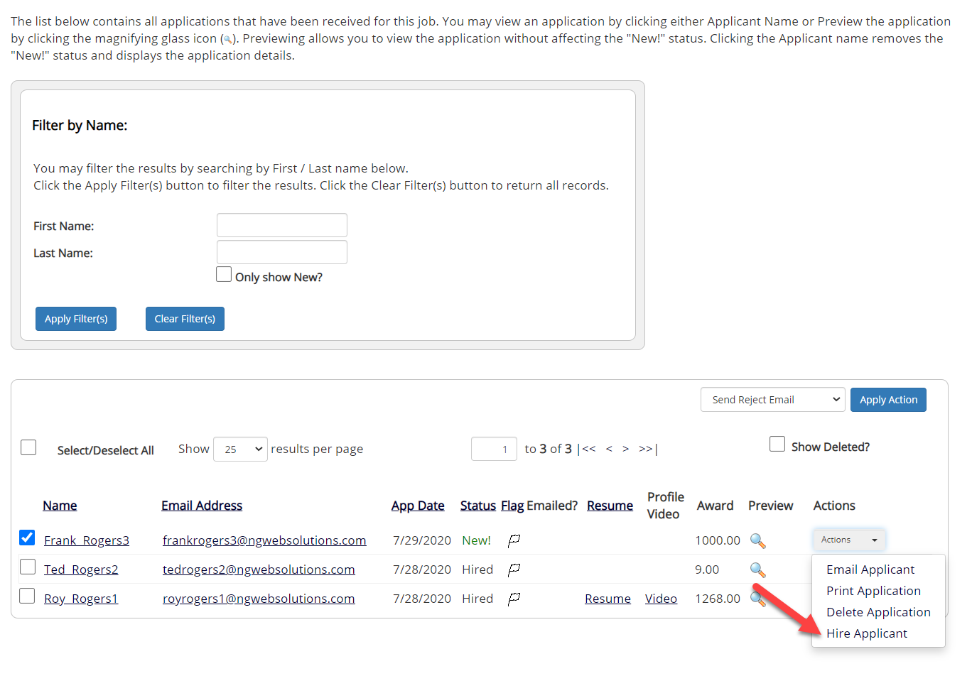
Hire an Applicant – Select Applicant who Applied
If you wish to hire the applicant, please select ‘Hire Applicant’ from the Actions dropdown list next to the applicant’s name you wish to hire.

Slide 22
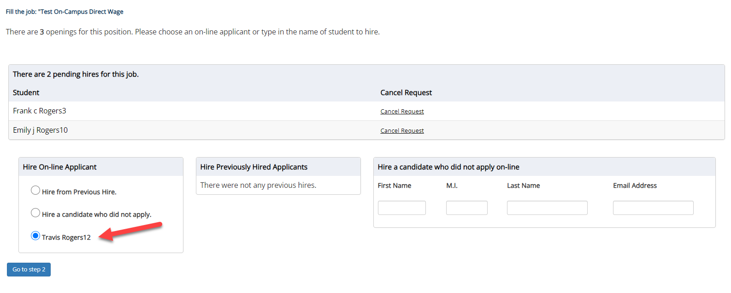
Hire an Applicant – Applied to Job Posting (TimesheetX Hires)
The applicant’s name will be automatically selected for you if you are hiring from an application. Otherwise, to hire an applicant who did not apply you will need to enter their information manually.
Next, click ‘Go to Step 2’.

Slide 23
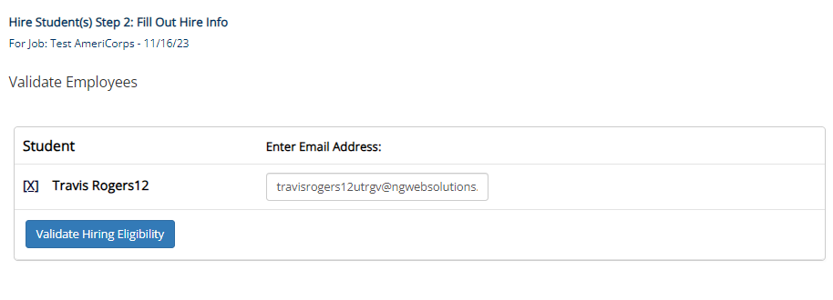
Hire an Applicant – JobX Only Hires
For AmeriCorps and Research Assistant Jobs, they have a different workflow because they will not use TimesheetX.
For these jobs, you will need to click ‘Validate Hiring Eligibility’ on the next page.

Slide 24
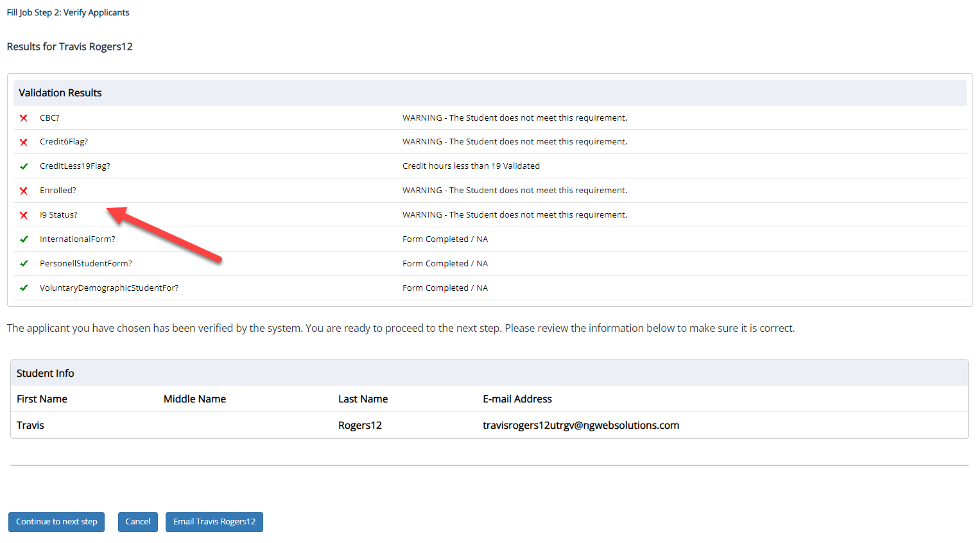
Hire an Applicant– Compliance Validation – Warning or Fail
The system will validate the employee’s account to ensure they are eligible to be hired.
If the employee does NOT pass one or more of the employment eligibility checks, the system will present a red X next to each eligibility requirement the employee did not meet.
If the supervisor wishes to email the employee regarding the employment eligibility results in an effort to get them resolved, they can click the ‘Email results’ link to open an email. The results of their validation check will be pre-filled in the body of the email. The supervisor can type additional text in the body of the email and add other recipients of the email in the cc or bc fields.
The supervisor will need to click the ‘Continue’ button to save their hire request or Cancel if the employee cannot be hired at that point in time.
If the employee has warning or fail validations, you may click the ‘Email’ button to inform the student of the validation results.

Slide 25
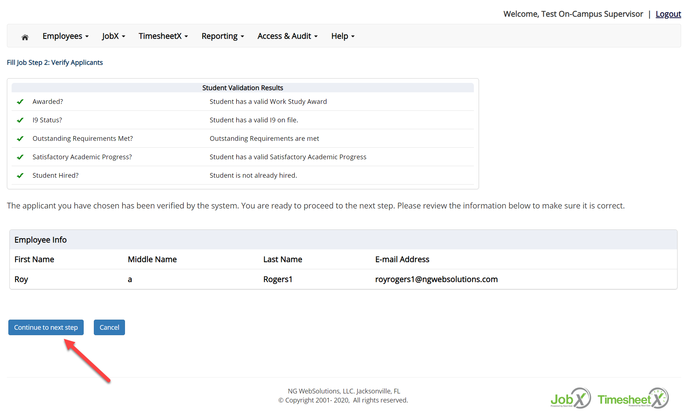
Hire an Applicant– Compliance Validation - Pass
If all the employment eligibility requirements have been successfully met, green check marks will be presented next to each eligibility requirement and a “Continue” button will be presented to continue the hire process.

Slide 26
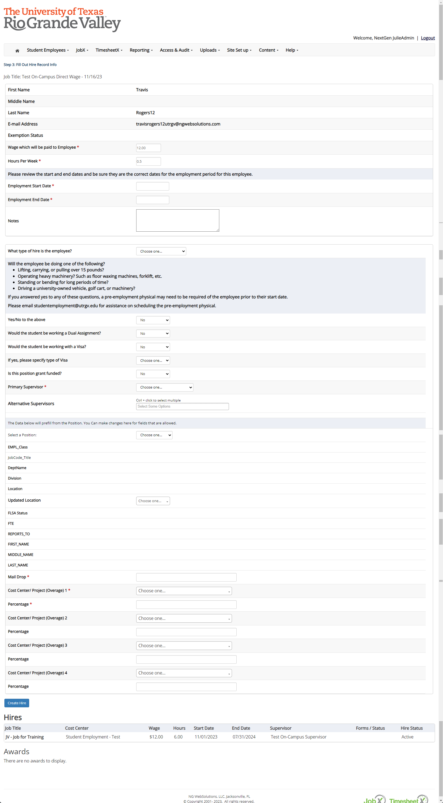
Hire an Applicant – Hire Request for Approval For Both Workflow
Data from the original job listing will be pre-filled in the Hire Request Form to reduce your data entry efforts.
You may edit the information prior to establishing the hire.
Click on the “Create Hire” button.

Slide 27
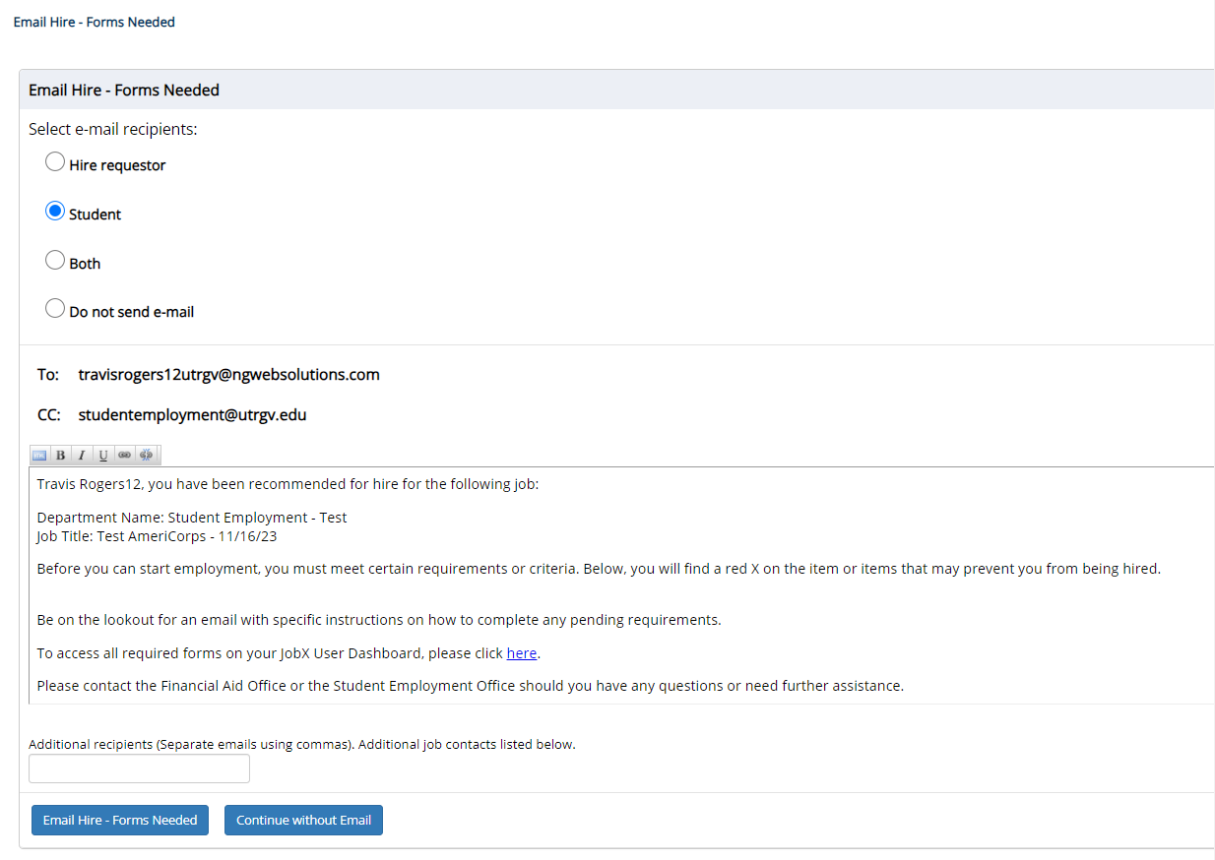
Hire an Applicant JobX Only Hires with Missing Forms
For AmeriCorps and Research Assistant Jobs, they have a different workflow because they will not use TimesheetX.
For the next step, when the student or non-student has missing forms, you will receive the email screen. Click ‘Email Hire – Forms Needed’ button to send the email to the student.

Slide 28
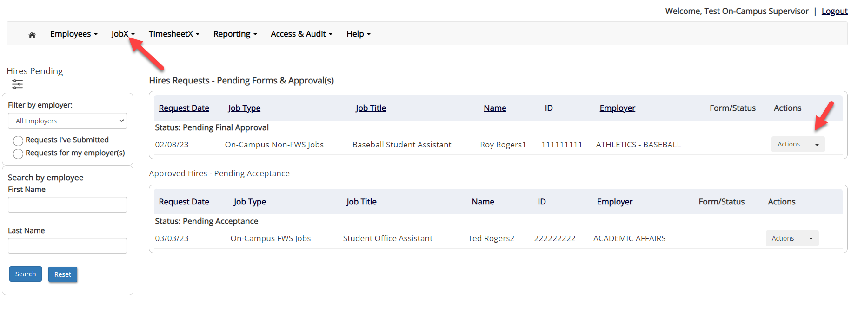
Hire Requests – Pending Approval
To view pending hire requests, you may click on the ‘JobX’ menu drop down and select ‘Hire Requests’.
In the ‘Action’ drop down, you have the option to ‘Preview’ the hire information, ‘Cancel’ the hire, or send a follow-up ‘Email’ to the student from this dashboard.

Slide 29
Approved for Hire

Slide 30
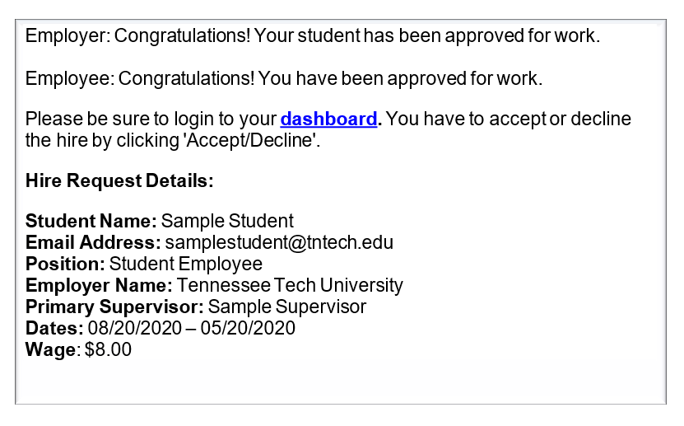
Hire Approval Email – Pending Acceptance
When the student has been approved to work you will receive the following email.
The student will need to accept the offer before they are officially hired.
You may follow up with these students on acceptance of the position through the ‘JobX’ menu item ‘Hire Requests’

Slide 31
Search Students

Slide 32
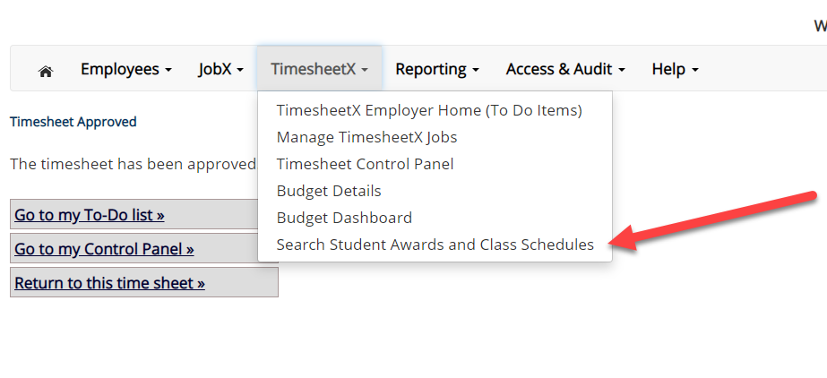
Search Student Awards & Class Schedule
To quickly view student’s award, employment eligibility flags, and/or class schedule information, click the ‘Search Student Awards & Class Schedules’ feature on the TimesheetX menu at the top of the screen.

Slide 33
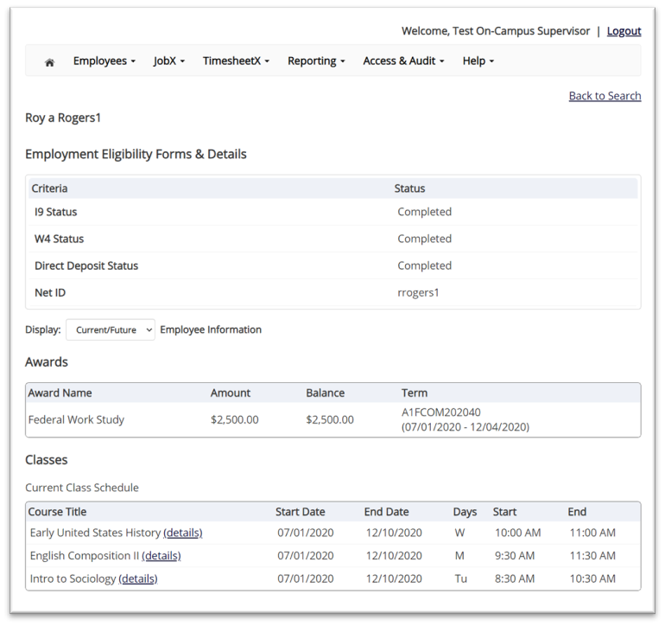
Search Student Awards & Class Schedule
Type the employee’s last name or Employee ID, then click the ‘Find Employees’ button.
Next, click the Employee’s name to access their account.
To view current, future, or past awards use the ‘Display’ drop down menu to select your desired results.

Slide 34
Online Help

Slide 35
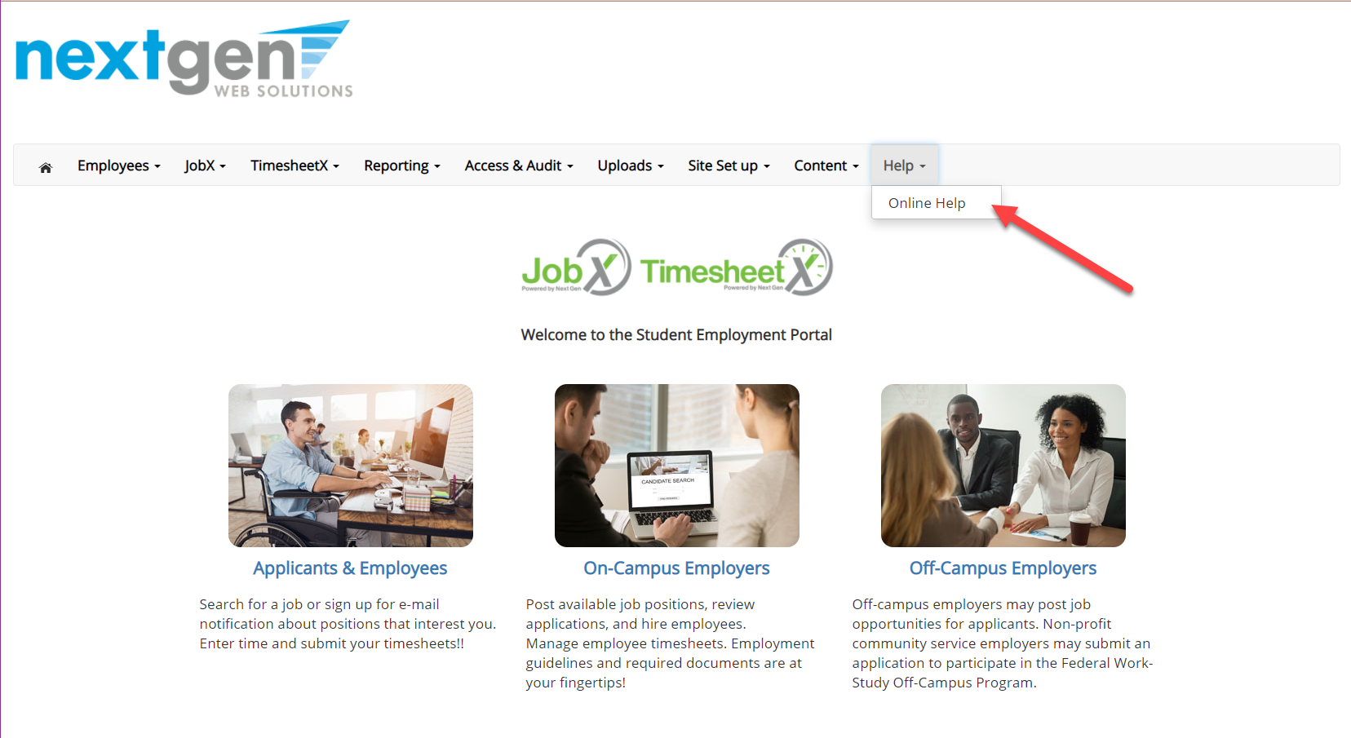
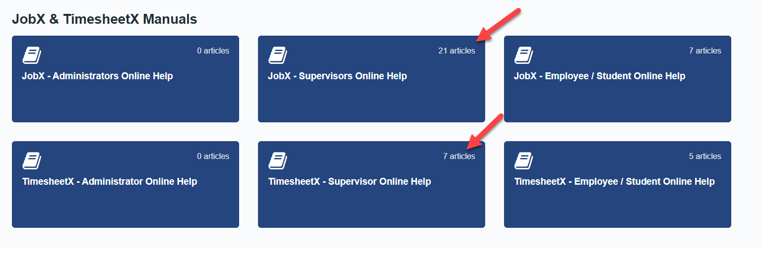
Online Help
Click the ‘Help’ menu after you login and select ‘Online Help’.
Online guides are available based on your login role.
Supervisors will be able to see Supervisor and Employee/Student.
Employee/Students can only see Online Help for Employee/Students.
You have the ability to search by keyword or topics in the search field.

Slide 36
Questions?
Please contact Student Employment at studentemployment@utrgv.edu.
For Work-Study related questions, please contact workstudy@utrgv.edu.

