Slide 1
Electronic Thesis and Dissertation (ETD)/ProQuest Submission Guide for The University of Texas Rio Grande Valley Graduate Students
1/2024

Slide 2
Accessing the Site
To access the ProQuest/ETD site and start your submission, follow the steps below:
Log on directly to the university’s homepage with ETD at www.etdadmin.com/utrgv
You can also use the link provided on the Thesis & Dissertation page under the UTRGV Graduate College site.

Slide 3
This is the opening page. Select “Log in” from the top right corner and select “student”.

Slide 4
Creating an Account: If you are a new user click on “Create new student account”, otherwise enter your username and password and click “Login”.

Slide 5
Creating an Account: Fill in the information as required. When complete click “create”.
You will receive an email to activate your account. Click “confirm your account” in the email before continuing with the process.

Slide 6
Instruction page: Click “continue” after reading the information.

Slide 7
Publishing Options: Here you may select restrictions. Click “save & continue” when complete.

Slide 8
ProQuest Agreement: This explains the publishing option selected on the previous page. After reading, click “accept” at the bottom of the page.

Slide 9
Contact Information: Enter the information as requested. Click “Save & Continue” when complete.

Slide 10
Fill in the details of your Thesis or Dissertation and your committee.
Title: Thesis or dissertation title
Year Manuscript Completed: The year in which you graduate
Degree Date: The year in which you graduate
Degree Awarded: Choose from the dropdown list of UTRGV degrees.
Department: Choose from the dropdown list of UTRGV departments.
Advisor/Committee Chair: Type your committee chair(s) name(s).
Committee Members: Enter the names of your committee members.

Slide 11
Fill in details of your Thesis or Dissertation and your committee.
Primary subject category: Choose your primary subject category. If you do not see your specific category, choose the closest category in relation to your subject.
Additional subject category: You may choose to select additional subject categories.
Keywords: You may choose some keywords about your subject matter, up to six words.

Slide 12
Thesis & Dissertation Details: Fill in details of your document and committee. Click “save & continue” when completed.
Abstract: Copy and paste your abstract in the box provided. Do not include the abstract line.
Primary Language: It defaults to English.

Slide 13
PDF of your thesis or dissertation: Confirm that your file is in PDF format and upload.
Indicate if you have any copyright permission documents and click “save & continue”.

Slide 14
Supplemental Files: These include media files, extra graphs, maps, etc. Click “save & continue”, regardless of whether you have uploaded supplemental files or not.

Slide 15
Notes to Administrator: You may add any comments you have for the graduate college. Click “save & continue”.

Slide 16
Copyright: You may choose to have ProQuest file for copyright on your behalf.

Slide 17
UTRGV Copyright Guide
UTRGV students have the option to process the Copyright through the assistance of the University Library, below is the link which will provide further information regarding the process.
https://utrgv.libguides.com/friendly.php?s=copyright

Slide 18
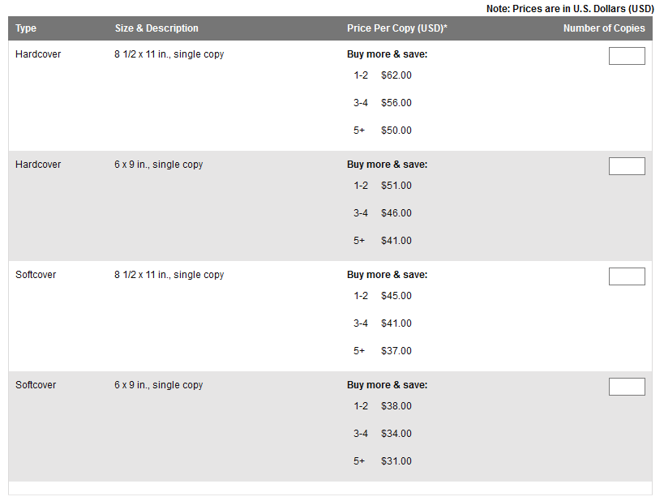
Ordering Copies: You may order personal copies of your manuscript in varying formats. You are not required to purchase copies for the university.
PRICES SUBJECT TO CHANGE

Slide 19
Ordering Copies: You may order personal copies of your document
Copies will be shipped to you 8-12 weeks after your document has been submitted to ProQuest.
Producing copies of your thesis/dissertation is least expensive at the time of opening your account; therefore, you might want to take advantage of the discount offer at this point and time.
Additional copies can be purchased after publication; you will need to contact ProQuest.
Please contact ProQuest regarding any address changes, about the process for publishing your work and fulfillment of your print orders.
Notes:
After the Degree Audit has completed their process for verifying graduation requirements. The Grad College will release the drafts to ProQuest.

Slide 20
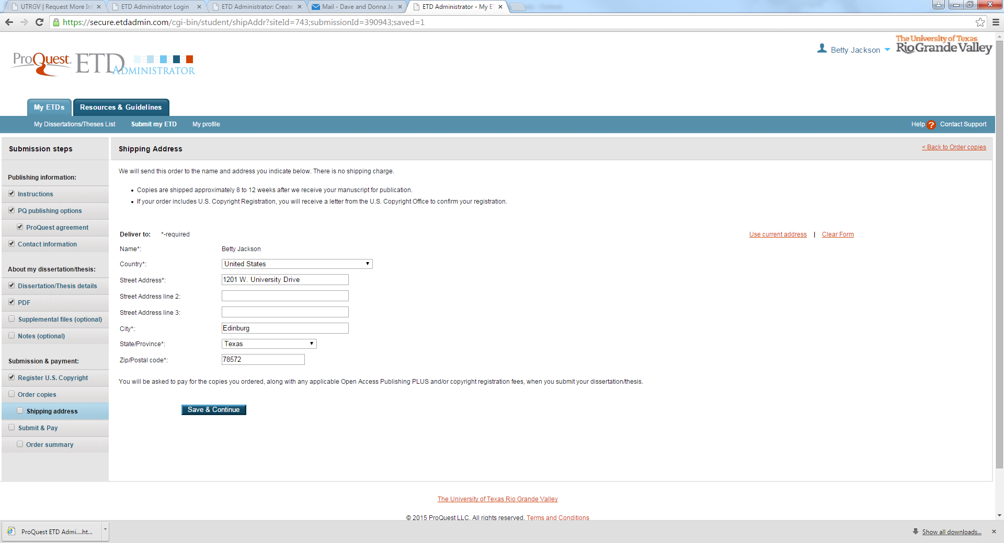
Shipping Address: Review shipping information

Slide 21
Submit & Pay: Verify information, then click “continue with submission”.

Slide 22
Submission Complete: When submission is successful, the following information will be displayed. Then click “Done”.

Slide 23
Submission Complete
You will be advised that the submission is complete.
You will receive a confirmation email when your draft is properly submitted.
After reviewing your draft, the Graduate College will send you an email advising the status of your submission.
If changes are needed, make the changes, then re-convert the file to PDF.
Sign into the ETD site to revise your draft.

Slide 24
Revising your draft
There are two options for accessing the site to revise your draft
Log on directly to the university’s homepage with ETD at www.etdadmin.com/utrgv
You can also use the link provided on the Thesis & Dissertation page under the UTRGV Graduate College site. Be advised that this link is only active for seven days from the time you receive your revision requests.

Slide 25
Revising your document
Click
Click “revise” to submit your draft for another check
Select
Select item(s) you wish to change from the left sidebar
Follow
Follow previous instructions for converting to PDF and uploading your document
Review
Review your submission
Click
When done reviewing, click “submit revisions”

Slide 26
Revising your document (continued)
You will be advised that submission is complete.
You will receive a confirmation email when your draft is properly submitted
After reviewing your draft, the Graduate College will send you an email advising the status of your submission.
If further changes are needed, make the changes, then re-convert it to PDF.
Sign into the ETD site to revise your draft.
Draft is not sent for publishing until all formatting is complete and all graduation requirements have been met.

Slide 27
Resource Links
ProQuest
Log on directly to ProQuest ETD at www.etdadmin.com/utrgv
T/D Page
Graduate College
Formatting Guides
Thesis/Dissertation Formatting Guides
To schedule an appointment with a Formatting Editor. Click here
Schedule an Appointment
email
For any questions you may have email: ETD@utrgv.edu
Thesis Formatting Guide
Dissertation Formatting Guide
Thesis & Dissertation Info Page

