Slide 1

Pre-Submission Guide for
The University of Texas
Rio Grande Valley
Graduate Students
9/2024

Slide 2
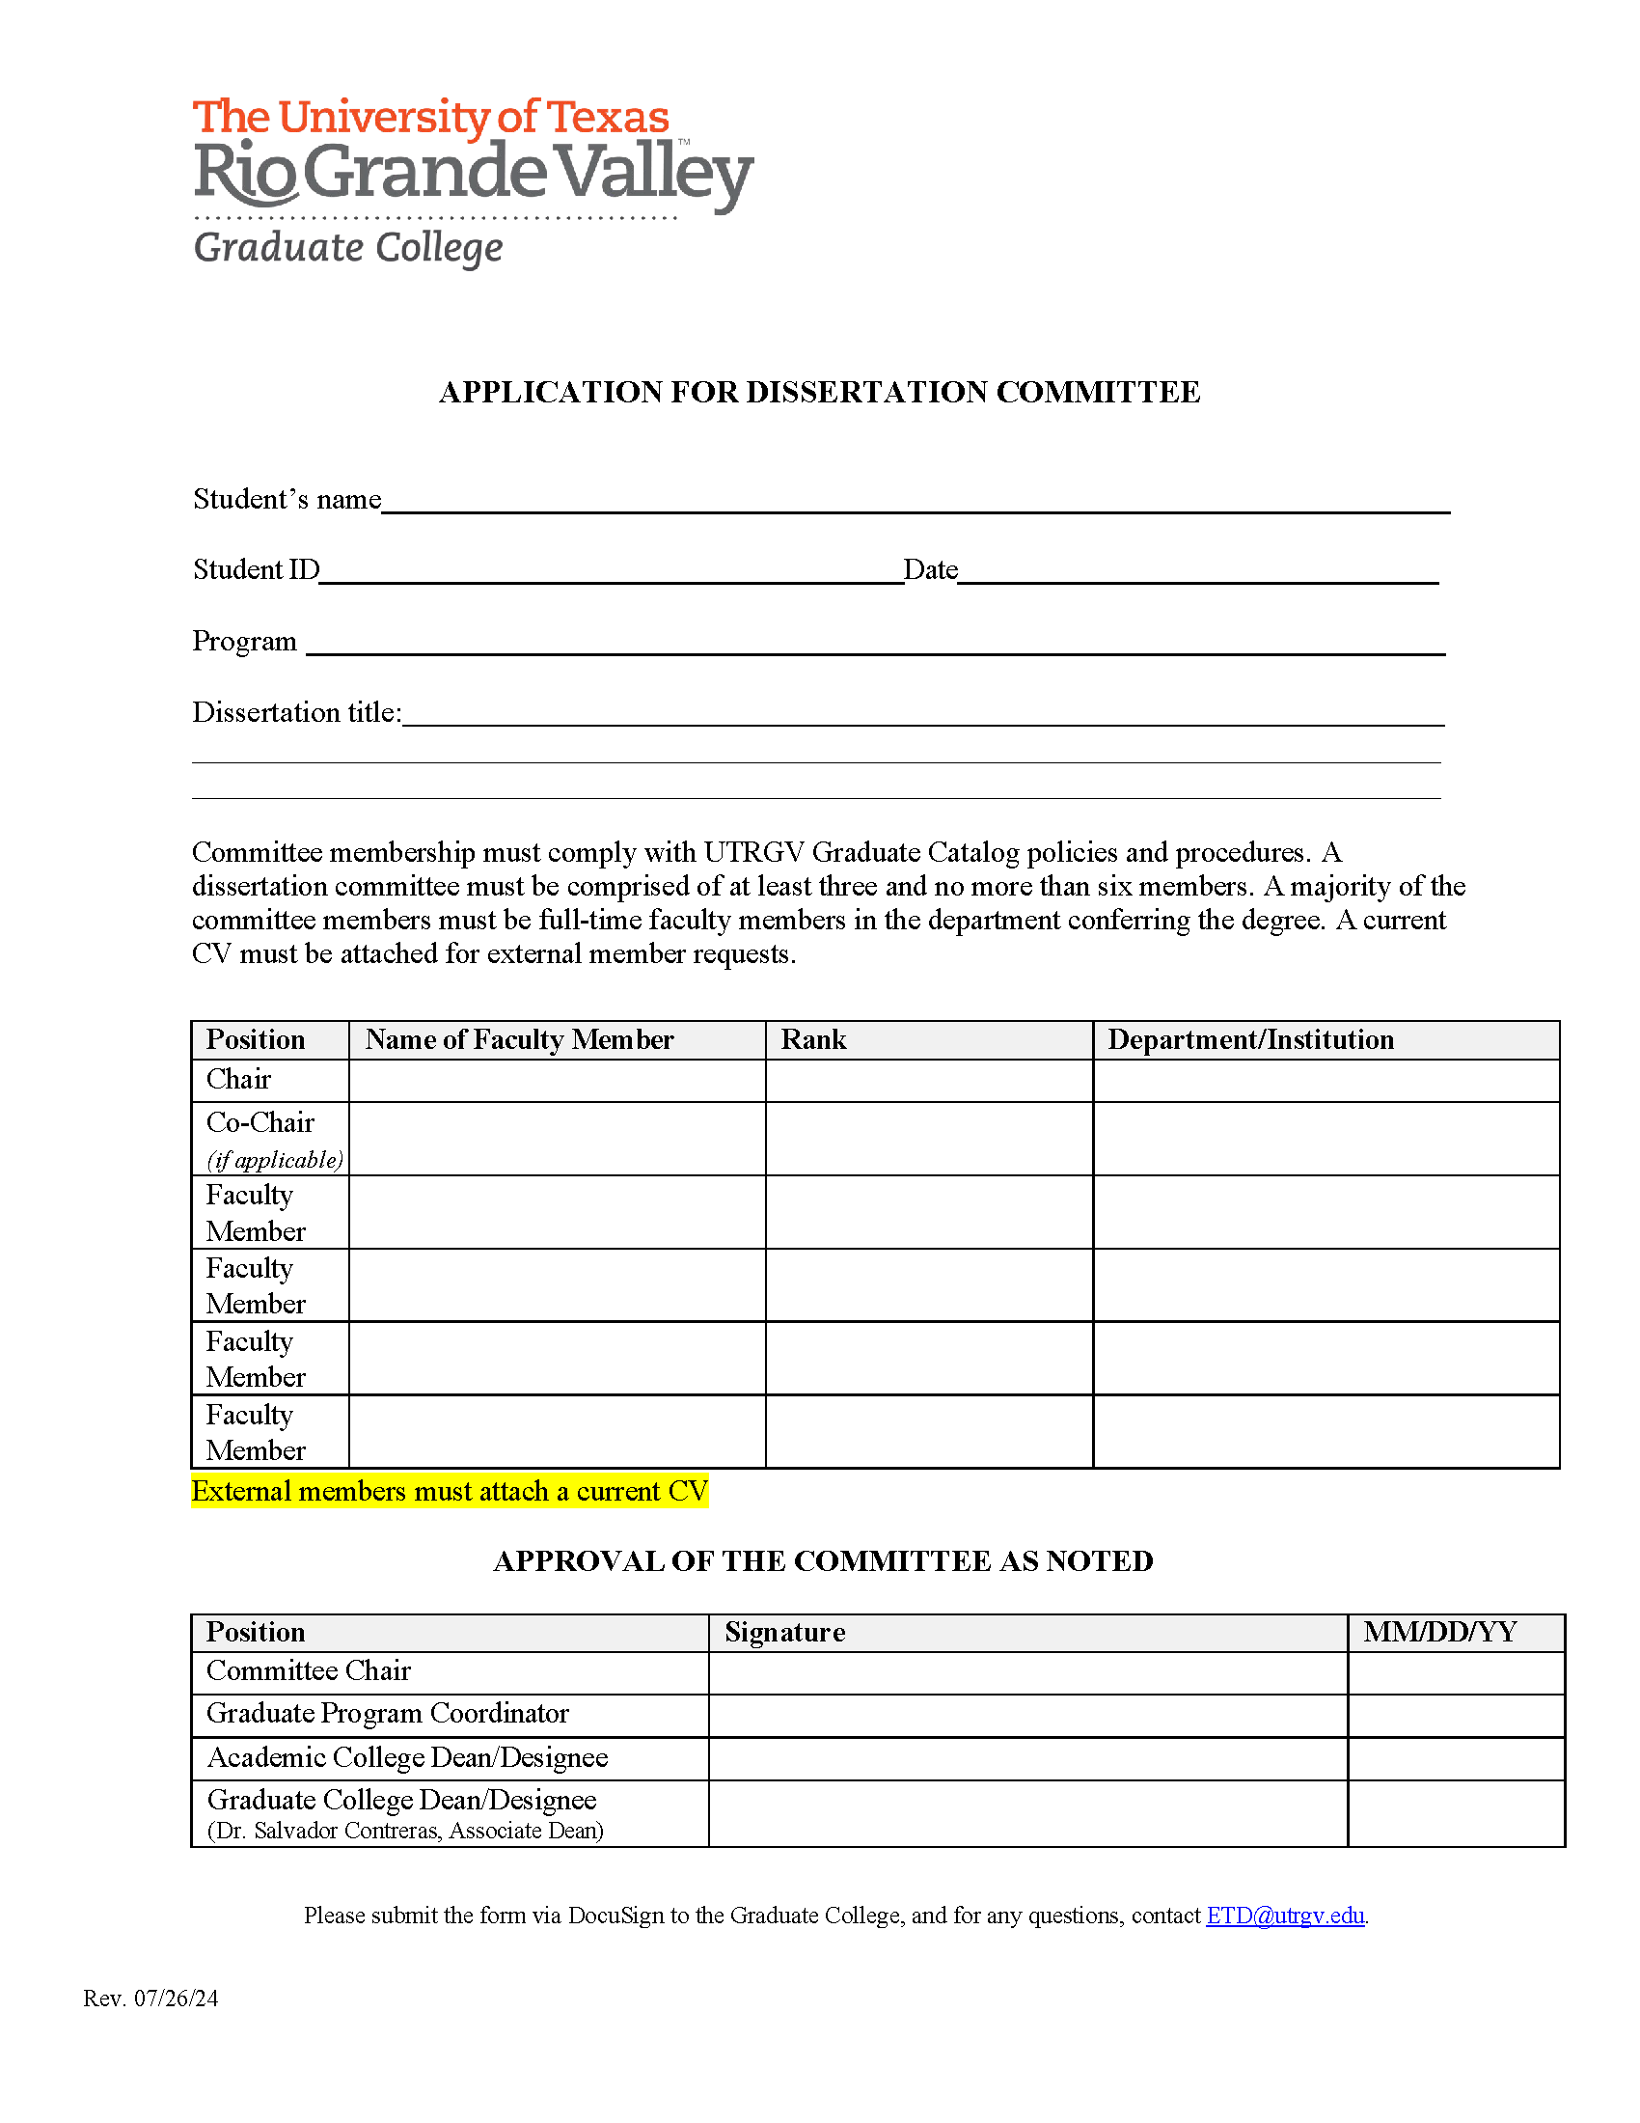
Application for Committee Form
The student will fill out the top section.
The bottom section will be signed and dated by the Committee Chair, the GPC, the Dean of the College, and the Associate Dean of the Graduate College.
It is highly recommended that all forms be routed through DocuSign for all signatures for easier tracking.
Contact your GPC for assistance in routing forms through DocuSign.
Dissertation Committee Form
Thesis Committee Form
Notes:
Students will need to have their committee forms on file with the Grad College before their last semester. Ideally, we would like them in before we begin reviewing your drafts. So, if you know that you have not sent in a signed copy to the GC please do so before the draft deadline of Feb. 26.

Slide 3
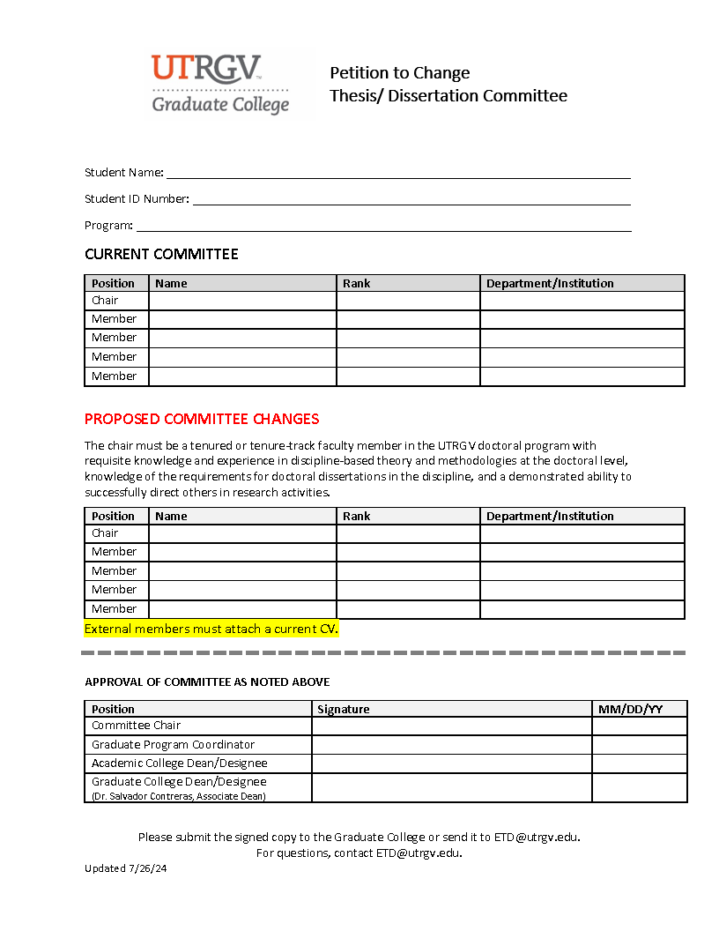
Petition to Change Thesis/Dissertation Committee Form
Students fill out all sections above the dotted line.
The Committee Chair, GPC, the Dean of the College, and the Associate Dean of the Graduate College sign and date below the dotted line.
NOTE: External committee members must have a current CV attached to this form.
Contact your GPC for assistance in routing the form through DocuSign.
Link to Change Thesis/Dissertation Committee form

Slide 4


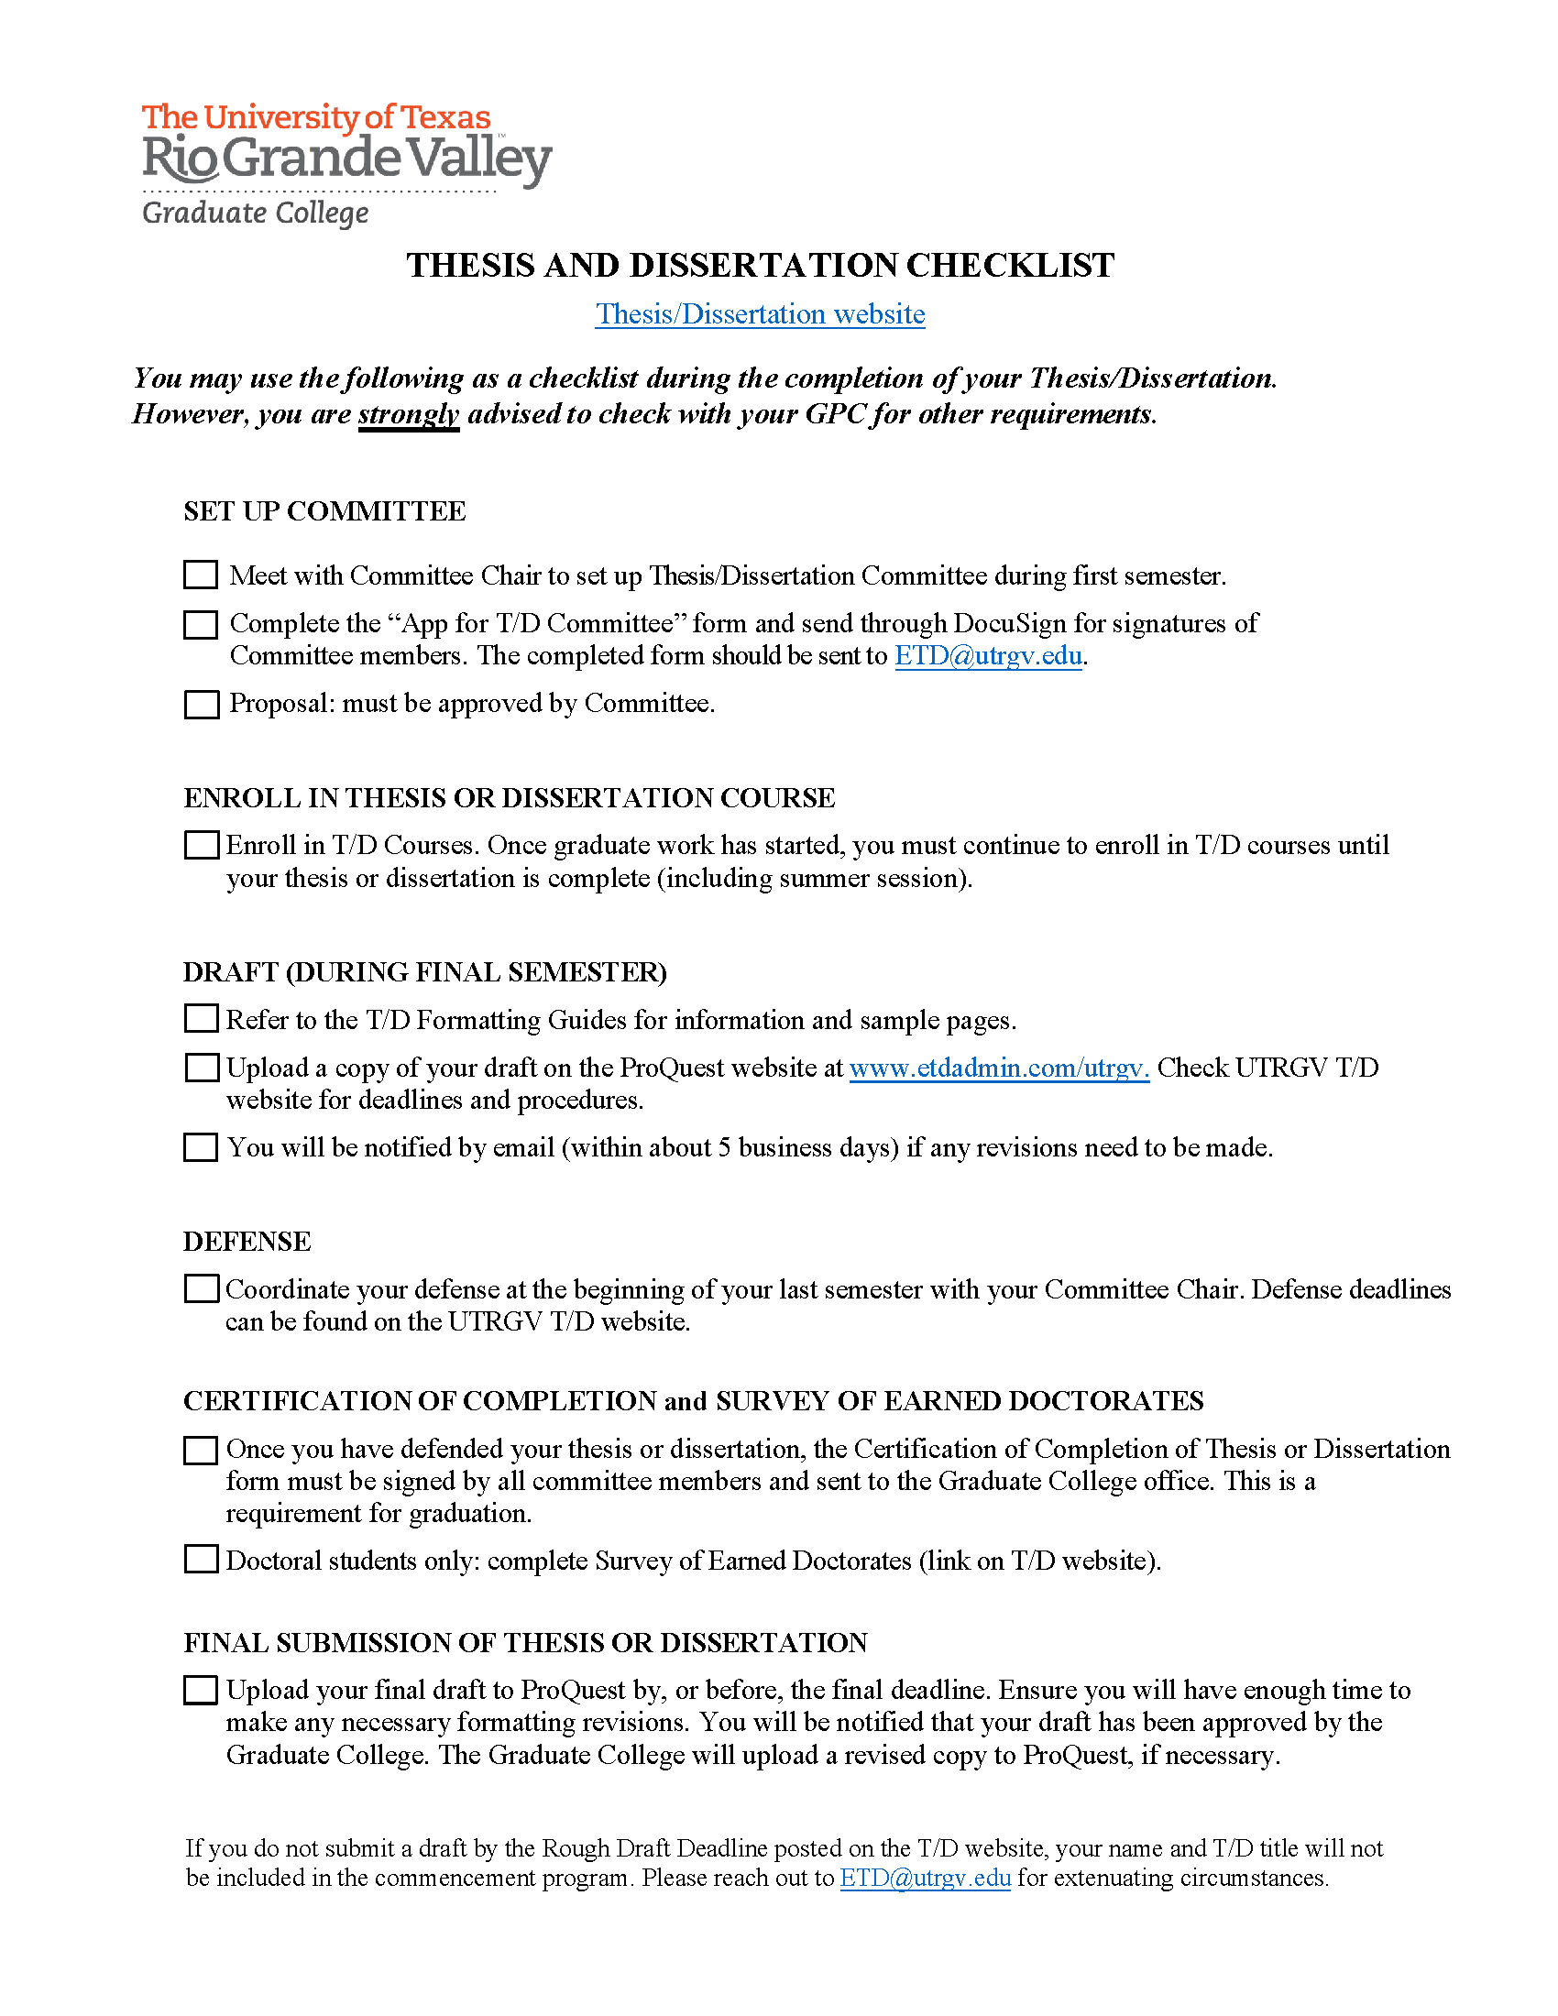
Thesis & Dissertation Checklist
Can also be found at the end of the Thesis and Dissertation Formatting Guides and under the Useful Tools and Information section of the T/D webpage.
Link to T/D webpage

Slide 5

Other useful information!
If you do not submit by the preliminary draft deadline, your name/title will not appear in the commencement booklet.
The name in the commencement booklet is the name on file at the registrar’s office. Check with the Registrar’s Office to verify or update your name.
Your defense must be scheduled at least two weeks before the final draft deadline. Defense Date Announcements may be made to the Graduate College at etd@utrgv.edu. The online form can be found under Useful Tools on the T/D webpage.

Slide 6
Resource Links
ProQuest
Log on directly to ProQuest ETD at www.etdadmin.com/utrgv
T/D Page
Graduate College
Formatting Guides
Thesis/Dissertation Formatting Guides Thesis Formatting Guide
To schedule an appointment with a Formatting Editor. Click here
Thesis & Dissertation Info Page
Schedule an Appointment
email
For any questions you may have email: ETD@utrgv.edu
Dissertation Formatting Guide

