Slide 1


Slide 2

THE UNIVERSITY OF TEXAS RIO GRANDE VALLEY
… Office of Governmental Relations
What you should know about political activity on campus and beyond…
“the Do’s & Don’ts”
Document found at… www.utrgv.edu/gcr/departments/governmental-relations/index.htm
UPDATED: October 2025

Slide 3

WHY IS IT IMPORTANT TO KNOW AND ABIDE BY THE DO’S & DON’TS…
We are a distributed campus with a presence in many cities throughout the region; collectively we are in contact with various local, state, and federal elected and appointed officials on a frequent basis.
Indeed, UTRGV’s service region spans some 120 miles… the Rio Grande Valley is a 4-county area encompassing more than 40 local governments, 3 Members of Congress, 3 State Senators, and 8 State Representatives.
We must work as a team to assure that our priorities are effectively communicated and that our elected and appointed officials are given appropriate and timely information; we must also assure that requests made to or from them are given thoughtful and timely consideration.
As a state agency, we are subject to rules and guidelines of the UT System, state law, and federal law.
To avoid the pitfalls of navigating the political landscape, we must avoid mistakes and continue to build the trust of government officials… but when we make a mistake, we will act quickly to repair the damage and restore the trust.

Slide 4
TRUST…
TAKES YEARS
TO BUILD
SECONDS
TO BREAK
AND FOREVER
TO REPAIR

Slide 5
TAKING A POSITION ON ISSUES & CANDIDTES…
You May NOT express – in your university capacity – a position for or against any proposition or measure before a public body or electorate, or for or against any candidate for office.
Example: Professor wearing a candidate’s t-shirt while teaching class.
Example: Producing marketing materials that advocate for or against an issue or express a position.
Example: Signing off on any communications, as a university employee, that ask legislators to vote for or against an issue.

Slide 6
TAKING A POSITION ON ISSUES & CANDIDTES (cont.)…
You May express how proposed rules, regulations or laws would impact the university or your college or program but CANNOT say you “oppose” or “support” particular action.
Example: You are asked by news media to comment on an institutional program that may be of particular interest to a candidate or campaign because the program was established or supported by the candidate in the past. Is this permissible?
It is PERMISSIBLE to provide objective facts but be careful to avoid comments that could be perceived as institutional support for or opposition to the candidate’s campaign. Focus on facts about the program, not the candidate.

Slide 7
TAKING A POSITION ON ISSUES & CANDIDTES (cont.)…
You May testify before legislative or local government committees if approval is first sought and approved from the Office of Governmental Relations (OGR) and from your supervisor.
Remember though – just the facts!
You May express opinions for or against a candidate, proposition, or legislative measure in your capacity as a private citizen.
There are times when it’s difficult to separate yourself from your title at the university so if you have concerns or questions on whether you can/should do something, contact OGR.
It’s always a good idea to qualify your statements as being your own, that you are appearing on your own time, and at your own expense.

Slide 8



TAKING A POSITION ON ISSUES & CANDIDTES (cont.)…
You may NOT use university resources, including but not limited to equipment, supplies or services to conduct political activity, support a person’s candidacy or to express personal opinions on legislative or local government measures.
Example: Sending an email on your university computer to a colleague or friend asking them to support or oppose a candidate or referendum and/or inviting them to a political event.

Slide 9


CANDIDTES – WHAT IS / IS NOT ALLOWABLE…
You MAY attend campaign events or assist a campaign or candidate on your personal time and expense… but only in your individual capacity.
To attend such an event during work hours, you must use accrued compensatory time, vacation time or a leave without pay granted for this purpose.
You MAY use personal funds (not public funds) to make a political contribution to a candidate or political committee.
You may NOT coerce employees or other persons to make or not make political contributions.
You may NOT allow photography or filming for a political advertisement to occur on campus. If you are unsure about the intended use of the photograph or film, ask for clarification from the candidate or officeholder and notify OGR.
You may NOT allow institutional logos or trademarks to be used in political advertisements.

Slide 10
INVITATIONS TO CANDIDATES…
Registered student organizations, faculty organizations, staff organizations or student government organizations MAY invite a candidate for political office to the university BUT must first make an application for use of a university facility to the university president and receive approval.
Approval must be received at least 48 hours prior to the time the event is scheduled to take place;
Approval of the application may include reasonable and nondiscriminatory time, place and manner restrictions for the event set by the university;
The organization must retain control over the event and may not be a “front” for an off-campus person or organization;
The organization may not jointly sponsor an event with an off-campus person or organization in violation of Regents’ Rule 80105; and
The organization must make it clear that the organization, and not the university, invited the speaker and that the views expressed do not represent the views of the institution.

Slide 11
INVITATIONS / COMMUNICATIONS / REQUESTS TO ELECTED OR APPOINTED OFFICIALS…
Do NOT schedule meetings with or send invitations to local, state or federal elected and appointed officials and/or their staff without first notifying OGR.
Do NOT request funding for a project or program from local, state or federal elected or appointed officials. Requests for funding should be made to your direct report and will be communicated to university leadership.
Do NOT request proclamations or resolutions from elected or appointed officials and/or their staff directly. Go through OGR to do so.
Do NOT make any gifts or schedule plaque presentations or the like to elected or appointed officials without first obtaining consent from OGR. Note: Special rules apply to federal officeholders and certain expenditures must be reported.

Slide 12
INVITATIONS / COMMUNICATIONS / REQUESTS TO ELECTED OR APPOINTED OFFICIALS (CONT.)…
You MAY invite elected or appointed officials to campus to be guest speakers… in their official capacities. However, you should first notify OGR of any meetings you wish to schedule or invitations you wish to send to local, state or federal elected officials and/or their staff.
Sometimes an elected official is also a candidate, so it is important to make that distinction. In this scenario the elected official is being invited to campus in his/her official officeholder capacity, so all parties must refrain from any campaign-related statements or activity (i.e. mention of the elected official’s re-election)
You MAY request letters of support (LoS) from elected and/or appointed officials for grant applications. However, please:
Go through OGR to do so;
Provide a template of the letter;
Provide the amount requested and the application deadline;
Grant opportunity number; and
Give adequate time for such a letter to be provided – Congressional support letters require 2 weeks lead time.

Slide 13

RESPONDING TO REQUESTS FROM ELECTED OR APPOINTED OFFICIALS AND/OR THEIR STAFF…
You MAY respond to requests from elected or appointed officials or their staff to provide information.
In fact, we should respond very quickly!
However, please advise OGR of any requests or inquiries you receive from elected or appointed officials and/or their staff prior to providing any information.

Slide 14
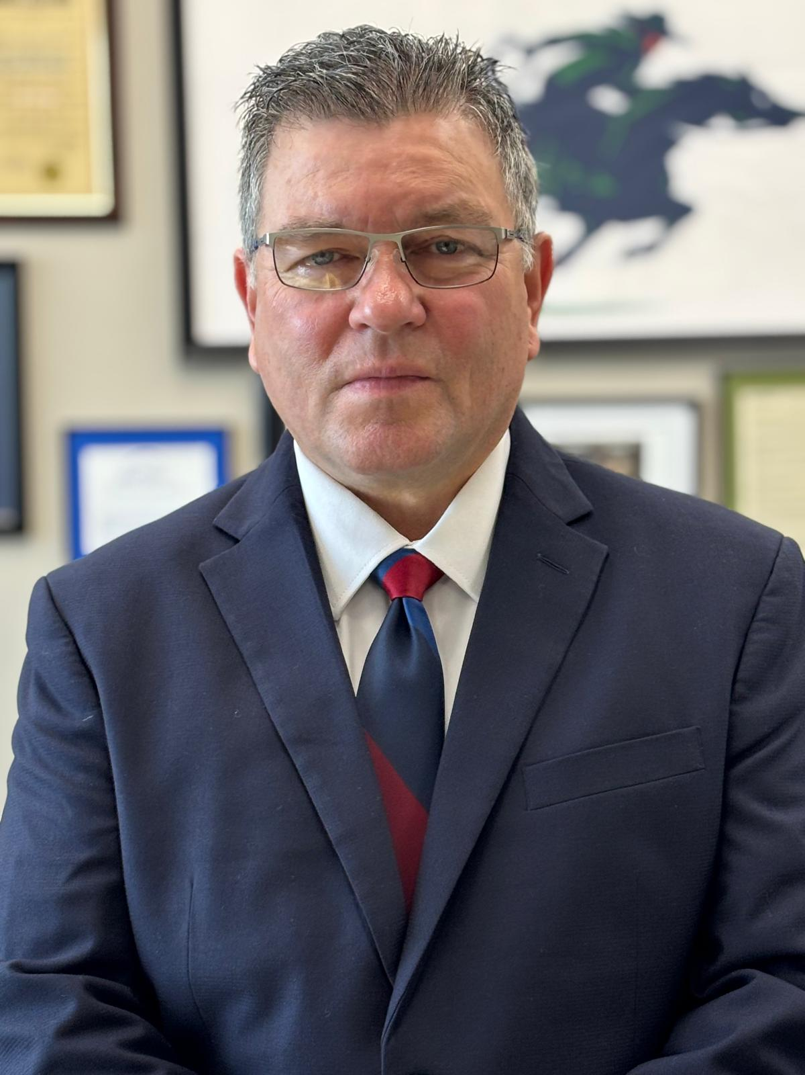
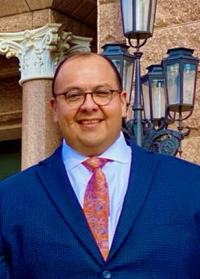


OFFICE OF GOVERNMENTAL RELATIONS - CONTACT INFORMATION
Veronica Gonzales
Sr. Vice President of Governmental & Community Relations
Veronica.Gonzales@utrgv.edu
956-665-2128
Richard P. Sanchez
Sr. Associate VP for Governmental Relations
Richard.Sanchez@utrgv.edu
956-369-1010
Veronica De La Garza
Director of Governmental Relations
Veronica.DeLaGarza@utrgv.edu
956-665-7373
Ruben O’Bell
Director of Governmental Relations
Ruben.Obell@utrgv.edu
956-665-3668
Grecia Galvan
Assistant Director of Governmental Relations
Grecia.Galvan01@utrgv.edu
956-665-3668
Lizette Galaviz
Governmental Relations Assistant
Lizette.Galaviz01@utrgv.edu
956-665-3668

Slide 15
LINKS TO DOCUMENTS WITH MORE DETAIL…
"Chancellor’s Memo" - Political Activity on Campus issued August 2024
UTRGV Campus Political Activity Guidance
STATE LAW:
Chapter 556, Government Code (Political Activities by Certain Public Entities and Individuals): https://statutes.capitol.texas.gov/Docs/GV/pdf/GV.556.pdf
Section 2203.004, Government Code (Requirement to Use State Property for State Purposes): https://statutes.capitol.texas.gov/Docs/GV/pdf/GV.2203.pdf
Section 39.02, Penal Code (Abuse of Official Capacity): https://statutes.capitol.texas.gov/Docs/PE/pdf/PE.39.pdf

Slide 16
REGENTS’ RULES & REGULATIONS…
Rule 30103, Section 5 (Political Activities):
https://www.utsystem.edu/board-of-regents/rules/30103-standards-of-conduct
Rule 40501 (Speech and Assembly):
https://www.utsystem.edu/board-of-regents/rules/40501-speech-and-assembly
Rule 80101 (Category of Facilities and Authorized Users):
https://www.utsystem.edu/board-of-regents/rules/80101-category-facilities-andauthorized-users
Rule 80103, Section 2.23 (Support of a Candidate or Proposition):
https://www.utsystem.edu/board-of-regents/rules/80103-solicitation
Rule 80104 (Use of Facilities):
https://www.utsystem.edu/board-of-regents/rules/80104-use-of-facilities
Rule 80105 (Joint Sponsorship of the Use of Property or Buildings):
https://www.utsystem.edu/board-of-regents/rules/80105-joint-sponsorship-useproperty-or-buildings
Rule 80106 (Special Use Facilities):
https://www.utsystem.edu/board-of-regents/rules/80106-special-use-facilities

