Slide 1
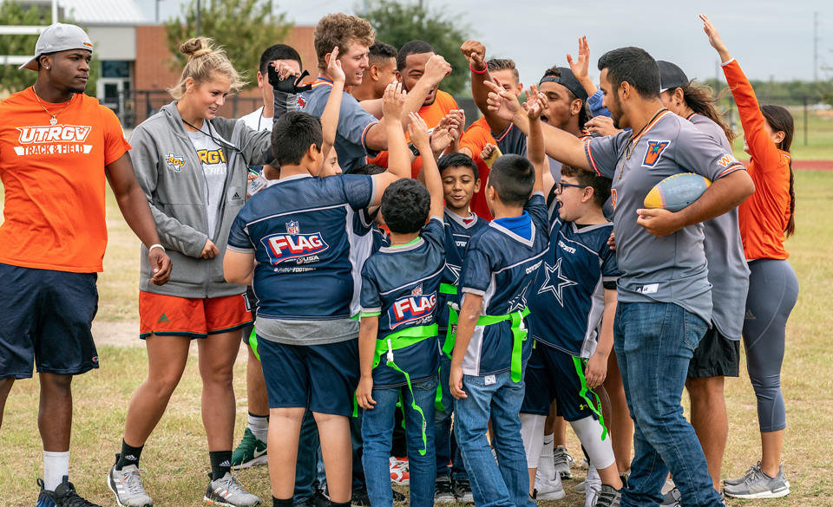

Transforming the Rio Grande Valley: Community Engagement at UTRGV
EMPOWER & ENGAGE
Dr. Christian Corrales
Assistant Vice President for Community Engagement

Slide 2
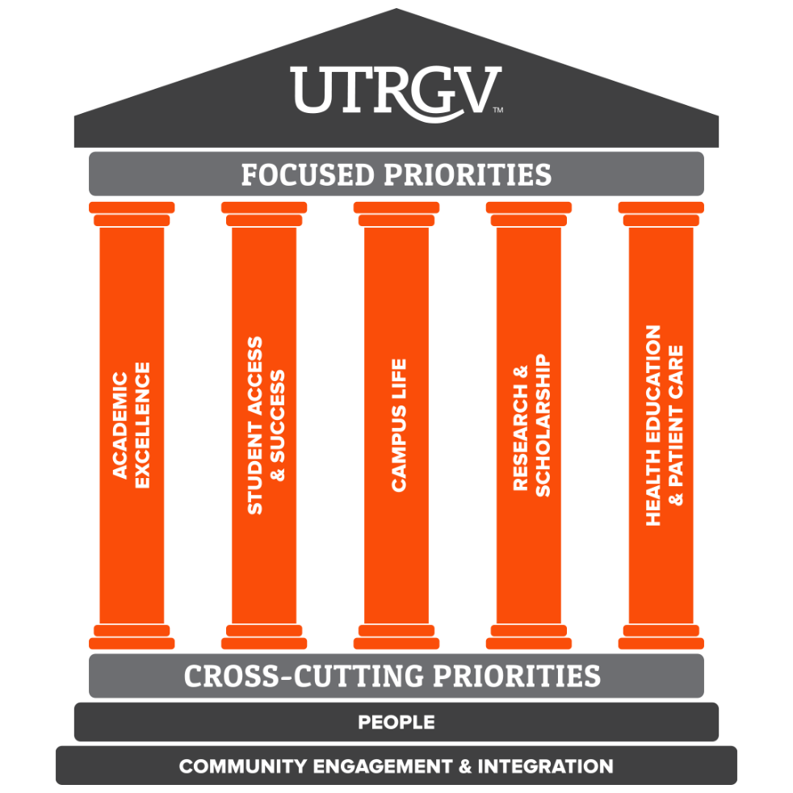
UTRGV Mission Statement
UTRGV serves the Rio Grande Valley and beyond via an innovative and unique multicultural education dedicated to student access and success. By championing leading research, healthcare, and application of University discoveries, we support sustainable development, community engagement, and well-being.

Slide 3
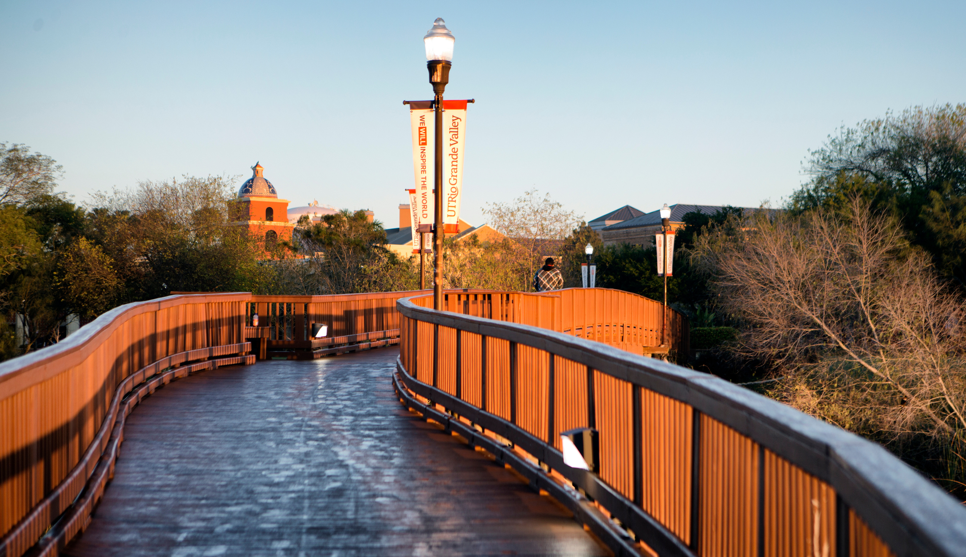
Community Engagement
As one of two cross-cutting strategic priorities, Community Engagement at UTRGV focuses on fostering mutually beneficial university and community partnerships.
Our goal is to enhance scholarship, research, teaching, learning, and creative endeavors, all while addressing important societal challenges and contributing to the public good.

Slide 4
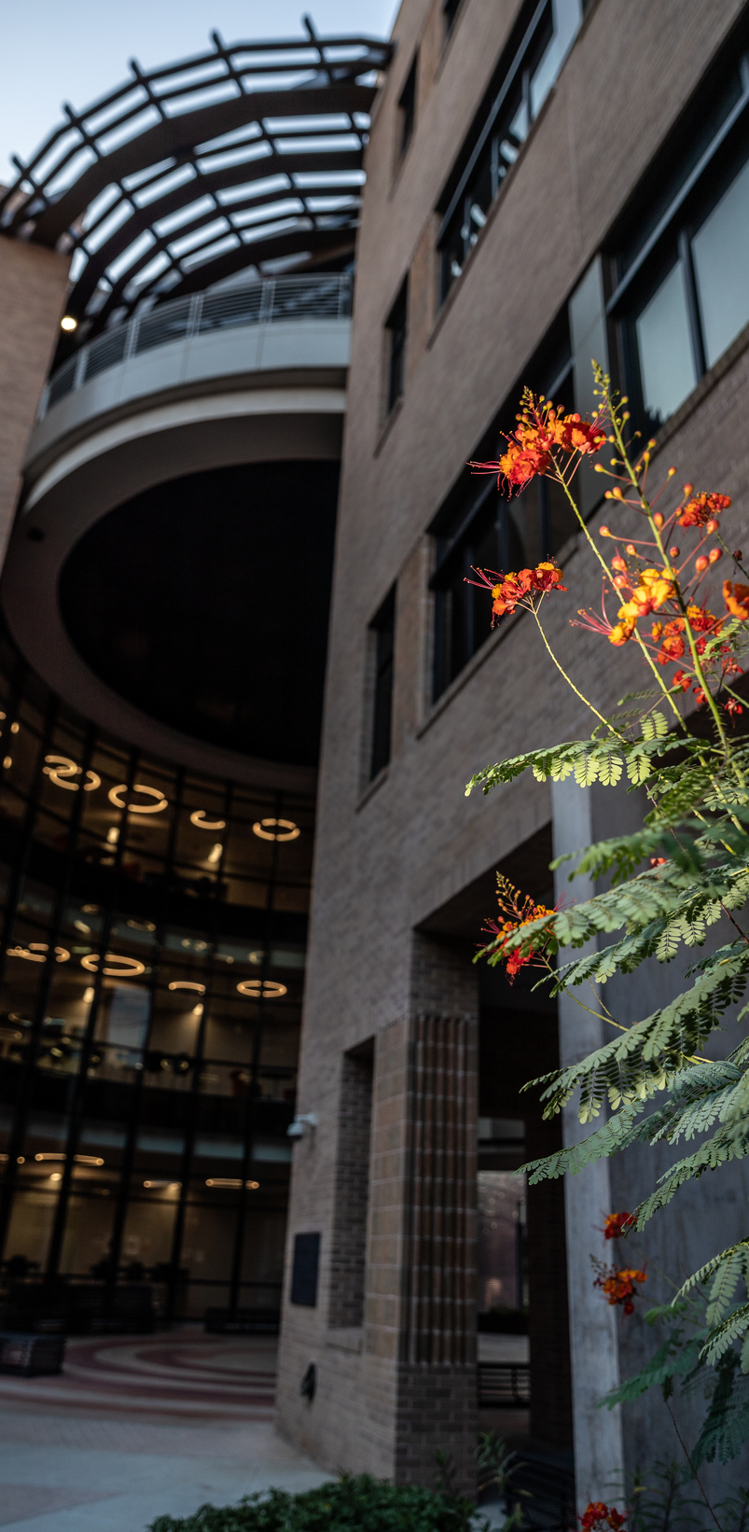


Slide 5
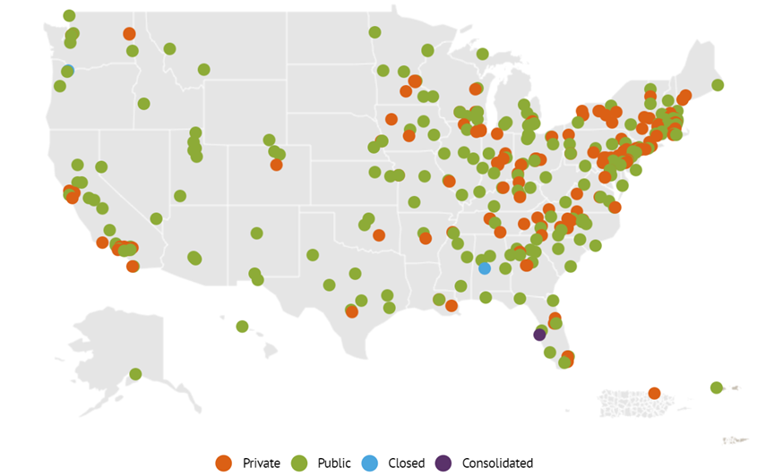
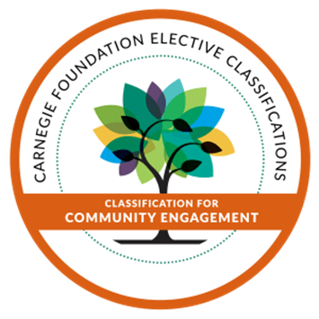

ELECTIVE CLASSIFICATION FOR
COMMUNITY ENGAGEMENT

Slide 6
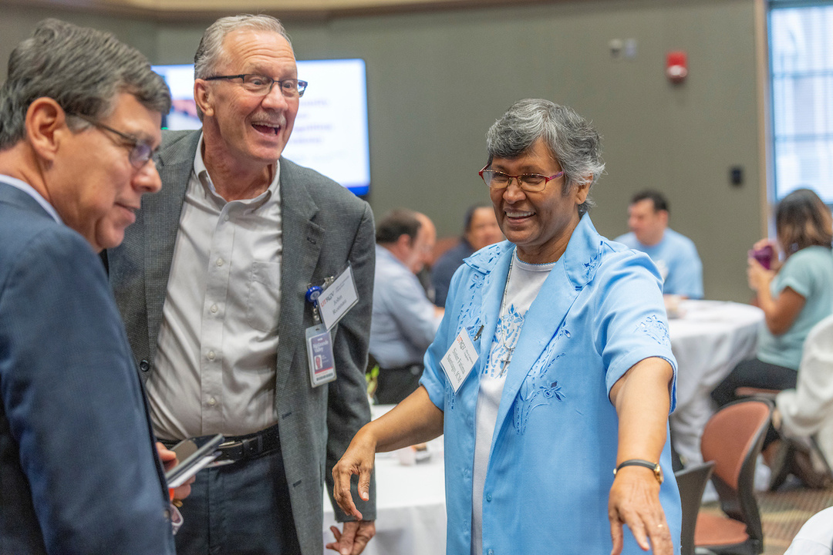
COMMUNITY ENGAGEMENT DEFINED
The collaboration between institutions of higher education and their larger communities for the mutually beneficial exchange of knowledge and resources in the context of partnership and reciprocity.

Slide 7
Community-Based vs Community-Engaged
Community-based
Community-Engaged
Campus holds decision-making power
Campus deﬁnes the problems, goals, and outcomes
Campus knowledge prioritized
  Campus and community share decision-making power
  Campus and community co-deﬁne problems and co-create goals and outcomes
  Asset-based: strengths, skills, and knowledges of those in the community are validated and legitimized

Slide 8
Integration of Community Engagement
Teaching
Community-engaged academic learning
  Designated Service-Learning Courses
  Experiential learning (Internships)
  Clinicals/Practicums
  Capstone Courses
Research
Community-based participatory research
  Research in communities that emphasizes participation and action
Service
An activity/event in the form of:
  Community service (volunteerism)
  Community Outreach (presentations/camps)
  Committees/Boards
Capacity Building
  Community Engagement-Faculty Learning Communities (CE-FLC)
  Nonprofit Resource Center
  Engagement Zone
Community Engagement
Teaching
Research
Service
Capacity Building

Slide 9

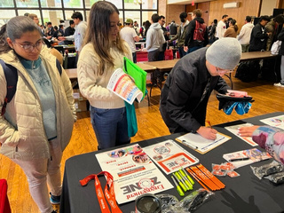
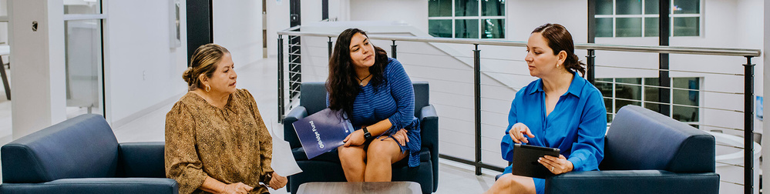

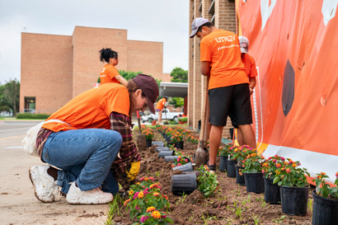
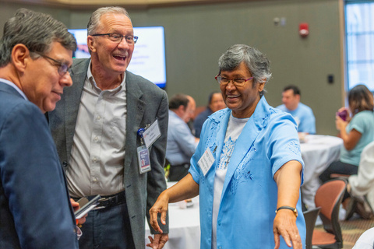
FORMS OF ENGAGEMENT
OUTREACH
SUSTAINED SERVICE
Invite someone to an event on campus; introduce someone to resources on campus; etc.
Serve with a greater, more sustainable purpose; beyond one day of service;
Serve on a Board; Be a committee member for an organization
VOLUNTEER
COMMUNITY-ENGAGED
One day of Service; i.e.: MLK Day;
Service Saturday; Make a Difference Day; Plant a tree; Bathe a dog
Asset based; Deliberate, Intentional; Involves partner in the planning; Involves reciprocity; i.e. Designated Service-Learning Course (DSL)

Slide 10


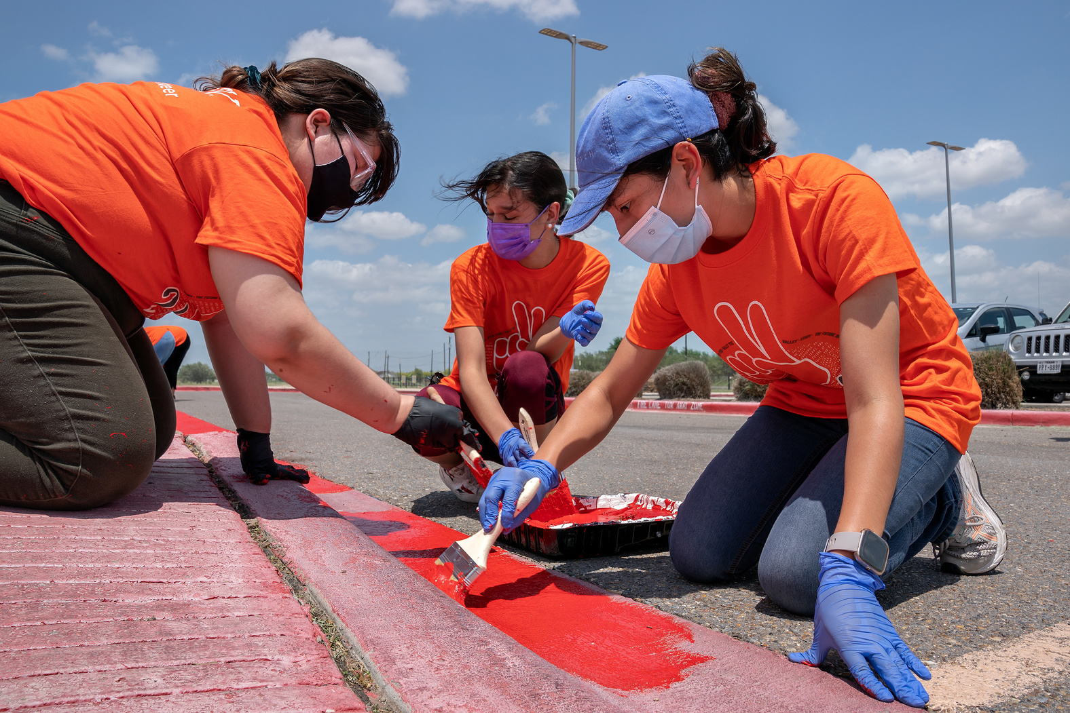



Thank You
956-665-7566
partnerships@utrgv.edu

