Slide 1
Learning Assessment Techniques
Javier Cavazos Vela, Ph.D.
Director, Center for Teaching Excellence (CTE)
Assistant Professor, College of Education and P-16 Integration

Slide 2
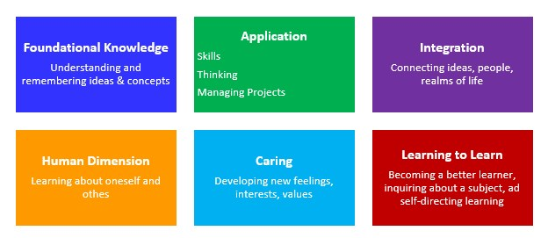
Learning Objectives
After this interactive workshop, you will be able to:
Identify important ideas and benefits of learning assessment techniques
Recognize and apply several learning assessment techniques across Fink’s (2013) taxonomy of learning
Create a plan to implement what you learned

Slide 3
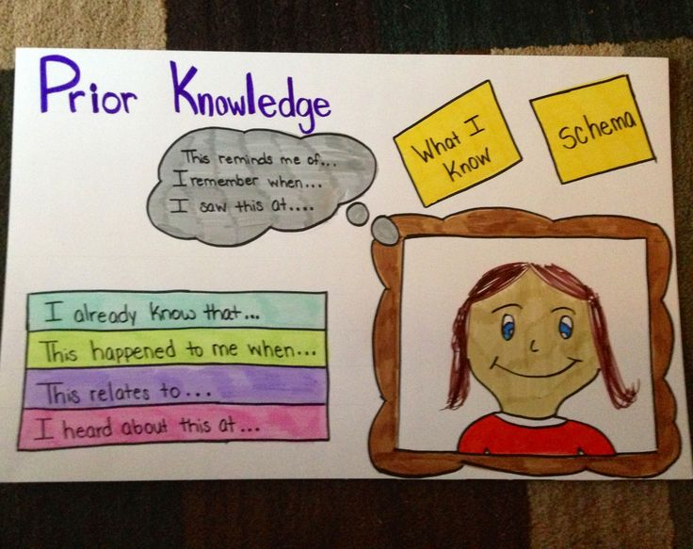
Learning Assessment Technique 1: Background Knowledge Probe for Foundational Knowledge
Take 1-minute to write what you know about learning assessment techniques and backward design.
We will call on two people to share and report out!

Slide 4
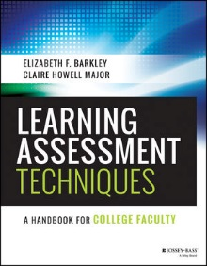
What is a Learning Assessment Technique?
Three-part structure that helps teachers:
Identify significant learning goals
Implement effective learning activities (active learning)
Produce an assessable learning artifact
Formative vs. summative assessment
Analyze and report outcomes

Slide 5
Why use LATs?
Provides just-in-time feedback
Provides information about student learning
Provides students with opportunities to monitor their learning
Helps students feel less anonymous in large classes
Helps students understand that learning is an ongoing process (Center for Teaching Excellence, Vanderbilt University)

Slide 6
What is Backward Design?
Backward Design is a process of lesson planning created by Grant Wiggins and Jay McTighe and introduced in Understanding by Design (1998).
Backward design focuses on results-based, student-centered learning
Topics
Activities
Assessments
Backward Design
Identify desired results
Traditional
Determine assessment activities
Wiggins, G & McTighe, J. (1998). Understanding by Design.
Alexandria, VA: Association for Supervision and Curriculum Development.
Plan learning experiences and Instruction

Slide 7
Why use Backward Design?
Focuses on student learning and understanding
Encourages instructor to establish purpose before implementation
Leads to transparent and explicit instruction

Slide 8
Fink’s Taxonomy of Learning Objectives
Foundational Knowledge (identify, describe)
Application (apply, demonstrate, practice)
Integration (combine, compare, evaluate)
Human Dimension (reflect, relate)
Caring (reflect, appraise, collaborate)
Learning how to Learn (reflect, collaborate, write)

Slide 9
Foundational Knowledge
Refers to discipline facts, principles, and concepts; lays groundwork for future learning
Important questions to address:
What information is important for students to remember in the future? What ideas are important for students to remember in this course?
Key verbs: identify, recognize, define, describe, and summarize
Sample LATs: background knowledge probe, entry ticket, exit ticket, minute paper, quick write, and guided reading notes

Slide 10
Learning Assessment Technique 1: Background Knowledge Probe for Foundational Knowledge
Learning goals: knowledge of key facts and ideas
Description: simple questionnaire that asks students to identify prior knowledge
Purpose: encourages students to think about what they already know about a topic

Slide 11
Sample Assessment Matrix

Slide 12
Learning Assessment Activity 2: Quick Write or Minute Paper
Learning Goals: foundational knowledge
Description: students write responses to an open-ended question
Purpose: forces students to focus and recall information

Slide 13
Learning Assessment Activity 2: Quick Write or Minute Paper
Take 1-minute to write what you recall about Fink’s taxonomy of learning dimensions
We will call on two people to share and report out!

Slide 14
Application
Refers to applying knowledge through skills, learning how to manage complex projects, and developing ability to engage in critical, creative, and practical thinking
Important questions to consider: what skills do students need to learn? What kinds of thinking are important for students to learn?
Key verbs: Apply, evaluate, formulate, plan, prepare, use, synthesize
Sample LATs: fact or opinion and Insights-Resources-Application

Slide 15
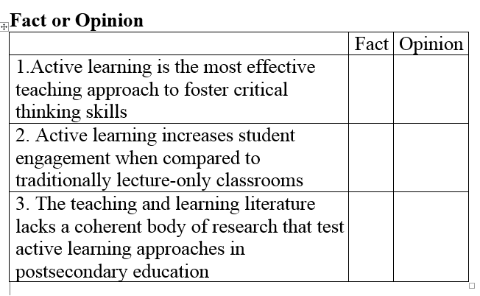
Learning Assessment Technique 4: Fact or Opinion
Learning Goals: application (critical thinking, reading)
Description: students read a text to identify authors’ facts or opinions
Purpose: fosters critical thinking and active learning

Slide 16
Learning Assessment Activity 5: Insights-Resource-Application
Learning Goals: analytical skills, creative thinking, critical thinking, research skills (Application)
Description: students complete a writing assignment based on assigned readings
Purpose: provides students with an opportunity to reflect on what they learned and apply what they learn to previous or current experiences
Insights: provide one sentence that represent new insights about today’s topic
Resource: provide one additional source that has similar thoughts, ideas, or themes
Application: how is what you learned today related to your current or past experiences?

Slide 17
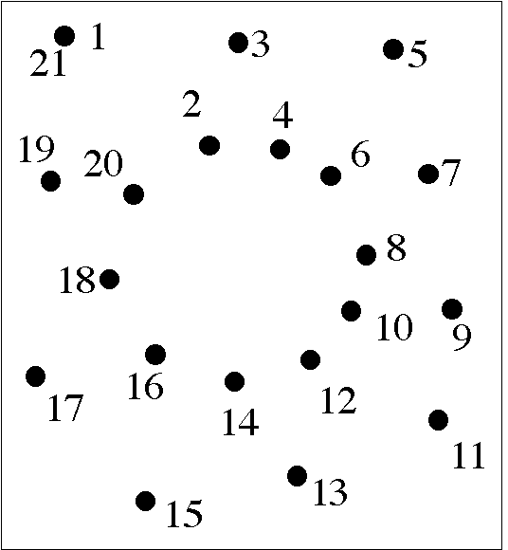
Integration
Refers to when learners integrate, connect, and relate various concepts and ideas together
Important questions to consider: What connections should students make in this course among various information, ideas, and perspectives? What connections should students make between previous and current learning experiences?
Key verbs: incorporate, organize, synthesize, compare, contrast, combine
Sample LAT: case study

Slide 18
Learning Assessment Activity 6: Case Study
Learning Goals: connect and synthesize to think holistically about a topic
Description:
Tells a real story about an important issue related to course content
Includes historical information about the case and a dilemma faced by a key character
Encourages students to identify a problem as well as take and support a solution
Encourages students to integrate information and resolve an issue (Davis, 1993)

Slide 19
Human Dimension
Refers to “important relationships and interactions we all have with ourselves and with others” (Fink, 2013, p. 50).
Important questions to address: What should students learn about themselves? What should students learn about interacting with others?
Key verbs: reflect, support, help, communicate
Sample LATs: role play, ethical dilemma

Slide 20
Rubric for Evaluating Peer Support and Interpersonal Skills

Slide 21
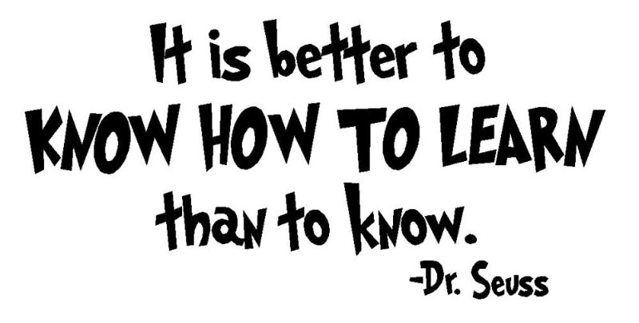
Learning How to Learn
Refers to when students learn about the process of learning or become self-directed learners
Key verbs: reflect, identify, organize, and write
Sample LATs: study outlines, invent the quiz, what? So what? Now what? Journal

Slide 22
Learning Assessment Technique 7: What? So What? Now What? Journal
Learning goals: Learning how to learn
Purpose: determine if students are able to reflect on what they learn and apply what they learned to develop a plan
Description: Students reflect and write responses to the following questions. A total of 5 sentences will be sufficient if they address each question.
What? (1) What happened in today’s session?
So What? (2) What did you learn today? (3) What connections can you make between what you learned today and previous learning experiences?
Now What? (4) How can you apply what you learned? (5) What would you like to learn more about and how will you learn more about this or a similar topic?

Slide 23
Final Remarks
Thank you for participating in this interactive workshop where we hope you met session objectives and developed a plan to implement learning assessment techniques.
Please complete evaluation questions about your learning experiences and level of satisfaction.
Please also take a look at “resources” on our website “utrgv.edu/cte” which will provide helpful and additional information.

Slide 24
References and Helpful Resources
Barkley, E. F., & Major, C. H. (2016). Learning assessment techniques: A handbook for college faculty. San Francisco, CA: John Wiley & Sons, Inc.
Center for Teaching Excellence, Vanderbilt University (2017). Retrieved from https://cft.vanderbilt.edu/

