Slide 1
UTRGV
Engagement Zone Overview
Office of Community Engagement & Economic Development Division of Governmental & Community Relations

Slide 2
Objectives
Define Community Engagement
Explore the Engagement Zone as a method of engagement
Identify ways you and your team can engage with the community

Slide 3
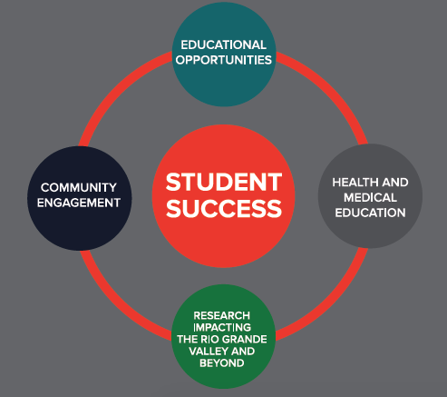
UTRGV Core Priority
COMMUNITY
ENGAGEMENT

Slide 4
UTRGV MISSION STATEMENT
To transform the Rio Grande Valley, the Americas, and the world through an innovative and accessible educational environment that promotes student success, research, creative works, health and well-being, community engagement, and sustainable development.

Slide 5
Community Engagement DEFINED:
The collaboration between institutions of higher education and their larger communities for the mutually beneficial exchange of knowledge and resources in the context of partnership and reciprocity.
http://classifications.carnegiefoundation.org/descriptions/community_engagement.php
It can involve partnerships and coalitions that help mobilize resources and influence systems and serve as catalysts for initiating and/or changing policies, programs, and practices.

Slide 6
Community Engagement
Volunteer: One day of Service; ie: MLK Day;
Service Saturday;
Make a Difference Day; Plant a tree; Bathe a dog
Outreach: Invite someone to an event on campus; Introduce someone to resources on campus; etc.
Outreach
Volunteer
Sustained Service
CE: Asset based; Deliberate, Intentional; Designed to help solve a mutually beneficial need; Involves partner in the planning; Involves reciprocity; ie.
Designated Service Learning Course, (DSLC)
Community Engaged Scholarship Learning Course (CESL)
Sustained Service: Serve with a greater, more sustainable purpose; beyond one day of service;
Serve on a Board;
Be a committee member for an organization
Community
Engagement

Slide 7
Why engage?
Develop professionally
Formalize civic-minded philosophy
Improve Staff Moral/Team Building
Promote
Value statements/Mission/Vision
Vaquero Culture/University Climate

Slide 8
What is Engagement Zone?

Slide 9
What is Engagement Zone?
Engagement Zone (EZ) is the university’s volunteering platform developed by a partnership between UTRGV and the United Ways of South Texas and Cameron County.
EZ is managed by the Nonprofit Resource Center, The Office of Engaged Scholarship and Learning, and Student Involvement
Utilizing EZ, UTRGV students, faculty and staff have the opportunity to connect with more than 250 nonprofit agencies within the community to make an impact.
Agencies can use EZ to create “needs” for volunteer opportunities, and can also create events.
Since its inception, profiles, active users, total hours of service

Slide 10
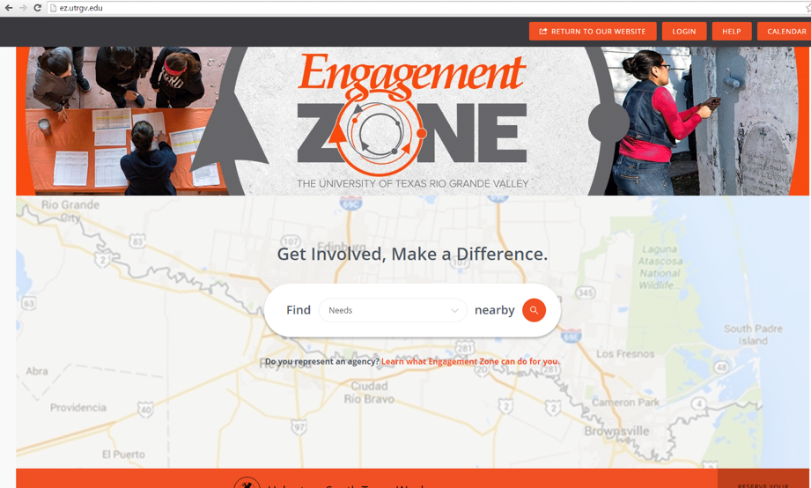
Step 1: Log on to ez.utrgv.edu
Step 2: Follow the directions

Slide 11
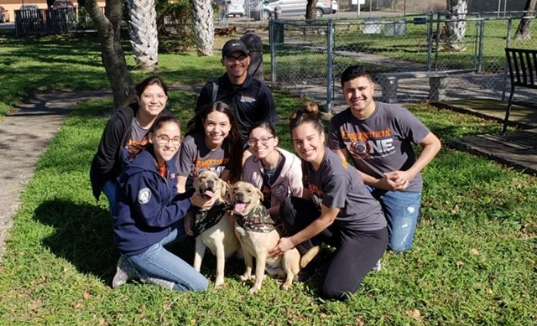
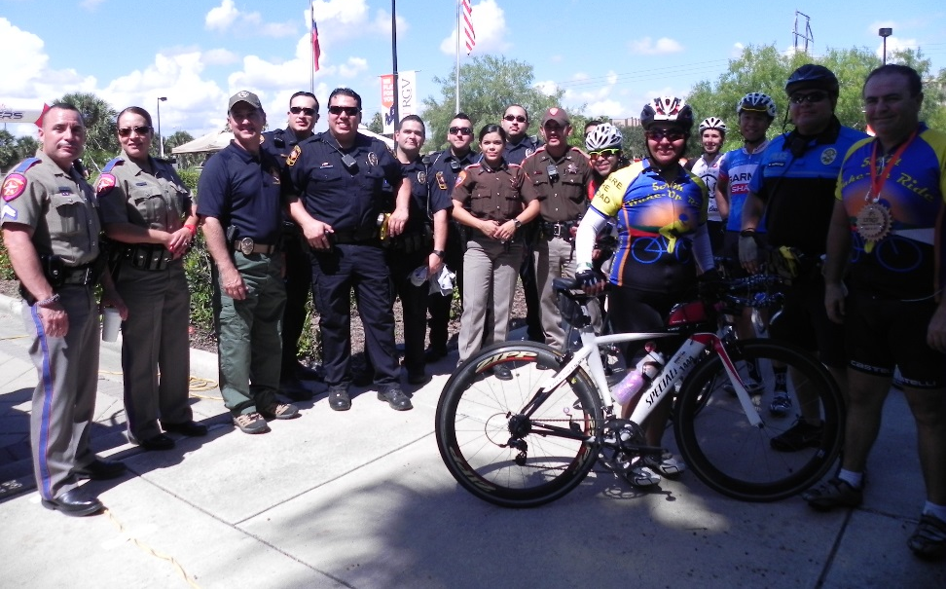
Get ENGAGED!

Slide 12
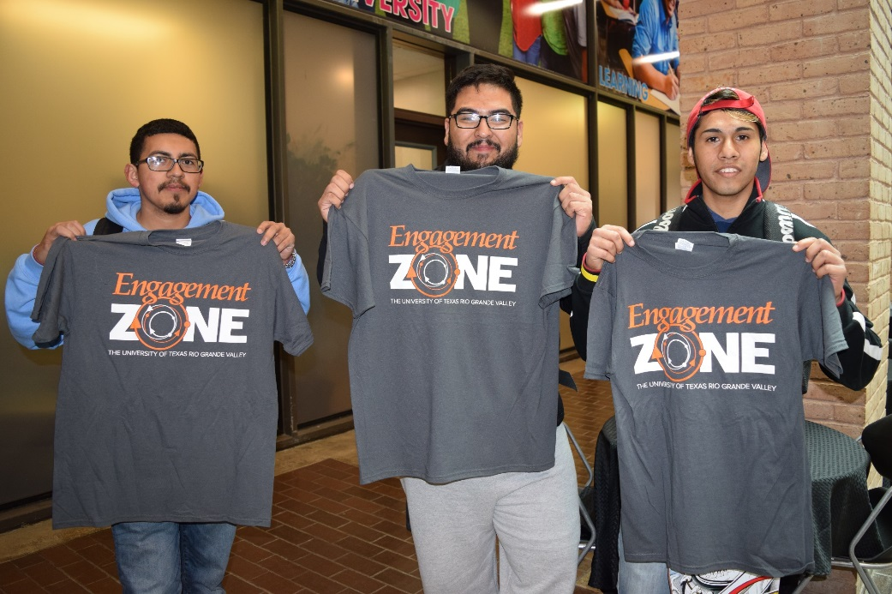
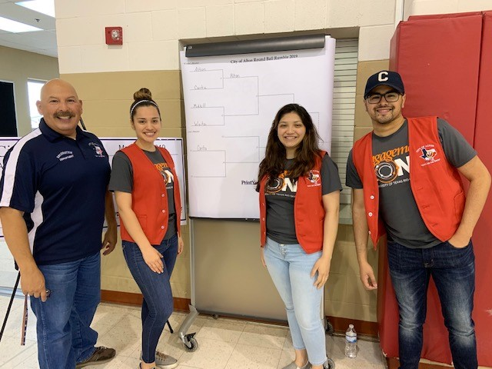

Slide 13
For questions or more information about the Engagement Zone, contact: volunteer@utrgv.edu Thank you

