Slide 1
UTRGV Community Engagement
Overview
Office of Community Engagement & Economic Development Division of Governmental & Community Relations

Slide 2
Objectives
Define Community Engagement
Explore different methods of engagement
Identify ways our teams can get involved, not only externally with the community, but internally at the institutional level

Slide 3
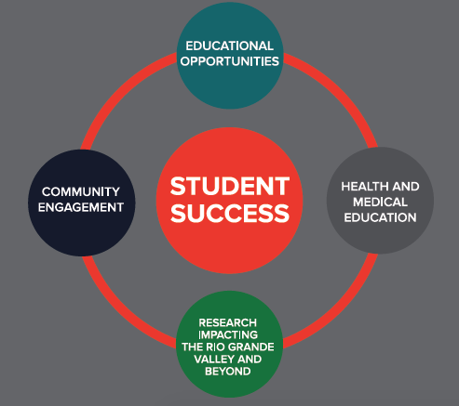
UTRGV Core Priority
COMMUNITY
ENGAGEMENT

Slide 4
UTRGV MISSION STATEMENT
To transform the Rio Grande Valley, the Americas, and the world through an innovative and accessible educational environment that promotes student success, research, creative works, health and well-being, community engagement, and sustainable development.

Slide 5
Community Engagement DEFINED:
The collaboration between institutions of higher education and their larger communities for the mutually beneficial exchange of knowledge and resources in the context of partnership and reciprocity.
http://classifications.carnegiefoundation.org/descriptions/community_engagement.php
It can involve partnerships and coalitions that help mobilize resources and influence systems and serve as catalysts for initiating and/or changing policies, programs, and practices.

Slide 6
Academia
CE Scholarship
Teaching
Research
Service
Designated Service Learning courses designed to meet community needs
CE Research
Research Agenda to create and disseminate knowledge to contribute to the existing body of knowledge, and to meet community needs
CE Teaching/Learning
Pedagogical approach that connects faculty and students with activities that meet community needs

Slide 7
Why engage?
Provide experiential learning opportunities for students
Exposure to research-based instruction
Encourage collaboration
Has a collective impact on relevant issues that affect our community
Helps build civically-minded students

Slide 8
Academia
Community
Adult
Literacy
Class
Help
Solve
Need
Youth
Activities ie:
Round Ball Rumble
University
College
Night
Partnership
Identify
Need
Solar
Powered
Energy
Project
This is what it can look like.

Slide 9
Community Engagement
Volunteer: One day of Service; ie: MLK Day;
Service Saturday;
Make a Difference Day; Plant a tree; Bathe a dog
Outreach: Invite someone to an event on campus; Introduce someone to resources on campus; etc.
Outreach
Volunteer
Sustained Service
CE: Asset based; Deliberate, Intentional; Designed to help solve a mutually beneficial need; Involves partner in the planning; Involves reciprocity; ie.
Designated Service Learning Course, (DSLC)
Community Engaged Scholarship Learning Course (CESL)
Sustained Service: Serve with a greater, more sustainable purpose; beyond one day of service;
Serve on a Board;
Be a committee member for an organization
Community
Engagement

Slide 10
Professional
Community
Children played with each other and with their siblings
Help Solve the Need
Identify
Need
Partnered with WREC and students in adaptive PE Course
Provided a half-day interactive Recreation Day for children with disabilities and their families
University
Families with children with disabilities would like a day out for entire family
While parents attended a half-day workshop on resources available to them locally
Partnership
This is what it looked like.

Slide 11
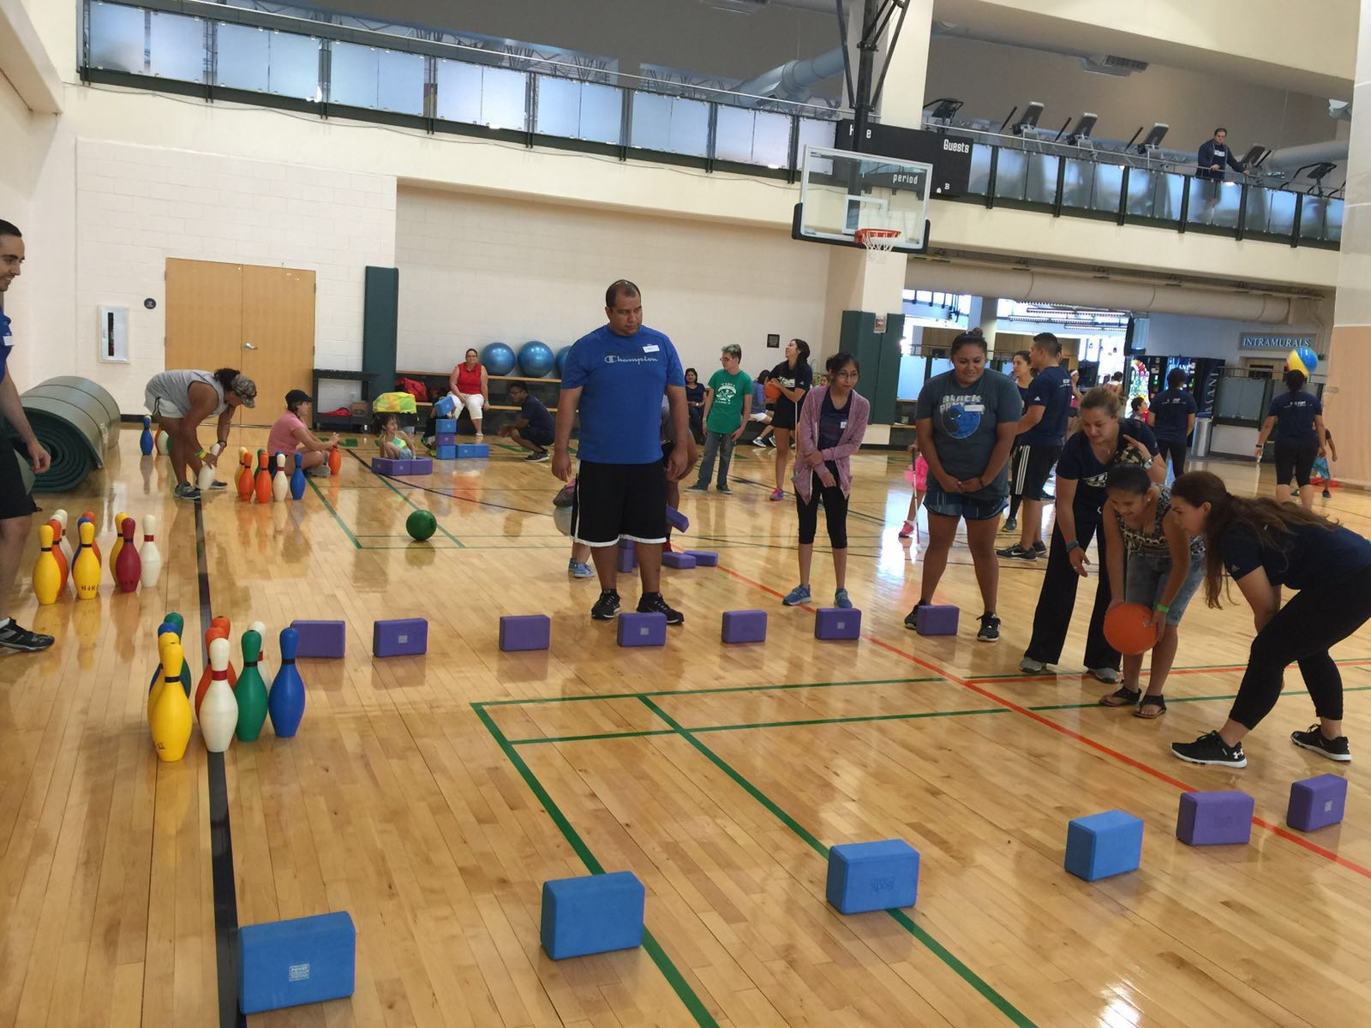
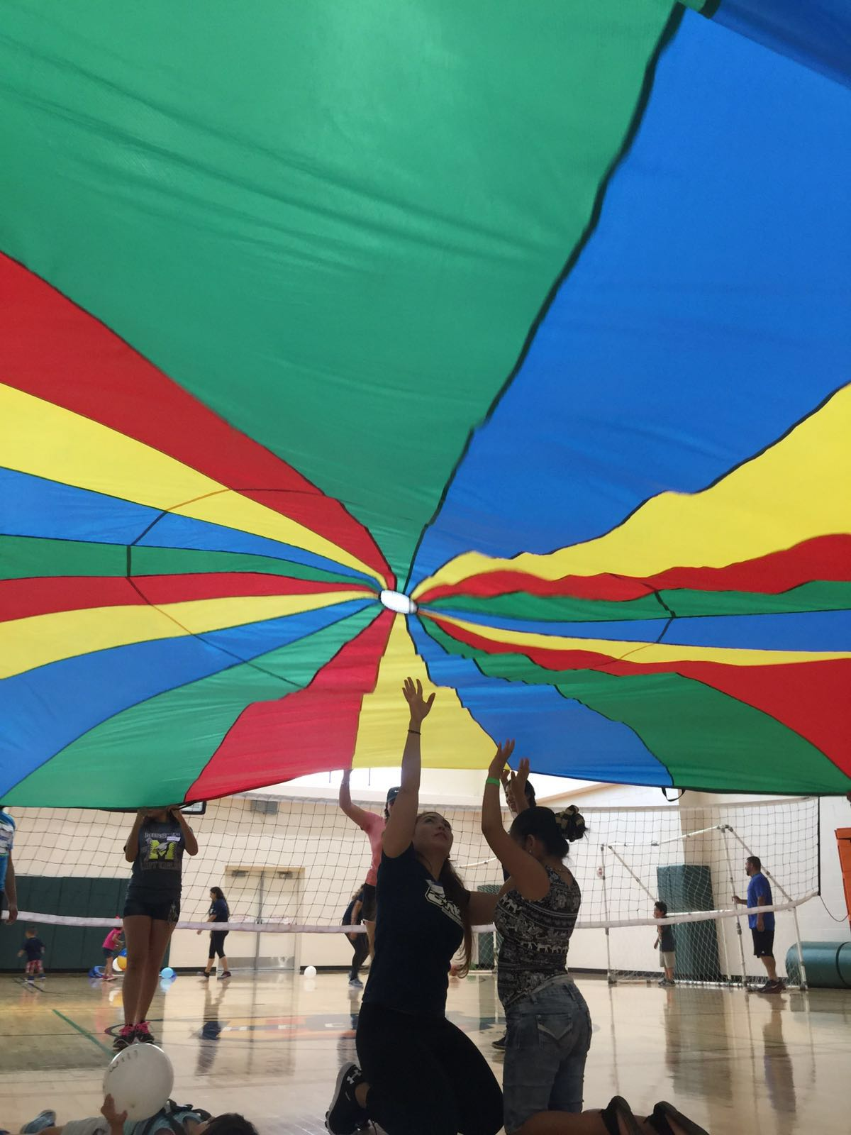

Slide 12
Professional
Community
Help
Solve
Need
University
Partnership
Identify
Need
What will it look like for you?

Slide 13
For questions or more information about Community Engagement at UTRGV, contact: nrc@utrgv.edu Thank you

