Slide 1




June 2nd & 3rd, 2026
Made possible by Doctors’ Educational Foundation

Slide 3

A Message of Gratitude
To Our Generous Donor,
On behalf of the UTRGV College of Health Professions, we extend our deepest gratitude for your generous support in making our Second-Year Summer Camp a reality. Your investment has done far more than fund a program; it has empowered a cohort of incoming high school seniors to begin their transition from students to future professionals in healthcare.
Because of your generosity, participants were immersed in a structured, hands-on experience designed not only to introduce health professions, but also to cultivate the habits, mindset, and skills essential for professional success. Through direct engagement with faculty, clinicians, and mentors, students developed a deeper understanding of accountability, communication, teamwork, and ethical responsibility, cornerstones of professionalism in any healthcare career.
For many of these students, this was their first opportunity to envision themselves as part of the healthcare workforce. Beyond exploring career pathways, they practiced professional behaviors, built confidence in academic and clinical environments, and gained clarity about the expectations they will encounter as they enter college and pursue advanced training. These early experiences are critical in shaping not only their aspirations, but also their readiness to meet the demands of higher education and professional programs.
As educators, mentors, and community leaders, we are honored to help guide students at this pivotal stage, when preparation, exposure, and encouragement can have a lasting impact. Your support has allowed us to intentionally nurture both their academic growth and their professional identity, ensuring they are better equipped to succeed as they take the next step into their senior year and beyond.
Your contribution has created a meaningful ripple effect, strengthening students’ confidence, reinforcing their sense of purpose, and preparing them to serve as future leaders in healthcare for the Rio Grande Valley and beyond. Thank you for your vision, your generosity, and your steadfast commitment to developing the next generation of skilled, compassionate professionals.
With sincere appreciation,
UTRGV College of Health Professions

Slide 4
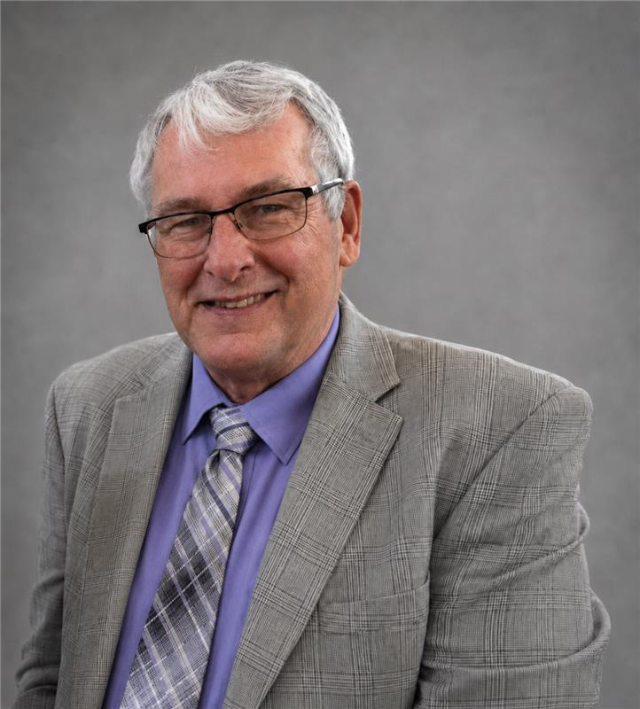
Message from the Dean
Welcome to the UTRGV College of Health Professions Second-Year Summer Camp! This program reflects our commitment to inspiring and preparing the next generation of healthcare professionals.
We are proud to welcome you, our incoming high school seniors, who have already taken an important step toward a future in healthcare. Over the next two days, you will engage in hands-on activities, explore diverse career paths, and begin developing the professionalism, teamwork, and communication skills essential for success in this field. We hope this experience strengthens your confidence and helps you envision yourself as a healthcare professional.
Our faculty and staff have designed engaging, interactive sessions to give you a firsthand look at patient care, diagnostic techniques, rehabilitation therapies, medical laboratory science, and more. Most importantly, you'll see how health professionals collaborate as vital members of a care team, whether your aspirations lie in physical therapy, biomedical science, speech-language pathology, physician assistant studies, occupational therapy, dietetics, clinical laboratory science, kinesiology, rehabilitation counseling, exercise physiology, health education, or a path you're still discovering.
Ask questions, stay curious, and fully embrace this opportunity. Every great healthcare professional started exactly where you are now.
This program is made possible through the generous support of the Doctors' Educational Foundation, whose belief in students like you creates meaningful opportunities for learning and growth. We are deeply grateful for their partnership.
We are thrilled you're here and honored to be part of your journey forward.
Warm regards,
Michael Lehker, Ph.D.

Slide 5
Welcome to
Discover Your Future in Health Care My Professionalism
UTRGV College of Health Professions
Empowering the Future of Healthcare
The UTRGV College of Health Professions proudly presents its Second-Year Summer Camp, a transformative experience designed to prepare and inspire the next generation of healthcare professionals. This unique initiative brings together incoming high school seniors from across the Rio Grande Valley, providing them with early exposure to the expectations, pathways, and responsibilities of careers in the health sciences.
Throughout this immersive program, students participate in interactive workshops and hands-on learning experiences that emphasize not only career exploration, but also the development of professionalism. Activities are intentionally designed to build essential skills such as communication, teamwork, critical thinking, and accountability, key attributes that will support their success as they transition into college and future healthcare training.
At the heart of this program are the students, motivated individuals who represent the future of our region’s healthcare workforce. As they begin to shape their professional identities, our faculty and staff are committed to mentoring and empowering them with the confidence, discipline, and sense of purpose needed to succeed. It is our privilege to support their growth as they take meaningful steps toward becoming skilled, compassionate professionals dedicated to serving their communities.

Slide 6
Agenda
DAY ONE
Breakfast and Welcome
9:00 AM – 9:30 AM Ballroom, Edinburg Campus
Walk to the rotation sites ( EHABW, EHABE, & EREBL)
9:45 AM - 9:55 AM
Sessions Begin 10:00 AM – 12:48 PM
Group Vaquero
Team 1: PA Simulation - 2nd Floor EHABE, Room 2.134
Team 2: Nutrition - 2nd floor EHABW, Room 2.114
Team 3: Medical Lab Science - 2nd Floor EHABW, Room 2.104
Team 4: COMD - 1st Floor EHABW, Room 1.206
Team 5: Biomedical Science -(across the parking lot/ Van Week St.) Research Bldg. 2nd floor EREBL, Room 2.320
Group UTRGV
Team 6: Exercise Science HPE II Rm 141
Team 7: Occupational Therapy HPE II RBC 143B
Team 8: Physical Therapy HPE II RBC 143D
Team 9: Rehabilitation Counseling and Services HPE II Gym117
Team 10: Integrated Health Science HPE II Rm 142
Transition & Lunch Break
1:00 PM – 1:30 PM @ Ballroom, Edinburg Campus
Special Activity
1:30 PM – 2:00 PM
Recap and Closing
Bus Pick up @ Bronc Edinburg Campus (2:30 PM)

Slide 7
Agenda
DAY TWO
Breakfast and Welcome
9:00 AM – 9:30 AM Ballroom, Edinburg Campus
Walk to the rotation sites ( EHABW, EHABE, & EREBL)
9:45 AM - 9:55 AM
Sessions Begin 10:00 AM – 12:48 PM
Group UTRGV
Team 1: Exercise Science HPE II Rm 141
Team 2: Occupational Therapy HPE II RBC 143B
Team 3: Physical Therapy HPE II RBC 143D
Team 4: Rehabilitation Counseling and Services HPE II Gym117
Team 5: Integrated Health Science HPE II Rm 142
Group Vaquero
Team 6: PA Simulation - 2nd Floor EHABE, Room 2.134
Team 7: Nutrition - 2nd floor EHABW, Room 2.114
Team 8: Medical Lab Science - 2nd Floor EHABW, Room 2.104
Team 9: COMD - 1st Floor EHABW, Room 1.206
Team 10: Biomedical Science -(across the parking lot/ Van Week St.) Research Bldg. 2nd floor EREBL, Room 2.320
Transition & Lunch Break
1:00 PM – 1:30 PM @ Ballroom, Edinburg Campus
Certification Ceremony (Please stay for the Group Picture)
1:30 PM - 2:15 PM
Camp Closing Remarks and Collection of Feedback
Closing
Bus Pick up @ Bronc Edinburg Campus 2:30 PM
Thank you and farewell.

Slide 8
Planning Committee
Dr. Michael Lehker – Senior VP of Health Affairs and Dean of College of Health Professions
Dr. Lin Wang – Associate Dean Student Success
Dr. Diana Paz -–Associate Dean of Interprofessional Education
Melissa Gonzalez-Faculty, Department of Health Sciences
Blanca Robles, M.S., CRC, LPC-S -Faculty, Department of Rehabilitation Services and Counseling
College of Health Professions
Administrative Staff
Sandra Guajardo - College Administrator
Victoria Hernandez - Administrative Associate
Dominga Delgado - Administrative Assistant I
Janey Pizana - Administrative Coordinator
Adriana Vela Roman - Financial Analyst
Romeo Ortega - Administrative Assistant I
Luisa Guerra - Administrative Analyst
Edinburg - Health Affairs Building West - EHABW 2.230
Brownsville - Biomedical Research & Health Building - BBRHB 2.101
Email: cohpinfo@utrgv.edu

Slide 9
Special Thanks
Thank you to all the faculty participating in this event. Your dedication and willingness to inspire our future health professionals is truly appreciated.
Department of Physician Assistant | Dr. Ashley Pena & Dr. Angelica Urbina
Department of Nutrition & Dietetics | Dr. Lisa Salinas, Professor Elizabeth Palacios & Profesor Laura Garza
Department of Medical Laboratory Science | Professor Virginia Miller & Dr. Daniela Gill
Department of Communication Disorders | Professor Betsaida Rodriguez & Dr. Ruth Crutchfield
School of Rehabilitation Services & Counseling | Professor Fidencio Mercardo & Professor Blanca Robles
Department of Health & Biomedical Sciences | Dr. Maria Quinones & Dr. Alfredo Blanco Guzman
Department of Health & Human Performance: Exercise Science | Dr. Murat Karabulut, Professor Ivan Figueroa & Professor Juan Paredes
Department of Occupational Therapy | Dr. John Luna, Dr. Eva Anger & Dr. Jack Ruelas
Department of Health Sciences | Ms. Bianca Farrell & Professor Mellisa Gonzalez
UTRGV Trailblazers | Thank you all

