Slide 1

Our River…
Our Home…
Our History
A Timeline
of the History
of the
Rio Grande Valley

Slide 2
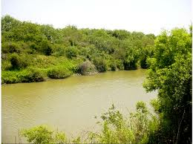
Rio Grande
Notes:
For thousands of years, the water of the Rio Grande has been a source of life for plants, animals, and people.

Slide 3
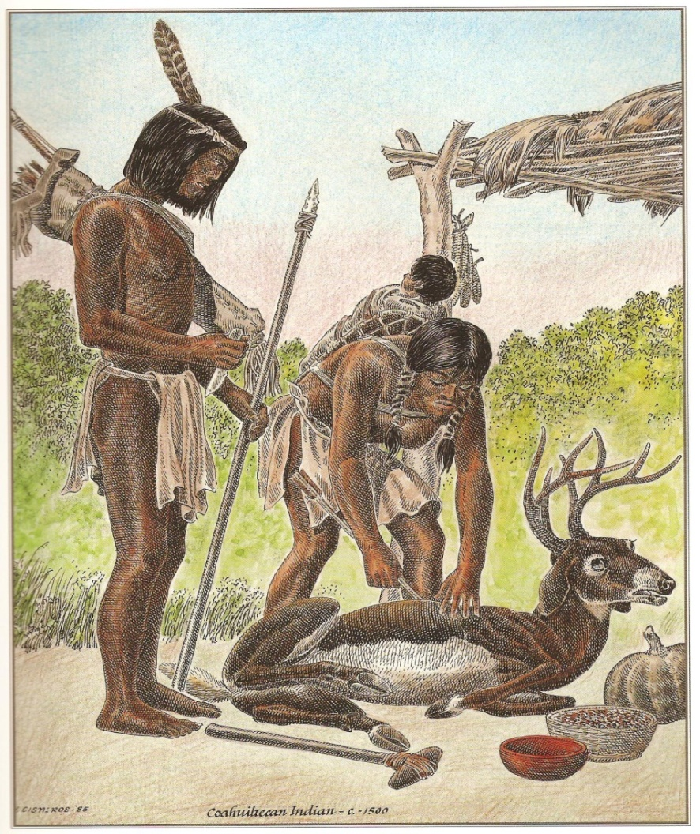
Coahuilatecans
Notes:
Until about 1750, the people who relied on the water of the Rio Grande were Native Americans like the Coahuilatecans. Then things changed.

Slide 4
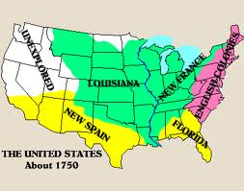
1750 – Rio Grande Valley is Not Part of U.S.
13 colonies ruled by
of England
Texas ruled by
Spain
Notes:
In 1750, the Rio Grande Valley was not a part of the United States. Why is that? Well, one reason is that the United States did not exist as a nation until the Declaration of Independence was signed in 1776. In 1750, the 13 original states were still British colonies which were ruled by the King of England. So what country did the Rio Grnade Valley belong to?

Slide 5
1750 – Rio Grande Valley is Not Part of U.S.
13 colonies ruled by
of England
Texas ruled by
Spain
Notes:
In 1750, the Rio Grande Valley was not a part of the United States. Why is that? Well, one reason is that the United States did not exist as a nation until the Declaration of Independence was signed in 1776. In 1750, the 13 original states were still British colonies which were ruled by the King of England. So what country did the Rio Grnade Valley belong to?

Slide 6
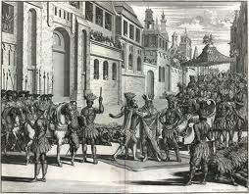
Rio Grande Valley
Belongs to Spain
Notes:
The Rio Grande Valley belonged to Spain. All of the country of Mexico belonged to Spain, too. The Spanish king watned to make sure that Spain’s lands in Noarth America would always belong to Spain. He decided to send settlers to build homes and towns along the Rio Grande. The king selected a strong leader to carry out these plans.

Slide 7
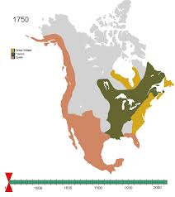
Spanish Lands in 1750
All the land in brown
belonged to Spain
From Alaska to California
and across Arizona,
Colorado, New Mexico,
Texas, and Florida
All of Mexico and
Central America
Notes:
The Rio Grande Valley belonged to Spain. All of the country of Mexico belonged to Spain, too. The Spanish king watned to make sure that Spain’s lands in Noarth America would always belong to Spain. He decided to send settlers to build homes and towns along the Rio Grande. The king selected a strong leader to carry out these plans.

Slide 8
Rio Grande

Slide 9
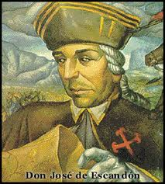
Jose de Escandon
Notes:
His name was Jose de Escandon. For more than 25 years, Jose de Escandon had worked with Spanish settlers in Mexico. Now, Escandon asked successful farmers and ranchers in northern Mexico to move to land along the Rio Grande. He promised them free land and reduced taxes if they agreed to settle the new frontier.

Slide 10
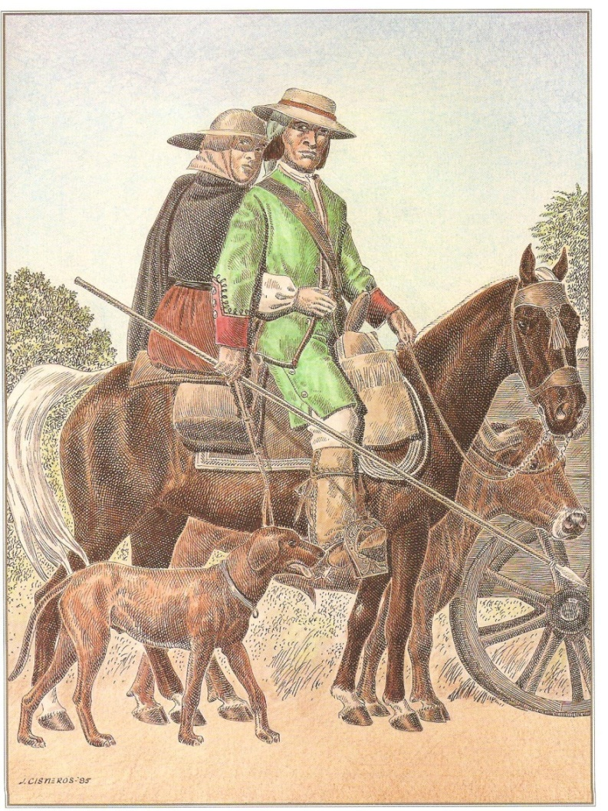
500 Families Join Escandon
Notes:
500 families accepted his offer.

Slide 11
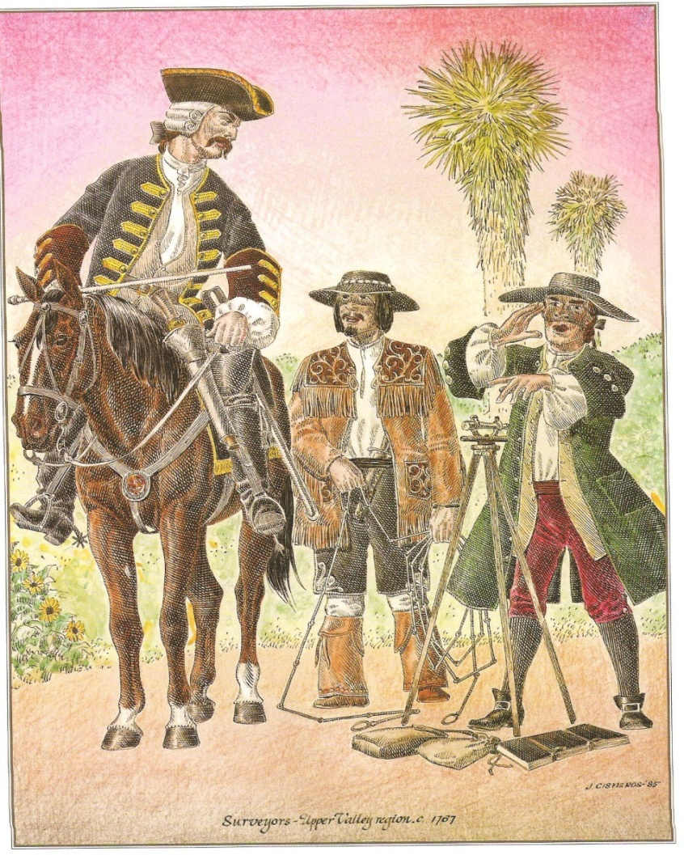
Surveying Nuevo Santander
Notes:
Escandon was a good organizer. He surveyed the land.

Slide 12
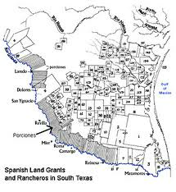
Las Villas Del Norte
Camargo
Reynosa
Mier
Revilla
Laredo
Dolores
Notes:
He named the area Nuevo Santander and set up 14 settlements which were called the Villas Del Norte. The villas included: Camargo, Reynosa, Mier, Revilla (now called Guerrero), Laredo, and Dolores. Each villa was led by a capitan who was under the authority of Escandon. One of the settler’s first tasks was to build home called jacales.

Slide 13
Stone Jacales
Starr County
Notes:
In Starr County, stone was available.

Slide 14
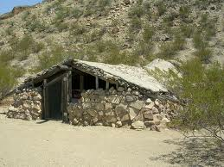
Jacal – home of settlers
Starr County:
Rio Grande City
Roma
Has stone
Stone jacales can
still be seen
Notes:
So the settlers made their homes out of stone. Some stone jacales an still be seen today.

Slide 15
Wood Jacales
Hidalgo &
Cameron
Counties
Notes:
In Hidalgo and Cameron counties, stone was not available.

Slide 16
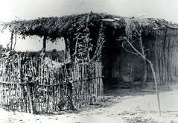
Jacal – home of settlers
Hidalgo County
(Mission & McAllen)
& all the way down to
Cameron County
(Brownsville & Rio Hondo)
Do not have stone
Jacales were made of
wood and mud
Notes:
So the jacales were made out of wood and mud. These jacales have decomposed and cannot be seen today.

Slide 17
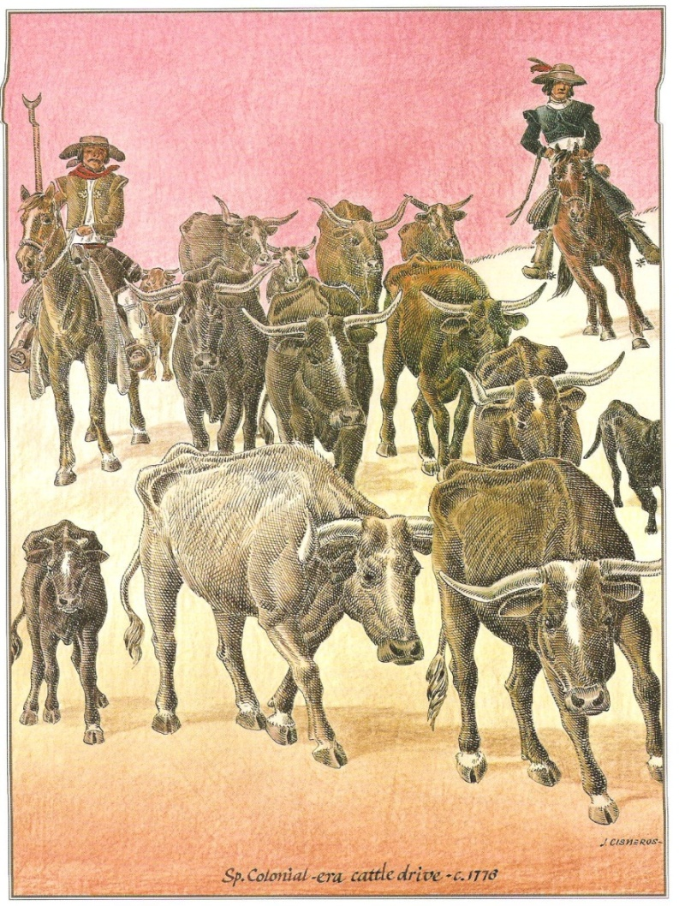
Raising Cattle
Cattle:
Meat
Hides
Tallow - candles
Notes:
The settlers raised cattle for meat and for their leather hides. They used the fat, called tallow, to make candles.

Slide 18
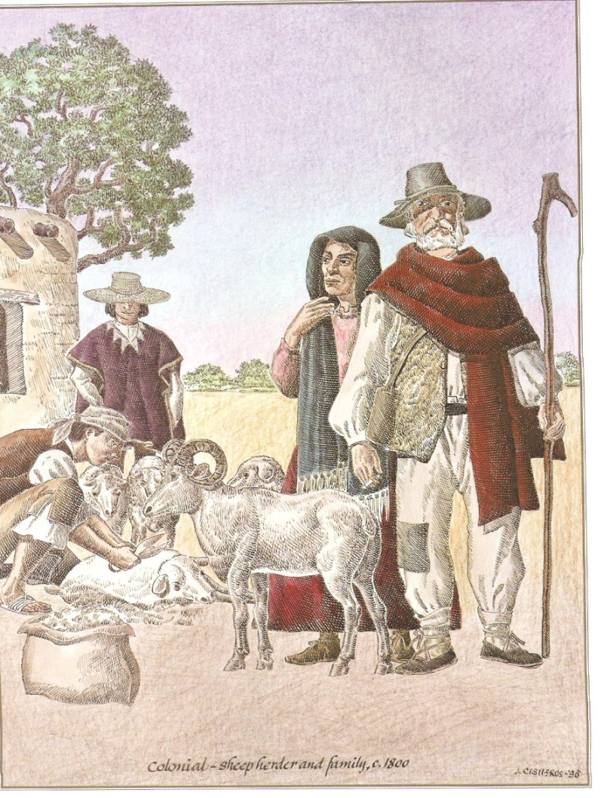
Raising Sheep
Sheep:
Meat
Wool
Notes:
In addition to building their homes, the settler raised sheep for wool and for meat. After a few years, the settlers realized that there was not enough grass to raise sheep. So they stopped raising sheep.

Slide 19
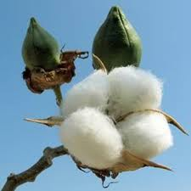
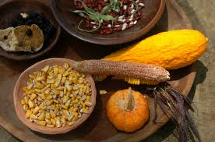
Raising Crops
Cotton
Corn
Beans
Squash
Notes:
The settlers also planted fields of cotton, corn, beans, and squash.

Slide 20
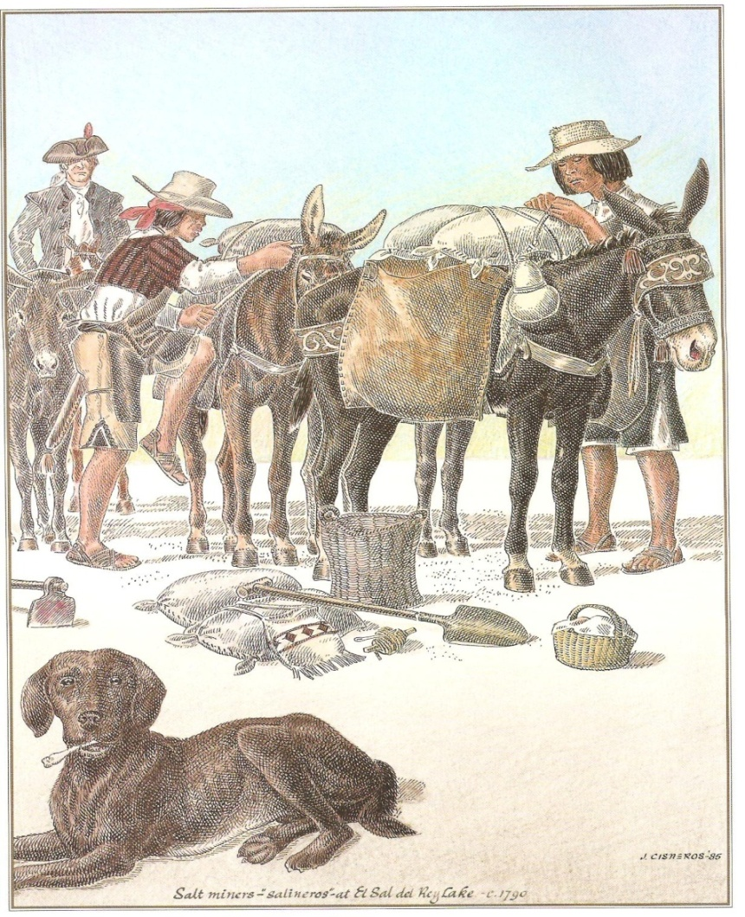
Collecting Salt
Notes:
They worked to dig blocks of salt out of the salt lakes in the area.

Slide 21
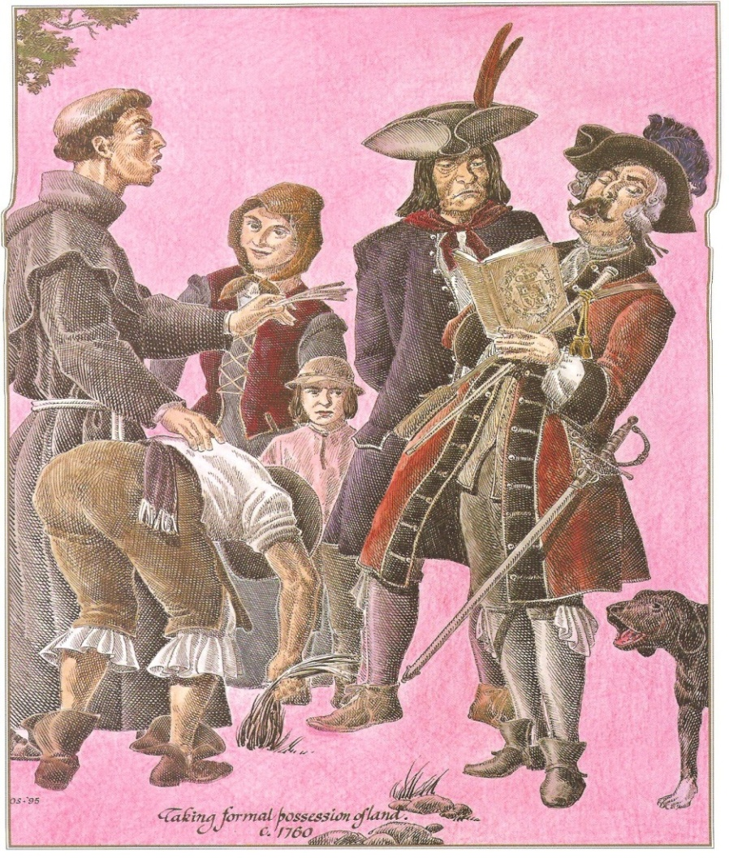
Spanish Land Grants
(porciones)
Notes:
Their hard work paid off, and in about 1760, the settlers celebrated when they received documents for the King of Spain giving them the land they were promised. After the settlers of Nuevo Santander received their porciones of land, they continued to be citizens of Spain for about another 50 years.

Slide 22
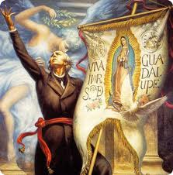
Mexico Wants Independence from Spain
1810
Notes:
Then, in 1810, Mexico began fighting Spain for independence. In 1821, Mexico won tis independence from Spain. Nuevo Santander was now part of Mexico.

Slide 23
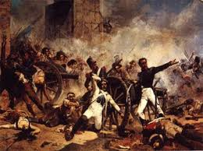
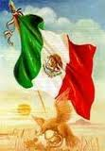
Mexico Wins Independence from Spain
1821
Notes:
Then, in 1810, Mexico began fighting Spain for independence. In 1821, Mexico won tis independence from Spain. Nuevo Santander was now part of Mexico.

Slide 24
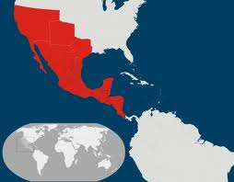
Texas Now a Part of Mexico
1821
All land
in red
belongs
to Mexico
Notes:
Texas had also been part of Spain. When Mexico won its independence from Spain, Texas became part of Mexico just like Nuevo Santander.

Slide 25
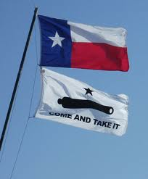
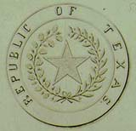
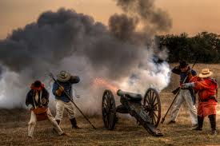
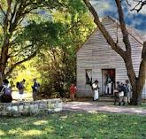
Texas Wins Independence
From Mexico
1836
Notes:
In time, settlers in Texas decided they wanted to be free. They did not want to be ruled by Mexico. On March 2, 1836, Texas declared its independence from Mexico and later won its freedom.

Slide 26
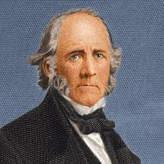
Texas is a Nation
1836
Sam Houston
First President
Notes:
Texas did not belong to Mexico anymore. Texas was now its own country. Its first president was Sam Houston. After a few years, Texans decided they did not want to be a free nation. They wanted to belong to the United States.

Slide 27
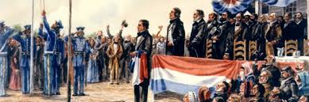
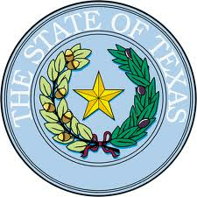
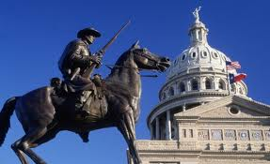
Texas Joins United States
1845
Notes:
In 1845, Texas became a state in the United States of America.

Slide 28
Review of Texas History
1700s Texas is settled by Spain
1821 Mexico wins independence from Spain
1836 Texas wins independence from Mexico
1845 Texas joins the United States
Notes:
Let’s stop and look back at all the changes that had taken place in the Rio Grande Valley up to this point. First, the Valley belonged to Spain and then Mexico. Later, Texas became an independent country. In 1845, Texas decided to join the United States.

Slide 29
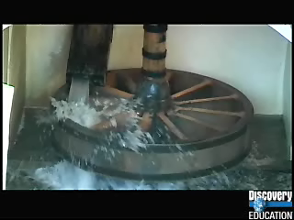
Video Review: American Geography Close-Ups: Southwestern States

Slide 30
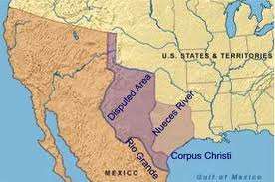
Disputed Land
Mexico
Texas
Notes:
Now, let’s see what happens to the Valley once Texas became a state of the United States. When Texas became a state, the border between Texas and Mesico was NOT the Rio Grande like it is today. Back then, the texas border was at the Nueces River (by present day Corpus Christi). Texas land had ALWAYS ended at th Nueces River. All the maps showed the border was supposed to be at the Nueces River, but some people in the United States did not like that. They wanted more land. They wanted the border between Texas and Mexico to be at the Rio Grande.

Slide 31
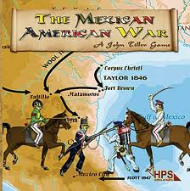
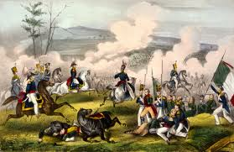
Mexican-American War
1846-1848
Notes:
Leaders in the United States decided to fight to get more land from Mexico. In 1846, the Untied Staes declared war on Mexico. They fought for two years. Finally, Mexico surrendered the land north of the Rio Grande, including Texas, the Southwestern United States, and California. The border between the United States and Mexico was now set at the Rio Grande.

Slide 32
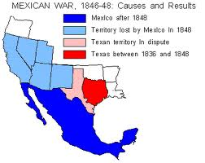
Land Mexico Lost
Mexico lost
all the land
in pink and
light blue
Notes:
When the U.S.-Mexico border was set at the Rio grande, the villas of Nuevo Santander were split between two countries. The villas south of the river were in Mexico; the villas north of the river were in the United States. Even though many changes had taken place, the people of Nuevo Santander kept busy farming and ranching on their land.

Slide 33
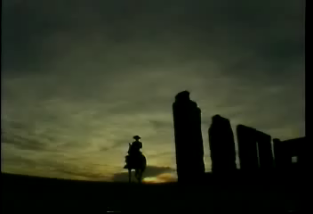
Video Review: U.S. Expansionism
Mexican American War

Slide 34
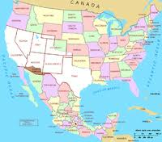
Texas and U.S. after War
Notes:
When the U.S.-Mexico border was set at the Rio Grande, the villas of Nuevo Santander were split between two countries. The villas south of the river were in Mexico; the villas north of the river were in the United States. Even though many changes had taken place, the people of Nuevo Santander kept busy farming and ranching on their land.

Slide 35
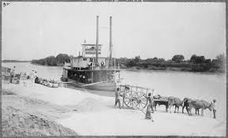
Steamboats on Rio Grande
1846-
1906
Notes:
Americans from outside Texas saw the opportunity to make money in South Texas. They moved to our area to start new businesses. For many years, one very successful business was transporting cargo on the river using steamboats.

Slide 36
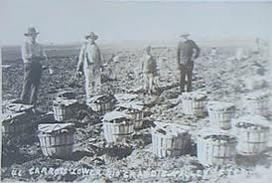
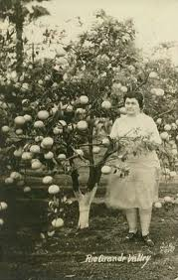
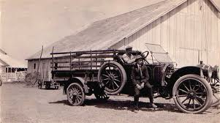
Land Agents Buy and Sell Land in Magic Valley
1920
Notes:
Some businessmen came to buy and sell land. In the 1920s, the businessmen invited American framers to come see the rich farm land. The farmers liked the warm weather. Since there was no snow, crops could be grown all year. They began calling the area by a new name: The Magic Valley.

Slide 37
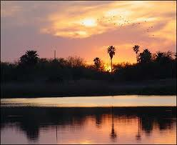
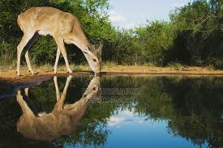
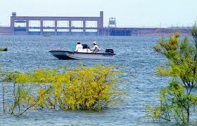
Rio Grande Valley
Notes:
Now, we call our home the Rio Grande Valey. Over the centuries, many changes have come, but one thing remains the same: the river.

Slide 38
Rio Grande River
Notes:
Today, the Rio Grande is still a source of life for plants, animals, and people.

Slide 39
Credits
Borderlands: the Heritage of the Lower Rio Grande Through the Art of Jose Cisneros, Cisneros, Jose, 1998
American Geography Close-Ups: Southwestern States: Volume 01Ancient Lights, 2006 . Full Video.
Discovery Education. Web. 16 March 2013. <http://www.discoveryeducation.com/>.
United States Expansionism 100% Educational Videos, 2001 . Full Video.
Discovery Education. Web. 16 March 2013. <http://www.discoveryeducation.com/>.

