Slide 1

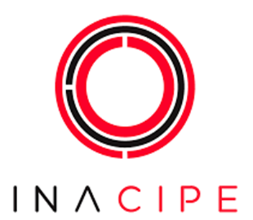
Why an “A” matters in STEM+A?
The role of educational poetics and disruption in our future
Dr. Xicoténcatl Martínez Ruiz
INACIPE
3rd Annual STEM Education Conference

Slide 2

I
CONTEXT

Slide 3
Experiences,overview and context:
-STEM in VET (Mexico and France)
-National Polytechnic Institute
-Non-Government Programs on Science and Technology for life

Slide 4
Why & what questions…
Why is STEM education important?
Why are the arts and humanities important in education?
Both questions should be considered under this scope:
What value do we place on the future?

Slide 5

Let us have a look at some facts & future literacy for STEM practices
PAST-PRESENT-FUTURE

Slide 6
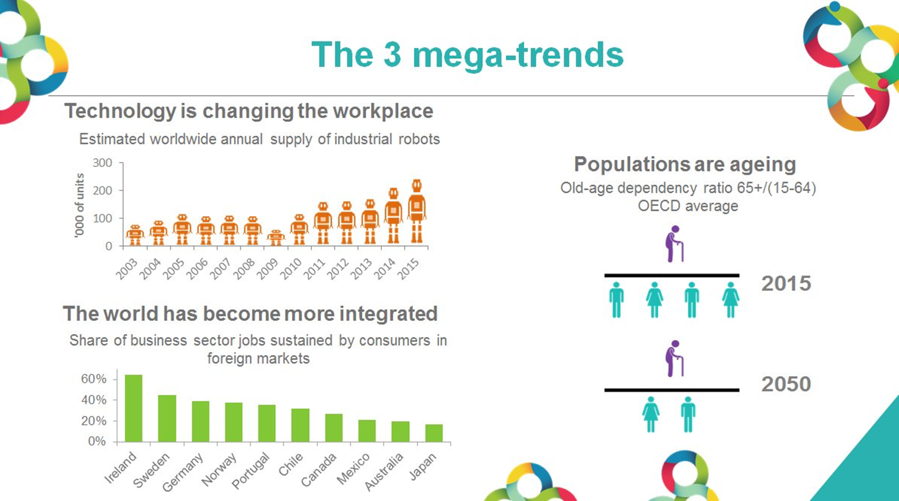

Slide 7
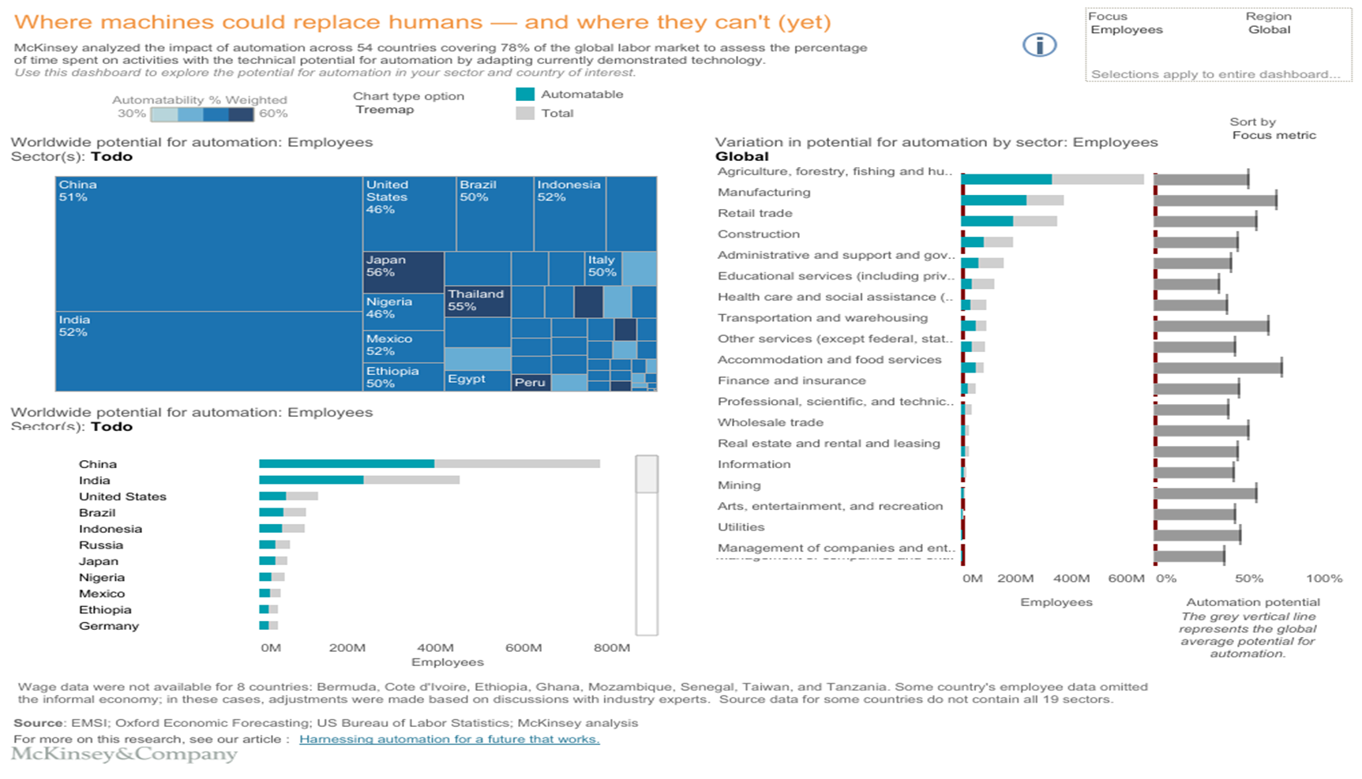

Slide 8
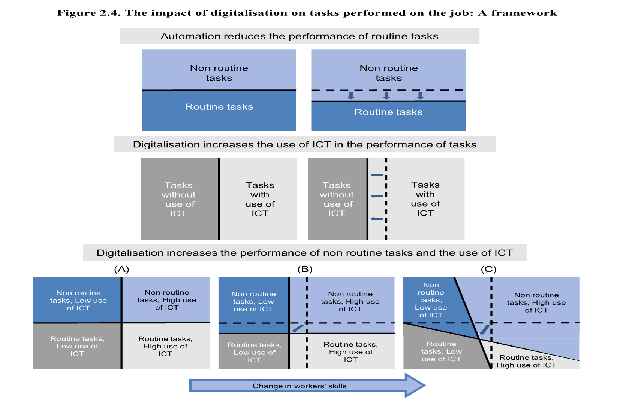

Slide 9
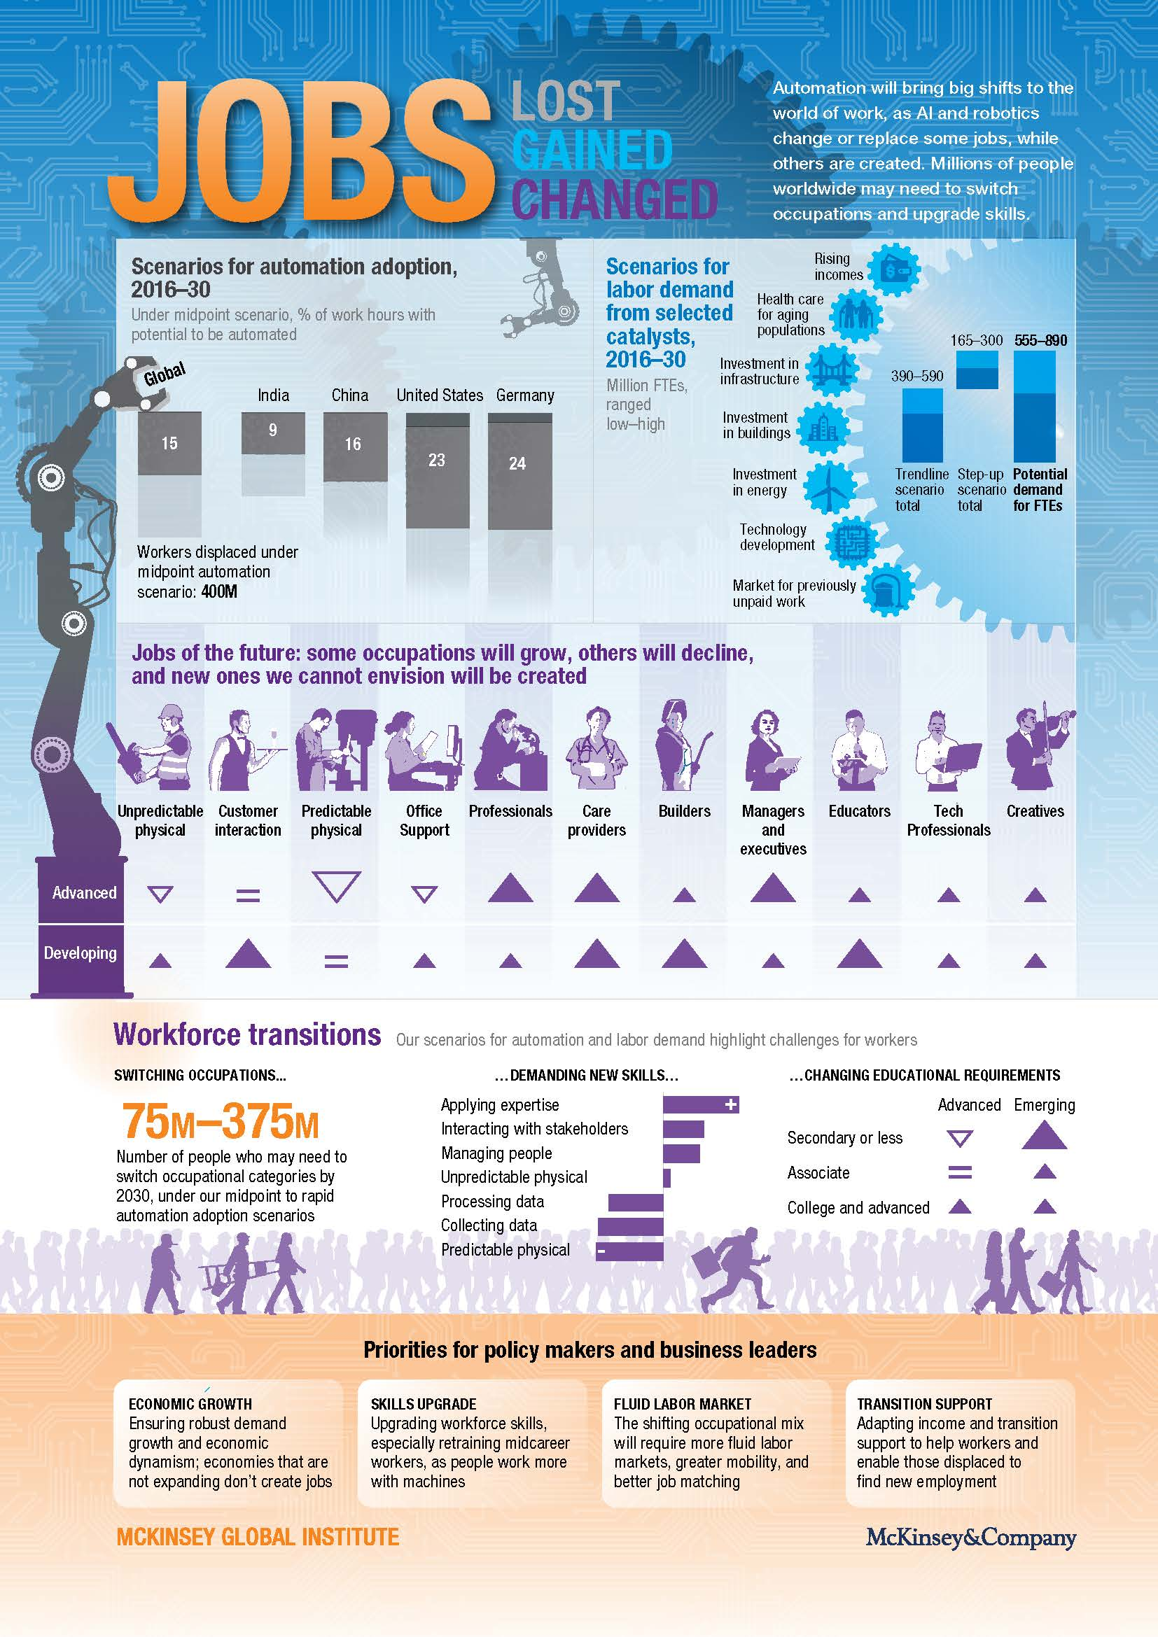
Source:

Slide 10
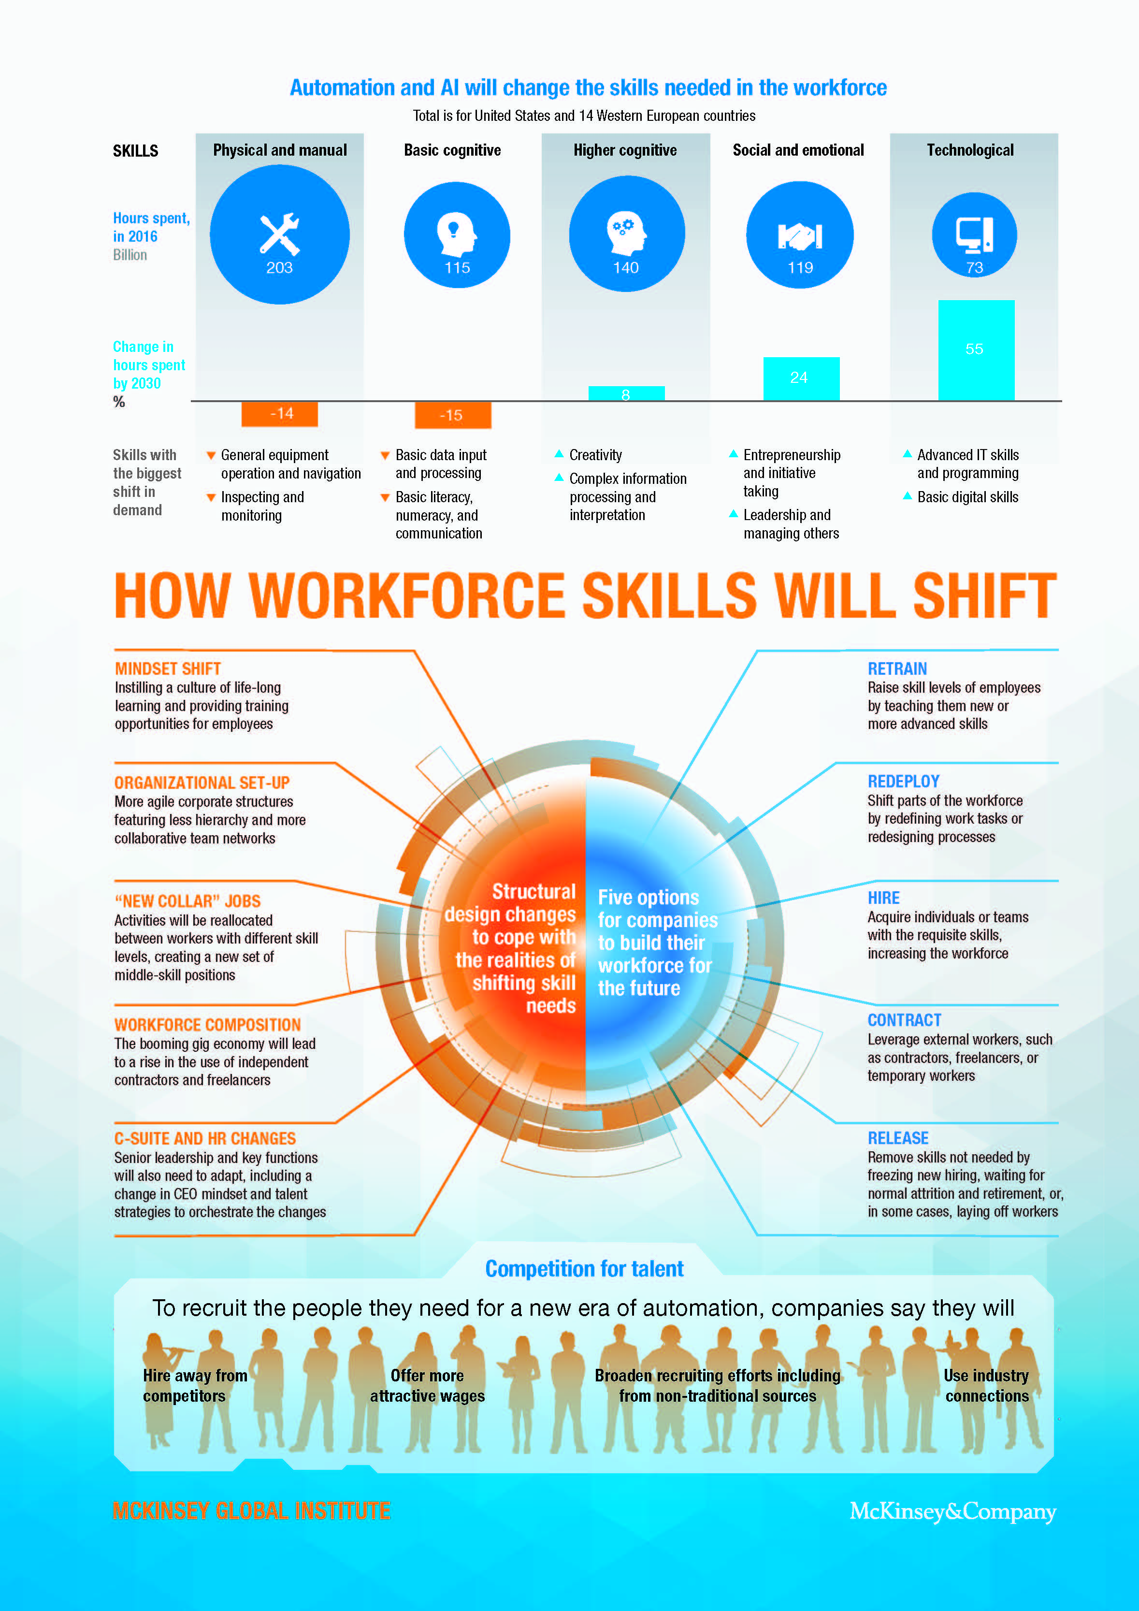
Mckinsey Global Institute 2018, source: www.mckinsey.org

Slide 11
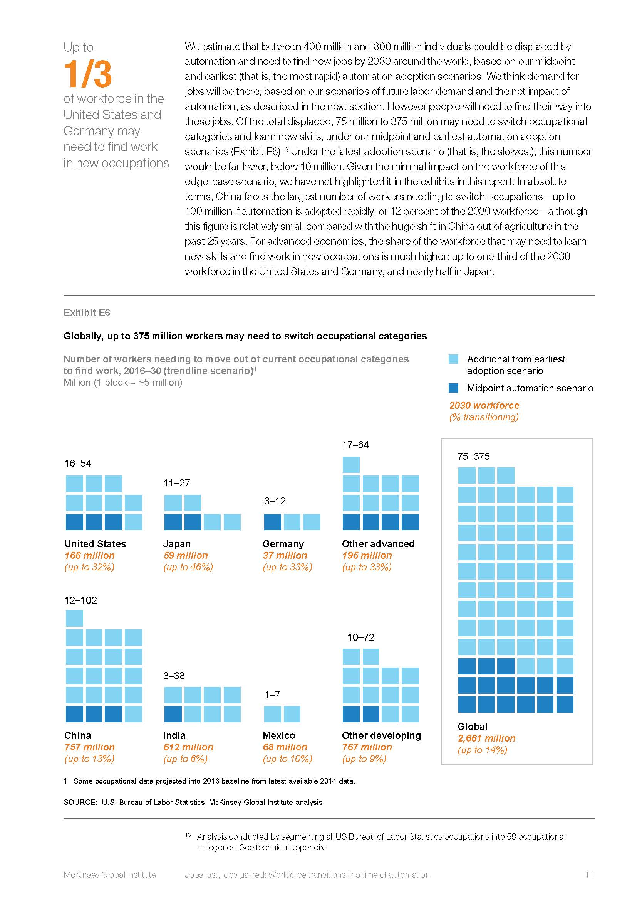

Slide 12
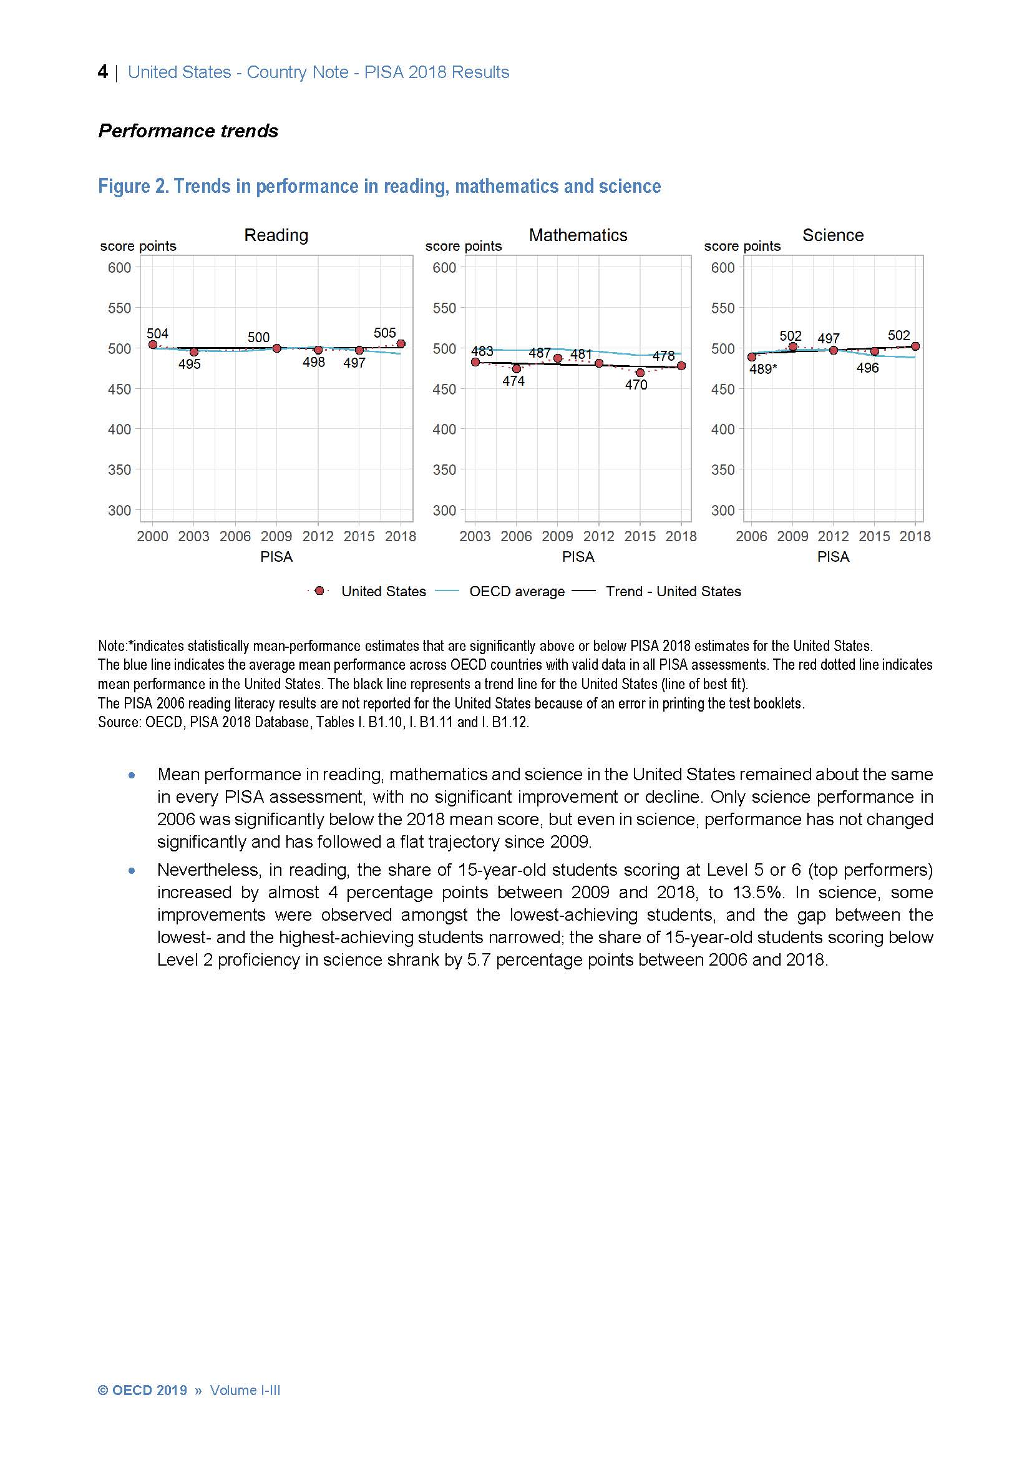
PISA 2018
Country Notes
Published in 2019

Slide 13

II
Problems & statement about STEM

Slide 14
21st-century workers require skills that some of today’s graduates don’t have…
(they said so!!)
STEM, then, is designed for a specific purpose—to integrate and apply knowledge of math and science in order to create technologies and solutions for problems, using an engineering approach”
STEM context is motivating, engaging in real world problems, so STEM develops a variety of skills that are essential in workplace
The focus of STEM is developing rigorous math and science skills through engineering. Thus, how can you think on other subjects (such as art) without losing the mission of STEM…

Slide 15
STEM education is one of the key programs that can build a more sustainable environment that cultivates equity, justice and peace.
There is a central role of STEM education as a transformative practice in confronting the risks that contains great dangers for the future of human race. But, how!!!

Slide 16
Key problems for children and young people engaged or not in STEM education for this decade.
This is something that I call:
“Society of predetermination”, expressed by:
The reduction or absence of contemplative, harmonious and free silence.
The increase of the mechanisms of homogenization in order to standardize the practices that do away with diversity, cultural wealth.
In a society of predetermination, human beings tend to become instruments of their instruments
The society of predetermination privileges technological development and the uses of technology that facilitate the anticipation of a person’s behavior
The society of predetermination creates the idea of the future as something given.
Automation is a sign of the society of predetermination.

Slide 17

III
“A” matters in STEM+A

Slide 18
My target is not present STEM vs STEAM

Slide 19
“A” doesn’t refers arts as an aggregate in STEM
For instance, “… as an artist, it seems we're missing the point and devaluing, or not realizing, art’s purpose and importance…”
How would Art benefit from STEM? Why not reverse the thinking process?
The arts provide ways for problem solving

Slide 20
My point when I use the term STEM+A, this “A” is not a simply addition or subordination of the arts as “design”.
I would like to say that the main issue is about the alignment of arts underlying STEM, but it must be clear in concept. Implementation and curriculum design..
-So, I arguing that arts are not simply tools to be instrumental information/skills for business. Arts are valuable on their on way.

Slide 21
- This “A” in STEM+A is not a simply addition or subordination of the arts as “design”.
-I would like to say that the main issue is about the alignment of arts underlying STEM, but it must be clear in concept. Implementation and curriculum design..
-So, I arguing that arts are not simply tools to be instrumental information/skills for business. Arts are valuable on their on way.

Slide 22
IV
The role of educational poetics and disruption in our future

Slide 23
(Tagore, R., 1951, The centre of Indian culture, p. 2)
“… our education should be in full touch with our complete life, economical, intellectual, aesthetic, social and spiritual; and our educational institutions should be in the very heart of our society, connected with it by the living bonds of varied co-operations.”

Slide 24
“I would develop in the child his hands, his brain and his soul. The hands have almost atrophied. The soul has been altogether ignored.”
(Gandhi, 2008, All men are brothers, p. 202)
,

Slide 25
Educational poetics (poiesis) is the convergence of three experieces and ideas:
(1) creative contemplation (Sanskrit, bhāvanā)
(2) practices of conscious attention in education, and specialized interventions with mindfulness (Sanskrit, dhāraņā)
(3) practices of non-violence that form the basis of a culture of peace (Sanskrit, ahimsā-śantȋ)
Educational poetics leads to a new perspective in thinking about the risks that jeopardize the future of young generations, as well as that of education and humanity itself.

Slide 26
Concluding remarks
Why is STEM education important?
Why are the arts and humanities important in education and future?
A proposal in this talk: STEM-educational poetics approach, because:
1. The learning and teaching process is not guided by the merely utilitarian purpose of educating in order to acquire an exchange value;
2. A position against whatever destroys nature, against the destruction of the environment is clear;
3. Their different interventions aim to disintegrate that which annihilates freedom, aesthetic sensitivity, moral power and wonder about life

Slide 27
“Every era has its educational diagnosis, its challenges and desires. Every era defines its priorities and illnesses, and in every era voices rise up that represent the critical conscience of the meaning and goals of education”.
(2019, Educational Poetics. p. 9)

Slide 28
References
Balgiu, B., y Zaleschi, V. (2017). Assessment procedure for the soft skills requested by Industry 4.0. MATEC Web of Conferences. Volume 121, 2017 DOI: 10.1051/matecconf/201712107005
Demartini, C., y Benussi, L. (2017). Do Web 4.0 and Industry 4.0 Imply Education X.0? IT Pro May/June 2017, IEEE Computer Society. Recuperado de:
https://pdfs.semanticscholar.org/e0b9/45ce38d3ea638de3c02f069a846cde9651fe.pdf
Floridi, L. (ed.), (2015). The Onlife Manifesto. Being Human in a Hyperconnected Era. Springer. DOI 10.1007/978-3-319-04093-6
Floridi, L. (2014). The Fourth Revolution. How the Infosphere is Reshaping Human Reality. Oxford, RU: Oxford University Press.
ILO (2019). Work for a brighter future – Global Commission on the Future of Work. International Labour Office, Geneva: ILO. Recuperado de:
https://www.ilo.org/wcmsp5/groups/public/---dgreports/---cabinet/documents/publication/wcms_662410.pdf
Mackinsey Global Institute (2017). Jobs lost, Jobs Gained: Workforce transitions in a time of automation. Recuperado de: www.mckinsey.com/mgi
-Martínez Ruiz, X. (2018) The alignment argument: at the crossroads between mindfulness and metacognition, Learning: Research and Practice, 4 (1), 29-38, doi:10.1080/23735082.2018.1428096 Retrieved from: https://www.tandfonline.com/doi/full/10.1080/23735082.2018.1428096
-Martínez Ruiz, X. (2019). Time for Educational Poetics. Why does the future need an educational poetics? The Netherlands: Brill. https://brill.com/view/title/54747
-Monier-Williams, M. (1999/1899). A Sanskrit English Dictionary Etymologically and Philologically Arranged with Special Reference to Cognate Indo-European Languages. Delhi, IN: Motilal Banarsidass Publishers
-Tagore, R., (1961). A Poet’s School. In L. K., Elmhirst. Rabindranath Tagore, Pioneer in Education. Essay and Exchanges between Rabindranath Tagore and L. K. Elmhirst. London, UK: John Murray Publishers Ltd. Retrieved from: https://archive.org/details/PioneerInEducation-RabindranathTagore
-Tagore, R. (1917). Personality. Lectures delivered in America. London, UK: MacMillan and Co. Limited. Retrieved from: https://archive.org/stream/personalitylectu00tagouoft#page/4/mode/2up
-Tobin, K. (2017). Researching Mindfulness and Wellness. In Malgorzata Powietrzyńska and Kenneth Tobin (2017) Weaving Complementary Knowledge Systems and Mindfulness to Educate a Literate Citizenry for Sustainable and Healthy Lives. The Netherlands: Sense Publishers. Retrieved from: https://www.springer.com/gp/book/9789463511827
Bughin, J., Hazan, E., Lund, S., Dahiström, P., Wesinger, A., Subramaniam, A. (2018). Skill Shift. Automation and the Future of the Workforce. Mackinsey Global Institute, Recuperado de: www.mckinsey.com/mgi
Levy, D. (2011). The Decline of Private Higher Education. PROPHE Working Paper Series WP No. 16. Revised and published as: Levy, D.C. (2013). The Decline of Private Higher Education. Higher Education Policy, 26, 25–42. Recuperado de: http://www.prophe.org/en/working-papers/the-decline-of-private-highereducation/
Maresova, P., Soukal, I., Svobodova, L., Hedvicakova, M., Javanmardi, E., Ali Selamat and Ondrej Krejcar (2018). Consequences of Industry 4.0 in Business and Economics. Economies, 6, 46. DOI:10.3390/economies6030046

Slide 29

Thanks
Xicoténcatl Martínez Ruiz, Ph.D xicotencatlm@gmail.com

