Slide 1
Be the Disruption!
STEAMing the Way to a Successful Future
Michelle Cline, Ed.D.
Detroit Public Schools Community District

Slide 2
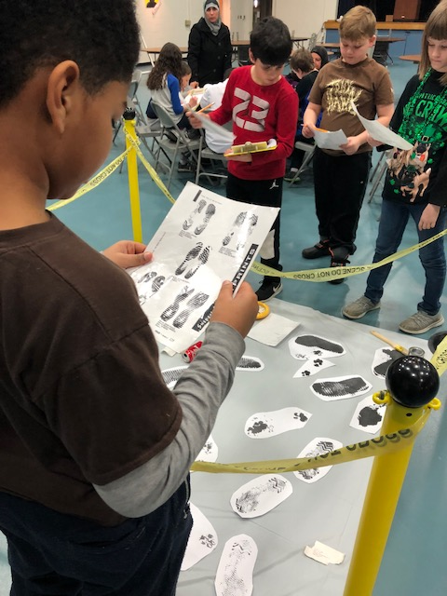
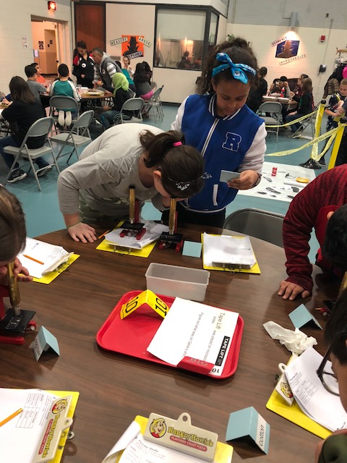
Be the Disruption!
CSI Investigations

Slide 3
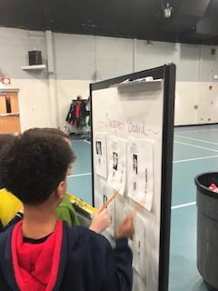
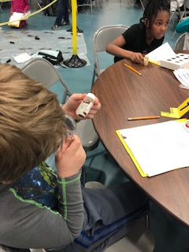
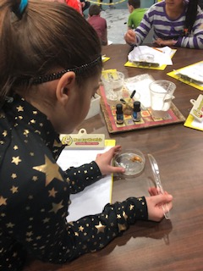
Be the Disruption!
CSI Investigations

Slide 4
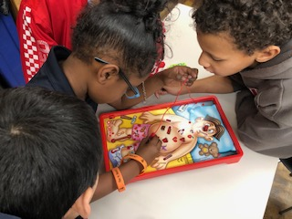
Be the Disruption!
Driving Questions
How does the game Operation work?

Slide 5
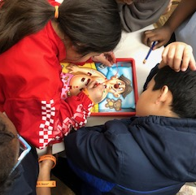
Be the Disruption!
Driving Questions
How does the game Operation work?
How can you redesign the game to make it better?

Slide 6
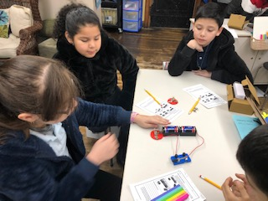
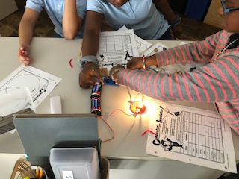
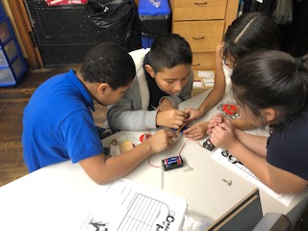
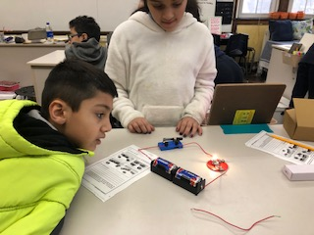
Be the Disruption!
Driving Questions
Building background knowledge!

Slide 7
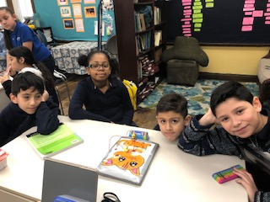
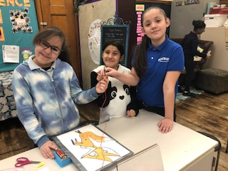
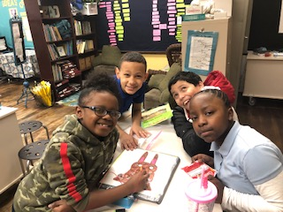
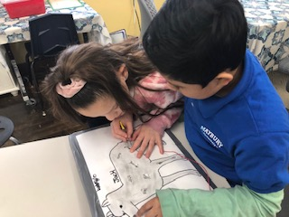
Be the Disruption!
Driving Questions
Our creations!

Slide 8
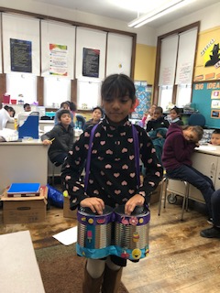
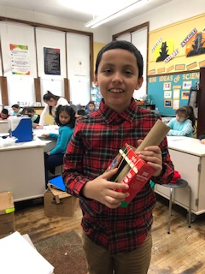
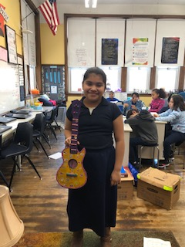
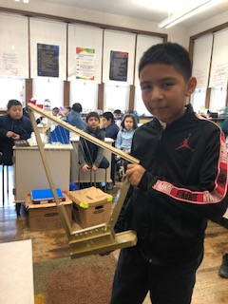
Be the Disruption!
Driving Questions
Design a musical instrument from recycled materials that will make two pitches and two volume levels.

Slide 9
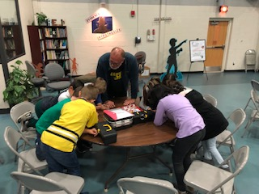
Be the Disruption!
Breakoutedu
A “Butts in the Air” Experience!
Let’s do one!
A Force to be Reckoned With!

Slide 10
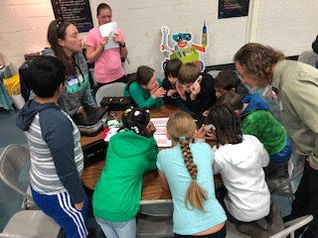
Be the Disruption!
Breakouteu

Slide 11
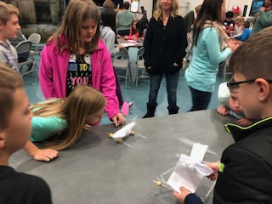
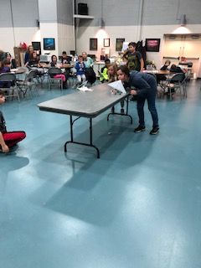
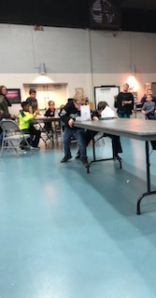
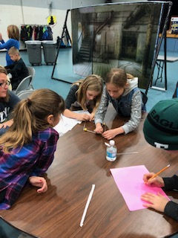
Be the Disruption!
Breakoutedu

Slide 12
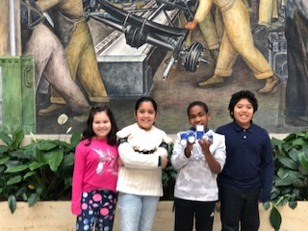
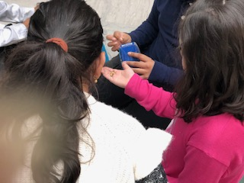
Be the Disruption!
Breakoutedu at the DIA!
Detroit Institute of Arts

Slide 13
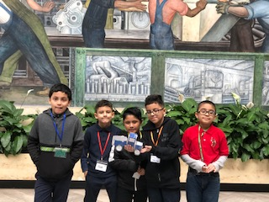
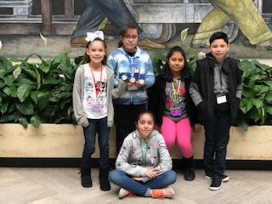
Be the Disruption!
Breakoutedu at the DIA!
Diego Rivera Mural

Slide 14
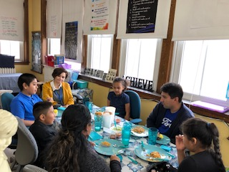
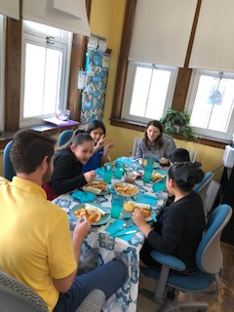
Be the Disruption!
Meet the Guest

Slide 15
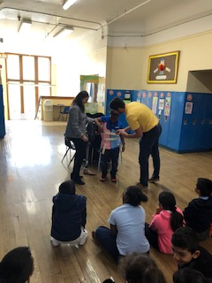
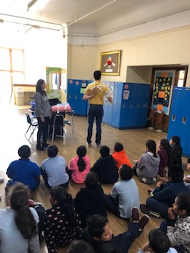
Be the Disruption!
Meet the Guest
Latina/o Engineers from Ford Motor Company
Grad students studying Orthotics and Prosthetics

Slide 16
Be the Disruption!
Any questions?
Michelle Cline, Ed.D
Detroit Public Schools Community District
Michelle Cline Educational Consulting, LLC
Michelle.cline@detroitk12.org
michellelavae@gmail.com

