Slide 1
Growing the STEM Workforce through Active Learning and a Growth Mindset
RGV STEM Education Conference (2/15/2020)
R. Deborah Overath, PhD
Martha Casquette, MS
Diana H. Cortez-Castro, Ed.D

Slide 2
1) How many students declared a STEM major between 2003 and 2009?
28% bachelor's degree
20% associate's degree
Department of Education (National Center for Education Statistics)

Slide 3
2) What was the attrition rate of students declared in STEM fields between 2003 and 2009?
48% bachelor's degree
69% associate's degree
Department of Education (National Center for Education Statistics)

Slide 4
Where are you with Mindsets?
Take this quiz to learn about your own mindset!
Notes:
Martha

Slide 5
Workshop Outcomes
By the end of this session you should be able to:
Define growth & fixed mindsets
Understand the consequences of students’ mindset
Understand the consequences of instructor’s mindset on students
Define neuroplasticity
Have some ideas of active learning activities you can use in your classroom to foster growth mindset
Jacque Watkins, Growing Takes Time
Notes:
Deb

Slide 6
Activity 1: Everyday Mindset Examples
Fixed, Growth, and Benefit Mindsets Video
Group Brainstorm #1
Examples of Fixed Mindset (3 min)
Group Brainstorm #2
Examples of Growth Mindset (3 min)
Notes:
Deb
Purpose — To name and share everyday examples of how each mindset shows up in your class / group.
Time — 30 mins
Materials — Sheets of paper and an assortment of colored pens
Process — Introduce Fixed, Growth and Benefit Mindsets via video (use link). Then, in small groups ask participants to write down as many examples as possible of a Fixed Mindset in 3 mins. (I actually said they could write words OR draw pictures.) At the end of the brainstorm, invite each group to share their favorite examples and explain why they think it’s a good example of that mindset. Repeat activity for the Growth Mindset. Facilitate a final discussion about what these examples mean for the groups future activities.
Taken from: https://medium.com/benefit-mindset/5-simple-activities-for-exploring-the-power-of-mindsets-8f92e533f19b

Slide 7
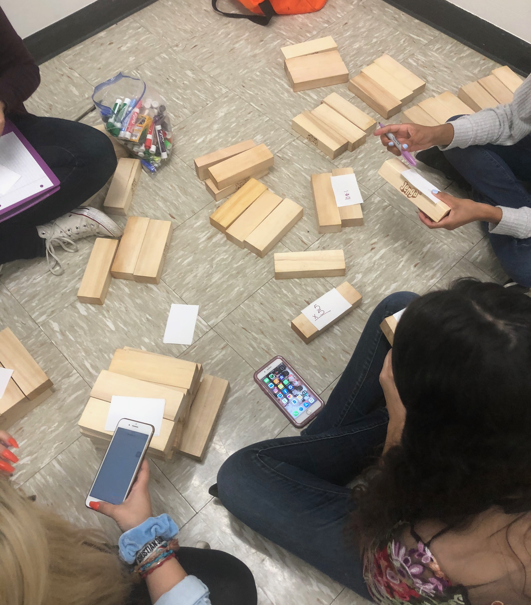
Activity 2:
Let's Play!
Notes:
Diana

Slide 8
Fixed vs. Growth Mindset
Notes:
Deb:
Keep or not?

Slide 9
Consequences of Mindsets
 | Fixed Mindset | Growth Mindset
Goal in School? | Look Smart | Learn
Values effort? | No | Yes
Reaction to Failure? | Give Up | Work Harder
Achievement | Lower | Higher
Source: MindsetKit PERTS Professional Development
Notes:
Deb
Students with a fixed mindset tend to show declines in their performance over time, particularly when they transition to a new environment such as from elementary to middle school or middle school to high school.
Students with a growth mindset typically show increases over time.

Slide 10
Response to Failure
Helpless
“I would spend less time on this subject from now on.”
“I would try not to take this subject ever again.”
“I would try to cheat on the next test.”
Resilient
“I would work harder in this class from now on.”
“I would spend more time studying for the tests.”
 | Fixed mindset | Growth mindset
Goals? | Look Smart | Learn
Values effort? | No | Yes
Reaction to Failure? | Give up | Work Harder
Notes:
Deb
Whereas students with a growth mindset are more likely to agree with…
“I would work harder in this class from now on.”
“I would spend more time studying for the tests.”

Slide 11
Neuroplasticity
The brain changes when we learn
Neurons create associations which are strengthened as we practice
Can grow and develop the more we learn and use
Productive Persistence
CHALLENGING the brain STRENGTHENS it!
BUT what effects does this have?
Notes:
Deb
Remember: Intelligence = Effort + Learning Strategies

Slide 12
Growth Mindset and Achievement
Decades of research show a powerful relationship between
mindset and achievement.
Students’ beliefs about intelligence and learning impact:
Motivation
Academic behaviors (e.g., studying and seeking help)
Responses to challenges and setbacks
Academic achievement
Source: MindsetKit PERTS Professional Development
Notes:
Deb
There are, of course, a lot of reasons kids don’t try hard. Over the last few decades, a lot of research has shown that there is a powerful relationship between students’ mindsets and their achievement.
These beliefs have a big impact on students’
Motivation
Academic behaviors (for example, studying and seeking help)
Responses to challenges and setbacks
Academic achievement

Slide 13
Does Growth Mindset Correlate with Achievement? Evidence from a Nationwide Sample in Chile
Chilean National Achievement Test
10th grade test incorporated Growth Mindset Assessment
n=147,000
Susana
Claro
Dave
Paunesku
Source: MindsetKit PERTS Professional Development
Claro, Paunesku, & Dweck (PNAS 2016)
Notes:
Deb
Numerous studies have shown that students with a growth mindset do better academically. In a recent, large-scale study, researchers had an opportunity to look at the relationship between mindsets and achievement in an entire nation. All of the 10th graders in Chile that took the national standardized test - so over 140,000 students - were also asked questions to assess their mindsets.

Slide 14
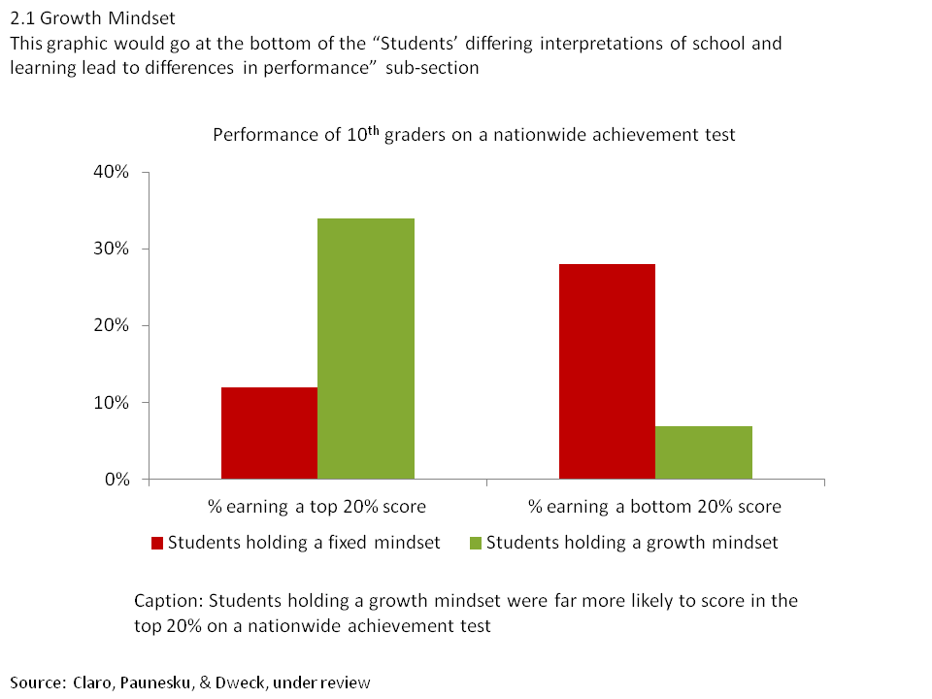
Does Growth Mindset Correlate with Achievement? Evidence from a Nationwide Sample in Chile
Claro, Paunesku, & Dweck (PNAS 2016)
Notes:
Deb
SLIDE 25And they found that students with a growth mindset (those who disagreed with statements like, “You can learn new things, but you can’t really change your basic intelligence”) were 3x as likely to score in the top 20%, whereas students with a fixed mindset were 4x more likely to score in the bottom 20%. GET PERMISSION TO USE

Slide 15
And it’s not just about the students…
Fig 1 Faculty mindset beliefs predict racial achievement gap in STEM courses.
Fig 2 Faculty mindset beliefs predict students’ experiences in STEM courses.
Canning et al. (2019)
Notes:
Deb
Fig 1: Predicted values are computed from the interaction between faculty mindset beliefs (fixed = −1 SD, growth = +1 SD) and students’ URM (Black, Hispanic, Native American) status. Error bars represent ±1 SE.
Fig 2: Higher scores on faculty mindset beliefs reflect a more growth mindset. Gender was coded as follows: female = 1, male = 0. Race/ethnicity was coded as follows: URM (Black, Hispanic, Native American) = 1, non-URM (White, Asian) = 0. Tenure status was coded as follows: tenured = 1, nontenured = 0. Biology was used as the reference group for STEM discipline dummy codes.

Slide 16
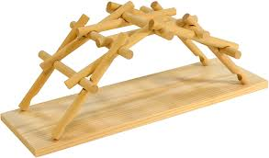
Activity 3: Da Vinci Bridge
In 1502 A.D., Leonardo Da Vinci came up with a novel bridge design to connect Istanbul with its neighbor city Galata.
The bridge was held together by compression only. All the forces were transferred within the structure.
Notes:
Martha

Slide 17
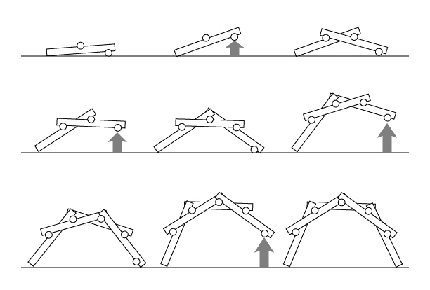
Activity 3: Da Vinci Bridge Instructions
Notes:
Martha

Slide 18
How Do We Change Mindset? How Do We Foster a Growth Mindset?
Notes:
Who?

Slide 19
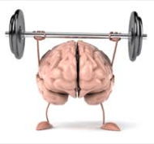
Mindsets Can Change!
Rigorous research also shows that mindsets can change
When they are changed to have a Growth Mindset, students do better
Source: MindsetKit PERTS Professional Development
Notes:
Who?
What’s exciting though is that there’s also research showing that students’ beliefs can be changed, and that when they are, students do better.

Slide 20
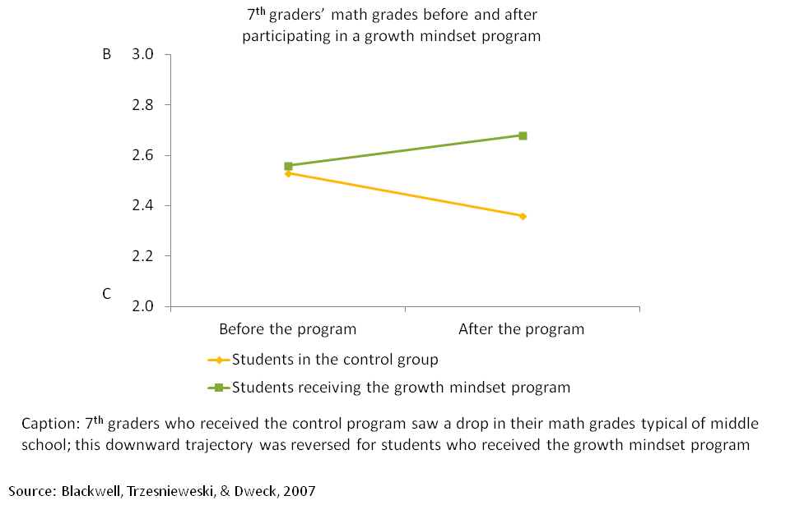
Mindset Interventions
Source: MindsetKit PERTS Professional Development
Notes:
Delete?—let me know what you think
In one study, 7th grade students were taught about neuroplasticity - how the brain changes when you learn new things. They were shown the evidence that you really can change your intelligence by challenging yourself and learning new strategies. Students in the treatment group who got this message did significantly better after the intervention than students in the control group.
Students in the treatment group showed an increase in their math grades

Slide 21
How Do Everyday Interactions Shape Mindsets?
The language we use tells others what we believe and what we value
Feedback tells us what is expected of us and what goals we should have
Source: MindsetKit PERTS Professional Development
Notes:
In addition to directly changing students mindsets by teaching them about the brain, how can our everyday interactions shape students’ mindsets?
Part of the answer is that our language signals to others what we believe and what we value.
- What beliefs are being reinforced?
- What goals are being promoted?
- Are mistakes valued?

Slide 22
Praise
Research Question:
Do different kinds of praise influence students’ response to failure?
Claudia Mueller
Notes:
Deb—I REALLY want to keep this one! It shows how the language we use for feedback can change mindset.
Researchers Claudia Mueller and Professor Dweck were worried that this type of praise might actually have unintended negative consequences--leading kids to develop more of a fixed mindset and to respond with less resilience when faced with setbacks.

Slide 23
Praise Effects on IQ Test Performance:
Completed moderately difficult IQ problems
Received positive feedback (intelligence praise, effort praise, or control)
Completed very difficult IQ problems
Received negative feedback that they did a lot worse
Completed moderately difficult IQ problems
Mueller & Dweck, 1998
Notes:
NOTE: THIS SLIDE IS ANIMATED. [ADVANCE] INDICATES WHEN YOU SHOULD CLICK ADVANCE TO BRING UP THE NEXT PART OF THE SLIDE.
Then they went back to working on moderately difficult problems.
To review:
All were given moderately difficult IQ test questions
Each group gets positive feedback - intelligence, effort, or neutral praise
Then complete hard questions
All get same negative feedback
Then, all given another set of moderately difficult IQ questions similar to the first set
[ADVANCE] So the first and last [ADVANCE] set of problems were of the same level of difficulty. The researchers were interested in how the different groups would perform on the last set of moderately difficult problems after they experienced a failure.

Slide 24
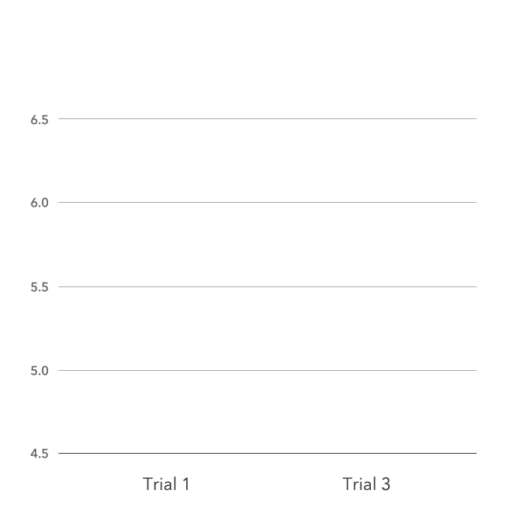
Number of Problems Solved Before and After Setback
Control praise
Intelligence praise
Effort praise
Source: MindsetKit PERTS Professional Development
Notes:
What they found was really interesting. Students who got neutral praise did about the same. They did slightly better, which you’d expect because they’d had more practice. The students who were given effort praise though did better. What’s most interesting though is that students who were praised for their intelligence were demoralized by that setback and actually did worse. Hearing that the reason they did well was because they were smart lead them to interpret the failure as evidence that they might not be so smart after all.
Keep in mind, these are tests that have been touted as measuring a supposedly fixed ability: IQ. Yet, just one slight modification to the praise students received had a significant impact on their performance.

Slide 25
Growth Mindset Praise
Don’t Focus On:
Qualities commonly interpreted as stable, like talent or intelligence
Do Focus On:
Effort and strategies used
“I like how you tried a new way to solve that.”
Abilities improving over time with practice
“You’ve been practicing and I can see it’s paying off.”
Mistakes and being challenged as necessary part of learning
“I love mistakes because they’re an opportunity to learn – being challenged is when the brain grows most.”
Source: MindsetKit PERTS Professional Development
Notes:
So, here’s a few do’s and don’ts of praise:
Don’t Focus On:
Qualities commonly interpreted as stable, like talent or intelligence
Instead
Do Focus On:
Effort and strategies used
“I like how you tried a new way to solve that.”
That abilities improving over time with practice
“You’ve been practicing and I can see it’s paying off.”
Mistakes and being challenged as necessary part of learning
“I love mistakes because they’re an opportunity to learn – being challenged is when the brain grows most when it’s being challenged.”
This last one is so important, because students are often really scared of making mistakes, but mistakes are an essential part of the learning process. Learning how to create opportunities and activities to help students become more comfortable making mistakes is something we’ll focus on in the professional development sessions.

Slide 26
Growth Mindset Teaching Practices
Encouraging Growth Mindset as the Norm
Teach about brain malleability and the effects of challenges
Emphasize that learning is the goal
Create an environment that embraces struggle
Create opportunities to celebrate and learn from mistakes publically
Source: MindsetKit PERTS Professional Development: Checklist of Growth Mindset Teaching Practices

Slide 27
Growth Mindset Teaching Practices
Strategies for Feedback & Assessment
Focus praise on the process rather than correctness or speed
Praise effort when warranted—and be authentic
Affirm high standards and reassurance that you believe in their ability to succeed when students are struggling
Structure assignment and provide feedback that emphasizes improvement opportunities
Encourage students to collaborate and seek help, but not as a shortcut
Source: MindsetKit PERTS Professional Development: Checklist of Growth Mindset Teaching Practices

Slide 28
Growth Mindset Teaching Practices
Avoid Sorting Students by Ability
Use mixed ability groupings instead
Emphasize high expectations for ALL students
Avoid use of labels such as “smart” or being a “math person”
Acknowledge different students publically
Easier and more authentic when basing praise on strategies/process
Source: MindsetKit PERTS Professional Development: Checklist of Growth Mindset Teaching Practices

Slide 29
Growth Mindset Teaching Practices
Think of one activity that you could do in your classroom that would encourage a growth mindset
Brainstorm with group and write short description on large Post-It
Report out
Source: MindsetKit PERTS Professional Development: Checklist of Growth Mindset Teaching Practices

Slide 30
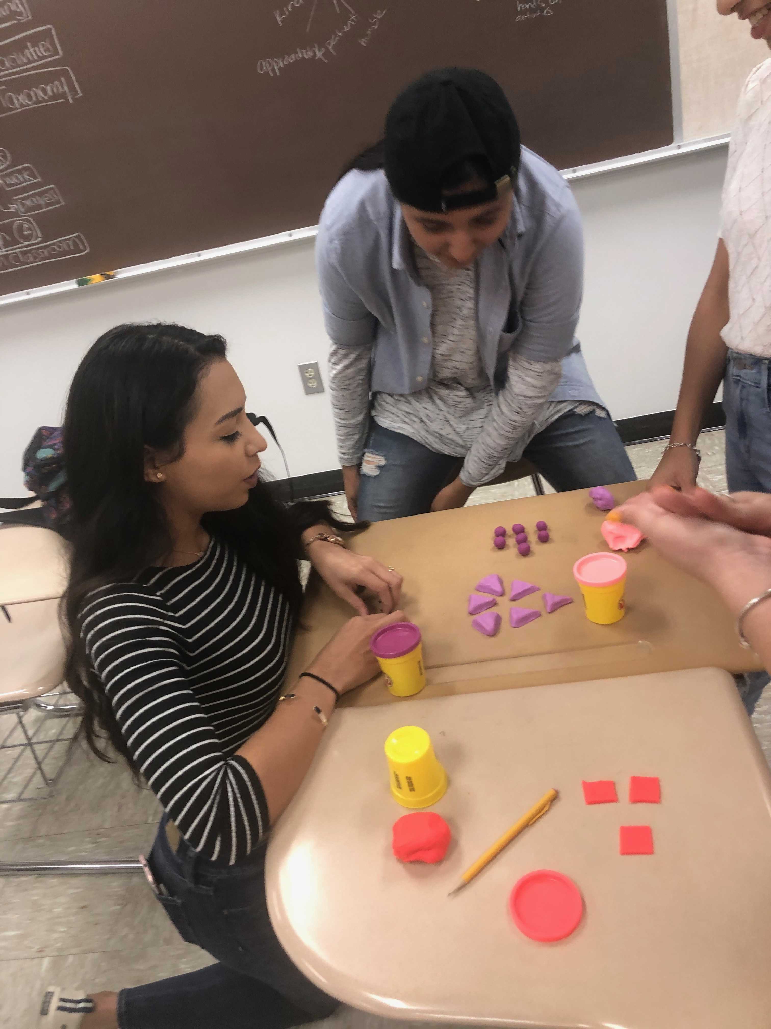
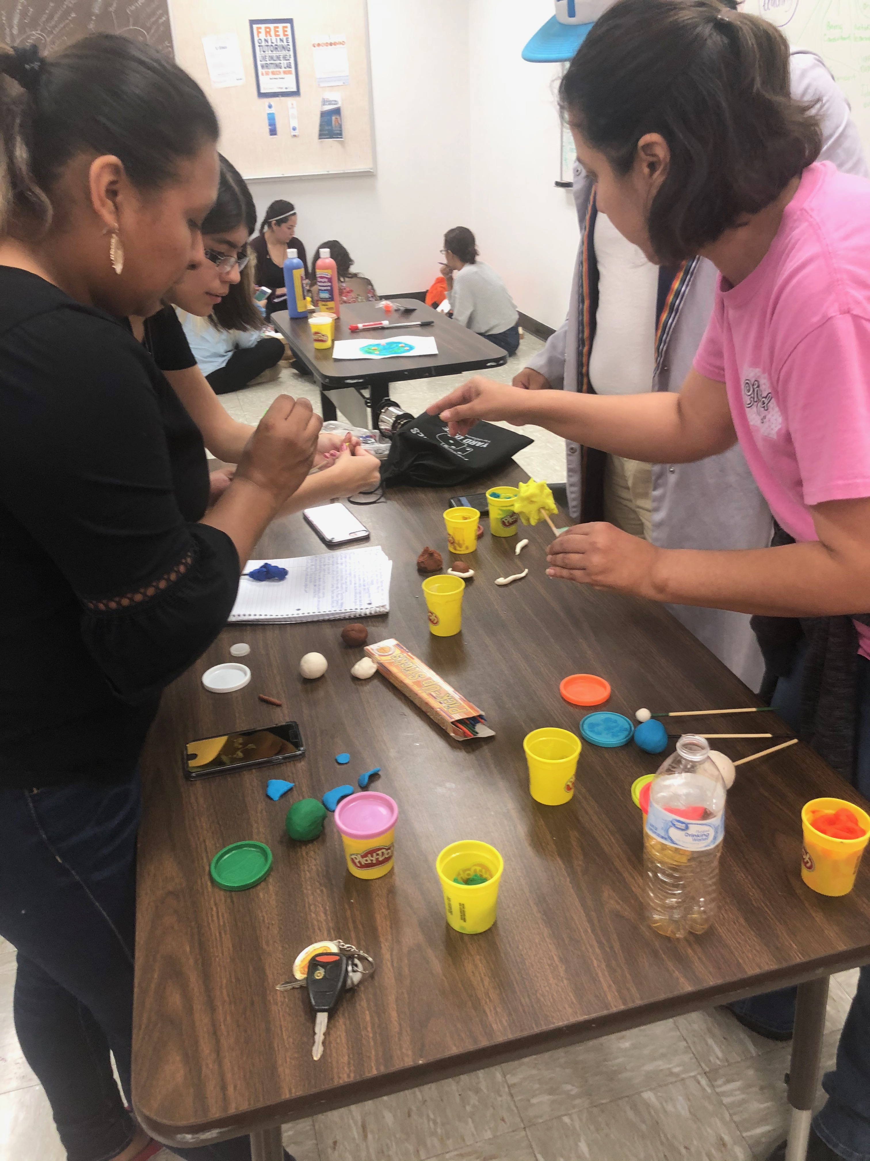
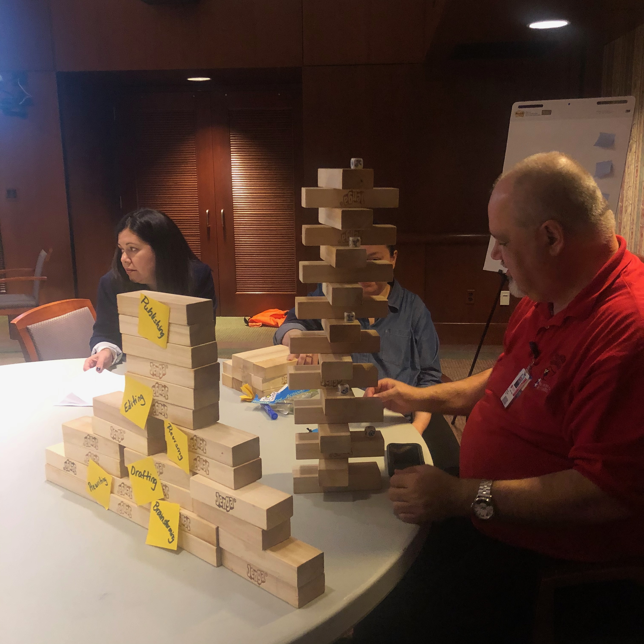
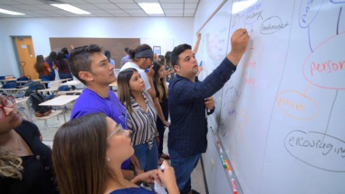
What is Active Learning?
“Active learning is generally defined as any instructional method that engages students in the learning process. In short, active learning requires students to do meaningful learning activities and think about what they are doing” (Prince, 2004).

Slide 31
Active Learning Works!
As one example, the National Survey of Student Engagement (NSSE) has examined the engagement experiences of hundreds of thousands of students from over 1600 colleges and universities since 2000. The consistent results of these data show that hands-on, integrative, and collaborative active learning experiences lead to high levels of student achievement and personal development (Kuh, O’Donnell, and Schneider, 2017).
There is a well-established evidence base supporting the use of active learning. The benefits to using such activities are many, including improved critical thinking skills, increased retention and transfer of new information, increased motivation, improved interpersonal skills, and decreased course failure (Prince, 2004).

Slide 32
Passive Learning Vs Active Learning

Slide 33
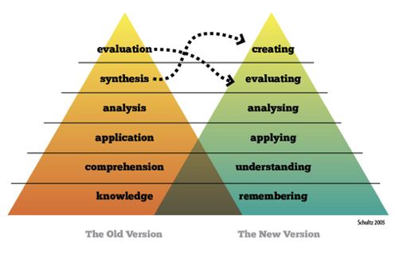
BLOOM’S TAXONOMY

Slide 34
Activity 4: Mindset Reflection
Write down one or two ways that you exhibited a fixed mindset today
Repeat for growth mindset
Notes:
Purpose — To reflect on how participants’ mindsets shifted at different stages during an activity.
Time — 5 mins
Materials — Paper and pens.
Process — At the end of an activity, invite participants to rule three columns with the headings Fixed Mindset, Growth Mindset, Benefit Mindset. Under each heading, write 1–2 ways they exhibited each mindset. Facilitate a short discussion to give voice to the groups reflections.
Taken from: https://medium.com/benefit-mindset/5-simple-activities-for-exploring-the-power-of-mindsets-8f92e533f19b

Slide 35
Dweck TED Talk: The Power of Believing That You Can Improve

Slide 36
Example Activity for Students: Letter to a Future Student
Consider a time when you struggled with learning
How did it make you feel?
How did you overcome it?
What did you learn from the experience?
Write a letter to a future student
Tell them about your struggle
Tell them what you learned from this struggle
Any advice you would like to give
Source: MindsetKit Growth Mindset Lesson Plan (Part III Letter to a Future Student)
Notes:
Example in case we need another activity
From the Growth Mindset Lesson Plan: Ask your students for a short story about a struggle they had when they were learning. How did it make them feel? How did they overcome it, and what did it teach them? Tell them to
write a letter to this future student to tell them about their struggle, what they learned from it,
and any advice they could give for the student. Collect their letters, and save them in order to
give them back to them during difficult testing periods, such as final exams.

