Slide 1
Transformation Through Equity Literacy
Rick Orozco, Ph.D.
College of Education
University of Arizona
UTRGV 3rd Annual STEM Education Conference
February 15, 2020
McAllen, TX

Slide 2
Transformation through Equity Literacy (EL)
Story telling: Student self-segregation(?)

Slide 3
Transformation through Equity Literacy
EL - knowledge and skills that enable us to be a threat to the existence of inequity in our spheres of influence.

Slide 4
Transformation through Equity Literacy
EL Goal:
“Multicultural curriculum development + bigger efforts to create equitable classrooms and schools”
(Gorski & Swallwell, 2015, p. 36)

Slide 5
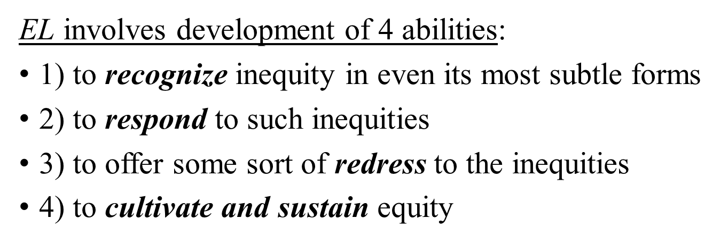
Transformation through Equity Literacy

Slide 6
Transformation through Equity Literacy
Common Math/Science argument:
Equity is important, but math/science content is “objective” and not open to such work.
4 EL Abilities are not content specific.

Slide 7
Transformation through Equity Literacy
Example:
Microaggressions as EL ability 1 - to recognize inequity in even its most subtle forms

Slide 8
Microaggressions
The everyday verbal, behavioral, or environmental indignities, whether intentional or unintentional, that communicate hostile, derogatory, or negative messages to target persons based solely upon their marginalized group membership
Categories
Microassault
Overt, explicit verbal or nonverbal assaults
Microinsult
Rude, inconsiderate, patronizing expressions
Microinvalidation Exclusion or denial of ones thoughts, feelings, or experiential reality
(Sue, et al., (2007). Racial microaggressions in everyday life: Implications for clinical practice. American Psychologist, 62(4), pp. 271-286).

Slide 9
Perceived discrimination
Negative Emotions (e.g. anxiety, anger, stress)
Increase in Hypothalamic-Pituitary-Adrenal
(HPA) Axis activity
Sleep Hours
and Quality
Increased Cortisol
Increased Blood Pressure and Respiratory Rate
Decreased Cognitive Function (e.g. attention, memory)
(Levy et. al., 2016)

Slide 10
Transformation through Equity Literacy Microaggression Types

Slide 11
Transformation through Equity Literacy
What types of microaggressions are these?
“You better watch him, I’ve seen his type before.”
Assumption of criminality
Asking an Asian student to help other students with math
Ascription of intelligence
“If only there were more like you.”
Different norming
“Mexican parents don’t care about education, they never show up to open house.”
Pathologizing cultures and values

Slide 12
Transformation through Equity Literacy
Thank you.
raorozco@email.arizona.edu

