Slide 1
STREAM Preparation for Pre-Service Bilingual Educators in Dual Language Classrooms
Dr. Esther Garza
Texas A&M University-San Antonio

Slide 2
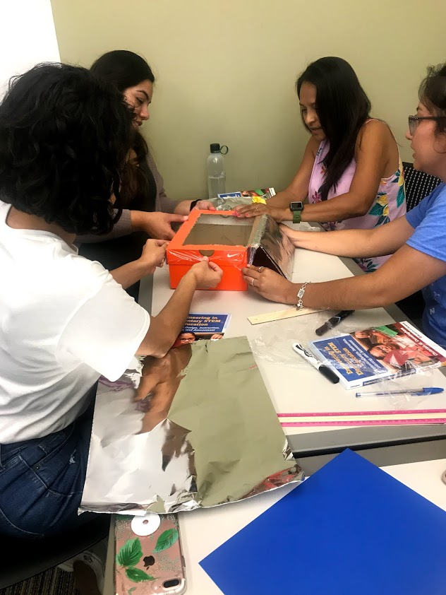
STEM to STREAM
Science
Technology
Reading
Engineering
Art
Mathematics

Slide 3
Dual Language Classrooms Engaging in STREAM
Focus/problem: Pre-service bilingual educators are entering a time in the teaching profession where STREAM approaches and methods in the DL classroom are necessary to explore content area learning in a dual language classroom. However, there is little to no research (Brenneman, Lange, Nayfield, 2019) in this area, and the premise of this paper will begin to formulate an understanding as to how STREAM teaching can develop efficaciously for the bilingual educator.

Slide 4
Theoretical Framework
Constructivism (Dewey, 1933/1998; Fensham, 1992)
Biliteracy (Hornberger & Skilton-Sylvester, 2000; Perez, 2003)
Funds of Knowledge (Moll et al, 1992)

Slide 5
Language Influence on Cognitive
Development in Science for Bilingual/Dual Langjuage Learners
Language is important for conceptual development in science. Language is the medium by which we negotiate and mediate learning. For example, bilinguals may have a broader view of science concepts when compared to monolingual English speakers (Bauer & Gort, 2012).
Positive literacy skills transfer across languages. Two interrelated propositions of bilingual education and dual language education are support of language and thus, literacy transfer which consequently results in proficiency in the first language and exposure to the heritage culture which promotes academic achievement. This can result in 1) increase English proficiency 2) increase self-esteem or positive self-worth (Bauer & Gort, 2012).
Notes:
Bilingual Educators teaching in DL classrooms

Slide 6
Rich Cultural Experiences for STREAM Learning
Children are exposed to predictable patterns of conceptual development about science-related concepts based on their social interactions and daily activities.
Bilingual children’s experiences can be built based on linguistic and cultural knowledge passed down from families and communities (Sheets, 2005).
Bilingualism’s positive effects results in greater cognitive flexibility and abstract thinking skills that are accessed through positive cultural capital in their families and ethnic communities.

Slide 7
Engineering Design Process in DL

Slide 8
Research Questions
How can we increase the self-efficacy of STREAM teaching in dual language classrooms for pre-service bilingual educators?
How is STREAM teaching approached by lower and upper elementary educators?
How can we increase the implementation of STREAM opportunities in both the indoor and outdoor classroom contexts?

Slide 9
Methodology
The paper employed a systematic review of the existing literature on STEM/STEAM/STREAM learning for bilingual learners (BLs) or English learners (ELs).
In addition, the literature on pre-service dual language teachers’ learning about the development of their self-efficacy for teaching using a STREAM approach to content area learning was also explored.
The literature gathered was used to understand the reasoning for the implementation of pedagogical strategies to support STREAM effective practices in the dual language classroom.

Slide 10
Findings: Challenges in STREAM Bilingual Pre-Service Teacher Preparation
New approaches to teaching content learning (Math, Sci, Rdng, Ss)
University Coursework focuses on dual language education to support efforts for Dual Language Models enacted in local school districts (ie. 2018-2019 SAISD increased DL programs from 13 to 45 campuses)
University Coursework for STEM education for pre-service teachers are pretty much non-existence (Bartels, Rupe, & Lederman, 2019)
Most methods courses for preservice elementary teachers are taught independently by content area and lack modeling integrated teaching strategies (Bartels, Rupe, & Lederman, 2019).

Slide 11
Findings: Challenges in STREAM Bilingual Pre-Service Teacher Preparation (Rosal, Roman & Barraba 2018)
Rosal, Roman and Barraba (2018) explore the preparation of pre-service bilingual educators who are seeking certification, working with university faculty and participating in partnerships with local school districts.
Positive affordances
  being part of a cohort, having more access to bilingual and specialized mentors, and additional training and development
Negative affordances
  inconsistency with partners’ expectations and mismatch in teaching assignments.
Pre-service bilingual educators began to enact their own agency by developing the following practices and goals: motivating each other and learning to teach each other, identifying issues of equity and finding solutions to systemic problems.

Slide 12
Findings Challenges in STREAM Bilingual Pre-Service Teacher Preparation (Brenneman, Lange, & Nayfield 2019)
In order to support teachers’ development in STEM education, on-going support should be implemented to sustain and progress in the teaching of STEM. SCIMATH DLL Professional Development - workshops, reflective coaching, and professional learning communities.
  support teachers in their instructional delivery
  address teachers’ attitudes in STEM.
  identify and present best practices for teaching STEM in DL classrooms

Slide 13
Findings: Science Biliteracy (Esquinca, de la Pierda, & Herrera Rocha, 2018)
Esquinca, de la Pierda, & Herrera-Rocha (2018) explore how the linguistic practices manifest themselves at the STEM elementary level focusing particularly in a 4th grade dual language classroom.
  The study found that when the use of the English language during science instruction supported the linguistic hegemony found in school discourses.
  As well, even though Spanish was taught, the researchers did not observe the use of translanguaging but rather language separation prevail in the science discourse in the classroom.
Notes:
Such a find was important to note from this study because it allows the reader to understand the complexity and dynamics of the elementary dual language classroom and the challenges that dual language teachers face when trying to implement promising programs and practices to assist students in having access to STEM education.

Slide 14
STEM Learning: Early and Upper Elementary Grades
Research has primarily been conducted in grades 3-5 in the upper elementary levels (Vasquez, Sneider, & Comer, 2013).
Based on the research design about how to instructionally plan for STEM learning, a continuum of STEM approaches to curriculum integration: disciplinary, multidisciplinary, interdisciplinary, and transdisciplinary (Cunningham, 2018).
The National Academy of Engineering committee articulated three key implications for STEM integrated instruction:
1. Integration is explicit 2. Individual discipline support 3. Challenges and benefits must
be taken into account

Slide 15
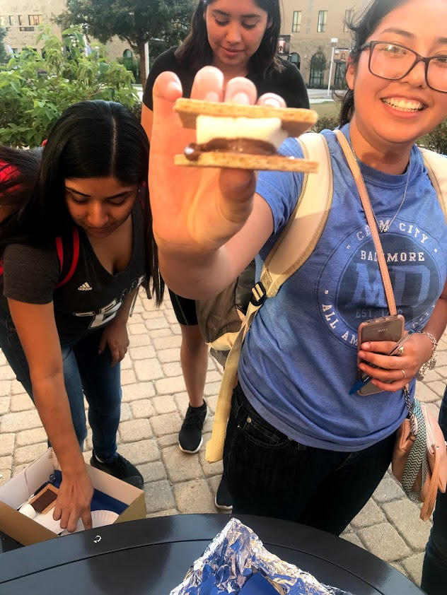
STREAM and Outdoor Learning
Fredreich Froebel (1782-1852) was a social and educational reformer who introduced the idea of kindergarten and the importance of outdoor learning for children
STREAM Education can thrive in outdoor environments by allowing students to explore the outdoor environments so they can identify and design possible solutions for everyday community challenges.

Slide 16
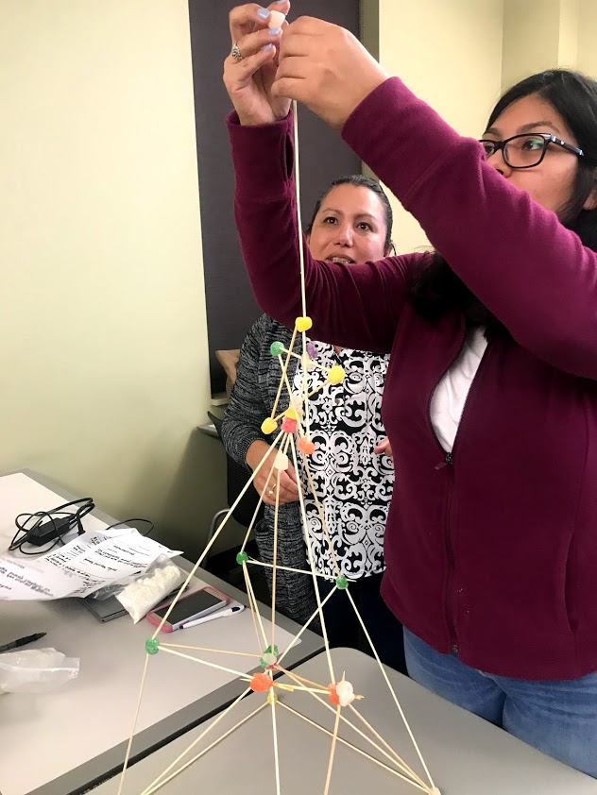

STREAM Preparation for Bilingual and Dual Language Educators
Conclusions
Bilingual Educators should be considered as strong cultural and linguistic
educators who can enhance the opportunities for STEM and STREAM
learning
Support that is explicit to demonstrate for Pre-service bilingual teachers effective practices in STREAM (university course work in STREAM)
Distinguishing practices between lower and upper elementary learning in STREAM for pre-service bilingual teachers
4. Engage in supporting outdoor STREAM learning
Implications
*More future research in finding ways to support pre-service teachers’ development in STREAM learning

Slide 17
Contact Information: esther.garza@tamusa.edu
Thank YOU!!!

