Slide 1
Exploring Student Learning of the Nature of Science through a Culturally Relevant Authentic Science Summer Program
Anthony Bailey, Donna ISD
Noushin Nouri, University of Texas Rio Grande Valley
Angela Chapman, University of Texas Rio Grande Valley

Slide 2
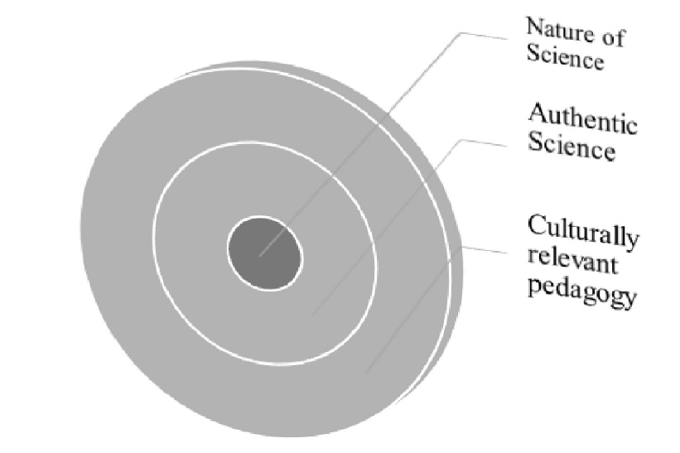
Nature of Science(NOS)
Culturally relevant pedagogy (CRP)
NOS is a rich description of what science is, how it works, how scientists operate as a social group, and how society itself both directs and reacts to scientific endeavors” (McComas, Clough, & Almazroa, 1998, p. 4).
Culturally relevant pedagogy (CRP) is a method of teaching in a cross- or multi-cultural setting that encourages students to relate course content to their cultural background. CRP is based on three tenets: academic success, cultural competence, and sociopolitical consciousness (Ladson-Billings 1995).
Authentic science (NOS)
Authentic science is that which reflects what scientists conduct in everyday practice (Roth,1995).

Slide 3
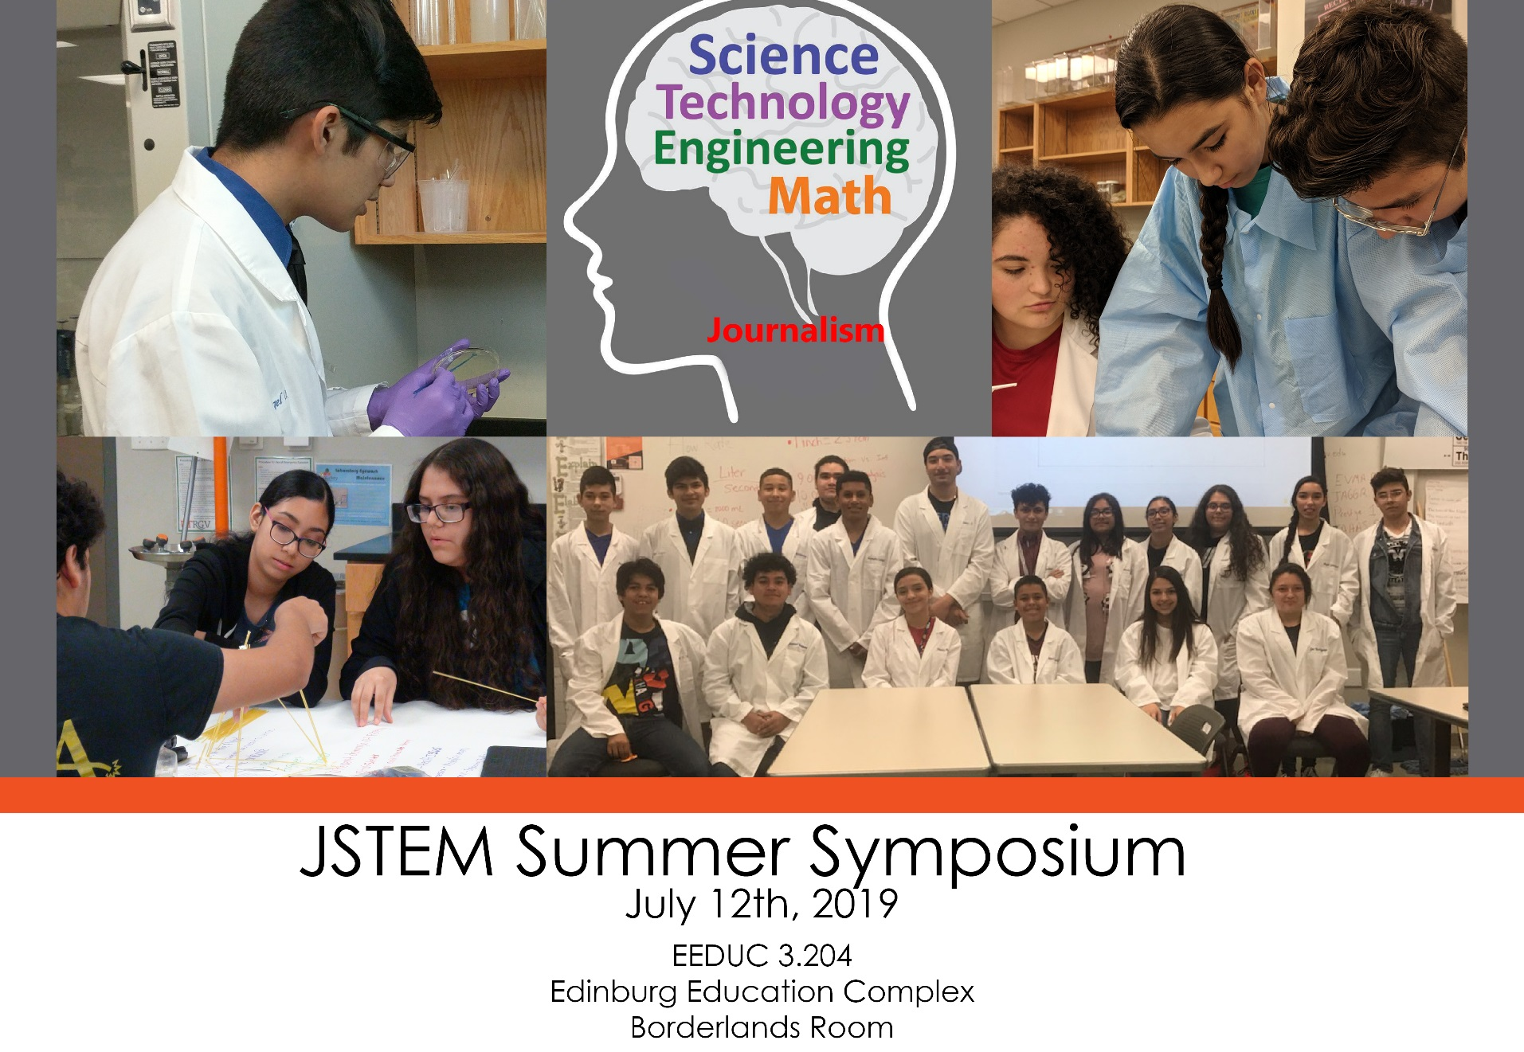

Slide 4
Participant
25 students from 8,9, and 10 grades (11 girls, 14 boys)
8 schools
2 teachers (1 secondary math, 1 secondary biology)
4 UTeach preservice teachers
2 STEM teacher educators

Slide 5
Biosand filter: authentic- relevant- relevant to NOS
Research questions for this presentation:
how to facilitate Learning of the Nature of Science through a Culturally Relevant Authentic Science Summer Program?
To what extent it was effective in improving students' understanding of NOS?

Slide 6
Why emphasizing Nature of Science (NOS)
Research shows without explicit mention to NOS and with doing authentic science students would not learn NOS (Schwartz, Lederman, & Crawford, 2004)

Slide 7
Elements of NOS
Observation/inference
Role of subjectivity
Creativity and imagination
Importance of reporting and sharing data
Importance of scientific community
Socio-cultural embeddedness of science

Slide 8
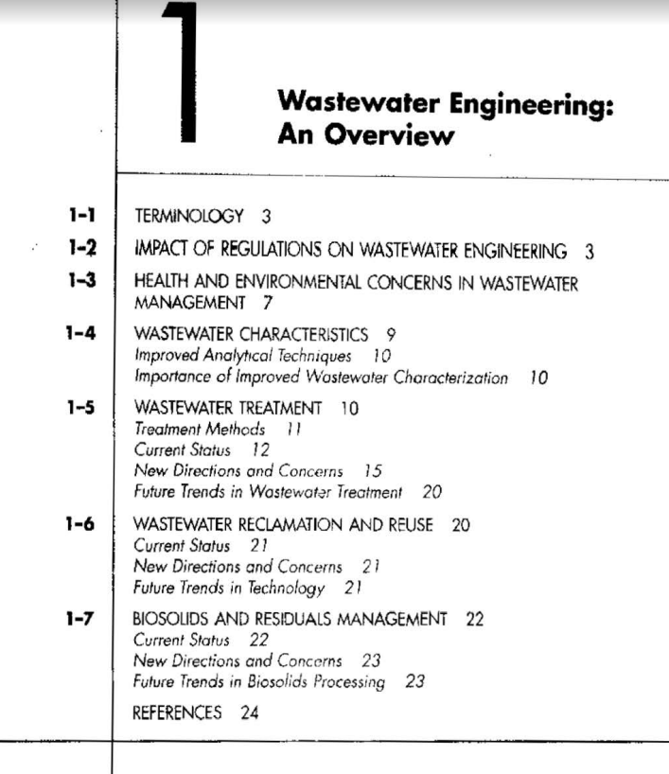
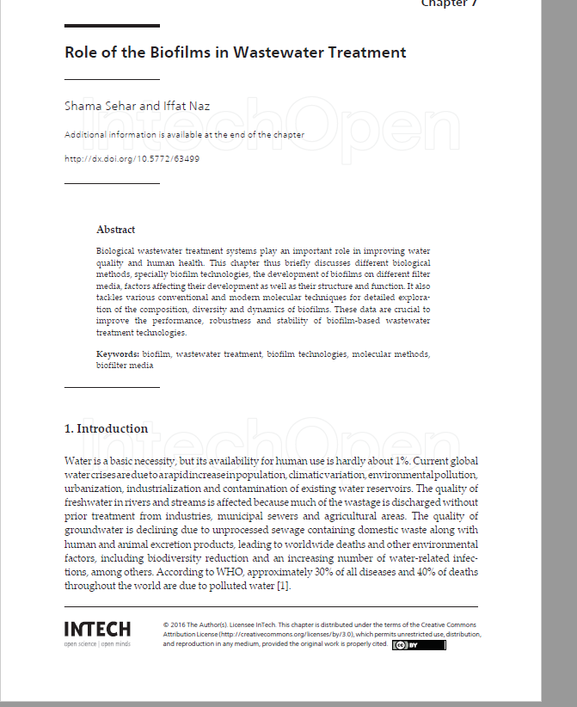
Authentic Science
Doing background research so they have something in mind-subjectivity-theory leaden

Slide 9
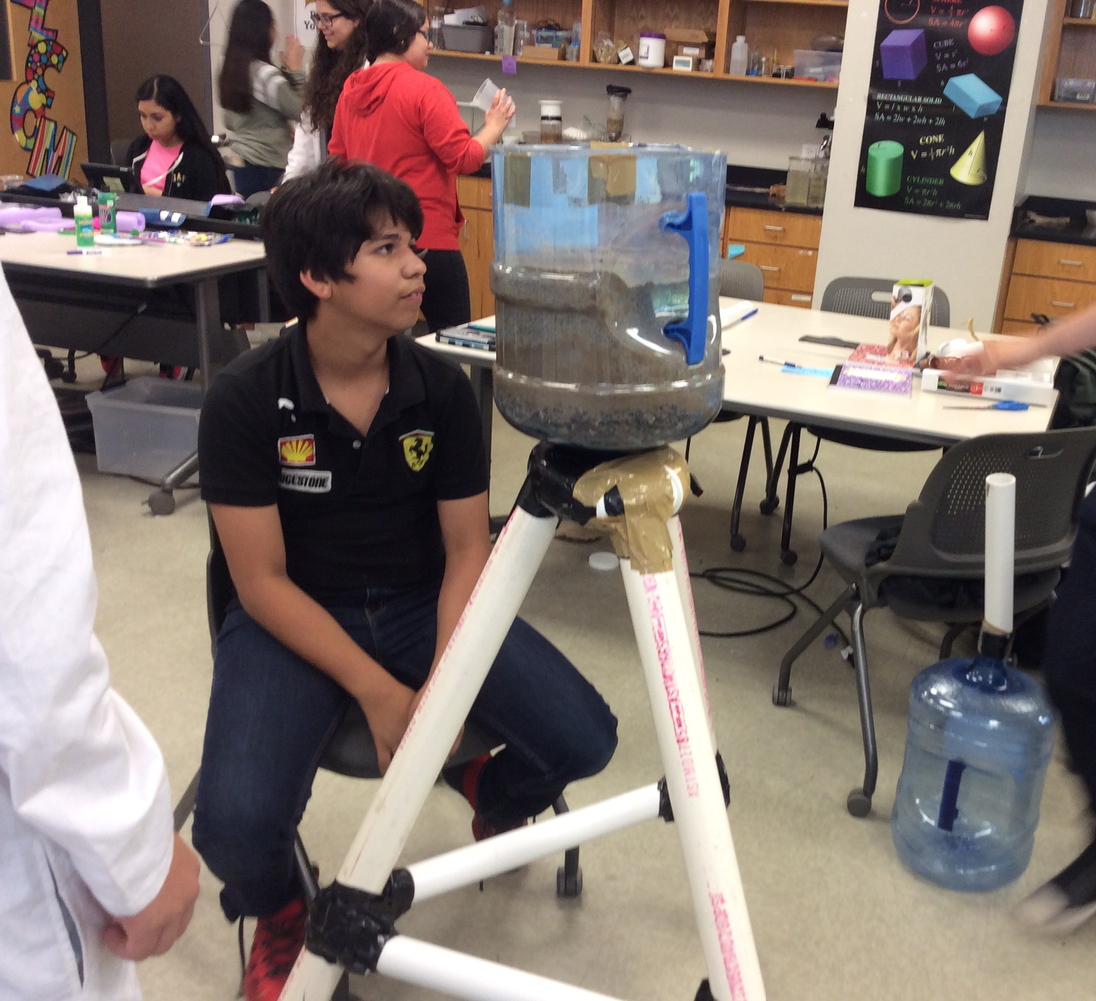
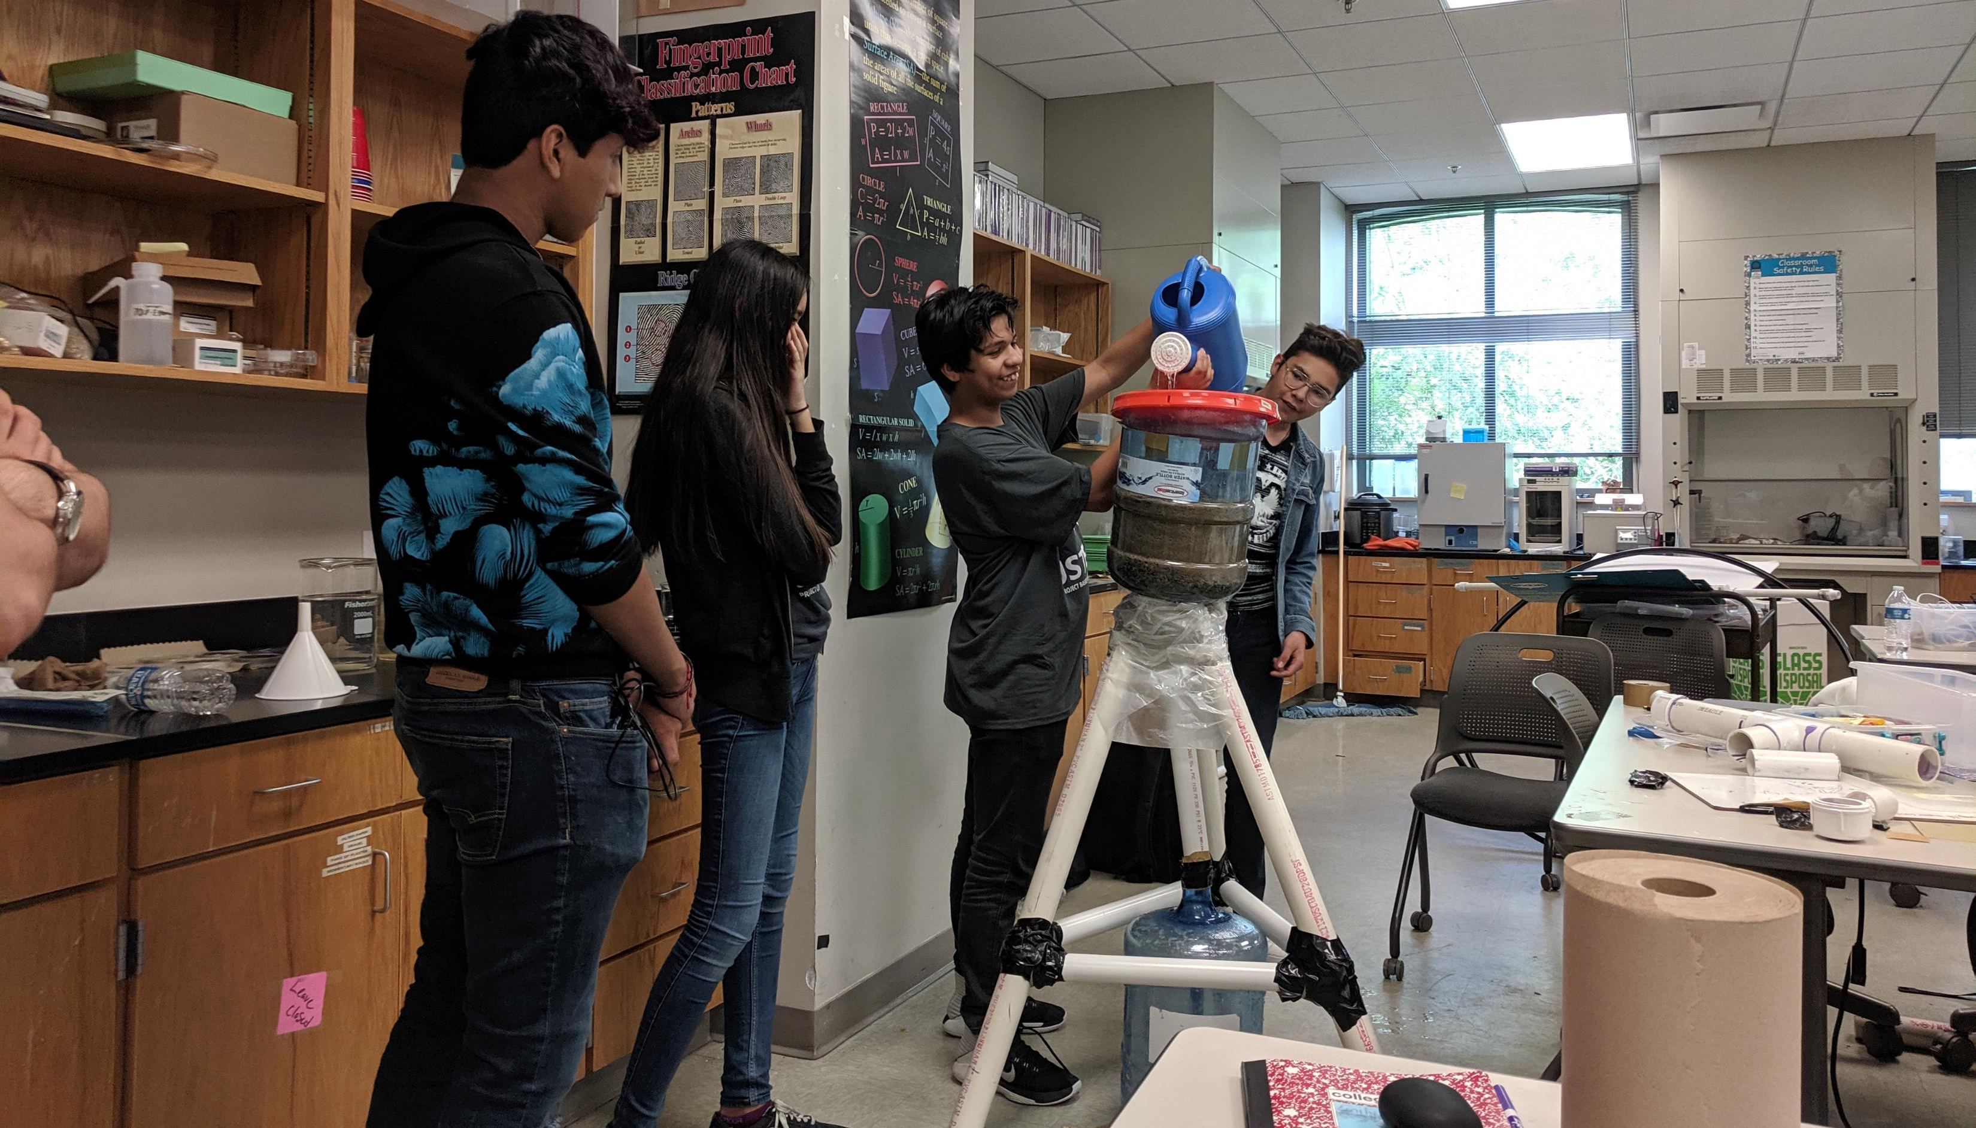
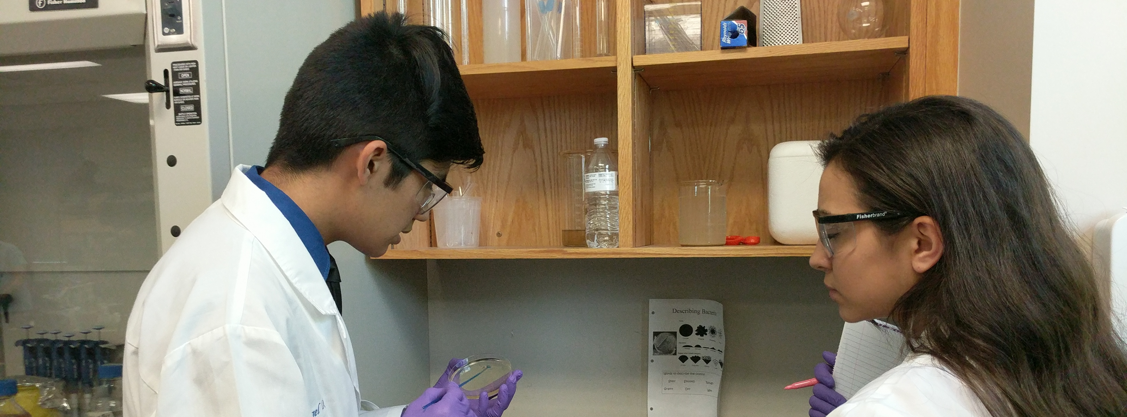
The question, resources, and their connections were related TO THEIR SOCIETY
Many observations and inferences were involved

Slide 10
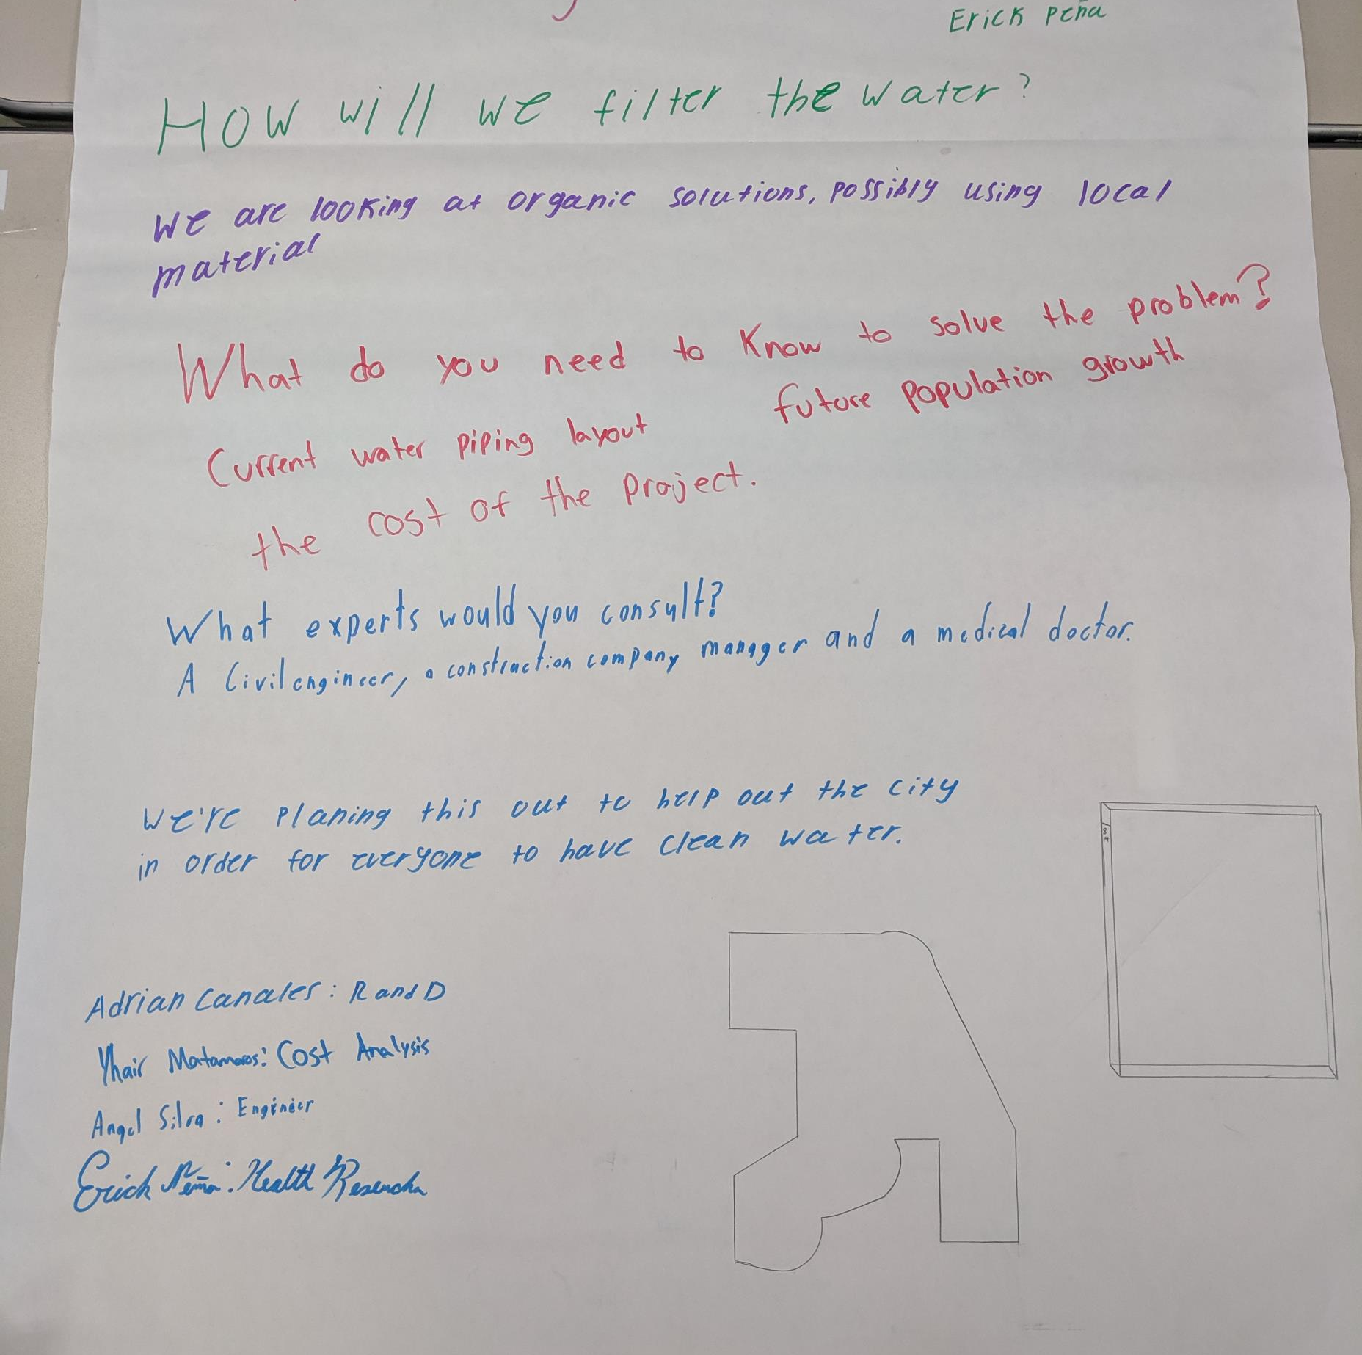
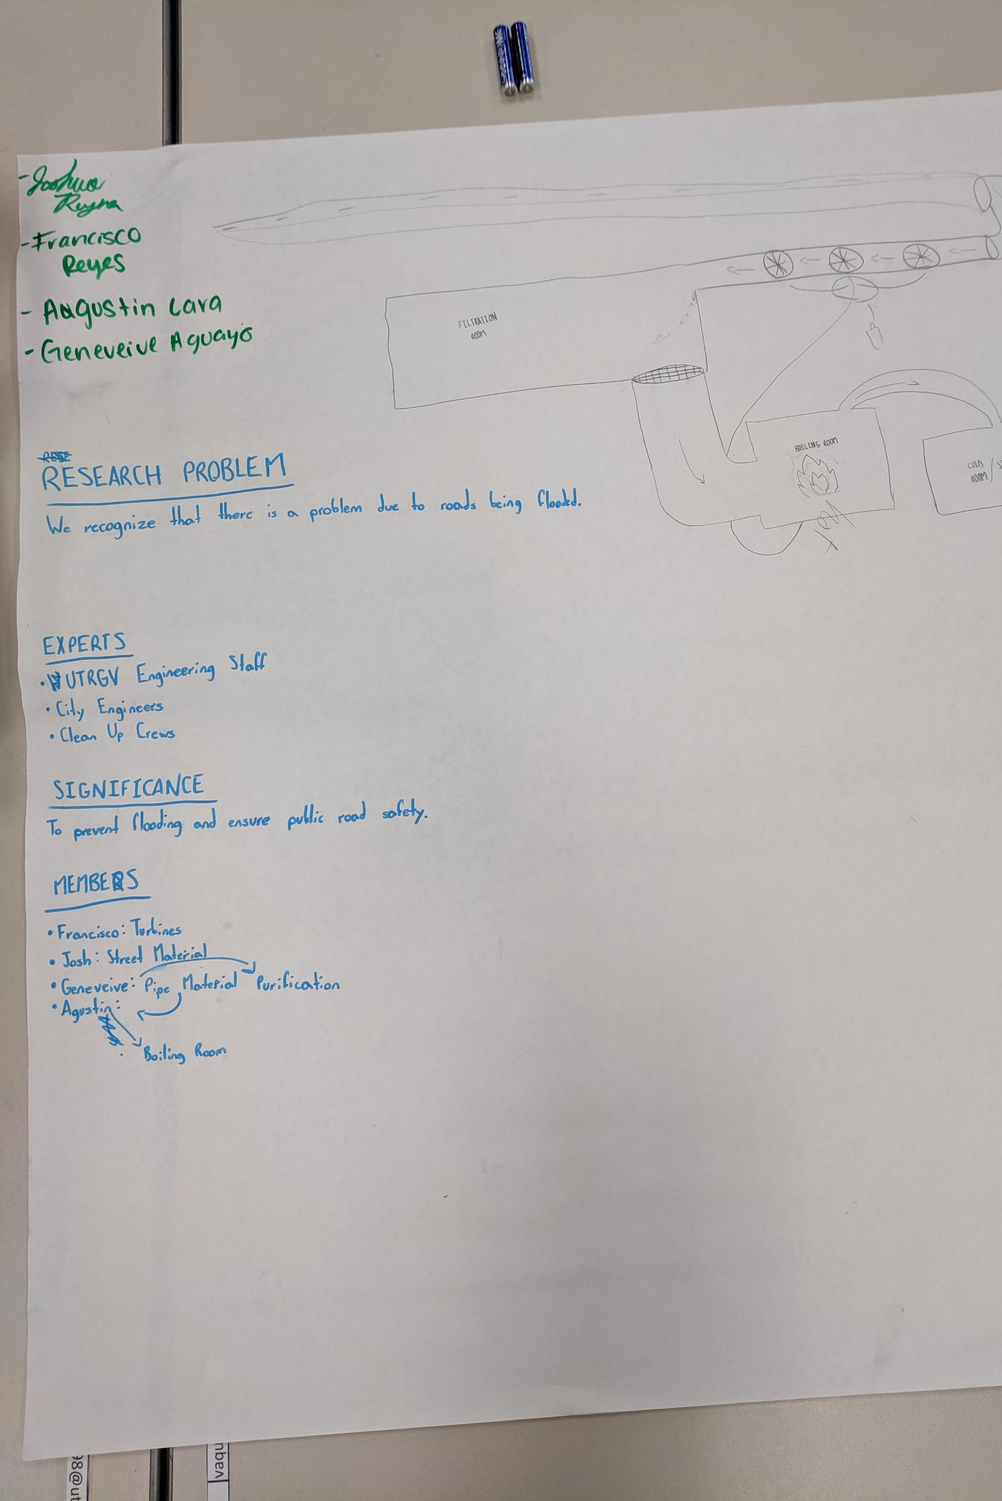
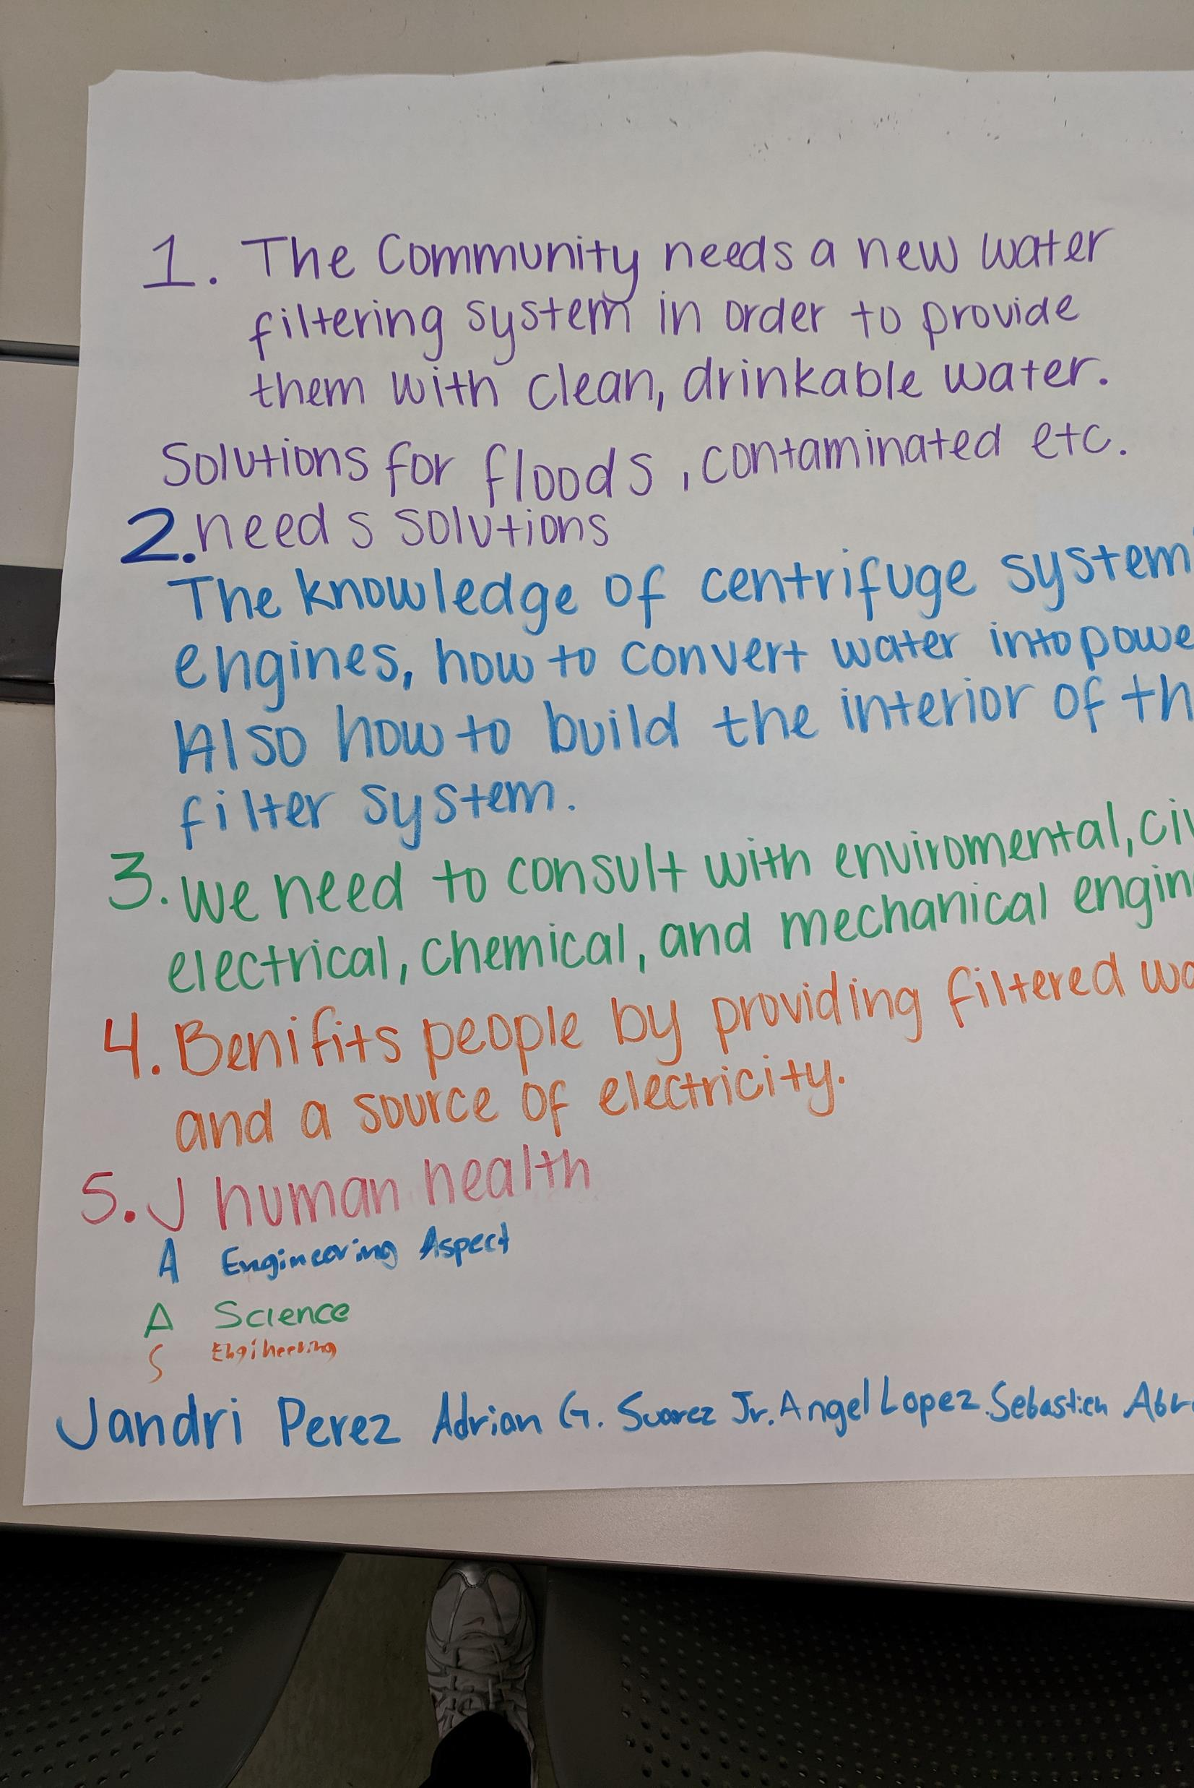
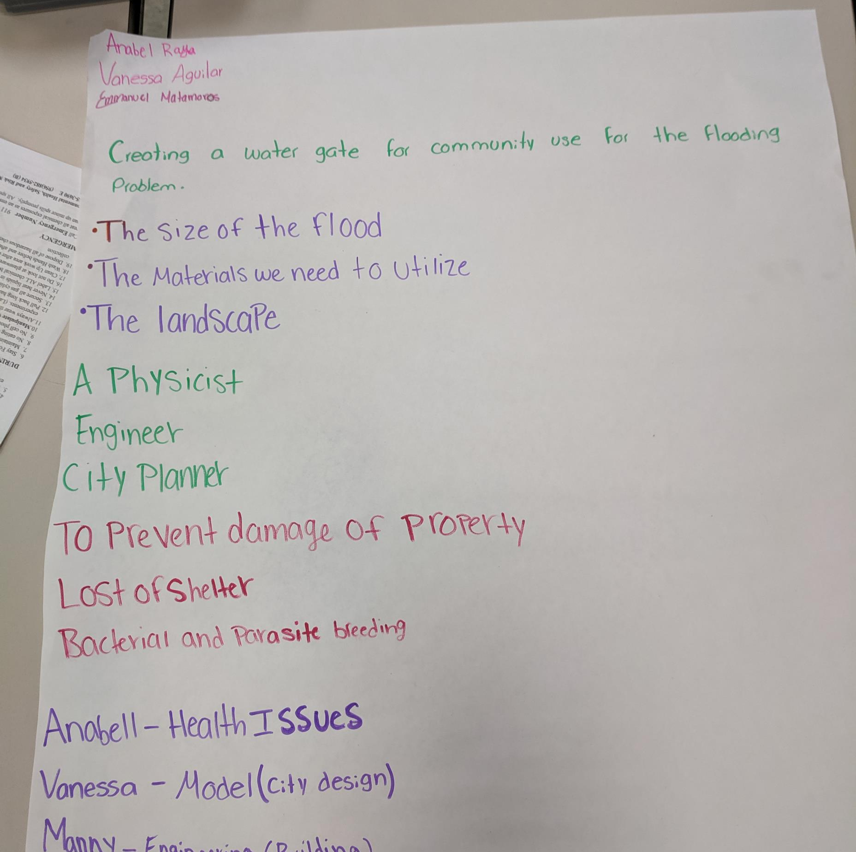
Imagination and creativity were bold

Slide 11
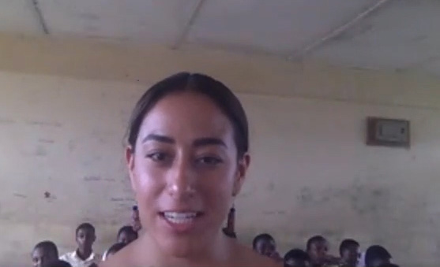
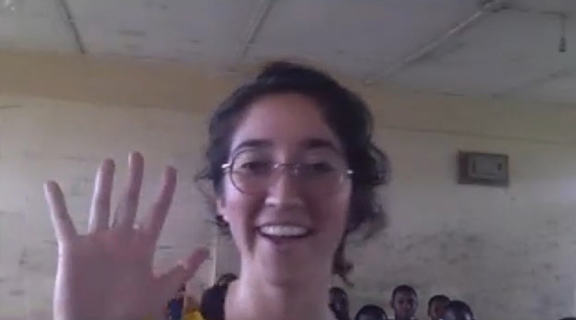
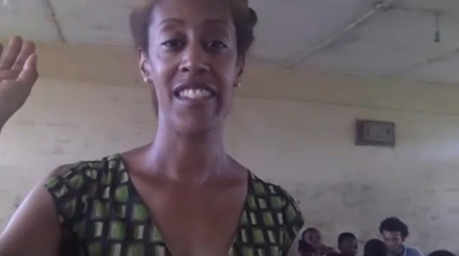
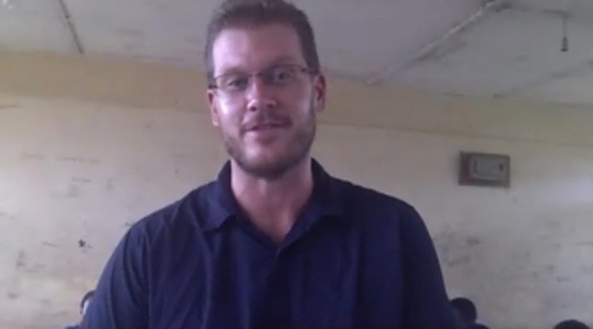
They were connected with scientific community

Slide 12
Results
Pretest / posttest View of NOS questionnaire
Classroom observation/direct discussion with students
5 below
Perfect Attendance:
Most Improved:
Team Leader:
Most imaginative:
Most creative:

