Slide 1

COE and P-16 Integration
Data Summit 2021
Notes:
Dean’s Welcome

Slide 2
Welcome to the 2021 Data Summit!
Welcome faculty, staff, school district officials and other distinguished guests.
Data Summit’s Objective:
To analyze data in order to identify area(s) of inquiry as part of the continuous improvement cycle using multiple measures of data retrieved from data dashboards.
Notes:
Dean Rodriguez (summer activity, SSR, TPDM, Introduce Associate Dean)

Slide 3
Overview of Activities/Agenda
8:30 – 8:45
Dean’s Welcome
8:45
9:00 Overview of Planned Activities, Community Agreements, Ice Breaker
9:00 – 9:30
State of the College
9:30 – 10:00
Data Dashboards (TPDM, CEP, DFI)
10:00 – 10:15
SLO Annual Reporting Process and Requirements
10:15 – 10:25
Coffee Break!
10:25 – 11:00
Scenario #1 Using Dashboard Data Whole Group
11:00 – 11:45
Scenario #2 Program Data Analysis in Breakout Rooms
11:45 – 12:00
Reflections, Next Steps, Exit Tickets
Notes:
Overview: Veronica

Slide 4
Community Agreements
Be honest
This is a safe space to share
Make commitment to each other and to our work
No quick solutions (“solutionitis”); live in problem-space to fully understand it
Learn from each other
Try new tools for processing and engaging in work
Be real with each other
Notes:
Veronica

Slide 5

What do you see?
Notes:
Veronica

Slide 6
What did you see?
If you saw a baby:
You prefer your own company more so than others and don’t exactly feel like going out too often. You shouldn’t feel guilty for who you are, and just enjoy being yourself.
If you saw a couple:
You care a great deal for your friends and would even do absolutely anything for them. At the same time, you do not exactly enjoy hanging out in big groups or going to noisy parties.
If you saw trees:
You are always ready to experience something new and have a bubbly personality. Change is what you love and you just happen to crave it.
Notes:
Veronica

Slide 7
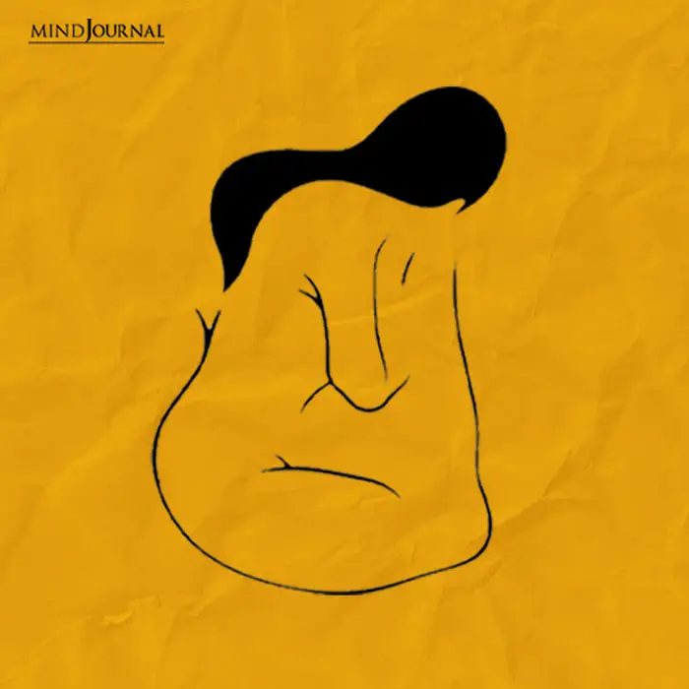
What do you see?
Notes:
Veronica

Slide 8
What did you see?
If you saw the body of a woman:
It implies that your character bend is towards generosity. Those around you admire the positive outlook you have about life. When in a group, your efficiency speaks for itself, and you are a highly motivated individual. You commit yourself to a goal and follow it through.
You are also known for your interpersonal skills. You are sharp at picking up the subtle signals in your surroundings and the emotions of others and how they move their body. You are empathetic and are careful not to hurt anyone by your words.
However, since you get easily affected by the energy around you, you are very selective when it comes to which people you would have around you. You are in balance with your own emotional state and can easily set healthy boundaries when it comes to others.
If you saw the face of a man:
You are good at keeping your emotions and feelings to yourself. Looking at you a person won’t be able to tell even if you are deeply bothered by something. In a group, you are known for your leadership and high energy levels.
You are very analytical and firm in your decisions. Though you might be called easy-going, doesn’t mean you blindly follow the crowd. You are curious and straightforward, and people like to be around you as you have a very strong positive aura.
Notes:
Veronica

Slide 9
State of the College
CEP Enrollment by Term
EPP UG Admit Enrollment by Term
EPP UG Admitted Students by Term
Completers UG & GR (Finishers) by Fiscal Year
Completer Impact Data
  Where are our students teaching
  Where are our students leading
Notes:
Veronica and Luis

Slide 10
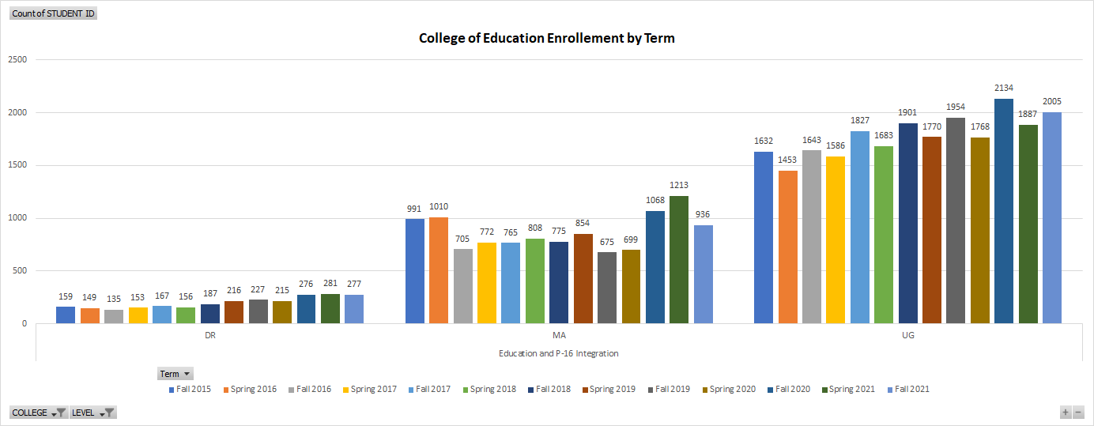
CEP Enrollment by Term
Notes:
Veronica and Luis

Slide 11
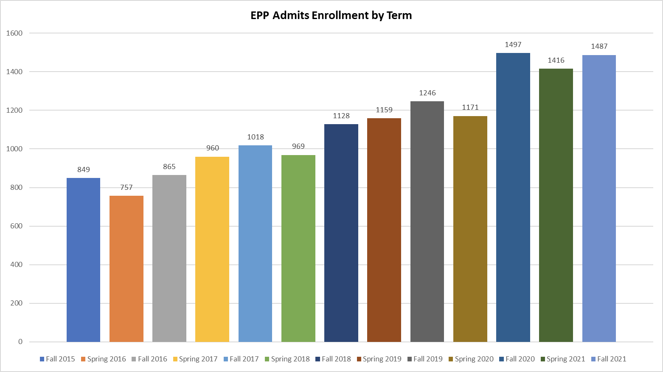
UG EPP Admits Enrolled by Term
Notes:
Veronica and Luis

Slide 12
EPP UG Admissions
 | 2019-2020 |  |  | 2019-2020 Total | 2020-2021 |  |  | 2020-2021 Total
 | Fall 2019 | Spring 2020 | Summer 2020 |  | Fall 2020 | Spring 2021 | Summer 2021 |  | Fall 2021*
High School 7 - 12 | 46 | 85 | 33 | 164 | 58 | 83 | 37 | 178 | 83
Chemistry |  | 3 | 2 | 5 | 1 | 1 | 2 | 4 | 1
Dance | 2 | 4 | 3 | 9 | 3 | 7 | 2 | 12 | 4
English | 18 | 21 | 5 | 44 | 16 | 25 | 12 | 53 | 22
Health |  |  |  |  |  |  | 1 | 1
History | 12 | 8 | 5 | 25 | 11 | 12 | 7 | 30 | 23
Journalism |  | 1 | 2 | 3 |  |  | 1 | 1 | 1
Life Science | 4 | 18 | 6 | 28 | 8 | 7 | 4 | 19 | 7
Mathematics | 4 | 19 | 10 | 33 | 14 | 15 | 3 | 32 | 12
Physics/Mathematics |  |  |  |  | 1 | 2 | 1 | 4
Science |  | 3 |  | 3 |  |  | 1 | 1
Social Studies Composite | 4 | 8 |  | 12 | 3 | 10 | 3 | 16 | 9
Speech | 2 |  |  | 2 | 1 | 4 |  | 5 | 3
Grand Total | 46 | 85 | 33 | 164 | 58 | 83 | 37 | 178 | 83
 | 2019-2020 |  |  | 2019-2020 Total | 2020-2021 |  |  | 2020-2021 Total
 | Fall 2019 | Spring 2020 | Summer 2020 |  | Fall 2020 | Spring 2021 | Summer 2021 |  | Fall 2021*
All Level EC-12 | 41 | 41 | 19 | 101 | 64 | 75 | 18 | 157 | 85
Art | 8 | 8 | 4 | 20 | 13 | 19 | 3 | 35 | 18
Health | 1 | 5 |  | 6 | 3 | 3 | 1 | 7 | 2
Music | 19 | 12 | 7 | 38 | 22 | 21 | 6 | 49 | 26
Physical Education | 10 | 7 | 5 | 22 | 17 | 21 | 3 | 41 | 21
Spanish | 3 | 6 | 2 | 11 | 7 | 9 | 4 | 20 | 13
Theatre |  | 3 | 1 | 4 | 2 | 2 | 1 | 5 | 5
Grand Total | 41 | 41 | 19 | 101 | 64 | 75 | 18 | 157 | 85
 | 2019-2020 |  | 2019-2020 Total | 2020-2021 |  |  | 2020-2021 Total
 | Fall 2019 | Spring 2020 |  | Fall 2020 | Spring 2021 | Summer 2021 |  | Fall 2021*
Elementary EC-6 | 286 | 184 | 470 | 348 | 235 | 1 | 584 | 325
Bilingual | 168 | 119 | 287 | 213 | 145 | 1 | 359 | 207
E.S.L. | 21 | 11 | 32 | 30 | 25 |  | 55 | 45
Early Childhood | 62 | 37 | 99 | 48 | 31 |  | 79 | 2
EC Pk-3 |  |  |  |  |  |  |  | 36
Special Education | 35 | 17 | 52 | 57 | 34 |  | 91 | 35
Grand Total | 286 | 184 | 470 | 348 | 235 | 1 | 584 | 325
 | 2019-2020 |  |  | 2019-2020 Total | 2020-2021 |  |  | 2020-2021 Total
 | Fall 2019 | Spring 2020 | Summer 2020 |  | Fall 2020 | Spring 2021 | Summer 2021 |  | Fall 2021*
Middle School 4 - 8 | 8 | 22 | 8 | 38 | 14 | 28 | 11 | 53 | 4
English | 2 | 6 |  | 8 | 7 | 9 | 2 | 18
Life Science |  |  |  |  | 1 |  |  | 1
Mathematics | 5 | 14 | 6 | 25 | 5 | 16 | 9 | 30 | 3
Science | 1 | 2 | 2 | 5 | 1 | 3 |  | 4 | 1
Grand Total | 8 | 22 | 8 | 38 | 14 | 28 | 11 | 53 | 4
Notes:
Veronica and Luis

Slide 13
EPP
Finishers (Completers)
 | 2019-2020 | 2020-2021*
GR | 41 | 61
Principal as Instructional Leader (EC-12) | 29 | 30
Reading Specialist (EC-12) | 3
School Counselor (EC-12) | 9 | 23
Superintendent (EC-12) |  | 8
 | 2019-2020 | 2020-2021*
UG | 372 | 697
Art (EC-12) | 9 | 24
Bilingual Education Supplemental-Spanish | 137 | 284
Chemistry (7-12) | 3 | 4
Core Subjects (EC-6) | 59 | 46
Core Subjects with STR (EC-6) |  | 33
Dance (6-12) | 1 | 5
English as a Second Language Supplemental | 5 | 15
English Language Arts and Reading (4-8) | 5
English Language Arts and Reading (7-12) | 16 | 36
English Language Arts and Reading with STR (4-8) |  | 4
Health (EC-12) | 2 | 7
History (7-12) | 7 | 19
Languages Other Than English - Spanish (EC-12) | 5 | 10
Life Science (7-12) | 7 | 30
Mathematics (4-8) | 14 | 25
Mathematics (7-12) | 21 | 28
Music (EC-12) | 32 | 37
Physical Education (EC-12) | 13 | 25
Physics/Mathematics (7-12) | 2 | 3
Science (4-8) |  | 7
Science (7-12) |  | 1
Social Studies (7-12) | 5 | 12
Special Education (EC-12) | 27 | 41
Theatre (EC-12) |  | 1
Speech (7-12) | 2
Pursuing a Certification
Notes:
Veronica and Luis

Slide 14
Professional Certification Impact Data
Role in Districts by Certification in 2015-2021
ROLE IN SCHOOLS | Educational Diagnostician (EC-12) | Legacy Master Reading Teacher (EC-12) | Principal (EC-12) | Principal as Instructional Leader (EC-12) | Reading Specialist (EC-12) | School Counselor (EC-12) | Superintendent (EC-12) | Grand Total
ASSISTANT PRINCIPAL |  |  | 53 | 1 |  | 1 | 7 | 62
BUSINESS SERVICES PROFESSIONAL |  |  |  |  |  | 1 |  | 1
DIST INSTR PGM DIR OR EXC DIR |  |  | 7 |  |  |  | 4 | 11
EDUCATIONAL DIAGNOSTICIAN | 63 |  |  |  |  |  |  | 63
INSTRUCT MATERIALS COORDINATOR |  |  | 3 |  |  |  |  | 3
OTH CAMP EXEMPT PROFESSNAL AUX |  |  | 15 | 3 |  | 3 |  | 21
OTHR LEA EXEMPT PROFESSNAL AUX | 4 | 1 | 3 |  |  | 1 | 2 | 11
PRINCIPAL |  |  |  |  |  | 1 | 14 | 15
RESEARCH/EVALUATN PROFESSIONAL |  |  | 1 |  |  |  |  | 1
SCHOOL COUNSELOR | 5 |  | 1 |  |  | 41 |  | 47
SUPERINTENDENT/CAO/CEO/PRESDNT | 1 |  |  |  |  |  | 1 | 2
TEACHER | 39 | 4 | 128 | 22 | 14 | 40 | 2 | 249
TEACHER FACILITATOR | 2 | 2 | 19 |  | 2 |  | 1 | 26
TEACHER SUPERVISOR |  |  | 3 |  |  |  |  | 3
Grand Total | 114 | 7 | 233 | 26 | 16 | 88 | 31 | 515
Notes:
Veronica and Luis

Slide 15
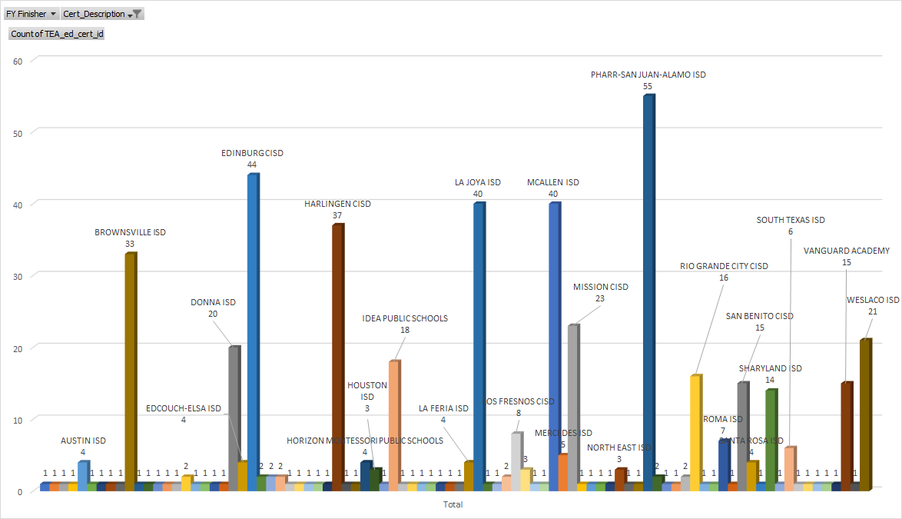
Professional Certifications Impact Data (Districts Hired)
Notes:
Veronica and Luis

Slide 16
2020-2021
Teacher Certification Impact Data
(Hire as Teacher by Certification)
Certification Program | # TEACHERS HIRED
Art (EC-12) | 33
Bilingual Education Supplemental-Spanish | 348
Bilingual Generalist-Spanish (EC-6) | 13
Chemistry (7-12) | 8
Core Subjects (EC-6) | 161
Dance (6-12) | 5
Dance (8-12) | 3
English as a Second Language Supplemental | 11
English Language Arts and Reading (4-8) | 18
English Language Arts and Reading (7-12) | 55
Generalist (EC-6) | 45
Health (EC-12) | 2
History (7-12) | 22
Journalism (7-12) | 1
Languages Other Than English - Spanish (EC-12) | 21
Life Science (7-12) | 46
Mathematics (4-8) | 54
Mathematics (7-12) | 82
Music (EC-12) | 137
Physical Education (EC-12) | 63
Physical Science (6-12) | 1
Physics/Mathematics (7-12) | 5
Science (4-8) | 6
Science (7-12) | 10
Social Studies (7-12) | 45
Special Education (EC-12) | 110
Superintendent (EC-12) | 2
Theatre (EC-12) | 1
Grand Total | 1308
Finishers
2015-2016 - 2019-2020
Notes:
Veronica and Luis

Slide 17
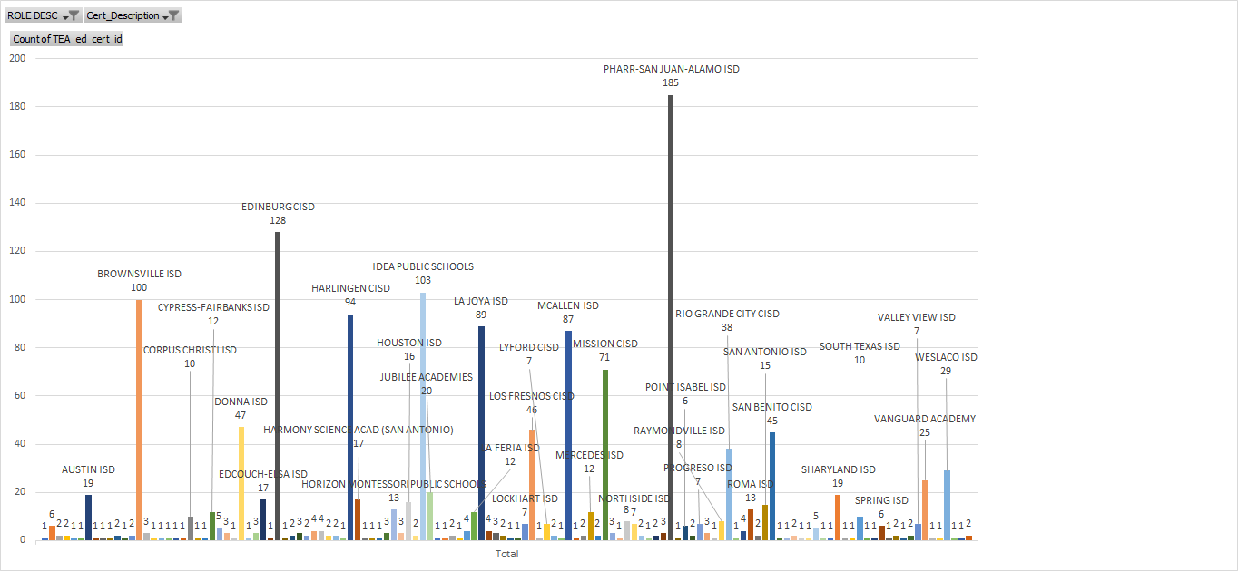
Teacher Certification Impact Data (Districts Hired)
Notes:
Veronica and Luis

Slide 18
Quality Assurance System
CAEP Standard 5:
The provider maintains a quality assurance system comprised of valid data from multiple measures, including evidence of candidates’ and completers’ positive impact on P-12 student learning and development. The provider supports continuous improvement that is sustained and evidence-based, and that evaluates the effectiveness of its completers. The provider uses the results of inquiry and data collection to establish priorities, enhance program elements and capacity, and test innovations to improve completers’ impact on P-12 student learning and development.
Notes:
Veronica

Slide 19
Culture of Inquiry
One of our 3 priorities in the College of Education and P-16 Integration.
When data are either not accessible or compartmentalized, it creates silos that limit collaboration and communication (Gummer, 2019; Young, Foster, & Peck, 2020).
The Teacher Preparation Data Model (TPDM) integrates data from multiple systems to obtain a complete picture of teacher candidates’ progress from admission to an educator preparation program (EPP) to effectiveness in the first year of teaching.
Notes:
Veronica

Slide 20
Early Adopters of the ed-Fi Teacher Prep Data Model
UTRGV is a key partner in the collaborative dashboard development process, participating with the aim of creating dashboards and reporting structures that allow regular access to and review of data.
Notes:
Alma and Luis M.

Slide 21
Goals
Integrate data from multiple systems and partners to obtain a complete picture of candidates’ progress.
Align high-impact data across UTRGV’s systems.
Establish meaningful opportunities for improvement through the regular review of data and the identification of common strengths and areas for growth.
Notes:
Alma and Luis

Slide 22
Teacher Preparation Data Model
Notes:
Alma and Luis

Slide 23

CEP Teacher Preparation Dashboards
With support from the Michael & Susan Dell Foundation, UTRGV is implementing a data standard and dashboards to enable stakeholders to address key questions and drive action for improvement
Are we effectively preparing Teacher Candidates to be quality teachers?
What do schools say about our students?
Who is enrolled?
Are our Teacher Candidates and Graduates having a positive impact on schools?
How are students performing?
Where are our graduates teaching?
Notes:
Alma and Luis

Slide 24
How to access the Power BI and College Dashboards?
Notes:
Luis Machuca: Share Out latest enrollment growth, grad rates, TExES pass rates, share completer data,

Slide 25
New Assessment Framework 2017-2022
Notes:
Veronica and Luis A.

Slide 26

Let’s take a break!

Slide 27

Whole Group Data Analysis: Sample Scenario
Notes:
Initial Programs Whole Group Sample Scenario

Slide 28
COLLEGE | LEVEL | DEPARTMENT | PROGRAM DESCRIPTION | Fall 2020 | Fall 2021
Education and P-16 Integration | Doctoral | Organization and School Leadership | Educational Leadership | 84 | 80
 |  | Teaching and Learning | Curriculum and Instruction | 192 | 197
 | Masters | Bilingual and Literacy Studies | Bilingual Education (MEd) | 32 | 37
 |  |  | Reading and Literacy | 22 | 27
 |  | Counseling | Counseling | 203 | 209
 |  | Human Development and School Services | Board Certified Beh Analy Cert | 7 | 13
 |  |  | Early Childhood Education | 44 | 25
 |  |  | School Psychology | 70 | 76
 |  |  | Special Education - accel online | 161 | 112
 |  | Organization and School Leadership | Educational Leadership | 217 | 177
 |  |  | Principal Certification | 36 | 12
 |  |  | Superintendent Certification |  | 4
 |  |  | Teacher Leadership | 43 | 11
 |  | Teaching and Learning | Curriculum & Instruction - Acc | 83 | 104
 |  |  | Educational Technology-Acceler | 133 | 116
 |  |  | E-Learning Certificate (Accel) | 2 | 2
 |  |  | Online Instruct Designer Cert | 4 | 6
 | Undergrad | Human Development and School Services | Early Care and Early Childhood | 315 | 355
 |  | Teaching and Learning | Interdisciplinary Studies | 1818 | 1650
Grand Total |  |  |  | 3465 | 3213

Slide 29
Breakouts: Program Data Analysis
Breakout by Departments and Programs for Data Analysis (Program Coordinators)
Tasks:
Review assessment data related to program SLO’s.
Engage in a discussion regarding continuous improvement using the guiding questions.
Identify an area for inquiry.
Provide a rationale for the area of inquiry.
Schedule a program faculty meeting to continue data analyses and program report writing to meet October and November deadlines.

Slide 30

SLO: Assessment Reports, Due Dates, and Links
The 2020-2021 Annual Assessment Results Report will be due by Oct. 1, 2021. This report requires assessment coordinators to provide the results for the outcomes that were assessed from September 1, 2020 to August 31, 2021 and the actions the program/department has taken or will take to seek further improvements for each outcome.
Coordinators will be able to submit this report in either Tk20 (the existing system) or Watermark Planning and Self-Study (the redesigned system). More information and training will be provided on this system later in the summer for those who are opting-in.
Notes:
Luis Azpeitia

Slide 31
Assessment Reports, Due Dates, and Links
The 2019-2021 Improvement Report will be due by Nov. 1, 2021. This report requires coordinators to reflect over the past two years (2019-2020 and 2020-2021) and provide a narrative summary of the actions taken to seek improvements to the expected outcomes and/or to the assessment process.
Note: this template remains unchanged since the last time it was submitted in 2019. Download and complete the Improvement Report Template and submit it via email to assessment@utrgv.edu by the due date.
Notes:
Luis Azpeitia

Slide 32
Assessment Reports, Due Dates, and Links
The 2021-2025 Comprehensive Assessment Plan will be due by Dec. 1, 2021. The updated template is significantly streamlined (from 2017) and requires coordinators to identify the essential components of the assessment plan that will be implemented during the next four years (2021-2022; 2022-2023; 2023-2024; 2024-2025).
Academic programs will need to also complete a curriculum map to identify how the courses align to the program SLOs. Download and complete the Comprehensive Assessment Plan Template and submit it via email to assessment@utrgv.edu by the due date.
Notes:
Luis Azpeitia

Slide 33
SLO Annual Reporting Process and Requirements
Resources for SLO Report: https://www.utrgv.edu/excellence/resources/index.htm#item2
Annual Report Rubric: Comprehensive Assessment Plan Rubric
Due Dates:
September 15th : Upload draft into Tk20
October 1st: Submit Completed report into Tk20 for meeting
UTRGV Office of Accountability and Institutional Excellence requirements
If you have questions contact: Veronica Estrada or Luis Azpeitia, Assessment Coordinator
Notes:
Luis Azpeitia

Slide 34
Reflection/Closure
Share an area for inquiry. Why was it selected?

Slide 35

Looking forward….
Notes:
SSR revisions, prep for mock CAEP Visit in January with consultant; prep for CAEP visit in March, continued assessment cycles and data gathering.

Slide 36

To Do: Fall 2021 and Spring 2022
CAEP Writing Team: Self-Study Revisions and Resubmission
Fall 2021: Preparation for mock CAEP Visit in January with consultant
Spring 2022: Preparation for CAEP visit in March 2022
Continuous data gathering for upcoming assessment cycles and movement towards continuous program improvements

Slide 37

Thank you!

