Slide 1

COE and P-16 Integration
Data Summit 2020
James A. Telese, Associate Dean for Assessment and Accreditation
Jesus ”Chuey” Abrego, Chair COE and P-16 Integration Assessment Committee
Luis Machuca, Systems Analyst
Luis Azpeitia, Assessment Coordinator

Slide 2
Welcome to the 2020 Data Summit!
Welcome faculty, staff, school district officials and other distinguished guests.
Data Summit’s Objective:
To analyze data in order to identify area(s) of inquiry as part of the continuous improvement cycle.

Slide 3
Overview of Activities/Agenda
9:00-9:10 Overview of Planned Activities
9:10-9:20 Quality Assurance System Overview
9:20-9:35 Continuous Improvement Framework
9:35-10:00 Data Dashboards (TPDM, CEP, DFI)
10:00-10:20 SLO Annual Reporting Process and Requirements
10:20-11:15 Breakout by Department/Program for Data Analysis
11:15-11:30 Reflection Closure

Slide 4
Quality Assurance System
CAEP Standard 5:
The provider maintains a quality assurance system comprised of valid data from multiple measures, including evidence of candidates’ and completers’ positive impact on P-12 student learning and development. The provider supports continuous improvement that is sustained and evidence-based, and that evaluates the effectiveness of its completers. The provider uses the results of inquiry and data collection to establish priorities, enhance program elements and capacity, and test innovations to improve completers’ impact on P-12 student learning and development.

Slide 5
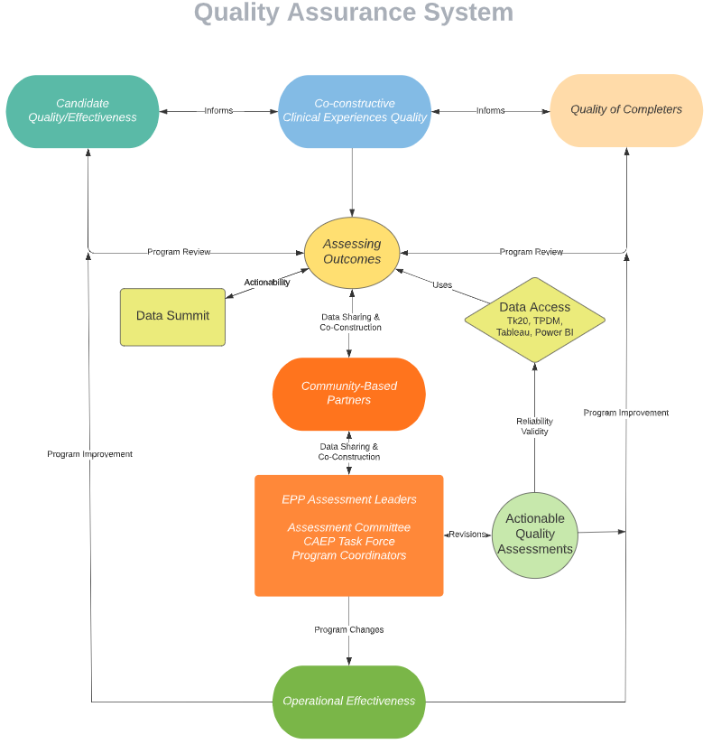
Quality Assurance System

Slide 6

Quality
“Do what you say you're going to do. And try to do it a little better than you said you would.”
Jimmy Dean

Slide 7
COE and P-16 Integration Assessment Process

Slide 8
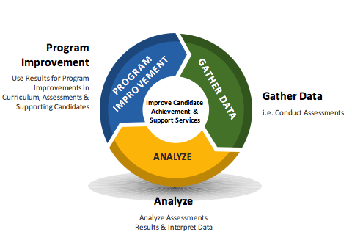
Continuous Improvement Cycle together with
DFI CI Framework
Implementation and Assess Efficacy
ID Area for Inquiry
Collecting Data
Identifying Causes
Assessing Current Reality
Identifying Causes
Develop a Theory of Action
Planning for Action
Analyze
Program Improvement
Gather Data
i.e. Conduct Assessments
Use Results for Program Improvements in Curriculum, Assessments & Supporting Candidates
PROGRAM
IMPROVEMENT
GATHER DATA
Improve Candidate
Achievement &
Support Services
ANALYZE
Analyze Assessments Results & Interpret Data

Slide 9
Culture of Inquiry
One of our 3 priorities in the College of Education and P-16 Integration.
When data are either not accessible or compartmentalized, it creates silos that limit collaboration and communication (Gummer, 2019; Young, Foster, & Peck, 2020).
The Teacher Preparation Data Model (TPDM) integrates data from multiple systems to obtain a complete picture of teacher candidates’ progress from admission to an educator preparation program (EPP) to effectiveness in the first year of teaching.

Slide 10
Teacher Preparation Data Model
In 2017 UTRGV began working with UPD Consulting to conduct a data diagnostic to uncover existing challenges in data management, reveal opportunities for improvement, and diagram future/desired state data systems. UPD proposed key recommendations including:
  Adopt the Ed-Fi Teacher Prep Data Model (TPDM) and implement a cloud-hosted Ed-Fi TPDM Operational Data Store (ODS).
  Configure the Ed-Fi API and Bulk Loader to load data from UTRGV sources and state and district partners.
  Implement data share agreements to routinely and securely receive reports from partner districts.
  Participate in collaborative EPP data visualization and reports development to display data from the UTRGV Ed-Fi TPDM ODS.
  Establish formal dashboard development and data governance processes to gain stakeholder feedback and guide the creation of dashboards.

Slide 11
Goals
Integrate data from multiple systems and partners to obtain a complete picture of candidates’ progress.
Align high-impact data across UTRGV’s systems.
Establish meaningful opportunities for improvement through the regular review of data and the identification of common strengths and areas for growth.

Slide 12
Early Adopters of the ed-Fi Teacher Prep Data Model
UTRGV is a key partner in the collaborative dashboard development process, participating with the aim of creating dashboards and reporting structures that allow regular access to and review of data.
  Relay Graduate School of Education
  US Prep

Slide 13

CEP Teacher Preparation Dashboards
With support from the Michael & Susan Dell Foundation, UTRGV is implementing a data standard and dashboards to enable stakeholders to address key questions and drive action for improvement
Are we effectively preparing Teacher Candidates to be quality teachers?
What do schools say about our students?
Who is enrolled?
Are our Teacher Candidates and Graduates having a positive impact on schools?
How are students performing?
Where are our graduates teaching?

Slide 14
Teacher Preparation Data Model

Slide 15
Links to Dashboards:
TPDM Dashboard
UG CEP Dashboard (in house)
GR CEP Dashboard (in house)
CIS Dashboard (Deans for Impact)

Slide 16
Guiding Questions: Identifying an Area for Inquiry
Purpose: to guide the writing of SLO Annual Report
Programs identify and prioritize an area for inquiry related to candidate learning and development. (What is in need of improvement?)
  What is a program outcome connected to candidate learning and performance that we collectively care about?
  What measure(s) will tell us something about this outcome (i.e., the extent to which candidate learning and performance has improved) and is meaningful to different program stakeholders?

Slide 17
Guiding questions: Assessing Current Reality
Programs examine multiple sources of evidence to better understand areas of strength and opportunities for growth with respect to candidate knowledge and skill in the identified area for inquiry.
What patterns or inconsistencies do we notice in the data?
What gaps exist in the outcomes examined?
What other data might we look at to triangulate our findings?
Based on the data, what areas of strength and areas for growth emerge?
Which areas of strength and/or growth do we want to learn more about?

Slide 18
Guiding Questions: Identifying Root Causes
Programs surface root causes related to an identified area for improvement and engage a broad group of stakeholders to brainstorm and prioritize potential root causes.
What are potential root causes of the identified area for growth?
What information might we collect to test our hypotheses?
How do different stakeholders experience and interpret this issue?
What does the evidence suggest are the likely root causes?

Slide 19
Guiding questions: Developing a Theory of Action
Programs design an intervention to address an identified root cause and develop a theory of action that articulates how they expect this intervention to improve the outcome of interest.
How have other programs tackled this issue? What does research tell us has
worked before?
What might we try to address the underlying root causes of this issue?
How widely will we pilot this intervention? With whom? Why?
What evidence will we collect to test our theory of action? Measured how? When?

Slide 20
Guiding questions: Planning for Action
Programs outline a detailed plan to implement their improvement strategy, gather evidence of progress, and assess overall efficacy.
What steps do we need to take? Who will take them? By when?
What resources will we need?
How feasible is this plan? What are the risks and how will we account for them?
How and to whom will we communicate about the pilot rationale and process?
When will we come together to review progress?

Slide 21
Guiding questions: Implementation and Assessing Efficacy
Programs implement their improvement plans and gather evidence to monitor progress and assess the efficacy of their intervention. Programs are encouraged to use evidence to refine their implementation plans at multiple points and to reflect on and document their learning to inform future improvement cycles.
What are we learning about implementation from different stakeholders? What has worked well and what hasn’t?
What do initial data tell us? Do they suggest a need for refinement of the intervention? If so, what refinements do we need to make, by when?
What do the results mean for candidates? For individuals’ practice? For our program?

Slide 22
SLO Annual Reporting Process and Requirements
Resources for SLO Report: https://www.utrgv.edu/excellence/resources/index.htm#item2
Annual Report Rubric: Comprehensive Assessment Plan Rubric
Due Dates:
September 15th : Upload draft into Tk20
October 1st: Submit Completed report into Tk20 for meeting UTRGV Office of Accountability and Institutional Excellence requirements
If you have questions contact: Associate Dean of Assessment and Accreditation or Luis Azpeitia, Assessment Coordinator

Slide 23
Continuous Improvement Form
Continuous Improvement Form is available in SharePoint.
The purpose of this form is to document that data are used to inform programmatic, curricular, assessment, and or course changes, based on the analysis of the data. Continuous improvement is critical to the College of Education and P-16 Integration quality assurance system. It is important to be reflective and deliberate in our work in preparing highly qualified educators /professionals. Upload this document to the CAEP SharePoint Site in the folder Continuous Improvement.
Check: ___Recommendation ___Approved Change
Description of Change; Evidence to Support Change; Rationale for the Change.
Attach data or evidence to support the change.

Slide 24
Data Analysis
Breakout by Department for Data Analysis (Program Coordinators)
Tasks:
Review assessment data related to program SLO’s.
Engage in a discussion regarding continuous improvement using the guiding questions.
Identify an area for inquiry.
Provide a rationale for the area of inquiry.
Complete the Continuous Improvement form (upon completion send to luis.azpeitia@utrgv.edu).

Slide 25
Reflection/Closure
Share an area for inquiry. Why was it selected?

