Slide 1

Fall 2017
Data Summit
Welcome!

Slide 2
Agenda
Welcome
Overview of Unit Level Data
Data Review and Reflection by Program
Working Lunch
Share Out
Closing

Slide 3
Access to Data
Tableau
Tk20
Data Dashboard

Slide 4
Overview of Unit Level Data
OEPA
Unit Key Assessments

Slide 5
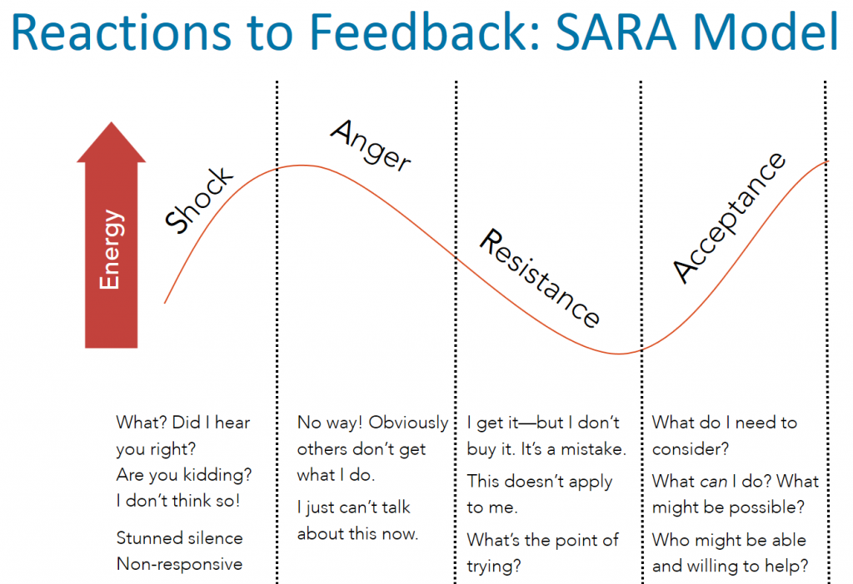

Slide 6
OEPA
John Jauregui

Slide 7
Data Review and Reflection
Small group work at the program level
  Counseling – Room 1.132
  OSL – Room 2.120
  T&L, BLS, and HDSS – Look for your table
Access data from Tk20
Access Data Review and Reflection Template from Tk20
Program Coordinators will facilitate discussion and record reflections
Be prepared to share out

Slide 8
Access to data in Tk20
Luis Machuca

Slide 9
Unit Assessments
Alma D. Rodríguez

Slide 10
TRIPOD 2-Year Comparison
Fall 2015 to Spring 2017
*please attend to n size for individual programs as generalizations are difficult to make if n is too small

Slide 11

Improved student performance depends on strengthening three legs of our teaching practice
Content
Pedagogy
Relationships
What should we teach? Does each teacher have deep knowledge of the curriculum?
How should we teach? Does each teacher use effective instructional techniques?
Are we a community? Do students and teachers care about, inspire, and motivate each other?

Slide 12
TRIPOD Domain Areas
Personal Support
Cultivating teacher-student relationships and a classroom climate where students feel valued and welcomed
Care: Show concern for students’ emotional and academic well-being
• Build relationships
• Address learning needs
Confer: Encourage and value students’ ideas and views
• Respect perspectives
• Promote discussion
• Invite input
Curricular Support
Teaching in ways that make the curriculum engaging, accessible, and coherent
Captivate: Spark and maintain student interest in learning
• Design stimulating lessons
• Facilitate active participation
Clarify: Help students understand content and resolve confusion
• Explain clearly
• Check for understanding
• Provide constructive feedback
Academic Press
Fostering classroom conditions that require students to stay focused on achieving their full potential
Consolidate: Help students integrate and synthesize key ideas
Review and summarize
Connect ideas
Challenge: Insist that students persevere and do their best work
Press for rigorous thinking
Press for quality work
Press for persistence
Classroom Management: Foster orderly, respectful, and on-task classroom behavior
Manage activities
Manage behavior

Slide 13
Legend:
Max Score=100%
Min Score=0%
Midpoint=50%

Slide 14
Legend:
Max Score=100%
Min Score=0%
Midpoint=50%

Slide 15
Legend:
Max Score=100%
Min Score=0%
Midpoint=50%

Slide 16
Legend:
Max Score=100%
Min Score=0%
Midpoint=50%

Slide 17
Legend:
Max Score=100%
Min Score=0%
Midpoint=50%

Slide 18
Legend:
Max Score=100%
Min Score=0%
Midpoint=50%

Slide 19
Legend:
Max Score=100%
Min Score=0%
Midpoint=50%

Slide 20
Legend:
Max Score=100%
Min Score=0%
Midpoint=50%

Slide 21
Legend:
Max Score=100%
Min Score=0%
Midpoint=50%

Slide 22
Clinical Teaching Observations
AY 2016-2017
1st and 4th Observations Reported

Slide 23
4 Domains
Domain 1 – Planning
  1.1 Standards and Alignment
  1.2 Data and Assessment
  1.3 Knowledge of Students
  1.4 Activities
Domain 2 – Instruction
  2.1 Achieving Expectations
  2.2 Content Knowledge and Expertise
  2.3 Communication
  2.4 Differentiation
  2.5 Monitor and Adjust
Domain 3 – Learning Environment
  3.1 Classroom Environment, Routines and Procedures
  3.2 Managing Student Behavior
  3.3 Classroom Culture
Domain 4 – Professional Practices and Responsibilities
  4.1 Professional Demeanor and Ethics
  4.2 Goal Setting
  4.3 Professional Development
  4.4 School Community Involvement

Slide 24
Definition of Scores
Distinguished = 5
Accomplished = 4
Proficient = 3
Developing = 2
Improvement Needed = 1

Slide 25
Definition of Scores
Distinguished = 5
Accomplished = 4
Proficient = 3
Developing = 2
Improvement Needed = 1

Slide 26
Definition of Scores
Distinguished = 5
Accomplished = 4
Proficient = 3
Developing = 2
Improvement Needed = 1

Slide 27
Teacher Work Sample
Academic Year 2016-2017
Means Analysis
*please attend to n size for individual programs as generalizations are difficult to make if n is too small

Slide 30
Professional Dispositions Inventory
Academic Year 2016-2017
Means Analysis
*please attend to n size for individual programs as generalizations are difficult to make if n is too small

Slide 31
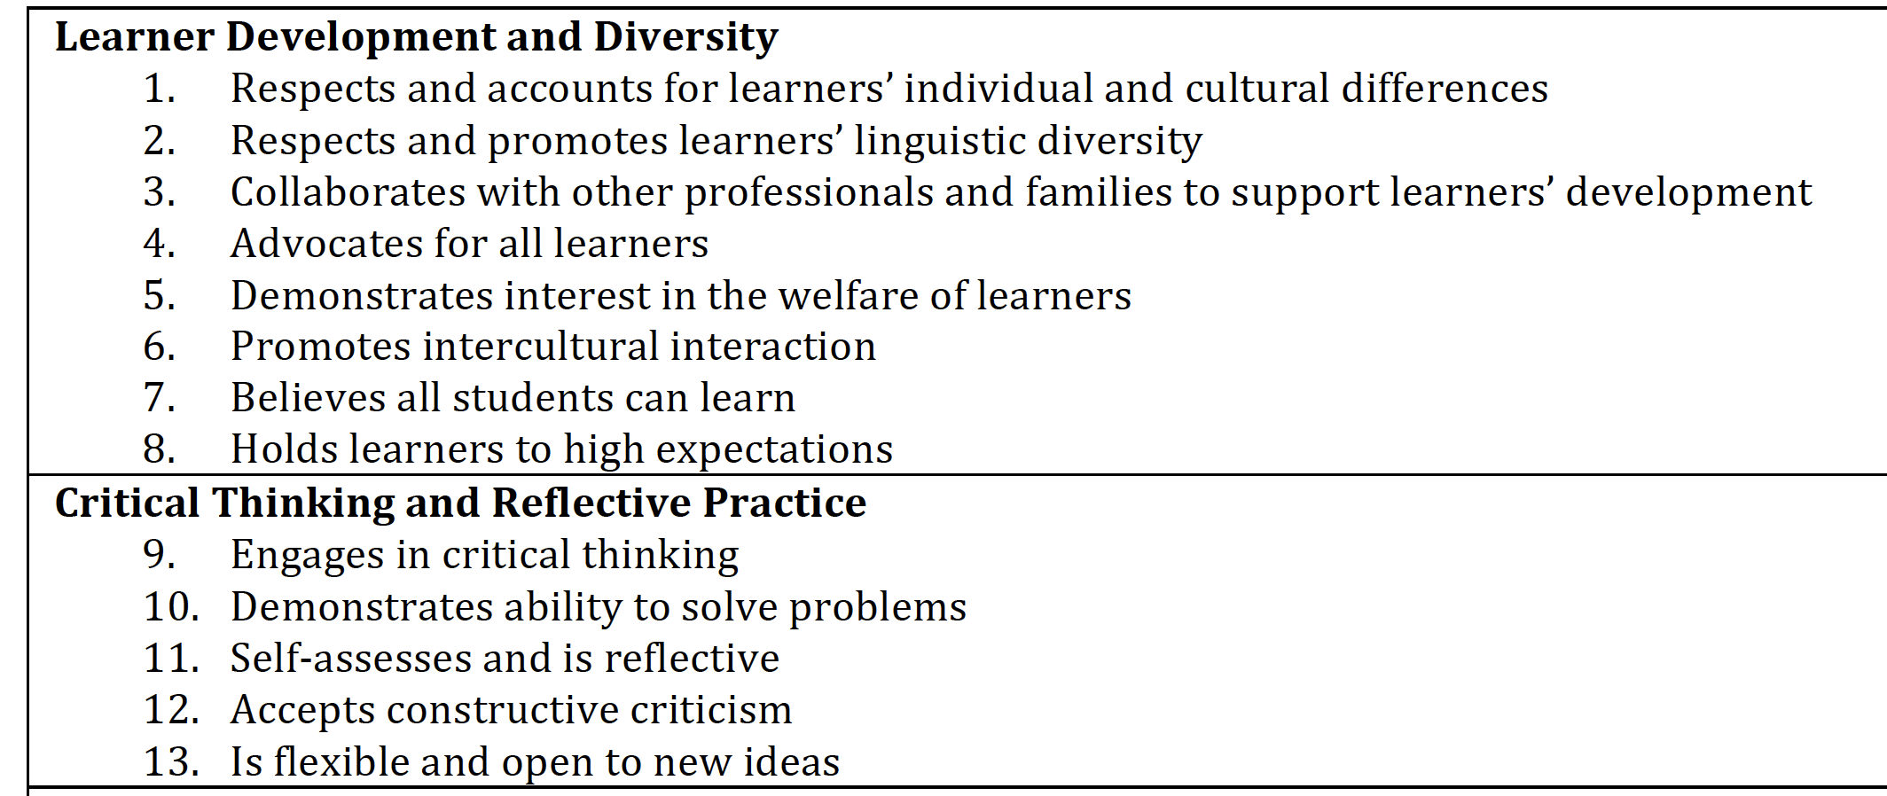

Slide 32
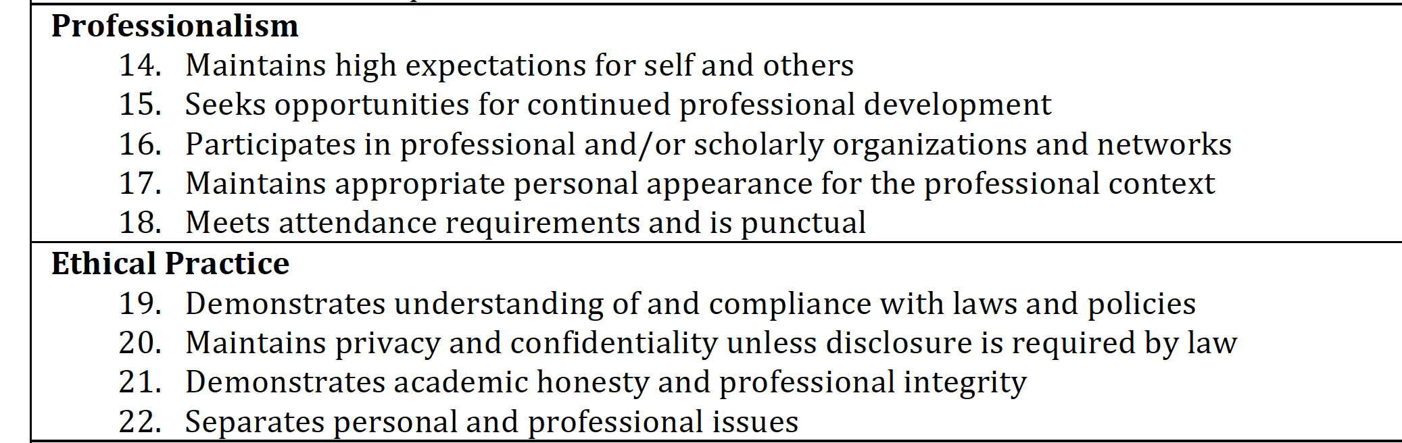

Slide 33
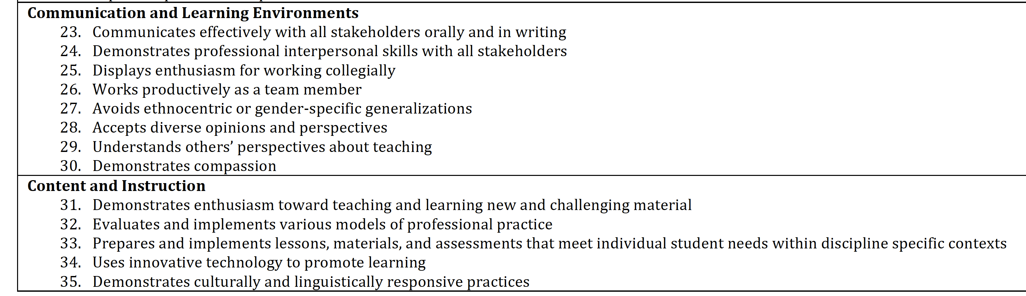

Slide 35
Exit Survey
Academic Year 2016-2017
*please attend to n size for individual programs as generalizations are difficult to make if n is too small

Slide 36
2016-2017 Results n=366
Highest percent of ‘very well prepared’
 | Inadequately Prepared |  | Adequately Prepared |  | Well Prepared |  | Very Well Prepared
 | # | % | # | % | # | % | # | %
39. Modeling ethical and respectful behavior | 2 | 1% | 14 | 4% | 91 | 25% | 259 | 71%
42. Using respectful language while interacting with students | 2 | 1% | 19 | 5% | 83 | 23% | 262 | 72%

Slide 37
2016-2017 Results n=366
Highest percent of ‘inadequately prepared’
 | Inadequately Prepared |  | Adequately Prepared |  | Well Prepared |  | Very Well Prepared
 | # | % | # | % | # | % | # | %
22. Demonstrating skills in managing difficult or off task student behaviors while teaching | 20 | 5% | 55 | 15% | 111 | 30% | 180 | 49%
33. Practicing data-driven instructional decision-making | 18 | 5% | 52 | 14% | 134 | 37% | 162 | 44%
43. Communicating with parents and families about student progress | 18 | 5% | 75 | 20% | 121 | 33% | 152 | 42%

Slide 38
Share Out
Program Coordinators

Slide 39
Assessment Policy
Next Steps

