Slide 1
Employee and Retiree Benefit Summary Life, AD&D, STD and LTD

Slide 2
Life and AD&D Plan Options

Slide 3
Employer-Paid Basic Term Life and AD&D
Coverage | Active Employee | Retired Employee
Basic Term Life | $50,000 | $10,000
Basic AD&D | $50,000 | N/A

Slide 4
Active Employee Voluntary Group Term Life Insurance
Active Employee Options | Evidence of Insurability (EOI) Requirements
1 to 10 times annual salary, up to a maximum of $2,000,000. | New Employees or Change of Status Up to 3 times annual salary, EOI approval not required Existing Employees EOI approval required for all increases in coverage

Slide 5
Active Employee Dependent Voluntary Group Term Life Insurance
Dependent Spouse and Children | EOI Requirements
$10,000 for spouse and each eligible child | EOI approval not required
Additional Voluntary Spouse GTL Benefit $15,000 or $40,000 | EOI approval always required

Slide 6
Retiree and Spouse Voluntary Group Term Life Insurance
Retired Employee and Spouse Options | Evidence of Insurability (EOI) Requirements
$7,000, $10,000, $25,000, $50,000 or $100,000 | At retirement No EOI required up to the amount of voluntary life coverage in force when you were an active employee, up to a maximum of $100,000 Retiree Increasing coverage EOI approval required
$3,000 spouse | Retiree Spouse EOI required unless dependent coverage in effect as spouse of an active employee and no break in coverage employee retired

Slide 7
Active Employee Voluntary AD&D Insurance
1 to 10 times annual salary
Cannot exceed $2,000,000
Rounds up to the next $10,000
No EOI required
Retired Employees – Not eligible

Slide 8
Dependent Voluntary AD&D Insurance
Spouse of Active Employee | 50% of what the Employee has elected 0.5 to 5x of Employee’s Annual Salary Cannot exceed $1,000,000 Rounded down to the nearest $10,000
Children of Active Employee | Each eligible dependent child can be covered for $10,000 under the Voluntary Dependent AD&D plan

Slide 9
STD and LTD Plan Options

Slide 10
STD Benefits
Elimination Period (Sick Leave must be exhausted) | 7 days (Or until leave exhausted, whichever is later)
Benefit Amount | 60% of weekly earnings Maximum of $850 per week
Maximum Period Payable | 22 weeks for disabilities not caused by pre-existing condition 4 weeks for disabilities caused by pre-existing condition
Evidence of Insurability (EOI) | EOI Waived during the 2024 special Open Enrollment Period 7/15-7/31

Slide 11
LTD Benefits
Elimination Period (Sick Leave must be exhausted) | 90 days (Or until leave exhausted, whichever is later)
Benefit Amount | 60% of monthly earnings Maximum of $15,000 per month
Maximum Period Payable | Dependent upon your age at the time of disability
Evidence of Insurability (EOI) | EOI Waived during the 2024 special Open Enrollment Period 7/15-7/31

Slide 12
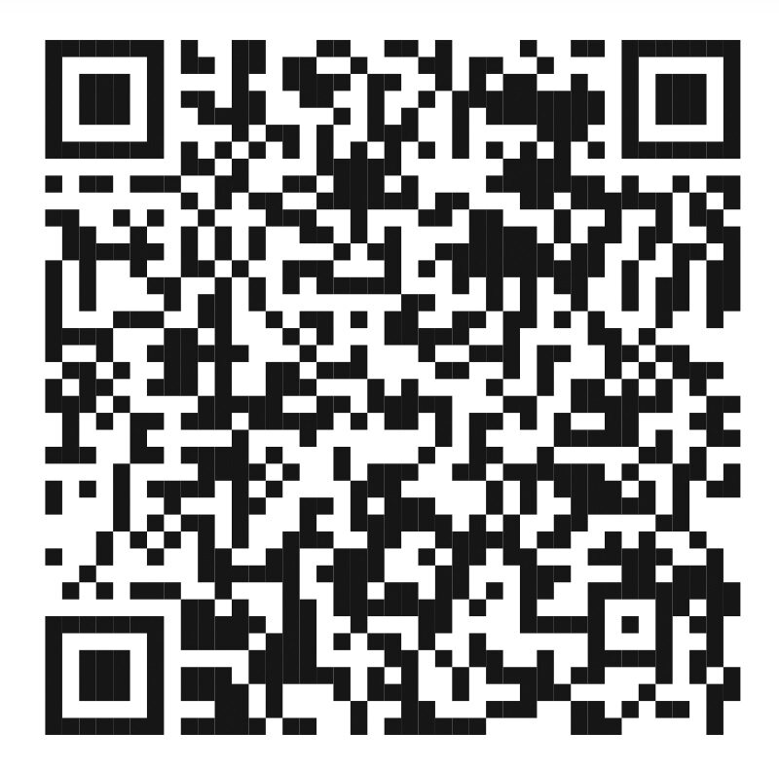
Questions?
Call Blue Cross and Blue Shield of Texas toll-free at 1-866-628-2606
Visit our web site for additional information at bcbstx.com/ancillary-ut

