Slide 1


Welcome to Open Enrollment 2024
Blue Cross and Blue Shield of Texas
UT SELECT plan
Blue Cross and Blue Shield of Texas, a Division of Health Care Service Corporation, a Mutual Legal Reserve Company, an Independent Licensee of the Blue Cross and Blue Shield Association

Slide 2


UNIFIED COLLABORATION CREATES A DIRECT
PERSONAL ONE-STOP EXPERIENCE
PERSONAL SUPPORT FROM THE
RIGHT EXPERT
WHEN MEMBERS NEED HELP
Benefits Guidance
Utilization Management Specialist
(RN)
Claims
Questions
Behavioral Health Concierge & Specialist
PHONE
Care
Support
MEMBER / FAMILY
HEALTH ADVOCATE TEAM
Pharmacist
APP
Find a Doctor
Clinical Health
Advocate (RN)
CHAT
(IN-APP AND ONLINE)
Dedicated
Clinical Health Advocate (RN)
Health
Advocate
Navigation Guidance
ONLINE
Dietitian
Cost Estimates
Social
Worker
Wellness
Resources
Medical Director
PROVIDERS

Slide 3

HEALTH ADVOCATES
The Heart and Soul of Health Advocacy Solutions

Slide 4

Your Personal
Health Advocate:
One call that does it all
Whether you are concerned about:
Understanding your benefits
Scheduling appointments
A chronic illness or a new diagnosis
An upcoming surgery
Getting prior authorization for a test
Saving money on health care
Your health advocate has answers.
We’re here for you 24/7,
just call 1-866-882-2034.*
Take the easy path to better health …
Your health advocate is your dedicated health care concierge.
*In case of a medical emergency, call 911.

Slide 5

A Health Advocate
Might Reach Out to You
If we’re calling, it’s because
we think we can help!
Here are a few reasons why we might be calling you:
You or your family recently had a
health event or a new diagnosis
To help you find the right doctor or care facility for your needs
If you had an emergency room visit, to see how you are doing and how we can help

Slide 6

Preventive Coverage
What’s Covered?
  Recommended routine gender- and age-specific preventive care and screenings — including yearly general wellness exams, recommended vaccines and screenings for things like diabetes, cancer and depression — both facility and professional services.
  Coverage provided in-network at 100% with no copay,
  no deductible. Out-of-network benefits may vary.
IMPORTANT to remember:
Lab tests related to a condition
such as diabetes or asthma —
are not considered preventive
and are covered under applicable
deductible and coinsurance levels.
Stay healthy by getting regular check-ups

Slide 7

COLLABORATION
Bringing People, Data and Providers Together

Slide 8







YOUR MULTI-DISCIPLINARY TEAM
WHERE IT ALL BEGINS
The team shares data and collaborates to provide guidance and support for members’ health issues.
Concierge Health Advocate
Clinical Health Advocate (usually an RN)
Social Worker
Pharmacist
Dietitian
Utilization Management Specialist
Medical Director

Slide 9
COLLABORATION
ACROSS THE HEALTH CARE
UNIVERSE
Address their needs and reach their goals.
Health Advocacy Solutions ensures your employees, and their families are getting the help they need.
We work across specialties
We work with providers
We work with ancillary and 3rd party service providers

Slide 10

Access to a Registered Dietitian
Nutrition plays a critical role in managing many chronic conditions including diabetes, high blood pressure,
heart disease and obesity. That’s why Health Advocacy Solutions added Registered Dietitians (RDs) to our multidisciplinary teams in 2023.
RDs add value by:
Improving nutritional health and improve
health outcomes/conditions
Empowering members to make positive changes
in their lifestyle
Increasing member engagement and
knowledge of nutritional health/dietary needs
Improving health outcomes
Reducing absenteeism and increasing productivity

Slide 11

INTEGRATED
PHARMACEUTICAL CARE MANAGEMENT
Health Advocacy Solutions uses medical and pharmaceutical data, along with algorithms to identify members who could benefit from additional clinical management around their pharmacy care plan.
Clinical Advocates and pharmacists work with members to:
Improve therapeutic health outcomes
Reduce medication nonadherence,
a national health care problem
Lower pharmacy costs via outbound outreach to maximize Rx benefits and improve cost efficiency

Slide 12


Slide 13


Slide 14

Blue Access for MembersSM

Slide 15
Blue Access for MembersSM
  Check claims and claims history
  View, save or print Explanation of Benefits (EOBs)
  Sign up for electronic EOBs, and save paper
  View benefits and covered dependents
  Check coverage details and Rx benefit information
  Manage mobile and texting preferences
  Request new ID cards or print temporary ID cards
  Access health and wellness information and guides
  Get details on wellness, discounts, 24/7 Nurseline
  Use Provider Finder® to find in-network doctors and hospitals
  Log in and perform protected transactions
  24 hours a day, 7 days a week*
Save time
with self-service support tools
and health and wellness resources available through a convenient and secure website
*Claim Statements/EOBs are not available from 3 – 6 a.m.

Slide 16

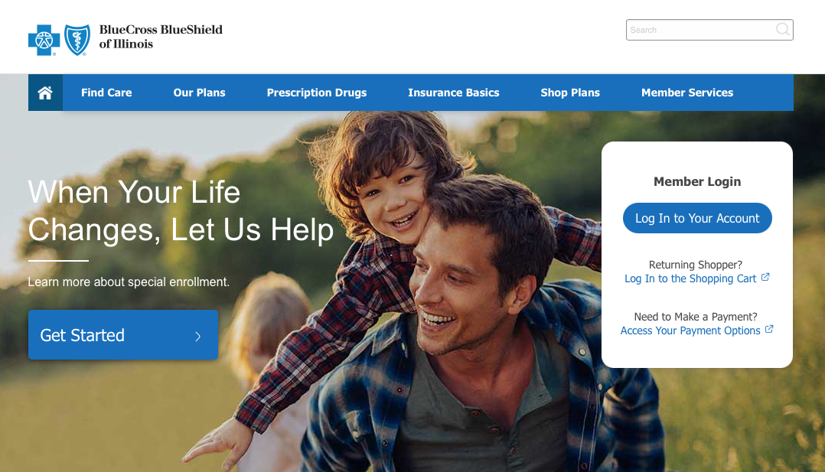

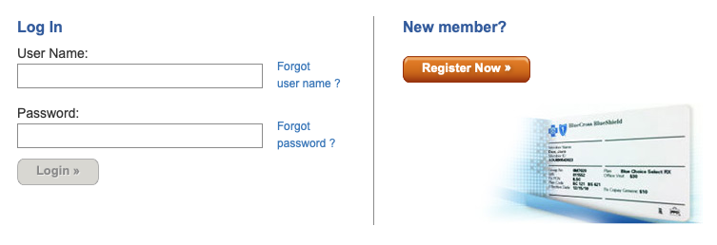
Sign Up for Blue Access for MembersSM
Go to bcbstx.com/ut and log in
to Blue Access for Members
via web or mobile
If you are a new user, click Register Now to sign up
1
2
To register you will need your identification number on the front
of your ID card OR you can call
the Customer Service number
on the back of the card.
Screen images are for illustrative purposes only.

Slide 17
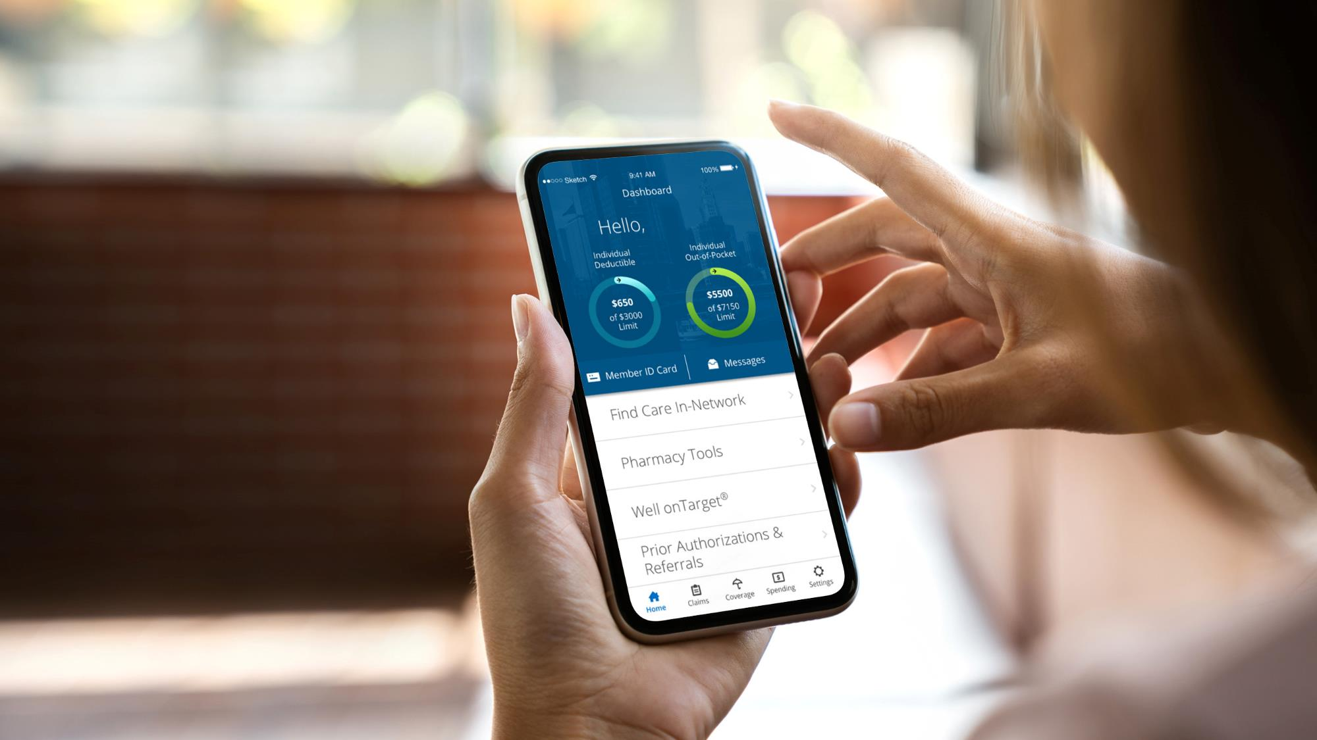

MOBILE APP
With the BCBSTX App,
you can manage your health care information whenever, wherever
To download, text
BCBSTXAPP
to 33633

Slide 18
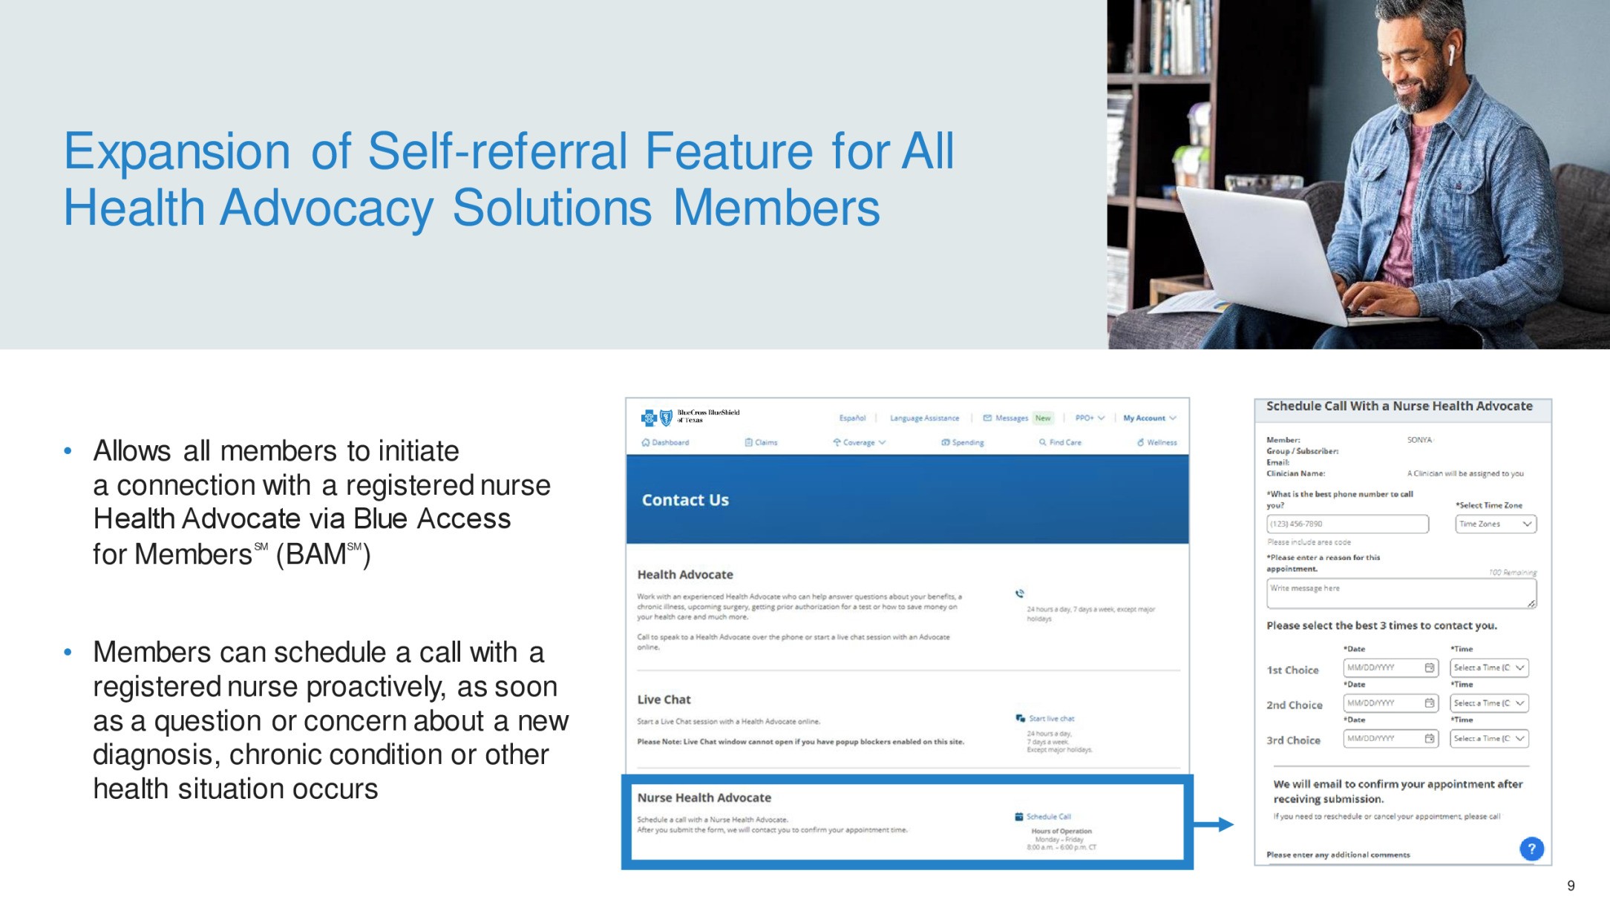

Slide 19
Your Health
and Wellbeing Programs
TO HELP YOU
FIT BETTER HEALTH
INTO YOUR SCHEDULE
Digital Mental Health supports your mental wellbeing with programs for stress, depression, sleep problems, panic and substance use.
24/7 Nurseline conveniently answers your health questions.
Fitness Program gives you access
to a network of gyms that fit your budget
and lifestyle.
Women’s and Family Health provides support for cycle tracking, pregnancy and parenting.
Digital coaching programs help you manage your weight, diabetes, high blood pressure and joint and spine issues.
Log in at bcbstx.com/ut
Click the Wellness / Healthy Living tab

Slide 20

Digital Mental Health
Online programs through Learn to Live
at no added cost for:
Stress, anxiety and worry
Depression
Social anxiety
Insomnia
Panic
Substance use
Resilience
Available to employees and their family members 13 years and older
Programs in English and Spanish
Personal coaching by phone, text or email
Get started with a mental health assessment:
Log in to Blue Access for MembersSM
Choose Wellness, then find
Digital Mental Health
Learn to Live provides educational behavioral health programs; members considering further medical treatment should consult with a physician.
Learn to Live, Inc. is an independent company that provides online behavioral health programs and tools for members with coverage through Blue Cross and Blue Shield of Texas. BCBSTX makes no endorsement, representations or warranties regarding third-party vendors and the products and services offered by them.

Slide 21

24/7 Nurseline
Advice anytime.
Advice isn’t just needed from 9 to 5.
Round-the-clock health and wellness advice from licensed nurses
Plus, you can also listen to more than 1,000 health topics
Call 866-882-2034
Available in English and Spanish

Slide 22



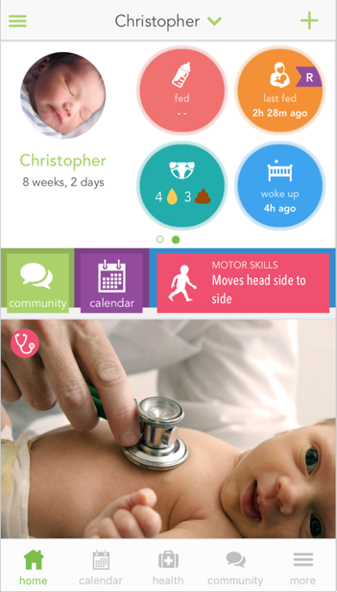



Ovia Now Supports Life’s Entire Journey
FERTILITY, PREGNANCY, PARENTING AND MENOPAUSE
Ovia Health is an independent company that has contracted with Blue Cross and Blue Shield of Texas to provide maternity and family benefits solutions for members with coverage through BCBSTX. BCBSTX makes no endorsement, representations or warranties regarding third-party vendors and the products and services offered by them.

Slide 23

Wondr®
Metabolic Syndrome Reversal Program
Coach –Led Digital Online program and mobile app allows members access anywhere at any time
Builds behavioral skills (no dieting) to promote long-term
weight loss and risk reduction
Integration with activity trackers and voice-controlled/
smart speakers
Services covered as preventive with no out-of-pocket cost
Wondr Health is an independent company that has contracted with Blue Cross and Blue Shield of Texas to provide metabolic syndrome reduction program for members with coverage through BCBSTX.
BCBSTX makes no endorsement, representations or warranties regarding third-party vendors and the products and services offered by them.
Blue Cross and Blue Shield of Texas, a Division of Health Care Service Corporation,
a Mutual Legal Reserve Company, an Independent Licensee of the Blue Cross and Blue Shield Association

Slide 24



Hinge Health
Hinge Health provides a digital, 12-week, coach-led musculoskeletal program based on proven non-surgical care guidelines. The program is delivered to you using mobile and wearable technology.
Access to a personal health coach
Convenient exercise therapy in your own home
Education articles to help you understand your condition and treatment options
No cost to eligible members and dependents
Hinge Health is an independent company that provides an online musculoskeletal program for Blue Cross and Blue Shield of Texas.
Hinge Health is solely responsible for the products and services that it provides.

Slide 25




Register Before You
Need Care
There are several convenient ways to activate your account with MDLIVE so it’s ready for you when you need care:
DESKTOP
MOBILE
APP
TEXT ASSISTANT
TELEPHONE
MDLIVE, a separate company, provides virtual visit services for Blue Cross and Blue Shield of Texas and is solely responsible for its operations and that of its contracted providers.

Slide 26


Blue365®
Member Discount Program
Member discounts simply for being a BCBSTX member
Exclusive health and wellness deals from national and local retailers
Save money on fitness gear, family activities, gym memberships, healthy eating, dental, vision, hearing aids and more from top national and local retailers
Log in to Blue Access for MembersSM and click “Member Discount Program” in Quick Links to view your available discounts and to register for weekly emails
Blue365 is a discount program only for BCBSTX members. This is NOT insurance. Some of the services offered through this program may be covered under your health plan. Employees should check their benefit booklet or call the Customer Service number on the back of their ID card for specific benefit facts. Use of Blue365 does not change monthly payments, nor do costs of the services or products count toward any maximums and/or plan deductibles. Discounts are only given through vendors that take part in this program and are subject to change. BCBSTX does not guarantee or make any claims or recommendations about the program’s services or products. Members should consult their doctor before using these services and products. BCBSTX reserves the right to stop or change this program at any time without notice.
BCBSTX makes no endorsement, representations or warranties regarding third-party vendors and the products and services offered by them.
Screen images are for illustrative purposes only.

Slide 27
Flexible Gym Network
A choice of gym networks to fit budgets and preferences.*
Membership Options to Choose From
Options | Digital-Only | Base | Core | Power | Elite
Monthly Fee | $10 | $19 | $29 | $39 | $129
Gym Facility Network Size | Digital Access Only | 3,000 | 7,500 | 12,000 | 12,400
Select a plan based on lifestyle and preferences to have access to all gyms included in the plan and
lower plans.
The Elite plan has the option to select a home elite gym and
access to all other gyms.
Members have the option to change their elite home gym monthly.
$19 Enrollment Fee (No enrollment fee for Digital-Only Option)
Studio Class Network: Boutique-style classes and specialty gyms are pay-as-you-go with 30% off every 10th class.
Family-Friendly: Expands gym network access to your covered dependents at a bundled price discount. Member pays one enrollment fee for the entire family.
Convenient Payment: Monthly fees are paid via automatic credit card or bank account withdrawals.
Represents possible network locations. Check local listings for exact network options as some locations may not participate. Network locations are subject to change without notice.
*
Taxes may apply. Individuals must be at least 18 years old to purchase a membership.

Slide 28

SilverSneakers
SilverSneakers is a comprehensive program that helps older adults take greater control of their health through physical activity, education, and social interaction. This program is available at no extra cost to the retiree or spouse and includes the following:
Group fitness classes;
A fitness membership with access to 13,000+ fitness locations nationwide;
SilverSneakers FLEX™ Community Fitness Classes such as tai chi, yoga, and Latin dance;
Health education seminars and social events;
A Program Advisor® for guidance and assistance; and
A member website with detailed information, resources and inspiration.
*This program is available with no out-of-pocket cost to retirees of the age of 50 and above who are covered under our UT SELECT Health Plan, including working retirees. Covered spouses of retirees and surviving spouses participating in the UT SELECT Health plan are also eligible to participate if they are of the age of 50 and above.

Slide 29

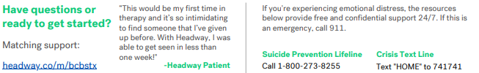
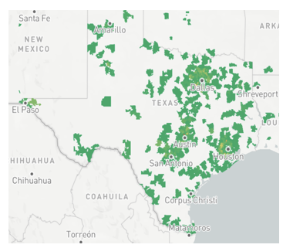
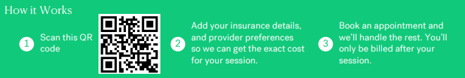
Let Headway help find your mental health provider.
Whether you know what you need or aren’t sure where to start, we’ll help you find the right fit- covered by your insurance
Headway is a contracted provider for the following plans: Blue Choice PPO, Blue High Performance Network, Blue Essentials HMO. Blue Premier, Medicare Advantage PPO.

Slide 30
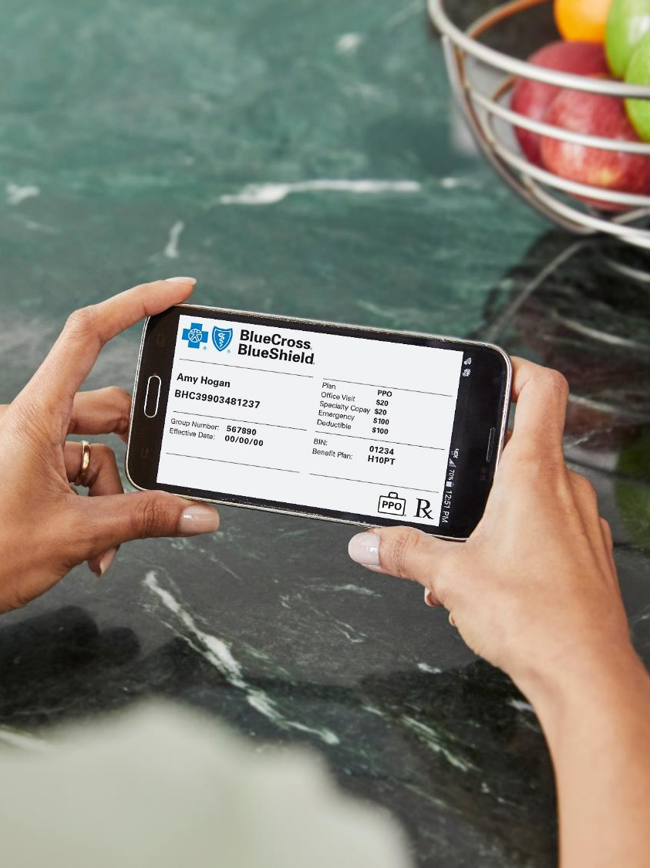
Stay Engaged in Your Health Care
QUESTIONS &
ANSWERS

Slide 31



THE ONLY
ONE YOU NEED
ONE
ID CARD
ONE
NUMBER
ONE
POINT OF
CONTACT
www.bcbstx.com
Health Advocate 1-866-882-2034
Preauth is required before rendering services for IP, SNF admission, home health/infusion care, private duty nursing services, emergency medical or BH admission. Preauth may be required for OP services including, but not limited to, advanced imaging, cardiology, sleep study, pain management, joint/spine surgery, radiation therapy or genetic testing. Check member benefits prior to rendering service.
Provider: File medical claims with your local BCBS Plan.
BlueCross BlueShield of Texas, an independent licensee of the BlueCross BlueShield Association, provides claims processing only and assumes no financial risk for claims.

