Slide 1

Welcome
Thank you for joining our Blue Cross Medicare Advantage Open Access (PPO) Virtual Education Session. We will begin momentarily.
A few reminders before we get started:
Your mic and camera have been disabled to save bandwidth and avoid disruptions.
If you have a question, you can utilize the Microsoft Teams chat feature at any time.
If you prefer to ask your question verbally, please wait until the end of our presentation, and use the Raise hand feature, and we will answer questions one at a time.

Slide 2
UT CARE™ Medicare PPO
Y0096_UTCAREPPTES23a_M

Slide 3

Today’s Topics
Medicare Refresher
Benefit and Supplemental Highlights
Visiting your Provider
Out of State/Country Coverage
Blue Access for Members
Care Coordination/In Home Assessments
Planning for Retirement

Slide 4
Medicare Basics
Part
A
Part
B
Medical Insurance
Hospital
Insurance
Prescription
Drug
Coverage
Medicare Advantage Plans
Part
C
Part
D
Express Scripts
Blue Cross and Blue Shield has contracted with the Centers of Medicare and Medicaid Services (CMS) to provide all the benefits of Original Medicare (Parts A & B) plus other health and wellness benefits not covered by Original Medicare. BCBSTX is administering/managing this plan on behalf of Medicare.
Notes:
You must be enrolled in both Part A and Part B to be enrolled in Part C.

Slide 5
UT CARE Medical and Supplemental Benefit Highlights

Slide 6
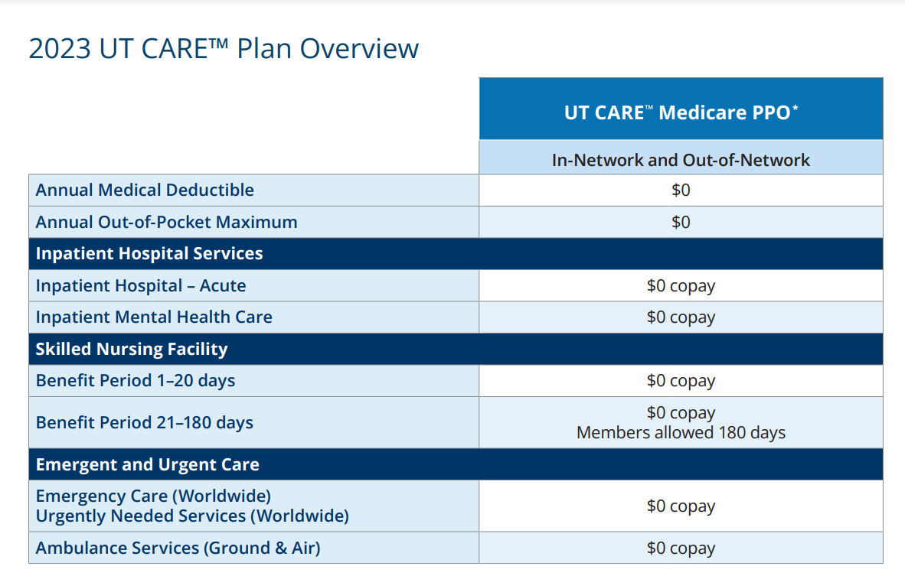
2024 UTS Retiree Medical Benefits Overview
* For Medicare Part A & B services at Medicare assigned-providers. Member must be enrolled in Medicare Parts A & B and continue to pay Part B premium.

Slide 7
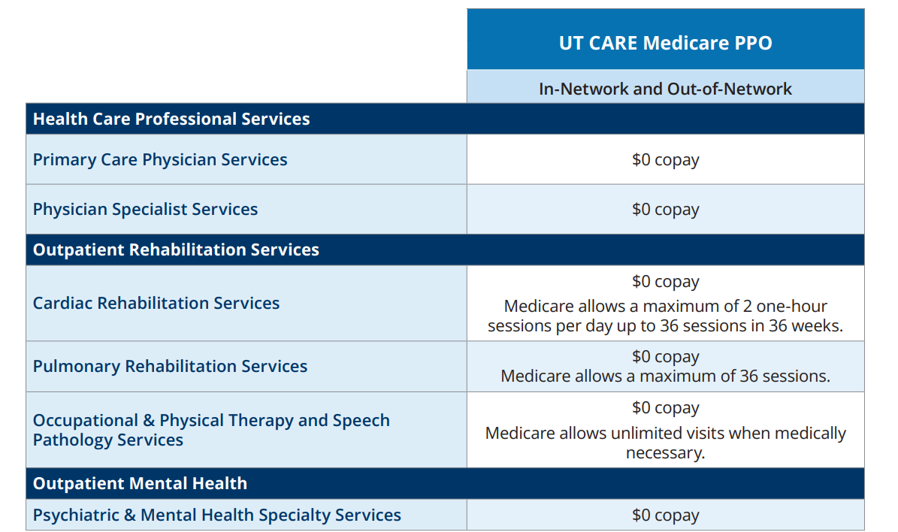

Slide 8
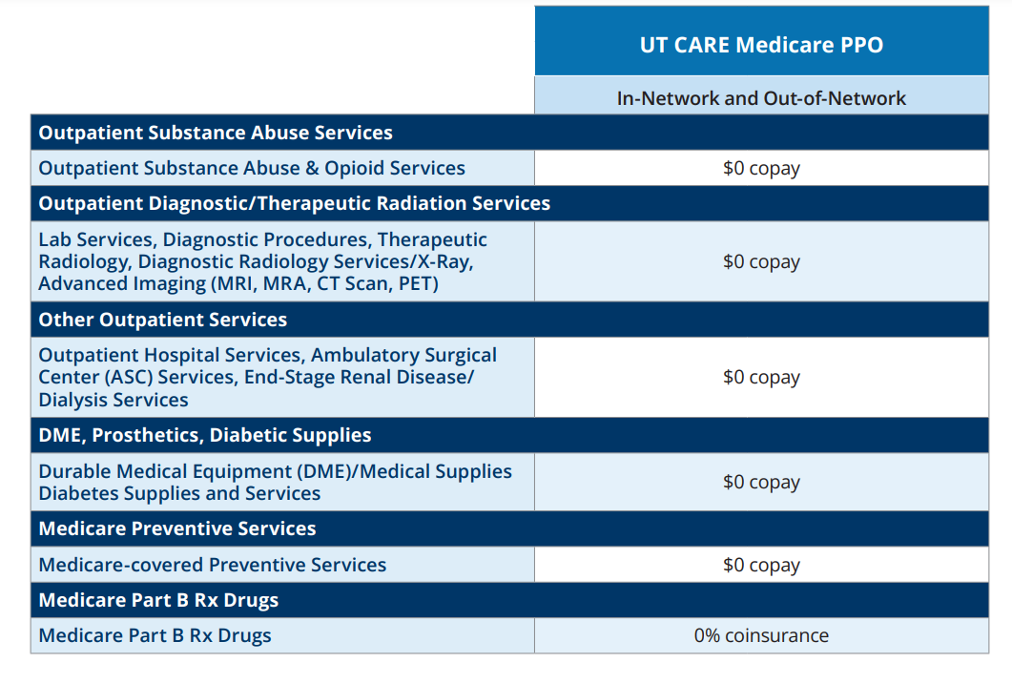

Slide 9
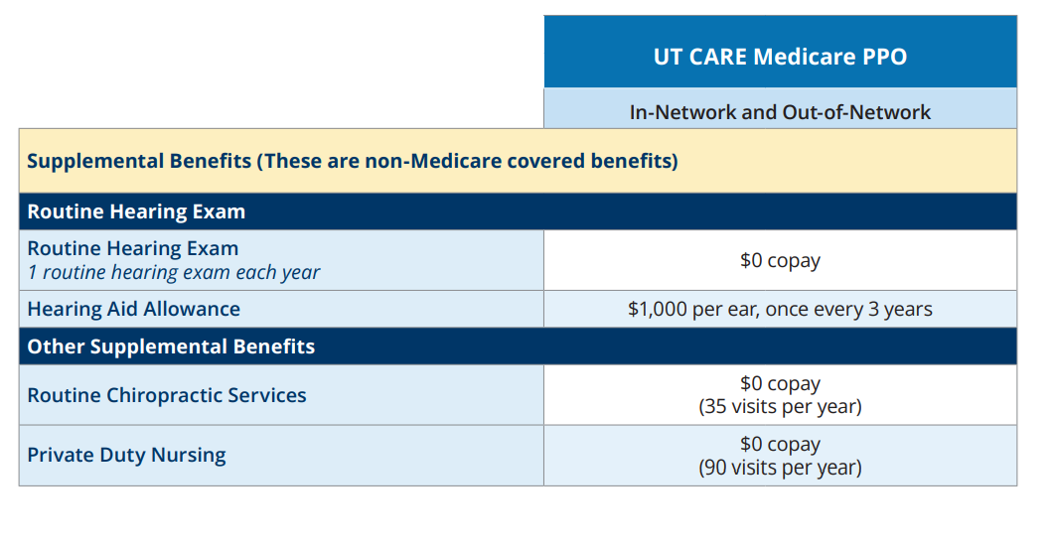

Slide 10

Health and Wellness Benefits
Included in your plan, you will have access to extra health and wellness benefits:
    MDLIVE® Virtual Visits
    24/7 Nurseline
    Blue365®
    TruHearing^{® -}
    SilverSneakers®
    Fitness Program
    Private Duty Nursing
    Hinge Health
    Livongo®
    Omada®
    Learn to Live
    Airrosti®
    Wondr Health™
    Catapult Health
Visit the UT CARE website at www.bcbstx.com/retiree-medicare-ut for additional information. (Healthy Living tab)

Slide 11

Hearing Services
Your plan includes benefits through TruHearing or another hearing provider.
Exams
A hearing exam/year plus necessary follow-up visits for fitting and adjustments. $0 copay.
Hearing aids
$1,000 per ear hearing aid allowance, once every 3 years.
TruHearing offers discounts on prescription hearing aids.
Over-the-Counter (OTC) Hearing Aids
TruHearing provides discounts on OTC hearing aids, but the plan hearing aid allowance does not apply.

Slide 12

Notes:
Retirees are not required to use TruHearing providers, but there are good discounts if retirees choose to use them. A hearing exam plus three follow up visits for fitting and adjustments are included as well as a 45 day-trial for hearing aids and a three-year warranty. This helps take some of the worry out of this kind of purchase

Slide 13

SilverSneakers®
What is SilverSneakers?
SilverSneakers is a fitness and lifestyle benefit that gives you the opportunity to connect with your community, make friends and
stay active.
What does SilverSneakers include?
Memberships to thousands of fitness locations
Group exercise classes designed for all abilities
SilverSneakers On-Demand® online workout videos that
feature tips on fitness and nutrition, and allow you to exercise
in the privacy and safety of your own home
SilverSneakers GO® mobile app with workout programs,
location finder and more

Slide 14
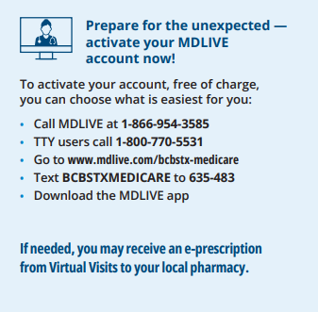
Virtual Visits
What are Virtual Visits?
Virtual Visits, powered by MDLIVE, allow Blue Cross Group Medicare Advantage plan members to access care for non-emergency situations by phone, mobile app or online video anytime, anywhere. Available 24/7.
You can speak to a board-certified doctor with an average wait time of less than 20 minutes, or you can schedule an appointment at a time that works best for you.
MDLIVE doctors can treat a variety of non-emergency conditions, including:
Allergies
Asthma
Cold/flu
Ear Infection
Fever
Headache
Insect Bites
Nausea
Pink Eye
Sinus Infection
Rash
And More

Slide 15

Virtual Visits – Behavioral Health
In addition, MDLIVE provides care for a large variety of mental health conditions and the life events that can prompt or intensify them, including:
• Loss of a loved one
• Health concerns
• Relationship issues
• Divorce or separation
• Experiencing a traumatic event
• Stress related to aging
Find a therapist that’s right for you and have a phone or video visit.
Evening and weekend appointments are available.
You may ask to see the same provider for all your behavioral health visits.

Slide 16
Visiting Your Provider

Slide 17
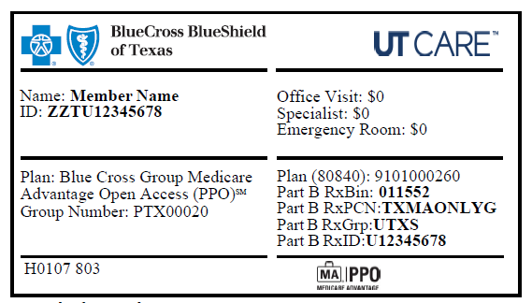
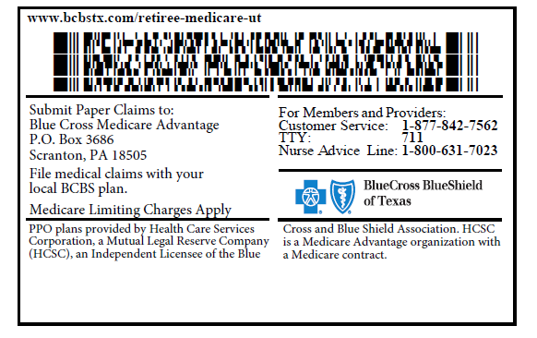

Member ID Card
You will only need to present your UT CARE member ID card whenever you receive a medical service or benefit covered by your plan.
You do not need to show your Original Medicare card.
Providers will send your claims directly to BCBSTX or their local BCBS.
Sample
Front of ID Card
Back of ID Card

Slide 18
The Importance of a Primary Care Provider (PCP)
Why Have a Primary Care Provider?
A Primary Care Provider (PCP) can be a doctor, physician assistant or nurse practitioner who works in family health, internal medicine or pediatric medicine. PCPs help with healthcare maintenance and preventative medicine, including vaccinations and screening tests for diseases like breast cancer or colon cancer.
Regularly visiting your PCP for preventive care and health concerns helps you avoid costly visits to the emergency room. It can mean catching medical issues early, which often leads to both better health results and less costly care down the road. Consistent primary care also keeps general costs across your plan in check so the University of Texas System can continue offering benefits with reasonable premiums and cost-sharing.

Slide 19

Open Access – Your Own National
Provider Network
Blue Cross Group Medicare Advantage Open Access (PPO) oﬀers members access to care from any provider nationwide who will
      see you as a patient
      accepts Medicare
      is willing to bill Blue Cross and Blue Shield of Texas (BCBSTX) or their local Blue Cross and Blue Shield plan
98% of U.S. physicians accept Medicare assignment, according to the U.S. Centers for Medicare & Medicaid Services (CMS)¹.
Members’ coverage levels are the same inside and outside their plan service area nationwide for covered benefits.
Referrals are not required for specialist visits.
Make more visual

Slide 20

Open Access – Your Own National
Provider Network
The “Your Providers, Your Personal Network” flyer, which comes in your enrollment and welcome kits, is a helpful document to bring to your provider’s office should they have any questions about how to work with your plan.
Side two of the flyer has all the information your provider’s office needs, including a number to call with any questions.
This letter can also be found on the website at https://www.bcbstx.com/retiree-medicare-ut on the Coverage tab where other plan documents are located.

Slide 21
Out of State
and Out of Country
Coverage

Slide 22
Out of State Coverage
Because this is an Open Access PPO plan, you can see any provider who agrees to see you as a patient, accepts Medicare assignment, and agrees to bill the local Blue Cross and Blue Shield plan. Providers are familiar with this claims process.
You have the same coverage in your home state or while traveling the country.

Slide 23
Out of Country Coverage
The Blue Cross and Blue Shield Global Core program gives retirees traveling outside of the United States and its territories access to urgent and emergency medical assistance services.
Claim Forms for care received abroad can be obtained at www.bcbsglobalcore.com or by calling 1-800-810-BLUE.
UT CARE retirees have the same emergency and urgent care benefits out of the country as they do within the United States.

Slide 24
Blue Access for Members (BAM)

Slide 25
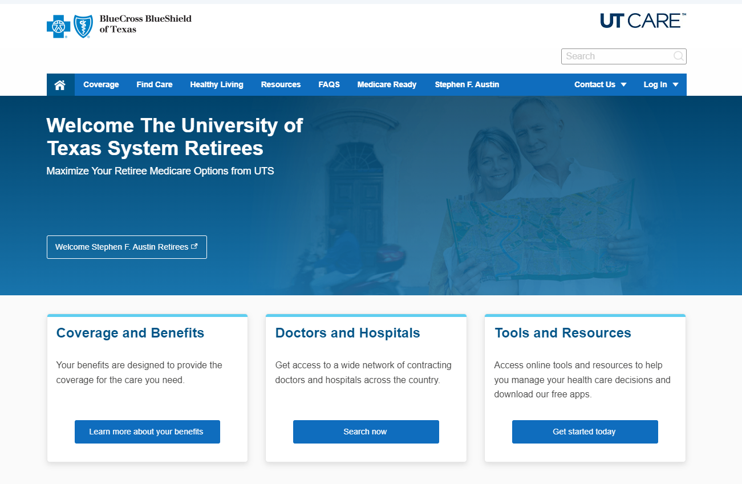
Logging Into Blue Access for Members (BAM)
From the UT CARE Homepage: https://www.bcbstx.com/retiree-medicare-ut
Locate the Tools and Resources section and click “Get started today”.

Slide 26
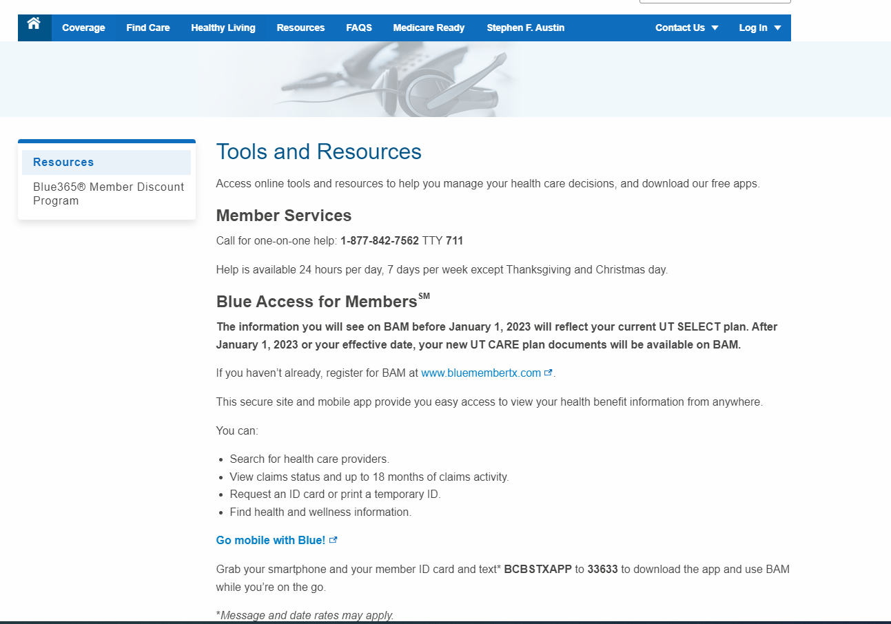

Slide 27
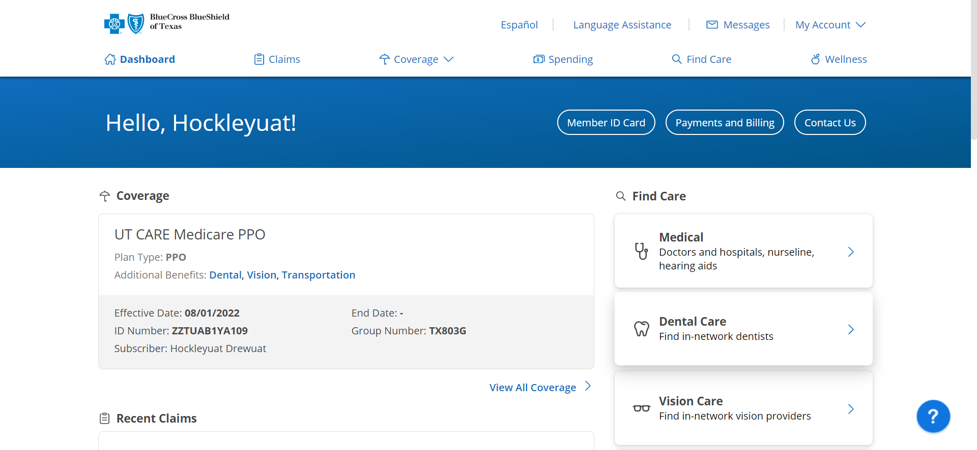
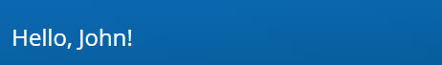
Dashboard/My Account
On the BAM Dashboard page, we currently highlight the three most recent claims as well as options to find care.
The dashboard also has navigation links to the other areas of BAM. Which includes:
  Profile and Preferences
  Coverage
  ID Card*
  Forms and Documents
  Wellness
* You can view your current Identification card and download a copy to your computer or cell phone.
Members also have the option to order a new ID card from here if you would like a physical replacement.

Slide 28
Care Coordination and In-Home Health Assessments

Slide 29
Care Coordination Overview
Your plan offers the ability to work with Care Coordinators* to help manage your health care needs. They can connect you with the right resources for overall care management.
Care Coordinators are clinicians who can help you:
    Adjust to being at home after a hospital stay
    Set up care with your doctor and other health care team members
    Better understand your health condition(s), medications and treatments
    Navigate the health care system to improve your quality of life and save money
*Care Coordinators are available to help you, but you do not have to use them to manage your care.

Slide 30

In-Home Health Assessment
Your plan includes an In-Home Health Assessment (IHA) by a licensed and credentialed clinician—Certified Nurse Practitioner, Physician Assistant or MD—from our trusted partners, Signify or Matrix, at no cost to you.
How can you make the most of your 45-to 60-minute IHE or telehealth visit?
Discuss health concerns and learn more about
disease management programs
Have your home checked for possible safety issues
Take the extra time outside of a primary care provider
visit to ask questions about your physical, emotional
and mental health in the comfort of your home
You receive a one-page summary of the evaluation. With your permission, a full report of the IHE is shared with your primary care provider (PCP).

Slide 31
Planning for Retirement

Slide 32
Planning for Retirement
If you are already retired, approximately 60 days before you (subscriber, spouse, active or retiree) turn 65, you will receive a letter from BCBSTX.
This letter will instruct you about what you need to do to enroll in Medicare, and we will give you the Social Security Administration phone number and website.
You must sign up for Medicare Parts A and Part B coverage and begin to pay your Part B premium.
Once you receive your Medicare card, please call 1-877-842-7562 and provide the 11-character Medicare Beneficiary Identifier (MBI) and Medicare effective date located on your red, white, and blue Medicare card. Enrollment in UT CARE cannot proceed without the MBI number.
You will receive your new UT CARE Member ID Card and a Welcome Kit 10-14 days after Medicare confirms your enrollment.

Slide 33
UT CARE Customer Service

Slide 34
For more information…
    Call UT CARE dedicated customer service for one-on-one help with your questions. 1-877-842-7562 / TTY 711.
      This number is on the back of your ID card.
      Customer Service is available 24/7.
    Neither your institution HR office nor OEB has access to your claims or coverage information, so be sure to call customer service.
    Visit the UT CARE website at
    www.bcbstx.com/retiree-medicare-ut for additional information including FAQs, presentations and a digital copy of plan materials.

Slide 35
Important Plan Information
PPO plans provided by Blue Cross and Blue Shield of Texas, which refers to HCSC Insurance Services Company (HISC) and GHS Insurance Company (GHSIC). PPO employer/union group plans provided by Health Care Service Corporation, a Mutual Legal Reserve Company (HCSC). HCSC, HISC, and GHSIC are Independent Licensees of the Blue Cross and Blue Shield Association. HCSC, HISC, and GHSIC are Medicare Advantage organizations with a Medicare contract. Enrollment in these plans depends on contract renewal.
UT CARETM Medicare PPO is an open access Medicare Advantage PPO plan. On occasion, you may receive automated communications that reference plan name ‘Blue Cross Group Medicare Advantage Open Access (PPO)℠ .’ This plan name also refers to UT CARE Medicare PPO.
Blue Cross®, Blue Shield® and the Cross and Shield Symbols are registered service marks of the Blue Cross and Blue Shield Association, an association of independent Blue Cross and Blue Shield Plans.
SilverSneakers® is a wellness program owned and operated by Tivity Health, Inc., an independent company. Tivity Health and SilverSneakers® are registered trademarks or trademarks of Tivity Health, Inc., and/or its subsidiaries and/or affiliates in the USA and/or other countries.
Virtual Visits may not be available on all plans. Non-emergency medical service in Montana and New Mexico is limited to interactive online video. Non-emergency medical service in Arkansas and Idaho is limited to interactive online video for initial consultation. MDLIVE is a separate company that operates and administers Virtual Visits for Blue Cross and Blue Shield of Illinois.
MDLIVE is solely responsible for its operations and for those of its contracted providers. MDLIVE® and the MDLIVE logo are registered trademarks of MDLIVE, Inc., and may not be used without permission.
TruHearing® is a registered trademark of TruHearing, Inc., which is an independent company providing discounts on hearing aids.

Slide 36
Additional Information
Blue Cross and Blue Shield of Texas complies with applicable Federal civil rights laws and does not discriminate on the basis of race, color, national origin, age, disability, or sex. Blue Cross and Blue Shield of Texas does not exclude people or treat them differently because of race, color, national origin, age, disability, or sex.
Blue Cross and Blue Shield of Texas:
Provides free aids and services to people with disabilities to communicate effectively with us, such as:
  Qualified sign language interpreters
  Written information in other formats (large print, audio, accessible electronic formats, other formats)
Provides free language services to people whose primary language is not English, such as:
  Qualified interpreters
  Information written in other languages
If you need these services, contact Civil Rights Coordinator.
If you believe that Blue Cross and Blue Shield of Texas has failed to provide these services or discriminated in another way on the basis of race, color, national origin, age, disability, or sex, you can file a grievance with: Civil Rights Coordinator, Office of Civil Rights Coordinator, 300 E. Randolph St., 35th floor, Chicago, Illinois 60601, 1-855-664-7270, TTY/TDD: 1-855-661-6965, Fax: 1-855-661-6960. You can file a grievance in person or by phone, mail, fax, or email. If you need help filing a grievance, Civil Rights Coordinator is available to help you.
You can also file a civil rights complaint with the U.S. Department of Health and Human Services, Office for Civil Rights, electronically through the Office for Civil Rights Complaint Portal, available at https://ocrportal.hhs.gov/ocr/portal/lobby.jsf, or by mail or phone at:
U.S. Department of Health and Human Services
200 Independence Avenue, SW
Room 509F, HHH Building
Washington, D.C. 20201
1-800-368-1019, 800-537-7697 (TDD)
Complaint forms are available at http://www.hhs.gov/ocr/office/file/index.html.
Notes:
[State-specific content]

Slide 37
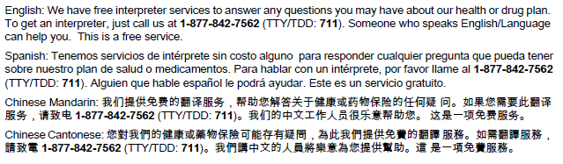

Additional Information
Notes:
[State-specific content]

Slide 38
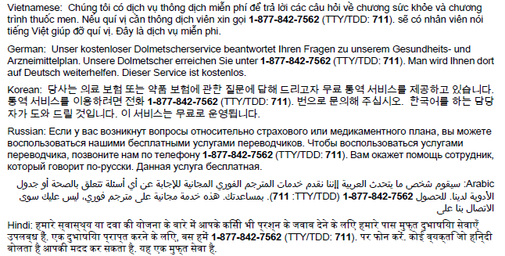
Additional Information
Notes:
[State-specific content]

Slide 39
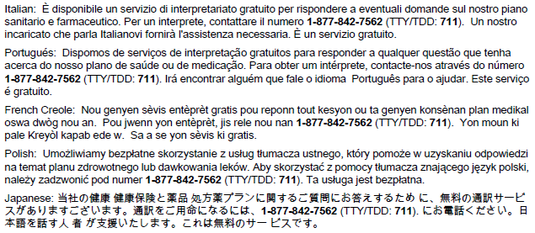
Additional Information
>
Notes:
[State-specific content]

