Slide 1
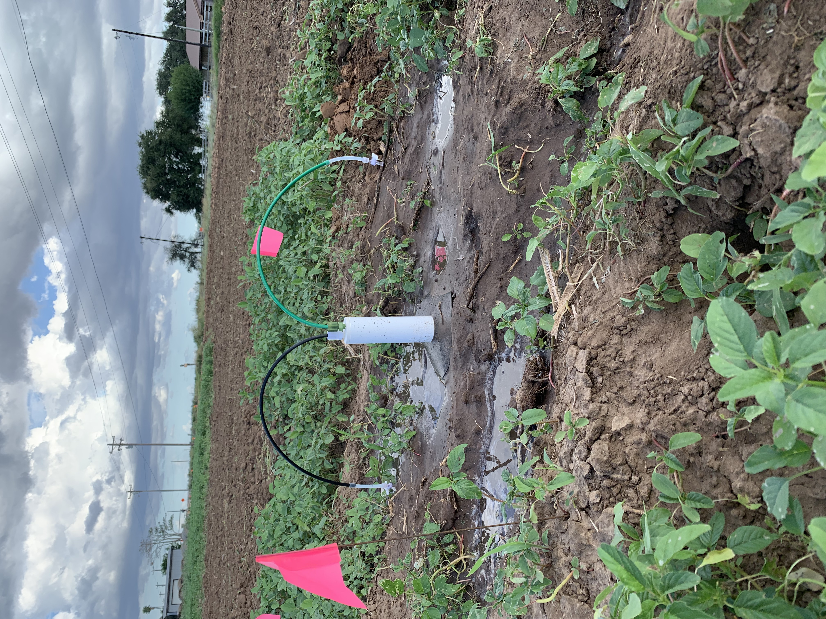
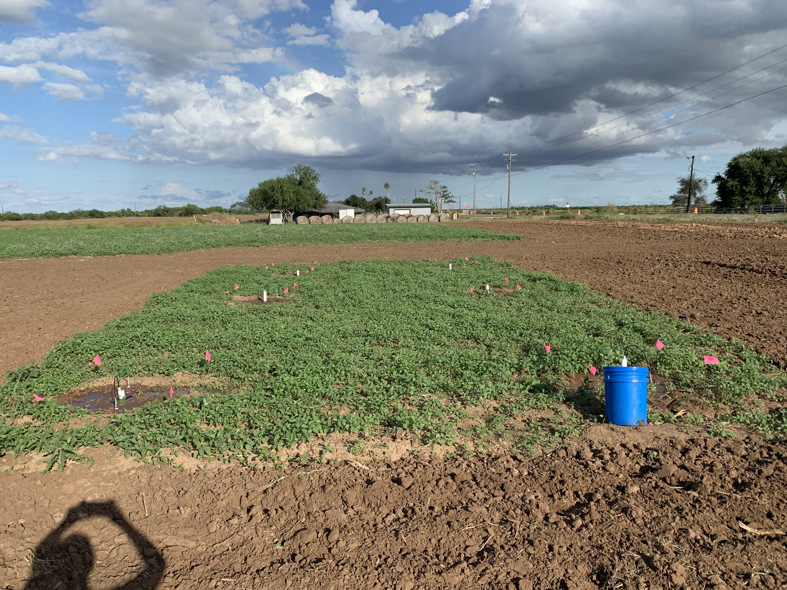
Measuring Nitrate Loss in the Form of Leaching in Different Soil Types and Nitrogen Fertilizers
Gladys De La Rosa, Chu-Lin Cheng, James J. Kang, Engil Pereira
School of Earth, Environment, and Marine Sciences, The University of Texas Rio Grande Valley, Edinburg TX.
Introduction
A
B
Table 1 Soil Characteristics
Nutrients, specifically nitrogen (N) are essential for crop production but when it is lost through an overuse of fertilizer application it can cause unwanted leaching.
Soil Type | Hargill
Soil Texture | Fine Sandy Loam
Clay % | 22
Sand % | 59
Silt % | 19
Organic Matter % | 1.20
Photo A Shows one plot with the lysimeter inserted and vacuumed. Photo B Shows six lysimeters inserted in each plot (two replicates with 3 plots ea.)
Figure 4 Shows cumulative nitrate leaching (kg NO₃ -N ha⁻¹) varying by crop type. The data was extracted from selected scientific literatures (10).
Results - Field Research
A
A
Photo Credit: https://www.haifa-group.com/haifa-blog
Objective
NO₃⁻ leaching can vary under many conditions but in this study, we aim to identify fertilizers and crops that promote the least NO₃ losses for sandy soils.
Research Questions:
Which two fertilizers (Urea or Calcium nitrate) will have the highest potential to be lost as NO₃⁻?
Will the type of soils and fertilizer have any effect on the soil microbial community?
Using a meta-analysis approach, is there a crop type that most efficiently uses fertilizer-N reducing the concentration of NO₃⁻ in leachate?
Figure 5 Shows how nitrate leaching varies from soil depth. This data is based on selected scientific literatures (10).
Conclusion
B
B
From the field trial and meta-analyses results, nitrate concentration is higher at the surface layers than in deeper layers.
Soil samples had a relatively high amount of ammonium in the soil when compared to nitrate. (Fig. 3A,B)
Maize had a more nitrate leachate when compared to other crops (Fig. 4)
The ongoing experiment has yet to test the fertilized soils to compare nitrate, ammonium, soil respiration and other untested analysis from the unfertilized soils.
Experimental Approach
Meta-analysis Research
Several articles were gathered using common terms:
“Nitrate leaching” AND “Suction cup lysimeter” OR “Suction lysimeter” OR “Suction cup water samplers” AND “Agriculture” OR “Cropland”.
Field Research
Acknowledgements
Location: An 18-acre farm in Raymondville, TX. Coordinates: 26°28'57.7"N 97°55'53.2"W
Plot Size: Six 3x3ft plots and 14ft apart from one another
2 Replicates: Each plot contained either Control, Calcium Nitrate, or Urea fertilizers.
Device: Six 24’ suction cup lysimeter (fig.3)
Soil Sampling Depth: 0-15cm, 15-30cm,30-45cm,45-60cm
Figure 2A Shows the correlation between soil depth and soil moisture content. Figure 2B Shows the correlation between soil depth and soil respiration. Average temperate for soils were 88.89F
Figure 3A Shows nitrate leaching through different soil depths. Figure 3B Shows ammonia leaching through different soil depths. Soil depths (0-15cm,15-30cm,30-45cm,45-60cm). Note: These samples are unfertilized soils.
Thank-you to farmer Avan Guerra. This work is supported by the College of Sciences Dean’s Graduate Assistantship Award and the UTRGV Agricultural, Environmental, Sustainability Sciences program. Supported by Hispanic Serving Institutions Education Grants Program grant no. 2018-38422-28568 from the USDA/NIFA. Any opinions, findings, conclusions, or recommendations expressed in this publication are those of the authors and do not necessarily reflect the view of the USDA.
Results – Meta-Analysis

