Slide 1



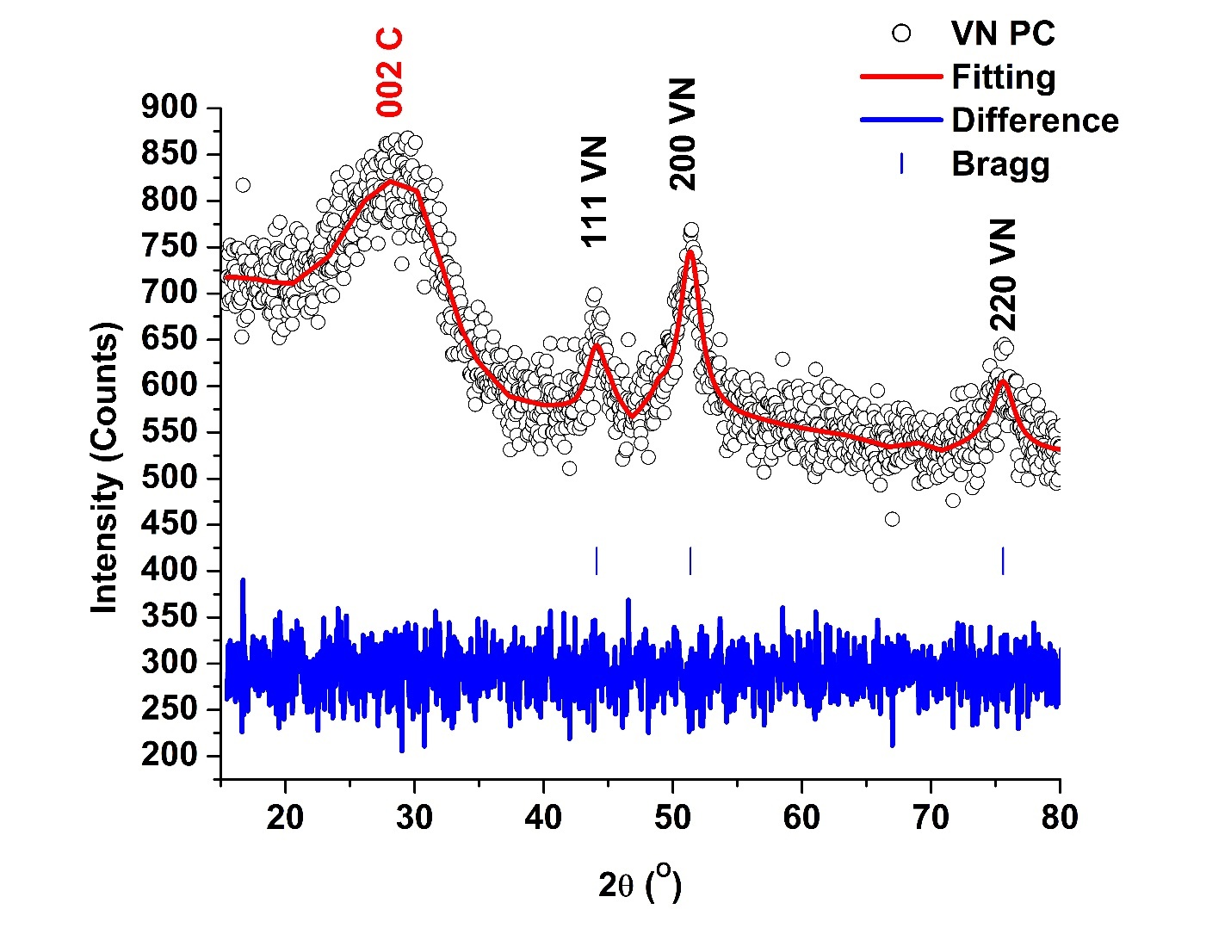
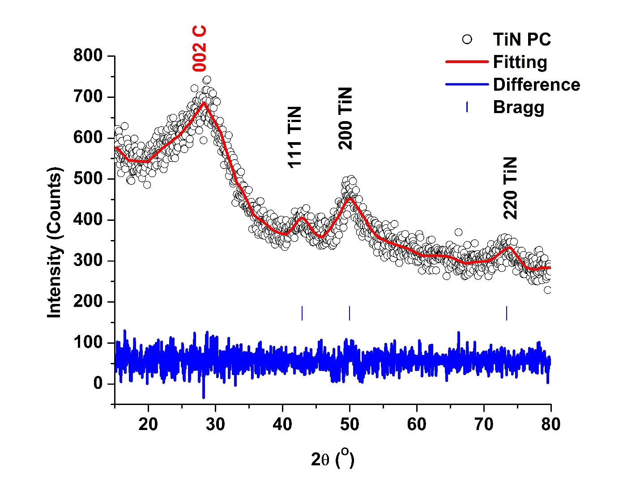
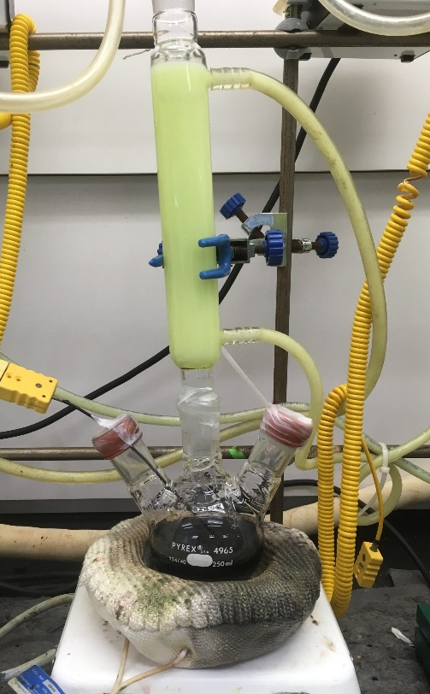
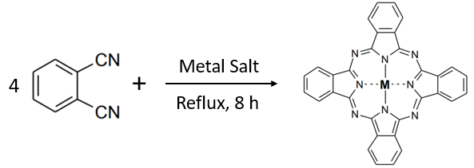
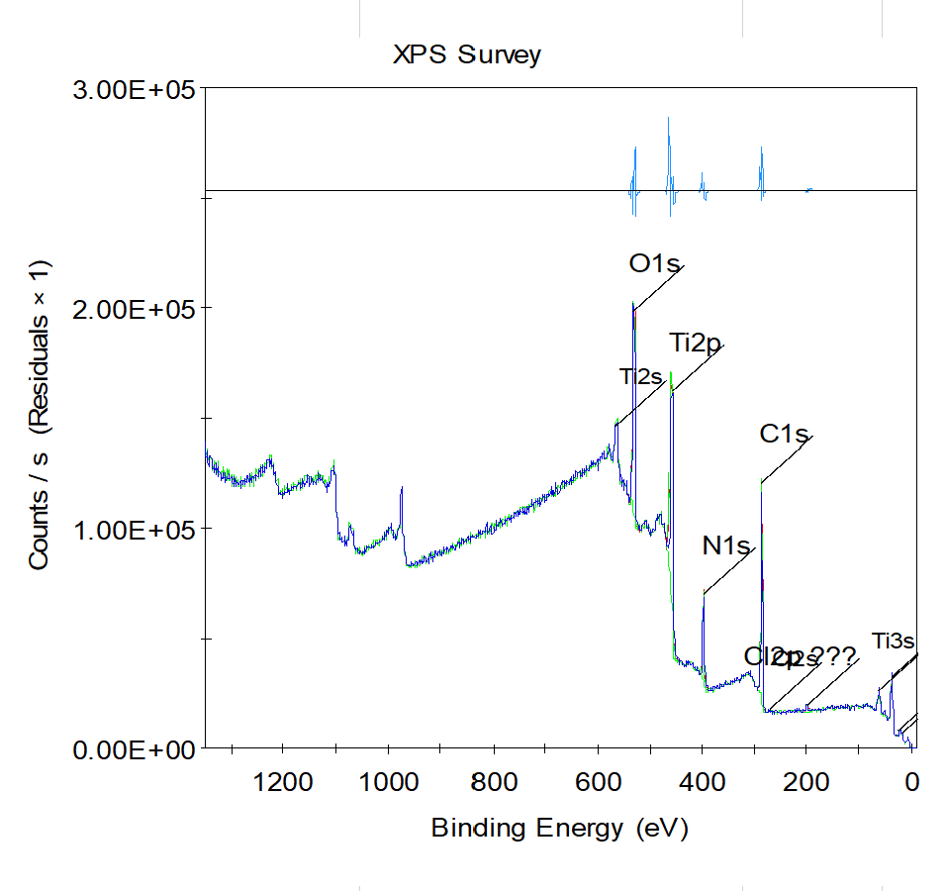
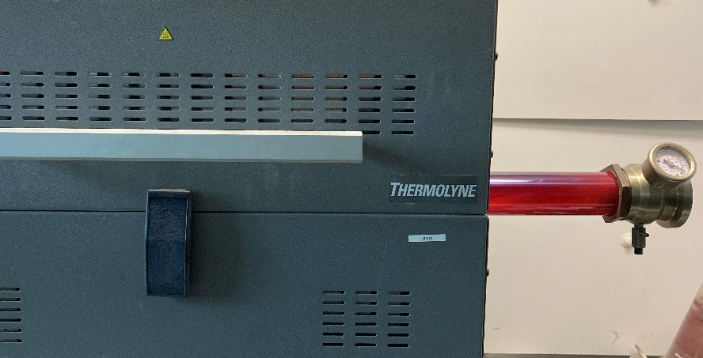




Vanadium and Titanium lithium-ion batteries synthesized
From Vanadium and Titanium Phthalocyanines
E. Fletes, H. Morales, M. Alcoutlabi, and J.G. Parsons
Department of Mechanical Engineering, The University of Texas – Rio Grande Valley
Abstract
Results
Discussion
The improvement of the electrodes in lithium-ion batteries (LIBs) is rapidly increasing in interest. It is crucial for obtaining optimal results for the battery’s performance with respect to stability, efficiency, and durability. Titanium and vanadium phthalocyanine complexes were synthesized as precursors for the fabrication of titanium nitride and vanadium nitride in carbon for application as anodes in LIBs. The metal complexes were synthesized through known synthetic routes and characterized by x-ray powder diffraction, scanning electron microscopy, and x-ray photoelectron spectroscopy. The characterization of the precursors showed the phthalocyanines were metalated with either Ti or V. The phthalocyanines were converted to TiN and VN through carbonization at 750°C. TiN and VN samples were characterized using SEM, XRD, and XPS, which showed the presence of TiN or VN as well as amorphous carbon. The electrochemical performance of the anodes was evaluated by cyclic voltammetry. The results for the first four initial curves indicate a steady state due to overlapping within the cycles. Additionally, both complexes performed similarly with comparable sharp oxidation and reduction peaks.
Synthesis and characterization
Titanium and Vanadium phthalocyanines and nitrides were successfully synthesized.
FITR and powder XRD patterns were consistent with the literature. FTIR, XRD and XPS confirm the presence of the metal.
LIBs Functionality
The electrochemical performance of the LIBs was analyzed using cyclic voltammetry:
In the first four cycles, the performing of the half-cells shows sharp peaks. This is an indication of the oxidation and reduction reactions occurring in the cell and suggests potential multiple steps transitions.
The cathodic peaks are attributed to the decomposition of the electrolyte and the formation of the solid electrolyte interface(SEI).
The overlapping of the cycles demonstrates a steady and stable reaction during the lithiation/delithiation process.
Figure 4. SEM image of Vanadium phthalocyanine
Figure 5. SEM image of Titanium phthalocyanine
Introduction
Phthalocyanine-based materials have shown to have a good stable electrochemical performance due to their chemical structure. Due to the presence of a metal ion, it is expected that metal substituted phthalocyanines will enhance the transfer of electrons in the LIBs. The objectives of this project are:
Synthesize and characterize Ti and V phthalocyanine-based materials.
Investigate the use of Ti and V phthalocyanine-based materials in LIBs’ anodes.
Figure 7. SEM image of Titanium Nitride
Figure 6. SEM image of Vanadium Nitride
Future work
Synthesize and study the use of different metal-based nitrides other than Titanium and Vanadium.
Study the effects of the use of different binder and solvent in the preparation of anodes at different concentrations.
Further testing on the LIBs through electrochemical impedance spectroscopy (EIS) and rate performance.
Methods
Synthesis of Ti and V phthalocyanines.
The metal phthalocyanines were synthesized though a condensation reaction of phthalonitrile with either VOSO₄ or TiCl₄ in 1-chloronaphtalene. The reaction mixture was refluxed for 5 hours.
Figure 8. Powder diffraction pattern of Vanadium Nitride
Figure 9. Powder diffraction of Titanium Nitride
References
Chen, Jun, et al. "A stable 2D nano-columnar sandwich layered phthalocyanine negative electrode for lithium-ion batteries." Journal of Power Sources 426 (2019): 169-177.
Wang, Heng-guo, et al. "Cobalt-phthalocyanine-derived ultrafine Co3O4 nanoparticles as high-performance anode materials for lithium ion batteries." Applied Surface Science 414 (2017): 398-404.
Oni, Joshua, and Kenneth I. Ozoemena. "Phthalocyanines in batteries and supercapacitors." Journal of Porphyrins and Phthalocyanines 16.07n08 (2012): 754-760.
Zhao, Jianjun, et al. "Phthalocyanine-based covalent organic frameworks as novel anode materials for high-performance lithium-ion/sodium-ion batteries." Chemical Engineering Journal 425 (2021): 131630.
Wang, Heng-guo, et al. "Cobalt-phthalocyanine-derived ultrafine Co3O4 nanoparticles as high-performance anode materials for lithium ion batteries." Applied Surface Science 414 (2017): 398-404.
Gould, R. D. "Structure and electrical conduction properties of phthalocyanine thin films." Coordination Chemistry Reviews 156 (1996): 237-274.
Figure 1. One-pot synthesis of Metal phthalocyanine
Synthesis of Ti and V nitrides.
The metal phthalocyanines were carbonized for 5 hours at 750°C in a tube furnace. Samples were allowed to cold down to room temperature.
Figure 2. Carbonization of metal phthalocyanines.
Preparation of slurry
Figure 10. XPS of Vanadium Nitride
Figure 11. XPS of Titanium Nitride
The slurries for the anodes were prepared using 90 wt.% of active material and 10 wt.% of a binder. Polyvinylidene fluoride (PVDF) was used as the binder, and dimethylformamide (DMF) was used as the solvent. The slurries were stirred for 48 hours. The homogenized slurry was vortexed and sonicated for two and fifteen minutes, respectively. Subsequently, the slurry was spread on a copper foil sheet with a thickness of 25 microns and let to dry. The fabricated anode was used to assemble a half-cell lithium-ion battery.
Lithium-ion battery assembly
Top cap
Spring
Steel spacer
Lithium chip
3-4 drops of electrolyte
Separator
3-4 drops of electrolyte
Anode/Cathode
Bottom cap
The LIBs were assembled in an Ar-filled glove box (Mbraun, USA) The electrolyte used was a 1 M LiPF₆ salt in ethylene carbonate (EC)/dimethyl carbonate (DMC) (1:1 v/v) solvent. The figure on the right demonstrates the format that was followed to fabricate the batteries.
Acknowledgements
Figure 3. Lithium-ion battery assembly.
Figure 12. Cyclic Voltammetry of Vanadium Nitride
Figure 13. Cyclic Voltammetry of Titanium Nitride
The authors gratefully acknowledge the support received by the NSF PREM award under grant No. DMR-2122178: UTRGVUMN Partnership for Fostering Innovation by Bridging Excellence in Research and Student Success. The Department of Chemistry at the University of Texas Rio Grande Valley is grateful for the generous support provided by a Departmental Grant from the Robert A. Welch Foundation (Grant No. BX-0048).

