Slide 1
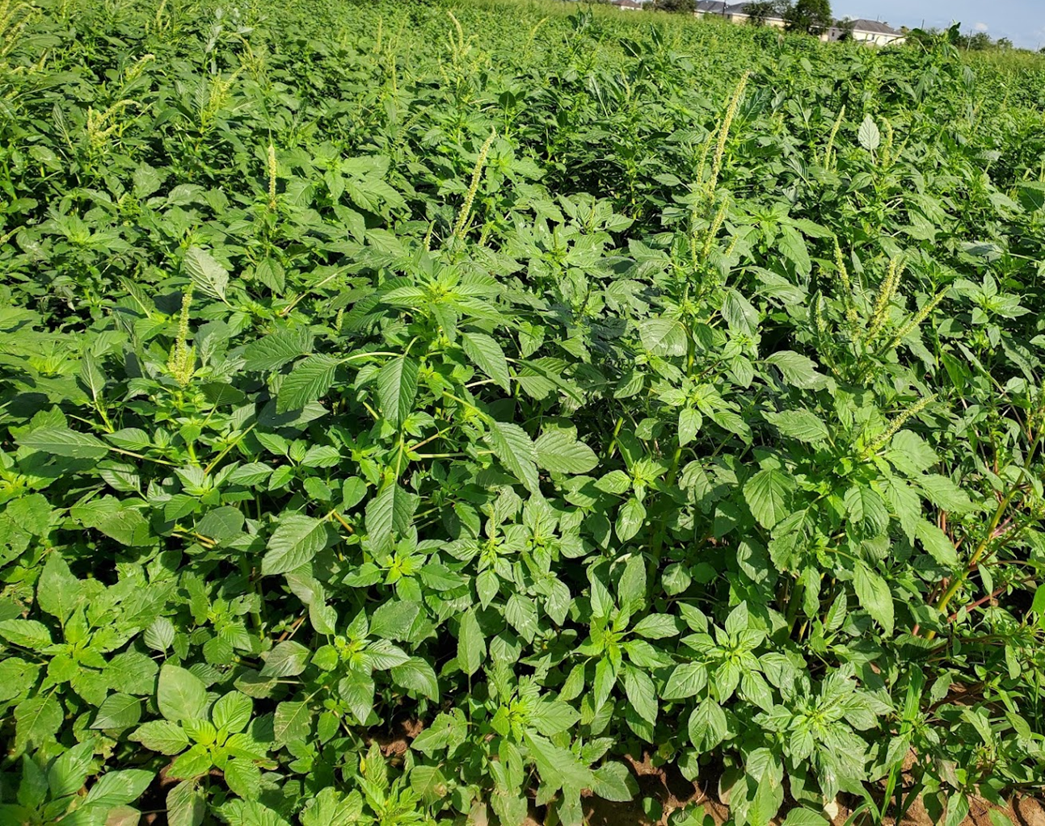
Influence of the two major weeds, Amaranthus palmeri and Parthenium hysterophorus, on the Soil Nematode Community
Orlando Garcia¹, Dana Garibaldi², Krissa Jhaveri³ Jake Lanoue⁴, Pushpa Soti¹
¹Biology Department, University of Texas Rio Grande Valley, Edinburg, TX, 78539
²Lamar Academy, McAllen, TX, 78501
³South Texas High School for Health Professions, 700 Med High Dr, Mercedes, Texas 78570
⁴UTRGV Mathematics and Science Academy, Edinburg, TX, 78539

Slide 2
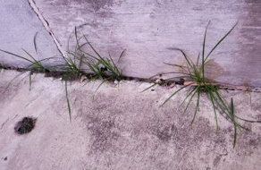
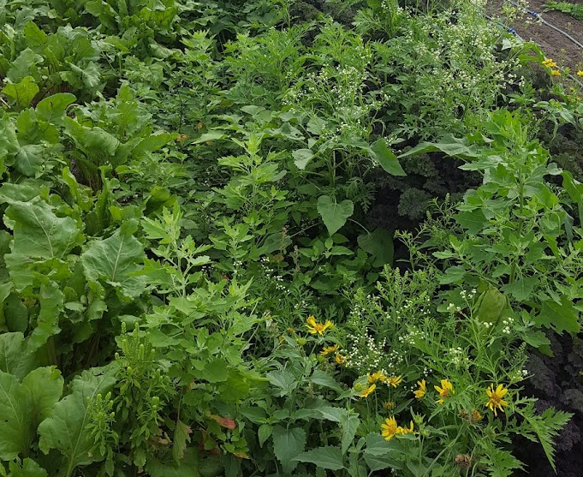
What are Weeds?
General: A plant out of place​ that thrives in disturbed habitats​
​
Agronomist: A plant that interferes with or reduces farm productivity​​
​
Weed Scientist: Any vegetation that interferes with the objectives of people​​
Plant Ecologist: A plant with high fecundity and short generation time.​
A pioneer of secondary succession (ruderal species)​

Slide 3
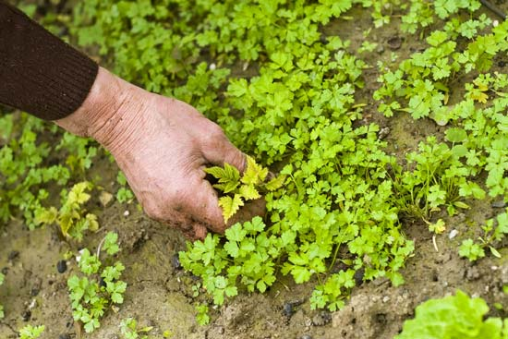
Problems Caused by Weeds
Direct impact ​ | Indirect impact​
Compete with crops for resources​ | Hosts of plant diseases ​
Increased labor cost​ | Hosts of pests​
Lower quality of crop yield​ | Changes in soil microorganisms​
Increase herbicide usage ​ | Changes organic matter​

Slide 4
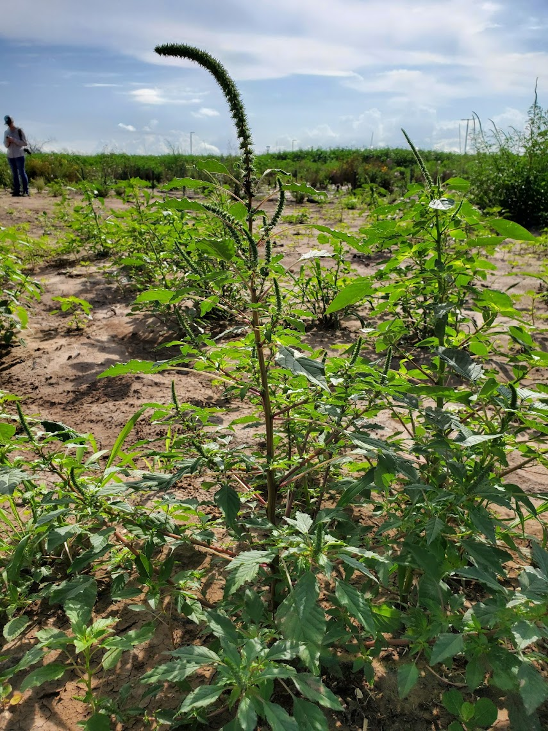
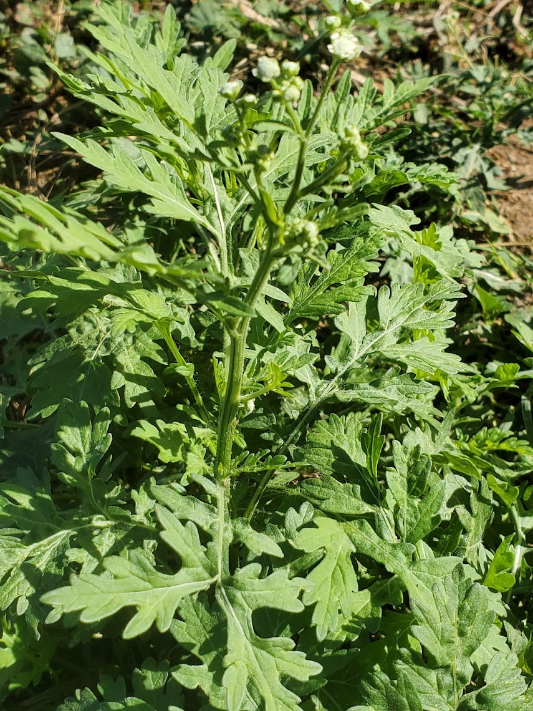
Study Species
Amaranthus palmeri (Pigweed)
Native to Texas
Annual weed species
Family: Amaranthaceae
Annual C4 plant
Can cause 6 to 94 percent in crop lost in cotton, peanut, and sorghum. (ward et al., 2013)
Adapted to heat and drought conditions.
Parthenium hysterophorus (White Top)
Native to Texas
Annual weed species
Family: Asteraceae
Grows in semi-arid and subtropical regions.
Weed to more than 45 countries (Bajwa et al., 2016)
Figure. Weed species: Amaranthus palmeri (left), Parthenium hysterophorus (right).

Slide 5
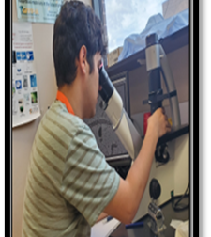
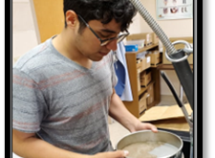
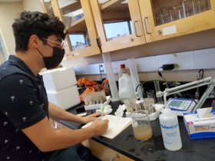
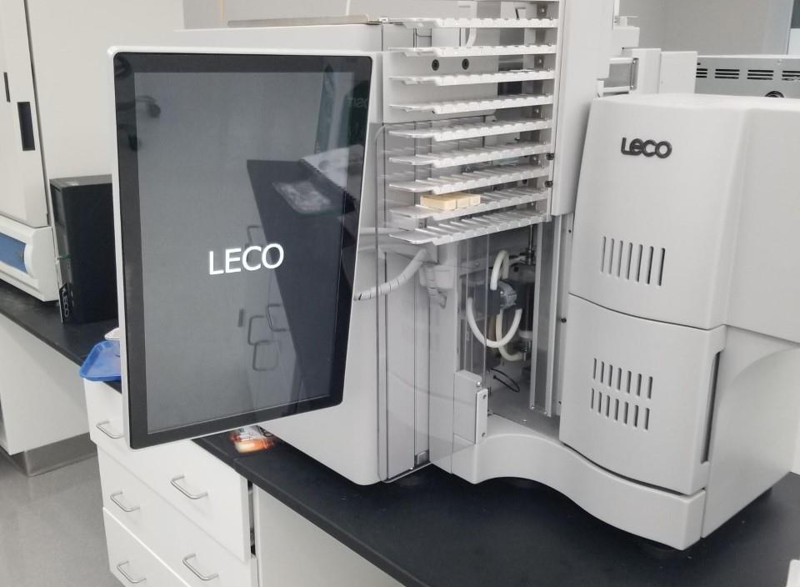
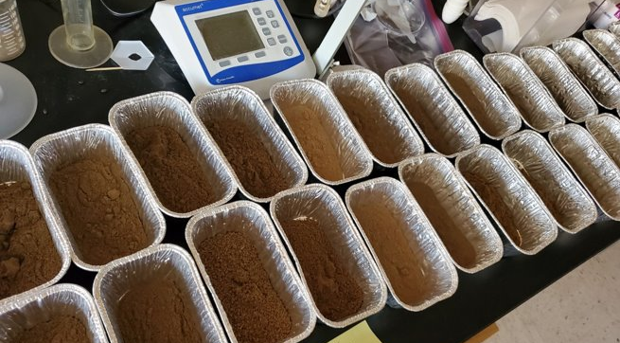
Materials and Methods
Field (Summers 2020 & 2021)
Edaphic properties:
  Moisture: (Gravimetric method)
  Organic Matter (Dry Combustion Method)
  pH (1:2 volume ratio in a soil-DI water solution)
  Salinity (1:2 volume ratio in a soil-DI water solution)
  C and N Percentage (Dry combustion method)
Sucrose Centrifuge-Flotation Technique (Jenkins, 1964)

Slide 6
Results
Table. Relative abundance of weed species between the summer of 2020 & 2021. Dominance of species (>10%)
Total Number of nematodes: 57,910
22 species identified
  Herbivore: 9
  Fungivore: 5
  Bacterivore : 3
  Predator: 1
  Unknown 4

Slide 7
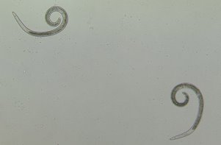
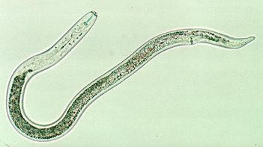
Results
Table. Herbivore Relative Abudance among the different weeds and different sampling years. Dominance of species (>10%)
Helicotylenchus spp had highest relative abundance in both the weeds. Pw being the highest with 51.75.
Pratylenchus spp was the second highest relative abundance having higher numbers in 2020 in both weed species.
PPV had dominance and higher relative abundance during 2021.
Helicotylenchus spp
Pratylenchus spp

Slide 8
Are these weeds benefiting from the presence of herbivore nematodes?
Herbivore nematodes are known to trigger the release of nutrient rich root exudates promoting soil microbial activity (Yeates et al., 1999; Ferris, 2010).
They can also improve the competitive advantage and fitness of plant species in agroecosystems promoting weeds over more susceptible corps (Schroeder et al., 2005)

Slide 9
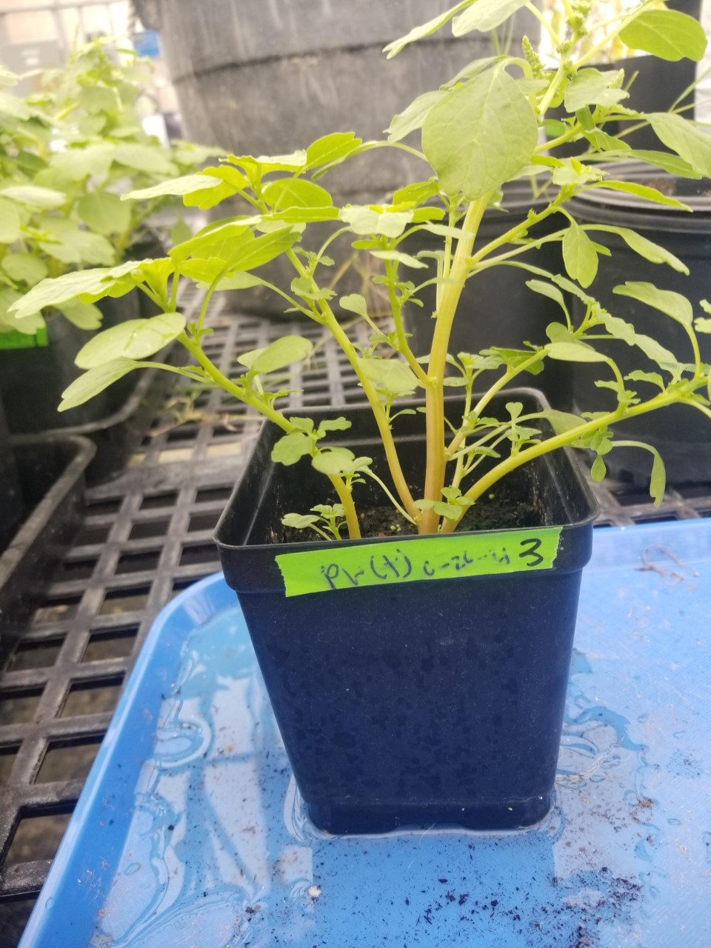
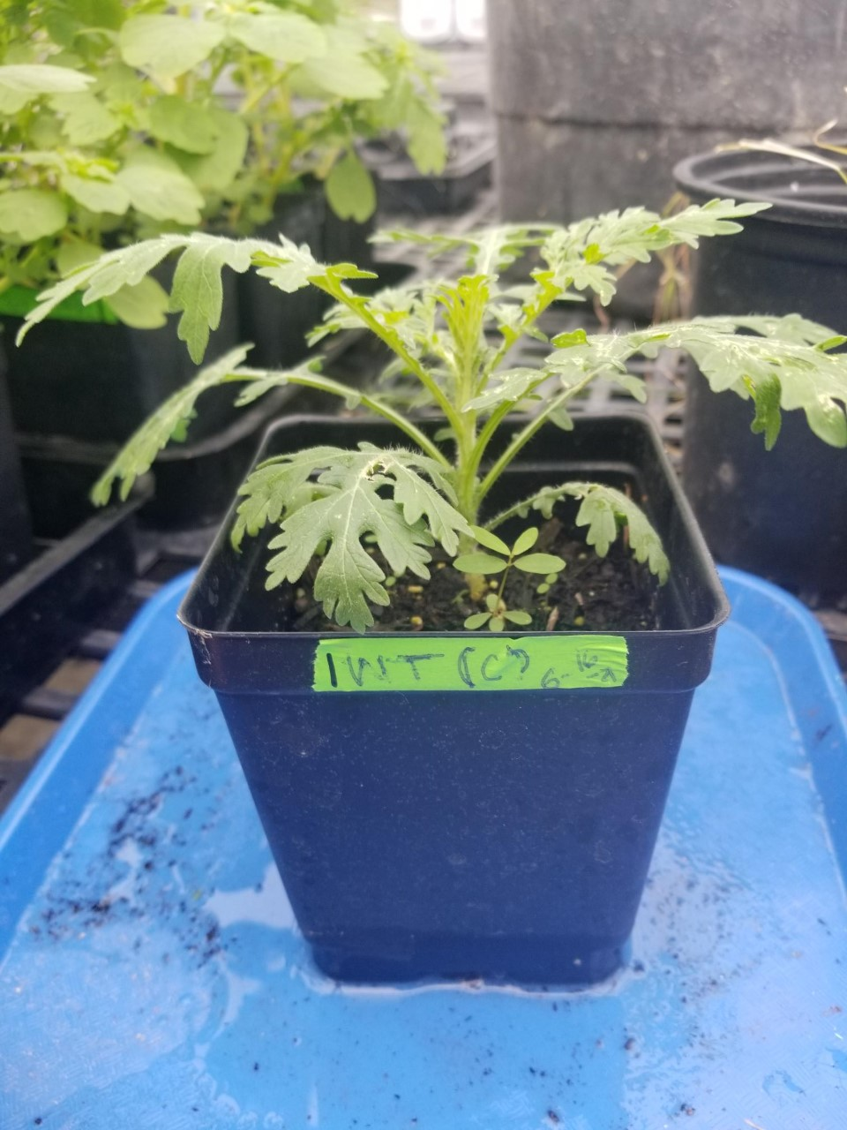
Are these weeds benefiting from the presence of herbivore nematodes?
Greenhouse Study
Duration: 6 weeks
Treatments: 2, control and nematodes
Replicates: 6 each
Measurements: total canopy cover
  stomatal conductivity
  fluorescence
  plant height
  total biomass

Slide 10
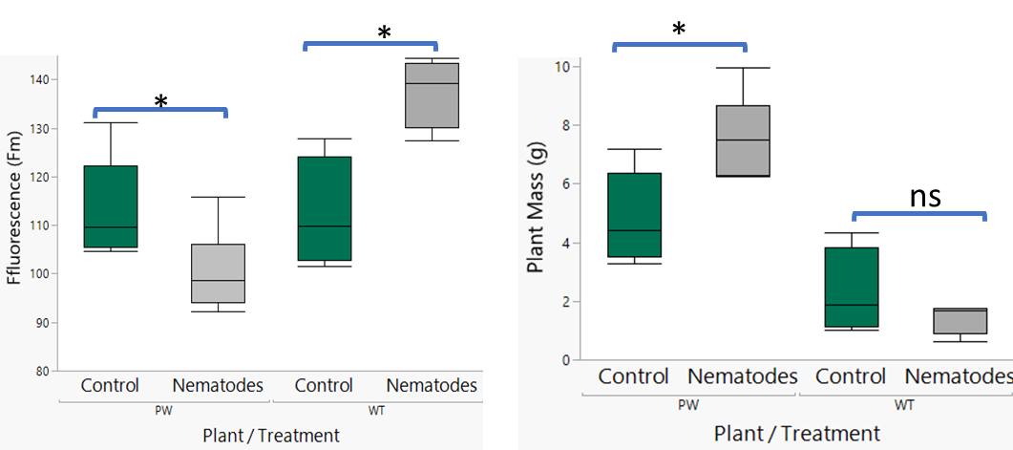
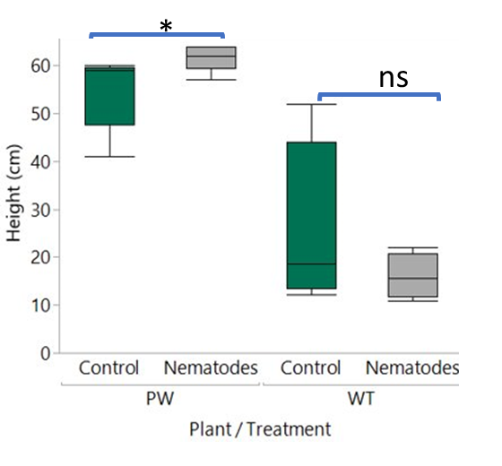
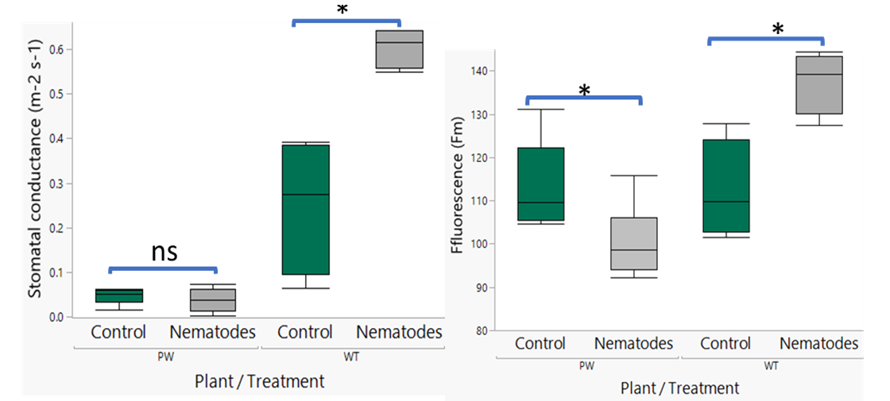
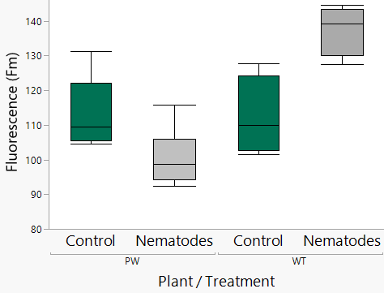
Results
Figure1. Impact of nematodes on the plant growth, height (left) and biomass (right).
*
*
ns
Figure2. Impact of nematodes on the plant physiology, stomatal conductance (left) and biomass (right).

Slide 11
Conclusions
Amaranthus palmeri and Parthenium hysterophorus both attract a high number of herbivore nematodes in their rhizosphere.
Both Amaranthus palmeri and Parthenium hysterophorus were not affected by the herbivore nematodes.
Amaranthus palmeri can potentially benefit from the low number of herbivore nematodes in its rhizosphere.
Since Amaranthus palmeri is one of the major weed worldwide, the plant-nematode feedback in Amaranthus palmeri requires further research.

Slide 12
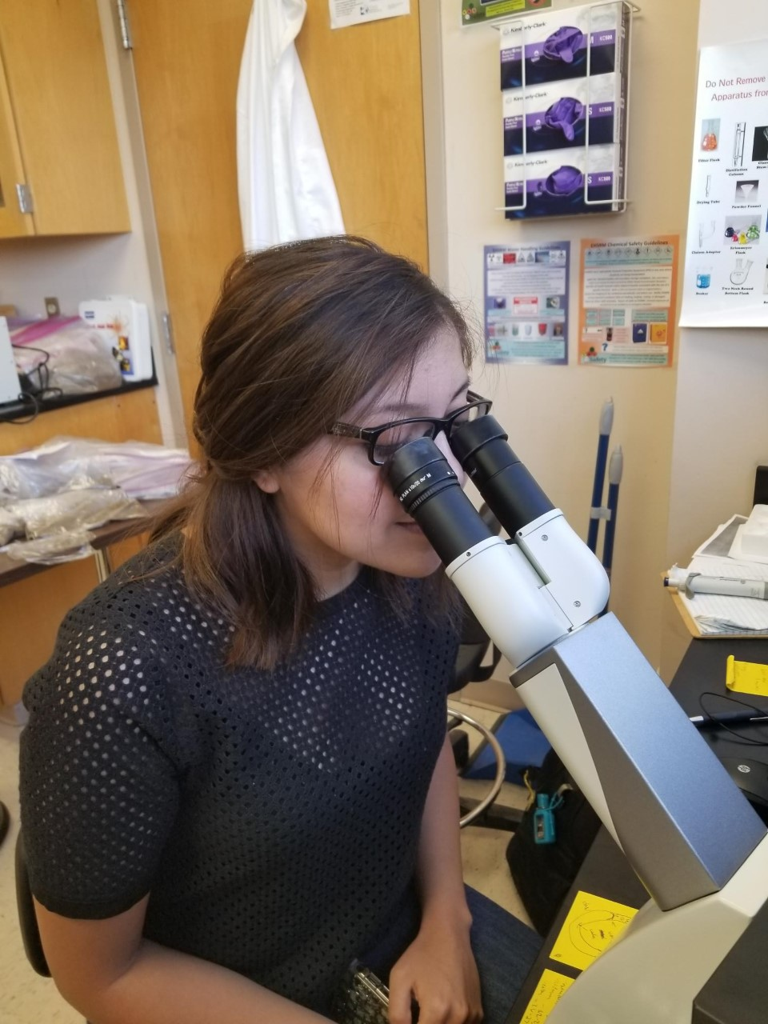
Acknowledgement
I would like to give thanks to the farmers that allowed me to collect soil samples from their farms. I would like to also thank Andrea Mota for her help in the nematode sample processing.

Slide 13

Thank you for your time.
Questions?

